Slide 1
Syntax Analysis

Slide 2
Top-Down Parsing
Builds a parse tree top down, from the start nonterminal
and creating tree nodes in preorder (a leftmost derivation)
34 – 3 * 42
exp → exp addop term | term
addop → + | -
term → term mulop factor | factor
mulop → *
factor → ( exp ) | number
exp
exp
addop
term
term
-
term
mulop
factor
factor
factor
*
number
number
number

Slide 3
Bottom-Up Parsing
Builds a parse tree bottom up, from the leaf nodes
(will be discussed in Chapter 5)
34 – 3 * 42
exp → exp addop term | term
addop → + | -
term → term mulop factor | factor
mulop → *
factor → ( exp ) | number
exp
exp
addop
term
term
-
term
mulop
factor
factor
factor
*
number
number
number
Notes:
and creating tree nodes in postorder (a rightmost reduction)

Slide 4
Top-Down Parsing (Chapter 4)

Slide 5
Top-Down Parsing
Backtracking parsers
try different possibilities
back up arbitrary number of input symbols once a try fails
Predictive parsers
use one or more lookahead symbols to narrow down the possibilities
More Powerful
Exponential Time
34 – 3 * 42
exp → exp addop term | term
addop → + | -
term → term mulop factor | factor
mulop → *
factor → ( exp ) | number

Slide 6
Top-Down Parsing (Predictive)
Recursive-descent parsing
versatile
better for a hand-written parser
LL(1) parsing
scan from left to right, and perform leftmost derivation
look ahead at most one input symbol
34 – 3 * 42
exp → exp addop term | term
addop → + | -
term → term mulop factor | factor
mulop → *
factor → ( exp ) | number

Slide 7
Recursive Descent Parsing

Slide 8
Recursive-Descent Parsing
Basic Ideas
for each nonterminal, define a function to recognize it
factor()
{
switch(token)
case (:
match(()
exp()
match())
case number:
match(number)
default:
error()
}
Lookahead
Match and consume the symbol
exp → exp addop term | term
addop → + | -
term → term mulop factor | factor
mulop → *
factor → ( exp ) | number
Notes:
token is the lookahead symbol (predictive)
match(): match and consumes the input symbol // a match is not needed for “(“ and ”number”, just to keep the API simple

Slide 9
Recursive-Descent Parsing
Basic Ideas
for each nonterminal, define a function to recognize it
match(expectedToken)
{
if (token == expectedToken)
token = getToken()
else
error()
}
advance the input
Notes:
token is the lookahead symbol (predictive)
match(): match and consumes the input symbol // a match is not needed for “(“ and ”number”, just to keep the API simple

Slide 10
Recursive-Descent Parsing
Basic Ideas
for each nonterminal, define a function to recognize it
factor()
{
switch(token)
case (:
match(()
exp()
match())
case number:
match(number)
otherwise
error()
}
factor()
exp()
Recursive & Descent
term()
factor()

Slide 11
Recursive-Descent Parsing
Exercise
Write down the pseudocode for recognizing if-stmt
if-stmt → if (exp) stmt else stmt
factor()
{
switch(token)
case (:
match(()
exp()
match())
case number:
match(number)
otherwise
error()
}
exp → exp addop term | term
addop → + | -
term → term mulop factor | factor
mulop → *
factor → ( exp ) | number
Notes:
assume token is a global variable

Slide 12
Recursive-Descent Parsing
EBNF
extended BNF
ifStmt()
{
match(if)
match(()
exp()
match())
stmt()
if(token == else)
match(else)
stmt()
}
if-stmt → if (exp) stmt
| if (exp) stmt else stmt
rewrite
if-stmt → if (exp) stmt [else stmt]
means “optional”
Notes:
natural correspondence between EBNF and implementation

Slide 13
Recursive-Descent Parsing
EBNF
extended BNF
exp()
{
term()
while(token == + or -)
{
match(token)
term()
}
}
left recursion
no “addop” call
exp → exp addop term
| term
rewrite
exp → term { addop term }
means “repetition”
Notes:
exp causes infinite recursion (left recursion) // write the code on white board to show the problem
note that match(token) always successfully matches as the expected token is just the current token; it can be replaced with “token = getToken()”.

Slide 14
Recursive-Descent Parsing
EBNF
extended BNF
term()
{
factor()
while(token == *)
{
match(token)
factor()
}
}
term → term mulop factor
| factor
rewrite
term → factor { mulop factor}
Notes:
as a quick practice
use general-purpose match(), instead of mulop()

Slide 15
Recursive-Descent Parsing
Calculation can be embedded in parsing
Preserve left associativity
int exp()
{
int temp = term()
while(token == + or -) {
switch(token)
case + :
match(+)
temp += term()
case - :
match(-)
temp -= term()
}
return temp
}
exp → term { addop term }
Notes:
5 – 3 – 6
like an interpreter

Slide 16
Recursive-Descent Parsing
Tree construction can be embedded in parsing
Example for generating a AST
treeNode exp()
{
treeNode node = term()
while(token == + or -)
{
treeNode newnode
newnode = makeOpNode(token)
match(token)
newnode.leftChild = node
newnode.rightChild = term()
node = newnode
}
return node
}
exp → term { addop term }
-
-
42
34
3
34 - 3 - 42
Notes:
to construct a parse tree, we should define a new node called exp, and attach it with three (or 5, 7, ...) children: term, addop, term, (addop, term, ...)

Slide 17
LL(1) Parsing

Slide 18
LL(1) Parsing
Use a stack rather than recursive calls to build a tree
Similar to running some pushdown automaton (PDA)
Begin by pushing the start nonterminal to the stack
Perform some actions based on the stack and next input symbol
Accept if both stack and input become empty
E.g.
tokens
grammar
()
S → ( S ) S | ε
Notes:
(())()
run the example on whiteboard: only need to draw an input and a stack.
EOF is $ in input

Slide 19
LL(1) Parsing
Example
tokens
grammar
()
S → ( S ) S | ε
$: marks stack bottom
 | Parsing Stack | Input | Action
1 | $ S | ( ) $ | S → ( S ) S
2 | $ S ) S ( | ( ) $ | match
3 | $ S ) S | ) $ | S → ε
4 | $ S ) | ) $ | match
5 | $ S | $ | S → ε
6 | $ | $ | match
stack top: leftmost of RHS

Slide 20
LL(1) Parsing
Two Actions:
If stack top is a nonterminal A and A → ⍺, replace A with ⍺ (generate)
If stack top is a terminal (token), match it with input token
If matched, pop stack and advance input
Otherwise, throw an error
Error Input:
)
 | Parsing Stack | Input | Action
1 | $ S | ) $ | S → ( S ) S
2 | $ S ) S ( | ) $ | mismatch
 | Parsing Stack | Input | Action
1 | $ S | ) $ | S → ε
2 | $ | ) $ | mismatch
Notes:
reverse order when “generate”
parsing stack may grow and shrink, but finally should become empty

Slide 21
LL(1) Parsing
Parse Tree Construction
root node is constructed at the beginning of the parse
construct and attach tree nodes in each generate action
S
 | Parsing Stack | Input | Action
1 | $ S | ( ) $ | S → ( S ) S
2 | $ S ) S ( | ( ) $ | match
(
S
)
S
Notes:
pointers tell where to attach the newly constructed nodes

Slide 22
First and Follow Sets

Slide 23
Why First ?
$ ...... A
b………….
Stack
Tokens
A → a B | X C | c D
X → Y y | Z z
Z → b b | z z
A → a B | b C | c D

Slide 24
First Set: Definition
Suppose ⍺ is a string of terminals and nonterminals, First(⍺) consists of the first terminals that can be derived from ⍺.
if ⍺ ⇒* aβ, then a ∈ First(⍺)
if ⍺ ⇒* ε (nullable), then ε ∈ First(⍺)
E.g.
Another grammar
First(ABc) = {a, c, d}
A → aB | CD
B → Bb | ε
C → c | ε
D → d
First(BC) =
{b, c, ε}
Notes:
{a, b}
{a}

Slide 25
First Set: Properties
If X is a terminal or ε, then First(X) = {X}
Suppose X is a nonterminal and X → Y₁Y₂...Y_{k}
if for some i, Y₁...Y_{i-1} ⇒* ε , then First(X) ⊇ First(Y_{i}) – {ε}
if Y₁...Y_{k} ⇒* ε, then ε ∈ First(X)
Why exclude it ?
E.g.
Another grammar
First(A) = {a, c, d}
A → aB | CD
B → Bb | ε
C → c | ε
D → d
Notes:
Note that ε is not a terminal, but an empty string; since ε ⇒* ε, so ε ∈ First(ε)
First(X) ⊇ First(Y1Y2…Yk)

Slide 26
First Set: Algorithm
Compute the First set for each nonterminal iteratively
for each nonterminal A
First(A) = {}
while some First set changed
for each A → X₁X₂...X_{n}
k = 1
continue = true
while continue == true and k<=n
add First(X_{k}) – {ε} to First(A)
if ε ∉ First(X_{k})
continue = false
k++
if continue == true
add ε to First(A)
Why iterative ?
Notes:
why “– {ε}”? because at this time, we are not sure if ε belongs to First(A).
why iterative? because when we compute First(A), we may not have known all First(X_{k}). e.g., A → B, B → bd

Slide 27
First Set: Algorithm
 | A | B | C | D
init | {} | {} | {} | {}
round-1 | {a} | {b} | {ε} | {d, ε}
round-2 | {a, ε, d} | {b} | {ε} | {d, ε}
round-3 | {a, ε, d} | {b} | {ε} | {d, ε}
The same results, so iteration stops
A → aB | CD
B → bC
C → ε
D → d | ε

Slide 28
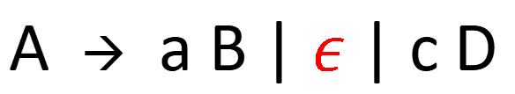
Why Follow ?
$ ......b A
b………….
Stack
Tokens
A → a B | $ε$ | c D
✔️
if b can Follow A

Slide 29
Follow Set: Definition
For a nonterminal A, if there exists a derivation from the start nonterminal S ⇒* ⍺Aaβ, then a ∈ Follow(A)
If S ⇒* ⍺A, then $ ∈ Follow(A)
E.g.
$ always in Follow set of start symbol
grammar
Follow(A) =
{$}
A → aBD | CC
B → a
C → bDe
D → d
Follow(B) =
{d}
Follow(C) =
{b, $}
Follow(D) =
{e, $}
Notes:
{d}
{b,$}
{e,$}

Slide 30
Follow Set: Definition
For a nonterminal A, if there exists a derivation from the start nonterminal S ⇒* ⍺ Aaβ (a ≠ ε), then a ∈ Follow(A)
If S ⇒* ⍺A, then $ ∈ Follow(A)
Exercise:
Another grammar
Follow(A) =
{$}
A → aBD | CC
B → a
C → De
D → d | ε
Follow(B) =
{d, $}
Follow(C) =
{d, e, $}
Follow(D) =
{e, $}

Slide 31
Follow Set: Properties
If A is the start symbol, $ ∈ Follow(A)
For any nonterminal A, ε ∉ Follow(A)
If A –> ⍺B𝛾 then First(𝛾) – {ε} ⊆ Follow(B)
If A –> ⍺B𝛾 and 𝛾 ⇒* ε then Follow(A) ⊆ Follow(B)
Notes:
followed by nothing means followed by $.
ask these properties as yes/no questions (remove {ε} in the third property; replace subset with equal in the fourth property)

Slide 32
Follow Set: Algorithm
Compute the Follow set for each nonterminal iteratively
for each nonterminal A
if A is start-symbol
Follow(A)={$}
else
Follow(A)={}
while some Follow set changed
for each A → X₁X₂...X_{n}
for each X_{i} that is a nontermianl
add First(X_{i+1}X_{i+2}...X_{n}) – {ε} to Follow(X_{i})
if ε ∈ First(X_{i+1}X_{i+2}...X_{n})
add Follow(A) to Follow(X_{i})
3rd property
4th property
Notes:
draw the A → X₁X₂...X_{n} on the whiteboard
A → X₁X₂...X_{i}
with First set of individual symbols, we can easily get the First set of any string (X_{i+1}X_{i+2}...X_{n} : suffix of the RHS).
iterative: A → bB, C → Aa

Slide 33
Follow Set: Algorithm
First | S | A | B | C
 | {e} | {e} | {b} | {e}
Follow | S | A | B | C
init | {$} | {} | {} | {}
round-1 | {$} | {b, a} | {$} | {b, a}
round-2 | {$} | {b, a} | {$} | {b, a}
The same results, so iteration stops
S → AB
A → eC
B → bAa
C → e
Notes:
iterative: B → bA, S → Aa

Slide 34
Example: Compute First/Follow Set
E → T E’
E’ → addop T E’ | ε
addop → + | -
T → F T’
T’ → mulop F T’ | ε
mulop → *
F → ( E ) | id
First(E) = { (, id }
First(E’) = { +, -, ε }
First(addop) = { +, - }
First(T) = { (, id }
First(T’) = { *, ε }
First(mulop) = { * }
First(F) = { (, id }
Follow(E) = { $, ) }
Follow(E’) = { $, ) }
Follow(addop) = { (, id }
Follow(T) = { $, ), +, - }
Follow(T’) = { $, ), +, - }
Follow(mulop) = { (, id }
Follow(F) = { $, ), +, -, * }
Notes:
practice after class

Slide 35
Example: E → T E’ E’ → + T E’ | ε T → F T’ T’ → * F T’ | ε F → ( E ) | id FIRST E { (, id } E’ { +, ε } T { (, id } T’ { *, ε } F { (, id }
F → ( E ) | id FIRST(F) = { (, id } T’ → * F T’ | ε FIRST(T’) = { *, ε } E’ → + T E’ | ε FIRST(E’) = { +, ε } T → F T’
FIRST(T) = FIRST(F) = { (, id } E → T E’ FIRST(E) = FIRST(T) = { (, id }

Slide 36
Example: E → T E’ E’ → + T E’ | ε T → F T’ T’ → * F T’ | ε F → ( E ) | id
FOLLOW(E)
E is the start symbol $ ε FOLLOW(E)
F → ( E )
) ε FOLLOW(E)
FOLLOW(E) = { $, ) }
FOLLOW(E’)
E → T E’ & E’ → + T E’
………E….… → ………TE’……..
- FOLLOW(E) is contained in FOLLOW(E’)
- { $, ) } is contained in FOLLOW(E’)
FOLLOW(E’) = { $, ) }

Slide 37
Example: E → T E’ E’ → + T E’ | ε T → F T’ T’ → * F T’ | ε F → ( E ) | id FIRST E { (, id } E’ { +, ε } T { (, id } T’ { *, ε } F { (, id }
FOLLOW(T)
E → T E’ & E’ → + T E’
FIRST(E’) – { ε } is contained in FOLLOW(T)
→ { + } is contained in FOLLOW(T)
ε belongs to FIRST(E’)
→ FOLLOW(E) is contained in FOLLOW(T)
→ { $, ) } is contained in FOLLOW(T)
FOLLOW(T) = { +, $, ) }

Slide 38
Example: E → T E’ E’ → + T E’ | ε T → F T’ T’ → * F T’ | ε F → ( E ) | id FIRST E { (, id } E’ { +, ε } T { (, id } T’ { *, ε } F { (, id }
FOLLOW(T’)
T → F T’ & T’ → * F T’
FOLLOW(T) is contained in FOLLOW(T’)
→ { +, $, ) } is contained in FOLLOW(T’)
FOLLOW(T’) = { +, $, ) }

Slide 39
Example: E → T E’ E’ → + T E’ | ε T → F T’ T’ → * F T’ | ε F → ( E ) | id FIRST E { (, id } E’ { +, ε } T { (, id } T’ { *, ε } F { (, id }
FOLLOW(F)
T → F T’ & T’ → * F T’
FIRST(T’) – { ε } is contained in FOLLOW(F)
→ { * } is contained in FOLLOW(F)
ε belongs to FIRST(T’)
→ FOLLOW(T) is contained in FOLLOW(F)
→ { +, $, ) } is contained in FOLLOW(F)
FOLLOW(F) = { *, +, $, ) }

Slide 40
Example: E → T E’ E’ → + T E’ | ε T → F T’ T’ → * F T’ | ε F → ( E ) | id
FIRST E { (, id } E’ { +, ε } T { (, id } T’ { *, ε } F { (, id }
FOLLOW E { $, ) } E’ { $, ) } T { +, $, ) } T’ { +, $, ) } F { *, +, $, ) }

Slide 41
Back to LL(1) Parsing

Slide 42
LL(1) Parsing
Parsing Table
if the stack top is N, and the lookahead token is T, then entry [N, T] in the table is the production rule to use
 | Parsing Stack | Input | Action
1 | … | … | …
2 | … | … | …
3 | $ … S | (…$
4 | … | … | …
5 | … | … | …
next token (terminal)
 | ( | ) | $
S |  | … | …
S → ( S ) S
S → ( S ) S
stack top
(nonterminal)

Slide 43
LL(1) Parsing
Parsing Table Construction
Given A → ⍺
- for each token a in First(⍺), add A → ⍺ to the entry [A, a]
- if ε ∈ First(⍺), for each a in Follow(A), add A → ⍺ to entry [A, a]
S → ( S ) S
S → ε
First(( S ) S) = { ( }
First(S) = { ε }
Follow(S) = { ), $ }
 | ( | ) | $
S | S → ( S ) S | S → ε | S → ε

Slide 44
LL(1) Parsing
Parsing Table Construction
Given A → ⍺
- for each token a in First(⍺), add A → ⍺ to the entry [A, a]
- if ε ∈ First(⍺), for each a in Follow(A), add A → ⍺ to entry [A, a]
Exercise:
S → A
A → ( A ) A
A → ε
 | ( | ) | $
S
A
S → A
S → A
A → ( A ) A
A → ε
A → ε

Slide 45
LL(1) Parsing
Parsing Table Construction: Example
r1
r2
r3
r4
r5
r6
r7
r8
r9
r10
r11
E → T E’
E’ → addop T E’
E’ → ε
addop → +
addop → -
T → F T’
T’ → mulop F T’
T’ → ε
mulop → *
F → ( E )
F → id
 | ( | id | ) | + | - | * | $
E | r1 | r1
E’ |  |  | r3 | r2 | r2 |  | r3
addop |  |  |  | r4 | r5
T | r6 | r6
T’ |  |  | r8 | r8 | r8 | r7 | r8
mulop |  |  |  |  |  | r9
F | r10 | r11

Slide 46
LL(1) Parsing
LL(1) Grammar
A grammar is an LL(1) grammar if the associated LL(1) parsing table has at most one production in each table entry
Cannot be ambiguous
A subset of CFG
S → A
A → ( A ) A
A → ε
 | ( | ) | $
S | S → A |  | S → A
A | A → ( A ) A | A → ε | A → ε

Slide 47
LL(1) Parsing: Algorithm
push start symbol S onto stack
while stack top ≠ $ and next token ≠ $
if stack top is a and a == next token
pop stack
advance input
else if stack top is A and next token is a
and [A,a] has rule A → X₁X₂...X_{n}
pop stack
for i from n to 1
push X_{i} onto stack
else
error
if stack top == next token == $
accept
else
error

Slide 48
Issues Related to LL(1)

Slide 49
A Grammar is LL(1) iff
A → ⍺ | β
First(⍺) First(β) = Φ
U
A → ⍺ | β
St β ⇒* ε
First(⍺) Follow(A) = Φ
U

Slide 50
Left Recursion
Left recursion often makes the grammar non-LL(1)
exp → exp addop term | term
addop → + | -
term → term mulop factor | factor
mulop → * | /
factor → ( exp ) | number
First(exp addop term) = { (, number }
First(term) = { (, number }
 | ( | number | …
exp | exp → exp addop term exp → term | exp → exp addop term exp → term
Notes:
we solved this problem in recursive descent parsing with EBNF
the left recursion ensures that First(exp) ⊇ First(term), so when exp → term needs to added to one table entry, so does exp → exp addop term
if the production rule with left recursion is unique for that nonterminal (e.g., there is no exp → term), then it seems okay

Slide 51
Left Recursion
Rewriting: break it into two rules: (i) generate base case first and (ii) generate the repetition using right recursion
A → A⍺₁|A⍺₂|...|A⍺_{n}|β₁|β₂|...|β_{m}
A → A ⍺ | β
A → β A’
A’ → ⍺ A’ | ε
A → β₁A’|β₂A’|...|β_{m}A’
A’ → ⍺₁A’|⍺₂A’|...|⍺_{n}A’|ε
right recursion
General Form
⍺ and β are strings of terminals and nonterminals and β does not begin with A
Notes:
β, β⍺, β⍺⍺, ...

Slide 52
Left Recursion
Exercise
A → A ⍺ | β
exp → exp addop term | term
A → β A’
A’ → ⍺ A’ | ε
exp → term exp’
exp’ → addop term exp’ | ε
Notes:
β, β⍺, β⍺⍺, ...

Slide 53
Left Recursion
Example
exp → exp addop term | term
addop → + | -
term → term mulop factor | factor
mulop → *
factor → ( exp ) | number
exp → term exp’
exp’ → addop term exp’ | ε
addop → + | -
term → factor term’
term’ → mulop factor term’ | ε
mulop → *
factor → ( exp ) | number
Notes:
β, β⍺, β⍺⍺, ...

Slide 54
Left Factoring
Issue: when grammar rule choices share a common prefix, look ahead one symbol may not be sufficient to determine the rule
Rewriting: take the common part out and add a new nonterminal
if-stmt → if (exp) stmt
| if (exp) stmt else stmt
A → ⍺ β | ⍺ 𝛾
A → ⍺ A’
A’ → β | 𝛾
if-stmt → if (exp) stmt else-part
else-part → else stmt | ε
Notes:
Common prefix will also cause multiple rules in one entry
For recursive descent parsing, we solved it with EBNF (in particular, the option notation)

Slide 55
Summary
Backtracking Parsing
(“brute force”)
Top-Down Parsing
Recursive Descent Parsing
a func for a nonterminal
leverage call stack
Predictive Parsing
(lookahead)
LL(1) Parsing
Common Issues:
use explicit stack
First and Follow sets
parsing table-driven
left recursion
common prefix
Notes:
For recursive descent parsing, we solved it with EBNF (in particular, the option notation)

Slide 56
SAMPLE PROBLEMS

Slide 57

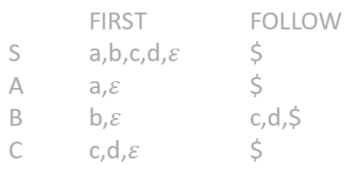
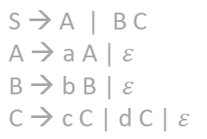
Example
FIRST FOLLOW
S a,b,c,d,$ε$ $
A a,$ε$ $
B b,$ε$ c,d,$
C c,d,$ε$ $
S → A | B C
A → a A | $ε$
B → b B | $ε$
C → c C | d C | $ε$
a b c d $
S S → A S → B C S → B C S → B C
A A → a A A → $ε$
B B → b B B → $ε$B → $ε$ B → $ε$
C C → c C C → d C C → $ε$
S → A
S → B C

Slide 58
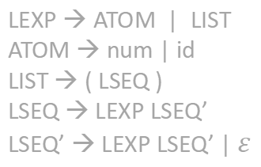
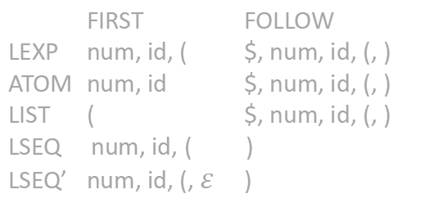
Example
LEXP → ATOM | LIST
ATOM → num | id
LIST → ( LSEQ )
LSEQ → LEXP LSEQ’
LSEQ’ → LEXP LSEQ’ | $ε$
LEXP → ATOM | LIST
ATOM → num | id
LIST → ( LSEQ )
LSEQ → LSEQ LEXP | LEXP
FIRST FOLLOW
LEXP num, id, ( $, num, id, (, )
ATOM num, id $, num, id, (, )
LIST ( $, num, id, (, )
LSEQ num, id, ( )
LSEQ’ num, id, (, $ε$ )

Slide 59
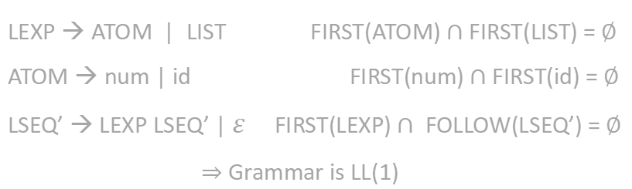
Example
FIRST FOLLOW
LEXP num, id, ( $, num, id, (, )
ATOM num, id $, num, id, (, )
LIST ( $, num, id, (, )
LSEQ num, id, ( )
LSEQ’ num, id, (, $ε$ )
LEXP → ATOM | LIST
ATOM → num | id
LIST → ( LSEQ )
LSEQ → LEXP LSEQ’
LSEQ’ → LEXP LSEQ’ | $ε$
LEXP → ATOM | LIST FIRST(ATOM) $∩$ FIRST(LIST) = $∅$
ATOM → num | id FIRST(num) $∩$ FIRST(id) = $∅$
LSEQ’ → LEXP LSEQ’ | $ε$ FIRST(LEXP) $∩$FOLLOW(LSEQ’) = $∅$
$⇒$ Grammar is LL(1)

Slide 60
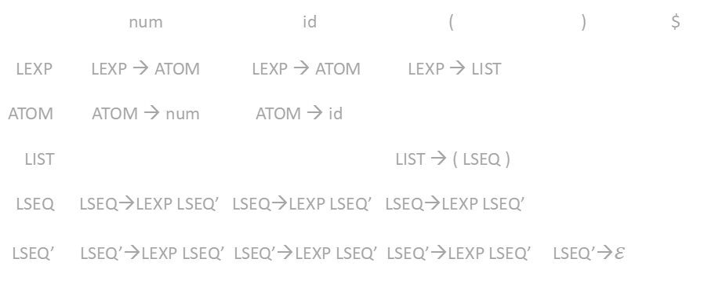
Example
FIRST FOLLOW
LEXP num, id, ( $, num, id, (, )
ATOM num, id $, num, id, (, )
LIST ( $, num, id, (, )
LSEQ num, id, ( )
LSEQ’ num, id, (, $ε$ )
LEXP → ATOM | LIST
ATOM → num | id
LIST → ( LSEQ )
LSEQ → LEXP LSEQ’
LSEQ’ → LEXP LSEQ’ | $ε$
num id ( ) $
LEXP LEXP → ATOM LEXP → ATOM LEXP → LIST
ATOM ATOM → num ATOM → id
LIST LIST → ( LSEQ )
LSEQ LSEQ→LEXP LSEQ’ LSEQ→LEXP LSEQ’ LSEQ→LEXP LSEQ’
LSEQ’ LSEQ’→LEXP LSEQ’ LSEQ’→LEXP LSEQ’ LSEQ’→LEXP LSEQ’ LSEQ’→$ε$

