Slide 1
TOP DOWN PARSING SAMPLE PROBLEMS

Slide 2
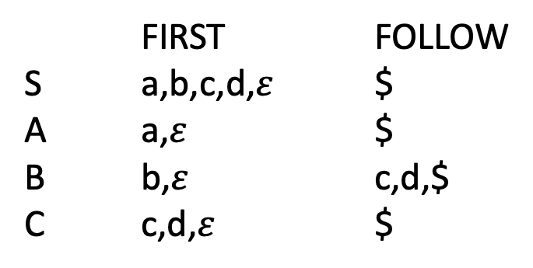
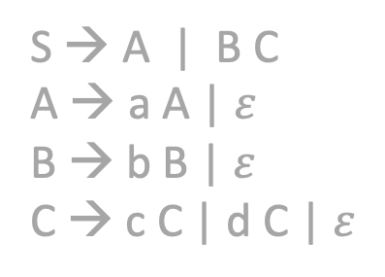
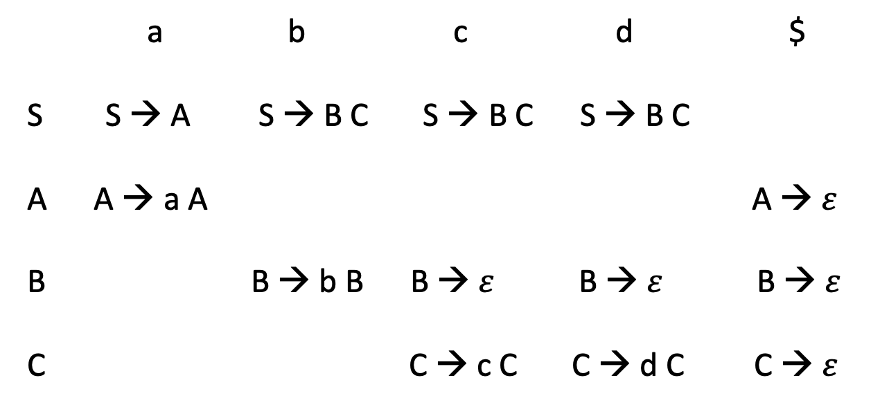
Example
FIRST FOLLOW
S a,b,c,d,$ε$ $
A a,$ε$ $
B b,$ε$ c,d,$
C c,d,$ε$ $
S → A | B C
A → a A | $ε$
B → b B | $ε$
C → c C | d C | $ε$
a b c d $
S S → A S → B C S → B C S → B C
A A → a A A → $ε$
B B → b B B → $ε$B → $ε$ B → $ε$
C C → c C C → d C C → $ε$
S → A
S → B C

Slide 3
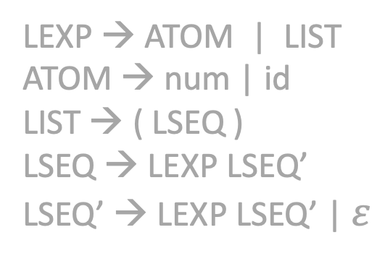
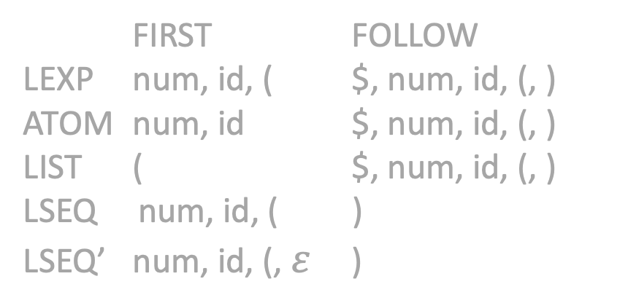
Example
LEXP → ATOM | LIST
ATOM → num | id
LIST → ( LSEQ )
LSEQ → LEXP LSEQ’
LSEQ’ → LEXP LSEQ’ | $ε$
LEXP → ATOM | LIST
ATOM → num | id
LIST → ( LSEQ )
LSEQ → LSEQ LEXP | LEXP
FIRST FOLLOW
LEXP num, id, ( $, num, id, (, )
ATOM num, id $, num, id, (, )
LIST ( $, num, id, (, )
LSEQ num, id, ( )
LSEQ’ num, id, (, $ε$ )

Slide 4
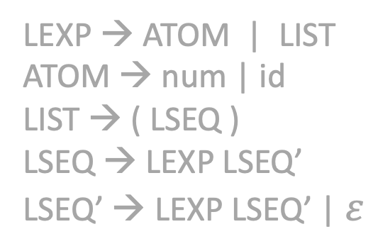

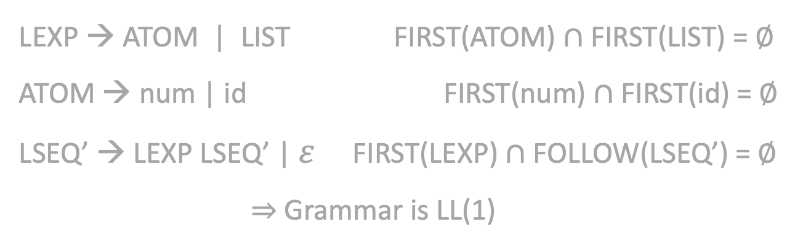
Example
FIRST FOLLOW
LEXP num, id, ( $, num, id, (, )
ATOM num, id $, num, id, (, )
LIST ( $, num, id, (, )
LSEQ num, id, ( )
LSEQ’ num, id, (, $ε$ )
LEXP → ATOM | LIST
ATOM → num | id
LIST → ( LSEQ )
LSEQ → LEXP LSEQ’
LSEQ’ → LEXP LSEQ’ | $ε$
LEXP → ATOM | LIST FIRST(ATOM) $∩$ FIRST(LIST) = $∅$
ATOM → num | id FIRST(num) $∩$ FIRST(id) = $∅$
LSEQ’ → LEXP LSEQ’ | $ε$ FIRST(LEXP) $∩$FOLLOW(LSEQ’) = $∅$
$⇒$ Grammar is LL(1)

Slide 5

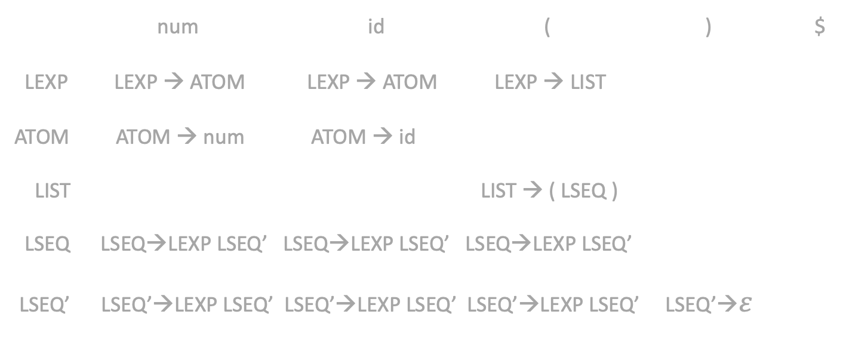

Example
FIRST FOLLOW
LEXP num, id, ( $, num, id, (, )
ATOM num, id $, num, id, (, )
LIST ( $, num, id, (, )
LSEQ num, id, ( )
LSEQ’ num, id, (, $ε$ )
LEXP → ATOM | LIST
ATOM → num | id
LIST → ( LSEQ )
LSEQ → LEXP LSEQ’
LSEQ’ → LEXP LSEQ’ | $ε$
num id ( ) $
LEXP LEXP → ATOM LEXP → ATOM LEXP → LIST
ATOM ATOM → num ATOM → id
LIST LIST → ( LSEQ )
LSEQ LSEQ→LEXP LSEQ’ LSEQ→LEXP LSEQ’ LSEQ→LEXP LSEQ’
LSEQ’ LSEQ’→LEXP LSEQ’ LSEQ’→LEXP LSEQ’ LSEQ’→LEXP LSEQ’ LSEQ’→$ε$

Slide 6
BOTTOM UP PARSING SAMPLE PROBLEMS

Slide 7


* S → A .
A
* S → . A
A → . a A a
A → .
* A → a A . a
a
A
a
* A → a . A a
A → . a A a
A → .
* A → a A a .
a

Slide 8
* S → A ., $
A
* S → . A, $
A → . a A a, $
A → . , $
a
* A → a A . a, $
* A → a A a ., $
a
A
* A → a . A a, $
A → . a A a, a
A → . , a
* A → a A . a, a
* A → a . A a, a
A → . a A a, a
A → . , a
A
a
a
* A → a A a ., a
a
Shift-Reduce Conflicts
when input token is a

Slide 9
S → C C
C → c C | d
C
* S → C C ., $
* S → C . C, $
C → . c C, $
C → . d, $
c
* C → c . C, $
C → . c C, $
C → . d, $
C
d
* S → . C C, $
C → . c C, c/d
C → . d, c/d
* C → d ., $
d
C
c
c
* C → c C ., $
d
* C → c . C, c/d
C → . c C, c/d
C → . d, c/d
C
* C → c C ., c/d
d
c
* C → d ., c/d

Slide 10
S → A
A → ( B ) | a
B → B A | A
(
A → ( . B )
B → . B A
B → . A
A → . ( B )
A → . a
S → A .
B
)
A → ( B . )
B → B . A
A → . ( B )
A → . a
A → ( B ) .
A
(
S → . A
A → . ( B )
A → . a
(
B → B A .
A
A
B → A .
a
a
a
A → a .
No Conflicts!

Slide 11
S → E
E → ( L ) | a
L → E L | E
* E → ( L ) .
)
* E → ( L . )
* S → E .
L
E
E
L
* E → ( . L )
L → . E L
L → . E
E → . ( L )
E → . a
* L → E . L
* L → E .
L → . E L
L → . E
E → . ( L )
E → . a
* L → E L .
* S → . E
E → . ( L )
E → . a
(
(
(
a
E
* E → a .
a
a

Slide 12
S → E
E → ( L ) | a
L → E L | E
* E → ( L ) . , $
E
)
* L → E . L , )
* L → E . , )
L → . E L , )
L → . E , )
E → . ( L ) , (/a/)
E → . a , (/a/)
* E → ( L . ) , $
L
* S → E . , $
* L → E L . , )
L
E
E
* E → ( . L ) , $
L → . E L , )
L → . E , )
E → . ( L ) , (/a/)
E → . a , (/a/)
a
* S → . E , $
E → . ( L ) , $
E → . a , $
(
(
E
(
a
* E → ( . L ) , (/a/)
L → . E L , )
L → . E , )
E → . ( L ) , (/a/)
E → . a , (/a/)
L
* E → ( L . ) , (/a/)
* E → a . , $
)
a
* E → ( L ) . , (/a/)
(
a
* E → a . , (/a/)

