Slide 1
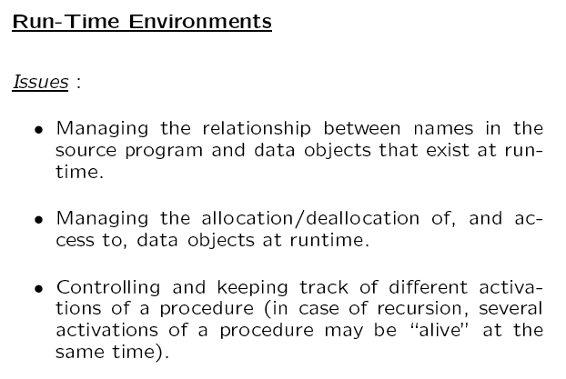

Slide 2
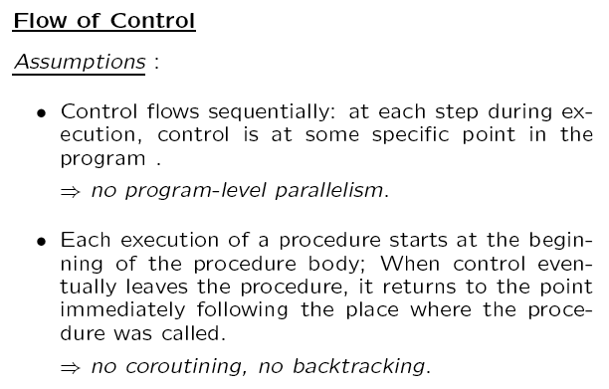

Slide 3
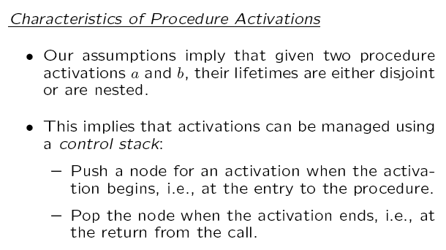

Slide 4
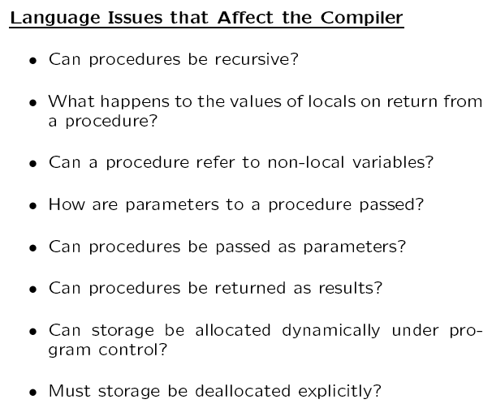

Slide 5
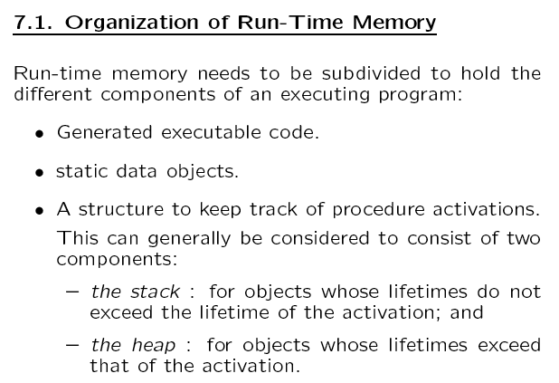

Slide 6
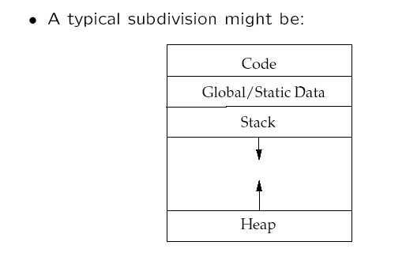

Slide 7

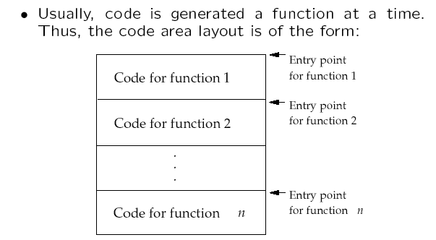
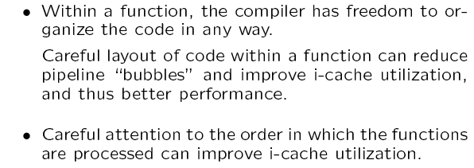

Slide 8

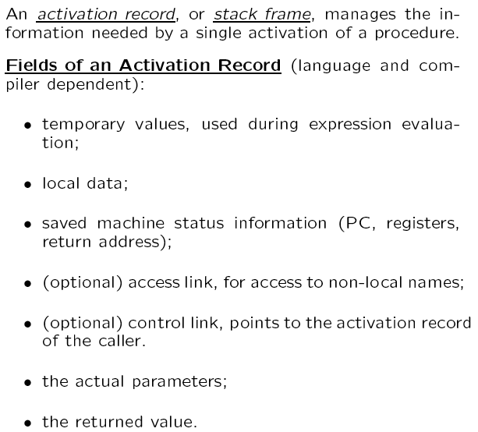

Slide 9
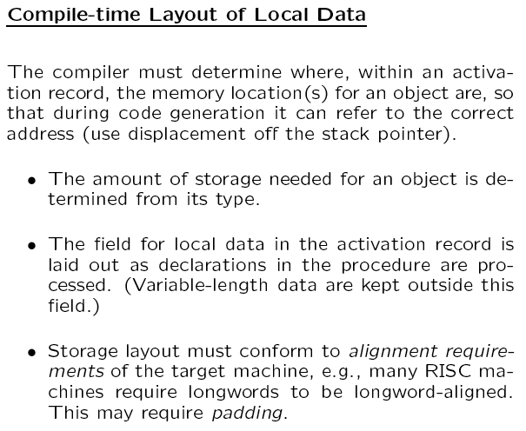

Slide 10
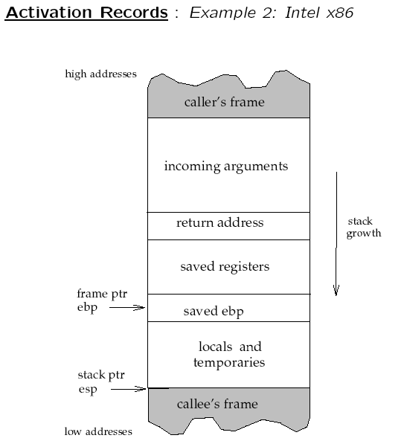

Slide 11
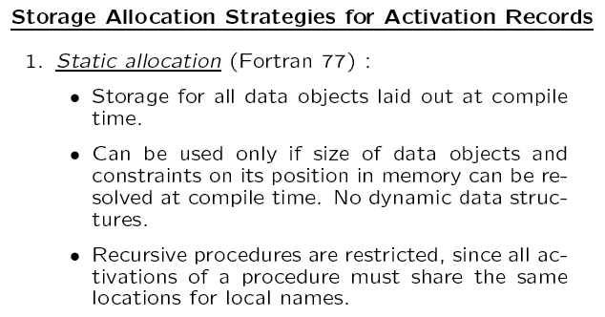

Slide 12
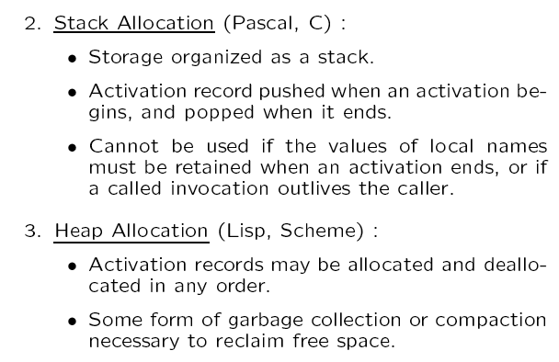

Slide 13
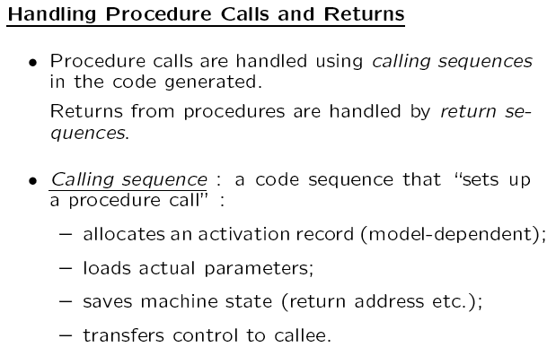

Slide 14
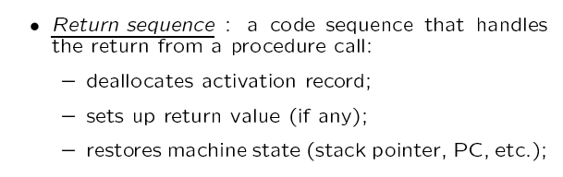

Slide 15
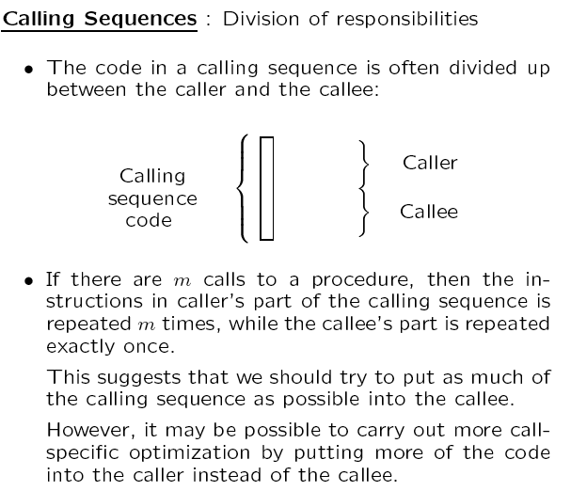

Slide 16
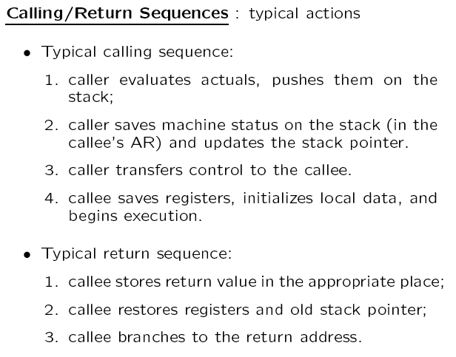

Slide 17
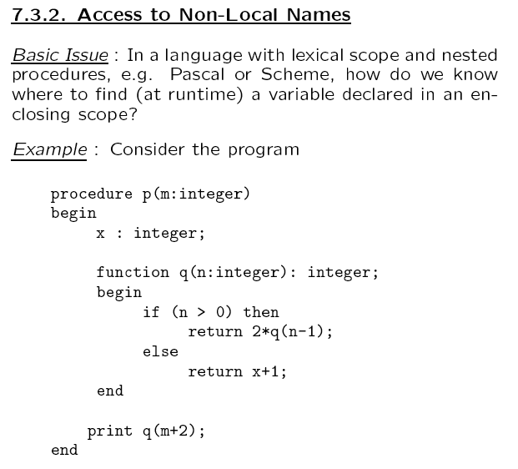

Slide 18
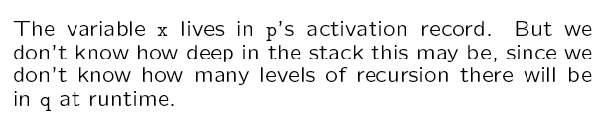
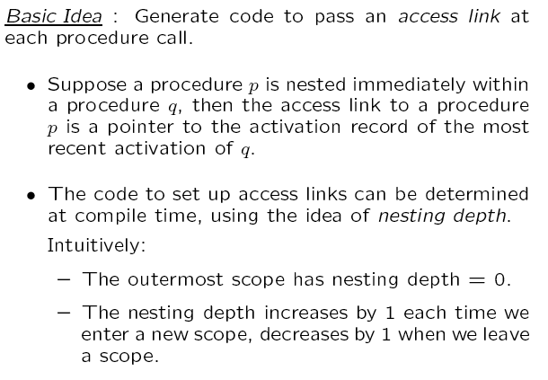

Slide 19
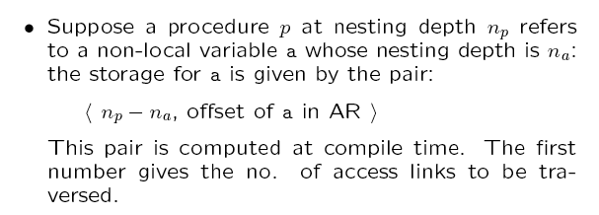

Slide 20
Example
Main
var I, J;
P1
var K, L;
P2
var Q;
Main: NL=1
P1: NL=2
NL=2
NL=3
use K → (1,0)
I : 0
J : 1
P1 : ……….
P3 : ……….
K : 0
L : 1
P2 : ……….
use J → (2,1)
use I → (1,0)
NL=1
P3
var H;
P2: NL=3
P3: NL=2
NL=2
use J → (1,1)
Q : 0
H : 0
offset
use I → (0,0)
number of access links
that must be traversed

Slide 21
Example Contd.
Call Chain: Main → P1 → P3 → P1 → P2
Main I J
P1 K L
P3 H
P1 K L
P2 Q
In P2 access K → (1,0)
In P2 access J → (2,1)
In P2 access I → (2,0)
………
Control Link /
Dynamic Link
Static Link /
Access Link

Slide 22
Example Contd.
Next call P3 – set up the access link
Main I J
P1 K L
P3 H
P1 K L
P2 Q
P3
P2 calls P3
c – current nesting level
d – nesting level of callee’s declaration
Traverse (c – d) links from P2 to find
where P3’s access link should point to
(c – d) = 3 - 1 = 2
P2 → P1 → Main
Access link of P3 points to Main
Control Link /
Dynamic Link
Static Link /
Access Link

Slide 23
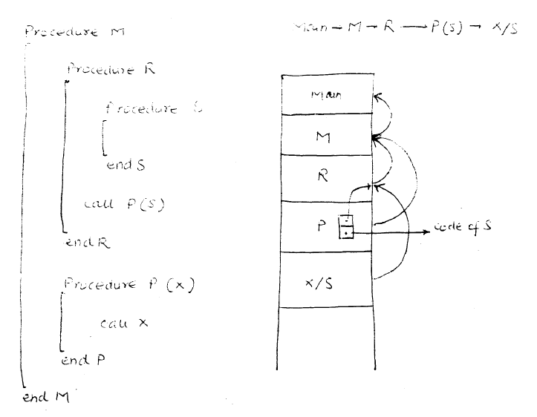
Procedure Parameters
Procedure M
Main → M → R → P(S) → X/S
Procedure R
Procedure S
End S
Call P(S)
End R
Procedure P(X)
Call X
End P
End M

Slide 24
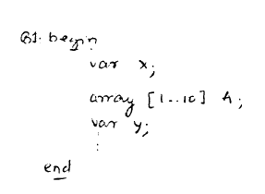
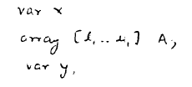
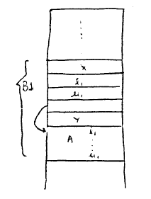
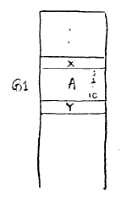
Dynamic Arrays – Maintaining Constant Offsets
B1: begin
Var X;
Array [1 .. 10] A;
Var Y;
end
Var X;
Array [l₁ .. U₁] A;
Var Y;
x
y

