Slide 1


Mahbod Afarin
CS152 Project Phase 1: Lexical Analyzer Generation Using flex
CS152 (Compiler Construction)
Spring 2021

Slide 2

Outline
Introduction to lexical analysis
What is flex?
How does it work?
Sample programs
1

Slide 3
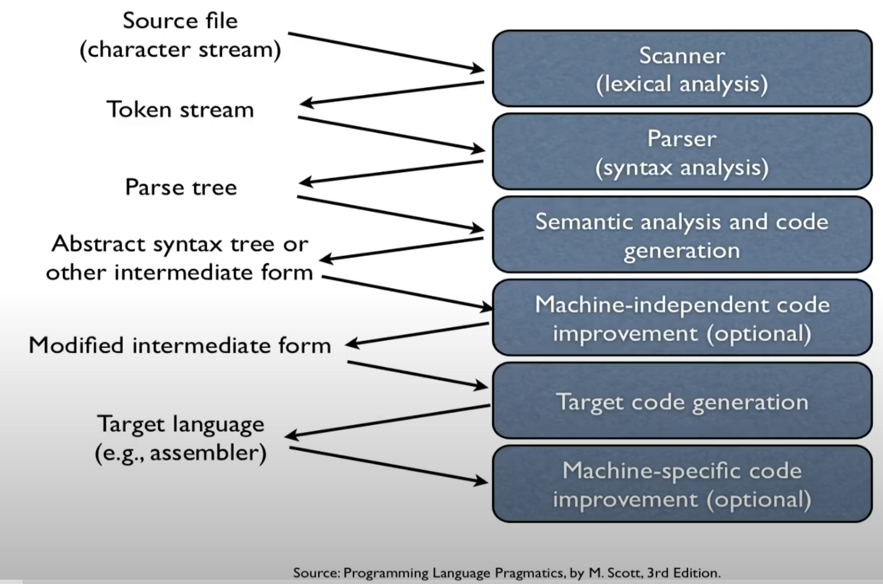
Language Processing
2

Slide 4
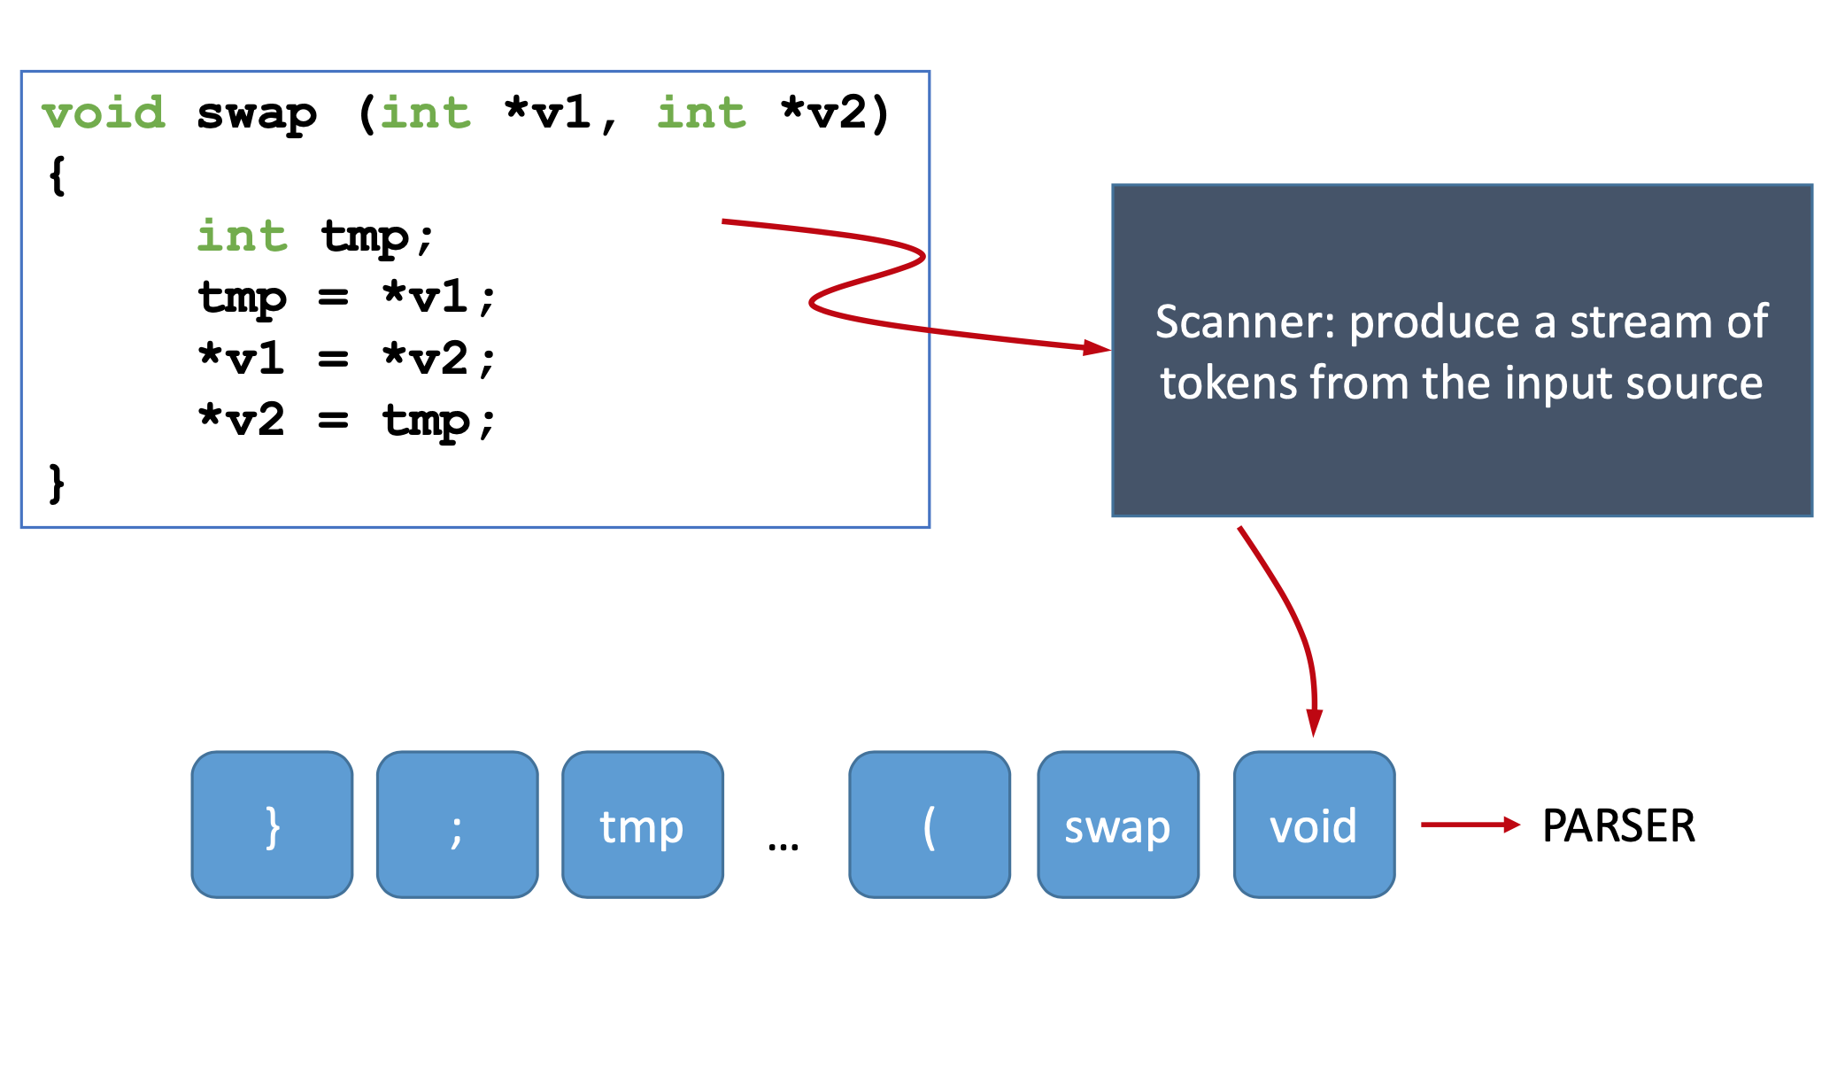
Lexical Analysis
3

Slide 5
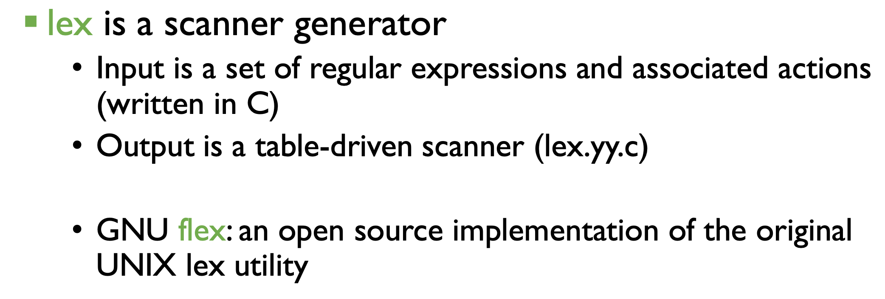
Lex/flex
4

Slide 6
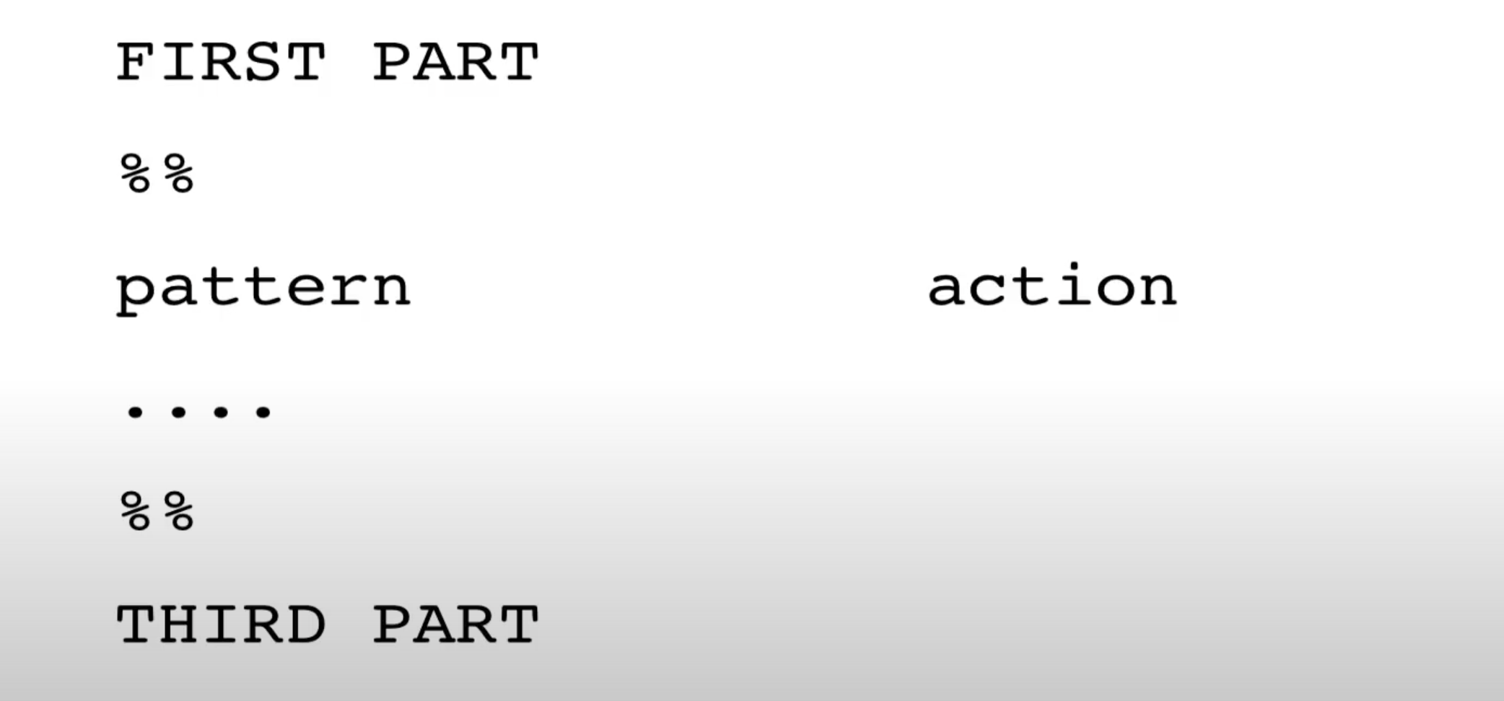
flex Input
5

Slide 7
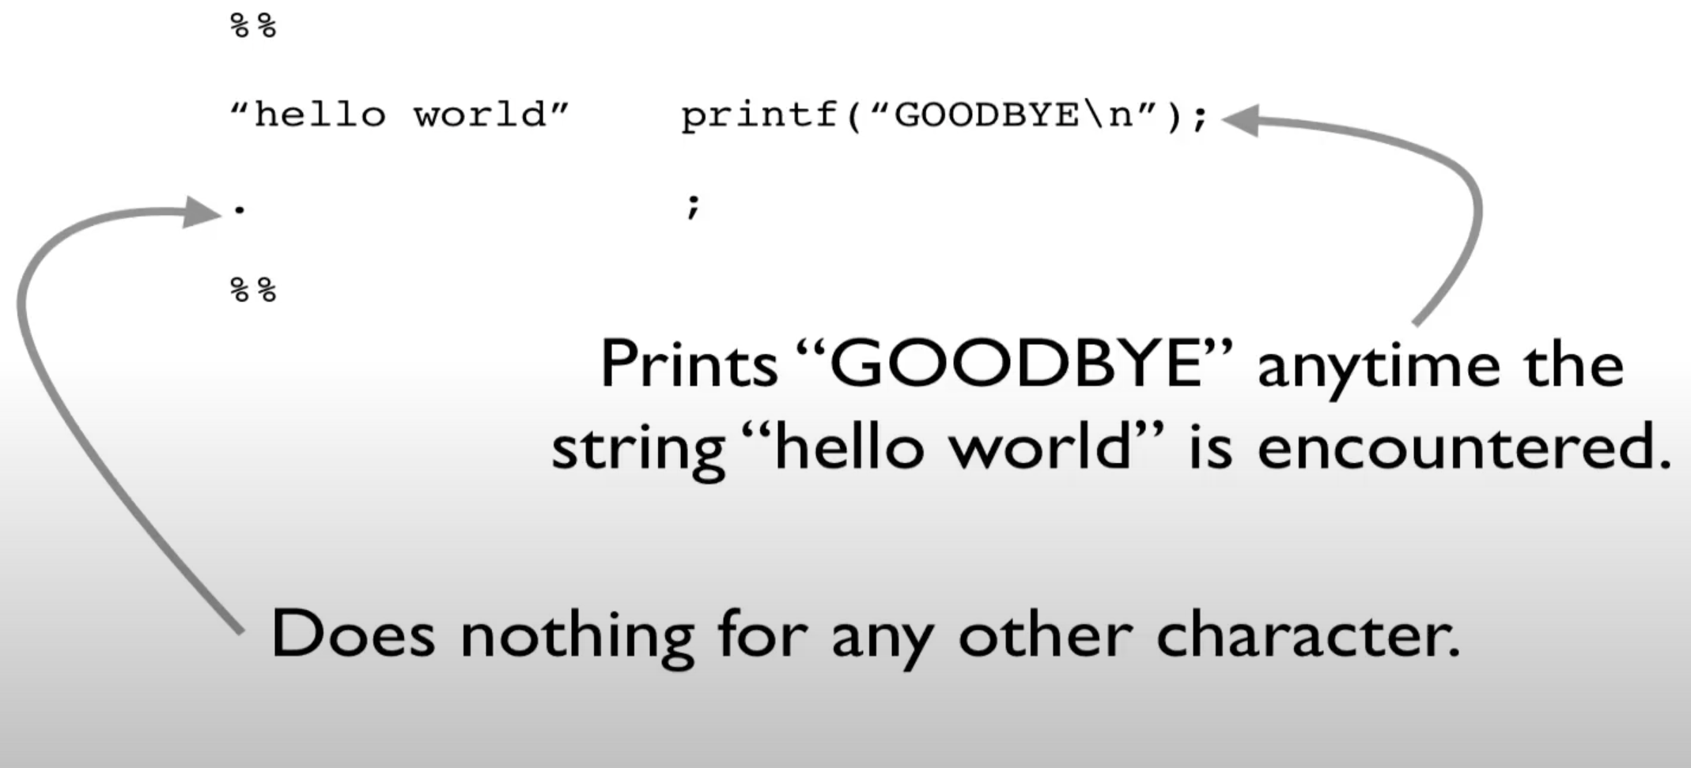
flex Input Example (I)
6

Slide 8
Running flex
$ flex exl.lex
$ gcc lex.yy.c -lfl
$ ./a.out
hello world
GOODBYE!
Process the flex file to generate a scanner (gets saved as lex.yy.c)
Compile the scanner
Run the scanner taking input from the standard input.
7

Slide 9
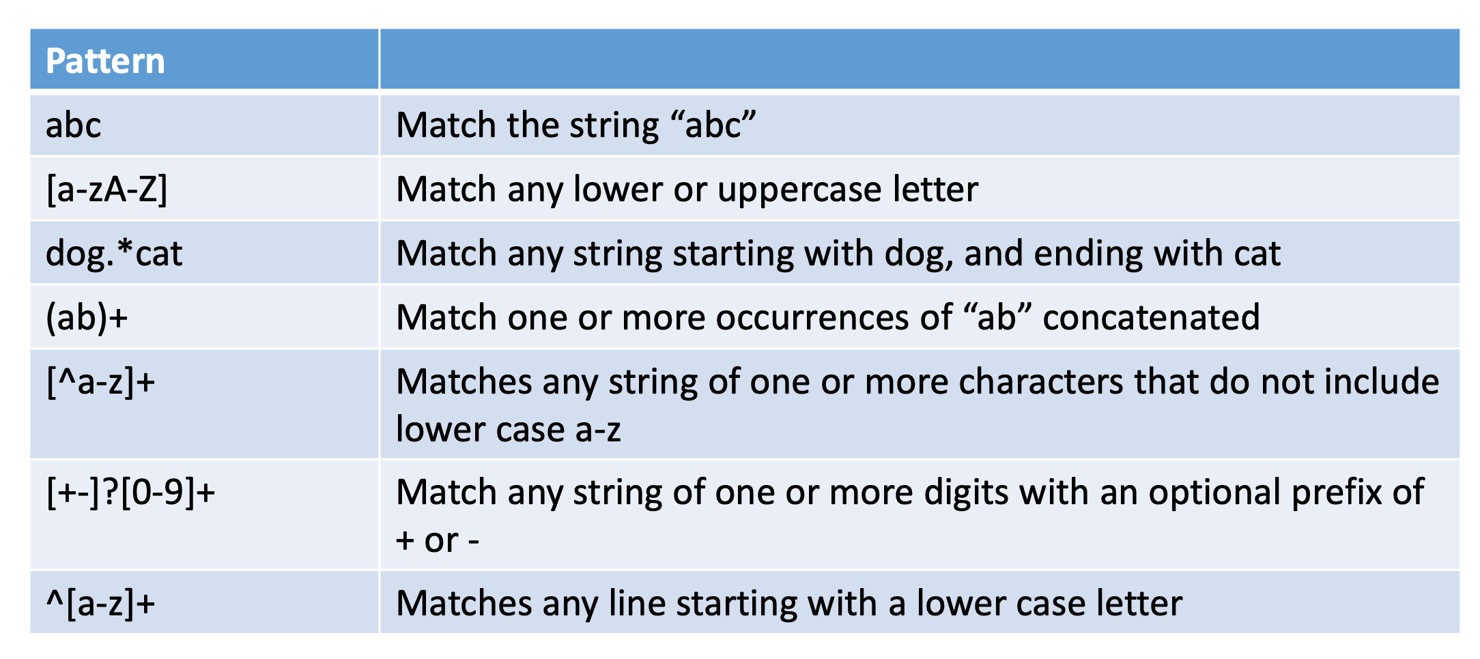
Flex pattern examples
8

Slide 10
Task 3
Enhance your flex specification so that in addition to printing out each encountered token, the lexical analyzer will also count the following.
The number of integers encountered
The number of operators encountered: +, -, *, /
The number of parentheses encountered: (, )
The number of equal signs encountered
The total counts should be printed to the screen after all input text has been tokenized. The counts need not be printed if an unrecognized character is encountered in the input (since the lexical analyzer should just terminate after issuing the error message).
9

Slide 11
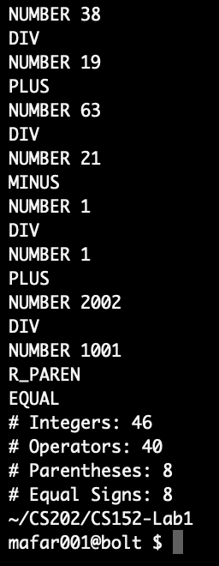
Sample Output for Task 3
Here is a sample output for task 3:
10

Slide 12
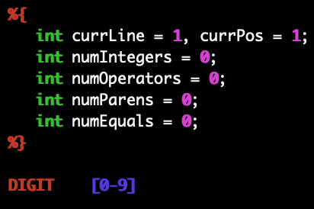
Pseudocode for Task 3
Here is a sample output for task 3 (the first part of the code):
11

Slide 13
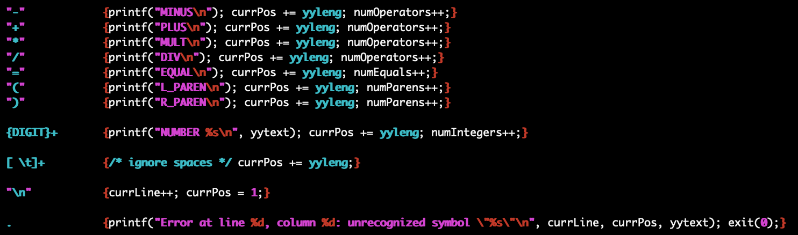
Pseudocode for Task 3 (Cntd.)
Here is a sample output for task 3 (the second part of the code):
11

Slide 14
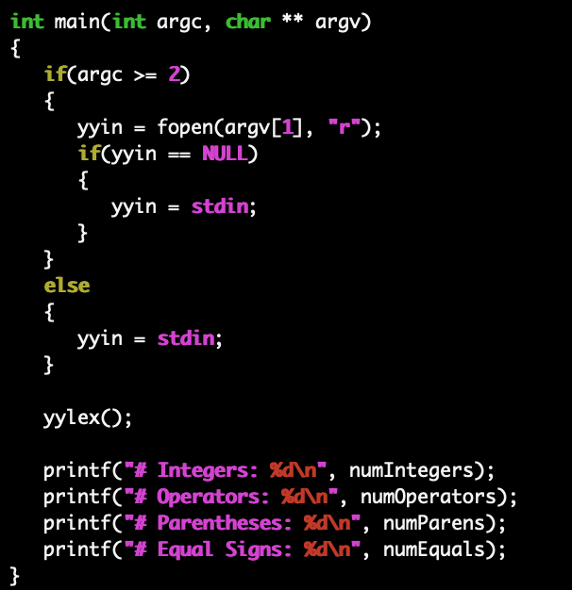
Pseudocode for Task 3 (Cntd.)
Here is a sample output for task 3 (the third part of the code):
12

Slide 15
Implementation
Now, try to implement the third task with your teammate.
How to run the third task:
flex calc_task3.lex
gcc lex.yy.c -lfl
./a.out test.txt
13

Slide 16
Task 4
For a challenge, you may want to try extending the calculator language to allow for decimal numbers in addition to regular integers. Thus, the following numbers should be recognized by your lexical analyzer.
.123 0.17 2.171 5.010 171.0023
14

Slide 17
Task 4 (Cntd.)
For an even greater challenge, extend the calculator language to allow for scientific notation in the numbers. After the number, there can be an optional "e-phrase" consisting of either "e" or "E", followed by an optional "+" or "-", followed by one or more digits. For example, the following numbers in scientific notation would be recognized by your lexical analyzer.
2e7 2e+7 2e-7 2E+102 5E0 0.201e+17
15

Slide 18
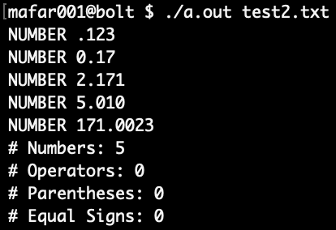
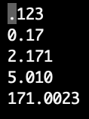
Sample Output for Task 4
Here is a sample output for task 3:
16

Slide 19
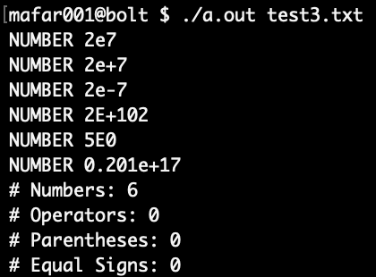
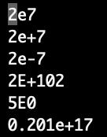
Sample Output for Task 4 (Cntd.)
Here is a sample output for task 3:
16

Slide 20
Pseudocode for Task 4
Here is a sample output for task 3:
17

Slide 21
Pseudocode for Task 4
Either e or E
Here is a sample output for task 3:
Or
Zero or more occurrence digits between 0 and 9
Dot
Either - or +
(\.{DIGIT}+)|({DIGIT}+(\.{DIGIT}*)?([eE][+-]?[0-9]+)?)
One or more digits between 0 and 9
One or more digits between 0 and 9
Dot
Previous prefix is optional
17

Slide 22
Flex regular expressions
Pattern | Explanation
s | string s literally
\c | character c literally
[s] | character class
^ | indicates beginning of line
[^s] | characters not in character class
[s-t] | range of characters
s? | s occurs zero or one time
. | any character except newline
s* | zero or more occurrences of s
s+ | one or more occurrences of s
r|s | r or s
18

Slide 23
Flex regular expressions (Cntd.)
Pattern | Explanation
(s) | grouping
$ | end of line
s{m,n} | m through n occurrences of s
a* | zero or more a’s
.* | zero or more of any character except newline
.+ | one or more characters
[a-z] | a lowercase letter
[a-zA-Z] | any alphabetic letter
[^a-zA-Z] | any non-alphabetic character
a.b | a followed by any character followed by b
rs|tu | rs or tu
19

Slide 24
Implementation
Now, try to implement the third task with your teammate.
How to run the third task:
flex calc_task4.lex
gcc lex.yy.c -lfl
./a.out test.txt
20

Slide 25
Lexical Errors to Catch
Your lexical analyzer should catch two different types of lexical errors. If any such error is encountered during parsing of a MINI-L program, your lexical analyzer should terminate immediately after reporting the error message. The error message must include information about the line number and column position number within the line of the token associated with the error. The details are below.
21

Slide 26
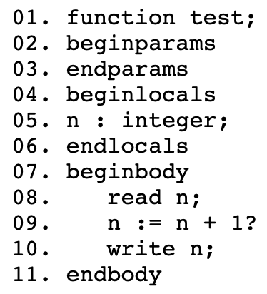
Error Type 1: Unrecognized Symbol
Your lexical analyzer should report an error and terminate if an unrecognized symbol is encountered that is outside of a comment. For example, consider the following MINI-L function:
Error at line 9, column 14: unrecognized symbol "?"
22

Slide 27
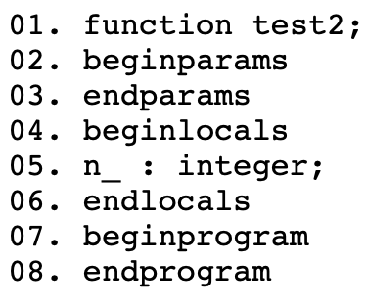
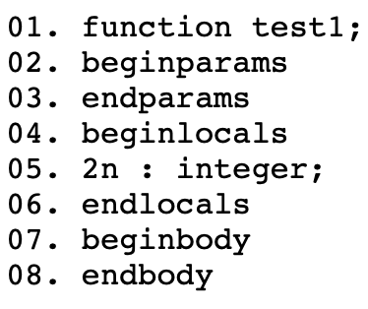
Error Type 2: Invalid Identifier
Your lexical analyzer should report an error and terminate if an invalid identifier is encountered. This can occur if the identifier starts with a digit or an underscore, or if the identifier ends with an underscore. For example, consider the following two MINI-L functions:
Error at line 5 , column 0: identifier "n_" cannot end with an underscore
Error at line 5, column 0: identifier "2n" must begin with a letter
23

Slide 28
Error Type 2: Invalid Identifier
In the first part:
ID [a-zA-Z][a-zA-Z0-9_]*[a-zA-Z0-9]
E_ID_1 [0-9_][a-zA-Z0-9_]*
E_ID_2 [a-zA-Z][a-zA-Z0-9_]*[_]
24

Slide 29
Comments
In the first part:
In the second part:
COMMENT ##.*
{COMMENT} {currLine++; currPos = 1;}
25

Slide 30


Thanks for your listening.

