Slide 1

A tutorial on yacc/bison
Compiler Construction
Spring 2021

Slide 2
Outlines
What is yacc/bison?
How it works?
A sample program
1

Slide 3
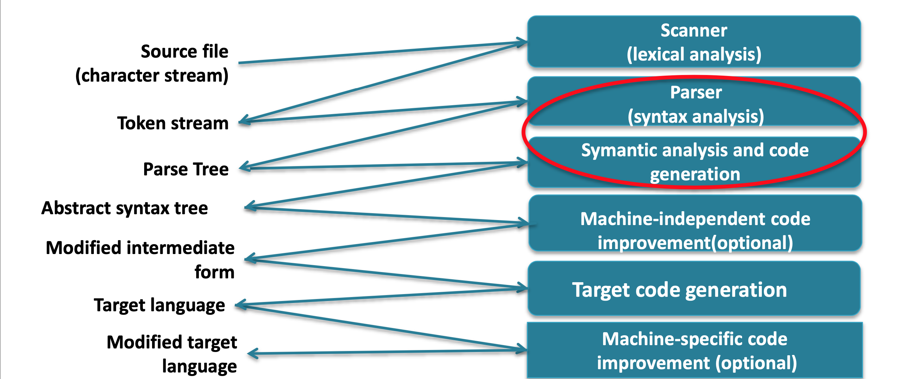
Language Processing
2

Slide 4
Lex/Yacc
Lex
lex generates C code for a lexical analyzer, or scanner.
lex uses patterns that match strings in the input and converts the strings to tokens.
Yacc (yet another compiler compiler)
Yacc generates C code for syntax analyzer, or parser.
Yacc uses grammar rules that allow it to analyze tokens from lex and create a syntax tree.
bison: GNU parser parser, upward compatibility with yacc.
2

Slide 5
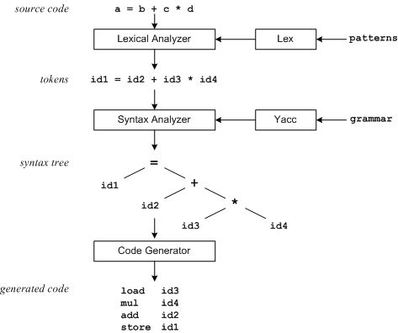
Lex/Yacc
3

Slide 6
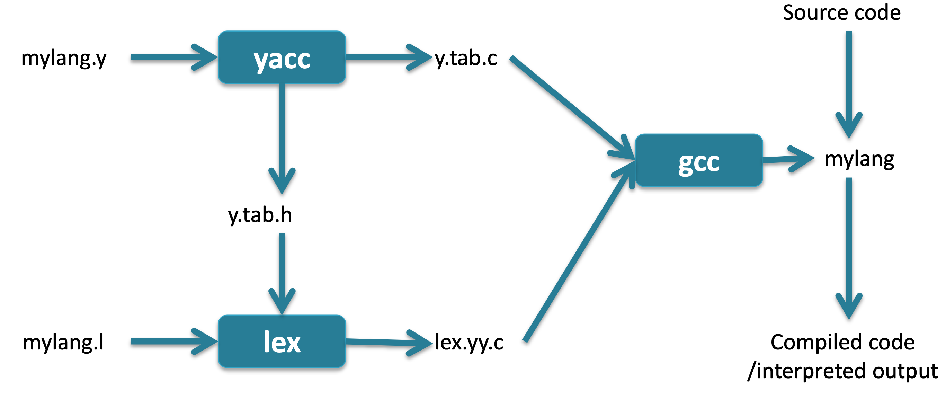
Lex with Yacc
4

Slide 7
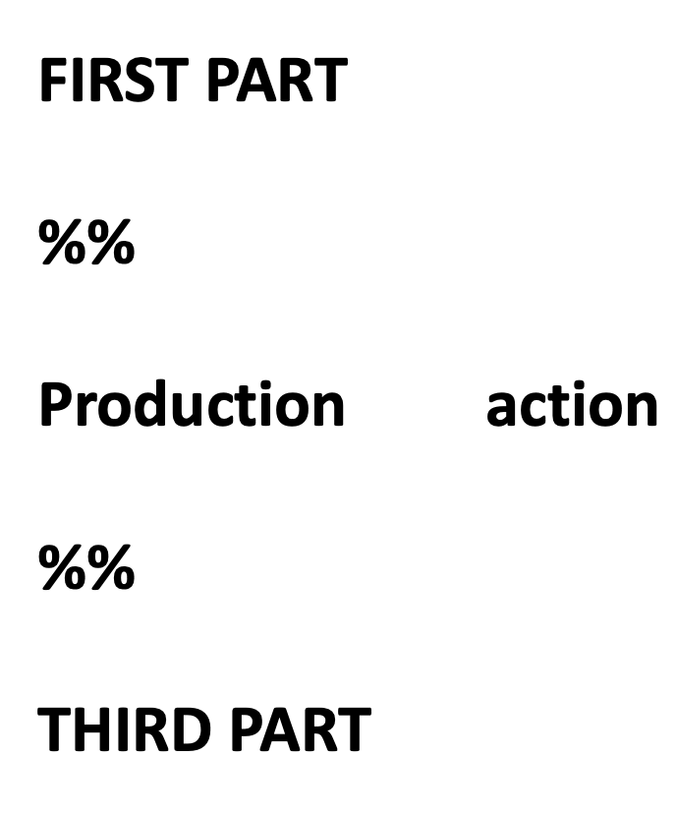
Yacc Input
5

Slide 8
Yacc / First Part
First part of the yacc specification includes:
C declarations enclosed in %{ %}
Yacc definitions:
%start The first non-terminal in the grammar
%token Terminal
%union Declare the collection of data types
%type Declare the type of semantic values for non-terminals
%right,%left Declare the associativity of tokens
%nonassoc Declare a token is not associative
6

Slide 9
Yacc / Second Part (Productions)
The middle section represents a grammar – a set of productions. The left-hand side of a production is followed by a colon, and a right-hand side.
Multiple right-hand side may follow separated by a “|”.
Actions associated with a rule are entered in braces.
7

Slide 10
Yacc Productions
$1, $2 … $n can be referred to the values associated with symbols.
$$ refer to the value of the left.
Every symbol have a value associated with it (including token and non-terminals).
Default action:
$$ = $1
9

Slide 11
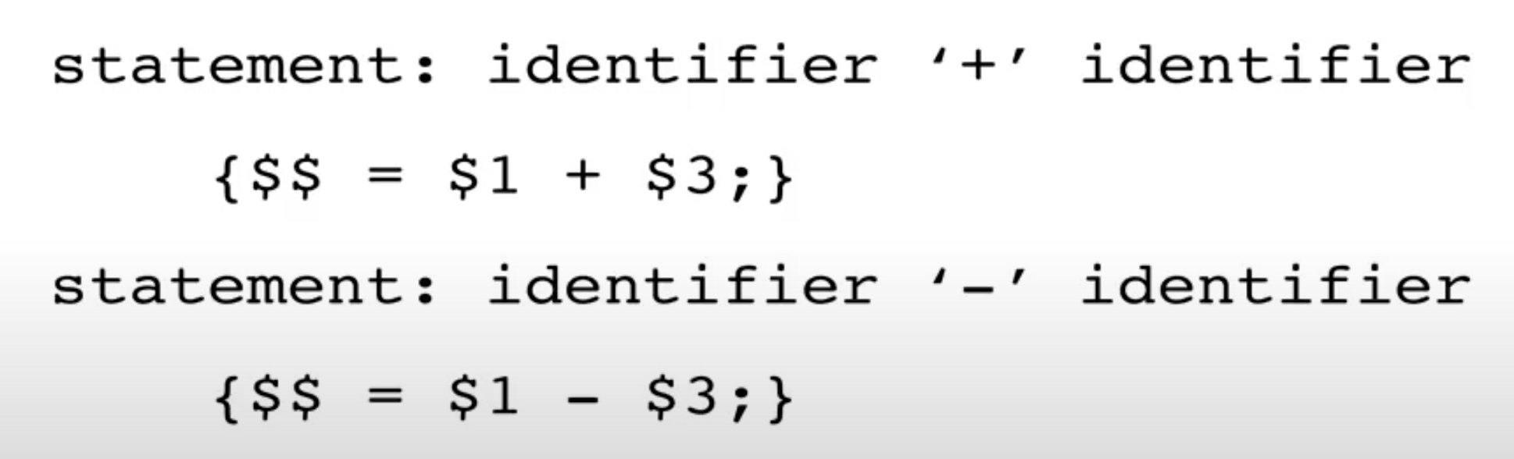
Yacc Example Productions
10

Slide 12
Yacc / Third Part
Contains valid C code that that supports the language processing.
Symbol table implementation.
Functions that might be called by actions associated with the productions in the second part.
11

Slide 13
Task 1
Create a Bison specification to evaluate expressions in the calculator language.
Print out an error message and exit if any unrecognized character is encountered in the input or if the input does not follow the calculator grammar.
Use Bison to compile your specification into an executable parser that reads text from standard-in and prints the results to the screen.
12

Slide 14
Task 1
Use the following commands to compile your calculator project:
bison -v -d --file-prefix=y calc.y
flex calc.lex
gcc -o calc y.tab.c lex.yy.c -lfl
13

Slide 15
Task 2
Enhance your Bison specification so that input text can be optionally read from an input file, if one is specified on the command line when invoking the parser.
14

Slide 16
Task 3
Enhance your Bison specification so that if the input expression is wrong (it does not follow the calculator grammar), it prints out where the error is and what token the parser was expecting.
15

Slide 17
Task 4
Change Bison specification so that in addition to evaluate expressions, the parser will also count the following.
The number of integers encountered
The number of operators encountered: +, -, *, /
The number of parentheses encountered: (, )
The number of equal signs encountered
16

Slide 18
Task 5
For a challenge, you may want to try extending the calculator language to allow for decimal numbers in addition to regular integers. Thus, the following numbers should be recognized by your parser.
For an even greater challenge, extend the calculator language to allow for scientific notation in the numbers. After the number, there can be an optional "e-phrase" consisting of either "e" or "E", followed by an optional "+" or "-", followed by one or more digits. For example, the following numbers in scientific notation would be recognized by your parser.
16

Slide 19


Thanks for your listening.

