Slide 1

CS152 Project Phase 2: Parser Generation Using bison
Compiler Construction – Spring 2021
Mahbod Afarin

Slide 2
Outlines
What to Submit?
Detailed Requirement
Writing the grammar
Lex/Flex with Yacc/Bison
Makefile
Project description
How to write the program?
1

Slide 3
What to Submit?
Due Date → 5/14/21
Grade Weight: 12% of total course grade
This project can be completed either individually or in pairs (with at most 1 other person)
You need to submit the following:
mini_l.lex
mini_l.y
mini_l_gramar.pdf
Makefile
For this phase, grading will be by interview. Both group members are expected to be able to answer questions about any aspect of the implementation.
2

Slide 4
Detailed Requirements
The following tasks will need to be performed to complete this phase of the project:
First, you will need to write the grammar for the MINI-L language, based on the specification for MINI-L that we have provided for you. You must submit this grammar along with the other files required for this phase of the class project!
Create the bison parser specification file using the MINI-L grammar. Ensure that you specify helpful syntax error messages to be outputted by the parser in the event of any syntax errors.
Example: write the bison specification in a file named mini_l.y.
3

Slide 5
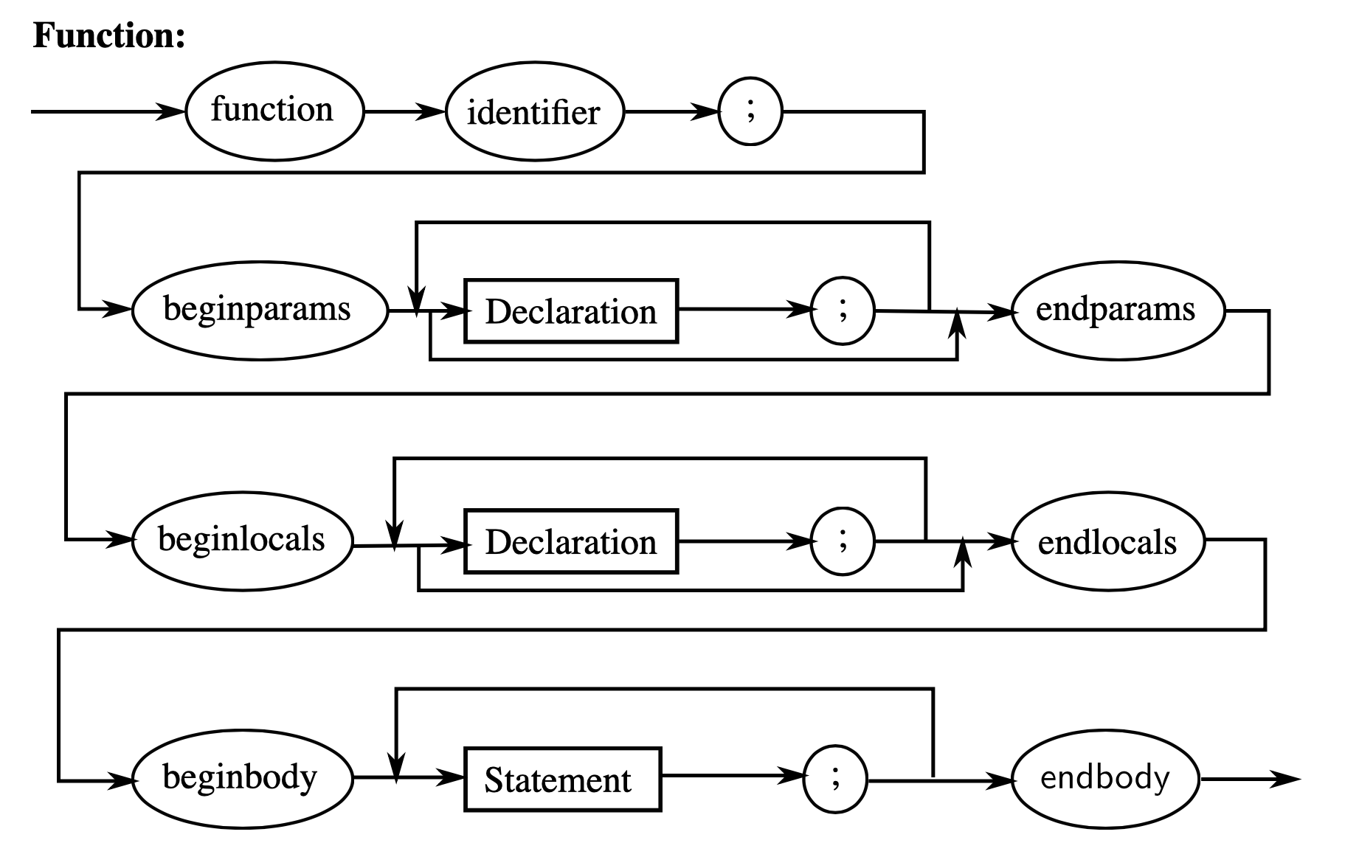
How to Write the Grammar?
Here is an example:
Function → “function” “identifier” “;” “beginparams” Dec “endparams” “beginlocals” Dec “endlocals” “beginbody” Statements “endbody”
Dec → Dealation “;” Dec | empty
4

Slide 6
How to Write the Grammar? (Cntd.)
Another example:
Statements → A|B|C|D|E|F|G|H
A → Var “:=” Expression B → “if” Bool-Exp “then” Statement “endif” | “if” Bool-Exp “then” Statement “else” Statement “endif” C → “while” Bool-Exp “beginloop” Statement “endloop” D → “do” “beginloop” Statement “endloop” “while” Bool-Exp E → “read” Var E’ E’ → “,” Var E’ | empty
F → “write” Var E’ G → “continue” H → “return” Expression
5

Slide 7
Detailed Requirements (Cntd.)
Run bison to generate the parser for MINI-L using your specification.
The -d flag is necessary to create a .h file that will link your flex lexical analyzer and your bison parser.
The -v flag is helpful for creating an output file that can be used to analyze any conflicts in bison.
The --file-prefix option can be used to change the prefix of the file names outputted by bison.
Example: execute the command:
This will create the parser in a file called y.tab.c, the necessary .h file called y.tab.h, and the informative output file called y.output.
bison -v -d --file-prefix=y mini_l.y
6

Slide 8
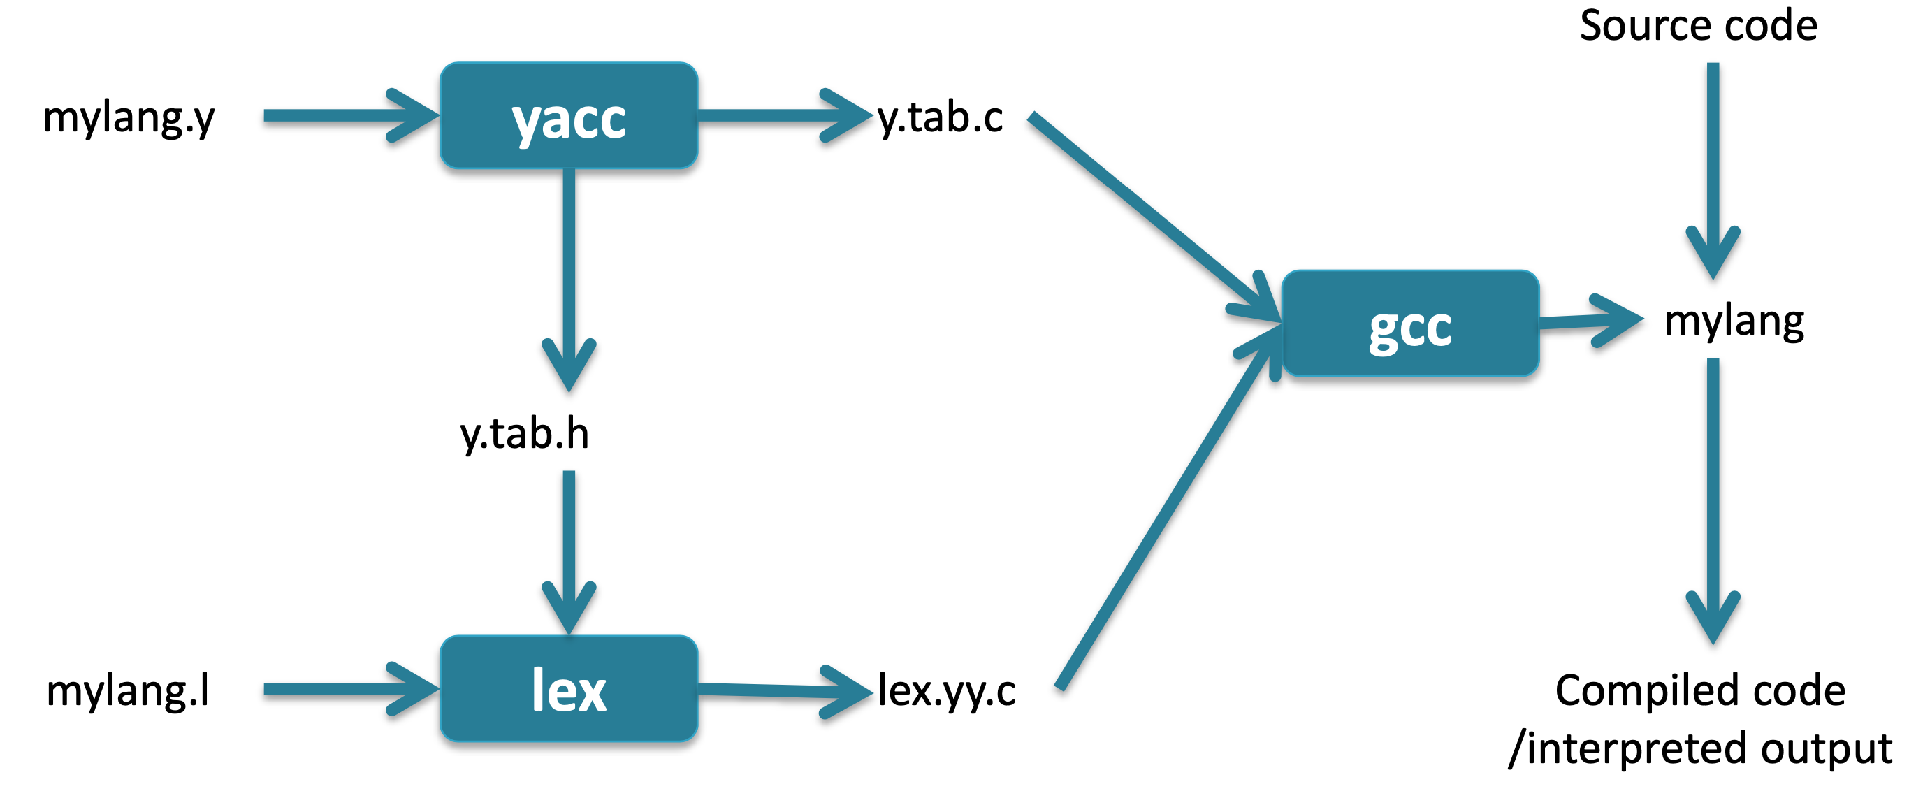
Lex/Flex with Yacc/Bison
7

Slide 9
Detailed Requirements (Cntd.)
Ensure that your MINI-L lexical analyzer from the first phase of the class project has been constructed.
Example: if your lexical analyzer specification is in a file called mini_l.lex, then use it with flex as follows: flex mini_l.lex. This will create the lexical analyzer in a file called lex.yy.c.
Compile everything together into a single executable. Example: compile your parser into the executable parser with the following command: gcc -o parser y.tab.c lex.yy.c -lfl. The program parser should now be available for use.
8

Slide 10
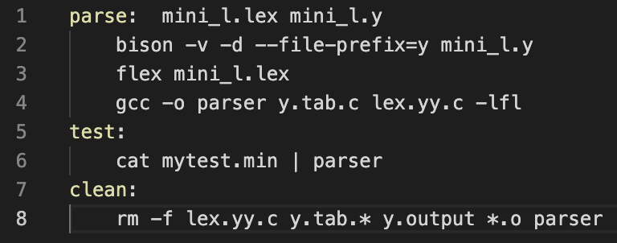
Makefile
9

Slide 11
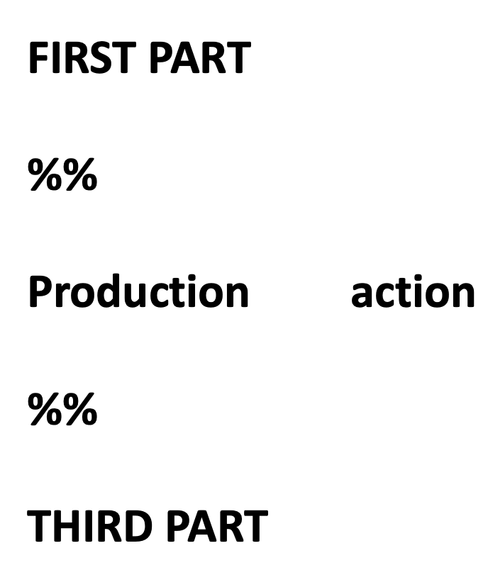
Bison Input
10

Slide 12
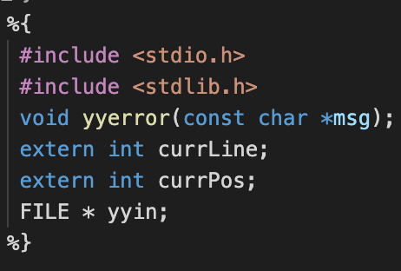
First Part
The Error Reporting Function
Position of each character
Input file
11

Slide 13
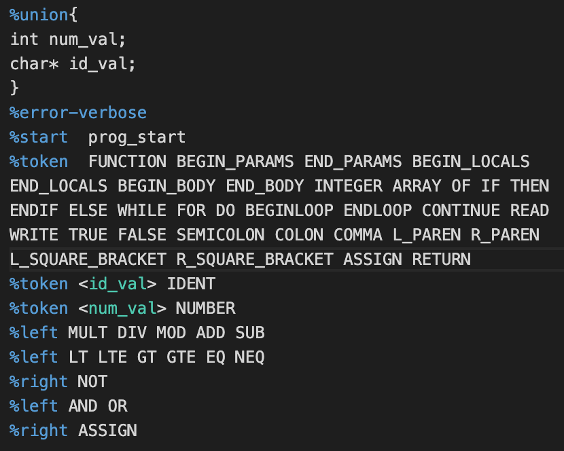
First Part (Cntd.)
12

Slide 14
Bison Input
13

Slide 15
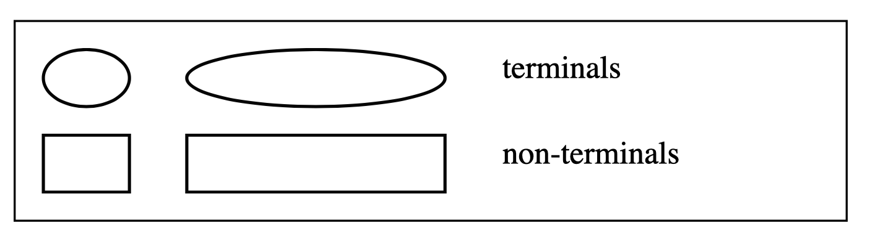
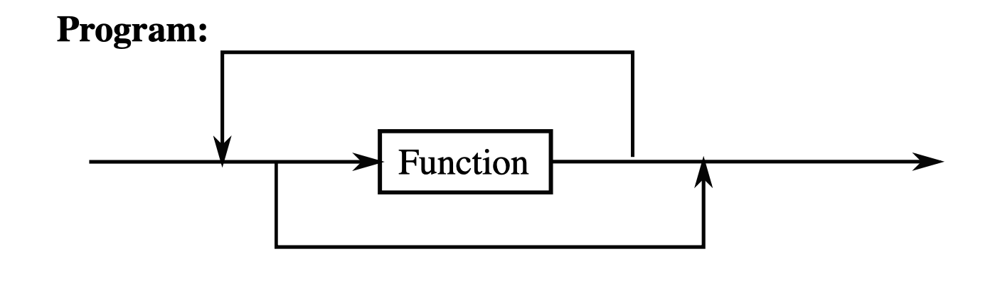
Syntax Diagrams for the MINI-L Language
14

Slide 16
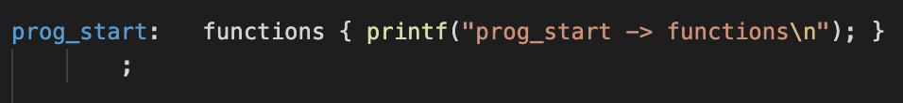
Program
15

Slide 17
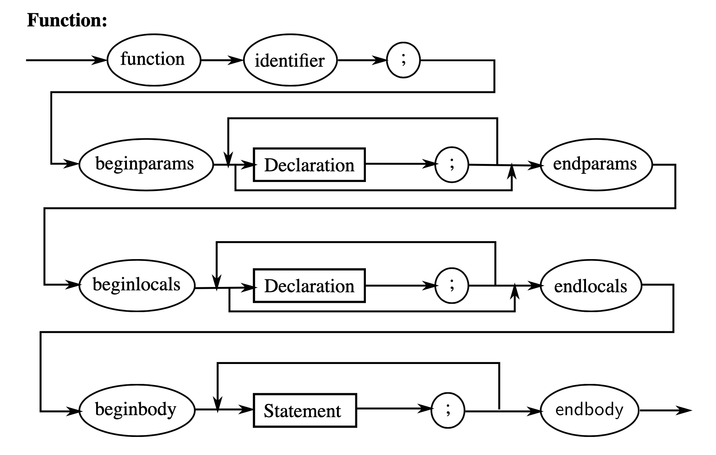
Function
16

Slide 18
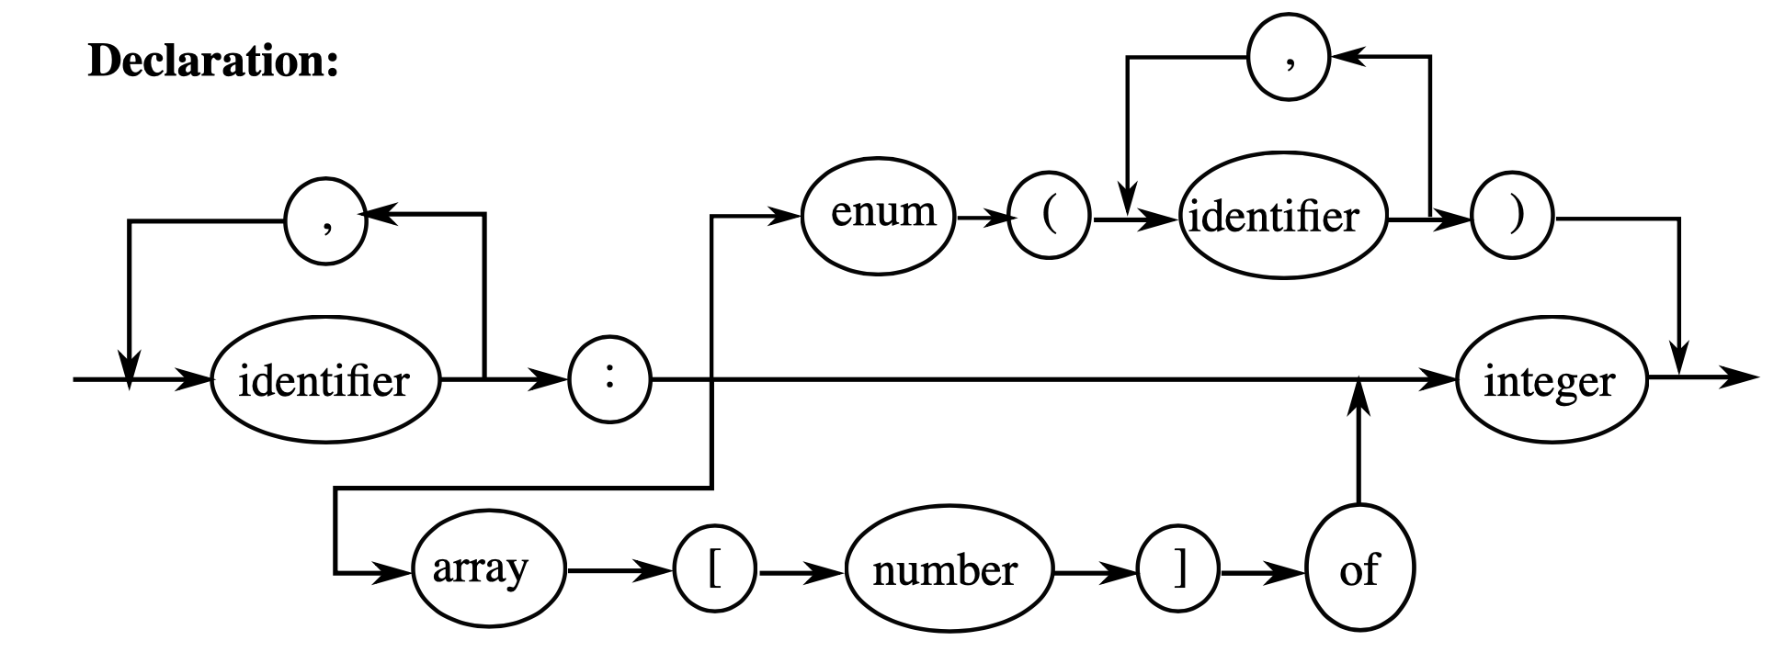
Declaration
Declarations
Declaration
17

Slide 19
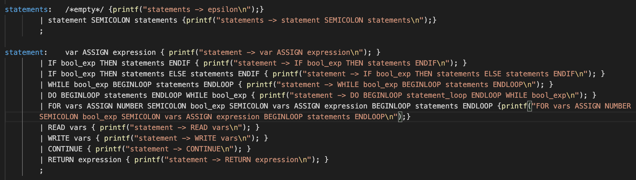
Statement
17

Slide 20
Bison Input
18

Slide 21
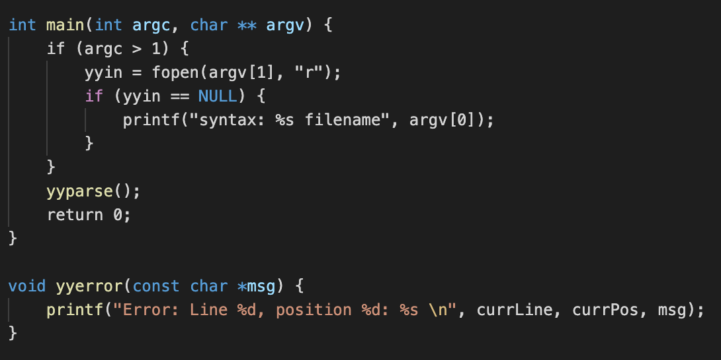
Third Part
19

Slide 22


Thanks for your listening.

