Slide 1

ALTA Shared Task
Contact:
Lizhen.Qu@data61.csiro.au
Hanna.Suominen@data61.csiro.au
http://www.alta.asn.au/events/sharedtask2016/
Notes:
52

Slide 2
Task Description
Whether two URIs are referring to same entity?
Attributes: uri pairs
Label:
1(same entity)
0 (different entities)
Training: 200 samples
160 for training, 40 for parameter learning
Testing: 200 samples
100 for public leaderboard, 100 for private leaderboard

Slide 3
Some Ideas of the Workflow
Split your training data into a train set and a validation set. Tune your hyperparameters on the validation set to avoid overfitting.
Download web pages from URLs
Clean the download web pages into plain text, optionally keep hyperlinks.
Optionally apply NER and NED systems on the plain text.
Build feature vectors based on similarity measurement.
Cosine, Jaccard etc.
euclidean distance based on averaged word/entity embeddings or more advanced NN models such LSTM.
Classification by using logistic regression, NNs, SVM.
For the final runs, train your best models with all available training data (train set + validation set), and submit your final results.

Slide 4
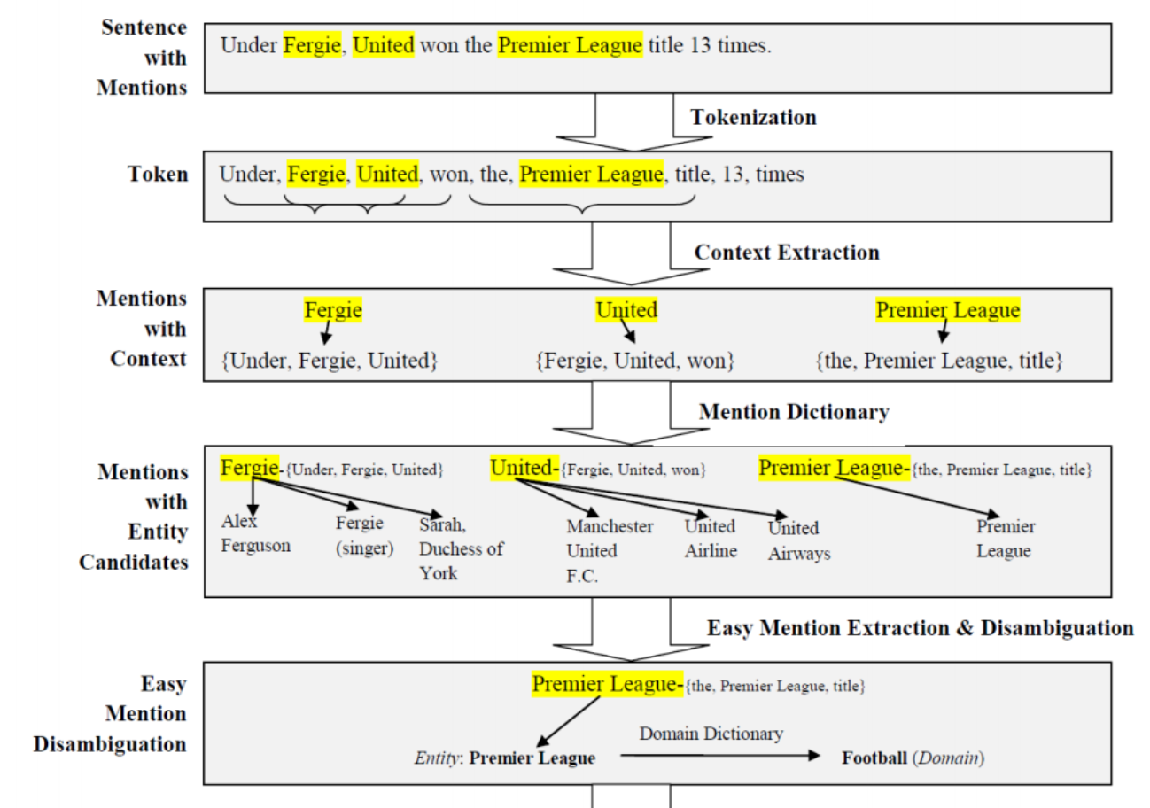
Entity Extraction and Disambiguation

Slide 5
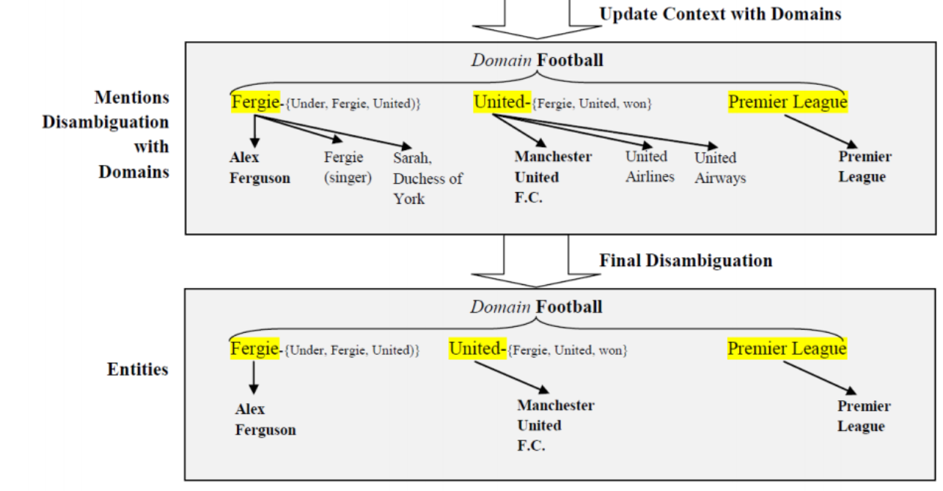
Entity Extraction and Disambiguation

Slide 6
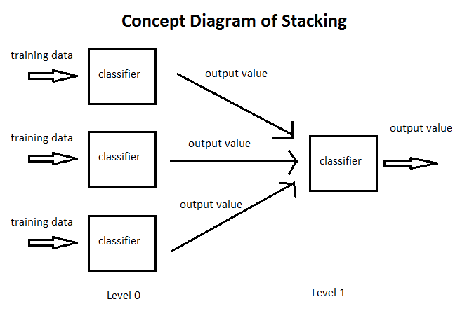
Stacking

Slide 7
Toolkit
AIDA
https://www.mpi-inf.mpg.de/departments/databases-and-information-systems/research/yago-naga/aida/
Wikifier
https://cogcomp.cs.illinois.edu/page/software_view/Wikifier
CMU twitter NLP
http://www.cs.cmu.edu/~ark/TweetNLP/
Freebase
We have a freebase dump.
https://jena.apache.org/
https://alchemy-language-demo.mybluemix.net/
https://en.wikipedia.org/wiki/Wikipedia:Database_download

Slide 8
REFERENCES
[1] Nguyen, Dat Ba, et al. "AIDA-light: High-Throughput Named-Entity Disambiguation." LDOW. 2014.
https://www.mpi-inf.mpg.de/departments/databases-and-information-systems/research/yago-naga/aida/
[2] Yamada, Ikuya, et al. "Joint Learning of the Embedding of Words and Entities for Named Entity Disambiguation." arXiv preprint arXiv:1601.01343 (2016). (http://arxiv.org/pdf/1601.01343.pdf )

