Slide 1
GGSB Prelim Q1 – Hang Chen
Question 1:
Transcriptional adaptation:
Concept: mutations in one gene -> Expression modulation in other genes -> phenotypic rescue
Why it is important: to maintain fitness in the presence of harmful mutations / robustness under perturbations
How it caught attention: different phenotypes between knockouts and knockdowns
Note: Knockouts are by early stop codon, not entire gene deletion
Note: Morpholinos are synthetic antisense nucleotide analogs

Slide 2
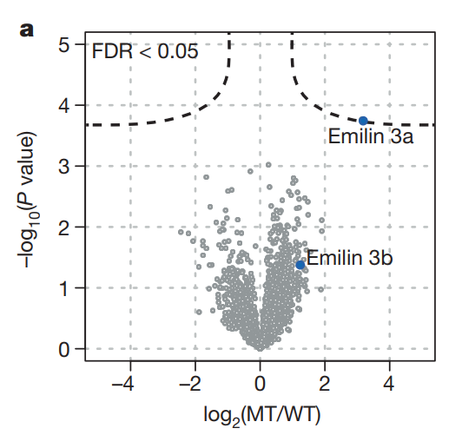
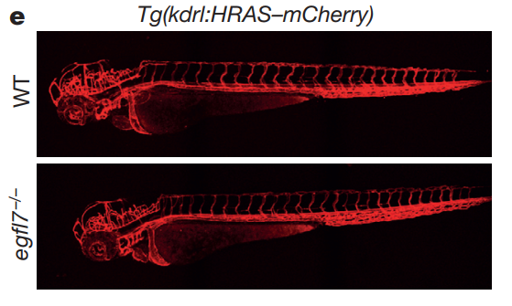
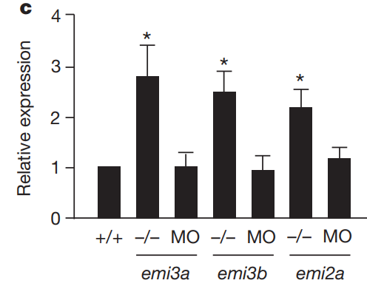
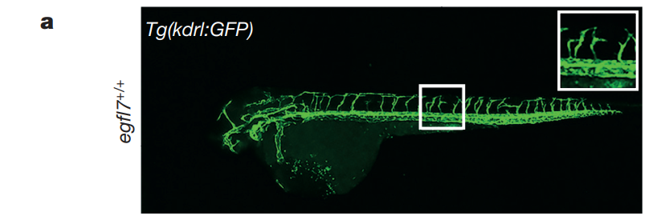
Example of Egfl7 and vasculogenesis
-MO
-MO
+MO
Rossi et al., 2015
(also extracellular matrix proteins)

Slide 3
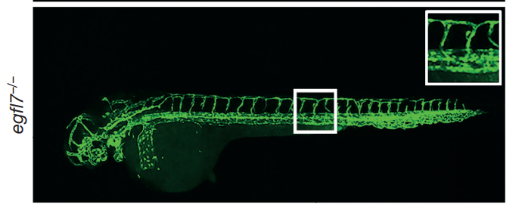
Question 2:
1
2
3
WT/WT
KO/KO
KO/KO
+MO
+MO
+MO
Defective phenotype
Normal phenotype
Still normal phenotype
(not off-target or
MO effects)
+MO
(If the vasculogenesis deficiency was caused by MO, then group 1 and 3 should have the same phenotype)
Rossi et al., 2015

Slide 4
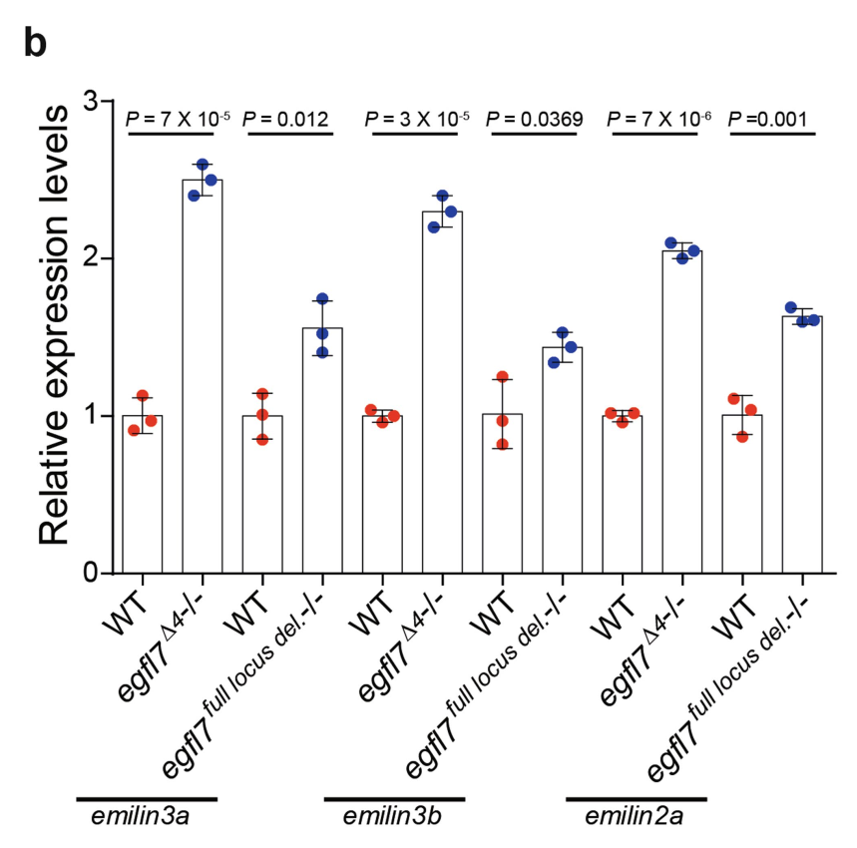
One possibility: increased transcription
Mutation
Early stop and degradation
The products induce other gene transcription
The products inhibit other mRNA degradation
EI-Brolosy et al., 2019

Slide 5
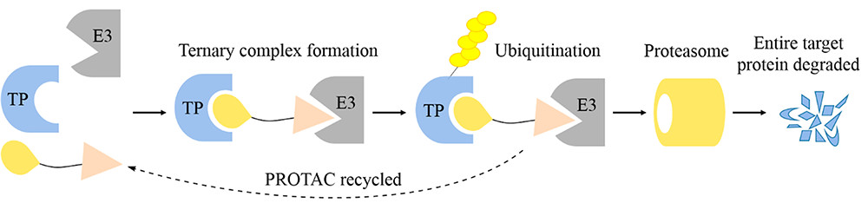
Question 3 and 4:
Another possibility: decreased degradation
Experiment design:
In silico search for RBPs ->
PROTAC for the RBPs in KO ->
expect MO-like phenotype and no RNA increase for adapting genes
(Ctrl: PROTAC for irrelevant RBPs in KO, expect WT-like phenotype)
Gao et al., 2020
Special thanks to Xiaochang Zhang group.

