Slide 1
GGSB Prelim Q2 – Hang Chen
Gene therapy: treating genetic disorders using genetic approaches
Major class of diseases that are conducive to gene therapy:
Monogeneic: easy to target
Loss-of-function or haploinsufficiency: easy to rescue
Many are also hematological diseases: easy to access
Lower-level restoration: easier to molecularly fix cells than tissues
Dx | Cause | Gene | Gene changes | Location | Vector
X-linked Severe Combined Immunodeficiency (SCID) | Lymphocytes development deficiency | IL2RG | Mutations in IL2RG gene | Ex vivo | RV
Thalassemia | Less alpha or beta hemoglobin | HBA1/2 and/or HBB1/2 | Mutations in HBA1/2 and/or HBB1/2 genes | Ex vivo | AAV
Sickle cell anemia | Hemoglobin polymerization | HBB | A mutation in both HBB alleles | Ex vivo | AAV
Congenital hemophilia | Blood does not clot properly | F8 and/or F9 | Mutations in F8 or F9 genes | In vivo | AAV
Vision Loss | Impaired retinoid cycle | RPE65 | Mutations in RPE65 gene | In vivo | AAV
Spinal muscular atrophy (SMA) | Insufficient survival motor neuron protein (SMN) | SMN1 | Mutations in SMN1 gene | In vivo | AAV
High et al., 2019

Slide 2
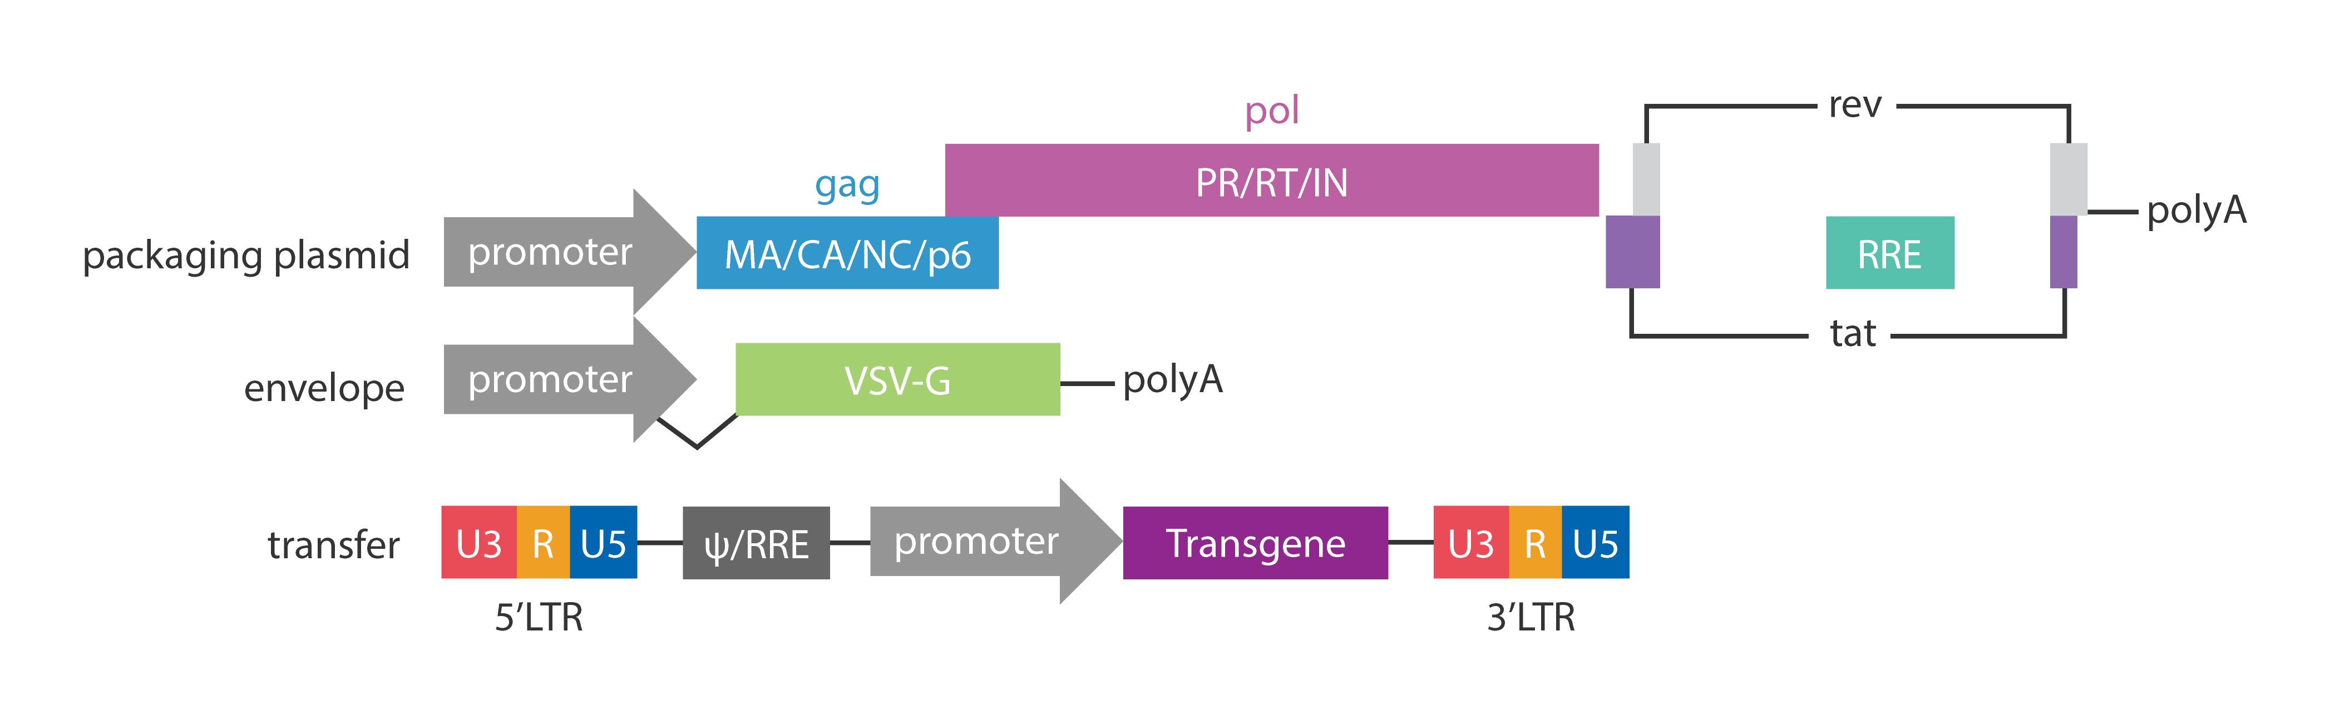
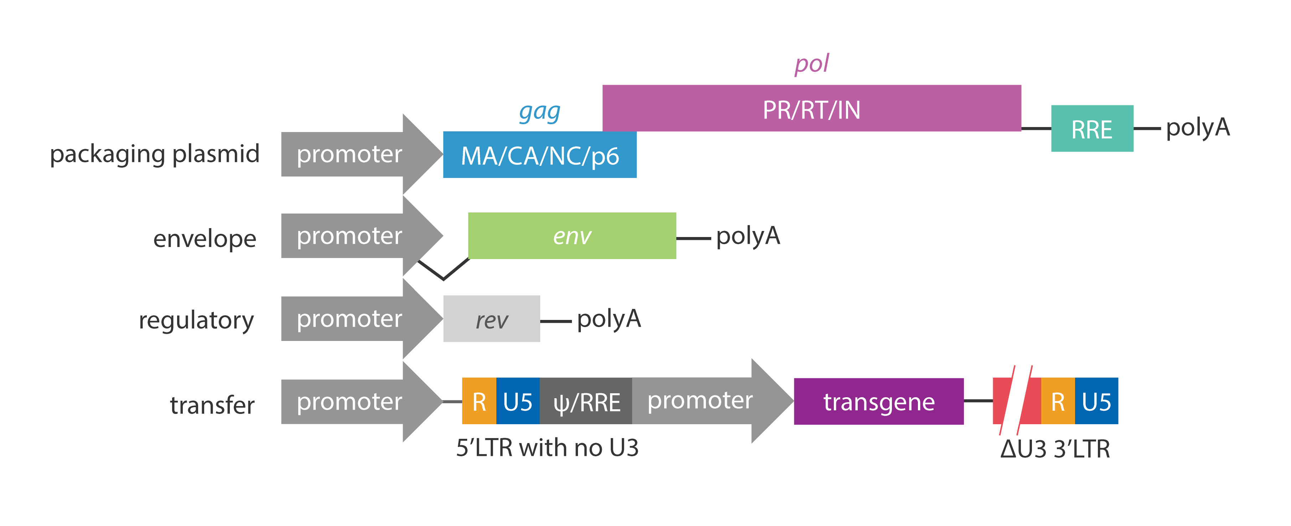
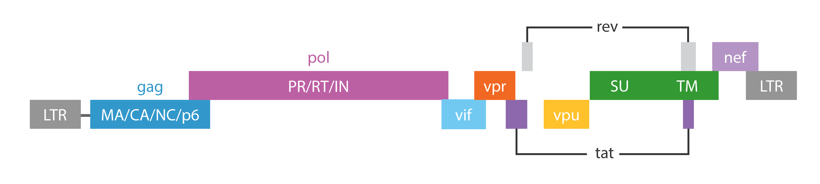
Lentivirus (LV)
Type
Retrovirus (enveloped)
Genome
Single stranded positive sense RNA
~10kb
5’ and 3’ LTRs: required for transcription and reverse transcription
gag: core
pol: reverse transcription
env: surface protein
rev/tat: regulatory
some other replication related genes
Recombined LV
Generation 2
Generation 3 (SIN)
Safer, but lower titer
env
Lentivirus genome
Abm Inc.

Slide 3
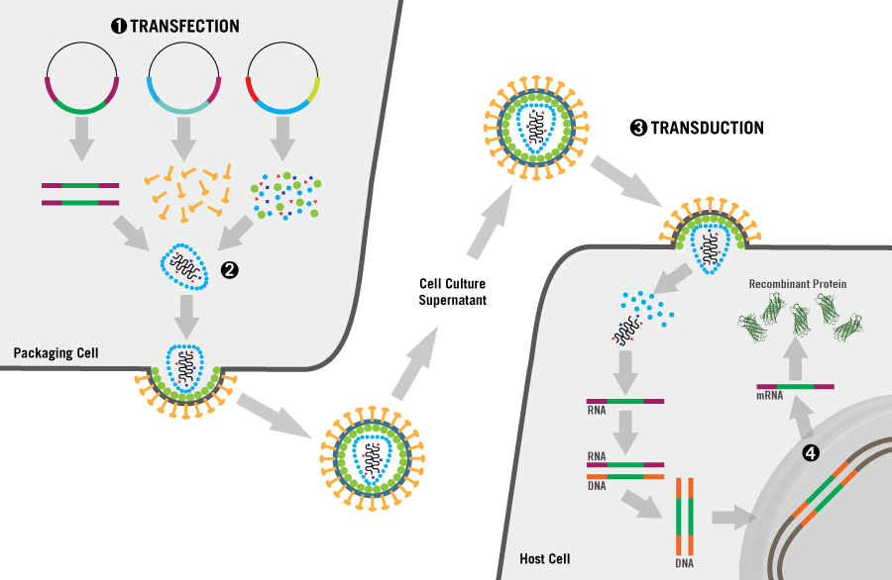
Recombined Lentivirus (LV)
Infection
Tropism: VSV-G, for most cells
Entry: membrane fusion and endocytosis
Dividing cells (hard to cross nuclear membrane)
Genome integration
Pros:
Large capacity for transgene
Easy to design (transfer plasmid)
SIN system for safety
Integrated into genome, permanent expression
Cons:
Insertional mutagenesis risks
Copy number issues
Suited for:
Dividing cells
Permanent correction
E.g., hematopoiesis diseases (ex vivo treatment)
Mirus Bio LLC

Slide 4
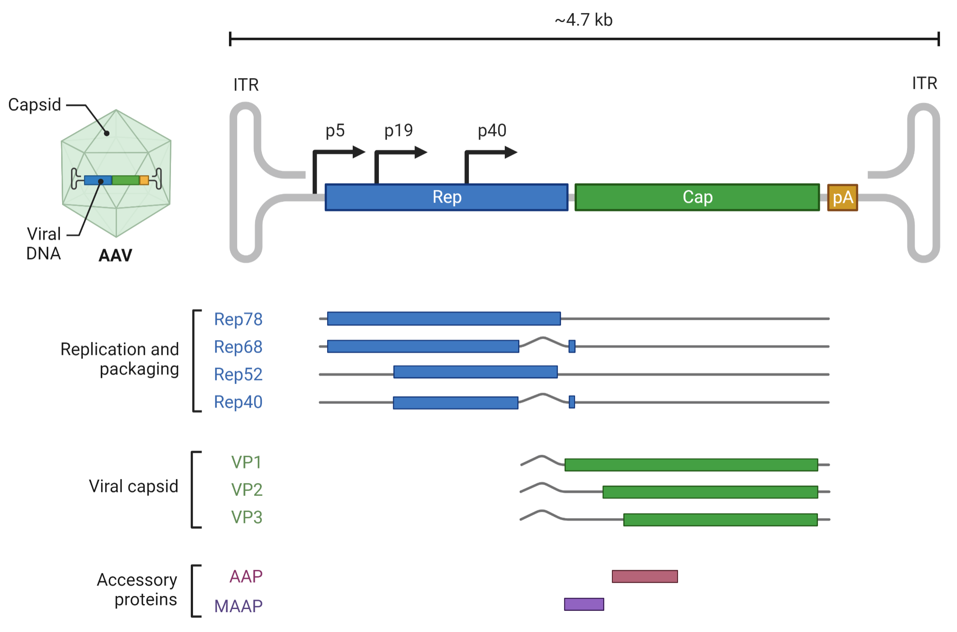
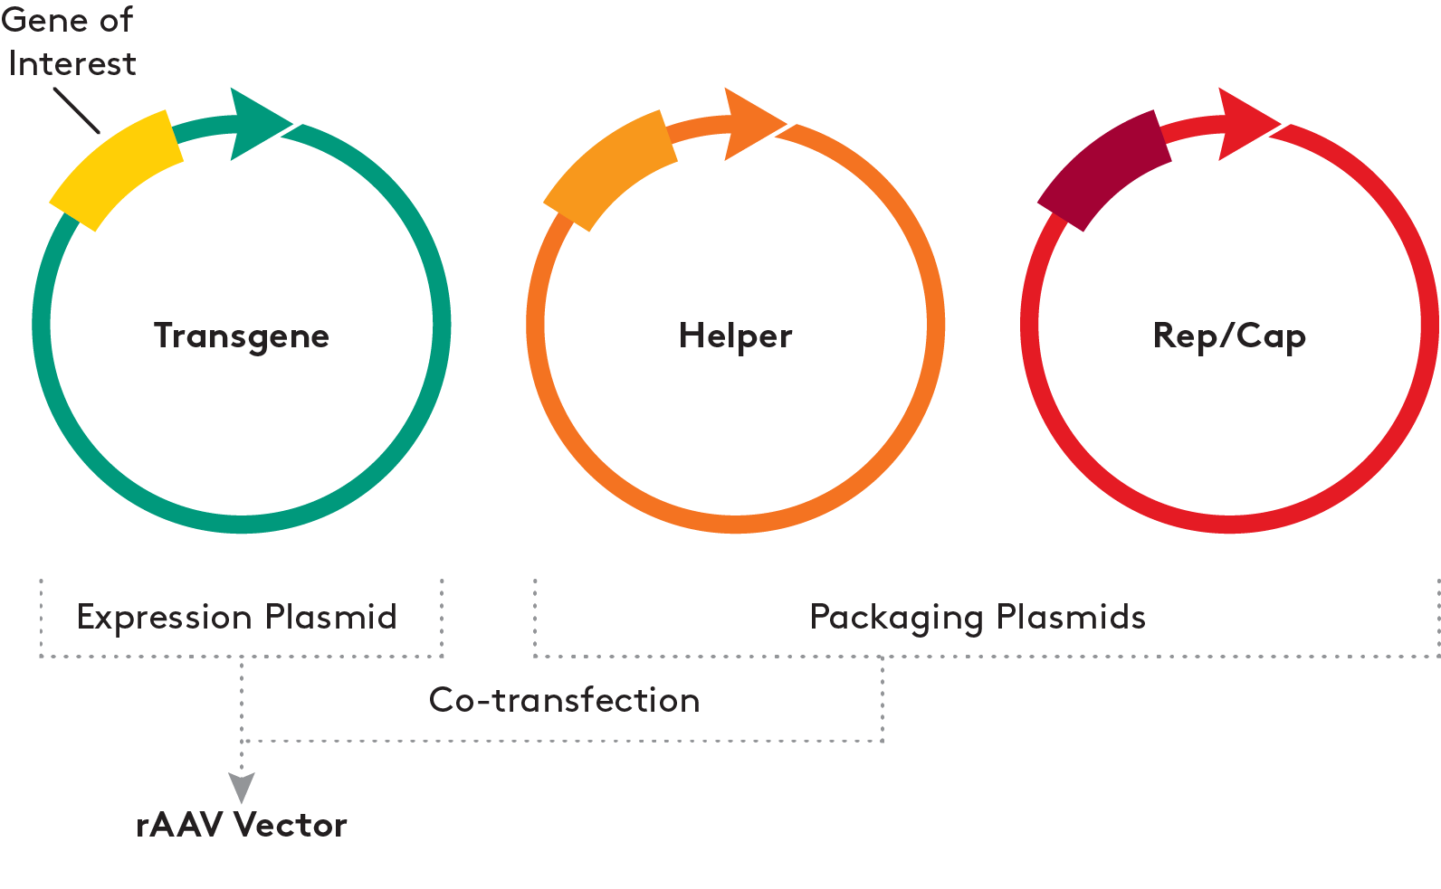
Adeno-associated virus (AAV)
Type
Dependovirus (non-enveloped, rely on other viruses to help replicate)
Genome
ssDNA
~4.7kb
5’ and 3’ ITRs: required for the synthesis of the complementary DNA
rep: replication genes
cap: capsid genes
Dyno Therapeutics
Recombined AAV (rAAV)
transfer plasmid: ITR and transgene
helper plasmid: required for virus replication
rep/cap plasmid: may require special design for targeted cells
Aldevron

Slide 5
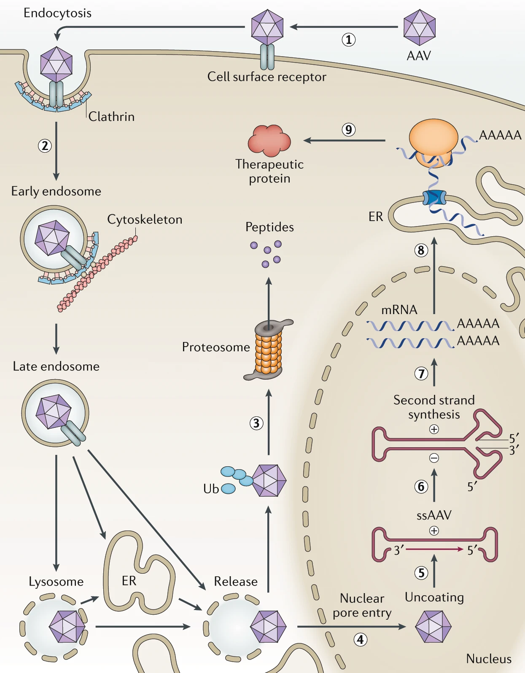
Recombined Adeno-associated virus (AAV)
Infection
Tropism: more specific (may require optimization, e.g., directed evolution, in silico design)
Entry: endocytosis
Both dividing and non-dividing cells
Very low genome integration
Pros:
Tissue specificity
Very low insertional mutagenesis risks (although it could happen if administrated in long term)
AAV itself does not cause disease
Cons:
Small capacity for transgene
Complicated to design, hard to manufacture in large scale
Some people may have immunity against naturally existing AAV, which can decrease the efficacy
Suited for:
Non-dividing cells
Transient expression
E.g., neurological disorders (in vivo treatment)

Slide 6
Challenges
Ethics
Bottomline: no germline editing
Safety
Genotoxicity (insertional mutagenesis, copy number issues)
Efficacy
Delivery (tropism, immunity, cell migration)
Cost
Up to $1.2 billion per patient
Some other directions:
ASO (RNAi issue)
CAR-T CAR-NK (exhaustion issue)
Maybe SARS-CoV-2 as a vector in the future?
(~30Kb capacity, strong infection ability)
Special thanks to Xiaochang Zhang group.

