Slide 1
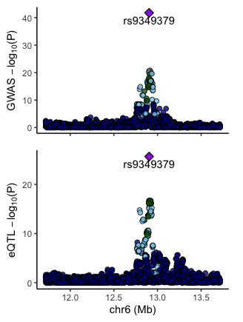
GGSB Prelim Q5 – Hang Chen
Question a)
1. Pleiotropy
SNP – X
|
| same SNP
|
SNP – X’ – Y
2. LD
SNP – X
|
| two SNPs in perfect LD
|
SNP’ – X’ – Y
3. Intermediate
SNP – Int. – X
|
| same Int.
|
| – X’ – Y
(X=gene, Y=disease)
What is colocalization:
Two association analyses (GWAS & eQTL)
Associated SNPs are overlapped
Why colocalization:
GWAS lack molecular mechanisms
GWAS hits are usually non-coding
How to do colocalization:
Eyeballing?
We may not conclude a SNP-associated gene is causal for the same SNP-associated disease, but we can calculate and rank the probabilities.
(Zhang Lab@Columbia, 2019)

Slide 2
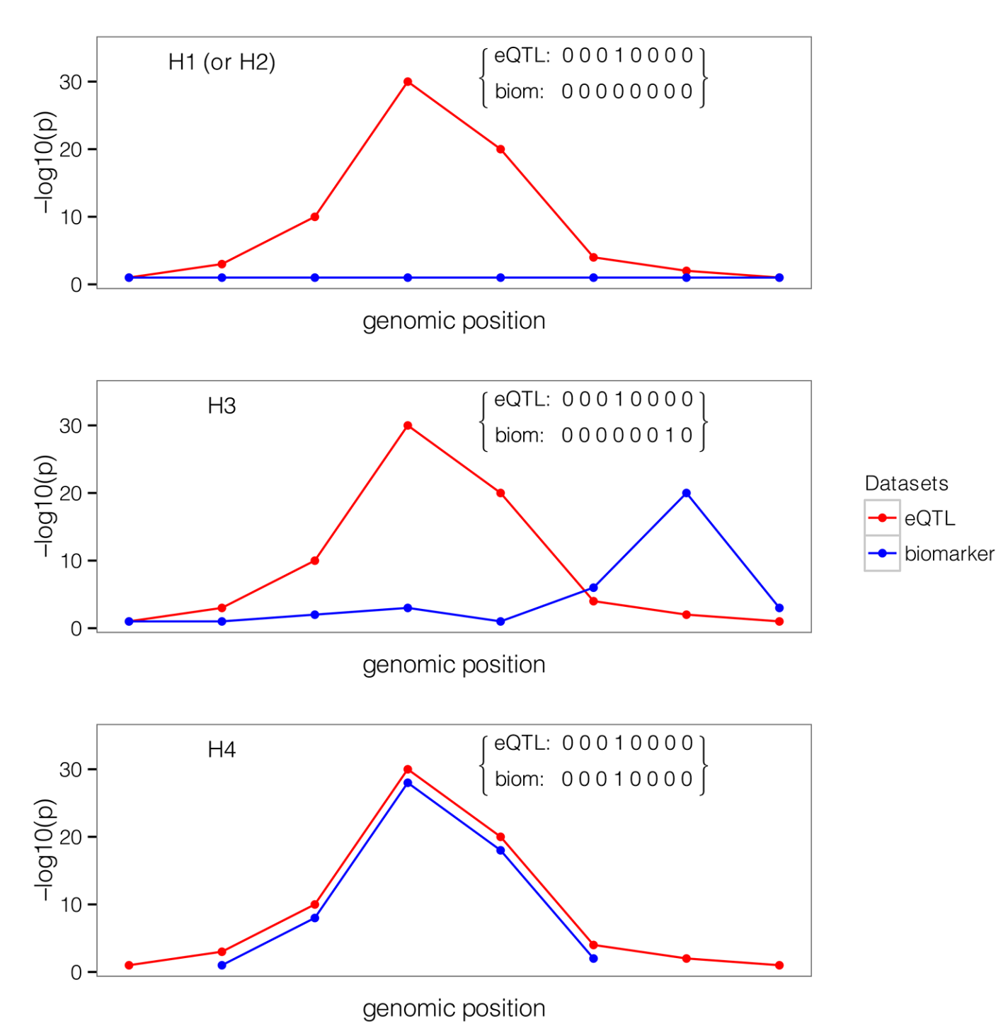
Colocalization analysis
Sequencing and routine QCs
Two separate association analyses
For each region, convert the association results to binary (each pair is a configuration, S)
Then, test the five hypothesis:
For a region,
- H₀: No association with either trait
- H₁: Association with trait 1, not with trait 2
- H₂: Association with trait 2, not with trait 1
- H₃: Association with trait 1 and trait 2, two independent SNPs
- H₄: Association with trait 1 and trait 2, one shared SNP
Assume there are Q SNPs in a region, and for each SNP, the probability of that it is associated with trait 1 is p₁, with trait 2 p₂, with both traits p₁₂, with no traits p₀.
(p₀ + p₁ + p₂ + p₁₂ =1)
Question b)
Probabilities for each configurations:
- P(S₀)=(p₀)^{Q}
- P(S₁)=(p₀)^{Q-1} · p₁
- P(S₂)=(p₀)^{Q-1} · p₂
- P(S₃)=(p₀)^{Q-2} · p₁ · p₂
- P(S₄)=(p₀)^{Q-1} · p₁₂
Giambartolomei, 2014

Slide 3


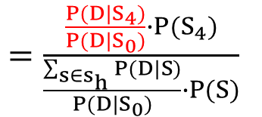
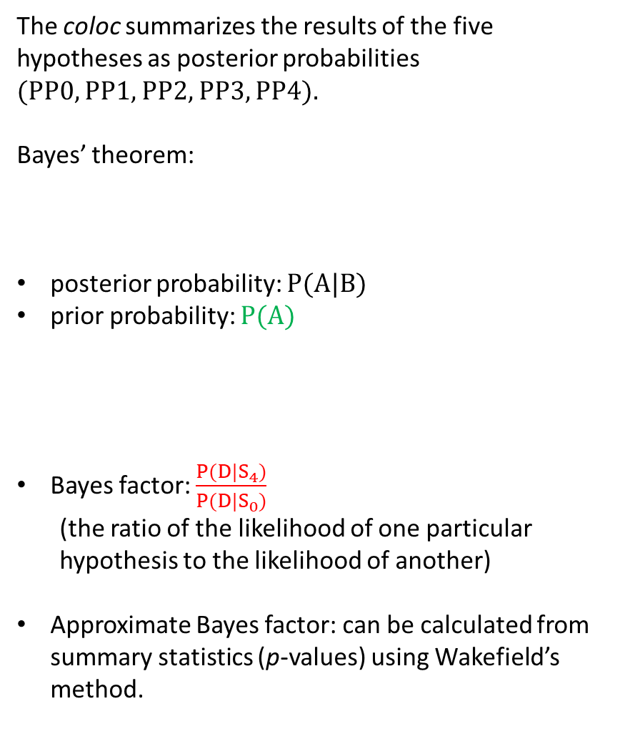



The coloc summarizes the results of the five hypotheses as posterior probabilities
(PP0, PP1, PP2, PP3, PP4).
Bayes’ theorem:
posterior probability: P(A|B)
prior probability: $P(A)$
Bayes factor: $\frac{P(D|S_{4})}{P(D|S_{0})}$
(the ratio of the likelihood of one particular hypothesis to the likelihood of another)
Approximate Bayes factor: can be calculated from summary statistics (p-values) using Wakefield’s method.
Question c)
Deriving the PPs as a function of BFs:
PP4 $=P(H_{4}|D)$
D: observed data
P(A|B) $=\frac{P(B|A)∙P(A)}{P(B)}$
$=\frac{P(D|S_{4})∙P(S_{4})}{P(D)}$
Reformatting P(D)
$=\frac{P(D|S_{4})∙P(S_{4})}{\sum_{s∈s_{h}}{P(D|S)∙} P(S)}$
Reformatting to BF
$=\frac{\frac{P(D|S_{4})}{P(D|S_{0})}∙P(S_{4})}{\frac{\sum_{s∈s_{h}}{P(D|S)}}{P(D|S_{0})}∙P(S)}$
$=\frac{{BF}_{4}∙P(S_{4})}{\sum{{BF}_{h}}∙P(S)}$
Slightly different from the equation in the coloc paper, but mathematically equivalent

Slide 4
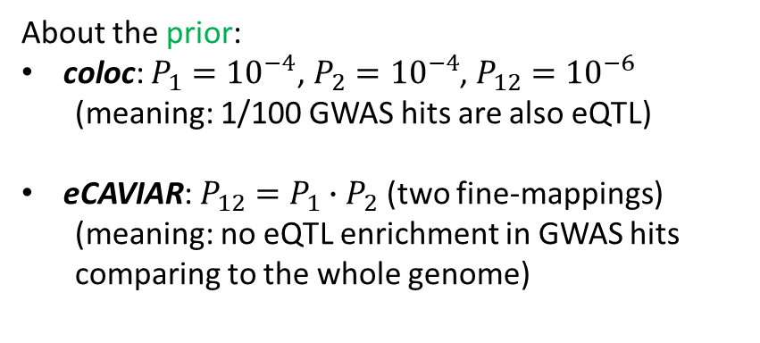

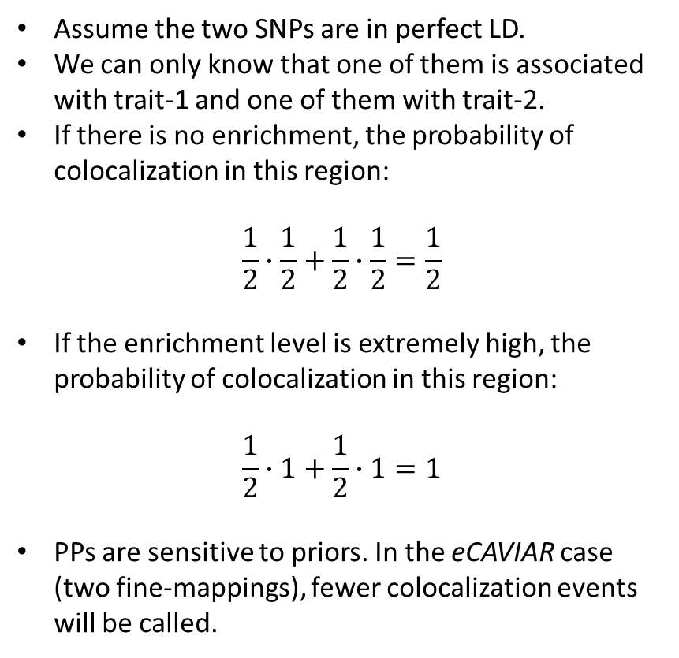
Question e): an extreme example
$PP4=\frac{{BF}_{4}∙P(S_{4})}{\sum{{BF}_{h}}∙P(S)}$
One is GWAS hit
One is eQTL hit
About the prior:
coloc: $P_{1}={10}^{−4}$, $P_{2}={10}^{−4}$, $P_{12}={10}^{−6}$
(meaning: 1/100 GWAS hits are also eQTL)
eCAVIAR: $P_{12}=P_{1}∙P_{2}$ (two fine-mappings)
(meaning: no eQTL enrichment in GWAS hits comparing to the whole genome)
Assume the two SNPs are in perfect LD.
We can only know that one of them is associated with trait-1 and one of them with trait-2.
If there is no enrichment, the probability of colocalization in this region:
$$\frac{1}{2}∙\frac{1}{2}+\frac{1}{2}∙\frac{1}{2}=\frac{1}{2}$$
If the enrichment level is extremely high, the probability of colocalization in this region:
$$\frac{1}{2}∙1+\frac{1}{2}∙1=1$$
PPs are sensitive to priors. In the eCAVIAR case (two fine-mappings), fewer colocalization events will be called.
About eQTL enrichment in GWAS hits:
eQTL
eQTL
All SNPs
GWAS hits

Slide 5
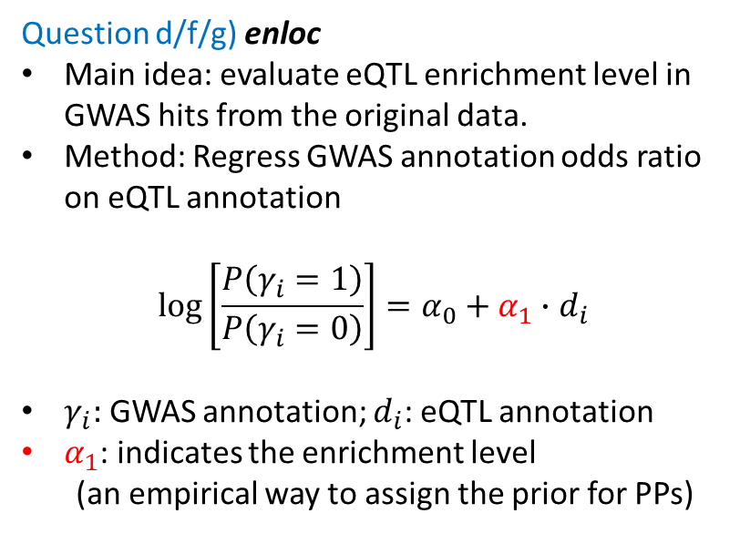
Question d/f/g) enloc
Main idea: evaluate eQTL enrichment level in GWAS hits from the original data.
Method: Regress GWAS annotation odds ratio on eQTL annotation
$$\log\left[\frac{P\left(γ_{i}=1\right)}{P\left(γ_{i}=0\right)}\right]=α_{0}+α_{1}∙d_{i}$$
$γ_{i}:$ GWAS annotation; $d_{i}$: eQTL annotation
$α_{1}$: indicates the enrichment level
(an empirical way to assign the prior for PPs)
Relationship between coloc and enloc:
coloc is a special case of enloc.
coloc requires artificially assigned priors, or in other words, it bypasses the enrichment level assessing.
enloc calculate the empirical priors from the data, which provides more accurate colocalization events calling.
Special thanks to Jing Gu, Charles Zhou, and Xuanyao Liu group.

Slide 6
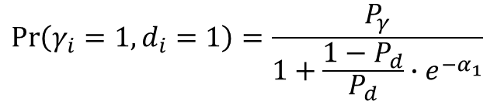

Appendix
$$ABF=\sqrt{1−r}∙e^{(\frac{Z^{2}∙r}{2})}$$
$$\operatorname{Pr}\left(γ_{i}=1,d_{i}=1\right)=\frac{P_{γ}}{1+\frac{1−P_{d}}{P_{d}}∙e^{−α_{1}}}$$
r: shrinkage factor, the ratio of the variance of the prior and total variance (r=W/(V+W))

