Slide 1
Cell-Type Annotation in Single-Cell Genomics
A gentle introduction for biology and chemistry audiences
Single-Cell RNA-seq
Gene Expression Matrix
Marker Genes
Zero-Shot Annotation
Reference Mapping
Chenhao Wu
Eduard Ansaldo
Juyeon Park
Xing Zhang
Team Annotator:
Scripps Research Hackathon 2026

Slide 2
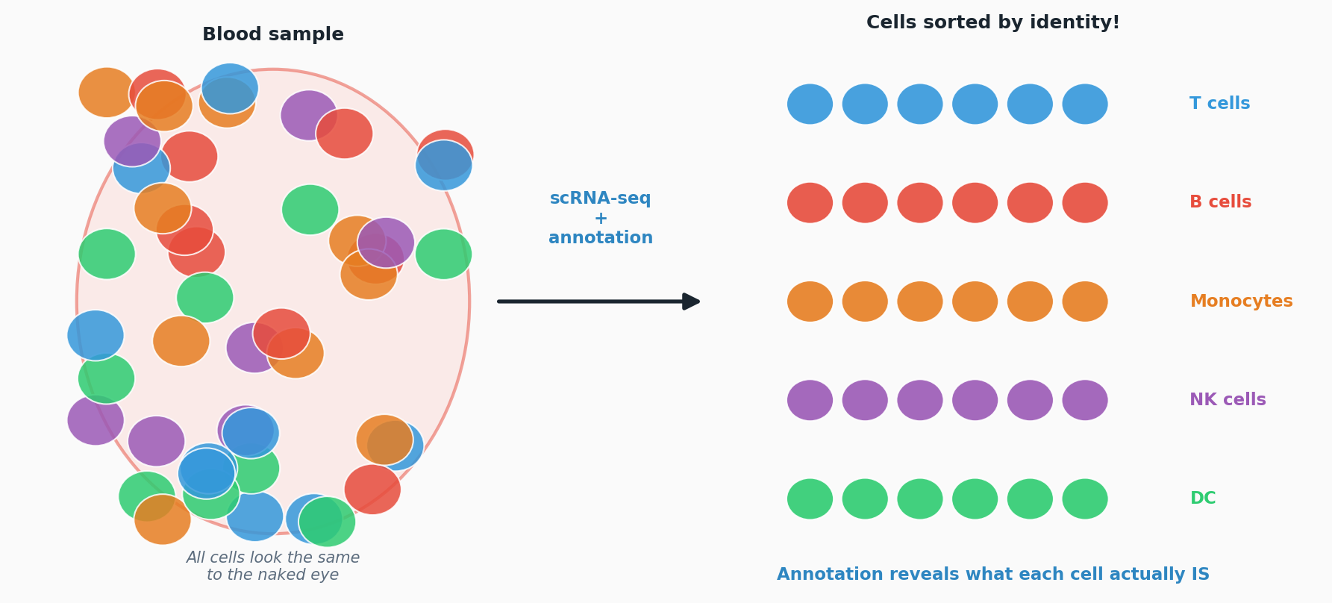
The Central Question
A tissue contains many different cell types — but how do we tell them apart?
Tissue sample

Slide 3
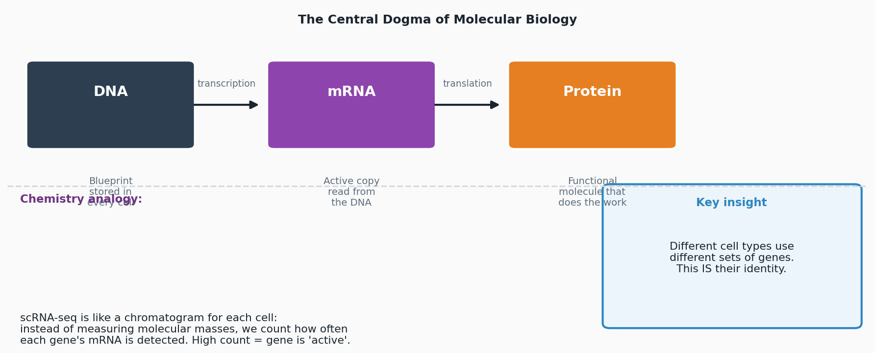
What is Gene Expression?
The molecular language that defines cell identity | Accessible for chemists and biologists
Introduction to Cell-Type Annotation | Scripps Research Hackathon 2026 | 3/10

Slide 4
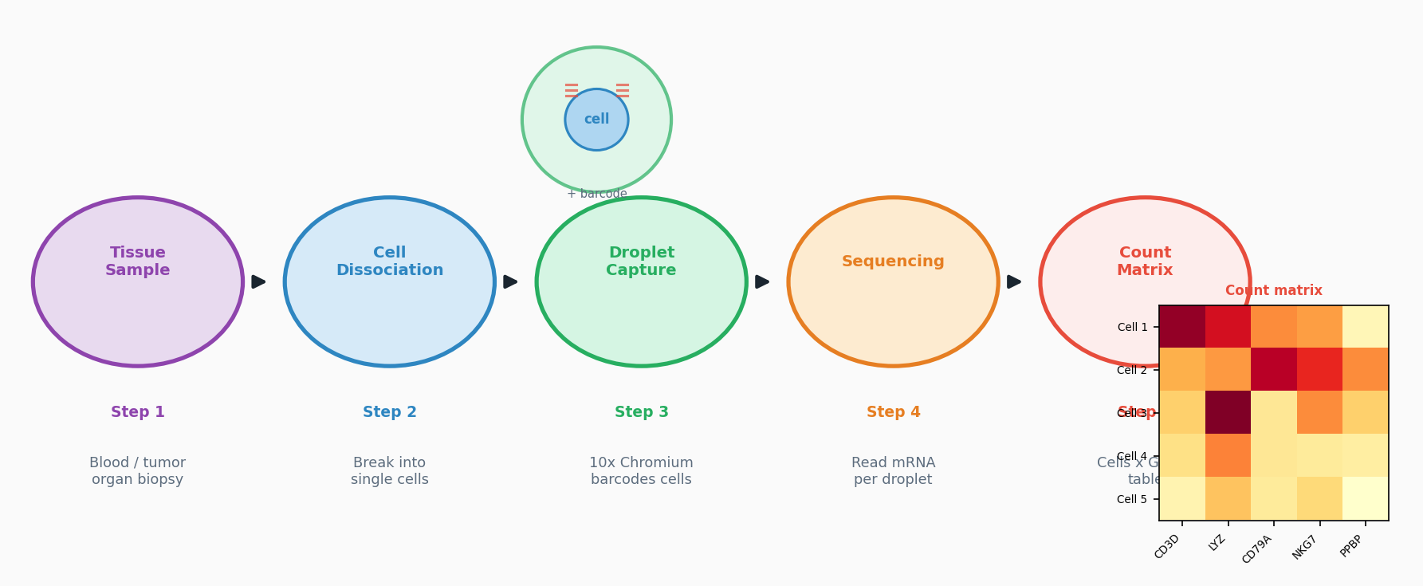
Single-Cell RNA Sequencing (scRNA-seq)
Measuring gene activity in thousands of individual cells simultaneously
Introduction to Cell-Type Annotation | Scripps Research Hackathon 2026 | 4/10

Slide 5
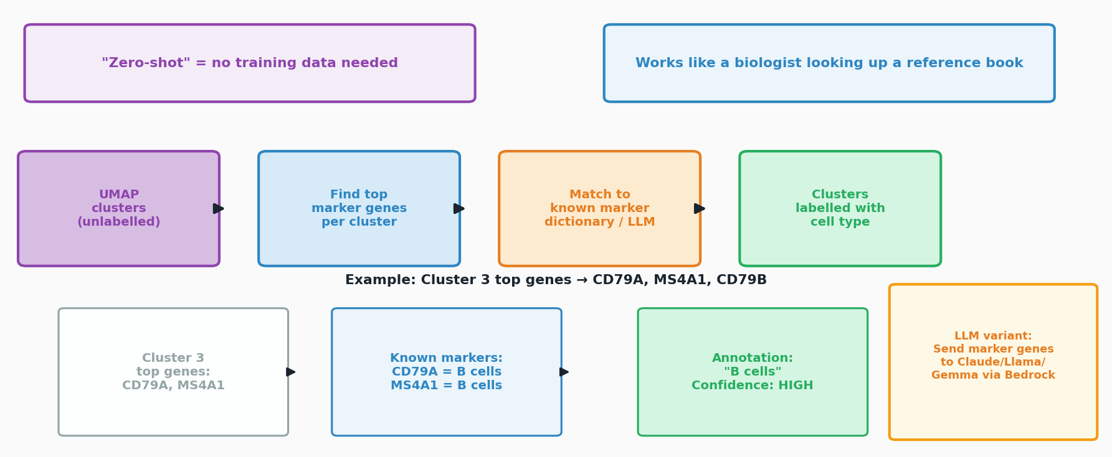
Method 1: Zero-Shot Annotation with Marker Genes
Annotate without training data — use biological prior knowledge directly

Slide 6
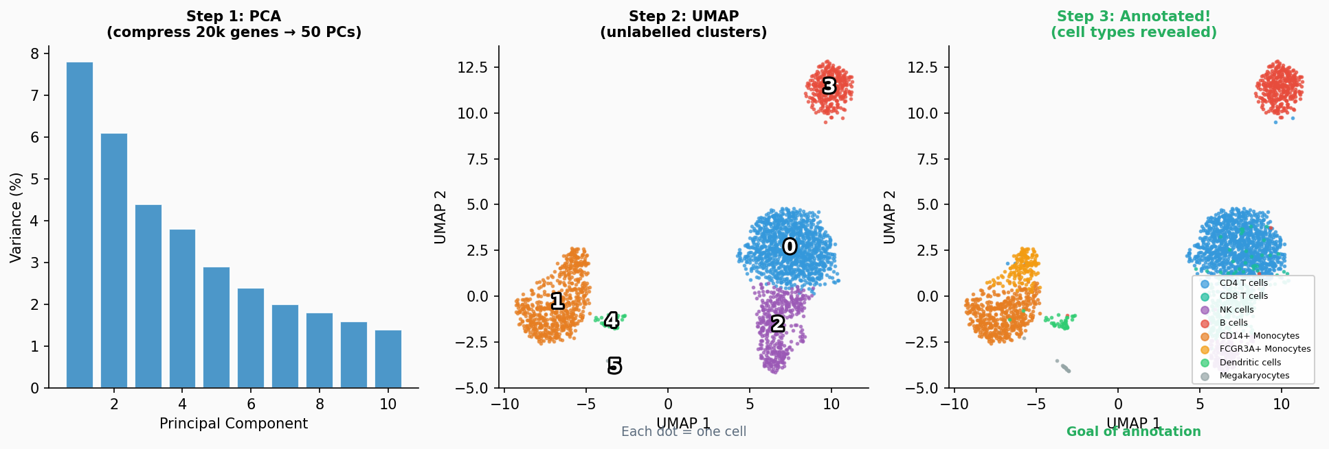
From Data Matrix to UMAP: Finding Cell Groups
Dimensionality reduction collapses 20,000 genes → 2D map. Similar cells cluster together.

Slide 7
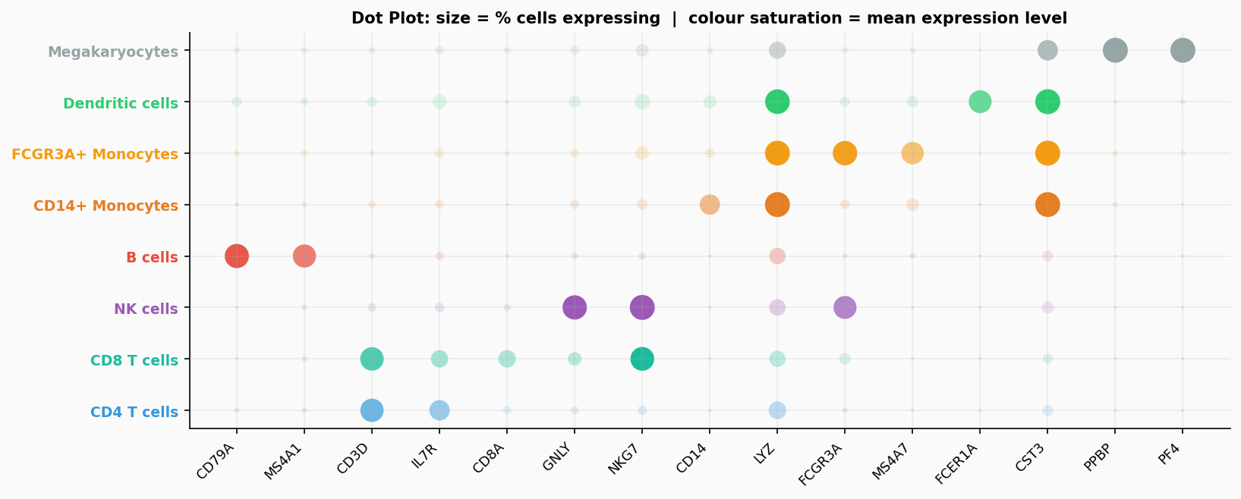
Marker Genes: The Molecular Fingerprints of Cell Identity
Some genes are uniquely and highly expressed in specific cell types
Gene(s) | Cell Type | Role
CD3D / CD3E | T cells | T-cell receptor complex
CD79A / MS4A1 | B cells | B-cell receptor complex
CD14 / LYZ | CD14+ Mono | Innate immunity / phagocytosis
FCGR3A | FCGR3A+ Mono | FC receptor (non-classical)
GNLY / NKG7 | NK cells | Cytotoxic granule proteins
FCER1A | Dendritic cells | IgE receptor
PPBP / PF4 | Megakaryocytes | Platelet factors

Slide 8
Difficulty in manual labeling clusters

Slide 9
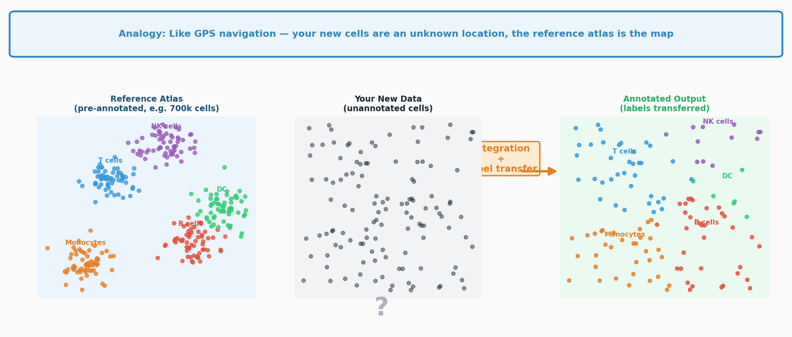
Method 2: Reference Mapping
Compare your cells to a large, annotated atlas and borrow their labels
Training +
Label transfer

Slide 10
Why Does Cell-Type Annotation Matter?
Annotated cells unlock biological and clinical insights
Disease Research
Drug Target Discovery
Immune Profiling
Identify which cell types are expanded or depleted in cancer, autoimmune disease, or infection
Find the exact cell type where a drug acts — or should act — in the body
Track how T, B, NK cells change before and after vaccination or treatment
Cell Atlas Projects
Biomarker Discovery
Drug Development
Build maps of every cell type in the human body (Human Cell Atlas project)
Identify rare cell populations that predict patient outcomes or disease progression
Understand off-target effects: which cell types are affected by a new compound
Without cell-type annotation, single-cell data is just 20,000 numbers per cell — annotation gives it biological meaning
Introduction to Cell-Type Annotation | Scripps Research Hackathon 2026 | 9/10

Slide 11
Summary: Zero-Shot vs Reference Mapping
Two complementary strategies — use both for the most reliable annotation
 | Zero-Shot (Marker Genes) | Reference Mapping
Granularity | Cluster-level (all cells in a cluster get same label) | Cell-level (each cell annotated independently)
Limitations | - Limited by cluster resolution, may misses rare cell types - Rely on one’s biological background - Very time consuming | - Needs a good reference - Less interpretive, black box
Advantages | - No reference needed, good for novel tissue - interpretive | - Benefit from large datasets, can achieve high accuracy Faster Do not require specific biology background

Slide 12
Summary: Zero-Shot vs Reference Mapping
Two complementary strategies — use both for the most reliable annotation
 | Zero-Shot (Marker Genes) | Reference Mapping
Granularity | Cluster-level (all cells in a cluster get same label) | Cell-level (each cell annotated independently)
Limitations | - Limited by cluster resolution, may misses rare cell types - Rely on one’s biological background - Very time consuming | - Needs a good reference - Less interpretive, black box
Advantages | - No reference needed, good for novel tissue - interpretive | - Benefit from large datasets, can achieve high accuracy Faster Do not require specific biology background
When using LLM, we expect… | Utilize their knowledge on marker genes Speed up the whole process | Help select right tool and reference datasets Build automated pipeline

Slide 13
Benchmark different LLM model on 2 methods
What did each LLM choose for each method?
Prompt:
Reference mapping:
Do cell-type annotation on pbmc3k datasets (do not use its existing annotation). Use reference mapping with whatever well-characterized reference you think suitable and whatever tool you think best fit. Generate whole pipeline and save scripts for review. In the end, compare output annotation with its existing annotation and calculate metrics that reflect accuracy, also output memory and time usage.
Zero-shot annotation:
Do cell-type annotation on pbmc3k datasets (do not use its existing annotation). Cluster and Use zero-shot annotation with marker genes based on your knowledge, instead of label transferring tools. Generate whole pipeline and save scripts for review. In the end, compare output annotation with its existing annotation and calculate metrics that reflect accuracy, also output memory and time usage.

Slide 14
Pipeline Design Comparison
What did each LLM choose for each method?
 | Claude (Haiku 4.5) | Llama (3.1 70B) | Gemma (3 27B)
Zero-Shot Approach | LLM API call via Bedrock (biological reasoning) | Avg marker gene expression per cluster | Sum marker gene expression per cell
Zero-Shot Granularity | Cluster-level | Cluster-level | Per-cell
Reference Method | CellTypist (logistic regression) | Centroid dot-product similarity | Scanorama integration + KNN label transfer
Reference Dataset | Immune_All_High (700k cells, 20+ studies) | pbmc68k_reduced (700 cells, 10x) | pbmc68k_reduced (700 cells, 10x)
Code Structure | 4 scripts (pipeline) | 1 monolithic script | 6 modular scripts
Requires Bedrock API | Yes (LLM call) | No | No
Accuracy — Zero-Shot | 85.1% | 85.1% | 76.4%
Accuracy — Reference | 88.9% | 73.2% | 77.0%
PBMC Cell-Type Annotation: LLM Pipeline Comparison | Scripps Research Hackathon 2026 | 2/8

Slide 15
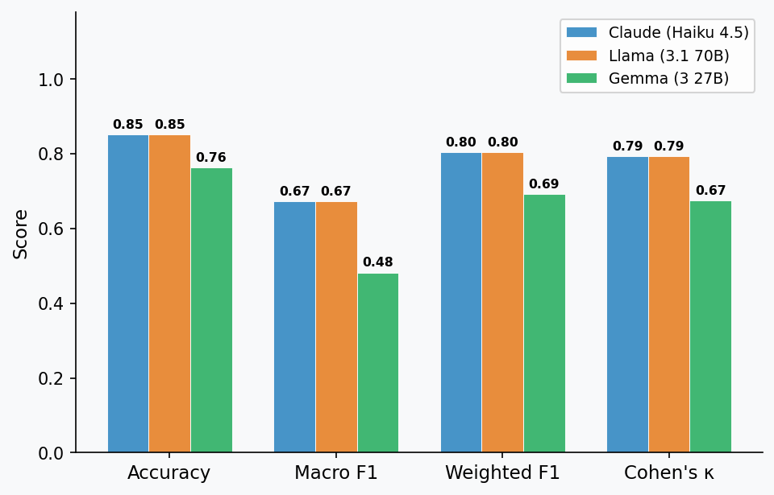
Zero-Shot Annotation Results
Cluster marker genes → cell type label | No reference data used
 | Claude (Haiku 4.5) | Llama (3.1 70B) | Gemma (3 27B)
Zero-Shot Approach | LLM API call via Bedrock (biological reasoning) | Avg marker gene expression per cluster | Sum marker gene expression per cell
Zero-Shot Granularity | Cluster-level | Cluster-level | Per-cell
Model | Accuracy | Macro F1 | Wtd F1 | Kappa | Time | Mem
Claude (Haiku 4.5) | 0.851 | 0.673 | 0.804 | 0.794 | 2.0 s | 10 MB
Llama (3.1 70B) | 0.851 | 0.673 | 0.804 | 0.794 | 1.1 s | 80 MB
Gemma (3 27B) | 0.764 | 0.482 | 0.692 | 0.674 | 23.5 s | 216 MB
Claude & Llama tie at 85.1% — identical cluster assignments despite completely different mechanisms

Slide 16
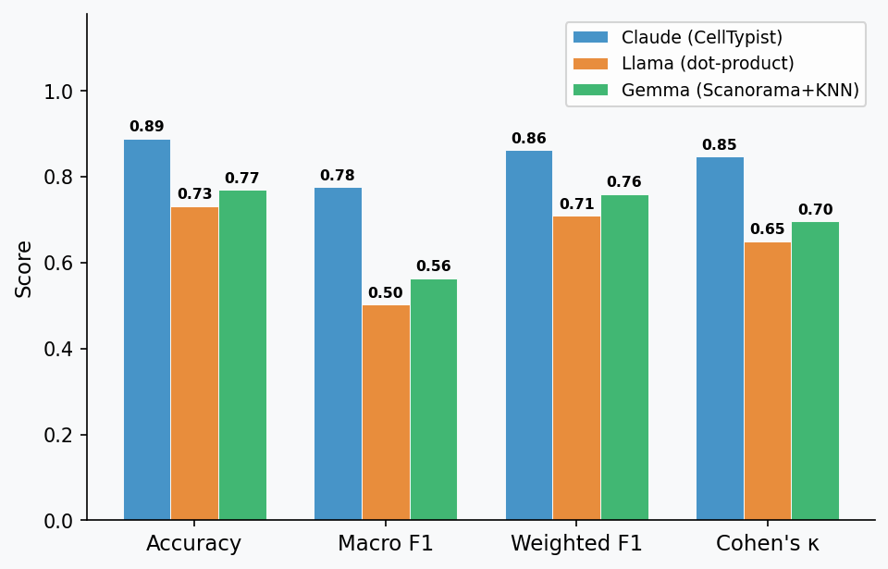
Reference Mapping Results
Annotate by comparing against a large, pre-labelled cell atlas
 | Claude (Haiku 4.5) | Llama (3.1 70B) | Gemma (3 27B)
Reference Method | CellTypist (logistic regression) | Centroid dot-product similarity | Scanorama integration + KNN label transfer
Reference Dataset | Immune_All_High (700k cells, 20+ studies) | pbmc68k_reduced (700 cells, 10x) | pbmc68k_reduced (700 cells, 10x)
Model | Accuracy | Macro F1 | Wtd F1 | Kappa | Time | Mem
Claude (CellTypist) | 0.889 | 0.776 | 0.863 | 0.847 | 1.5 s | 255 MB
Llama (dot-product) | 0.732 | 0.502 | 0.710 | 0.650 | 0.3 s | 35 MB
Gemma (Scanorama+KNN) | 0.770 | 0.564 | 0.760 | 0.697 | 1.4 s | 77 MB
CellTypist (Claude) wins by +12-16 pp by choosing a pre-trained 700k-cell model

Slide 17
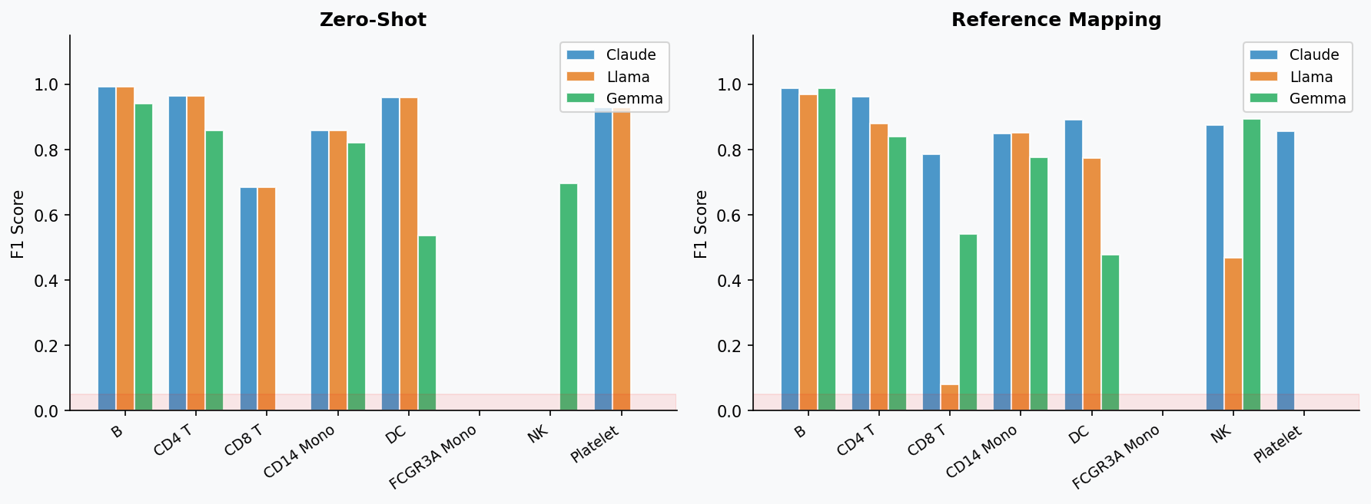
Per-Class F1 Score Breakdown
Which cell types does each method handle well — and which does it miss?
Red zone (F1≈0): FCGR3A Mono undetected by all — merged with CD14 Mono in the same Leiden cluster
PBMC Cell-Type Annotation: LLM Pipeline Comparison | Scripps Research Hackathon 2026 | 5/8

Slide 18
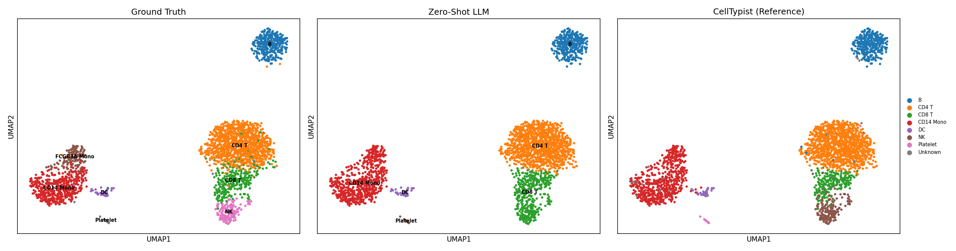
UMAP Visualisations — Claude Pipeline
Ground Truth (left) | Zero-Shot LLM (centre) | CellTypist Reference Mapping (right)
PBMC Cell-Type Annotation: LLM Pipeline Comparison | Scripps Research Hackathon 2026 | 6/8

Slide 19
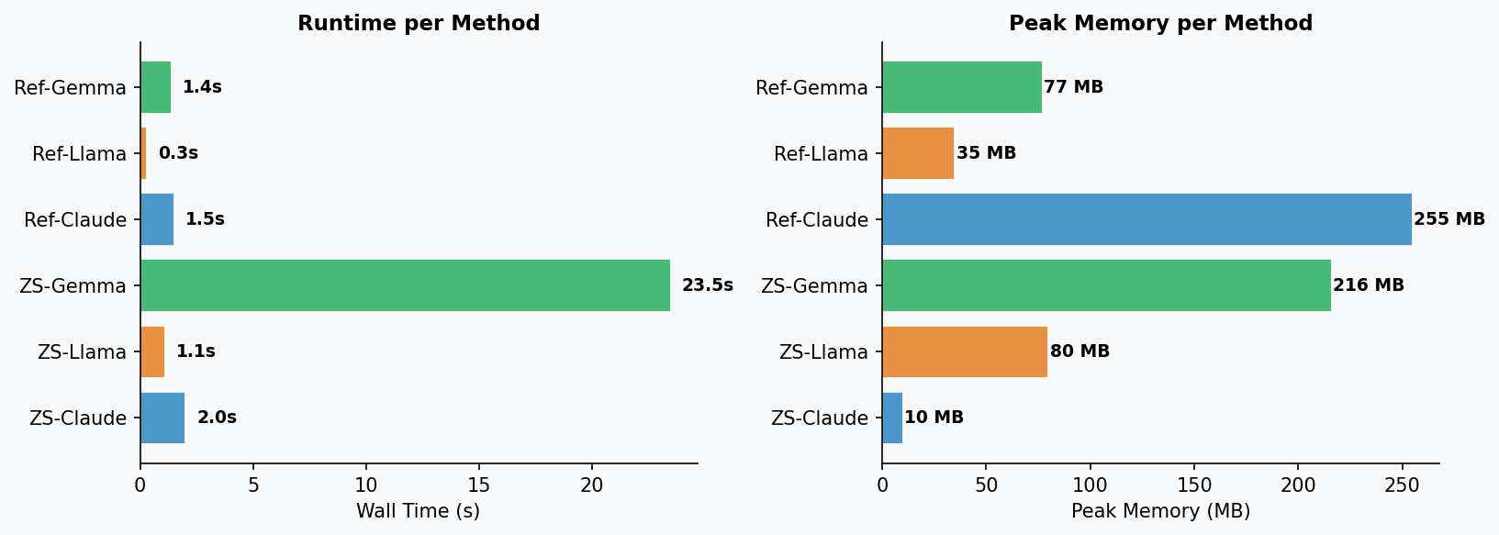
Resource Usage: Time & Memory
Wall-clock time and peak memory for each annotation step
Lighter = Zero-Shot | Solid = Reference Mapping

Slide 20
Summary: Effects of LLMs on 2 methods
Zero-shot
refence
[1] For zero-shot mapping: great improvement
• LLMs extremely accelerate annotation process
• when following correct pipeline, LLM tends to give okay results consistently
[2] For reference mapping: marginal support
[2] SHARED LIMITATIONS
• For different LLM, we observe large variety in tool and reference selections, and some are bad.
• while picking the right tool and reference, it can give good results, better than zero-shot.
• Suggested practice: specify tool and reference and ask LLM to build a pipeline.

Slide 21
Summary: Effects of LLMs on 2 methods
Zero-shot
refence
Next question:
- how much does zero-shot mapping depend on agents while giving more specific prompt?
- Will more advanced LLM model give better results than reference mapping?
[1] For zero-shot mapping: great improvement
• LLMs extremely accelerate annotation process
• when following correct pipeline, LLM tends to give okay results consistently
[2] For reference mapping: marginal support
[2] SHARED LIMITATIONS
• For different LLM, we observe large variety in tool and reference selections, and some are bad.
• while picking the right tool and reference, it can give good results, better than zero-shot.
• Suggested practice: specify tool and reference and ask LLM to build a pipeline.

Slide 22
Zero-shot annotation--agents and strategy comparison
Question: can an LLM reading a cluster's top marker genes match an established reference-transfer tool or even better— and does context help?
Three strategies compared:
• 1) LLM + context — tissue + experimental design + retrieved PubMed abstracts
• 2) LLM agnostic — marker genes only, no context
• 3) CellTypist — pre-trained reference label transfer
Benchmarked vs. ground truth on PBMC + pancreas; measured accuracy, runtime, and peak memory.
Notes:
Two LLM variants isolate the value of context. CellTypist is the incumbent. Ground truth: Seurat PBMC (immune) + scIB pancreas.

Slide 23
Built with Claude Code — from one prompt to a plan
The initial prompt (verbatim, abridged):
“Generate a tool to perform cell-type annotation in single-cell sequencing. Compare (1) zero-shot annotation from top marker genes interpreted by Claude, specifying tissue & experimental design, leveraging published manuscripts; (2) the same but agnostic of design — vs. (3) reference label transfer using CellTypist with an appropriate model. Benchmark against ground truth using the Seurat PBMC dataset. Also report time and memory. … This should run locally.”
Follow-up questions — my answers shaped the build:
• LLM access → AWS Bedrock Converse API, comparing multiple providers
• literature → retrieve real abstracts from PubMed (NCBI E-utilities)
Notes:
The human-in-the-loop part: one prompt, Claude planned it, and 3 design questions set the direction. Bedrock Converse gives one interface to many model providers.

Slide 24
Tool design
Config-driven · runs locally (128 GB / 16 cores, no GPU)
scanpy pipeline — QC → CP10k+log1p → Leiden clustering → top-25 markers/cluster
3 annotation methods — LLM+context (PubMed) · LLM agnostic · CellTypist
LLM-judge harmonization — free-text labels → canonical ground-truth classes
evaluation + profiling — accuracy, balanced-acc, macro-F1, κ, ARI + time/peak-RSS
report — markdown + accuracy/cost charts + confusion matrices
Notes:
Key engineering choices: Bedrock Converse for uniform multi-model calls; an LLM judge to map free-text predictions onto the dataset's label set so every method is scored the same way; cluster-level comparison since the LLM annotates per cluster.

Slide 25
Choices & fixes along the way
Human + Claude, iterating
Multi-model roster reality-check
Opus 4.8 returned AccessDenied despite being listed → pruned it; report now surfaces per-model API errors.
No data leakage for CellTypist
Initial fallback trained on a 50% split of the eval data (inflated to 0.97). Removed → pre-trained models only.
Granularity matching matters most
PBMC CellTypist scored 0.33 with the coarse Immune_All_High model — it called 61% of cells “T cells” (vs CD4/CD8/NK ground truth). Switched to fine Immune_All_Low → 0.85.
Two datasets · 3 methods · 4 LLMs · full evaluation — one session.
Notes:
This slide is the story of the collaboration: each issue was caught by inspecting results and corrected. The granularity fix is the big lesson — match the reference's resolution to your ground truth.

Slide 26
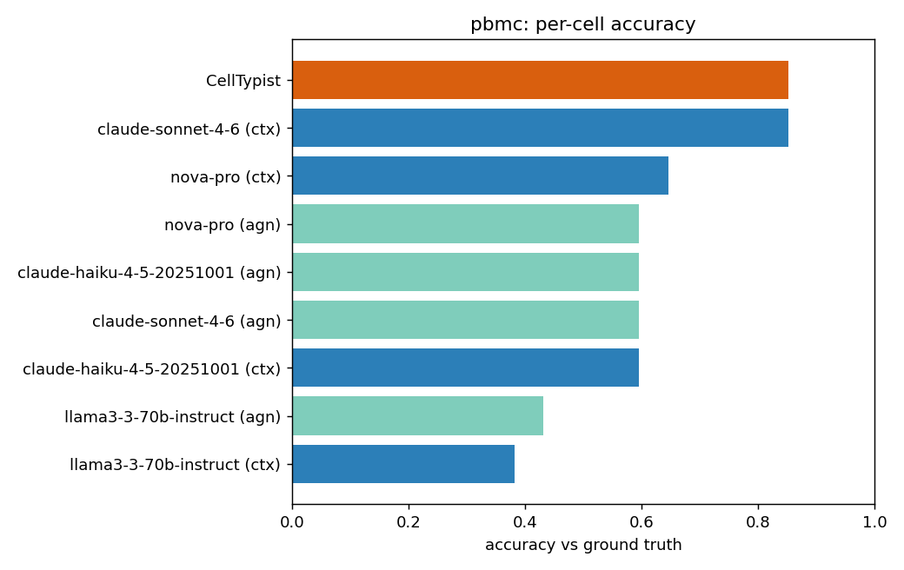
Results — PBMC (2,638 cells, 8 fine immune types)
CellTypist (fine model) and LLM+context tie at the top
0.85 CellTypist (Immune_All_Low) ≈ 0.85 LLM+context (Sonnet 4.6)
Context lifts Sonnet from 0.60 → 0.85 on PBMC.
ctx: use context
agn: no context
Notes:
Headline: with a fine-grained reference model, CellTypist matches the best LLM — and is far faster. But it needed the RIGHT model.

Slide 27
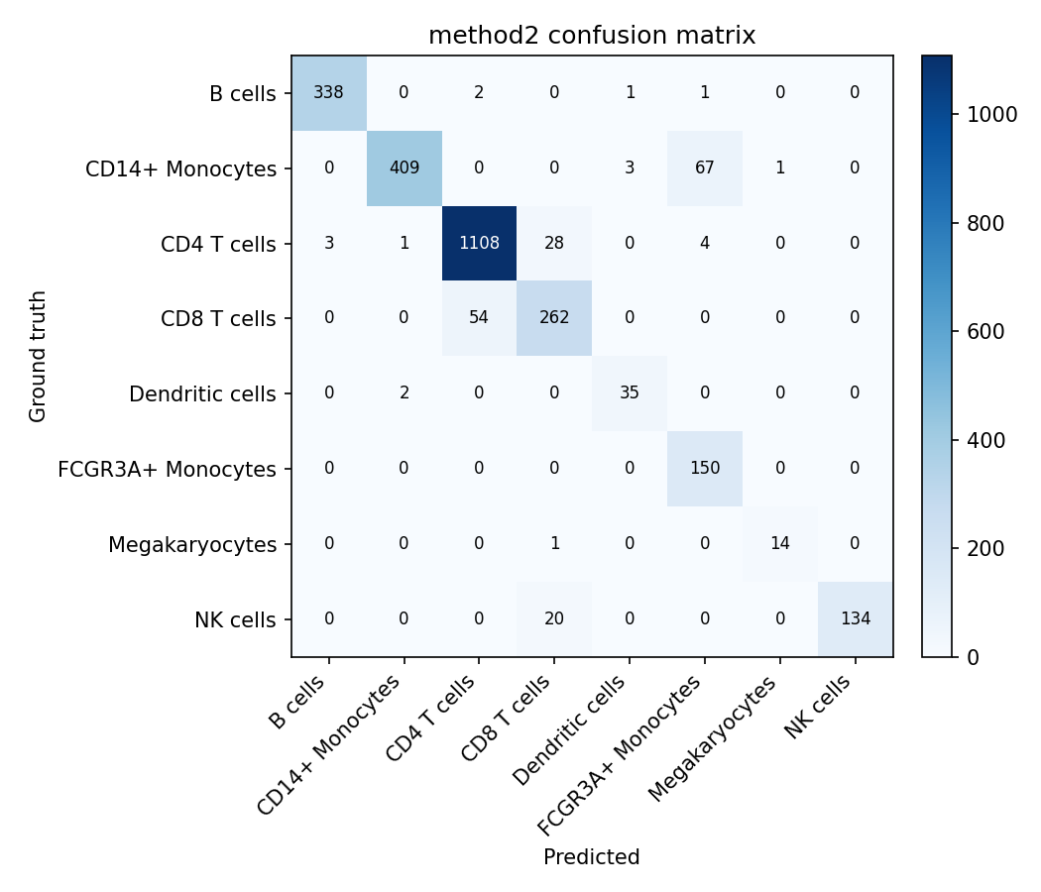
Results — scored on 2,638 labeled cells
Metric | Method 1 Ref. mapping | Method 2 Zero-shot
Accuracy | 0.877 | 0.929
Balanced accuracy | 0.904 | 0.923
Macro-F1 | 0.879 | 0.912
Cohen's κ | 0.836 | 0.904
ARI | 0.742 | 0.868
NMI | 0.782 | 0.851
Wall time (s) | 54.6 | 23.3
Peak memory (MiB) | 478 | 349
• Both methods agree strongly with the curated labels (acc ≥ 0.88).
• Zero-shot markers edged ahead here: +5 pts accuracy, ~2.3× faster, lower memory.
• Shared error modes: CD4↔CD8 T cells and CD14↔FCGR3A monocytes.
• Caveat: the ground truth was itself made by clustering + markers, favoring Method 2.
• Method 1 needs no manual markers and yields finer immune subtypes for free.
Green = better value. ARI/NMI are name-independent partition-agreement metrics.

Slide 28
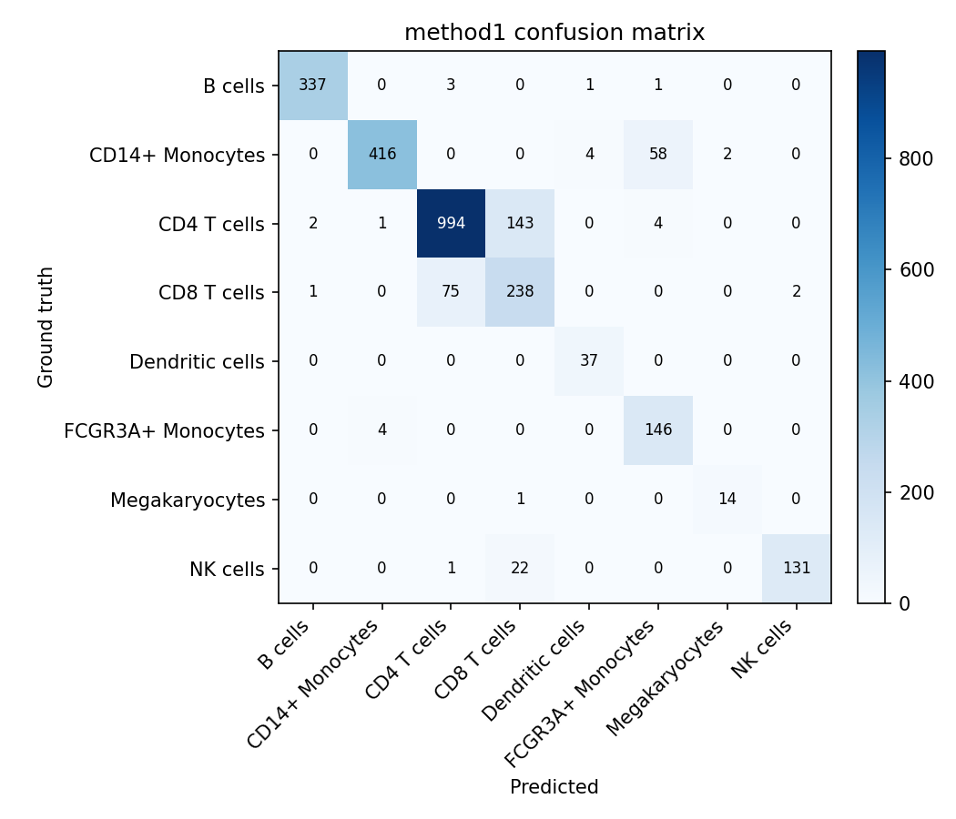
Where the errors are — confusion matrices
Method 1 — reference mapping
Method 2 — zero-shot markers

Slide 29
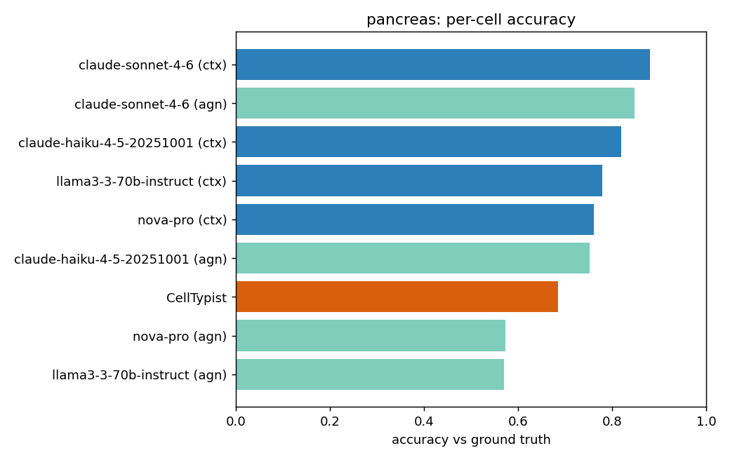
Results — Pancreas (16,382 cells, 14 types)
Context-grounded LLM leads
0.88 LLM+context (Sonnet 4.6) > 0.68 CellTypist (islet model)
Top of the table:
• LLM+context Sonnet 0.88 · agnostic Sonnet 0.85 · context Haiku 0.82
• context Llama 0.78 · context Nova 0.76
• CellTypist Adult_Human_PancreaticIslet — acc 0.68, but macro-F1 only 0.23
Why so low F1? The islet model only knows endocrine cells — it can't label acinar / ductal / stellate (see caveats).
Notes:
On a tissue where no perfectly-matched reference model exists, the context-grounded LLM wins. CellTypist's accuracy is propped up by abundant endocrine cells; it fails the rest.

Slide 30
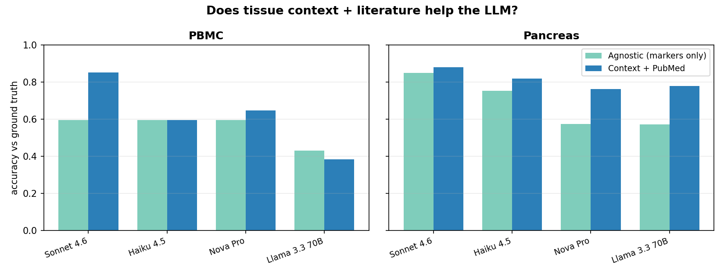
Does tissue context + literature help?
Yes — most for stronger models and the less-canonical tissue
Pancreas: every model improved with context (Nova +0.19, Llama +0.21). PBMC: large lift for Sonnet (0.60→0.85); flat where markers are already unambiguous.
Notes:
Context + PubMed grounding helps, but not uniformly — biggest gains when the task is harder (unfamiliar tissue) or the model is strong enough to use the extra information.

Slide 31
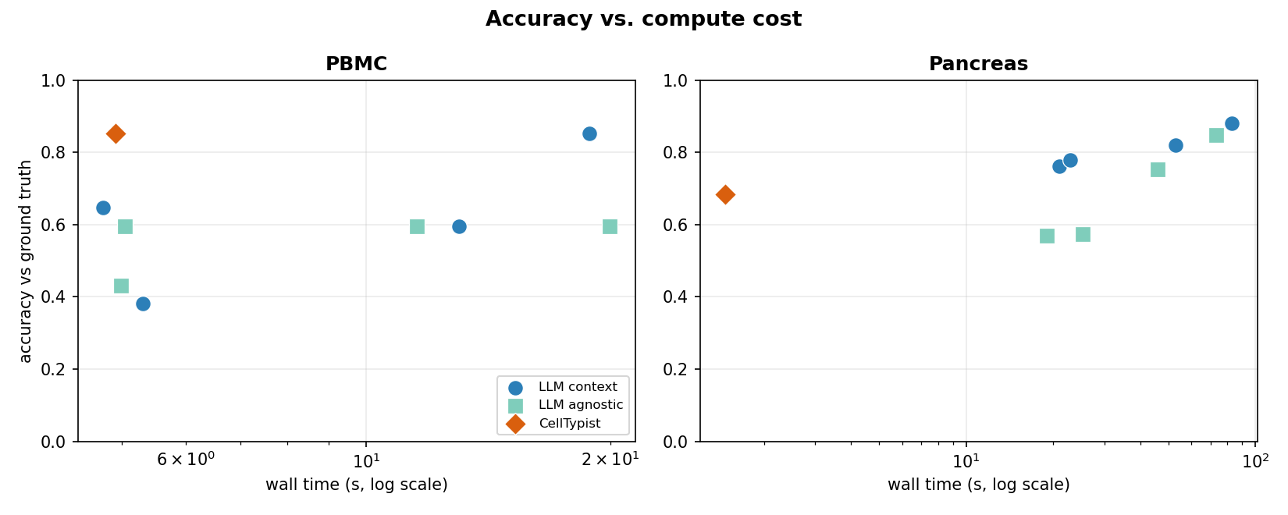
Accuracy vs. compute cost
The real engineering trade-off
CellTypist: sub-second–seconds, but bounded by available pre-trained references. LLMs: 5–80 s, no reference needed, generalize to any tissue; model choice matters. Memory flat (~1 GB PBMC, ~6 GB pancreas).
Notes:
CellTypist is cheap when a matching model exists. LLMs cost more wall-time but need no reference and work on any tissue. Pick by whether a good reference model exists for your tissue.

Slide 32
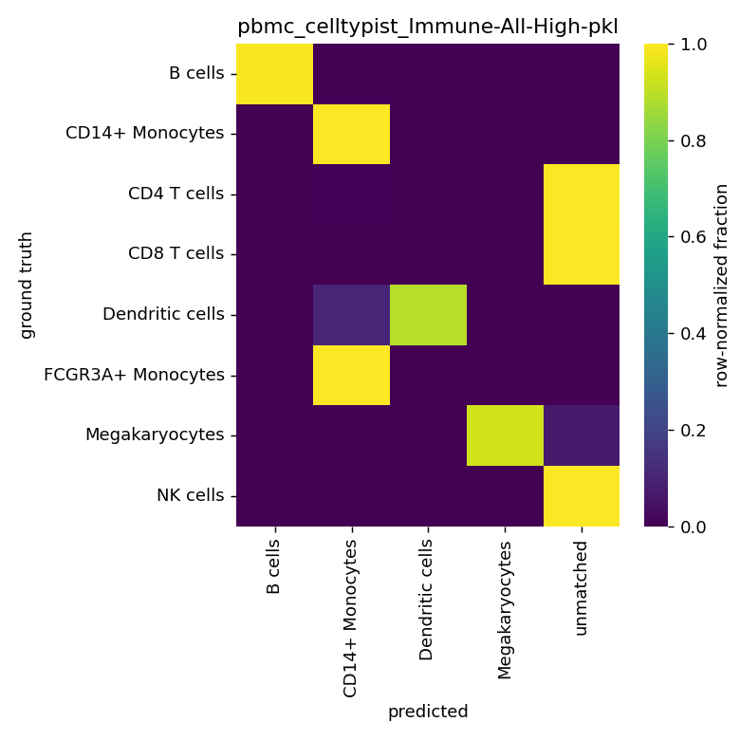
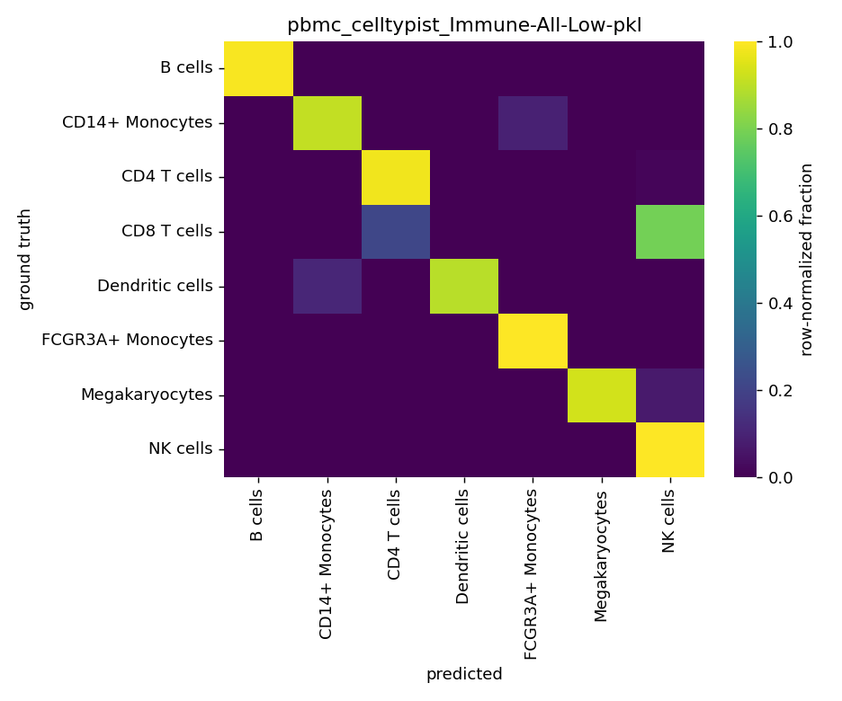
Caveats & interpretation
Granularity matching dominates
Same cells, same tool: coarse model 0.33 → fine model 0.85. Match the reference's resolution to your ground truth.
Reference coverage ≠ tissue coverage
Islet model can't label acinar/ductal/stellate → high accuracy, low macro-F1.
The LLM-judge is itself a measurement layer
Mapping free-text → canonical labels is noisy (it even scored coarse “T cells” differently for two methods).
Scope
Cluster-level eval · no data leakage · only 2 datasets — not a universal claim.
PBMC CellTypist: coarse (top) vs fine (bottom) model
Notes:
Most important caveat: the granularity-matching effect. Also flag that the harmonization judge is an imperfect ruler, and that this is 2 datasets, not a general benchmark.

Slide 33
Conclusion
When well established reference available, reference mapping tends to give high accurate results. LLMs can support pipeline building when specify tools and reference.
For novel tissues, using correct prompts with advanced LLMs can achieve better results than reference mapping and largely accelerate manual labeling.
Notes:
CellTypist is cheap when a matching model exists. LLMs cost more wall-time but need no reference and work on any tissue. Pick by whether a good reference model exists for your tissue.

Slide 34
Q & A

Slide 35
Takeaways
• When fairly matched, a context-grounded LLM ≈ CellTypist on accuracy.
• CellTypist: faster and cheap — but bounded by which pre-trained references exist.
• LLM: reference-free, tissue-agnostic, improves with context + literature; best with a strong model (Sonnet).
• Emerging practice: LLMs for novel tissues / niche subsets; reference transfer when a well-matched model exists.
• Entire tool — design, multi-model benchmark, debugging — built in one Claude Code session.
Notes:
Close: the two paradigms are converging on accuracy; choose by cost and whether a matching reference exists. And — meta-point — this was built collaboratively with Claude Code start to finish.

