Slide 1
Cell-Type Annotation in Single-Cell Genomics
A gentle introduction for biology and chemistry audiences
Single-Cell RNA-seq
Gene Expression Matrix
Marker Genes
Zero-Shot Annotation
Reference Mapping
Scripps Research Hackathon 2026
Introduction to Cell-Type Annotation | Scripps Research Hackathon 2026 | 1/10

Slide 2
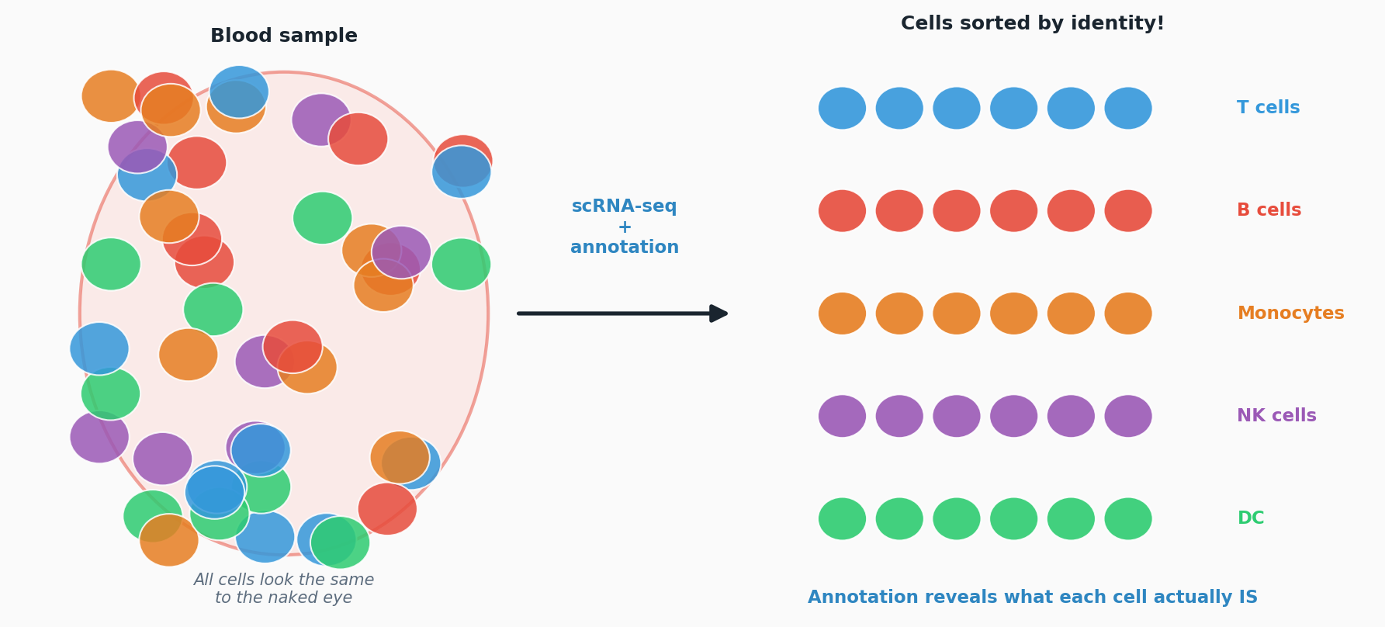
The Central Question
A tissue contains many different cell types — but how do we tell them apart?
Introduction to Cell-Type Annotation | Scripps Research Hackathon 2026 | 2/10

Slide 3
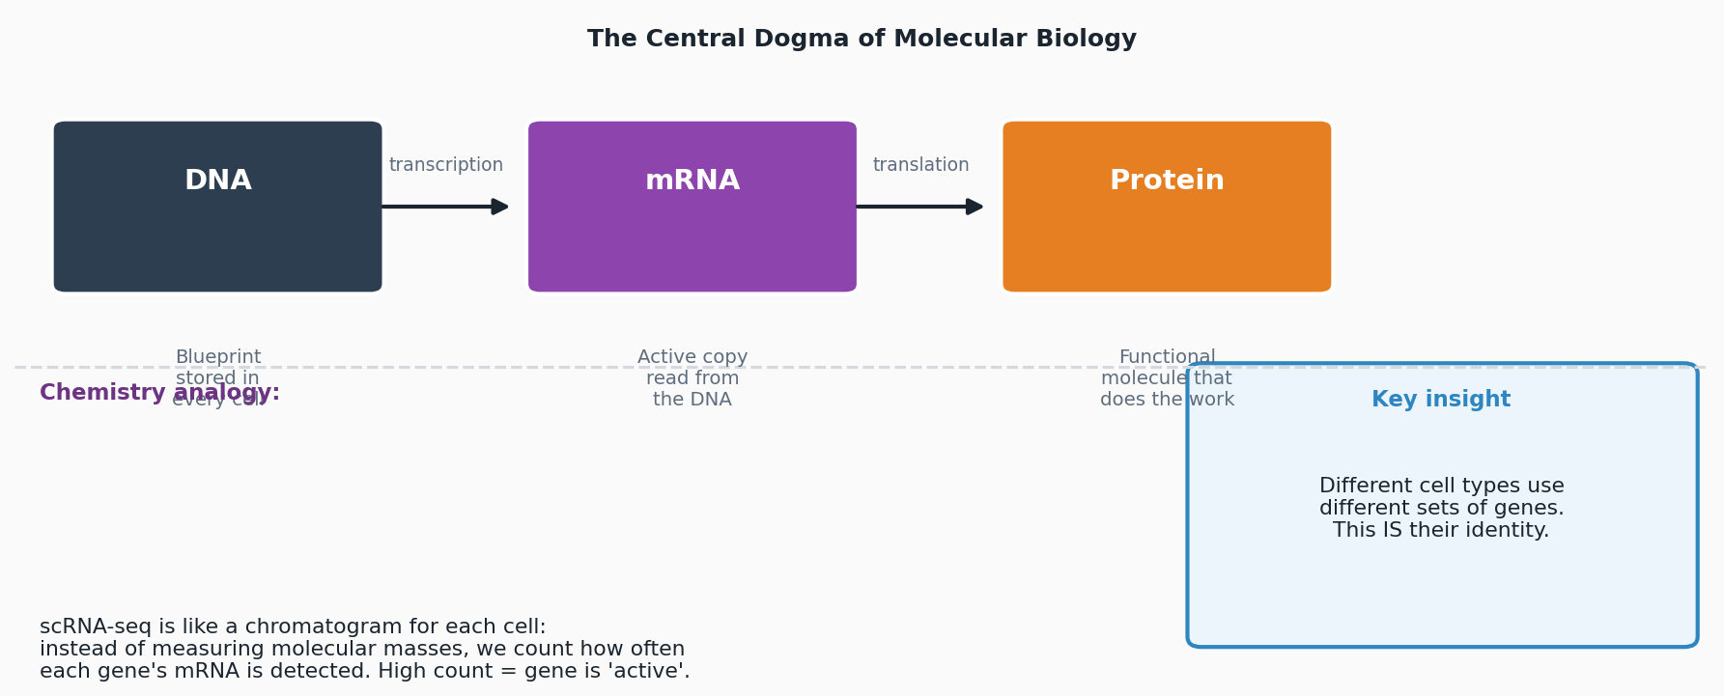
What is Gene Expression?
The molecular language that defines cell identity | Accessible for chemists and biologists
Introduction to Cell-Type Annotation | Scripps Research Hackathon 2026 | 3/10

Slide 4
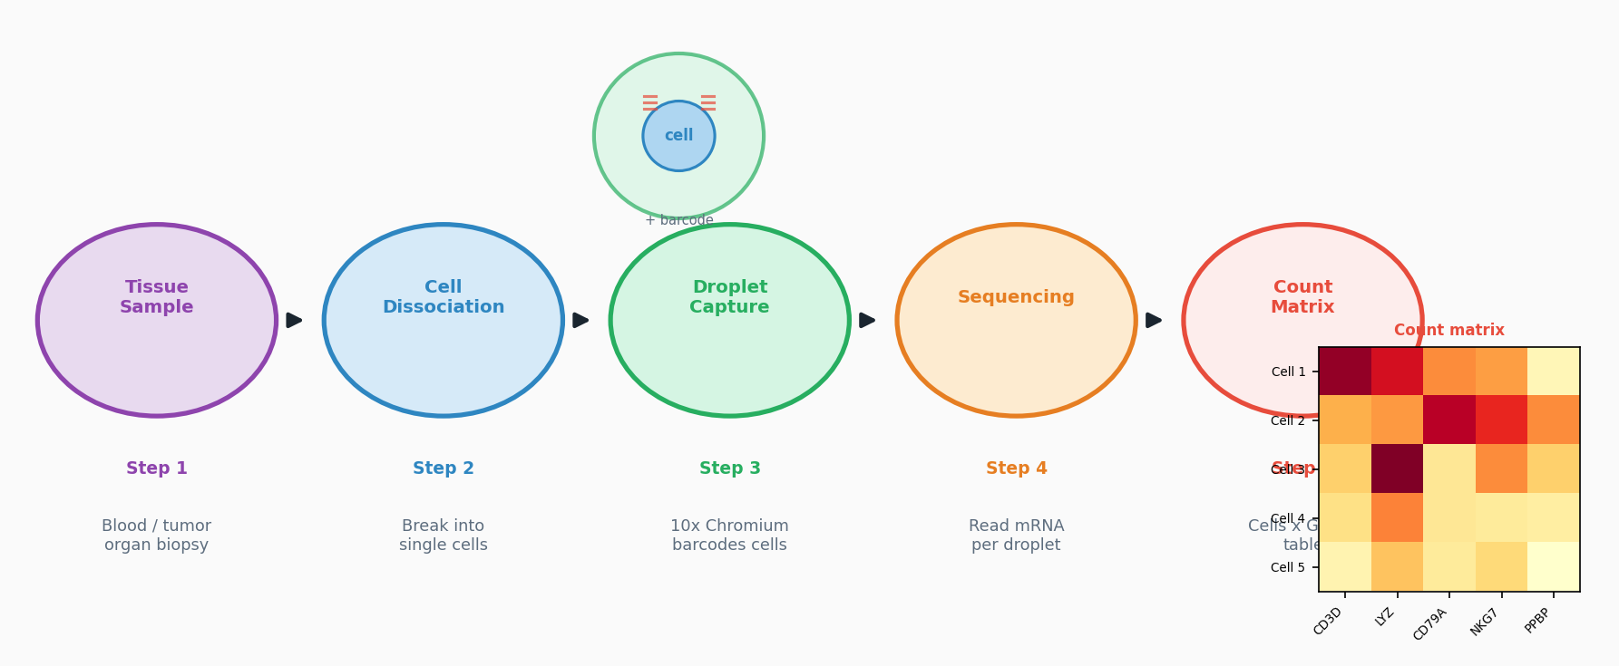
Single-Cell RNA Sequencing (scRNA-seq)
Measuring gene activity in thousands of individual cells simultaneously
Introduction to Cell-Type Annotation | Scripps Research Hackathon 2026 | 4/10

Slide 5
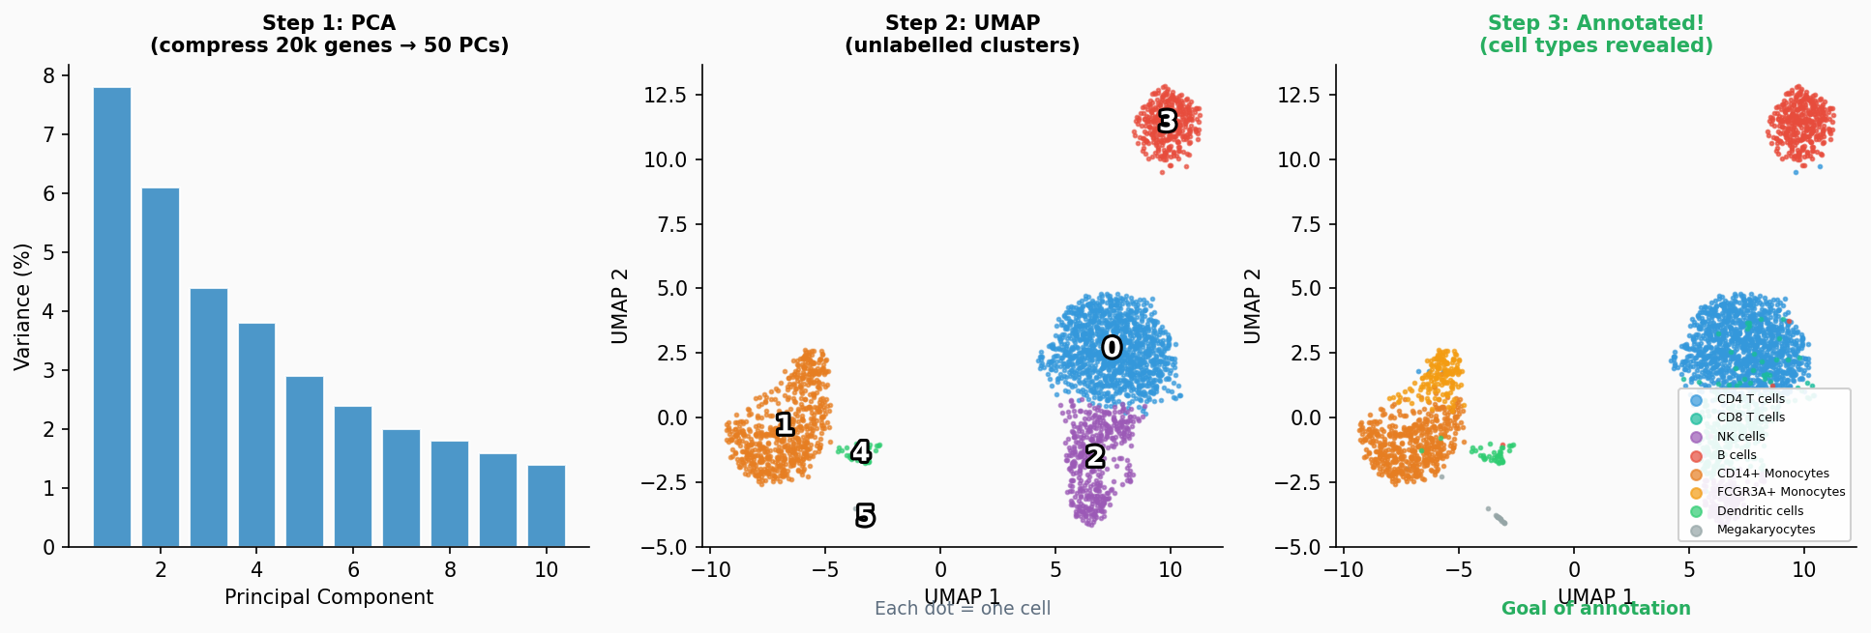
From Data Matrix to UMAP: Finding Cell Groups
Dimensionality reduction collapses 20,000 genes → 2D map. Similar cells cluster together.
Introduction to Cell-Type Annotation | Scripps Research Hackathon 2026 | 5/10

Slide 6
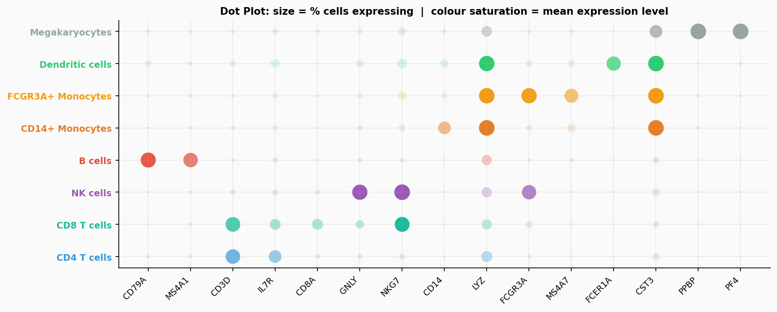
Marker Genes: The Molecular Fingerprints of Cell Identity
Some genes are uniquely and highly expressed in specific cell types
Gene(s) | Cell Type | Role
CD3D / CD3E | T cells | T-cell receptor complex
CD79A / MS4A1 | B cells | B-cell receptor complex
CD14 / LYZ | CD14+ Mono | Innate immunity / phagocytosis
FCGR3A | FCGR3A+ Mono | FC receptor (non-classical)
GNLY / NKG7 | NK cells | Cytotoxic granule proteins
FCER1A | Dendritic cells | IgE receptor
PPBP / PF4 | Megakaryocytes | Platelet factors
Introduction to Cell-Type Annotation | Scripps Research Hackathon 2026 | 6/10

Slide 7
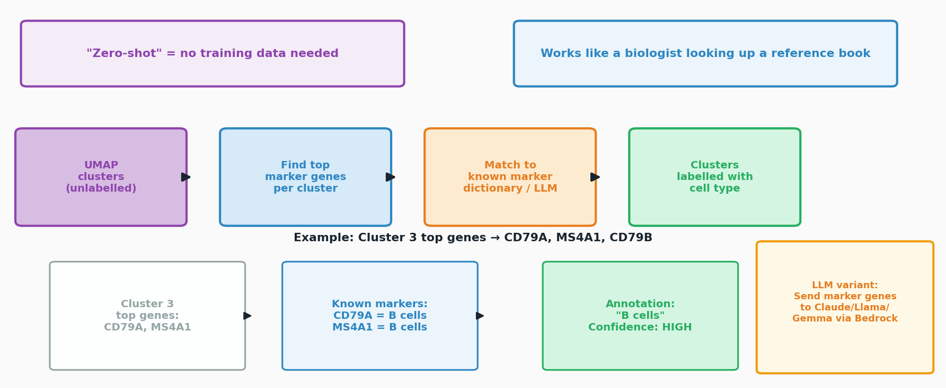
Method 1: Zero-Shot Annotation with Marker Genes
Annotate without training data — use biological prior knowledge directly
Introduction to Cell-Type Annotation | Scripps Research Hackathon 2026 | 7/10

Slide 8
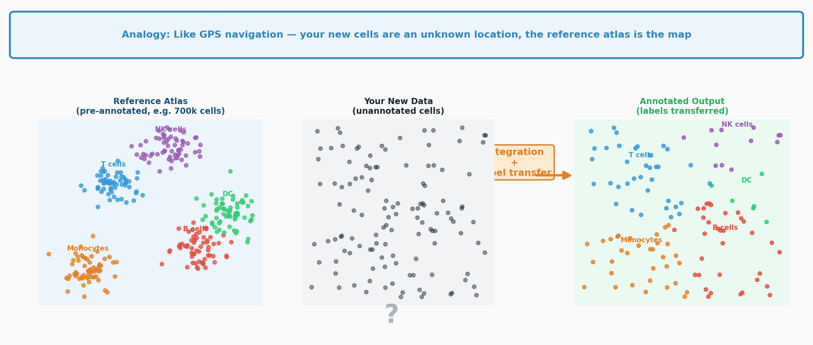
Method 2: Reference Mapping
Compare your cells to a large, annotated atlas and borrow their labels
Tools used in this project: CellTypist (Claude) | Scanorama+KNN (Gemma) | Centroid dot-product (Llama)
Introduction to Cell-Type Annotation | Scripps Research Hackathon 2026 | 8/10

Slide 9
Why Does Cell-Type Annotation Matter?
Annotated cells unlock biological and clinical insights
Disease Research
Drug Target Discovery
Immune Profiling
Identify which cell types are expanded or depleted in cancer, autoimmune disease, or infection
Find the exact cell type where a drug acts — or should act — in the body
Track how T, B, NK cells change before and after vaccination or treatment
Cell Atlas Projects
Biomarker Discovery
Drug Development
Build maps of every cell type in the human body (Human Cell Atlas project)
Identify rare cell populations that predict patient outcomes or disease progression
Understand off-target effects: which cell types are affected by a new compound
Without cell-type annotation, single-cell data is just 20,000 numbers per cell — annotation gives it biological meaning
Introduction to Cell-Type Annotation | Scripps Research Hackathon 2026 | 9/10

Slide 10
Summary: Zero-Shot vs Reference Mapping
Two complementary strategies — use both for the most reliable annotation
 | Zero-Shot (Marker Genes) | Reference Mapping
Core idea | Match cluster's top genes to known marker gene lists | Align cells to a pre-annotated atlas and transfer labels
Prior knowledge | Curated marker gene lists (literature or LLM knowledge) | A labelled reference dataset (e.g. Human Cell Atlas)
Granularity | Cluster-level (all cells in a cluster get same label) | Cell-level (each cell annotated independently)
Strengths | - No reference data required - Fast and interpretable - Any organism | - Cell-level resolution - Handles novel datasets - Large training sets
Weaknesses | - Limited by cluster resolution - Misses rare cell types - Needs good markers | - Needs a good reference - Batch effects can mislead - Reference may be incomplete
Accuracy (PBMC3k) | 85.1% (Claude & Llama) 76.4% (Gemma) | 88.9% (Claude/CellTypist) 77.0% (Gemma/Scanorama) 73.2% (Llama/dot-product)
Best when... | No reference available or working with novel tissue | High accuracy needed and a well-matched reference exists
Introduction to Cell-Type Annotation | Scripps Research Hackathon 2026 | 10/10

