Slide 1
PBMC Cell-Type Annotation
LLM Pipeline Comparison: Claude vs Llama vs Gemma
Dataset: PBMC 3k | AWS Bedrock | scanpy · CellTypist · Scanorama
Claude Haiku 4.5
Llama 3.1 70B
Gemma 3 27B
Scripps Research Hackathon 2026
PBMC Cell-Type Annotation: LLM Pipeline Comparison | Scripps Research Hackathon 2026 | 1/8

Slide 2
Pipeline Design Comparison
What did each LLM choose for each method?
 | Claude (Haiku 4.5) | Llama (3.1 70B) | Gemma (3 27B)
Zero-Shot Approach | LLM API call via Bedrock (biological reasoning) | Avg marker gene expression per cluster | Sum marker gene expression per cell
Zero-Shot Granularity | Cluster-level | Cluster-level | Per-cell
Reference Method | CellTypist (logistic regression) | Centroid dot-product similarity | Scanorama integration + KNN label transfer
Reference Dataset | Immune_All_High (700k cells, 20+ studies) | pbmc68k_reduced (700 cells, 10x) | pbmc68k_reduced (700 cells, 10x)
Code Structure | 4 scripts (pipeline) | 1 monolithic script | 6 modular scripts
Requires Bedrock API | Yes (LLM call) | No | No
Accuracy — Zero-Shot | 85.1% | 85.1% | 76.4%
Accuracy — Reference | 88.9% | 73.2% | 77.0%
PBMC Cell-Type Annotation: LLM Pipeline Comparison | Scripps Research Hackathon 2026 | 2/8

Slide 3
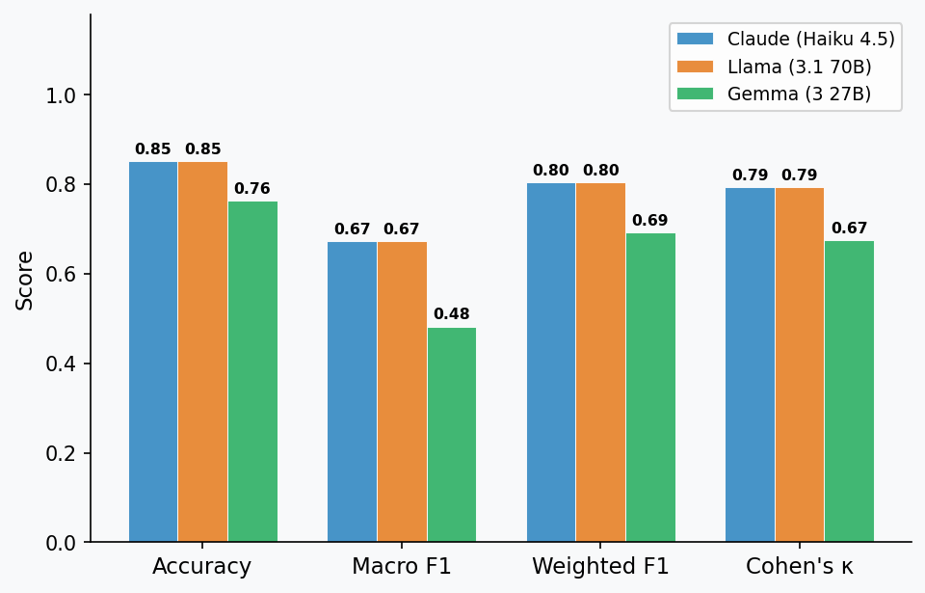
Zero-Shot Annotation Results
Cluster marker genes → cell type label | No reference data used
Model | Accuracy | Macro F1 | Wtd F1 | Kappa | Time | Mem
Claude (Haiku 4.5) | 0.851 | 0.673 | 0.804 | 0.794 | 2.0 s | 10 MB
Llama (3.1 70B) | 0.851 | 0.673 | 0.804 | 0.794 | 1.1 s | 80 MB
Gemma (3 27B) | 0.764 | 0.482 | 0.692 | 0.674 | 23.5 s | 216 MB
Claude & Llama tie at 85.1% — identical cluster assignments despite completely different mechanisms
PBMC Cell-Type Annotation: LLM Pipeline Comparison | Scripps Research Hackathon 2026 | 3/8

Slide 4
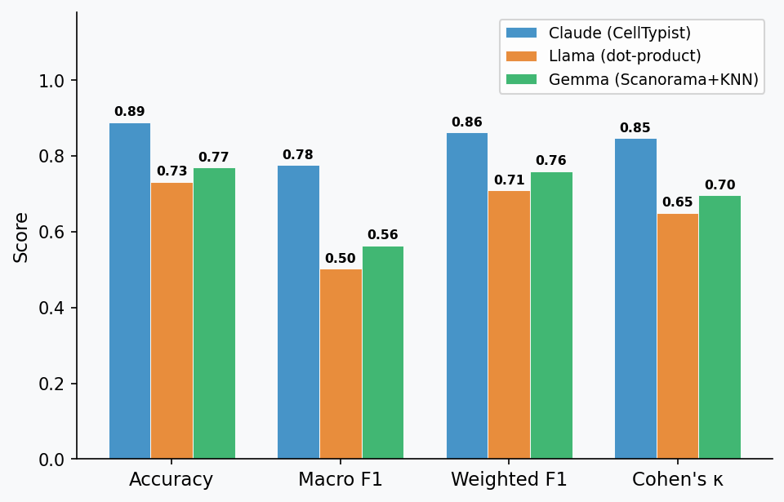
Reference Mapping Results
Annotate by comparing against a large, pre-labelled cell atlas
Model | Accuracy | Macro F1 | Wtd F1 | Kappa | Time | Mem
Claude (CellTypist) | 0.889 | 0.776 | 0.863 | 0.847 | 1.5 s | 255 MB
Llama (dot-product) | 0.732 | 0.502 | 0.710 | 0.650 | 0.3 s | 35 MB
Gemma (Scanorama+KNN) | 0.770 | 0.564 | 0.760 | 0.697 | 1.4 s | 77 MB
CellTypist (Claude) wins by +12-16 pp by choosing a pre-trained 700k-cell model
PBMC Cell-Type Annotation: LLM Pipeline Comparison | Scripps Research Hackathon 2026 | 4/8

Slide 5
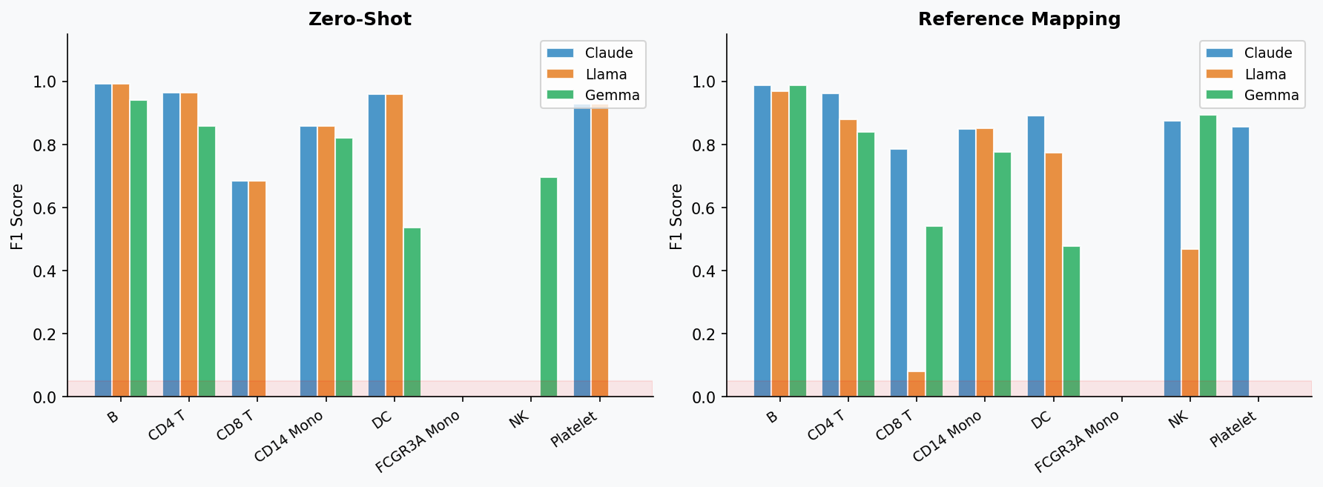
Per-Class F1 Score Breakdown
Which cell types does each method handle well — and which does it miss?
Red zone (F1≈0): FCGR3A Mono undetected by all — merged with CD14 Mono in the same Leiden cluster
PBMC Cell-Type Annotation: LLM Pipeline Comparison | Scripps Research Hackathon 2026 | 5/8

Slide 6
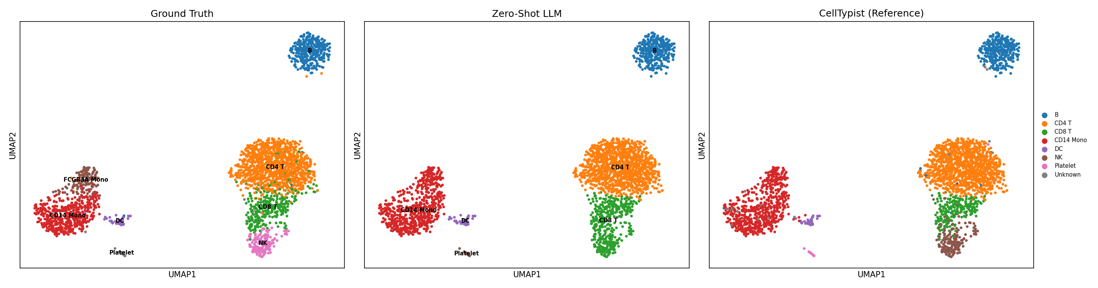
UMAP Visualisations — Claude Pipeline
Ground Truth (left) | Zero-Shot LLM (centre) | CellTypist Reference Mapping (right)
PBMC Cell-Type Annotation: LLM Pipeline Comparison | Scripps Research Hackathon 2026 | 6/8

Slide 7
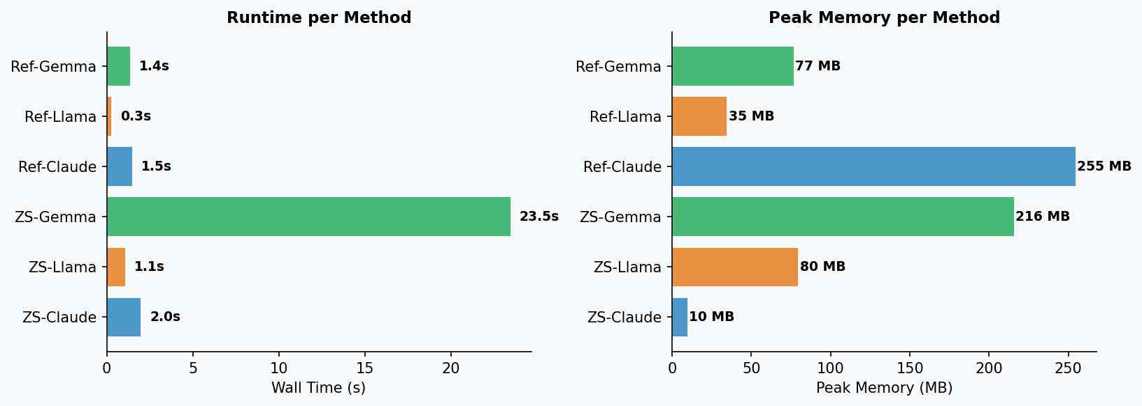
Resource Usage: Time & Memory
Wall-clock time and peak memory for each annotation step
Lighter = Zero-Shot | Solid = Reference Mapping
PBMC Cell-Type Annotation: LLM Pipeline Comparison | Scripps Research Hackathon 2026 | 7/8

Slide 8
Key Differences & Limitations
[1] METHOD DIFFERENCES
• Claude: Only LLM that called the Bedrock API — used biological reasoning to annotate from marker genes
• Llama: Cluster-level marker scoring — no API call, faster, but identical zero-shot accuracy to Claude
• Gemma: Suggested Scanorama (proper batch-correction) — most sophisticated integration approach
• Reference tool choice drove the biggest accuracy gap: CellTypist (700k cells) vs dot-product/KNN (700 cells)
[2] SHARED LIMITATIONS
• Leiden resolution 0.5 yields 6 clusters for 8 ground-truth types — FCGR3A Mono & NK merge with neighbors
• FCGR3A+ Monocytes: F1 = 0.00 for ALL methods — requires higher clustering resolution to rescue
• pbmc68k reference (Llama/Gemma) too small (700 cells) for reliable centroid estimation
• Ground truth labels from scanpy are coarser than Seurat (no Naive/Memory CD4 T distinction)
[3] LLM CODE QUALITY
• Claude: Produced a complete, runnable pipeline — chose CellTypist without being prompted to
• Llama: Skeleton with bugs (wrong argmax logic, wrong boto3 syntax) — required ~10 fixes to run
• Gemma: Most structured output (6 files) but wrong reference (suggested Mouse Brain Atlas for PBMC!)
• All 3 omitted memory/time tracking — left as 'exercise for the reader'
PBMC Cell-Type Annotation: LLM Pipeline Comparison | Scripps Research Hackathon 2026 | 8/8

