Slide 1

Homework-2 > java IO
Author: Haiyan.chen
Date:19th Dec,2016

Slide 2
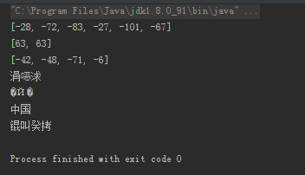
Problem1
得到 String s="中国" 这个字符串的utf-8编码，gbk编码，iso-8859-1编码的字符串，看看各自有多少字节，同时解释为什么以utf-8编码得到的byte[]无法用gbk的方式“还原”为原来的字符串?
String str="中国"; byte[] bytesUtf_8=str.getBytes(StandardCharsets.UTF_8); byte[] bytesIos_8859_1=str.getBytes(StandardCharsets.ISO_8859_1); byte[] bytesGbk=str.getBytes("GBK"); System.out.println(Arrays.toString(bytesUtf_8));//[-28, -72, -83, -27, -101, -67] 6个字节 System.out.println(Arrays.toString(bytesIos_8859_1));//[63, 63] 2个字节 System.out.println(Arrays.toString(bytesGbk));//[-42, -48, -71, -6] 4字节 String str3=new String(bytesUtf_8,"GBK"); System.out.println(str3);//编码方式不一样 不能还原 /* GBK的文字编码是用双字节来表示的，即不论中、英文字符均使用双字节来表示，为了区分中文，将其最高位都设定成1 GBK、GB2312等与UTF8之间都必须通过Unicode编码才能相互转换 UTF_8 是用以解决国际上字符的一种多字节编码，它对英文使用8位（即一个字节），中文使用24为（三个字节）来编码。 UTF-8包含全世界所有国家需要用到的字符，是国际编码，通用性强。 UTF-8编码的文字可以在各国支持UTF8字符集的浏览器上显示。如果是UTF8编码，则在外国人的英文IE上也能显示中文 */ String str1=new String(new String(bytesUtf_8,"GBK").getBytes("GBK"),StandardCharsets.UTF_8);//utf8 编码的byte数组可以通过GBK转换成字符串，然后转成GBK编码的byte数组， String str2=new String(new String(bytesGbk,StandardCharsets.UTF_8).getBytes(StandardCharsets.UTF_8),"GBK");//GBK 编码的byte数组不行， /*bytesGbk[]字节数组里面存的是gbk编码， 如果用utf-8到unicode的转换算法。 这个字节数的某些位用这种算法无法解析， 于是数据就出现了错误，数据错误之后，想转换回来当然不行了(所谓的兼容性不好)组里面。*/ System.out.println(str1); System.out.println(str2);
result

Slide 3
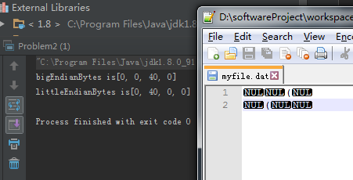
Problem2
分别用大头和小头模式将整数 a=10240写入到文件中（4个字节），并且再正确读出来，打印到屏幕上，同时截图UltraEdit里的二进制字节序列，做对比说明
public static void main(String[] args) throws IOException { int number=10240; RandomAccessFile rf=new RandomAccessFile("myfile.dat","rw"); byte[] bigEnDianBytes=intToByte4(number); System.out.println("bigEndianBytes is"+Arrays.toString(bigEnDianBytes)); byte[] littleEndianBytes=new byte[bigEnDianBytes.length]; for (int i = 0; i <bigEnDianBytes.length ; i++) { littleEndianBytes[bigEnDianBytes.length-i-1]=bigEnDianBytes[i]; } System.out.println("littleEndianBytes is"+Arrays.toString(littleEndianBytes)); try { rf.write(bigEnDianBytes); rf.write("\r\n".getBytes()); rf.write(littleEndianBytes); } catch (IOException e) { e.printStackTrace(); } finally { rf.close(); } } public static byte[] intToByte4(int i) { byte[] targets = new byte[4]; targets[3] = (byte) (i & 0xFF); targets[2] = (byte) (i >> 8 & 0xFF); targets[1] = (byte) (i >> 16 & 0xFF); targets[0] = (byte) (i >> 24 & 0xFF); return targets; }
Result:
Unicode的&#40;代表（
bigEndian 和littleEndian 字节顺序相反

Slide 4
Problem4
随机生成 Salary {name, baseSalary, bonus }的记录，如“wxxx,10,1”，每行一条记录总共1000万记录，写入文本文件（UFT-8编码），然后读取文件，name的前两个字符相同的，其年薪累加，比如wx，100万，3个人，最后做排序和分组，输出年薪总额最高的10组：
wx, 200万，10人
lt, 180万，8人....

Slide 5
Solution4
public class Salary { byte[] name; int baseSalary; int bonus; public int getBaseSalary() { return baseSalary; } public void setBaseSalary(int baseSalary) { this.baseSalary = baseSalary; } public int getBonus() { return bonus; } public void setBonus(int bonus) { this.bonus = bonus; } public byte[] getName() { return name; } public void setName(byte[] name) { this.name = name; } public Salary() { super(); } public Salary(byte[] name, int baseSalary, int bonus) { this.name = name; this.baseSalary = baseSalary; this.bonus = bonus; } }
public class GroupSalary implements Comparable { public int sumYearSalary; public int total; public String beginName2; @Override public int compareTo(Object o) { if(o==this)return 0; GroupSalary other=(GroupSalary)o; if(other.sumYearSalary>sumYearSalary) return 1; if(other.sumYearSalary<sumYearSalary) return -1; return 0; } @Override public String toString() { return "GroupSalary{" + "sumYearSalary=" + sumYearSalary + ", total=" + total + ", beginName2='" + beginName2 + '\'' + '}'; }

Slide 6
Solution4
public static final int NUMBER=10000000; public static void main(String[] args) throws IOException { long time1=System.currentTimeMillis(); generatorFile(); Long time2=System.currentTimeMillis(); System.out.println("generatorFile cost time"+(time2-time1)/1000+"s"); groupThenSort(); Long time3=System.currentTimeMillis(); System.out.println("groupThenSort cost time"+(time3-time2)/1000+"s"); }
private static void generatorFile() throws IOException { File file = new File("C:\\Users\\thinkpad\\Desktop\\myfile4.dat"); if(file.exists()){ file.delete(); } RandomAccessFile rf=new RandomAccessFile("C:\\Users\\thinkpad\\Desktop\\myfile4.dat","rw"); FileChannel filech=rf.getChannel(); MappedByteBuffer buffer=filech.map(FileChannel.MapMode.READ_WRITE,0,7*NUMBER); for (int i = 0; i <NUMBER ; i++) { Salary salary=new Salary(generatorName(5).getBytes(StandardCharsets.UTF_8),generatorBaseSalary(),generatorBonus()); buffer.put(salary.name); buffer.put(Integer.valueOf(salary.baseSalary).byteValue()); buffer.put(Integer.valueOf(salary.bonus).byteValue()); } }

Slide 7
private static void groupThenSort() throws IOException { //group() RandomAccessFile rf=new RandomAccessFile("C:\\Users\\thinkpad\\Desktop\\myfile4.dat","r"); FileChannel filech=rf.getChannel(); Map<String,List<Salary>> mapSalarys=new HashMap<>(); MappedByteBuffer buffer=filech.map(FileChannel.MapMode.READ_ONLY,0,7*NUMBER); for (int i = 0; i <NUMBER ; i++) { byte[] begin2=new byte[2]; byte[] begin5=new byte[5]; byte[] begin6=new byte[1]; byte[] begin7=new byte[1]; /*buffer.get(begin2,0,2); buffer.clear();*/ buffer.get(begin5,0,5); buffer.get(begin6,0,1); buffer.get(begin7,0,1); begin2=Arrays.copyOfRange(begin5,0,2); Salary salary=new Salary(begin5,bytesToInt(begin6[0]),bytesToInt(begin7[0])); String str=new String(begin2,StandardCharsets.UTF_8); if(mapSalarys.containsKey(str)){ mapSalarys.get(str).add(salary); }else { mapSalarys.put(str,new ArrayList<>()); mapSalarys.get(str).add(salary); } } // sort(); Map<String,GroupSalary> map=new HashMap<>(); for (String str: mapSalarys.keySet()) { GroupSalary groupSalary=new GroupSalary(); groupSalary.total=mapSalarys.get(str).size(); groupSalary.beginName2=str; for (Salary sa:mapSalarys.get(str)) { groupSalary.sumYearSalary+=sa.getBaseSalary()*12+sa.getBonus(); } map.put(str,groupSalary); } List arrayList=new ArrayList<>(); for (String str:map.keySet()) { arrayList.add(map.get(str)); } Collections.sort(arrayList); for (int i = 0; i <10; i++) { System.out.println(arrayList.get(i).toString()); } }
private static Integer generatorBaseSalary(){ Random random=new Random(); return random.nextInt(95)+5; } private static Integer generatorBonus(){ Random random=new Random(); return random.nextInt(10); } private static String generatorName(int length){ String base = "abcdefghijklmnopqrstuvwxyz"; Random random = new Random(); StringBuffer sb = new StringBuffer(); for (int i = 0; i < length; i++) { int number = random.nextInt(base.length()); sb.append(base.charAt(number)); } return sb.toString(); } public static int bytesToInt(byte data) { return data&0xFF; }

Slide 8
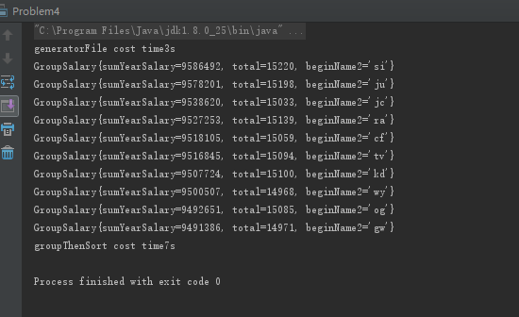
Solution4
Result：

Slide 9

Author : haiyan.chen
The End, Thanks!!

