Slide 1
Homework5-java内存模型
陈海燕
2017-01-09

Slide 2
1 解释下你所理解的Happens-before含义和JVM里的几个Happens-before约定？
Two actions can be ordered by a happens-before relationship。
If one action happens-before another, then the first is visible to and ordered before the second.
If we have two actions x and y, we write hb(x, y) to indicate that x happens-before y.
If x and y are actions of the same thread and x comes before y in program order, then hb(x, y).程序次序规则
There is a happens-before edge from the end of a constructor of an object to the start of a finalizer for that object.对象终结规则
If an action x synchronizes-with a following action y, then we also have hb(x, y).
If hb(x, y) and hb(y, z), then hb(x, z). 传递性
An unlock on a monitor happens-before every subsequent lock on that monitor.管理锁定规则
A write to a volatile field happens-before every subsequent read of that field. volatile变量规则
A call to start() on a thread happens-before any actions in the started thread.线程启动规则
All actions in a thread happen-before any other thread successfully returns from a join() on that thread.线程终止规则
The default initialization of any object happens-before any other actions (other than default-writes) of a program.对象初始规则

Slide 3
2 不依赖任何的同步机制(syncronized ,lock),有几种方式能实现多个线程共享变量之间的happens-before方式?
多个线程共享变量，由于这些变量会缓存在 CPU 的缓存中，为了避免出现内存一致性错误而采用 volatile 关键字。
。。。。。？

Slide 4
3 编程验证normal var ,volaitle，synchronize,atomicLong ,LongAdder，这几种做法实现的计数器方法，在多线程情况下的性能，准确度 class MyCounter { private long value;//根据需要进行替换 public void incr(); public long getCurValue();//得到最后结果 } 启动10个线程一起执行，每个线程调用incr() 100万次， 所有线程结束后，打印 getCurValue()的结果，分析程序的结果 并作出解释。 用Stream和函数式编程实现则加分！

Slide 5
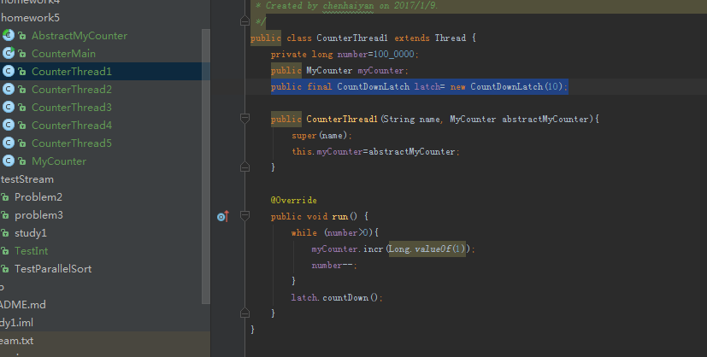
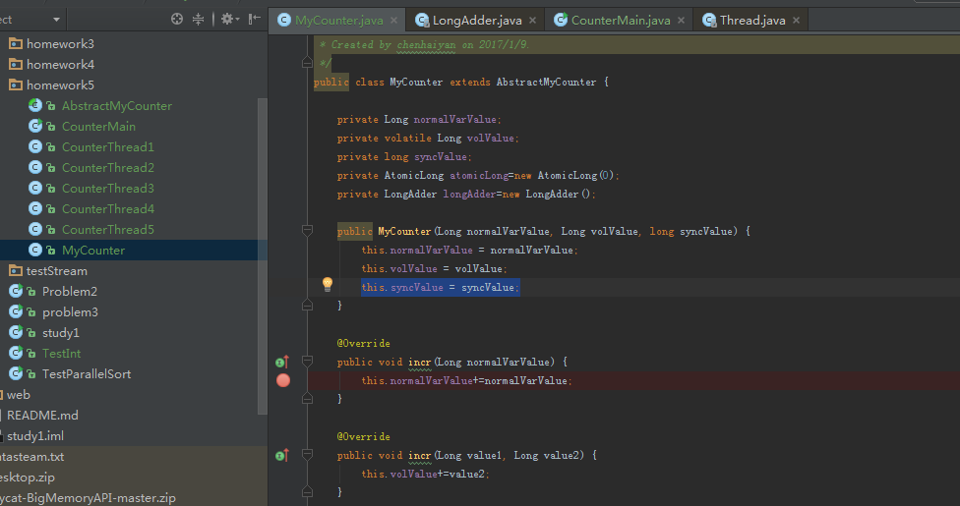
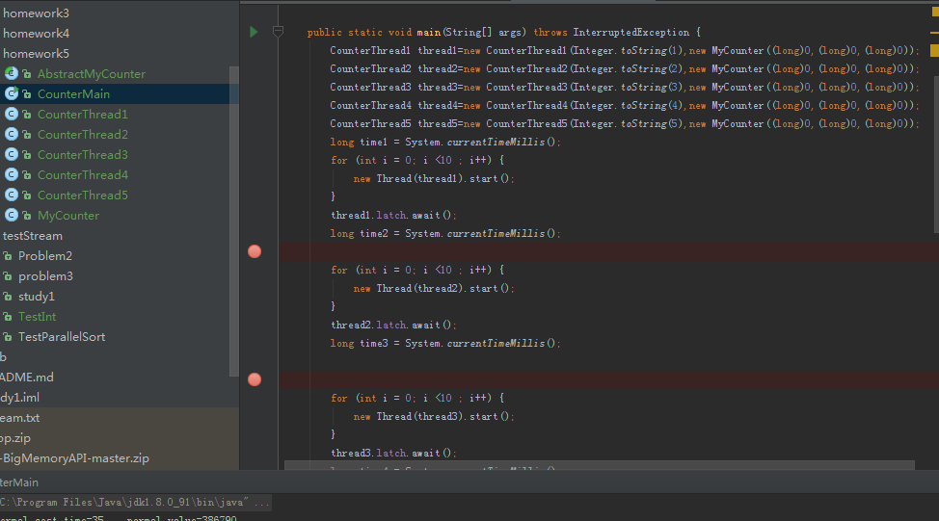
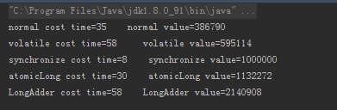
后两个值有误？？？

Slide 6
End thanks!

