Slide 1
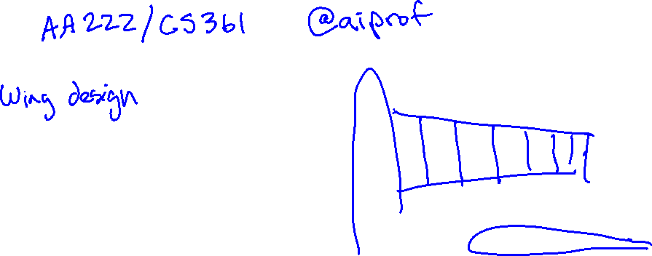

Slide 2
Students
Aeronautics and Astronautics
Mechanical Engineering
Computer Science
Energy Resource Engineering
Civil and Environmental Engineering
Mathematics
Management Science and Engineering
Materials Science and Engineering
Geological Sciences

Slide 3
Agenda
What is optimization?
Introduction of course staff
Logistics
Mathematical formulation
Overview of course
Derivatives (?)

Slide 4
Introduction

Slide 5
Introduction
Applications of Optimization
Physics
Business
Biology
Engineering
Objectives to Optimize
Efficiency
Safety
Accuracy
Constraints
Cost
Weight
Structural Integrity
Challenges
High-Dimensional Search Spaces
Multiple Competing Objectives
Model Uncertainty

Slide 7
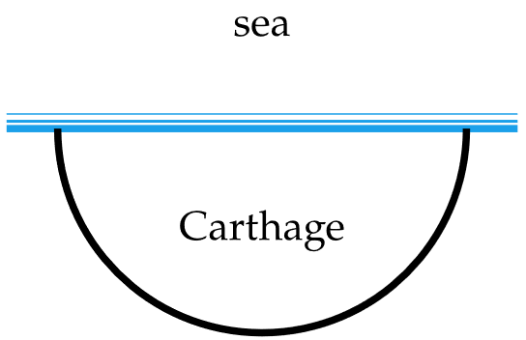
A History
Queen Dido’s Optimization Problem

Slide 8
A History
Calculus
Numerical Algorithms
Artificial Intelligence

Slide 9
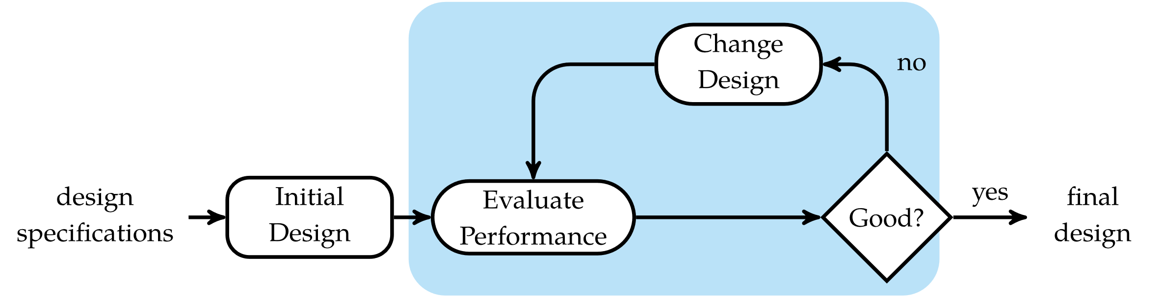
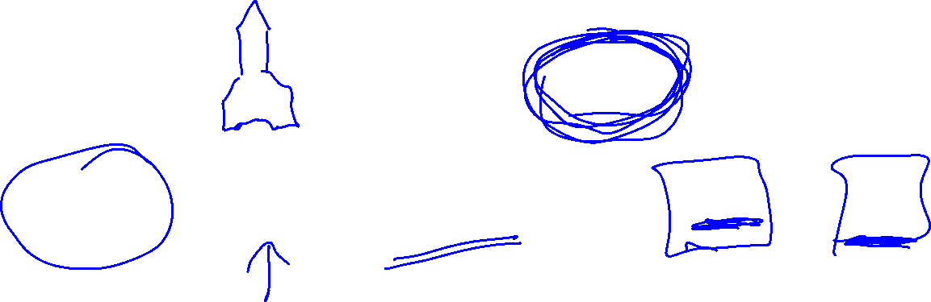
Optimization Process

Slide 10
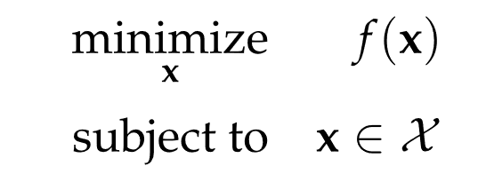
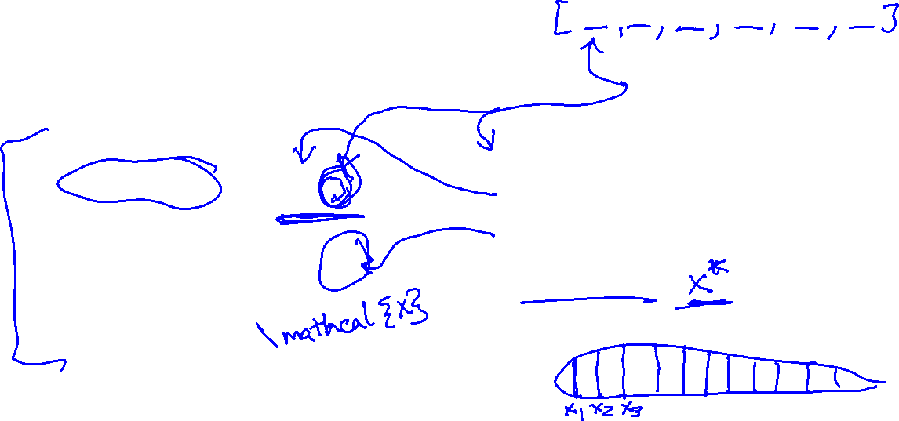
Basic Optimization Problem
Design Point
Design Variables
Objective Function
Feasible Set
Minimizer

Slide 11
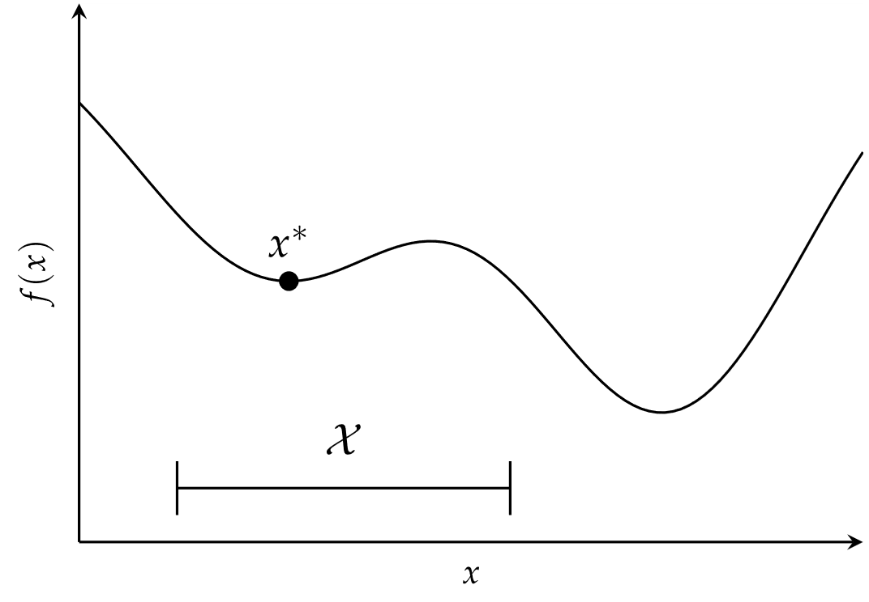
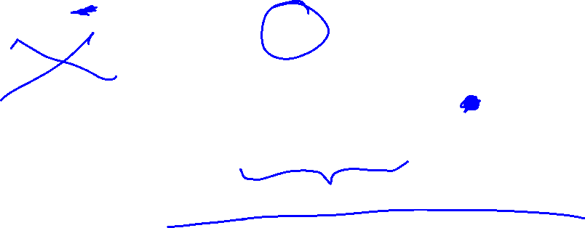
Basic Optimization Problem

Slide 12
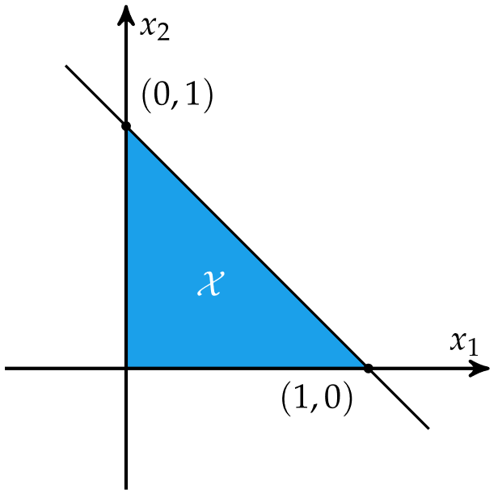

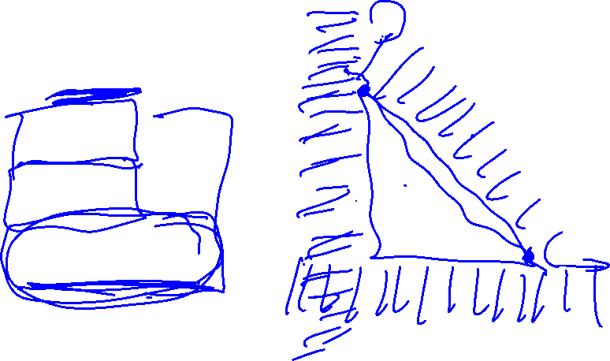
Constraints

Slide 13
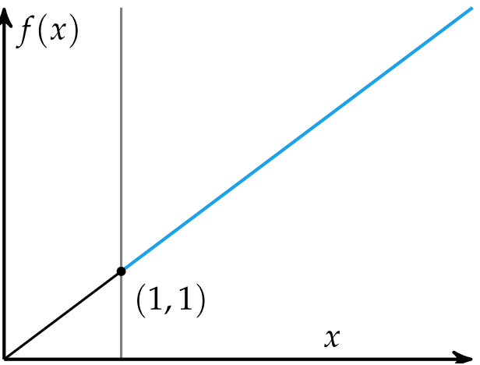
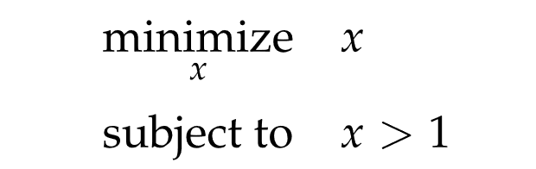
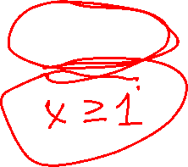
Constraints

Slide 14
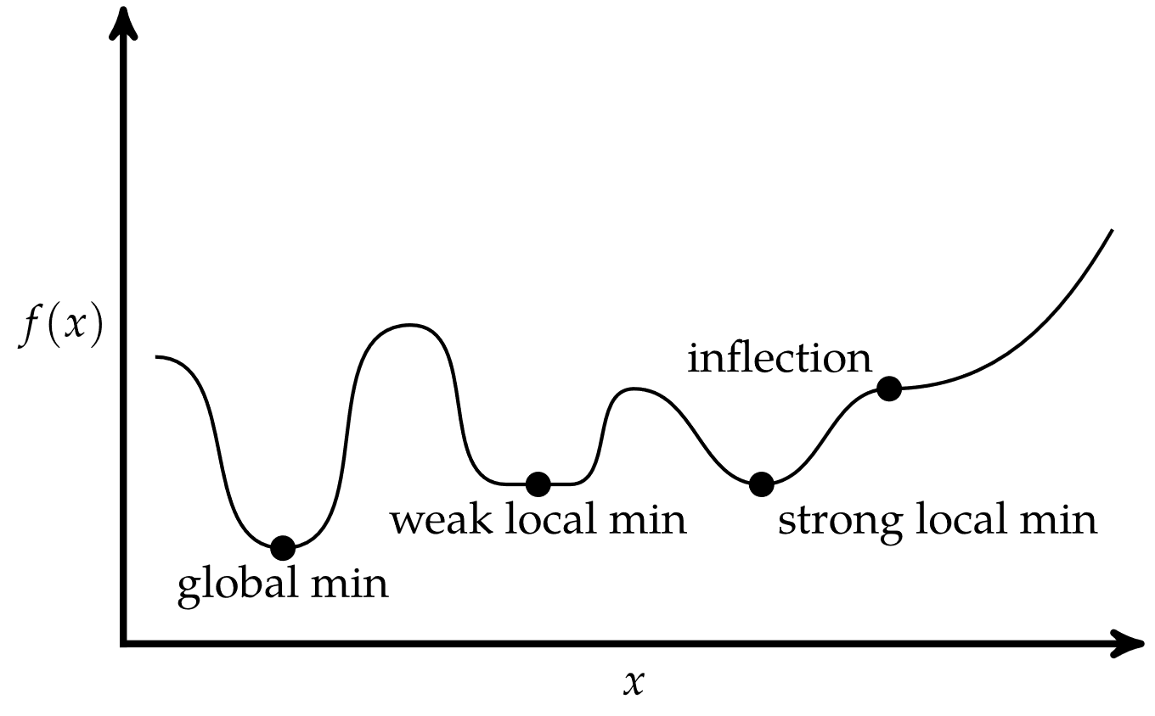

Critical Points
Univariate Function

Slide 15
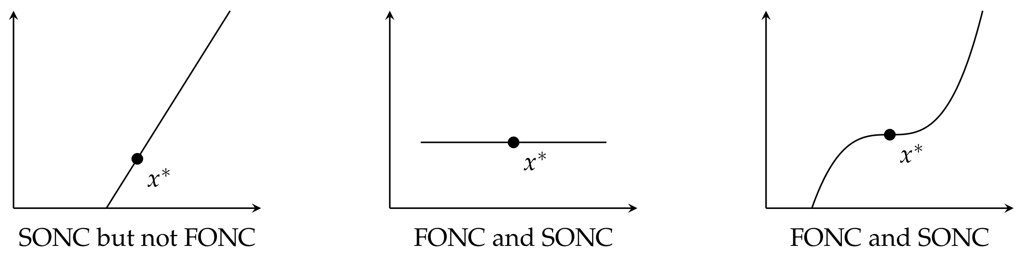


Conditions for Local Minima
Univariate Function
$=0,$ the first-order necessary condition (FONC)
$,$ the second-order necessary condition (SONC)

Slide 16


Conditions for Local Minima
Multivariate Functions
$=0,$ the first-order necessary condition (FONC)
$≥0,$ the second-order necessary condition (SONC)

Slide 17
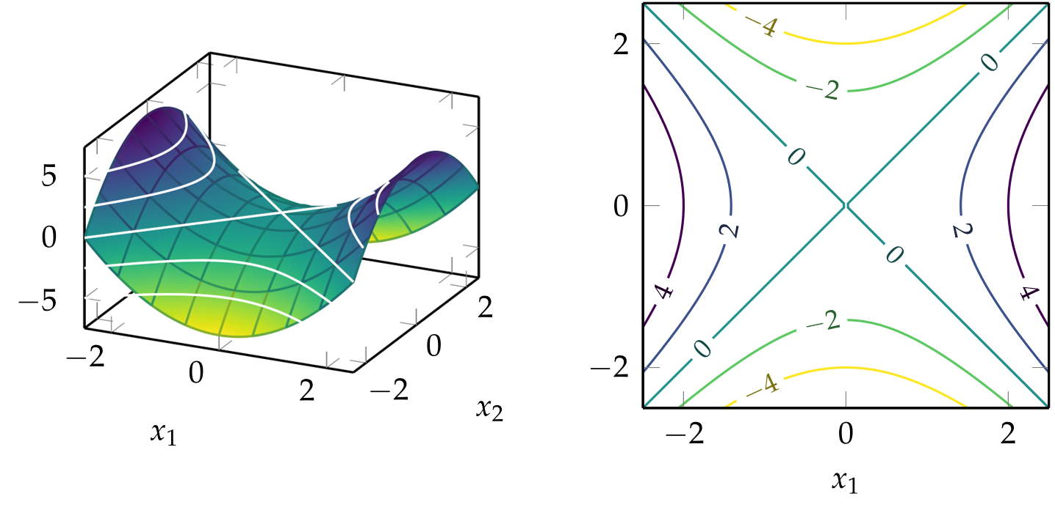


Contour Plots
$f\left(x_{1},x_{2}\right)={x_{1}}^{2}−{x_{2}}^{2}$

Slide 18
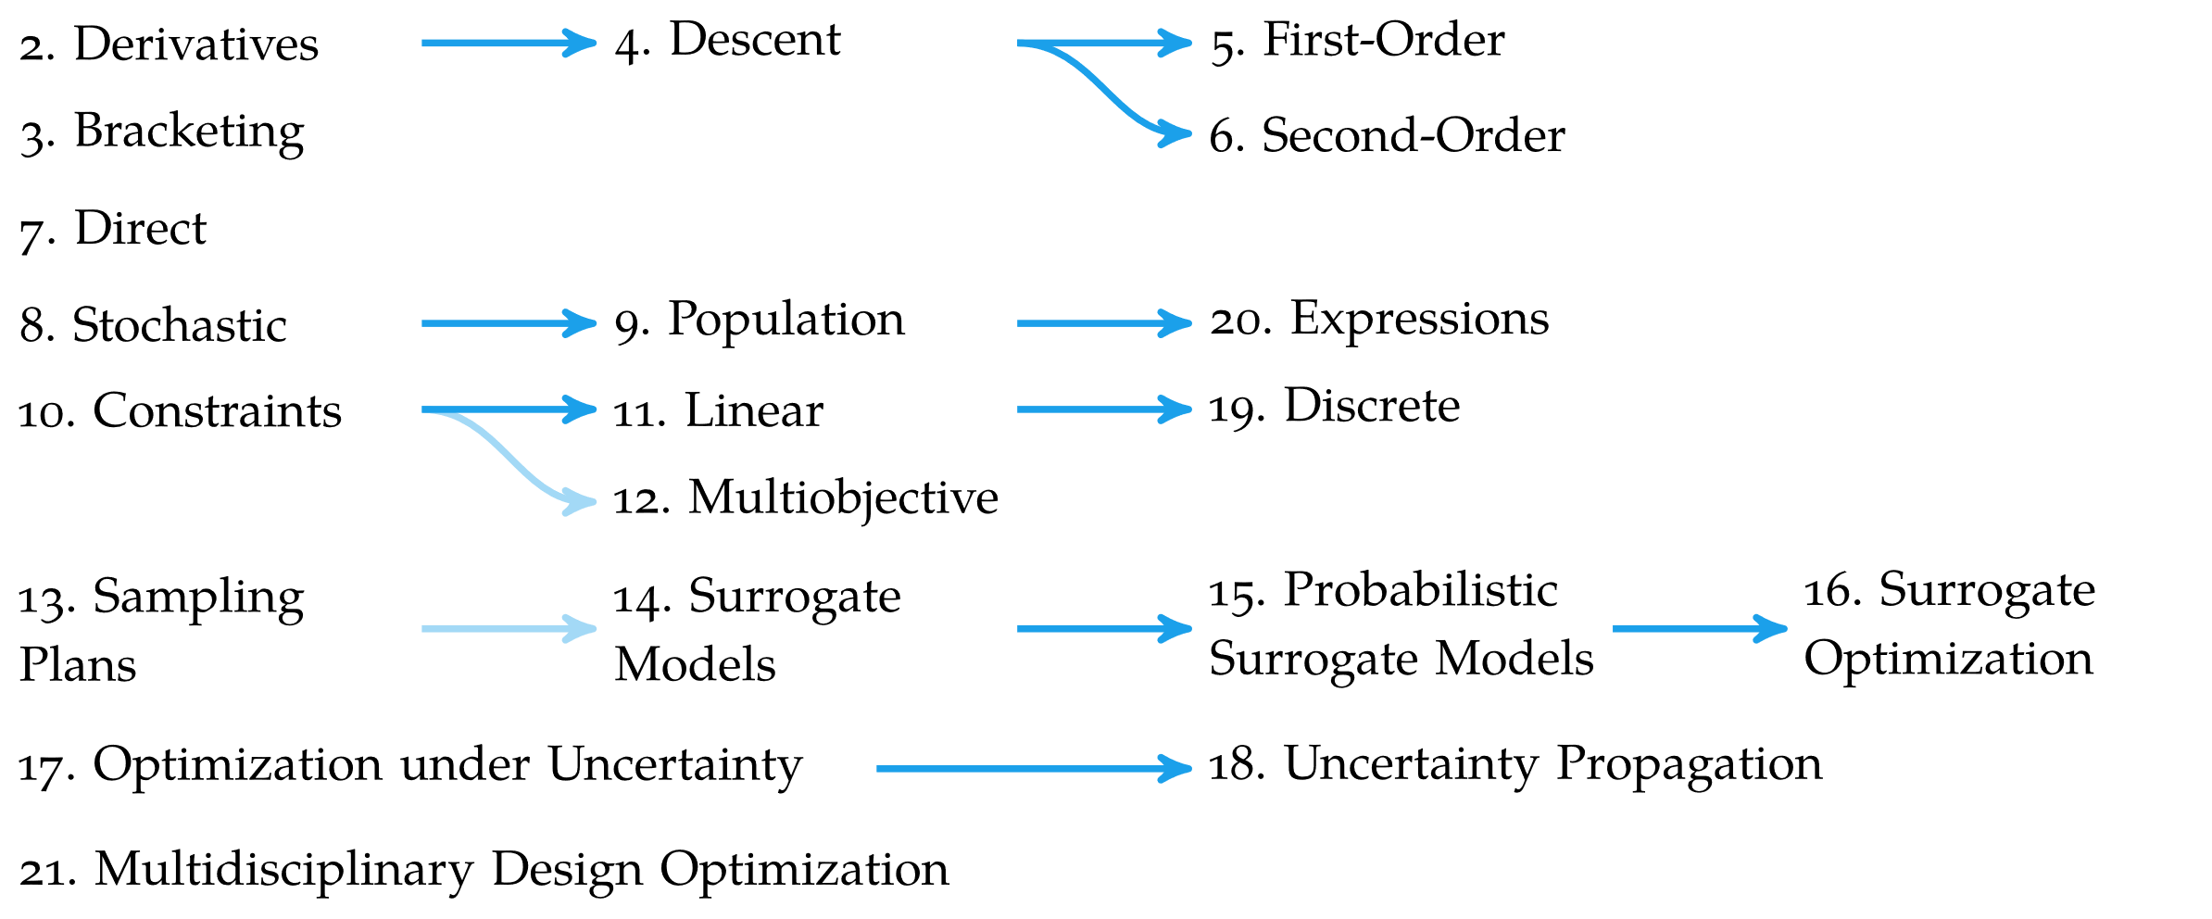

Overview

Slide 19
Summary
Optimization in engineering is the process of finding the best system design subject to a set of constraints
Optimization is concerned with finding global minima of a function
Minima can occur where the gradient is zero, but zero-gradient does not imply optimality

