Slide 1
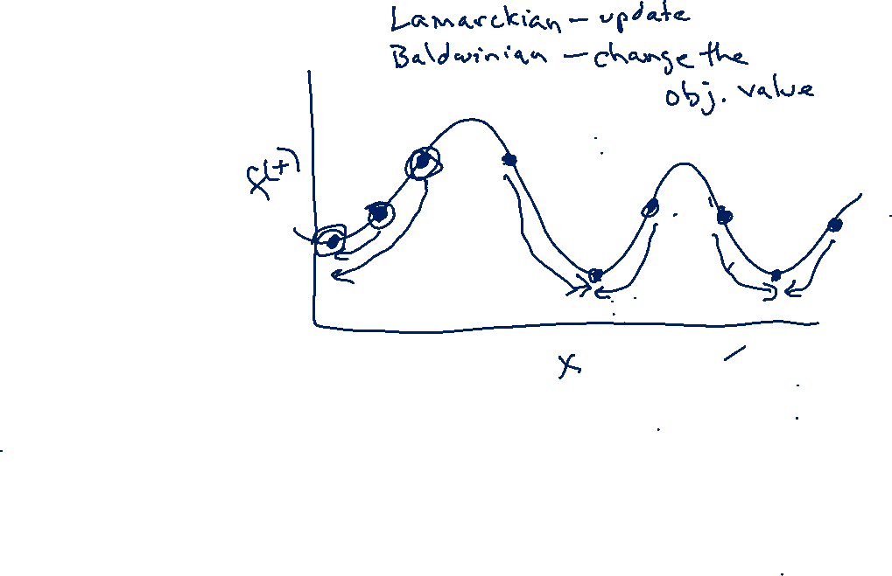
Agenda
Hybrid methods
Constraints (Ch. 10)
Quiz 1 review

Slide 2
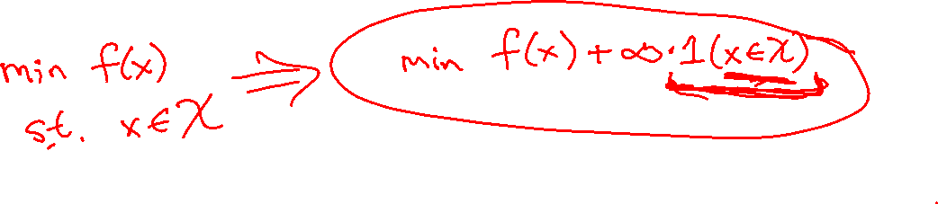
Constraints

Slide 3

Constrained Optimization
Minimizing an objective subject to design point restrictions called constraints
A variety of techniques transform constrained optimization problems into unconstrained problems
New optimization problem statement
The set is called the feasible set

Slide 4
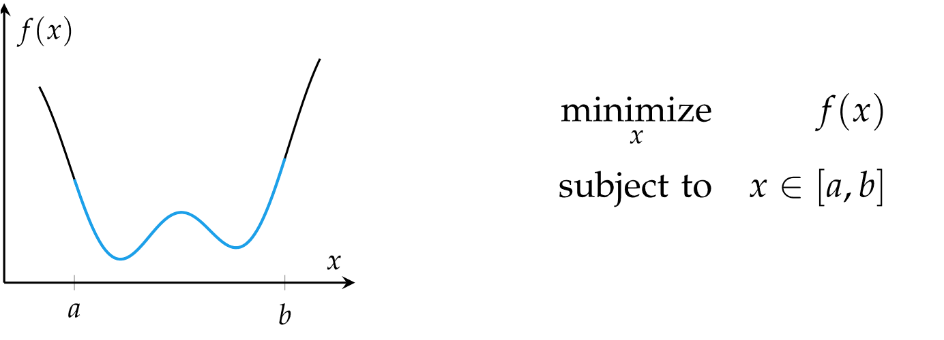
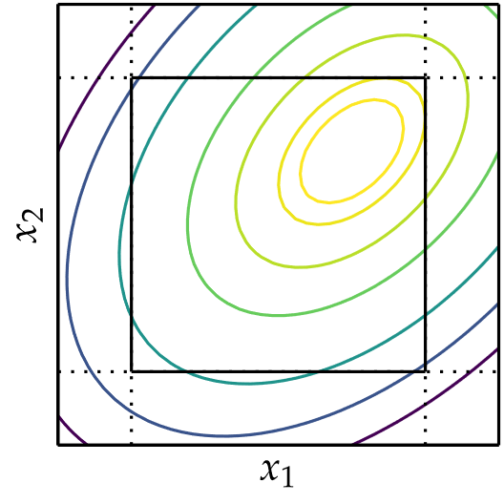
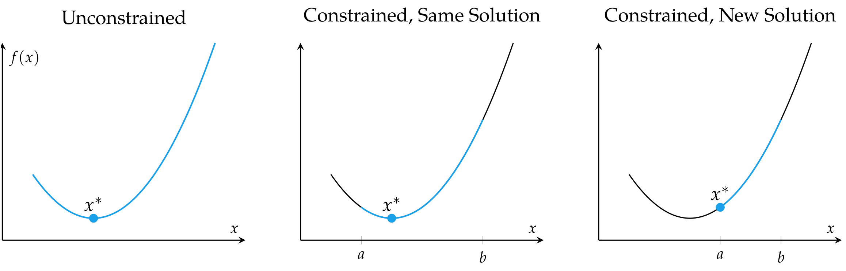
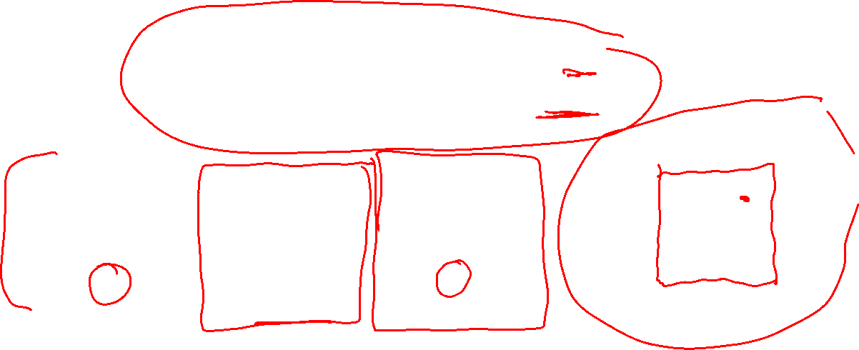
Constrained Optimization
Constraints that bound feasible set can change the optimizer

Slide 5
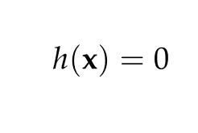

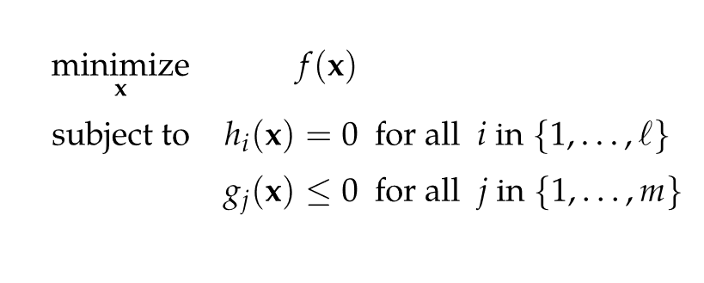

Constraint Types
Generally, constraints are formulated using two types
Equality constraints:
Inequality constraints:
Any optimization problem can be written as

Slide 6
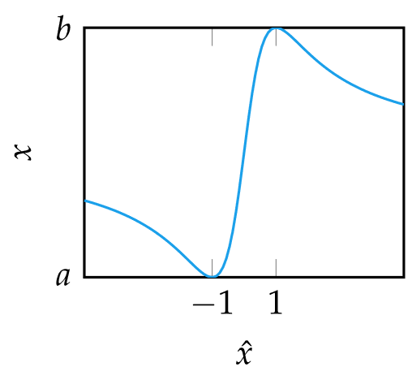
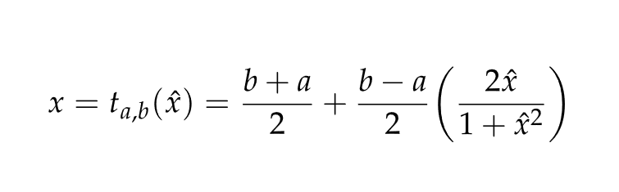
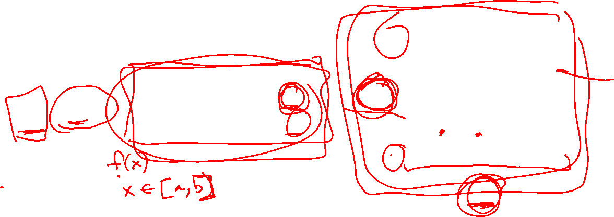
Transformations to Remove Constraints
If necessary, some problems can be reformulated to incorporate constraints into the objective function
If x is constrained between a and b

Slide 7
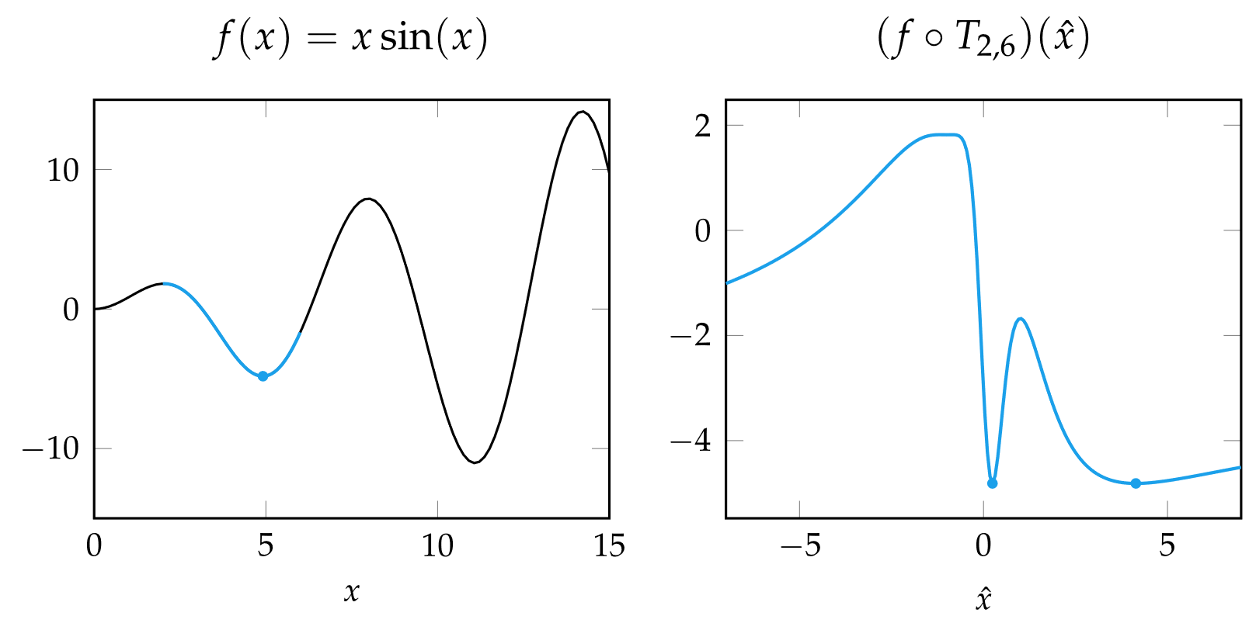
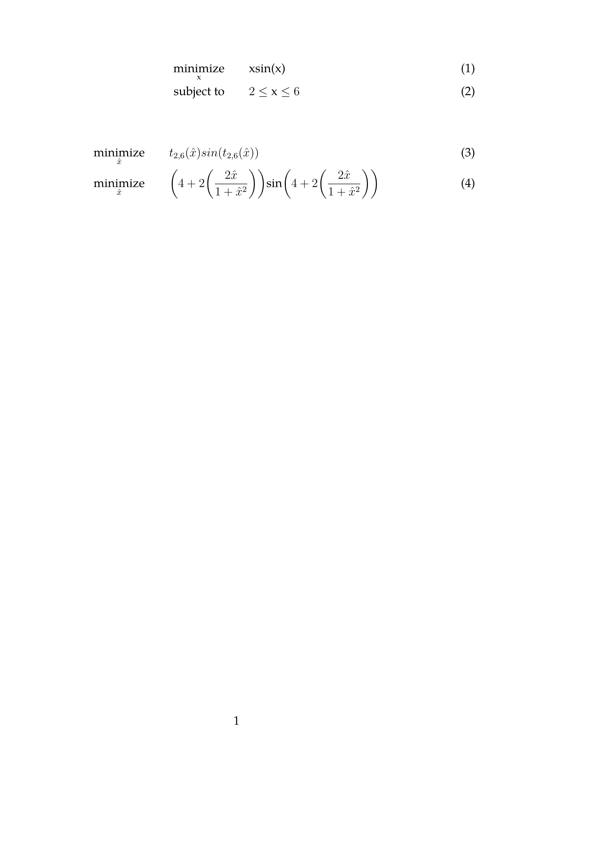
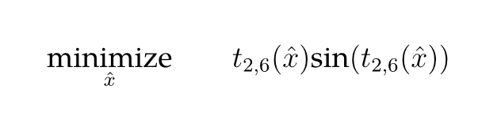
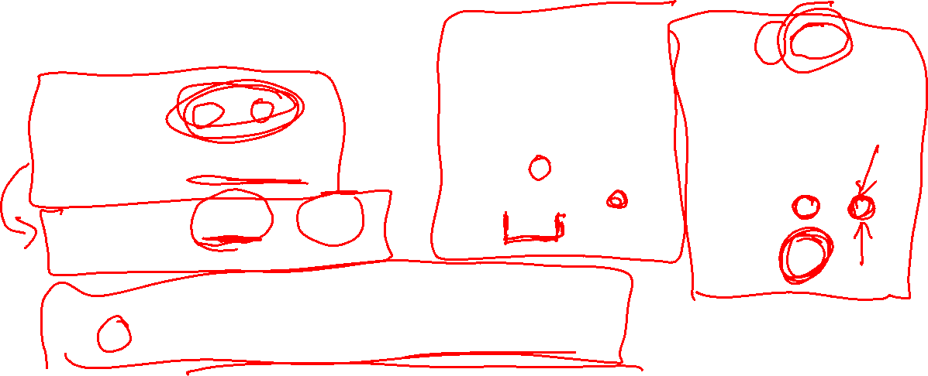
Transformations to Remove Constraints
Example 1

Slide 8
Lagrange Multipliers
The method of Lagrange multipliers is used to optimize a function subject to only equality constraints
Lagrange multipliers also refer to the variables introduced by the method denoted by λ

Slide 9




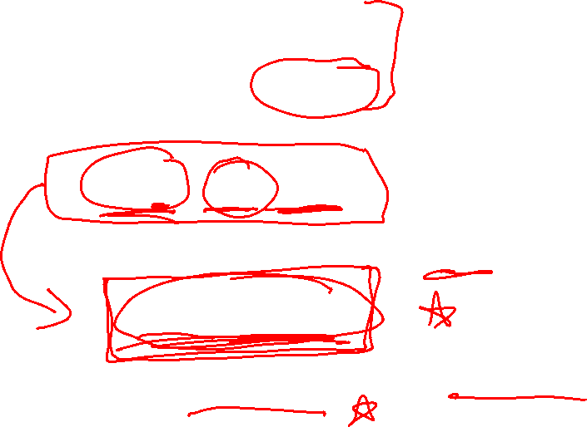
Lagrange Multipliers
Form Lagrangian equation
Set gradient of Lagrangian with respect to x to zero to get
Use constraint equation , solve for x and λ

Slide 10
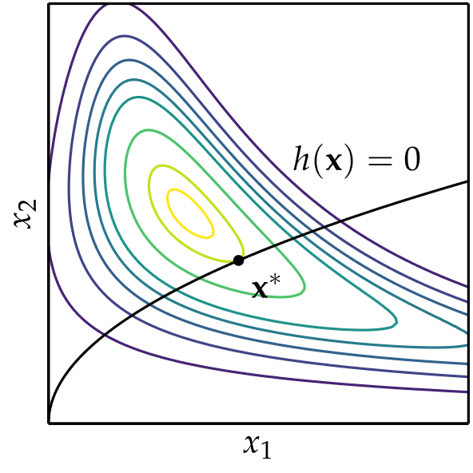
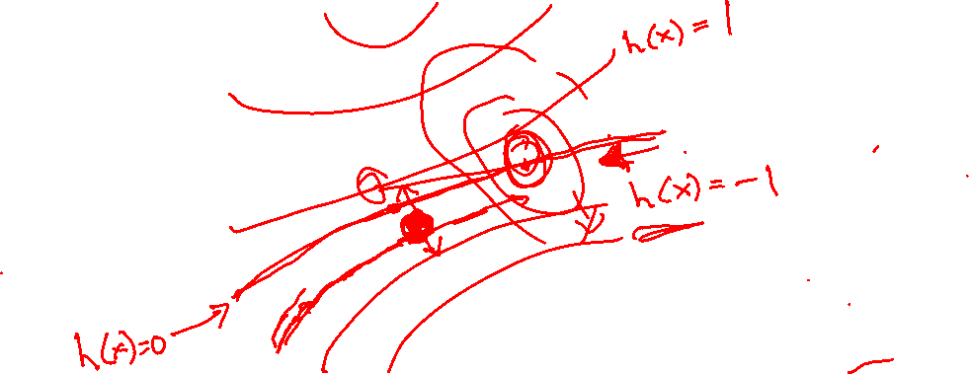
Lagrange Multipliers
Intuitively, the method of Lagrange multipliers finds the point x* where the constraint function is orthogonal to the gradient

Slide 11
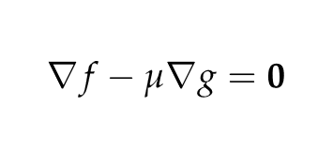

Inequality Constraints
If solution lies at the constraint boundary, the constraint is called active, and the Lagrange condition holds for a constant μ
If the solution lies within the boundary, the constraint is called inactive, and the Lagrange condition holds if μ = 0

Slide 12



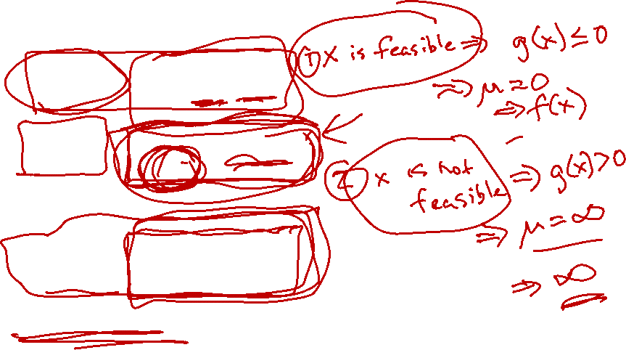
Inequality Constraints
This can be formulated so that the Lagrangian evaluates to infinity outside the feasible set if
then
The new optimization problem becomes
This is called the primal problem

Slide 13



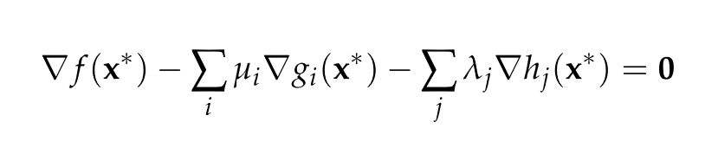
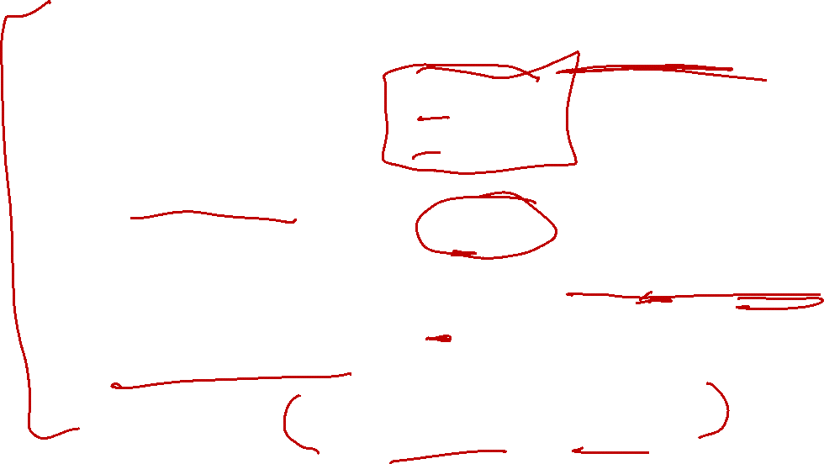
Inequality Constraints
Any primal solution must satisfy the KKT conditions
Feasibility:
Dual Feasibility: Penalization is toward feasibility
Complementary Slackness: Either µ_{i} or g_{i}(x*) is zero
Stationarity: Objective function tangent to each active constraint

Slide 14



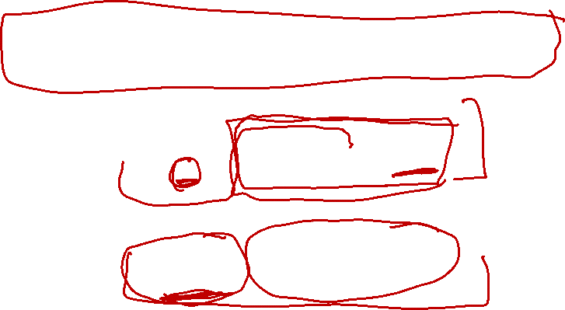
Duality
The method of Lagrange multipliers can be generalized to define generalized Lagrangian
As previously mentioned, the primal form is
Reversing the order of operations leads to the dual form

Slide 15


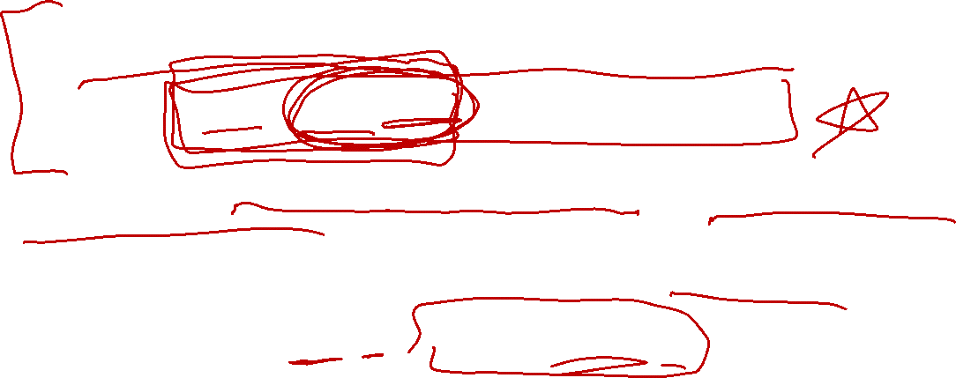
Duality
The min-max inequality states that for any function f(a,b)
Therefore, the solution to the dual problem is a lower bound to the primal solution
The dual problem can be used to define the dual function

Slide 16
Duality
By the max-min inequality, the dual solution is a lower bound to the primal solution
d* ≤ p*
The difference between dual and primal solutions d* and p* is called the duality gap
Showing zero-duality gap is a “certificate” of optimality

Slide 17
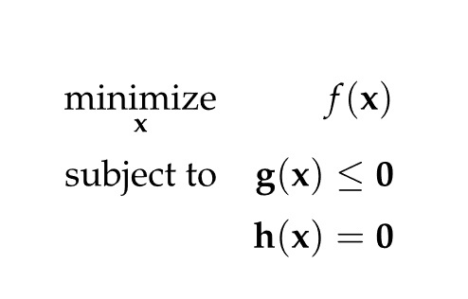

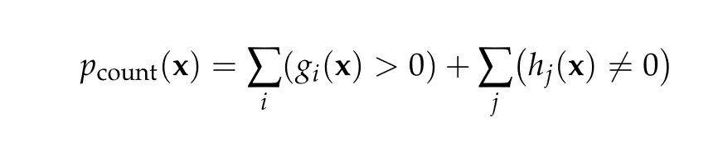
Penalty Methods
Penalty methods are a way of reformulating a constrained optimization problem as an unconstrained problem by penalizing the objective function value when constraints are violated
Simple example
→

Slide 18
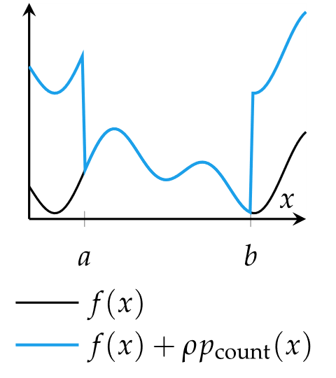
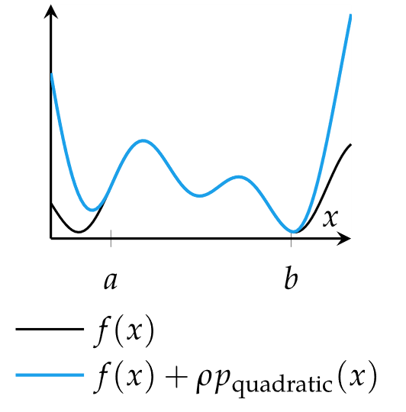

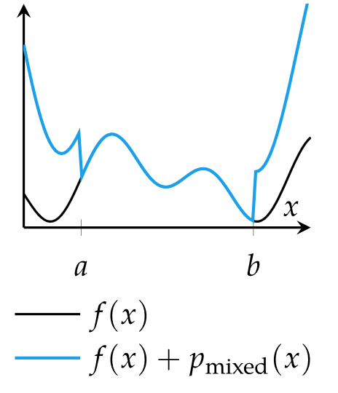

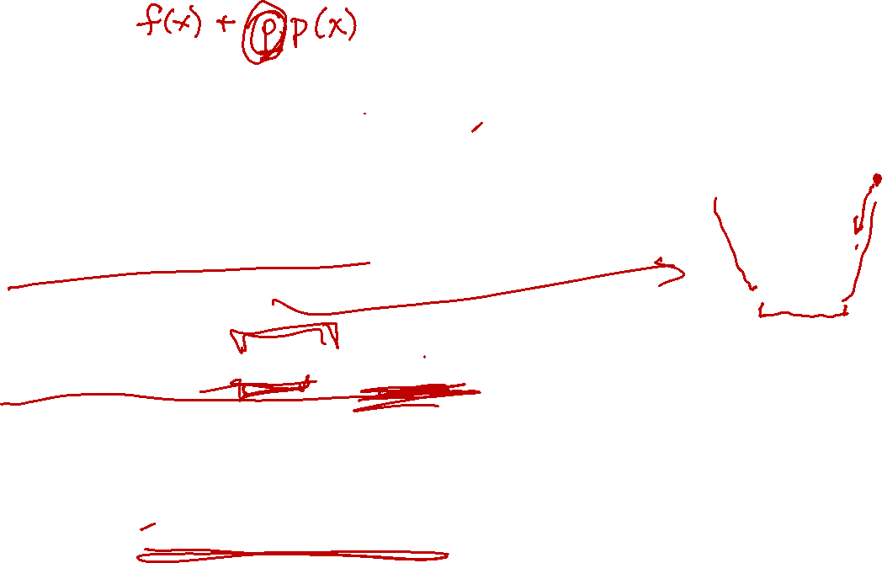
Penalty Methods
Count penalty:
Quadratic penalty:
Mixed Penalty:

Slide 19
Interior Point Methods
Also called barrier methods, interior point methods ensure that each step is feasible
This allows premature termination to return a nearly optimal, feasible point
Barrier functions are implemented similar to penalties but must meet the following conditions
Continuous
Non-negative
Approach infinity as x approaches boundary

Slide 20
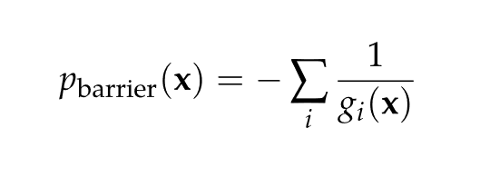
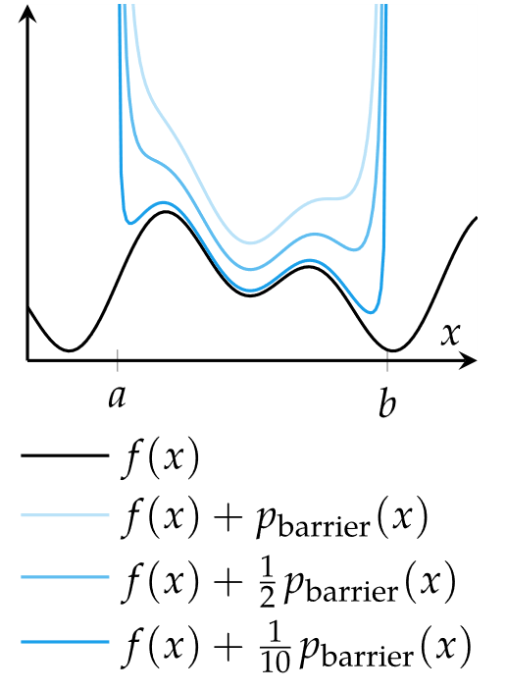
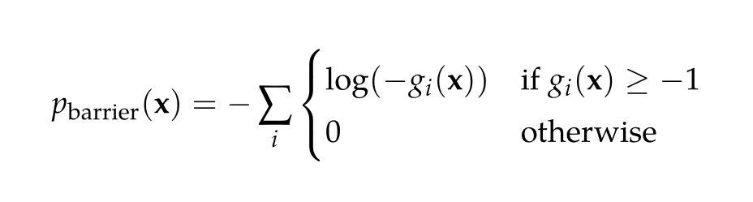
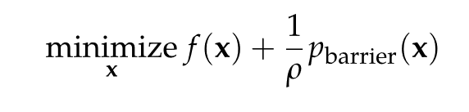
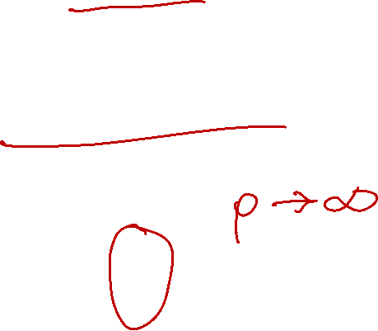
Interior Point Methods
Inverse Barrier:
Log Barrier:
New optimization problem

Slide 21
Summary
Constraints are requirements on the design points that a solution must satisfy
Some constraints can be transformed or substituted into the problem to result in an unconstrained optimization problem
Analytical methods using Lagrange multipliers yield the generalized Lagrangian and the necessary conditions for optimality under constraints
A constrained optimization problem has a dual problem formulation that is easier to solve and whose solution is a lower bound of the solution to the original problem

Slide 22
Summary
Penalty methods penalize infeasible solutions and often provide gradient information to the optimizer to guide infeasible points toward feasibility
Interior point methods maintain feasibility but use barrier functions to avoid leaving the feasible set

