Slide 1
Agenda
Project 2 Winners
“No TA” Office Hours
Surrogate Optimization
Optimization under Uncertainty
Review

Slide 2
Surrogate Optimization

Slide 3
Surrogate Optimization
Given a surrogate model with both prediction and confidence parameters, an optimization procedure must balance the search for the expected optimal point and decreasing uncertainty
In other words, the optimization algorithm must balance exploitation with exploration

Slide 4
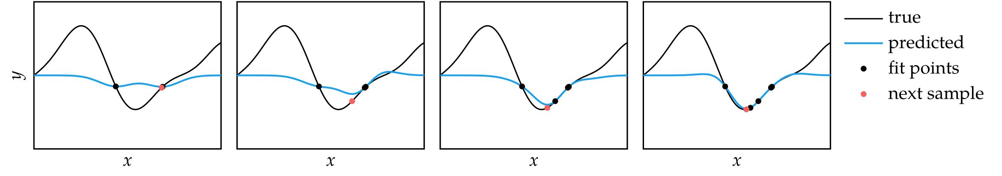

Prediction-Based Exploration
Focuses exclusively on exploitation, also called greedy approach
When using a Gaussian process surrogate model, prediction-based exploration simply optimizes over the mean function and ignores uncertainty

Slide 5
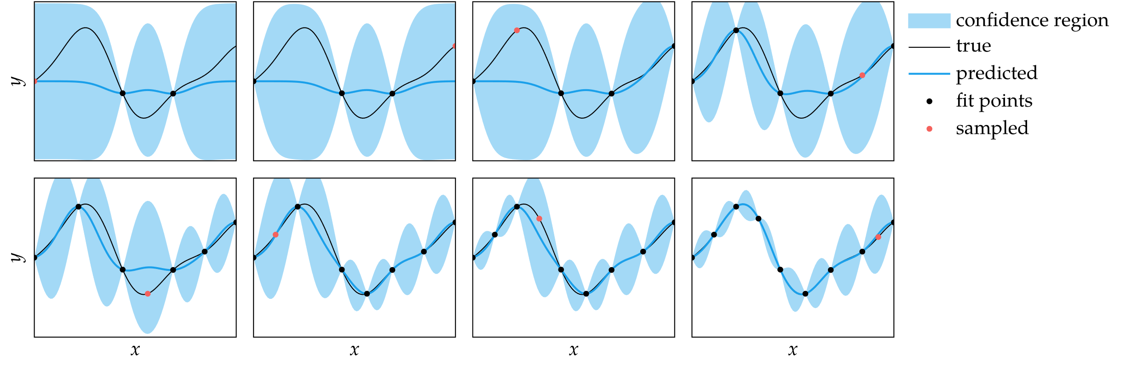

Error-Based Exploration
Focuses exclusively on exploration
For Gaussian processes, error-based exploration simply minimizes the maximum standard deviation within a specified domain

Slide 6

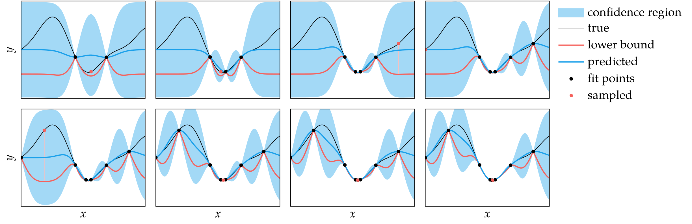
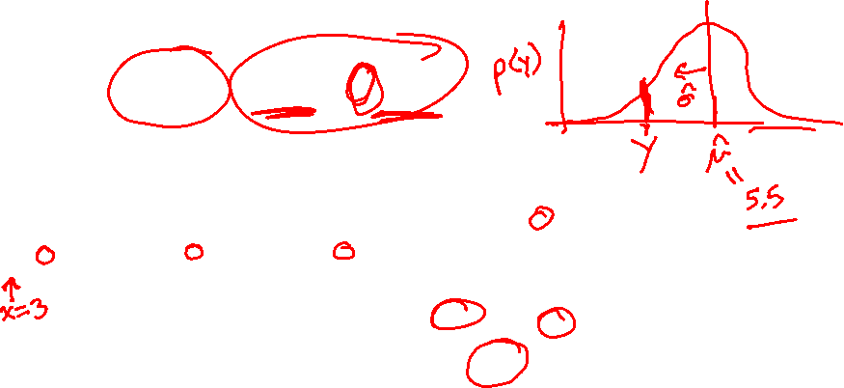
Lower Confidence Bound Exploration
Tradeoff between exploration and exploitation
The next sample minimizes the lower confidence bound of the objective function
where α ≥ 0 is the tradeoff parameter

Slide 7
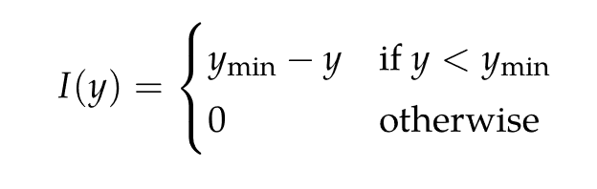
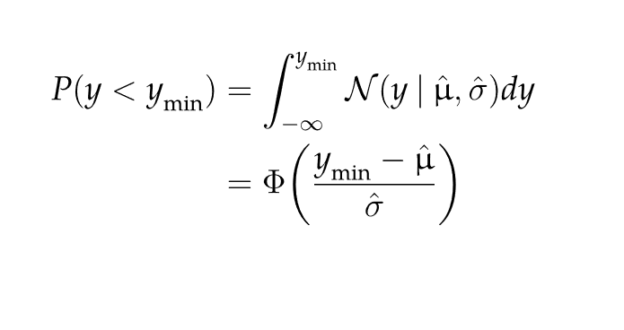
Probability of Improvement Exploration
Searches at the location with the highest probability of improvement
Improvement is defined as
The probability of improvement is defined as

Slide 8
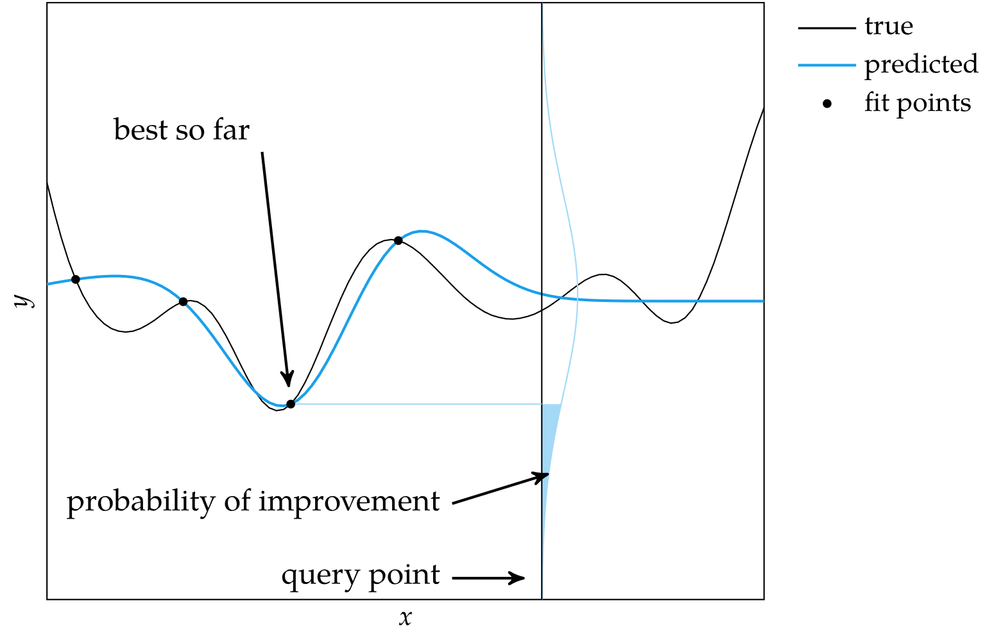
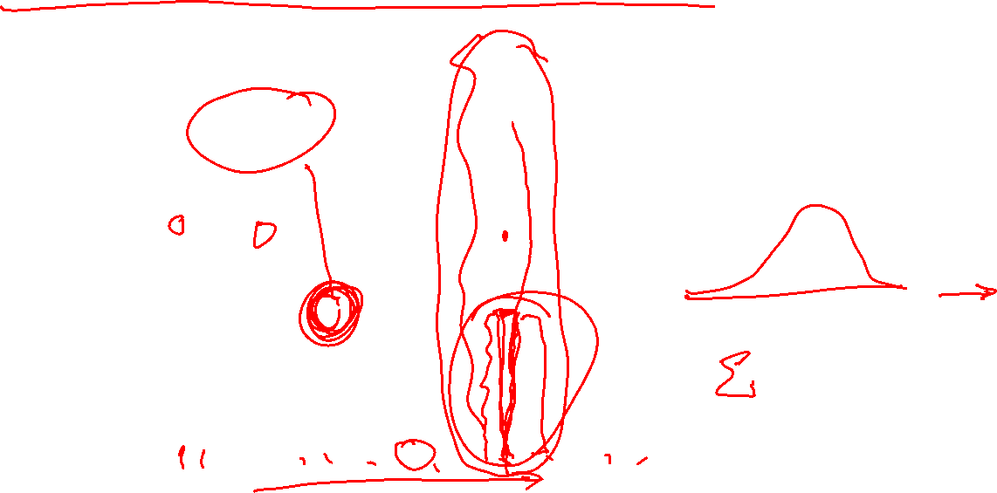
Probability of Improvement Exploration

Slide 9
Expected Improvement Exploration
While probability of improvement exploration seeks to ensure some expected improvement at each step, expected improvement exploration seeks to maximize expected improvement at each step

Slide 10
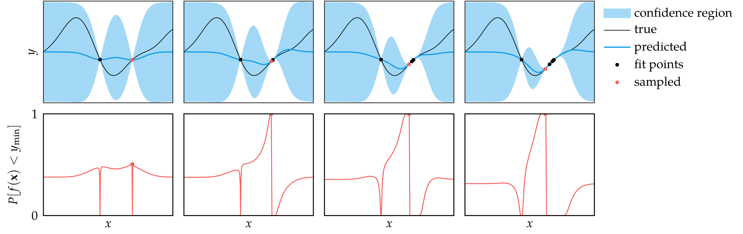
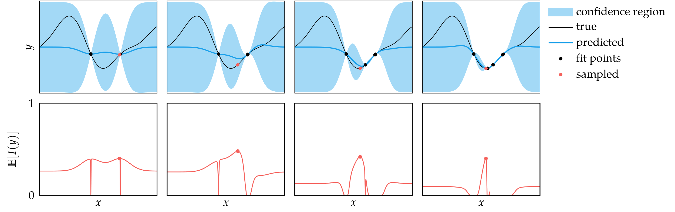

Expected Improvement Exploration
Probability of Improvement Exploration
Expected Improvement Exploration

Slide 11
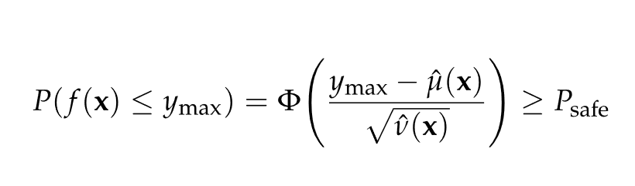
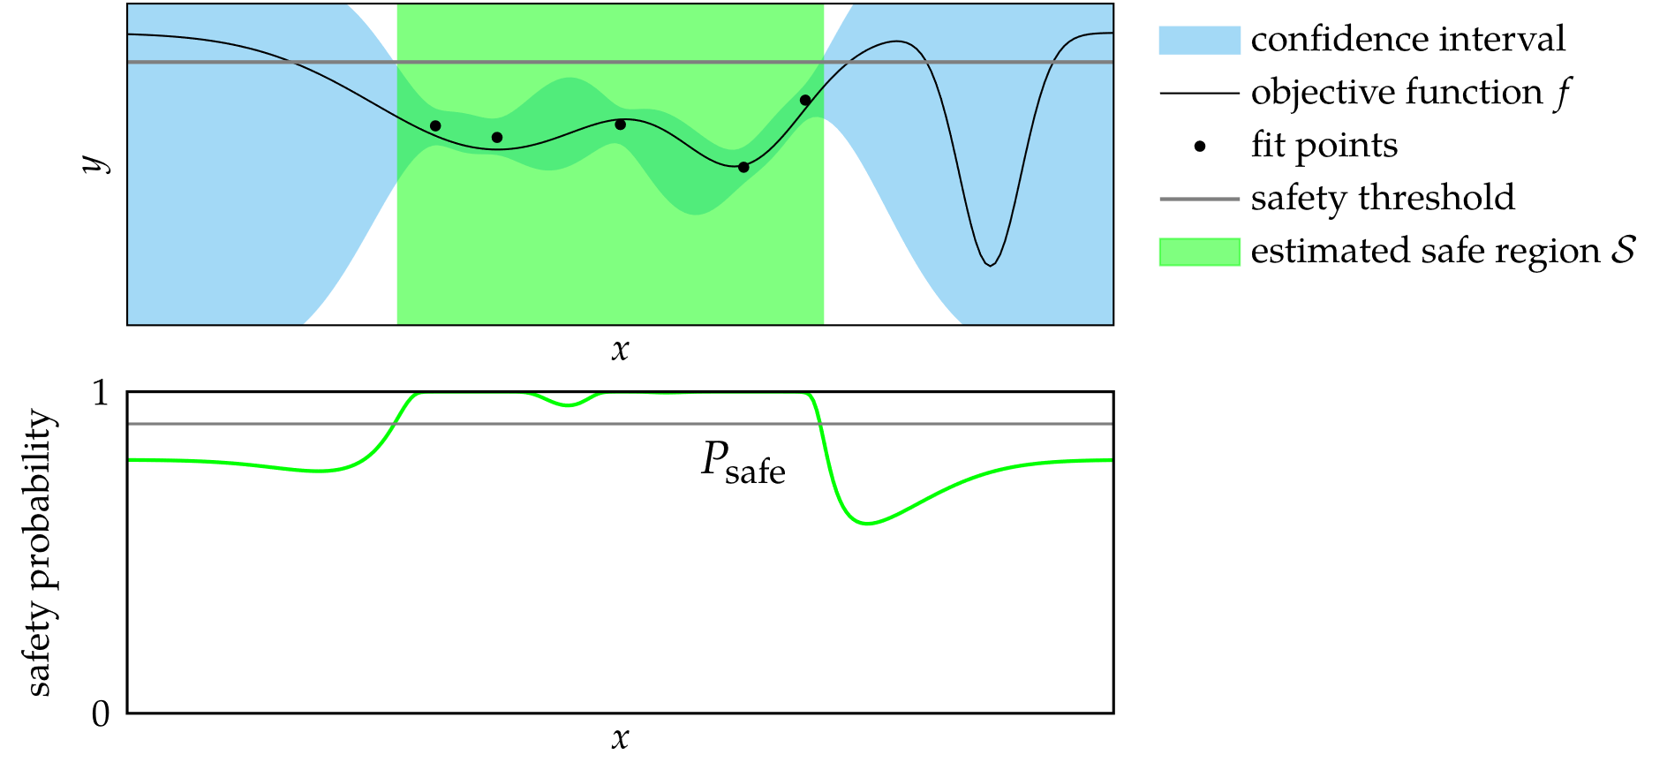

Safe Optimization
In some problems, certain function evaluation outcomes are considered unsafe
Safe optimization seeks to find the minimum while avoiding function evaluation points that exceed a safety threshold
This can be extended to a probabilistic model by only exploring in regions where the probability the function is too high is below a threshold

Slide 12
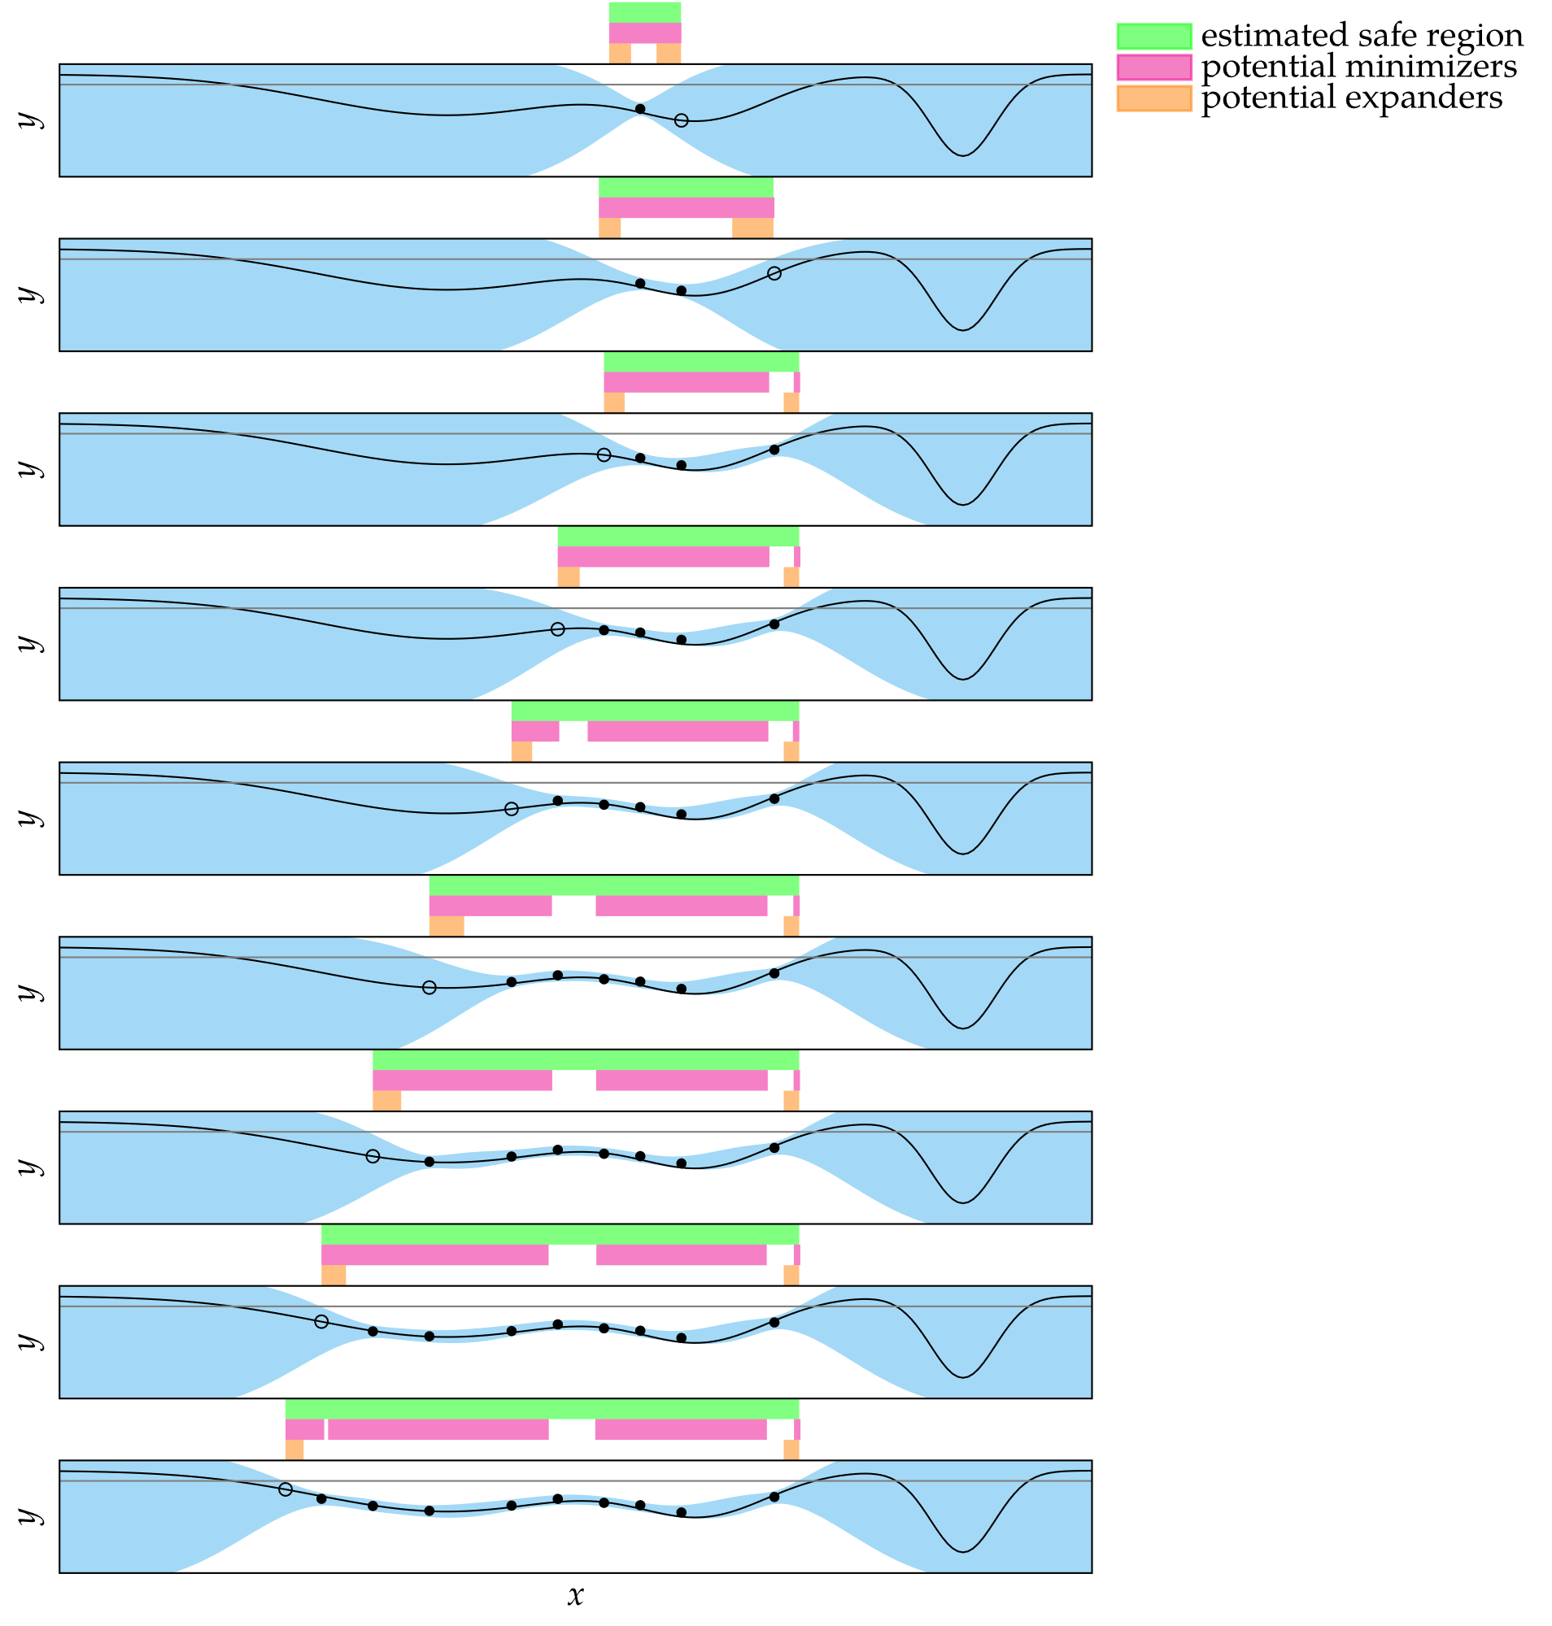
Safe Optimization

Slide 13
Summary
Gaussian processes can be used to guide the optimization process using a variety of strategies that use estimates of quantities such as the lower confidence bound, probability of improvement, and expected improvement
Some problems do not allow for the evaluation of unsafe designs, in which case we can use safe exploration strategies that rely on Gaussian processes

