Slide 1
Optimization under Uncertainty

Slide 2

Uncertainty
Irreducible uncertainty is inherent to a system
Epistemic uncertainty is caused by the subjective lack of knowledge by the algorithm designer
In optimization problems, uncertainty can be represented by a vector of random variables z over which the designer has no control
Feasibility now depends on (x , z)
Uncertainty can be part of the design points, objective function, and/or constraints

Slide 3
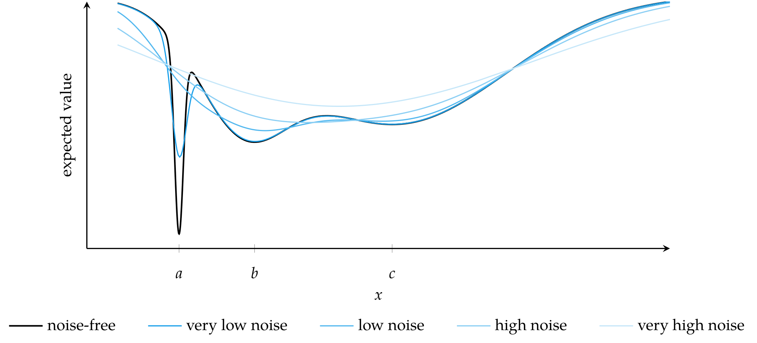
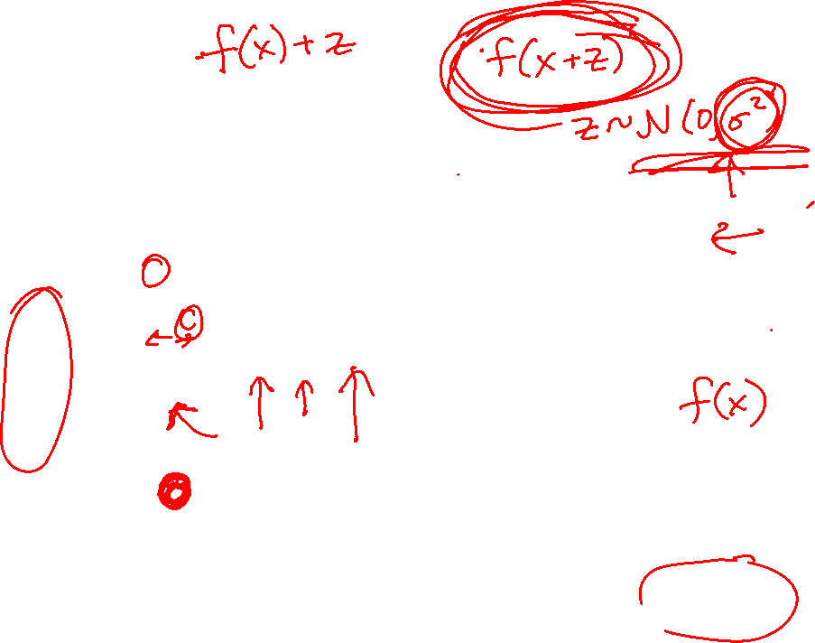
Uncertainty
Design choices are affected by uncertainty

Slide 4

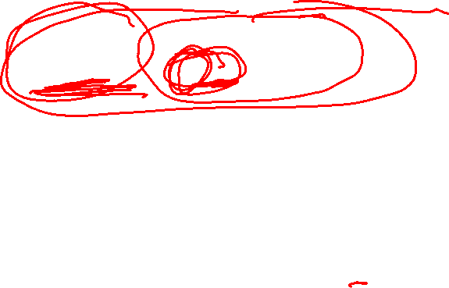
Set-Based Uncertainty
Set-based uncertainty treats z as belonging to a set Z
Often used to solve problems with minimax approach
The minimax approach seeks to minimize f(x,z) assuming a worst-case value of z

Slide 5
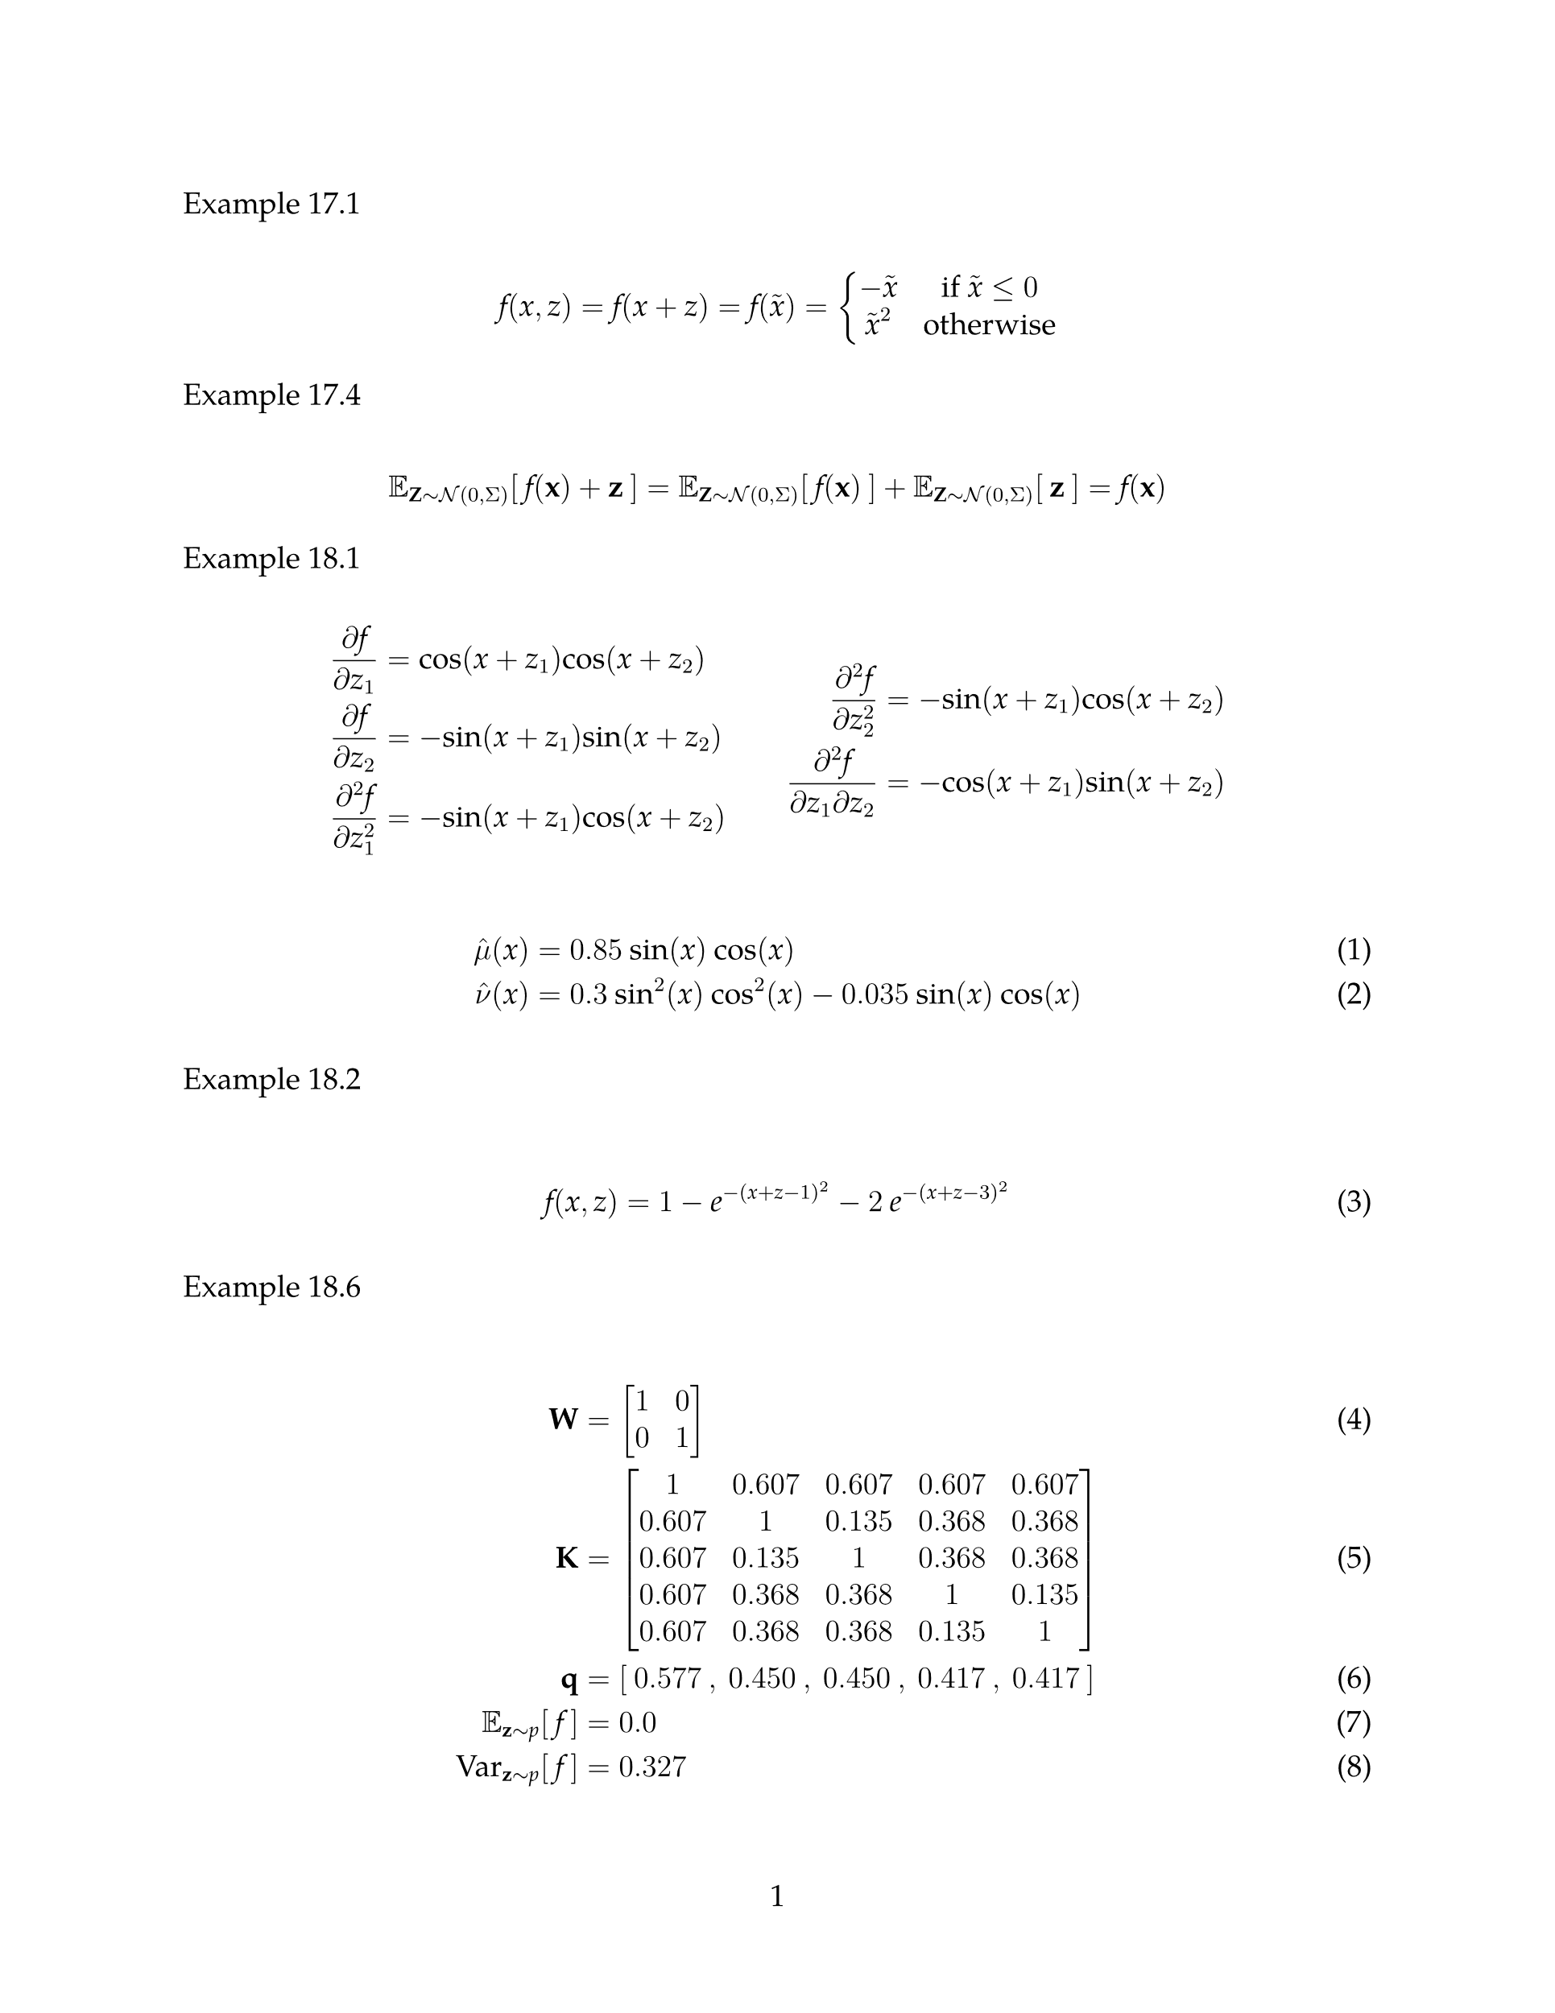
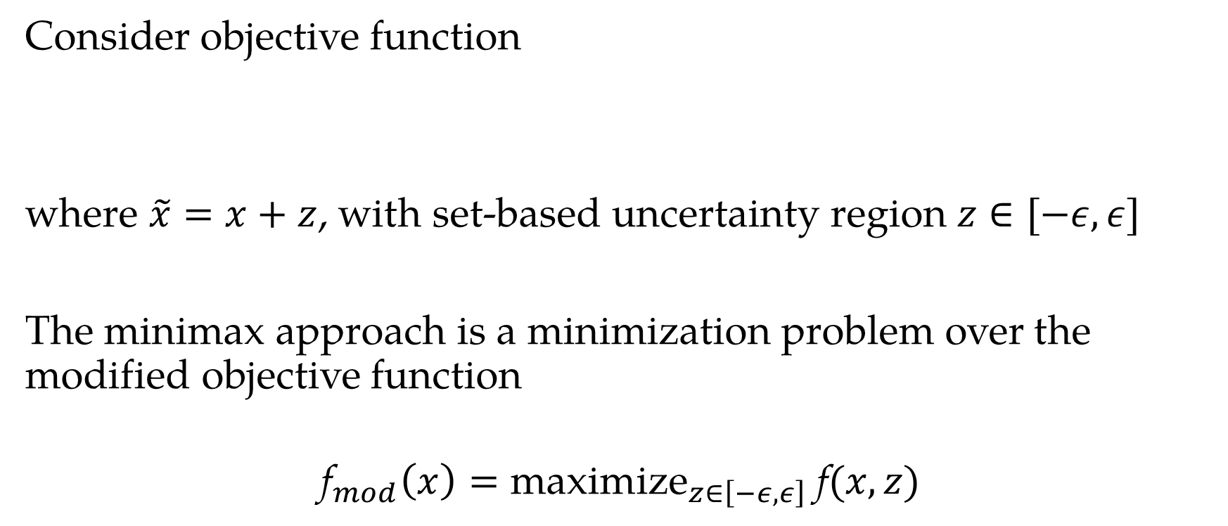

Set-Based Uncertainty: Example
Consider objective function
where $\tilde{x}=x+z$, with set-based uncertainty region $z∈[−ε,ε]$
The minimax approach is a minimization problem over the modified objective function
$${\text{f}}_{mod}\left(x\right)={\text{maximize}}_{z∈\left[−ε,ε\right]} \text{f}(x,z)$$

Slide 6
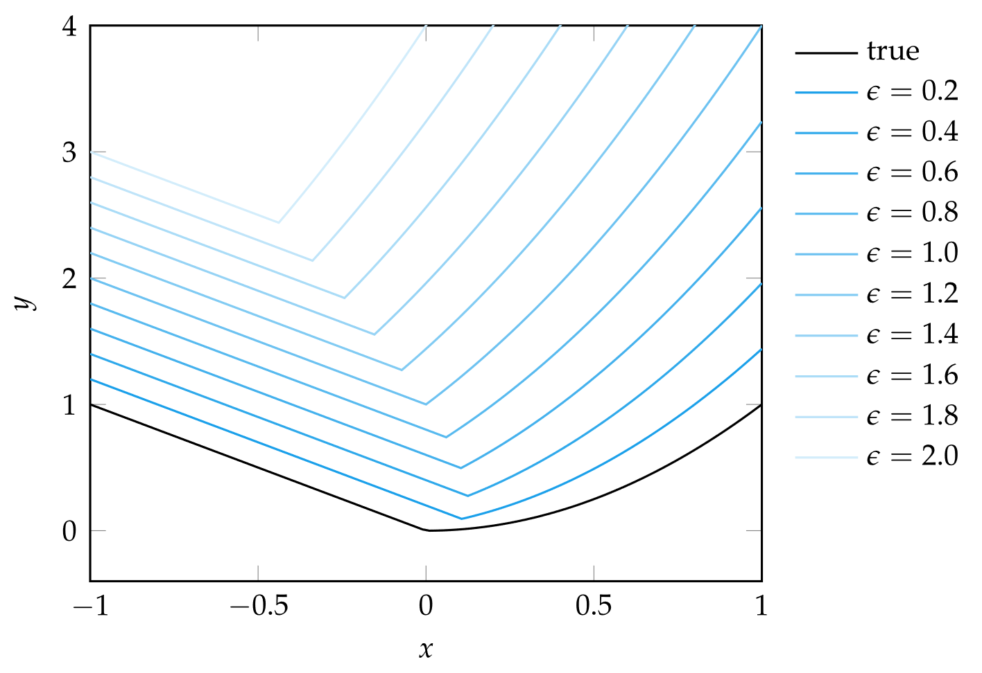

Set-Based Uncertainty: Example

Slide 7
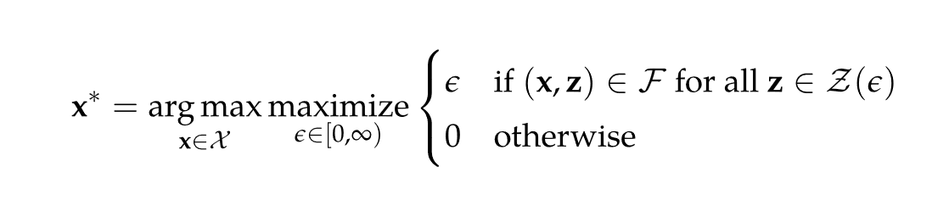

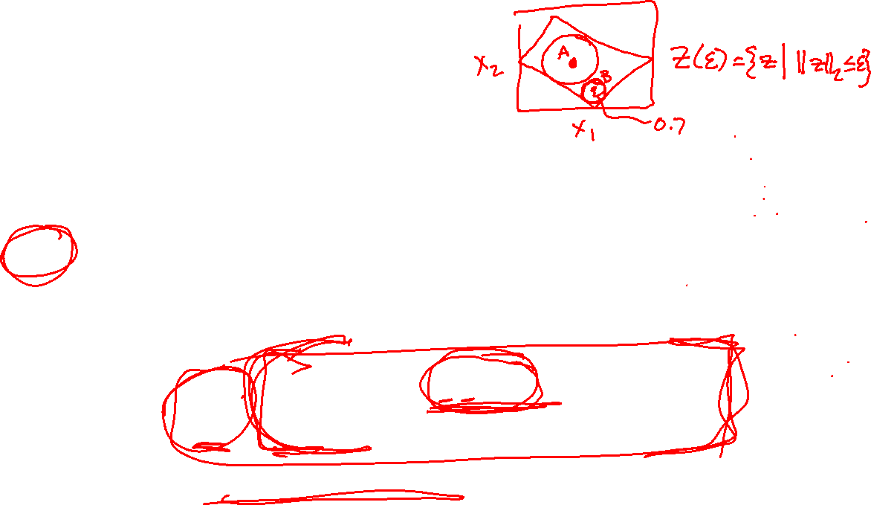
Set-Based Uncertainty
Information-gap decision theory parameterizes the uncertainty set by a nonnegative scalar gap parameter ϵ
This gap parameter controls the volume of the uncertainty set Z(ϵ)
The goal in information-gap decision theory is to find the design point that is both feasible and allows the largest possible uncertainty gap
Searches for the most robust designs

Slide 8
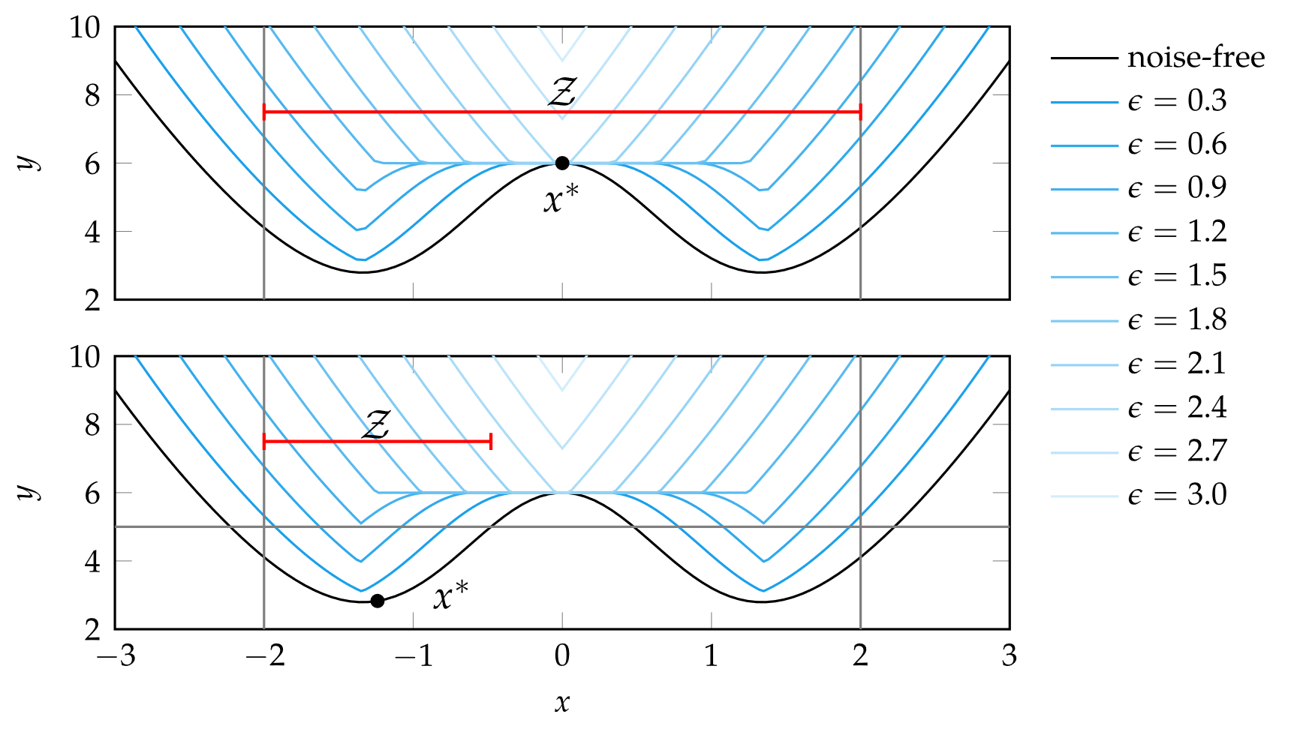

Set-Based Uncertainty: Example
Consider robust optimization of $\text{f} \left(x,z\right)={\tilde{x}}^{2}+5e^{−{\tilde{x}}^{2}}$
with $\tilde{x}$ = x + z subject to the constraint $\tilde{x}∈[ −2 ,2 ]$ with the uncertainty set $𝒵\left(ε\right)=[−ε,ε]$

Slide 9

Probabilistic Uncertainty
Probabilistic uncertainty uses distributions over the set Z
Based on expert knowledge or learned from data
Given a distribution p over Z, this section covers five different metrics that convert distributions to scalar values to be optimized

Slide 10
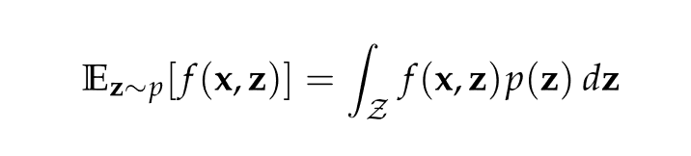
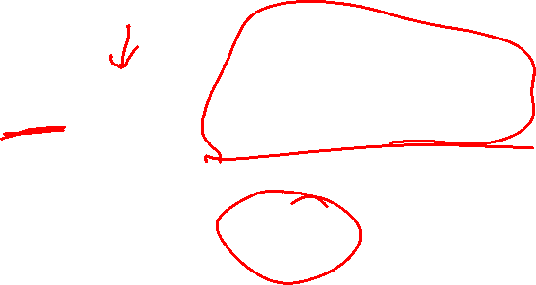
Probabilistic Uncertainty: Expected Value
A simple scalar representation of a distribution is by the expected value or mean
Often this integral is not computable analytically, but other techniques will be presented in Ch 18

Slide 11
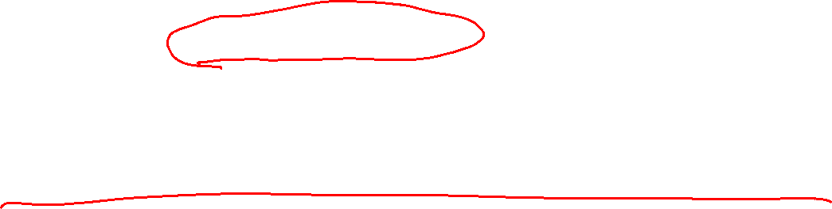
Probabilistic Uncertainty: Expected Value
A common model is to apply zero-mean Gaussian noise to the function output, f (x,z) = f (x) + z
The expected value is equivalent to the noise-free case

Slide 12

Probabilistic Uncertainty: Expected Value
Noise can also be added to the design vector,
f (x,z) = f (x+z) = f ($\tilde{\text{x}}$)
In this case, the expected value is affected by the variance of the zero-mean Gaussian noise

Slide 13
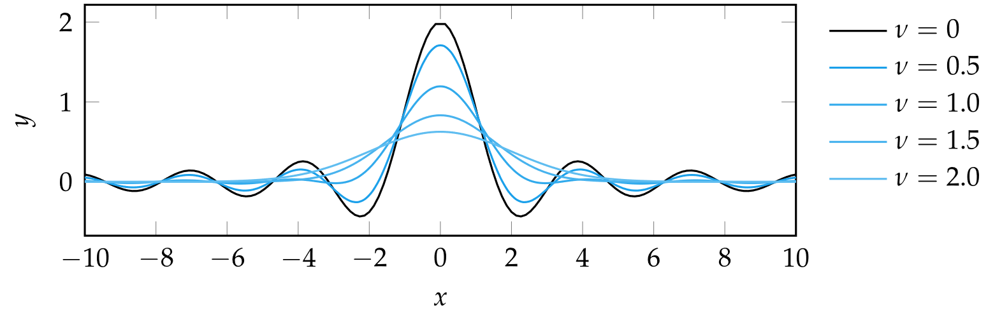

Probabilistic Uncertainty: Expected Value
Consider minimizing the expected value of
f($\tilde{\text{x}}$) = sin(2 $\tilde{\text{x}}$)/ $\tilde{\text{x}}$
with $\tilde{x}=x+z$ where z is drawn from zero-mean Gaussian distribution with variance ν.

Slide 14
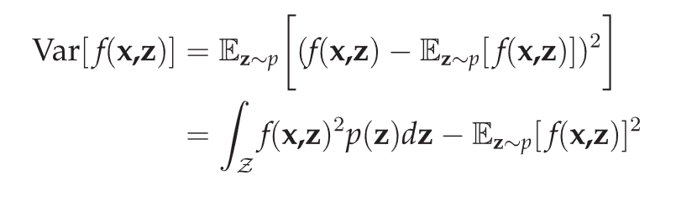
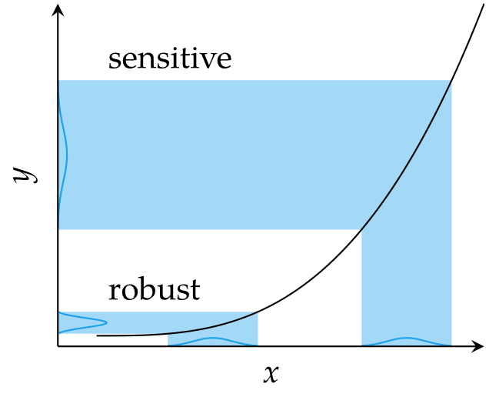

Probabilistic Uncertainty: Variance
When minimized, corresponds to design points that are not overly sensitive to uncertainty
Design points with large variance are
called sensitive and those with small
variance are robust

Slide 15
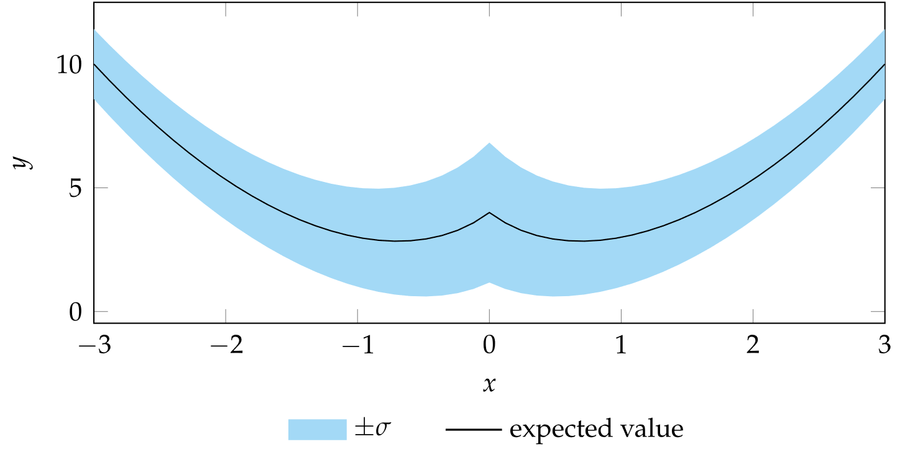
Probabilistic Uncertainty
Consider the function f(x,z) = x²+z with z drawn from a Gamma distribution that depends on x.
This distribution has mean 4/(1+|x|) and variance 8/(1+|x|)

Slide 16
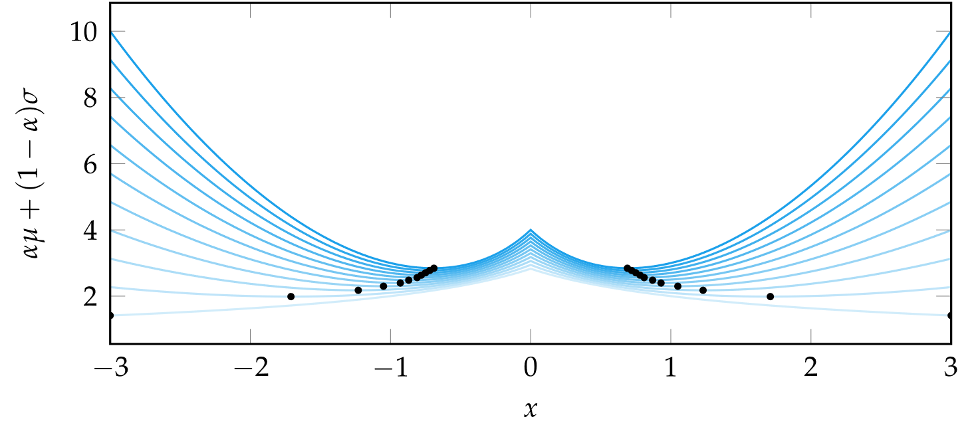
Probabilistic Uncertainty

Slide 17


Probabilistic Uncertainty: Statistical Feasibility
The probability that a design point is feasible
Can be estimated through sampling
This metric is maximized

Slide 18
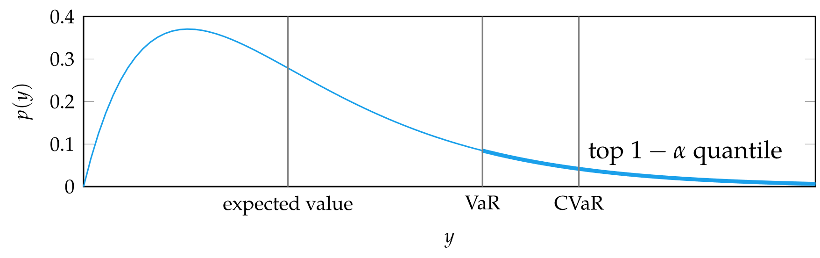
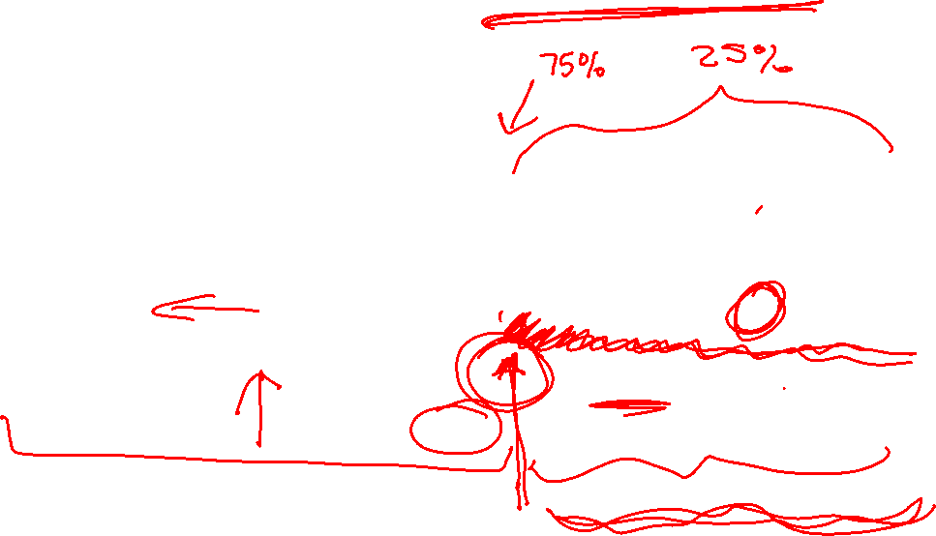
Probabilistic Uncertainty: Value at Risk

Slide 19
Summary
Uncertainty in the optimization process can arise due to errors in the data, the models, or the optimization method itself
Accounting for these sources of uncertainty is important in ensuring robust designs
Optimization with respect to set-based uncertainty includes the minimax approach that assumes the worst-case and information-gap decision theory that finds a design robust to a maximally sized uncertainty set
Probabilistic approaches typically minimize the expected value, the variance, risk of infeasibility, value at risk, conditional value at risk, or a combination of these

