Slide 1
Agenda
Language choices
Overview
Derivatives and Gradients
Bracketing

Slide 2
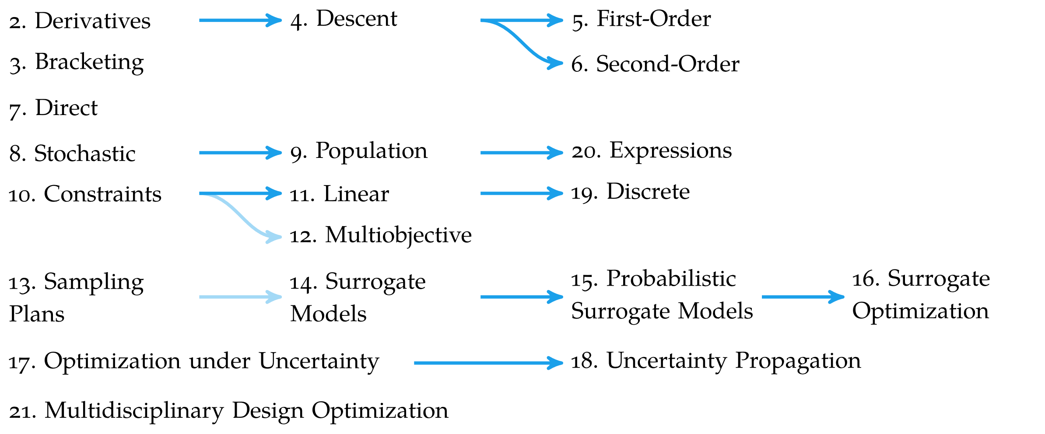
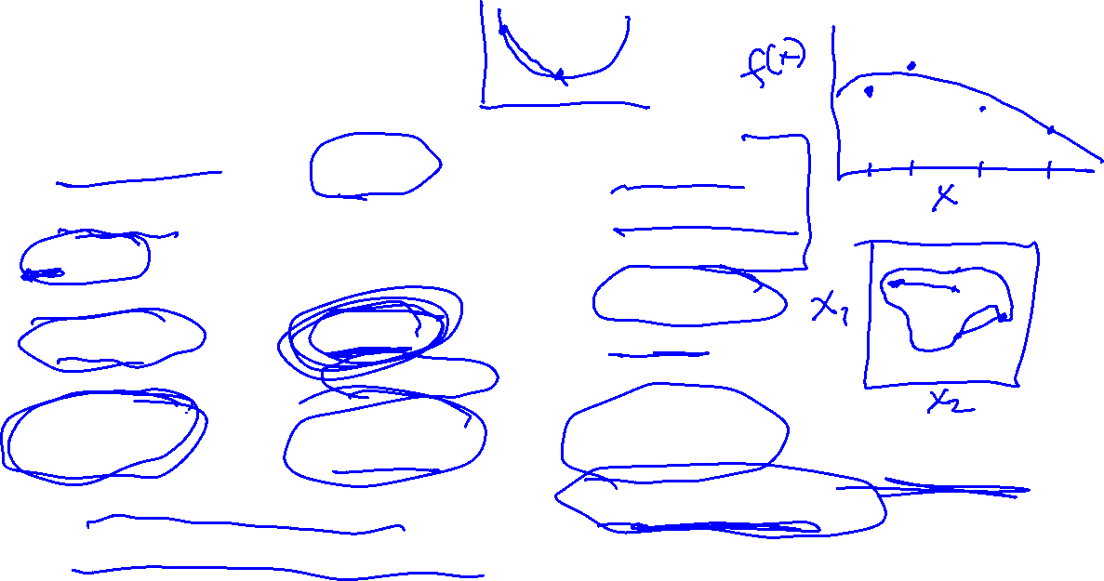
Overview

Slide 3
Derivatives and Gradients

Slide 4
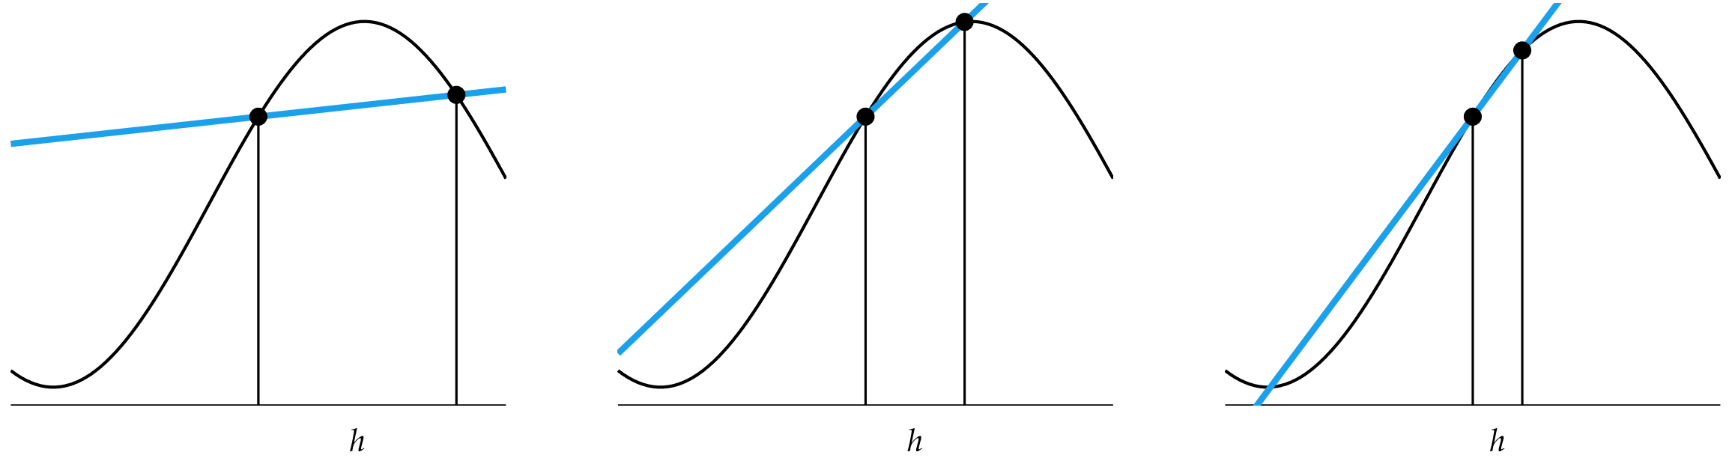
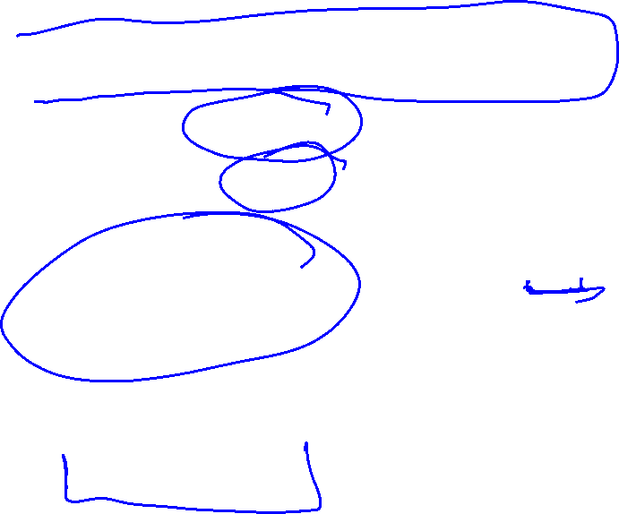
Derivatives

Slide 5
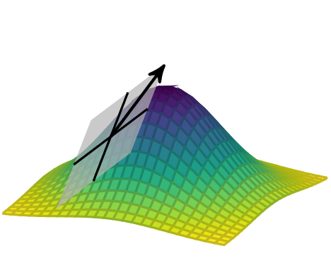

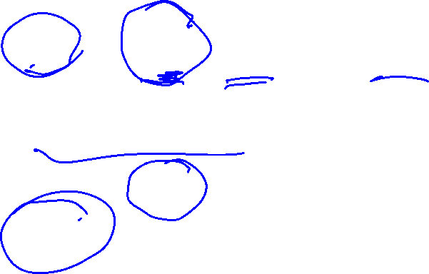
Derivatives in Multiple Dimensions
Gradient Vector
Hessian Matrix

Slide 6


Derivatives in Multiple Dimensions
Directional Derivative

Slide 7
Numerical Differentiation
Finite Difference Methods
Complex Step Method

Slide 8
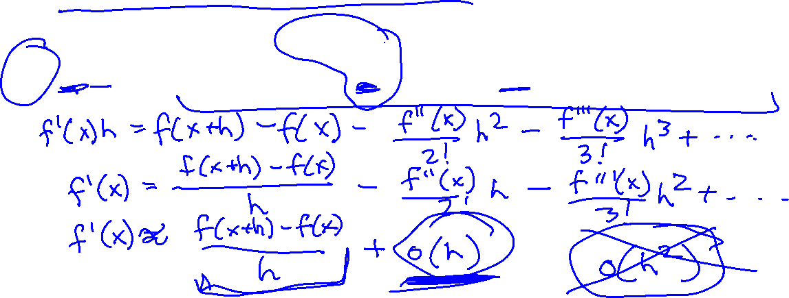
Numerical Differentiation: Finite Difference
Derivation from Taylor series expansion

Slide 9
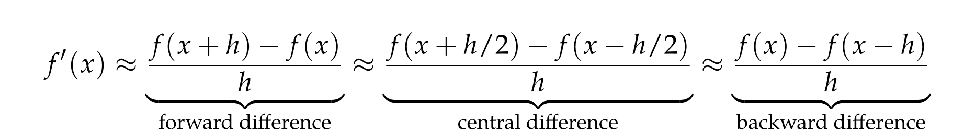

Numerical Differentiation: Finite Difference
Neighboring points are used to approximate the derivative
h too small causes numerical cancellation errors

Slide 10

Numerical Differentiation: Finite Difference
Error Analysis
Forward Difference: O(h)
Central Difference: O(h²)

Slide 11
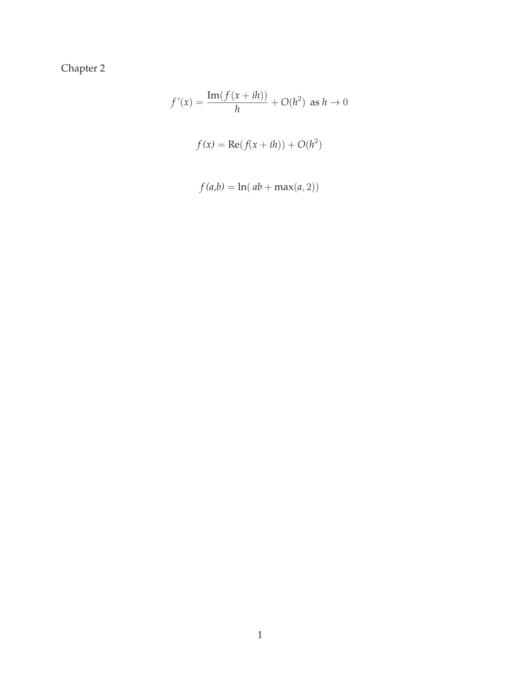
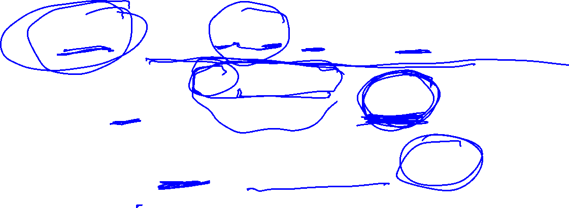
Numerical Differentiation: Complex Step
Taylor series expansion using imaginary step

Slide 12
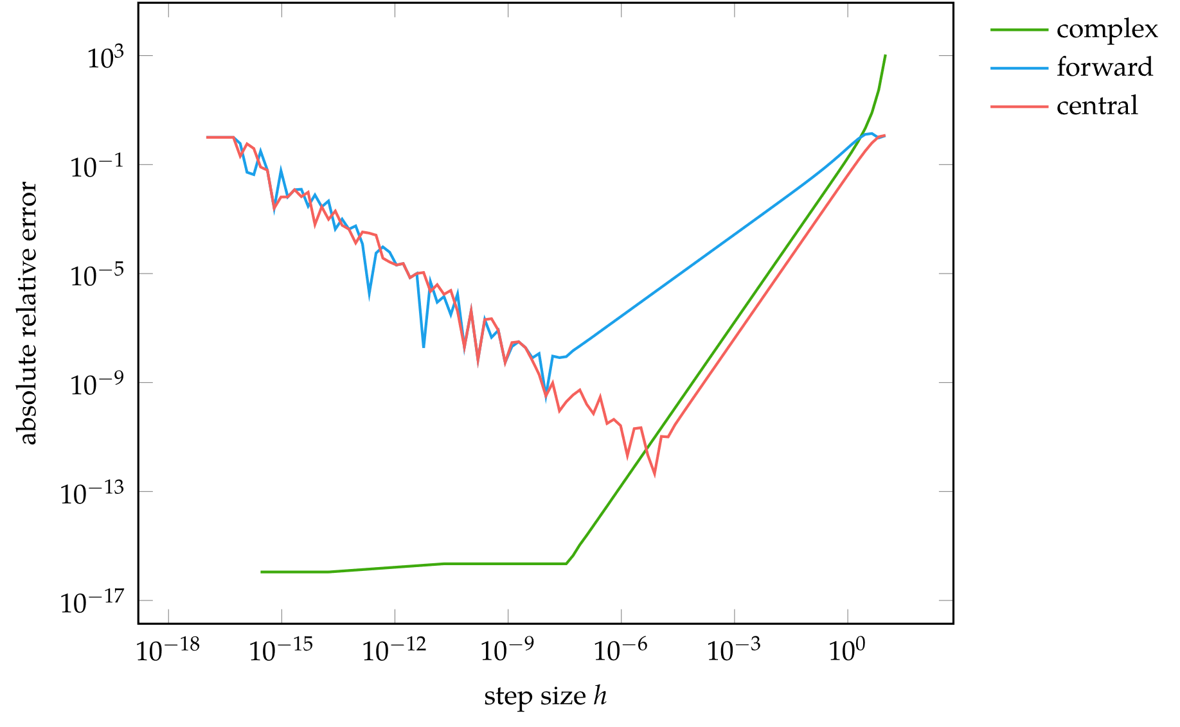
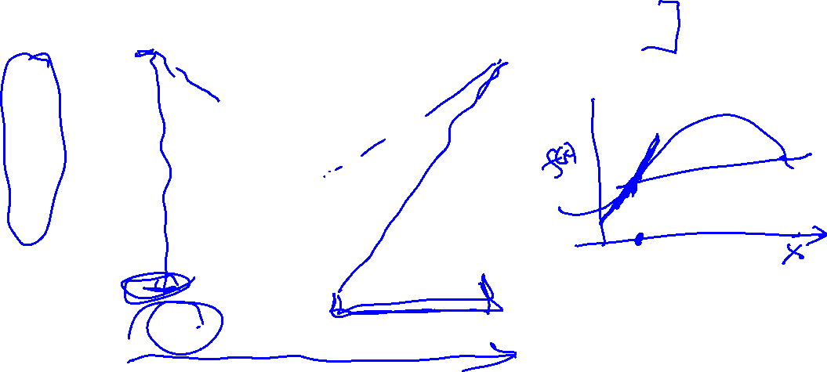
Numerical Differentiation Error Comparison

Slide 13

Automatic Differentiation
Forward Accumulation is equivalent to expanding a function using the chain rule and computing the derivatives inside-out
Requires n-passes to compute n-dimensional gradient
Example

Slide 14
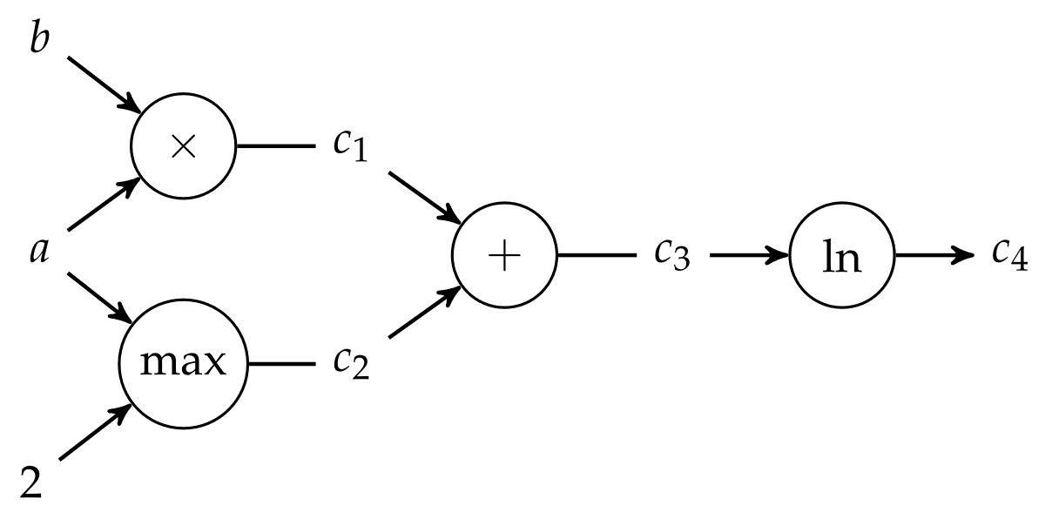
Automatic Differentiation
Forward Accumulation

Slide 15
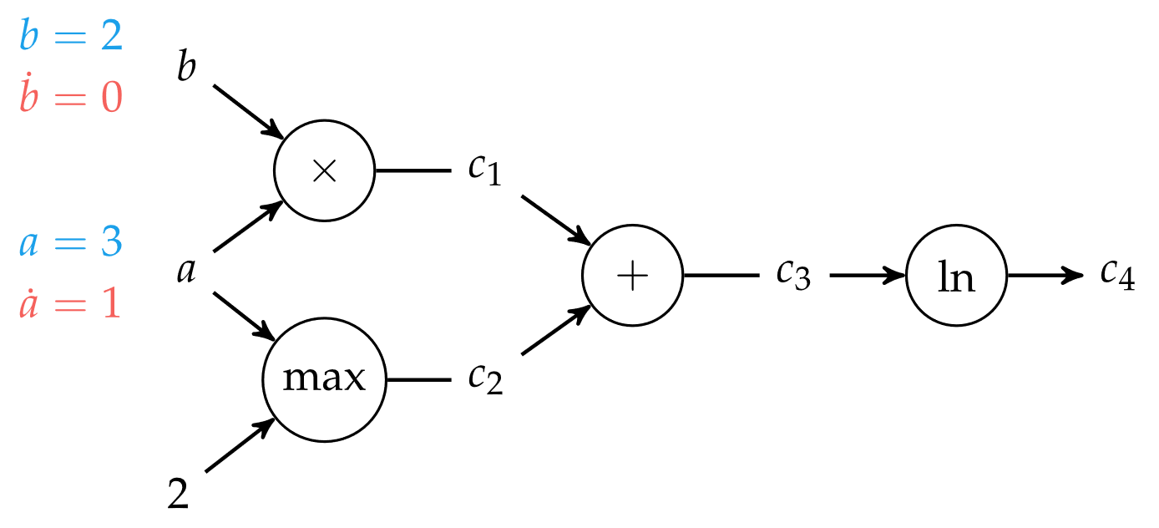

Automatic Differentiation
Forward Accumulation

Slide 16
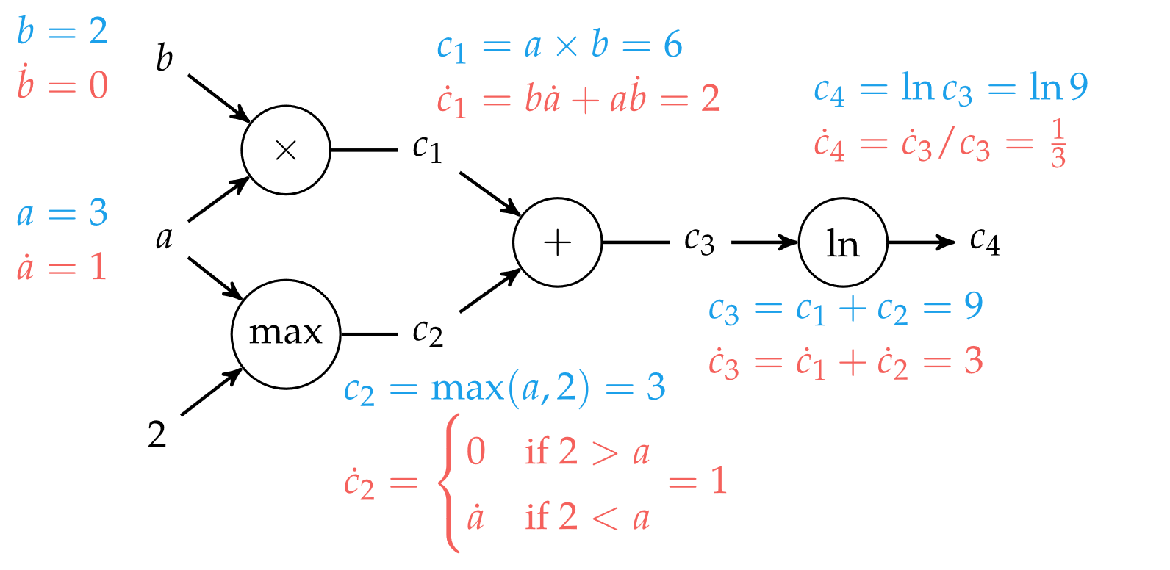

Automatic Differentiation
Forward Accumulation

Slide 17
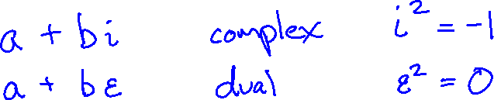
Dual Numbers

Slide 18
Summary
Derivatives are useful in optimization because they provide information about how to change a given point in order to improve the objective function
For multivariate functions, various derivative-based concepts are useful for directing the search for an optimum, including the gradient, the Hessian, and the directional derivative
One approach to numerical differentiation includes finite difference approximations

Slide 19
Summary
Complex step method can eliminate the effect of subtractive cancellation error when taking small steps
Analytic differentiation methods include forward and reverse accumulation on computational graphs

