Slide 1

Bracketing

Slide 2
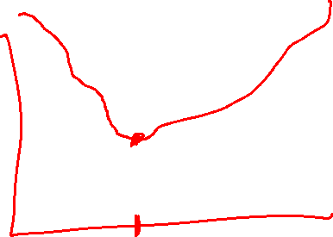
Unimodality
There exists a unique optimizer x* such that f is monotonically decreasing for x ≤ x* and monotonically increasing for x ≥ x*

Slide 3

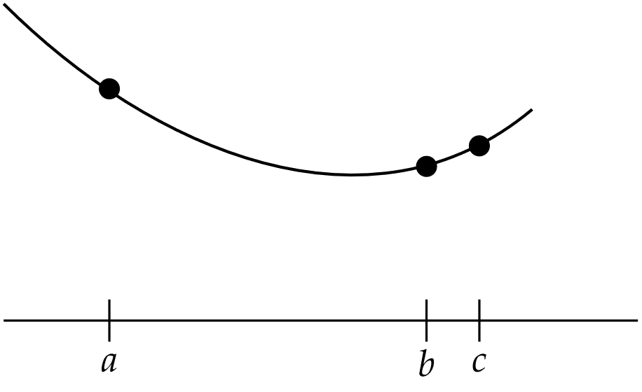

Finding an Initial Bracket
Given a unimodal function, the global minimum is guaranteed to be inside the interval [a,c] if

Slide 4
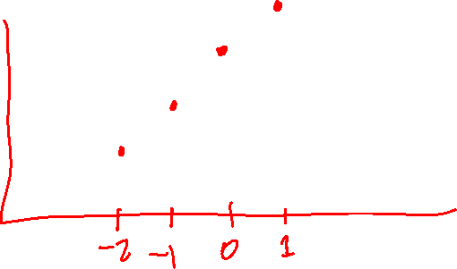
Finding an Initial Bracket

Slide 5
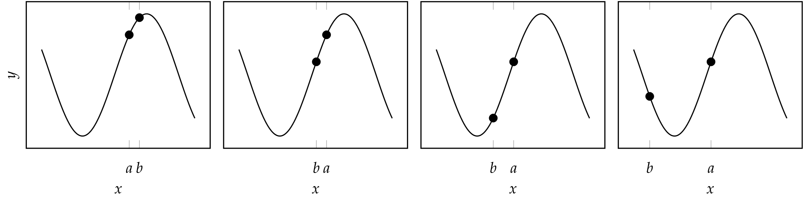

Finding an Initial Bracket
Example bracketing sequence

Slide 6
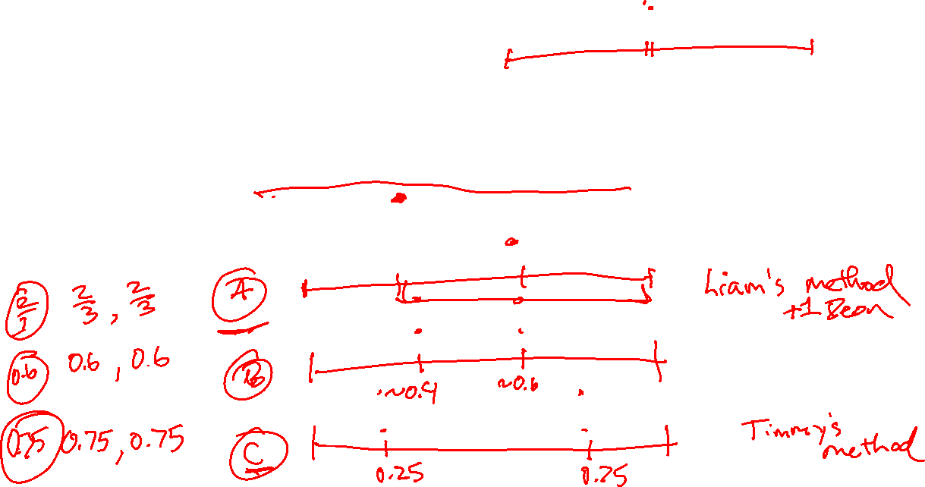
Fibonacci Search
When function evaluations are limited, the Fibonacci Search algorithm is guaranteed to maximally shrink the bracketed interval

Slide 7
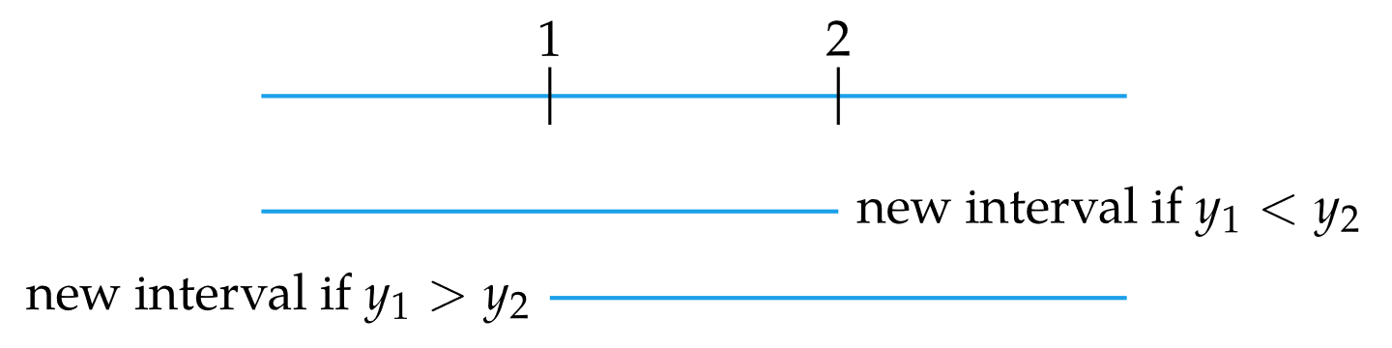
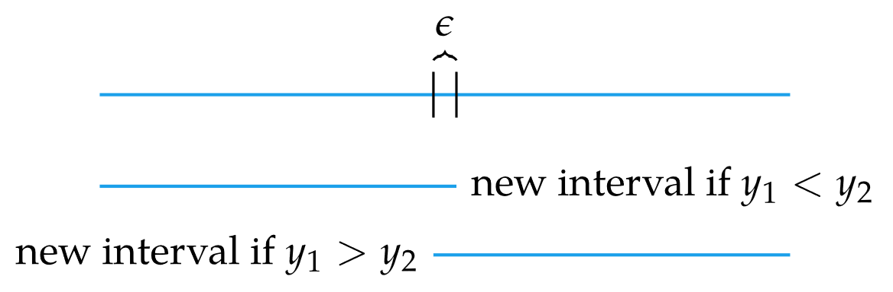
Fibonacci Search
When restricted to two function evaluations, compare

Slide 8

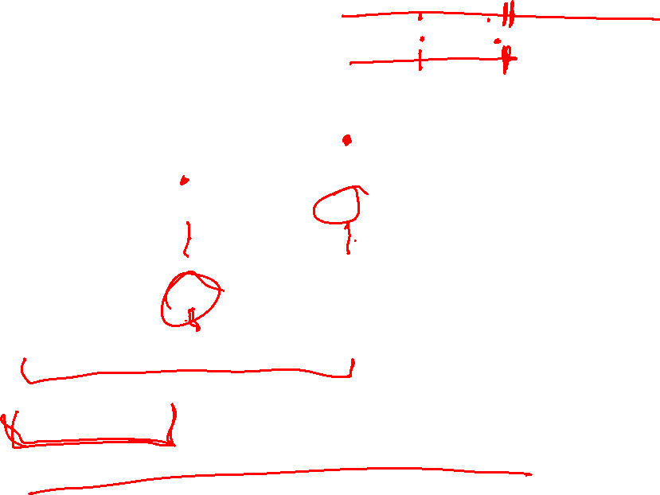
Fibonacci Search
When restricted to three function evaluations

Slide 9

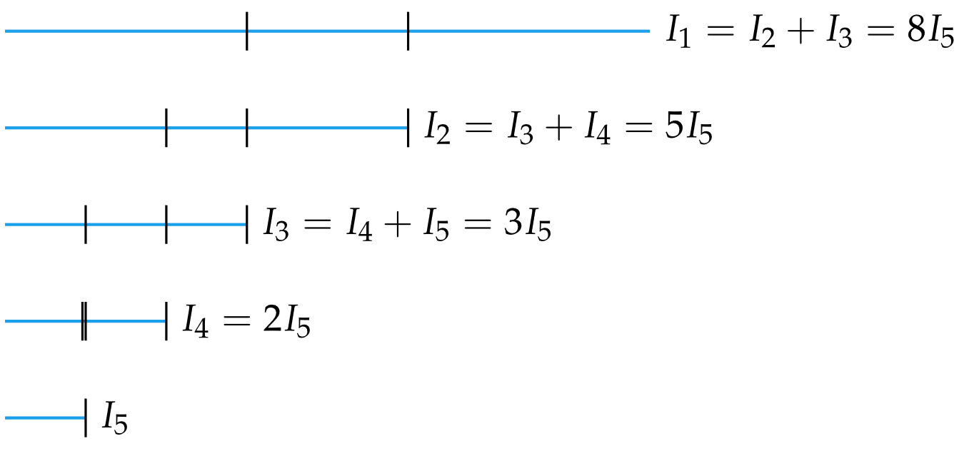



Fibonacci Search
When restricted to n function evaluations

Slide 10
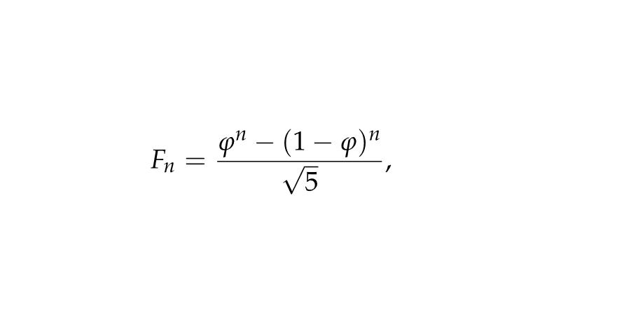



Fibonacci Search
Binet’s formula defines a Fibonacci number analytically where φ is the Golden Ratio, φ=(1+$√5)/2≈1.61803$
The ratio between successive Fibonacci numbers is
where $s=\frac{1−\sqrt{5}}{1+\sqrt{5}}≈−0.382$

Slide 11

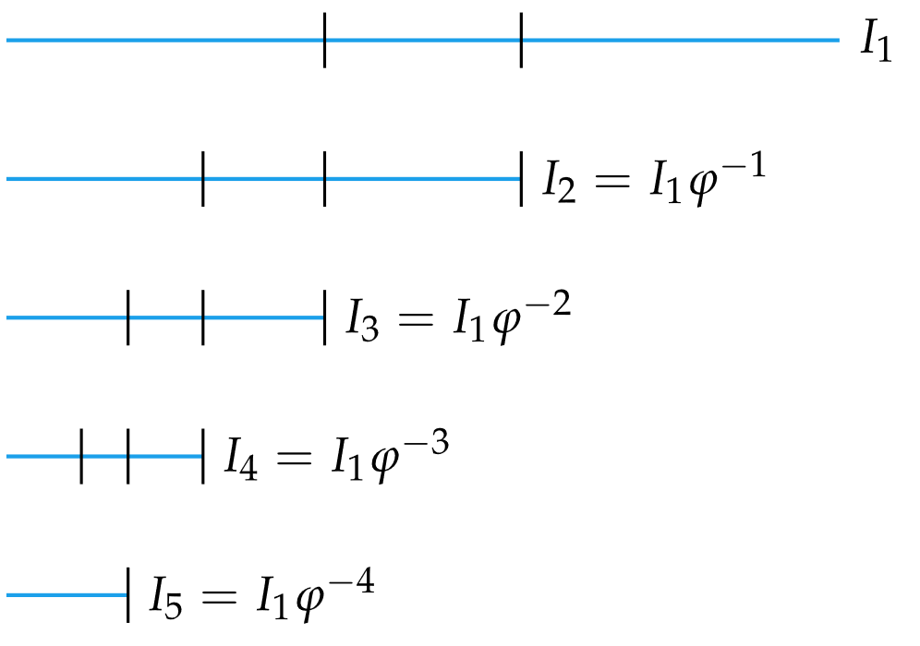

Golden Section Search
In the limit of large N, the ratio of successive Fibonacci numbers approaches the Golden Ratio, so φ can be used to perform approximate Fibonacci search

Slide 12
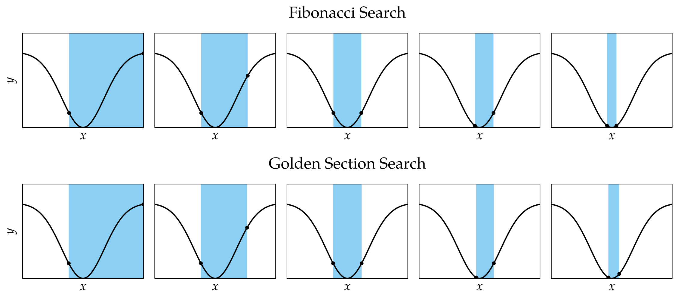

Fibonacci/Golden Section Search Comparison

Slide 13
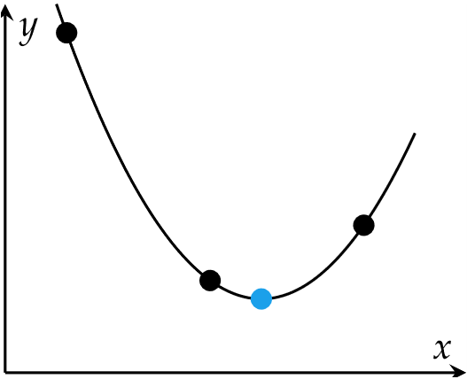

Quadratic Fit Search
Leverages ability to analytically minimize quadratic functions
Iteratively fits quadratic function to three bracketing points

Slide 14
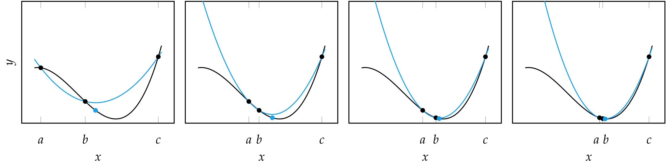

Quadratic Fit Search
If a function is locally nearly quadratic, the minimum can be found after several steps

Slide 15
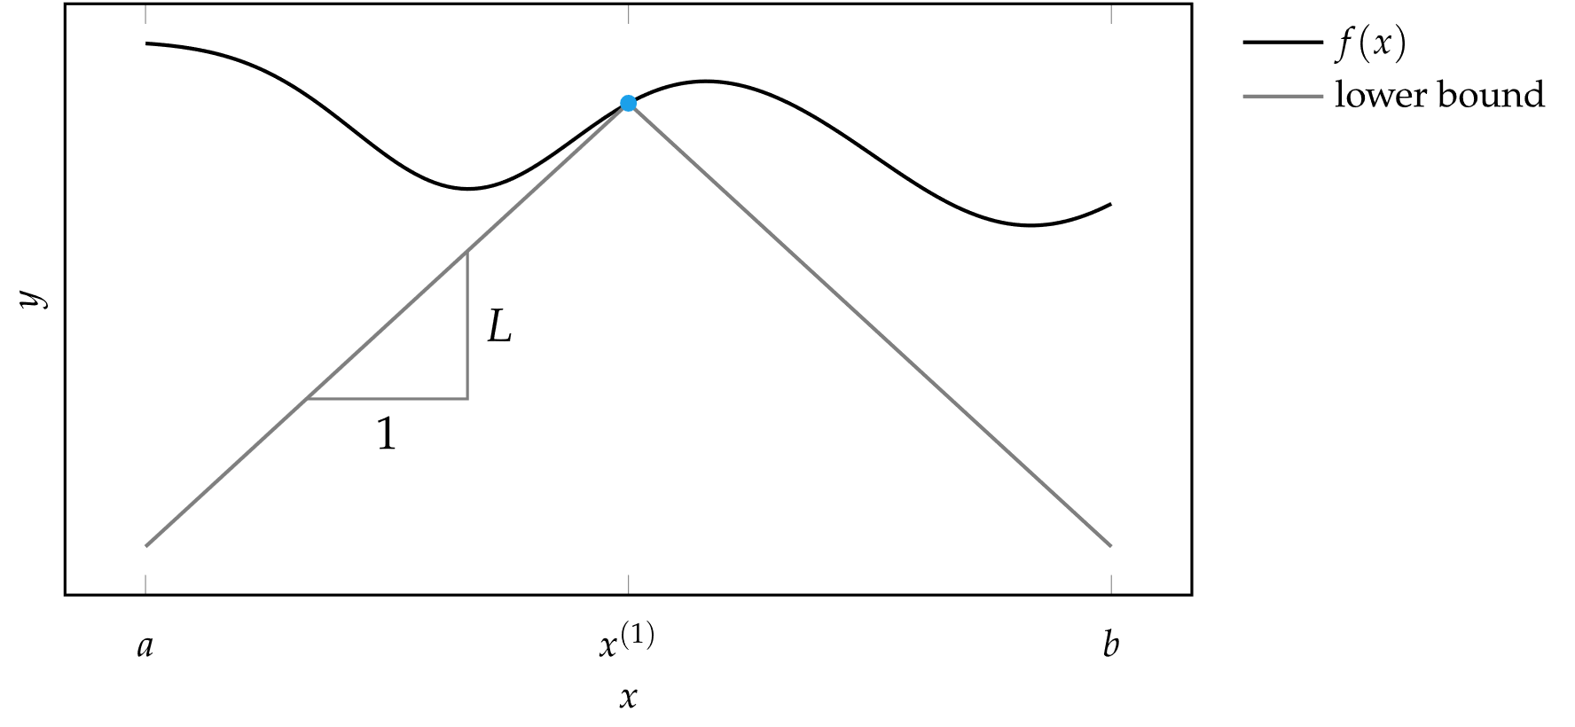
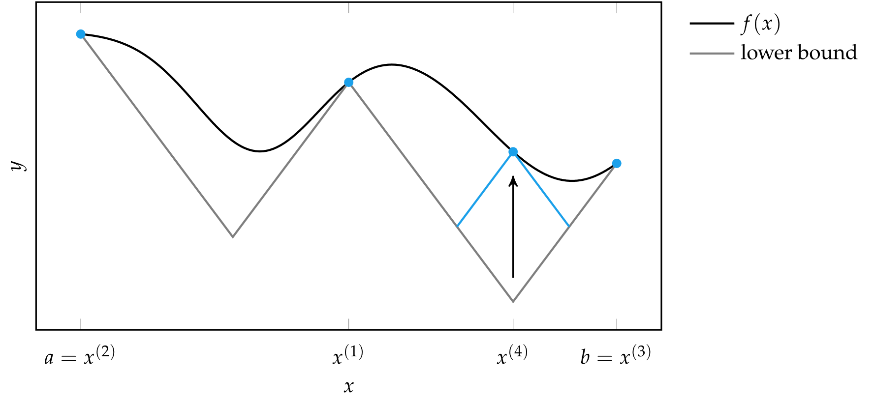
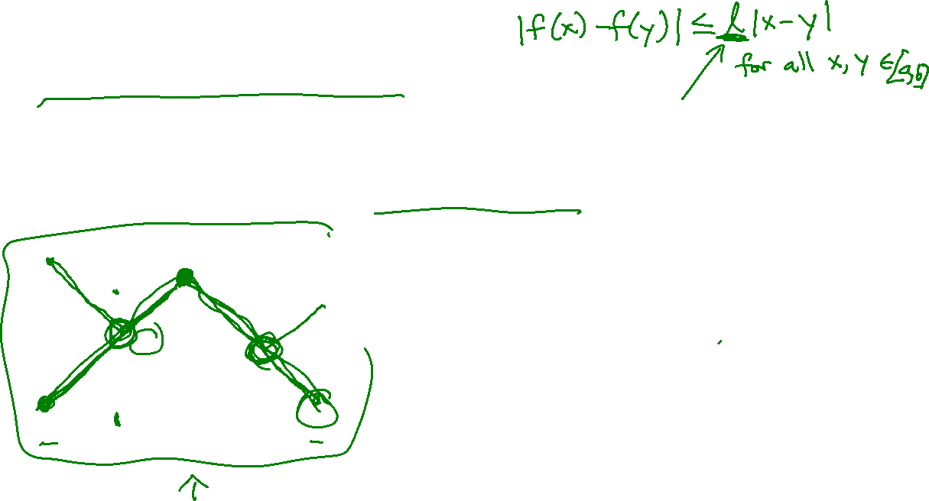
Shubert-Piyavskii Method
Guaranteed to find the global minimum of any bounded function
Requires the function be Lipschitz continuous

Slide 16
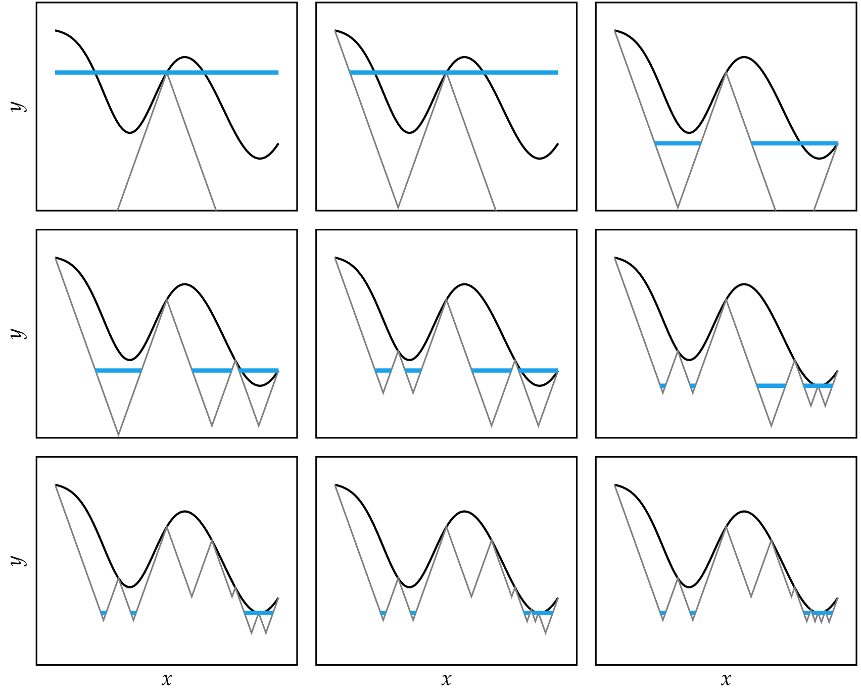
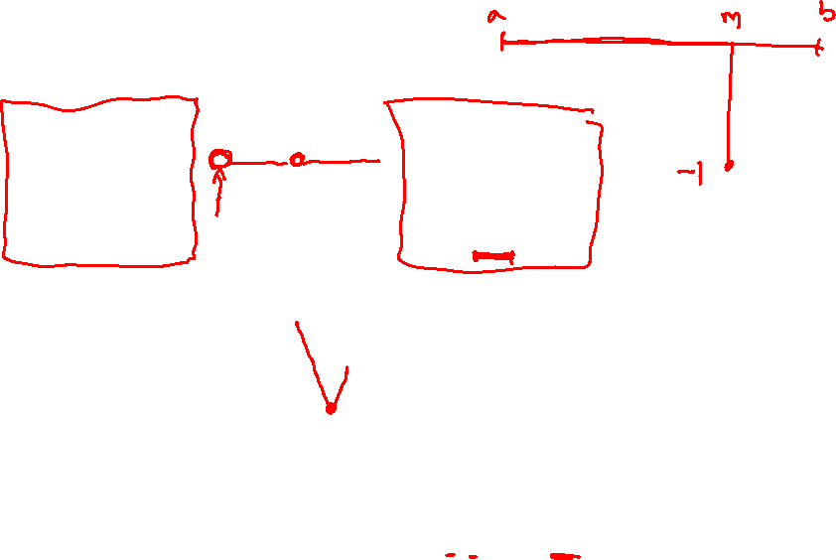
Shubert-Piyavskii Method

Slide 17
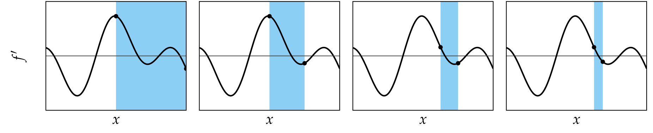

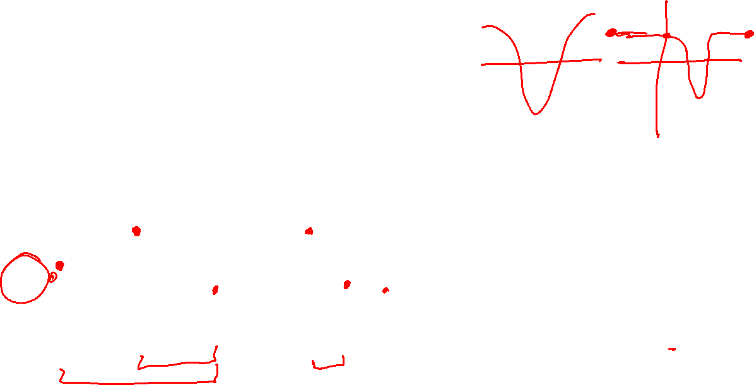
Bisection Method
Used in root-finding methods
When applied to $f′(x)$, can be used to find minimum

Slide 18
Summary
Many optimization methods shrink a bracketing interval, including Fibonacci search, golden section search, and quadratic fit search
The Shubert-Piyavskii method outputs a set of bracketed intervals containing the global minima, given the Lipschitz constant
Root-finding methods like the bisection method can be used to find where the derivative of a function is zero

