Slide 1
Agenda
Last few topics on bracketing
Second-order methods
Direct methods

Slide 2
Second-Order Methods

Slide 3
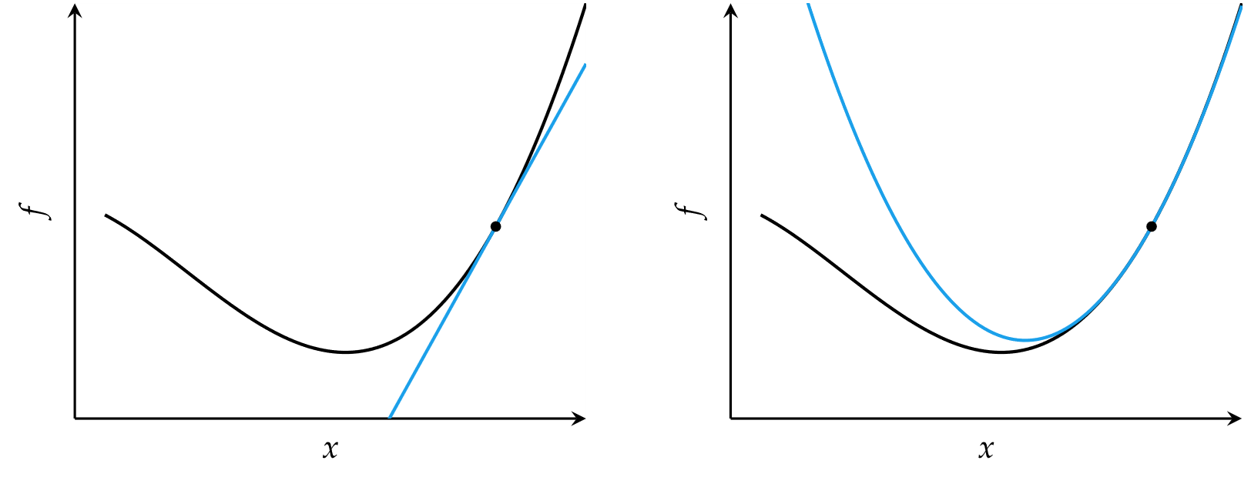
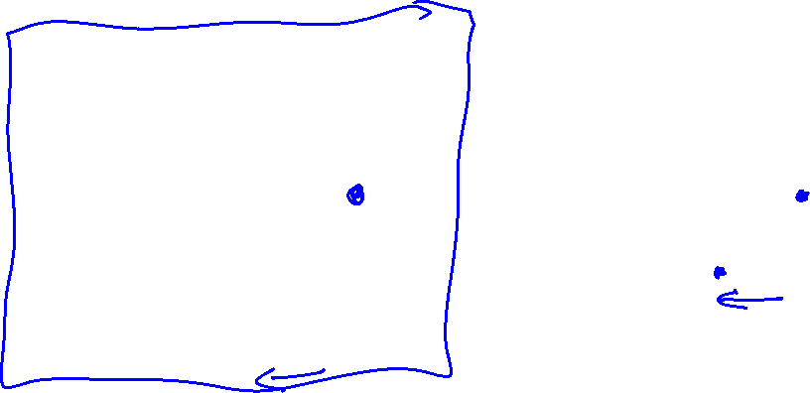
Second-Order Methods
Locally approximate function as quadratic
Comparison of first-order and second order approximations

Slide 4
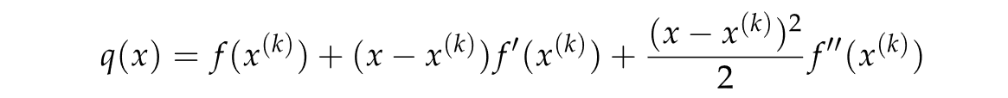
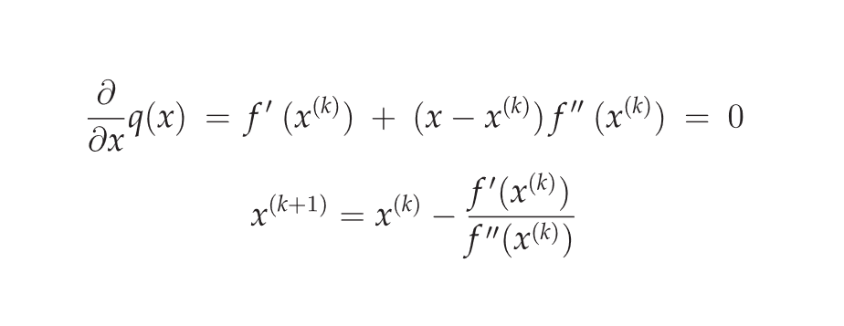
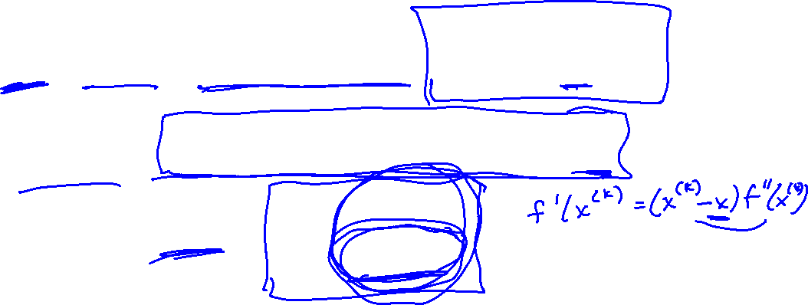
Newton’s Method
Approximate a function using second-order Taylor series expansion
Univariate function

Slide 5
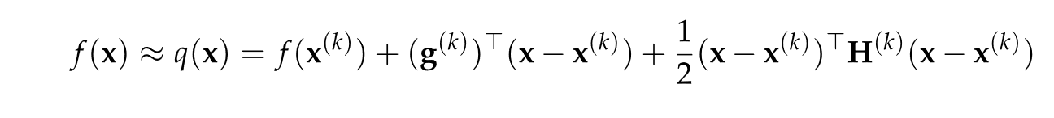


Newton’s Method
Multivariate function
Multivariate update rule
H is the Hessian matrix

Slide 6
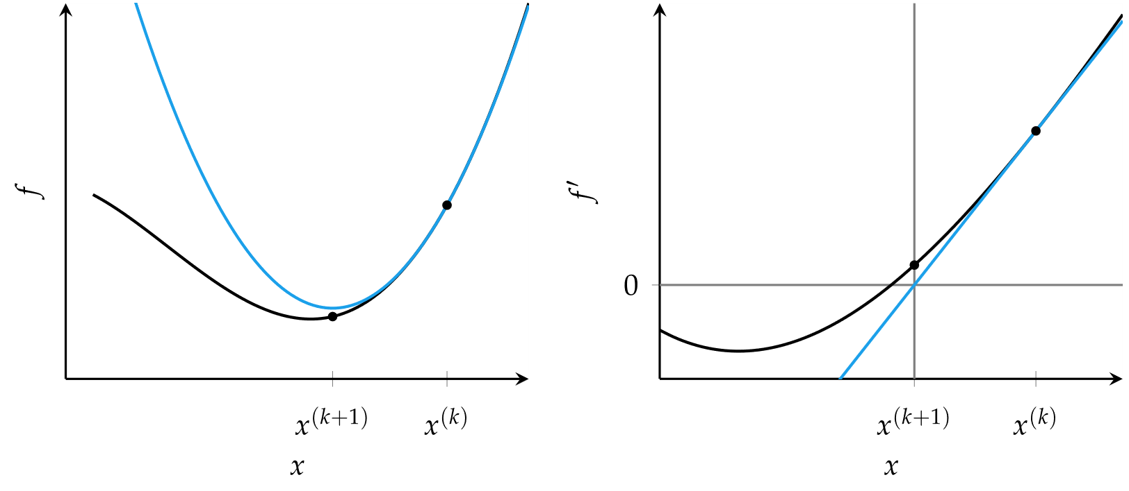
Newton’s Method
Newton’s method for optimization is equivalent to finding the roots of the derivative function

Slide 7
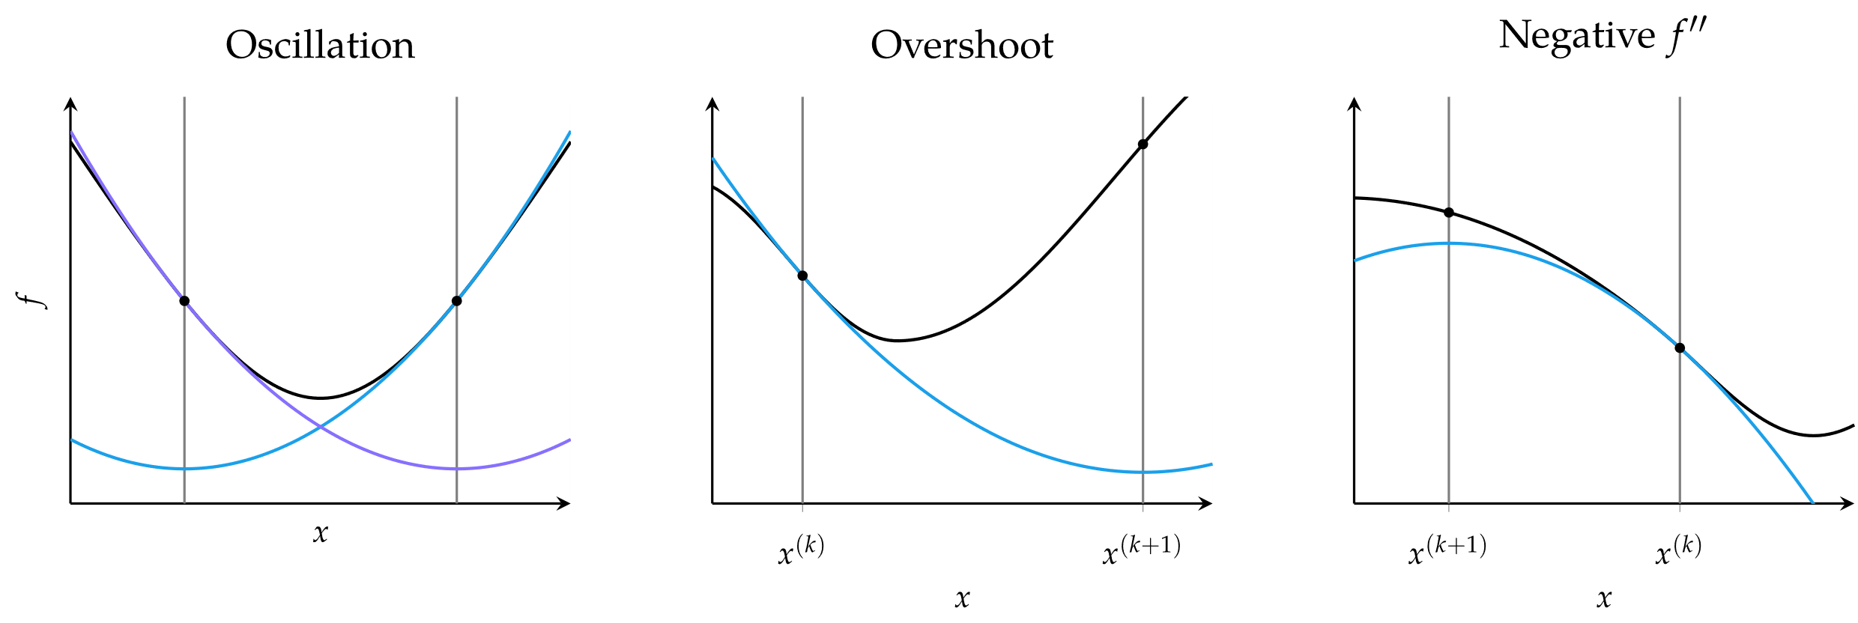

Newton’s Method
Common causes of error in Newton’s method

Slide 8



Secant Method
For univariate functions, if the second derivative is unknown, it can be approximated using the secant method
Update equation

Slide 9
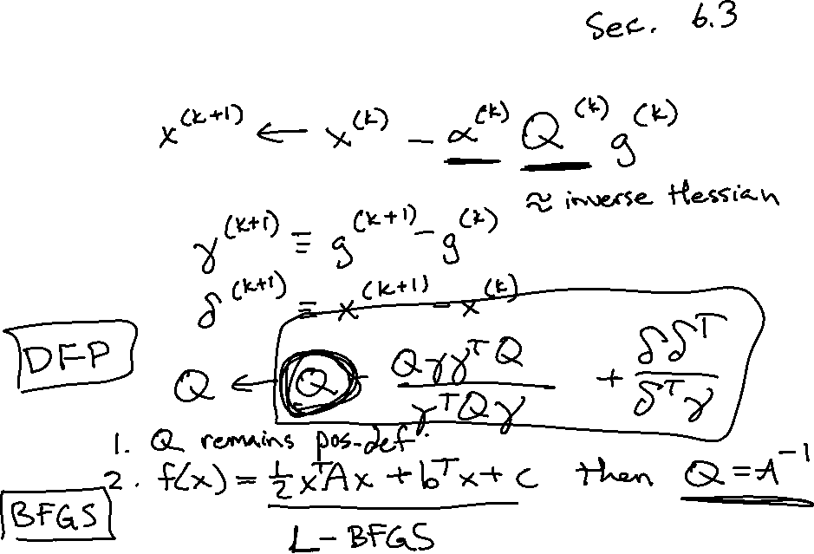
Quasi-Newton Methods

Slide 10
Quasi-Newton Methods

Slide 11
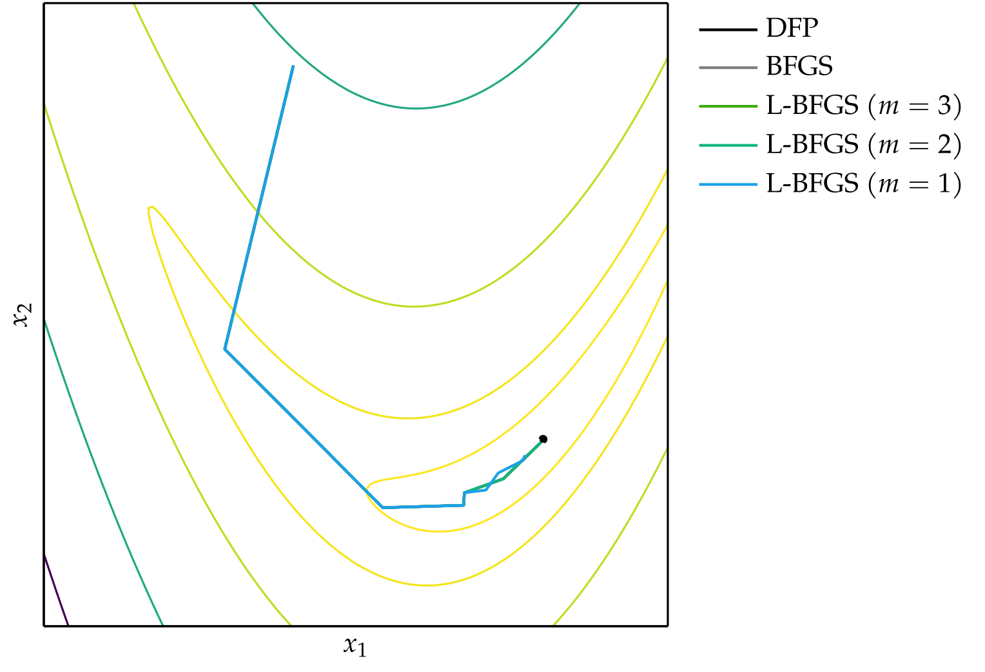

Quasi-Newton Methods

Slide 12
Summary
Incorporating second-order information in descent methods often speeds convergence.
Newton’s method is a root-finding method that leverages second-order information to quickly descend to a local minimum.
The secant method and quasi-Newton methods approximate Newton’s method when the second-order information is not directly available.

