Slide 1
Direct Methods

Slide 2
Direct Methods
Direct method search using function evaluations only
Also called zero-order, black box, pattern search, or derivative-free methods

Slide 3
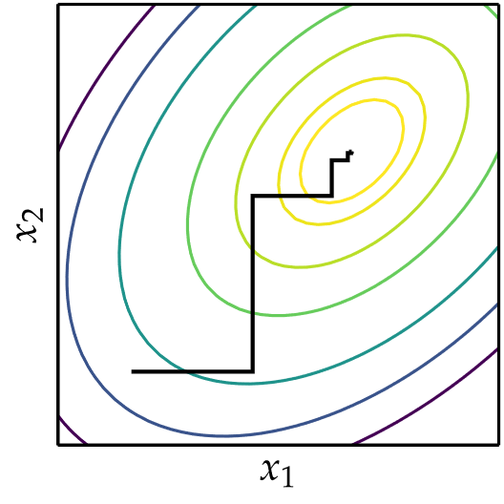

Cyclic Coordinate Search
Also known as coordinate descent, or taxicab search
Performs line search in alternating coordinate directions

Slide 4
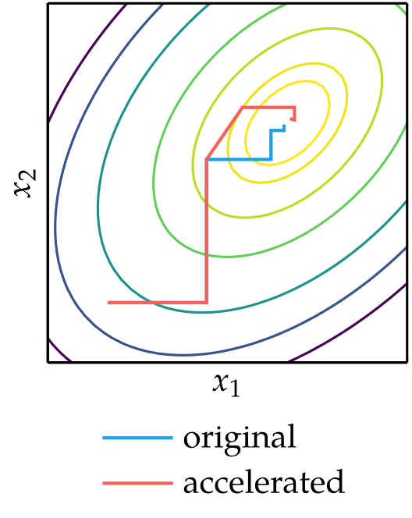
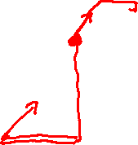
Cyclic Coordinate Search
Can be augmented to accelerate convergence

Slide 5
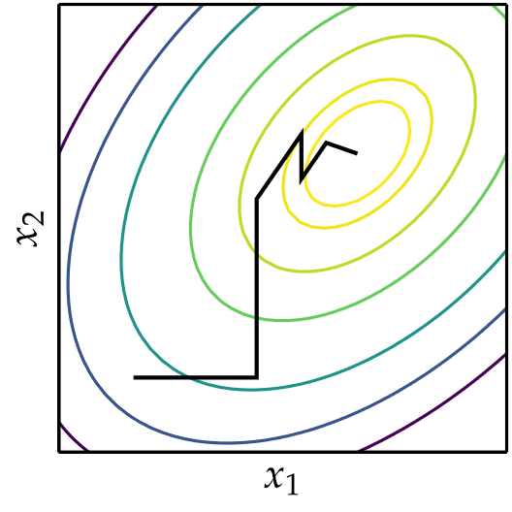
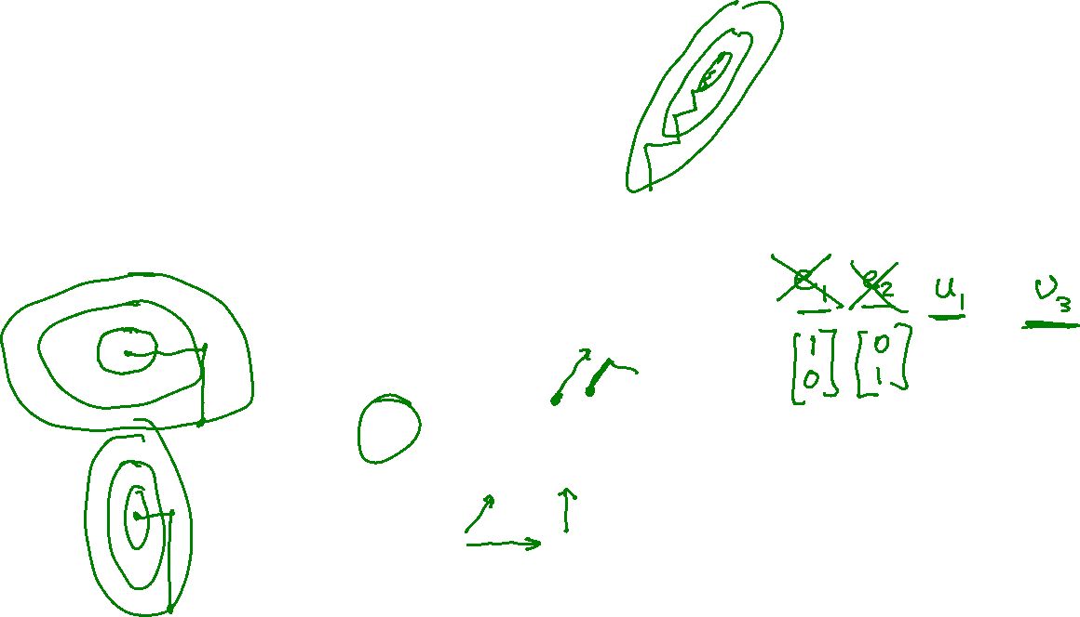
Powell’s Method
Similar to Cyclic Coordinate Search, but can search in non-orthogonal directions

Slide 6
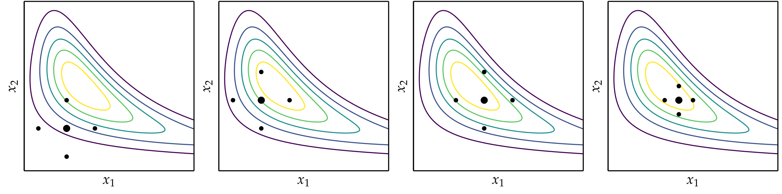

Hooke-Jeeves

Slide 7
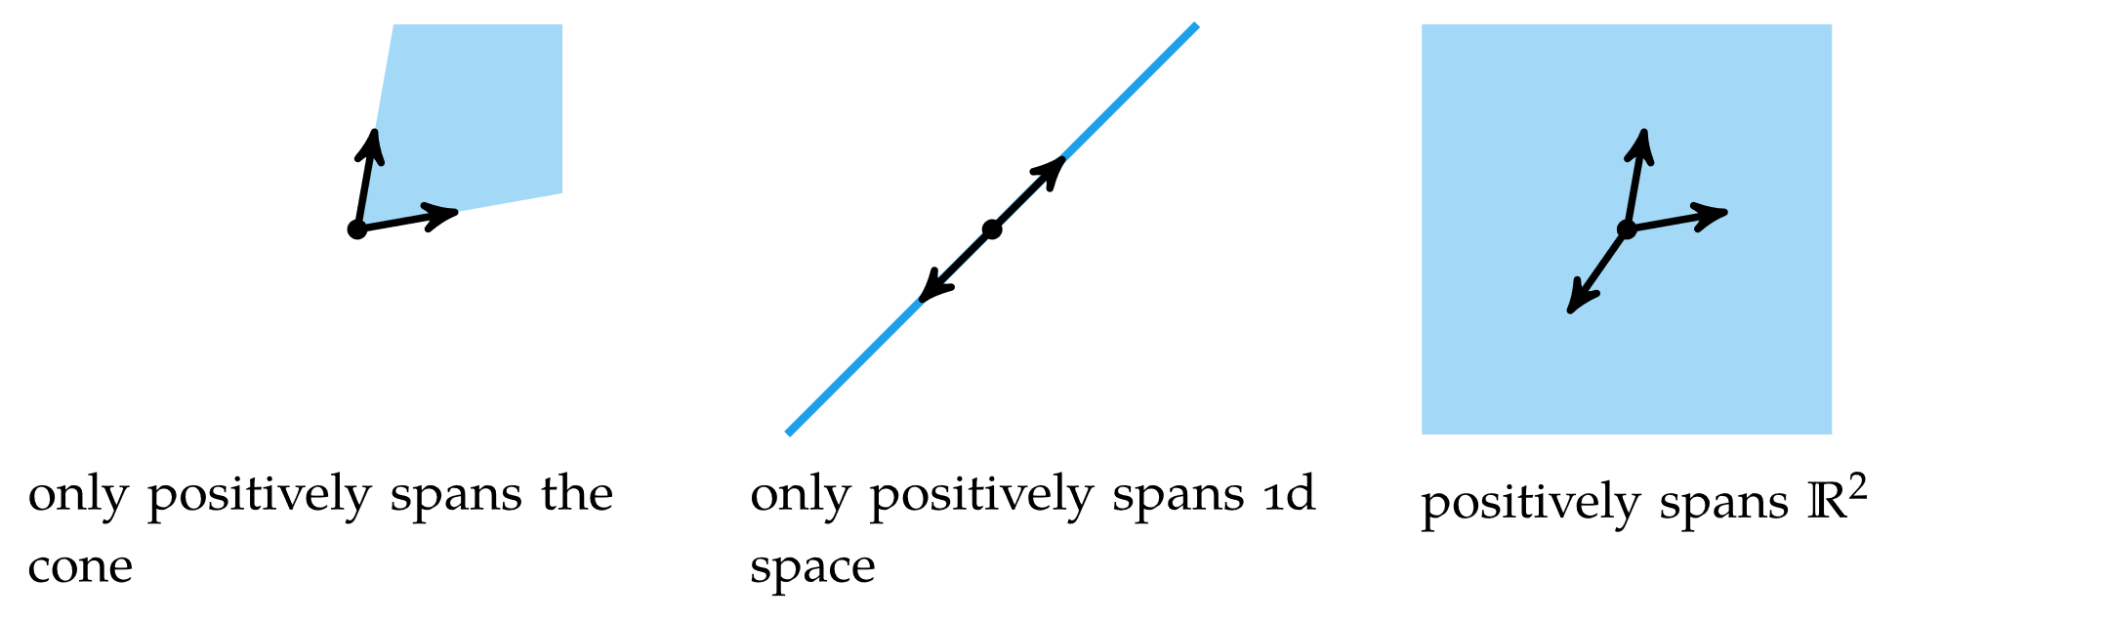
Generalized Pattern Search
Generalization of Hooke-Jeeves method
Searches in set of directions that positively spans search space

Slide 8
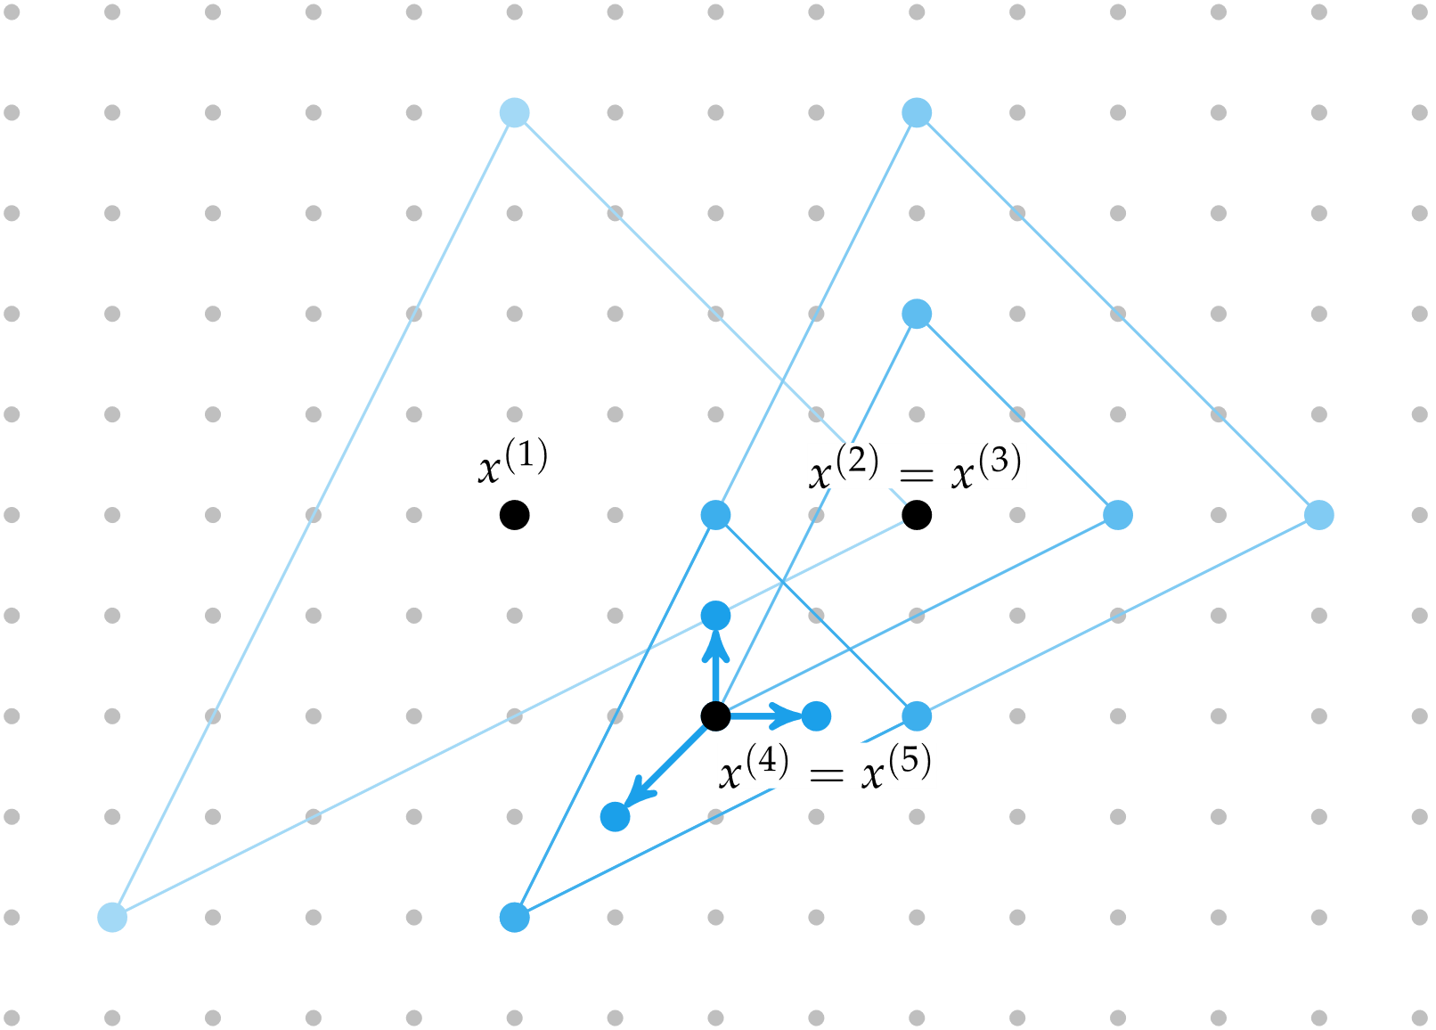
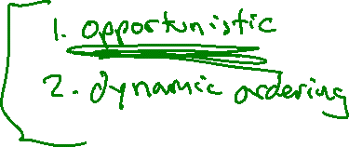
Generalized Pattern Search

Slide 9
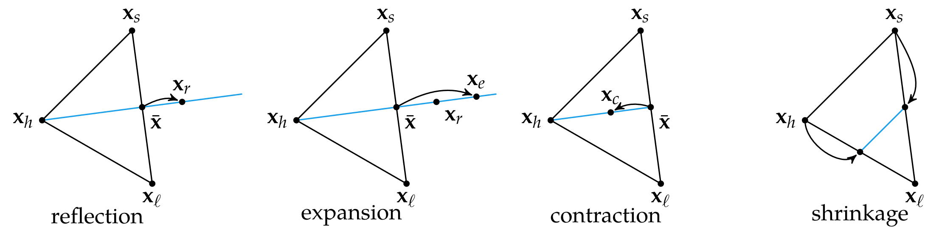

Nelder-Mead Simplex Method
Uses simple algorithm to traverse search space using set of points defining a simplex

Slide 10
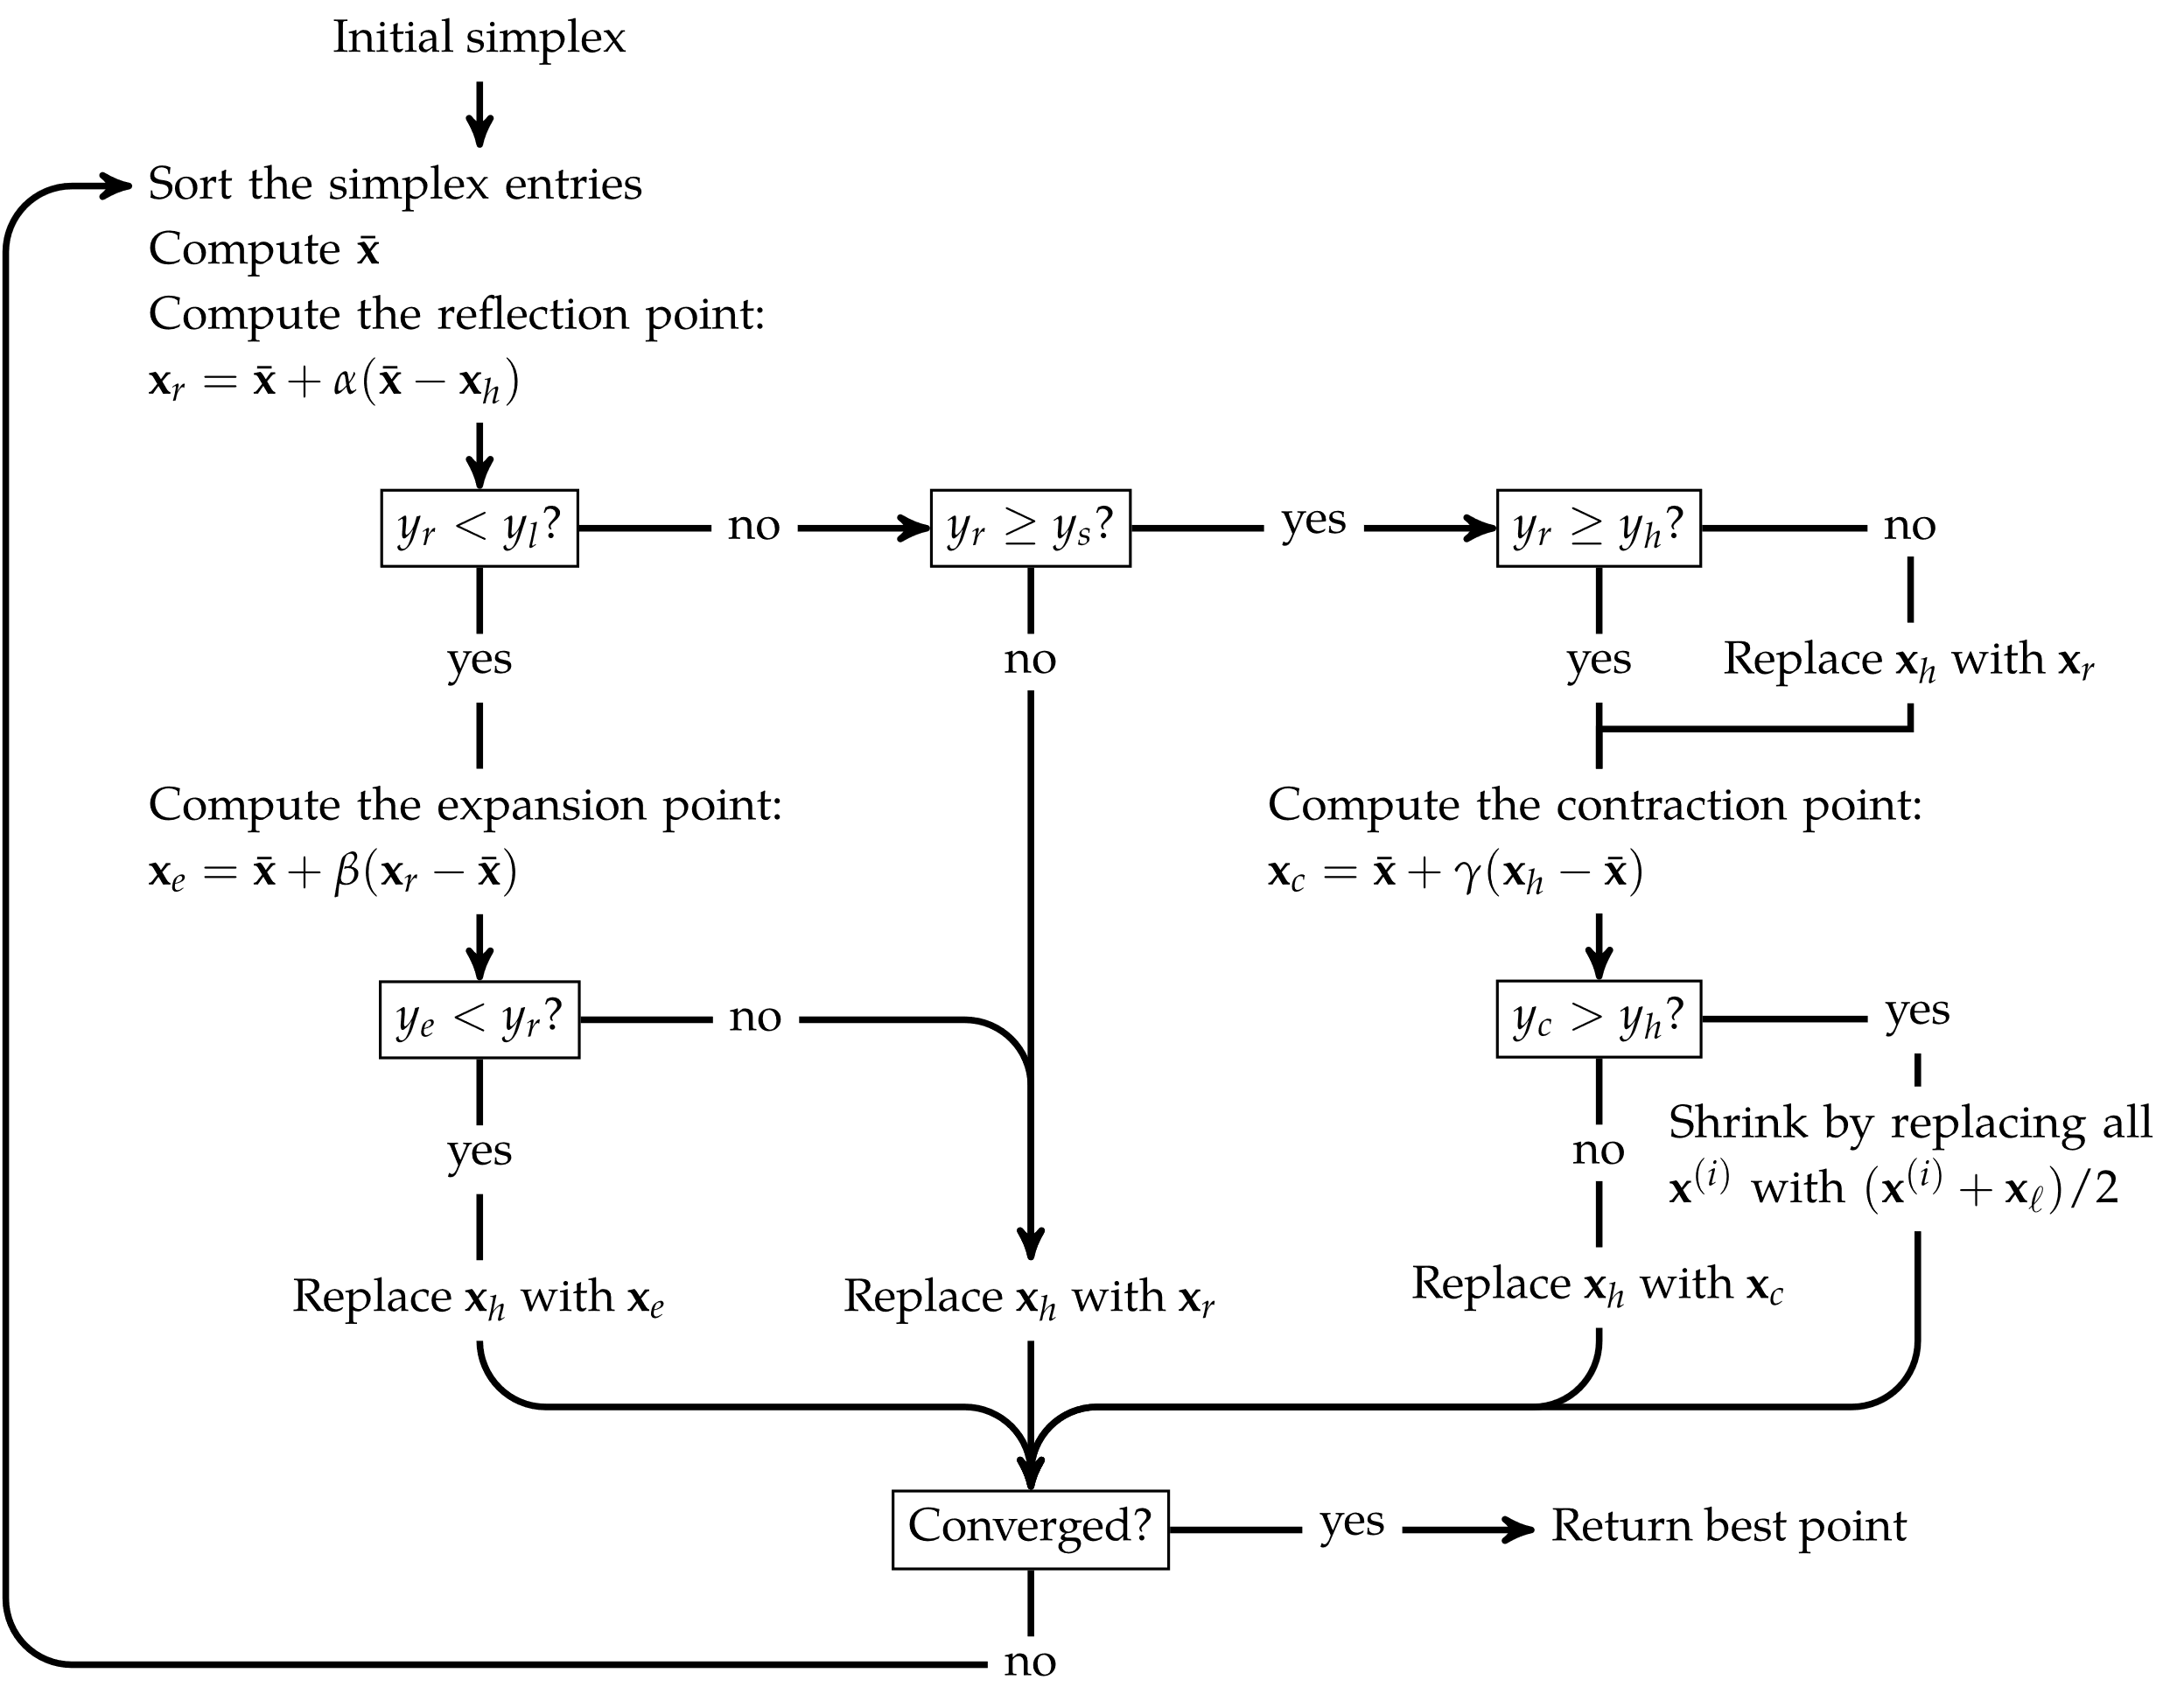
Nelder-Mead Simplex Method

Slide 11
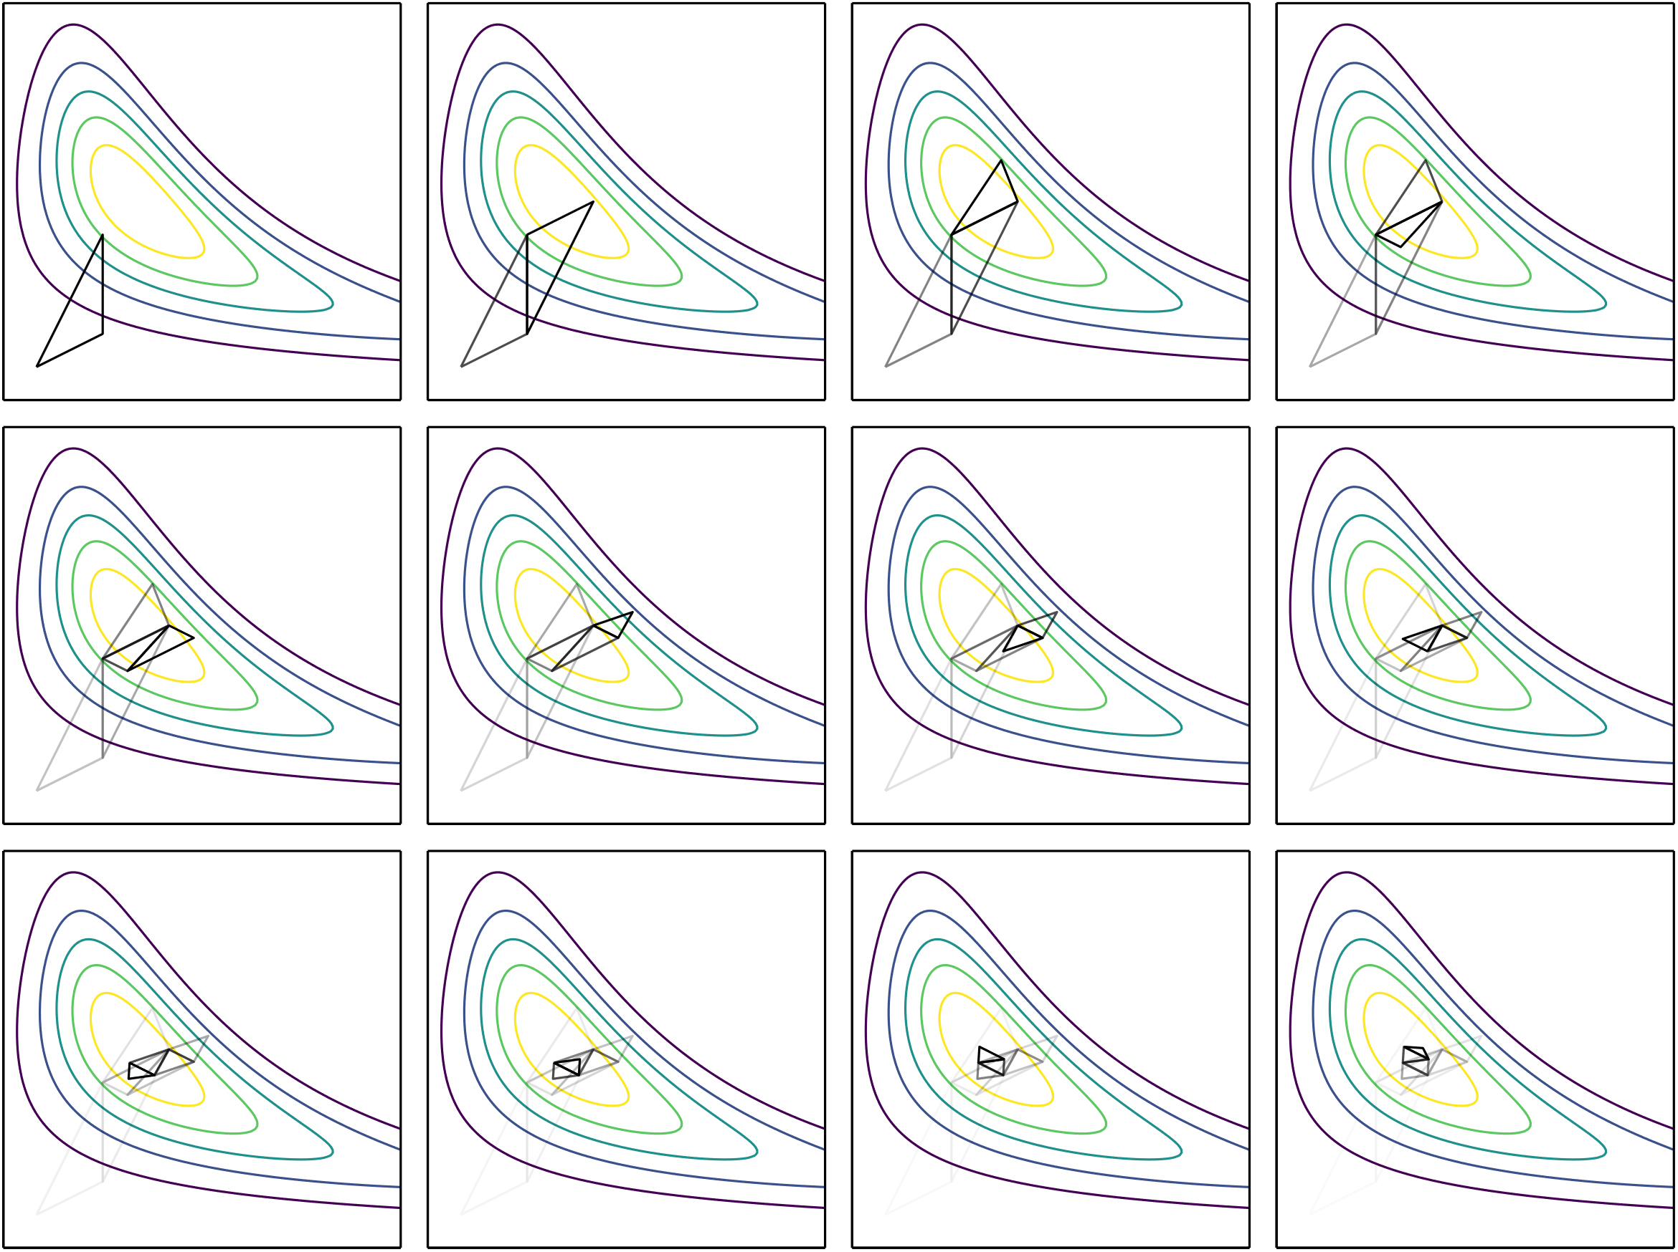
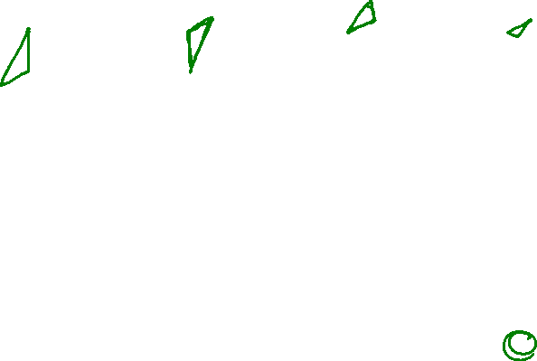
Nelder-Mead Simplex Method

Slide 12
Divided Rectangles
Also called DIRECT for Divided RECTangles
Same approach as Shubert-Piyavskii method, but does not need to specify Lipschitz constant and is more efficiently expanded to multiple dimensions

Slide 13
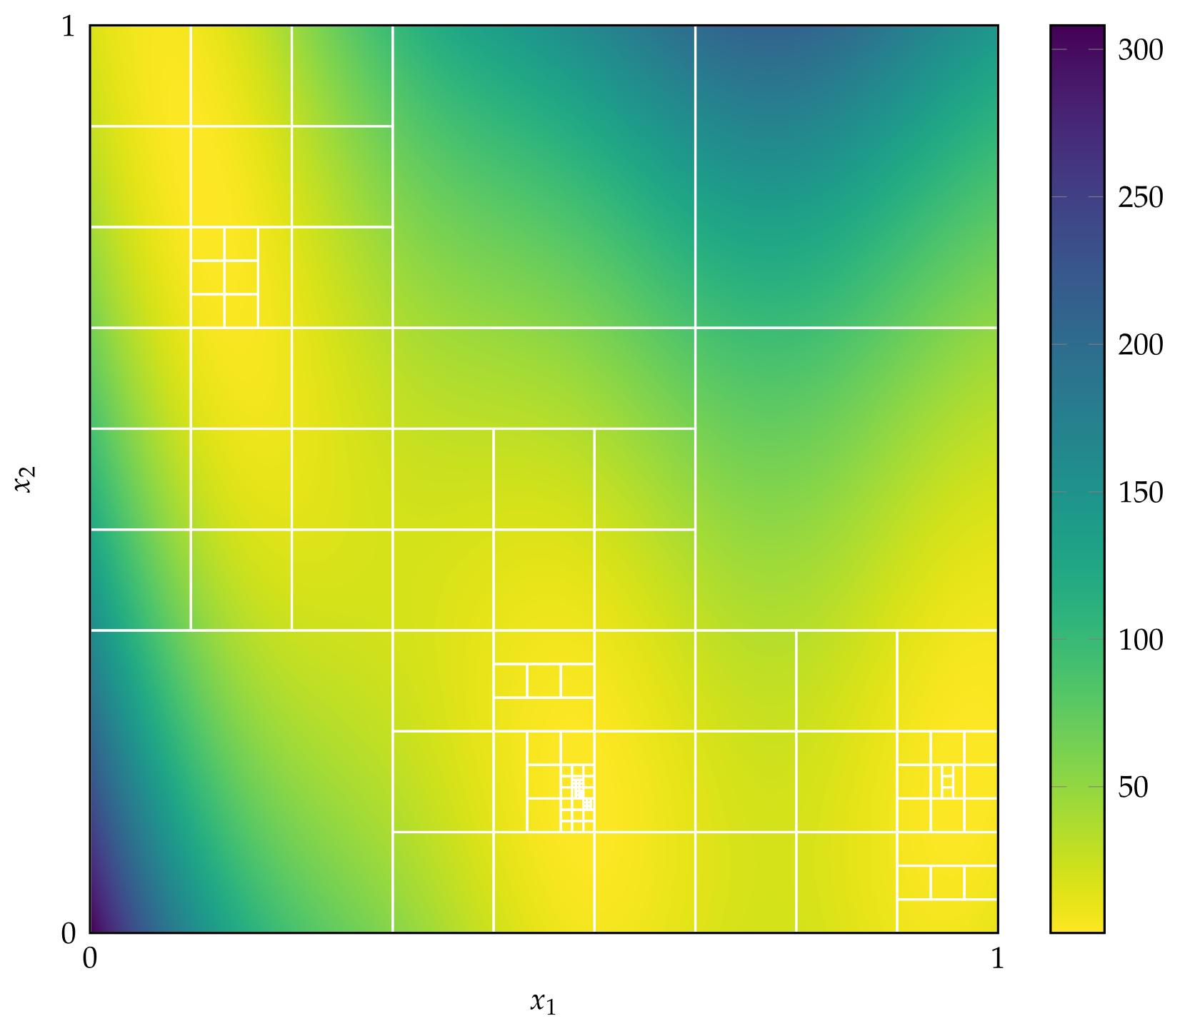
Divided Rectangles

Slide 14
Summary
Direct methods rely solely on the objective function and do not use derivative information.
Cyclic coordinate search optimizes one coordinate direction at a time.
Powell’s method adapts the set of search directions based on the direction of progress.
Hooke-Jeeves searches in each coordinate direction from the current point using a step size that is adapted over time.

Slide 15
Summary
Generalized pattern search is similar to Hooke-Jeeves, but it uses fewer search directions that positively span the design space.
The Nelder-Mead simplex method uses a simplex to search the design space, adaptively expanding and contracting the size of the simplex in response to evaluations of the objective function.
The divided rectangles algorithm extends the Shubert-Piyavskii approach to multiple dimensions and does not require specifying a valid Lipschitz constant.

