Slide 1
Large-scale Interactive Recommendation with Tree-structured Policy Gradient
Haokun Chen,¹ Xinyi Dai,¹ Han Cai,¹ Weinan Zhang,¹
Xuejian Wang,¹ Ruiming Tang,² Yuzhou Zhang,² Yong Yu¹
¹Shanghai Jiao Tong University
²Huawei Noah’s Ark Lab

Slide 2
Outlines
Background
Interactive Recommender System
Challenges in IRS
Our model
Architecture of the TPGR
Superiorities of the TPGR
Experiments
Environment Simulator
Performance Comparison

Slide 3
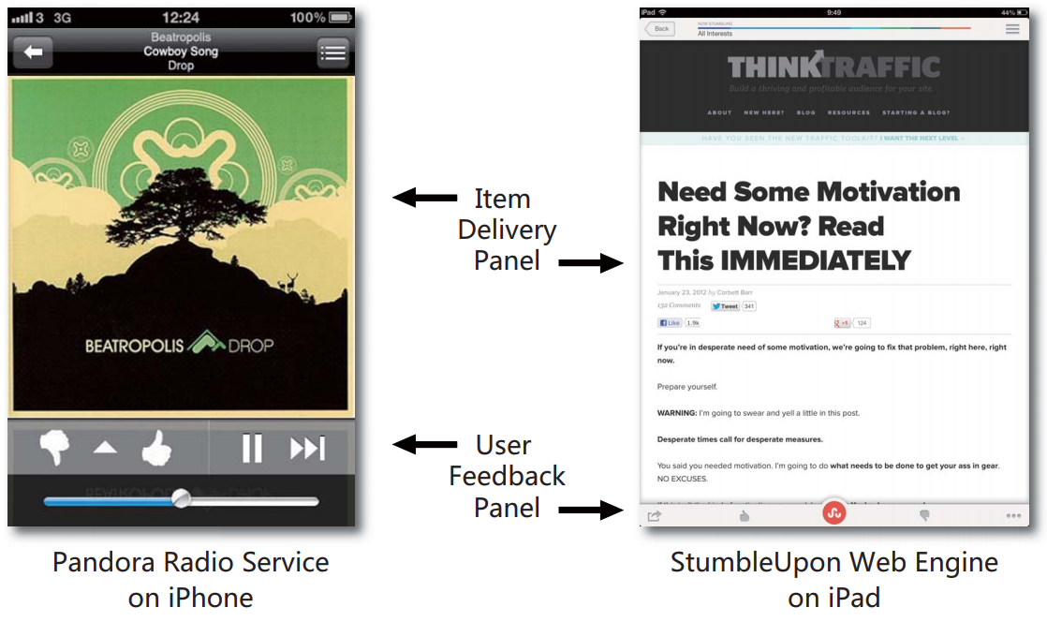
Background--Interactive Recommender Systems
Two examples of Interactive Recommender Systems

Slide 4
Background--Interactive Recommender Systems
An IRS consecutively recommends items to individual users and receives their feedbacks.
IRSs are widely used in online applications, especially on mobile devices.
It is possible to refine the recommendation policy during such interactive processes.

Slide 5
Background--Challenges in IRS
Three challenges in IRS
Dynamic preference: user preference may drift due to the interactions with the IRS.
Long-run benefit : long-run benefit may be more important than immediate benefit.
Efficiency: recommender systems are always with plenty of items to recommend which may slow the systems.

Slide 6
Background--Challenges in IRS
Conventional models are not suitable for IRS
CF and Content-based methods model the recommendation as a static procedure.
MAB-based methods assume that the user preference remains unchanged during the recommendation.
RL models may be promising for solving IRS
RL models naturally can learn from interactions.
RL models have the capacity of dynamic adaptation and long-run planning.

Slide 7


Background--Challenges in IRS
Most RL models for IRS are inefficient
The time complexity of making a decision is linear to the size of action space (the number of available items).
For DQN-based models, the policy is where evaluations are needed.
For most DDPG-based models, a specific ranking score function is applied over all items.
This inefficiency problem is called the large discrete action space problem in RL.

Slide 8
Background--Challenges in IRS
DeepMind proposes a solution, however, it suffers from several problems
The inconsistency between the continuous action representation and the real discrete action.
The utilized approximate KNN method may cause trouble as the found neighbors may not be exactly the nearest ones.
Only when the value of K is small, the model is efficient, which, however, may lead to a performance discount.

Slide 9
Preliminary--Model the IRS using the MDP
State. A state is defined as the historical interactions between a user and the recommender system, which can be encoded as a low-dimensional vector via a recurrent neural network (RNN).
Action. An action is to pick an item for recommendation, such as a song or a video, etc.
Reward. An reward reflects the user's feedback to the recommended item.
Transition. As the state is the historical interactions, once a new item is recommended and the corresponding user's feedback is given, the state transition is determined.

Slide 10
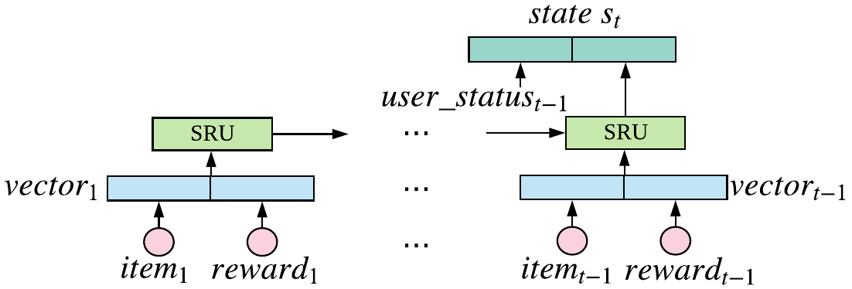
Our work--State representation
To construct state representation, we adopt a Simple Recurrent Unit (SRU), which encodes the interaction sequence to a low-dimensional vector.
We also explicitly incorporate some statistic information, e.g., the number of positive and negative items before timestep t into the state.

Slide 11
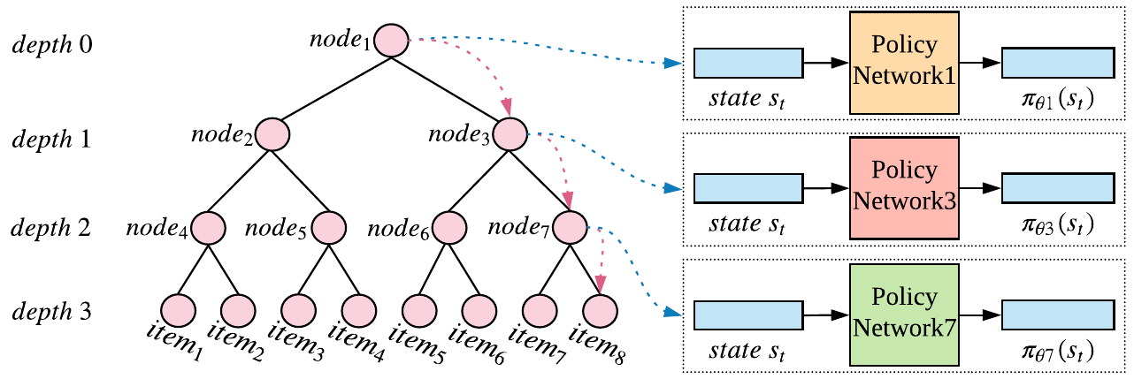


Our work--Architecture of TPGR
We propose to conduct balanced hierarchical clustering over items and utilize the REINFORCE algorithm to learn the stochastic policy.
Picking an item is formulated as seeking a path from the root to a certain leaf and the corresponding item is recommended to the user.
The model reduces the time complexity of making a decision from to .

Slide 12
Our work--Hierarchical clustering over items
Divisive hierarchical clustering
Repeatedly utilize a clustering modules to divide the items into sub-clusters until each sub-cluster is with only one item.
Require the clustering tree to be balanced.
Three ways of item representation
Rating-based
VAE-based
MF-based
Two clustering modules
K-means-based
PCA-based

Slide 13

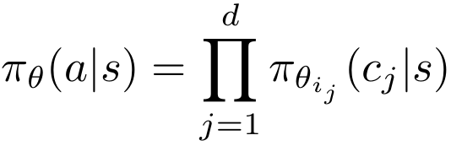

Our work--The policy of TPGR
Details about TPGR
Each leaf node of the constructed tree is mapped to an item after hierarchical clustering.
Each non-leaf node is associated with a simple policy network.
The policy of TPGR
Given a state, assuming that the node indexes along the path to reach the action are and the corresponding choices are , then we have:

Slide 14
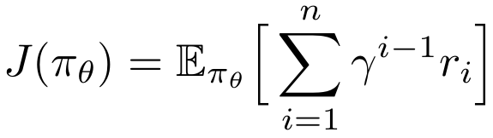
Our work--Training by Reinforce Technique
The objective of the RL methods is to maximize the expected discounted cumulative reward, i.e.,
The corresponding gradient can be approximated by

Slide 15
Our work--Superiorities of the TPGR
Effective
The model is constructed under the RL framework, which can achieve dynamic adaptation and long-run planning.
The tree-structured decomposition may ease the training process and lead to better performance.
Efficient
The model reduce the time complexity of making a decision from to .

Slide 16
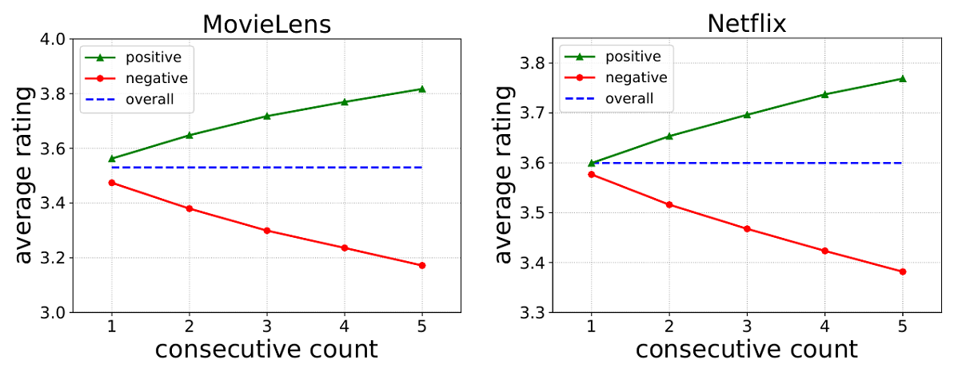

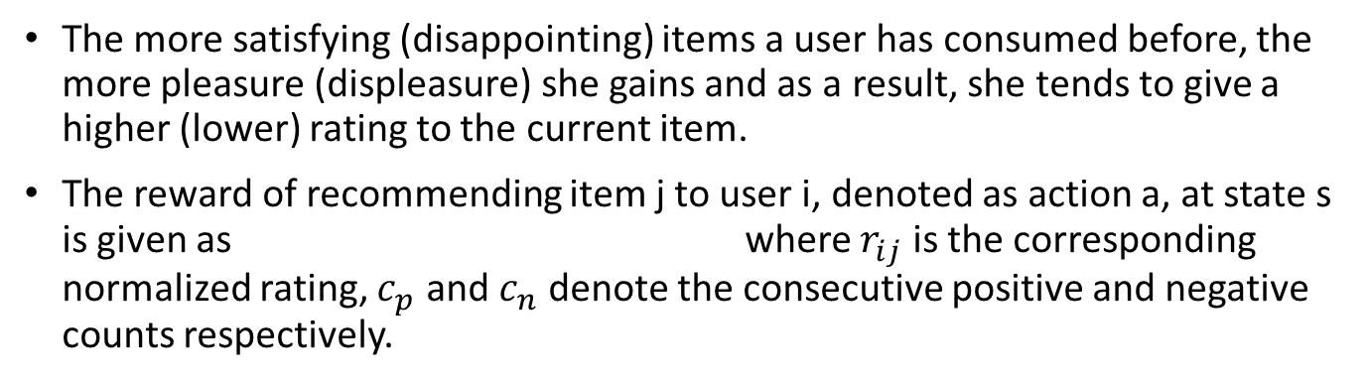
Experiments--Environment Simulator
The more satisfying (disappointing) items a user has consumed before, the more pleasure (displeasure) she gains and as a result, she tends to give a higher (lower) rating to the current item.
The reward of recommending item j to user i, denoted as action a, at state s is given as where $r_{ij}$ is the corresponding normalized rating, $c_{p}$ and $c_{n}$ denote the consecutive positive and negative counts respectively.

Slide 17
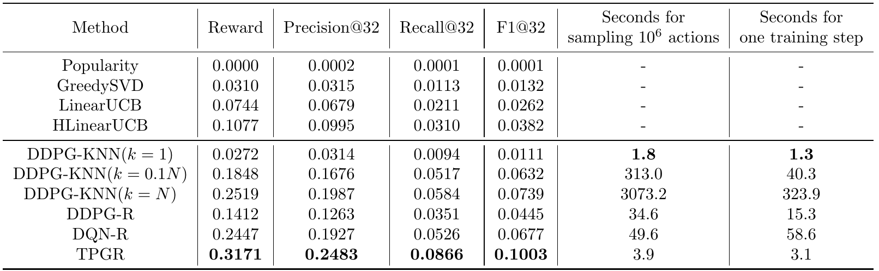
Experiments--Comparison
Most RL-based models perform better than the non-RL-based models.
TPGR outperforms all competed models in term of effetiveness.
TPGR can achieve high effectiveness and high efficiency at the same time.

Slide 18
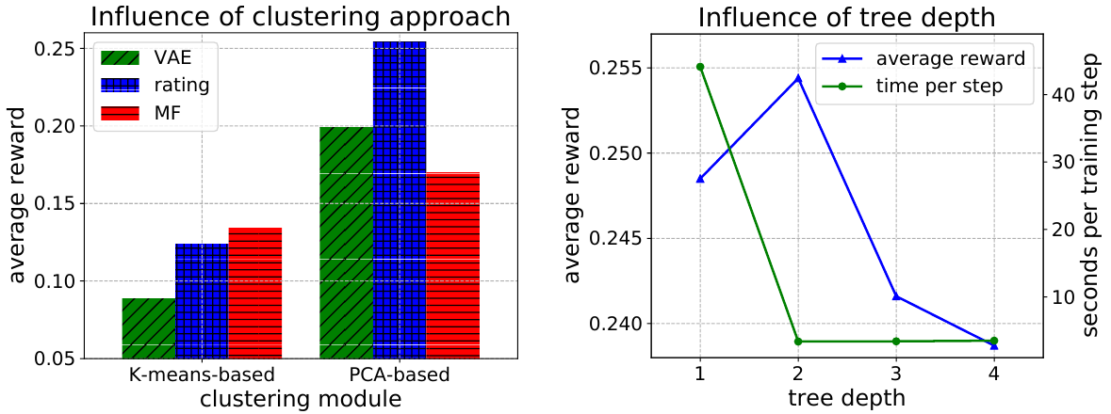
Experiments--Influence of other factors
Applying PCA-based clustering module with rating-based representation achieves the best performance.
Setting the tree depth to 2 is good start point to explore suitable tree depth which significantly reduce the time complexity with satisfying performance.

Slide 19
Future work
Deploy the TPGR onto an online commercial recommender system if possible.
Explore more clustering tree construction schemes based on the current recommendation policy.
Expand the proposed tree-structured framework to value-based reinforcement learning methods.

Slide 20
Thank you!

