Slide 1
Brain Lesion Detection with deep q learning
Chenhao Lu

Slide 2
Inspiration and Goal
Lesion detection using traditional CNNs has been widely studied and can achieve decent performance on unseen data, but there still exist several drawbacks to this approach.
Requires large annotated brain image dataset
Lacks interpretability as CNN is more like a black box due to its architecture
Can we use reinforcement learning instead?
Deep Q Learning
Inspired by https://bmcmedimaging.biomedcentral.com/articles/10.1186/s12880-022-00919-x

Slide 3
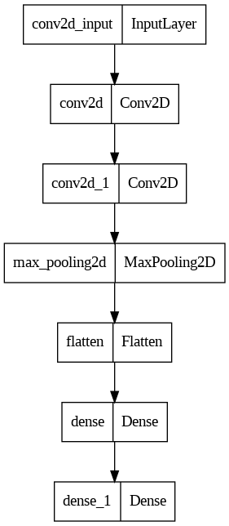
DQN Setup
Combination of reinforcement learning and deep neural networks
Uses 2 neural networks in the algorithm:
Q-network: It takes in a state and outputs the Q values for all possible actions. This network is trained using the loss between the predicted Q-values and the target Q-values. During inference, we use this network to obtain the Q values and pick an action
Target network: It has the exact same architecture as the other one but different weights. This network is only updated periodically by copying over the weights from the Q-network and is used to generate target Q-values.
Experience Replay

Slide 4
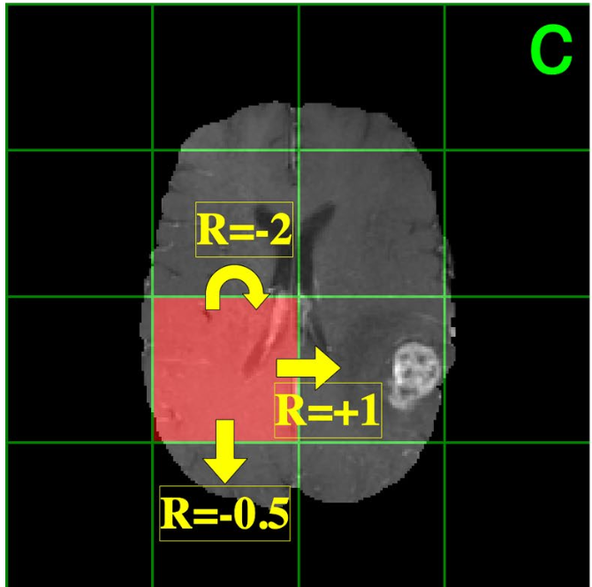
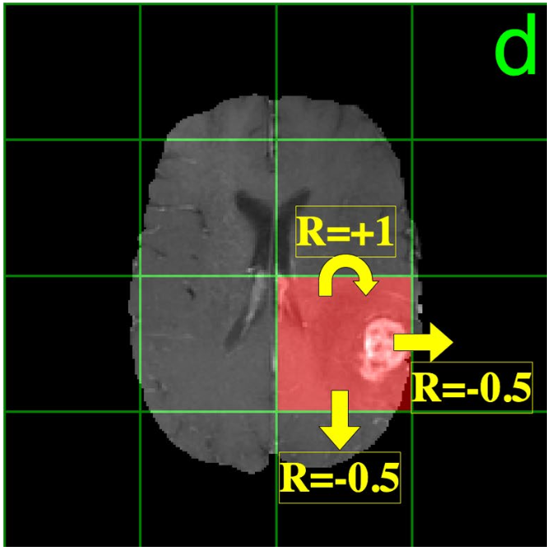
Environment Setup
Each image is divided into 16 equal-size grids, with one or more grids containing the lesion
The agent starts in the top left grid, and can take 1 of 3 actions every move according to the decaying epsilon-greedy algorithm
Stay still, go down, go right
The reward for every state is
+1 if the agent stays in or moves into a lesion state
-0.5 if the agent moves into a non-lesion state
-2 if the agent stays in a non-lesion state

Slide 5
Pseudocode
For each episode:
For each image:
Divide the image into 16 regions
For each region:
Select action for the current region/state
Execute the action and calculate reward
Store the transition (state, action, reward, next_state, done) in agent's memory buffer
Randomly select batch_size samples from memory and perform replay to update Q-network parameters
Update target network parameters

Slide 6
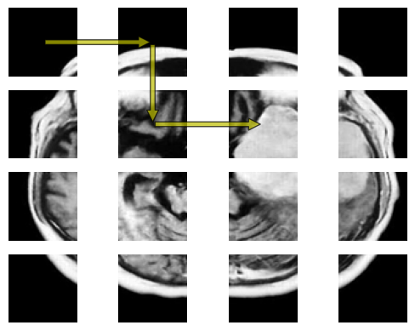
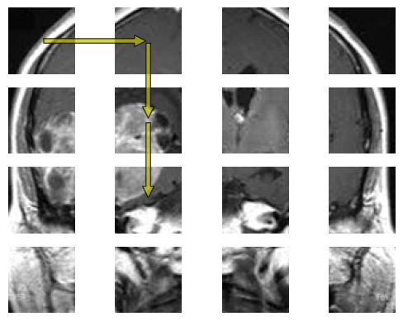
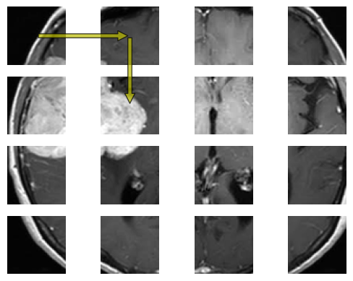
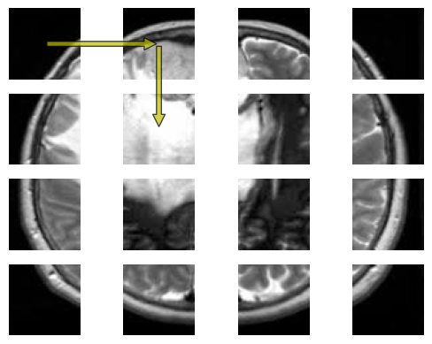
Results
Agent and networks are trained on 62 images for 20 episodes
Agents are allowed to take maximum 15 steps during inference
Arrows not drawn if agent stays still

