Slide 1

Language Models for Open-Ended Domains
Mourad Heddaya
PhD Dissertation Defense, 5/12/2026
Department of Computer Science
University of Chicago
Committee:
Chenhao Tan (advisor)
Ari Holtzman
Alexander Zentefis

Slide 2




LLMs excel at tasks with clear answers
But many language tasks are open-ended
PALINDROME.PY
def is_palindrome(s):
s = s.lower()
return s = s[::-1]
Saint-Exupéry · Le Petit Prince · 1943
« On ne voit bien qu’avec le cœur. L’essentiel est invisible pour les yeux. »
Katherine Woods
“It is only with the heart that one can see rightly ; what is essential is invisible to the eye.”
is_palindrome(“Stop pots”) == True PASS
is_palindrome(“hello”) == False PASS
T.V.F. Cuffe
“It is only with the heart that one can see clearly. What is essential is invisible to the eye.”
is_palindrome(“kayak”) == True PASS
Richard Howard
“One sees clearly only with the heart. Anything essential is invisible to the eyes.”
is_palindrome(“racecar”) == True PASS
Notes:
Example coding - clear answer
LLM Excel at tasks with clear answers (math, factual QA, coding)
Many language tasks not like this.
Book translation.
Multiple valid translations. No objective correct / incorrect
Determining which output is preferred required considering context
Central research question shifts to language behavior that works in context
LLMs are genuinely strong when there’s a clear target—coding is a good example.
There’s a well-defined success criterion did the code produce the expected results?
So: for closed-form tasks, progress is easy to see and measure.
_

Slide 3

LLMs excel at tasks with clear answers
But many language tasks are open-ended
PALINDROME.PY
def is_palindrome(s):
s = s.lower()
return s == s[::-1]
Saint-Exupéry · Le Petit Prince · 1943
« On ne voit bien qu’avec le cœur. L’essentiel est invisible pour les yeux. »
Katherine Woods
“It is only with the heart that one can see rightly ; what is essential is invisible to the eye.”
is_palindrome(“Stop pots”) == True PASS
is_palindrome(“hello”) == False PASS
T.V.F. Cuffe
“It is only with the heart that one can see clearly. What is essential is invisible to the eye.”
Richard Howard
“One sees clearly only with the heart. Anything essential is invisible to the eyes.”
Notes:
Example coding - clear answer
LLM Excel at tasks with clear answers (math, factual QA, coding)
Many language tasks not like this.
Book translation.
Multiple valid translations. No objective correct / incorrect
Determining which output is preferred required considering context
Central research question shifts to language behavior that works in context
LLMs are genuinely strong when there’s a clear target—coding is a good example.
There’s a well-defined success criterion did the code produce the expected results?
So: for closed-form tasks, progress is easy to see and measure.
_

Slide 4
Work Overview
Language of Bargaining [M. Heddaya, Dworkin, Tan, Voigt, Zeng, Zentefis, 2023]
Causal Micro-Narratives [M. Heddaya, Zeng, Tan, Voigt, Zentefis, 2024]
  A Century of Inflation Narratives [M. Heddaya, Zeng, Tan, Voigt, Zentefis, 2025]
CaseSumm: A Large-Scale Dataset for Long-Context Summarization from Supreme Court Opinions [M. Heddaya, MacMillan, Malani, Mei, Tan, 2025]
When Internalization Fails: Finding Better Targets for Reasoning Compression [Mourad Heddaya, Roberts, Wadhawan, Tan, 2026]
CivicChats: Shaping the Future of Civic Discourse [M. Heddaya, Zhou, Margie, Lee, Tan, Xie, Mendelsohn]
Notes:
First project: economic narratives and defining, measuring and analyzing them at scale
Second project: a dataset for legal summarizatio
Third project: controlled experiment and public system to help voters reason about ballot measures

Slide 5
Work Overview
Language of Bargaining [M. Heddaya, Dworkin, Tan, Voigt, Zeng, Zentefis, 2023]
Causal Micro-Narratives [M. Heddaya, Zeng, Tan, Voigt, Zentefis, 2024]
  A Century of Inflation Narratives [M. Heddaya, Zeng, Tan, Voigt, Zentefis, 2025]
CaseSumm: A Large-Scale Dataset for Long-Context Summarization from Supreme Court Opinions [M. Heddaya, MacMillan, Malani, Mei, Tan, 2025]
When Internalization Fails: Finding Better Targets for Reasoning Compression [Mourad Heddaya, Roberts, Wadhawan, Tan, 2026]
CivicChats: Shaping the Future of Civic Discourse [M. Heddaya, Zhou, Margie, Lee, Tan, Xie, Mendelsohn]
Notes:
First project: how to measure economic narratives in text, at scale, in a way that stays interpretable.

Slide 6



Economic narratives are a mechanism for behavior change
Buying a home
Investing in stock market
Pursuing higher education
If we fail to consider and understand the properties of narratives, “we remain blind to a very real, very palpable, very important mechanism for economic change, as well as a crucial element for economic forecasting.” [Shiller, 2017]
Notes:
Argue economic narratives influence people's behavior.
Not just facts but WHAT is happening and WHY
Narratives can affect whether you buy a home, invest in the stock market, or pursue higher education.
*CLICK*
Shiller illustrates this motivation -> mechanism for economic change and forecasting
IF MATTER -> MEASURE AT SCALE
TRANSITION:
existing work gives concepts not measurement

Slide 7
Measuring narratives: prior work captures concept but not scale
Definitions of narrative are not built to be extracted and measured from actual text
Extraction methods are not built around any definition of narrative
  “We can contain costs and help enable every American have access to health insurance coverage.”
    americans have healthcare [Ash et al., 2022]
Notes:
Prior work has two limitations.
conceptually rich -> not built to be extracted from actual text
extraction methods are scalable -> no definition of narrative
__________________________________________________
Narratives shape beliefs
Theoretical framework + structural model [Benabou et al. 2018]
Beliefs about the economy that spread contagiously [Flynn & Sastry 2022]
Optimism vs. pessimism [Flynn & Sastry 2022]

Slide 8
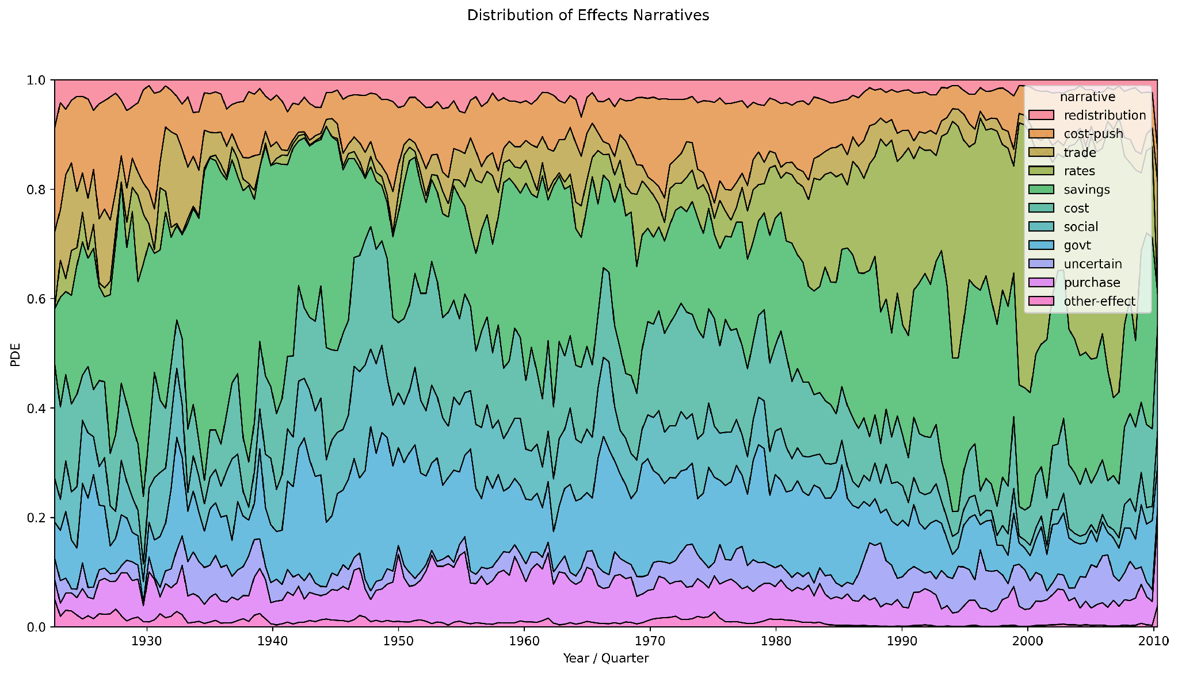

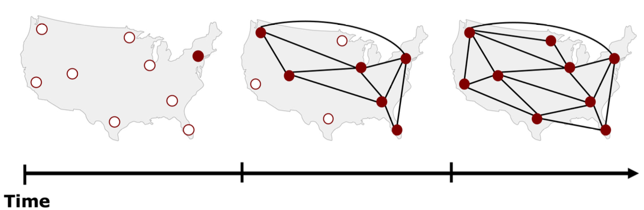
How can we measure narratives in millions of documents?
1923 - 2025
…
Notes:
How can we measure narratives in millions of documents?
ensure what we measure is meaningful?
Ultimately we care about analyses and forecasting
*CLICK*
Need extraction. UNSTRUCTURED NEWS -> STRUCTURED NARRATIVES
Let's consider an example.

Slide 9
How can we measure narratives in millions of documents?
1923 - 2025
…
Notes:
The data scale is very large—decades of news.
But the core methodological question is: what do we extract from text so it’s meaningful?
A bag of words won’t capture narrative structure. We need something interpretable, scalable, and tied to causal explanations people use.
Prior work has tried to capture narratives through sentiment analysis [Flynn & Sastry], DAG representations [Eliaz & Spiegler], or controlled experiments [Kendall & Charles] — but these either don't scale to real-world text or require strong structural assumptions.
“Rather than trying to recover full stories from articles, we make the task tractable by focusing on the smallest measurable narrative unit: a sentence that explains a cause or effect of inflation.”

Slide 10
Example: Causal Micro-Narratives
If these fiscal policies materialize, they are likely to boost economic growth and spur inflation, potentially forcing the Fed to hike rates more quickly to keep up.
A year ago the administration assumed inflation would run at 7.5 percent in 1979.
No narrative
N1 :
Fiscal Factors
Inflation
cause
Effect
N2 :
Inflation
Rates Increased
cause
effect
Causal Micro-Narrative: a sentence-level explanation of the cause(s) and/or effect(s) of a target subject.
Notes:
As a case study, focus on narratives about inflation.
N1: This one mentions inflation historically but doesn’t explain a cause/effect—so it’s not a micro-narrative under our definition.
N2: This sentence explicitly links fiscal policies → growth/inflation. And , in turn, inflation → Fed hikes.
That’s a narrative: causes + downstream effects.
This illustrates the distinction: we’re not labeling ‘mentions’, we’re labeling causal explanation.

Slide 11
Definition: Causal Micro-Narratives
a sentence-level explanation of the cause(s) and/or effect(s) of a target subject.
Prioritize measuring meaningful and interpretable narratives.
Make limited assumptions about text structure and syntax.
Sentence as unit of analysis.
Notes:
We are not simply counting mentions of inflation.
We are extracting explanations around inflation.

Slide 12
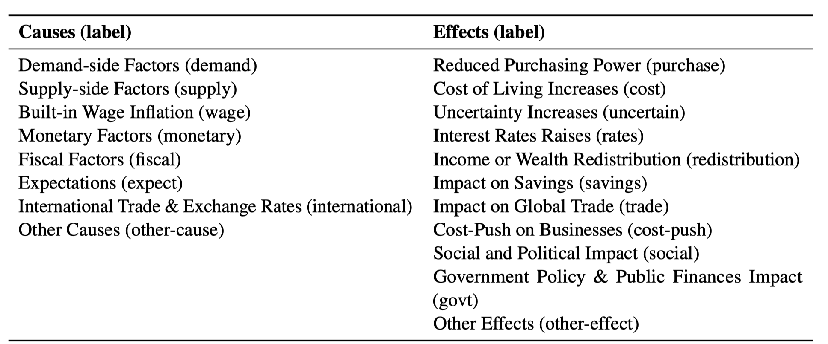
We annotated ~2.5k news sentences with
causes & effects of inflation
Notes:
To build this, we annotated around 2,500 sentences
ontology includes causes like....
important because it translates a domain concept into a measurable task.
but turns out challenging pragmatic judgment

Slide 13
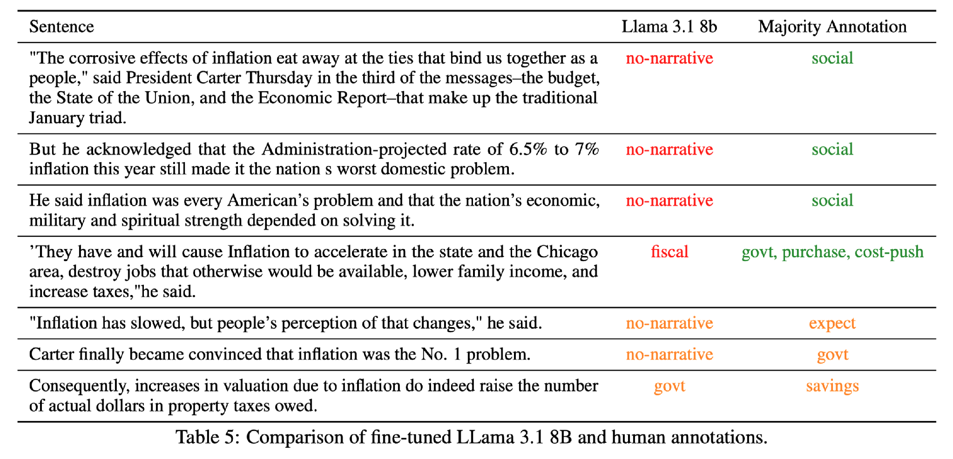

This is a challenging pragmatic annotation task
Good inter-annotator agreement for a pragmatic annotation task (0.6 – 0.8 Krippendorff’s alpha)
We use these annotations to train and evaluate language model classifiers on this task
Notes:
change right column to "annotation disagreement" and drop llama 3.1 8b
Some sentences are ambiguous -> narrative is implied rather than stated.
Human annotators can disagree in systematic ways, because they are making judgments about whether a sentence actually provides an explanation.
Overall good agreement.
And good model should capture the structure of that disagreement.

Slide 14

10x smaller fine-tuned models achieve good performance & outperform GPT-4
And fine-tuned Llama better reflects the natural human disagreements than GPT-4
( r = 0.97 vs 0.70)
Notes:
When we evaluate the classifiers, we find that much smaller fine-tuned models perform well and outperform prompted GPT-4 on this task.
Smaller models not always better. But for a domain specific pragmatic tasks such as this one:
strong alignment with the task definition matters.
This also helps us operationally: measure narratives over millions of articles
So far, I’ve shown that we can define and extract these narratives.

Slide 15
Analyzing narratives in millions of articles
1923 - 2025
…
Notes:
Once the narrative classification works, we can run it at scale: measure narrative prevalence over time and geography.
And now we can use the resulting structured data to ask and answer more specific macro-economic and social science questions.

Slide 16
Does narrative prevalence predict inflation expectations?
Survey data: “By about what percent do you expect prices to go (up/down) on the average, during the next 12 months?”
We design a regression that relates narrative prevalence to inflation expectations, controlling for actual/lagged inflation and number of inflation-mentions
Notes:
in context of inflation, an important measure of belief is inflation expectation
we find some interesting results and id like briefly walk you through two of them

Slide 17
Show some narratives
Narrative composition particularly expectations and purchase/savings framing correlates with both near- and long-term expectations beyond
Notes:
The volume of inflation-related news has minimal predictive power for national average expectations after controlling for realized inflation, with coefficients indistinguishable from zero at both horizons. Specific narrative frames show predictive power beyond realized inflation and news volume, though at the national-average level they fall short of conventional 5\% significance. For 1-year expectations, the social narrative is the most influential predictor (coefficient 0.034, t-statistic 1.82), approximately 29\% of the magnitude of the realized inflation effect. The wage narrative (0.031, t-statistic 1.67) and trade narrative (0.027, t-statistic 1.73) show comparable associations. For long-run expectations, the redistribution narrative is the strongest predictor (0.037, t-statistic 1.73), about 1.32 times the realized inflation effect at that horizon, while the expectations narrative carries a negative coefficient ($-0.025$, t-statistic $-1.87$), suggesting that media framing of expectations themselves may operate differently across horizons.

Slide 18

Social/political impact narratives strongly predict greater disagreement in inflation expectations
Notes:
We did find that narrative exposure predicts disagreement in expectations more than actual inflation does both in the short and long term.
Interpretation: This seems to be one mechanism for why expectations can diverge even under similar conditions.
Disagreement = standardized standard deviation of individual inflation expectations.

Slide 19

Lower-income households are more sensitive to narratives
Expectations and social/political narratives predict inflation expectations for lower-income households
Suggests these households may be more sensitive to both media quantity and framing
Notes:
We find that Lower-income households are more sensitive to narratives
lower-income households’ expectations move more with narrative framing
This suggests narratives may just be ‘informational’ in a basic sense, but they interact with particular socio-economic or demographic variables.
And this isn't because certain narratives are better predictors of what inflation will actually do—none of them are. The effect is about how the framing shapes beliefs, not about conveying economic information.

Slide 20

Inflation narratives vary across local newspapers
Notes:
Narrative prevalence differs systematically: North vs South, Urban vs Rural, Dem vs Rep areas.
North emphasizes fiscal, south cost of living and interest rates
Urban emphasizes savings and fiscal.
Two uses:
1. Descriptive: mapping narrative ecosystems.
2. Causal/forecasting: tying narrative variation to belief and behavior differences.

Slide 21
Contribution Summary
Causal Micro-Narratives is a scalable, interpretable framework for extracting narratives from text.
Certain narratives have significant predictive power of inflation expectations controlling for realized inflation
Some narratives predict more disagreement in inflation expectations
Sharp differences in narrative sensitivity across household income groups
Notes:
Contribution 1: a scalable, interpretable framework for extracting causal narratives.”
“Contribution 2: enables large-scale analysis of how framing shapes beliefs—beyond inflation.”
“Contribution 3: evidence that narrative exposure plausibly mediates inflation expectations and disagreement.”
“Next I’ll discuss a different consequential domain where evaluation is a significant bottleneck—legal summarization.
large-scale data analysis
better understanding mechanisms for behavior and belief change

Slide 22
Work Overview
Language of Bargaining [M. Heddaya, Dworkin, Tan, Voigt, Zeng, Zentefis, 2023]
Causal Micro-Narratives [M. Heddaya, Zeng, Tan, Voigt, Zentefis, 2024]
  A Century of Inflation Narratives [M. Heddaya, Zeng, Tan, Voigt, Zentefis, 2025]
CaseSumm: A Large-Scale Dataset for Long-Context Summarization from Supreme Court Opinions [M. Heddaya, MacMillan, Malani, Mei, Tan, 2025]
When Internalization Fails: Finding Better Targets for Reasoning Compression [Mourad Heddaya, Roberts, Wadhawan, Tan, 2026]
CivicChats: Shaping the Future of Civic Discourse [M. Heddaya, Zhou, Margie, Lee, Tan, Xie, Mendelsohn]
Notes:
The first project showed how expert judgment can define a measurable task in an open-ended domain.
The next project asks a complementary question: once LLMs generate outputs in a open-ended domain like law, how do we evaluate whether those outputs are actually good?

Slide 23
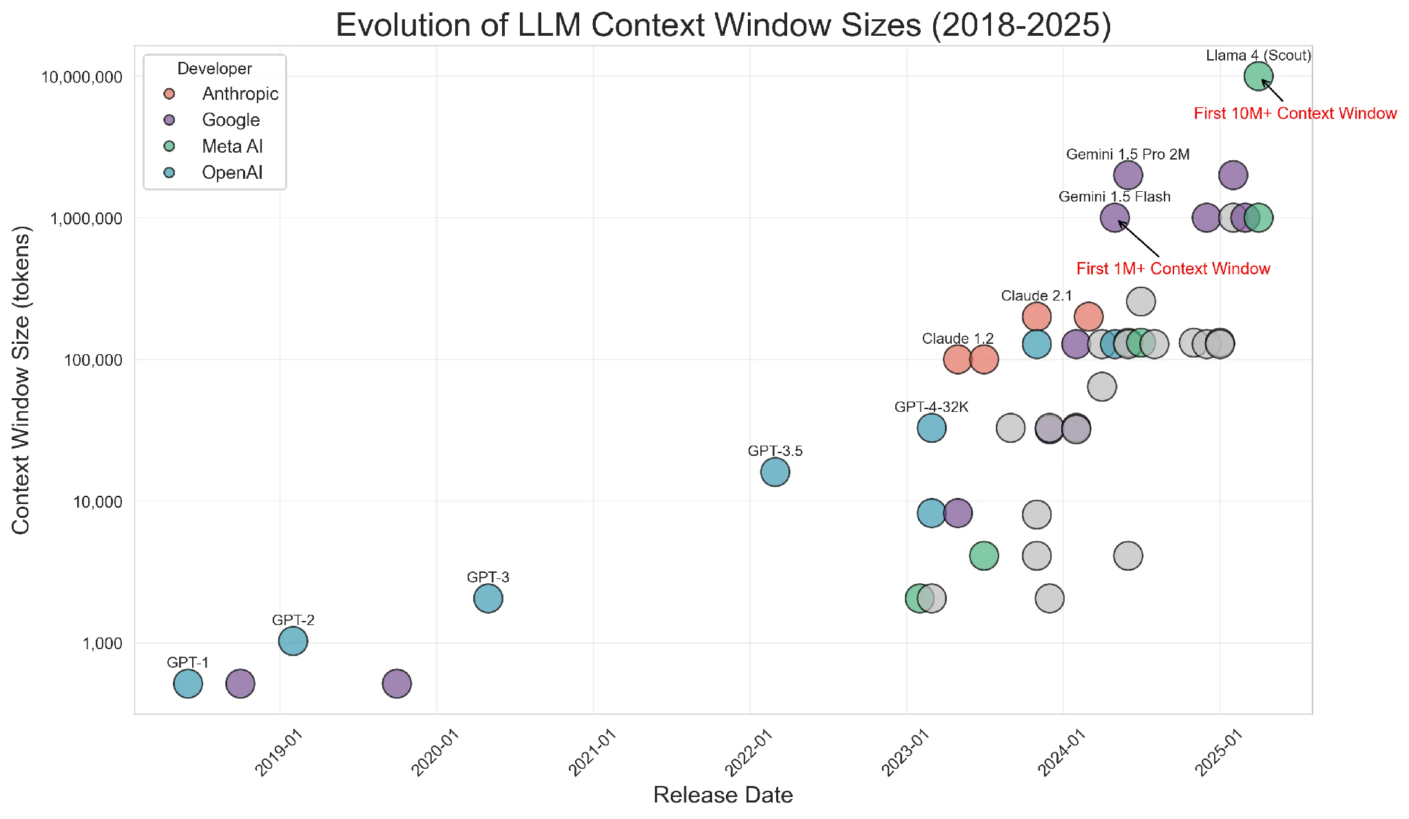
Better LLMs unlock new uses but quality is unclear
LLMs now handle longer, more
complex inputs
This makes it possible to apply
LLMs to new domains such as
law, medicine, and finance
But evaluation is a bottleneck
  Good data to build benchmarks is hard to find
  Model performance is hard to measure

Slide 24
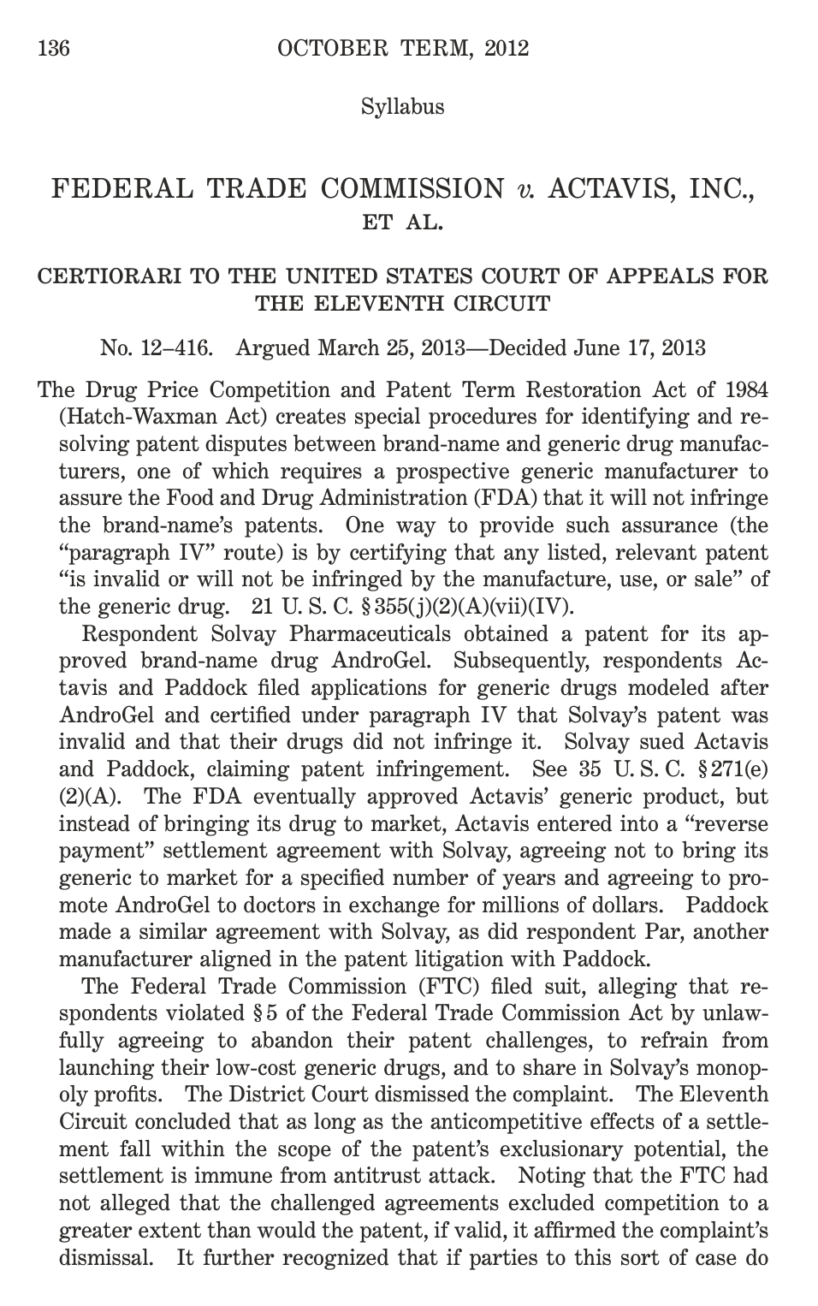

CaseSumm is a dataset for long-context legal summarization
25.6K U.S. Supreme Court cases and their official summaries
25% larger, covers 3 times as many years (1815-2019), and is publicly available with fewer copyright restrictions than similar legal datasets
Rich resource for both legal and long-context AI research communities
Notes:
Key idea: SCOTUS opinions come with an authoritative syllabus—a structured summary meant to reflect what matters.
We can treat that as a strong reference point
Long-context is real in this data—opinions are large, and they’ve grown over time. The syllabus summaries are long too.
Public on huggingface, download over 5 thousand times

Slide 25
Error Analysis of Model Performance & Evaluation Metrics
We test 3 LLMs on summarizing CaseSumm opinions.
We compare reference-overlap metrics, expert human judgments, and LLM-based eval.
Automatic metrics reward models fine-tuned on syllabuses, but experts most often prefer GPT-4 summaries, including over human-written ones.
LLM-based evaluators correlate poorly with experts, and errors are increasingly hard to notice, and require careful expert attention to detect.
Notes:
This reveals a mismatch: reference summaries are useful for dataset construction, but overlap with references is not the same as expert-perceived quality.

Slide 26
Work Overview
Language of Bargaining [M. Heddaya, Dworkin, Tan, Voigt, Zeng, Zentefis, 2023]
Causal Micro-Narratives [M. Heddaya, Zeng, Tan, Voigt, Zentefis, 2024]
  A Century of Inflation Narratives [M. Heddaya, Zeng, Tan, Voigt, Zentefis, 2025]
CaseSumm: A Large-Scale Dataset for Long-Context Summarization from Supreme Court Opinions [M. Heddaya, MacMillan, Malani, Mei, Tan, 2025]
When Internalization Fails: Finding Better Targets for Reasoning Compression [Mourad Heddaya, Roberts, Wadhawan, Tan, 2026]
CivicChats: Shaping the Future of Civic Discourse [M. Heddaya, Zhou, Margie, Lee, Tan, Xie, Mendelsohn]
Notes:
In the legal setting, we saw that expert evaluation is hard even when the output is a summary.
The final project moves from evaluation to design:
can we build an AI system to support civic reasoning
Start with motivation.

Slide 27

Democracy & AI
Democratic participation depends on an informed electorate
Technology offers more access to information but can be counterproductive
LLM chat interfaces allow personalized and interactive access to information
  But these chatbots can be sycophantic
How can we build AI to strengthen democracy?
Notes:
sycophancy - adopt and defer to user perspective in many cases
fail to challenge underlying beliefs of assumptions
hindering the ability to learn new perspective

Slide 28
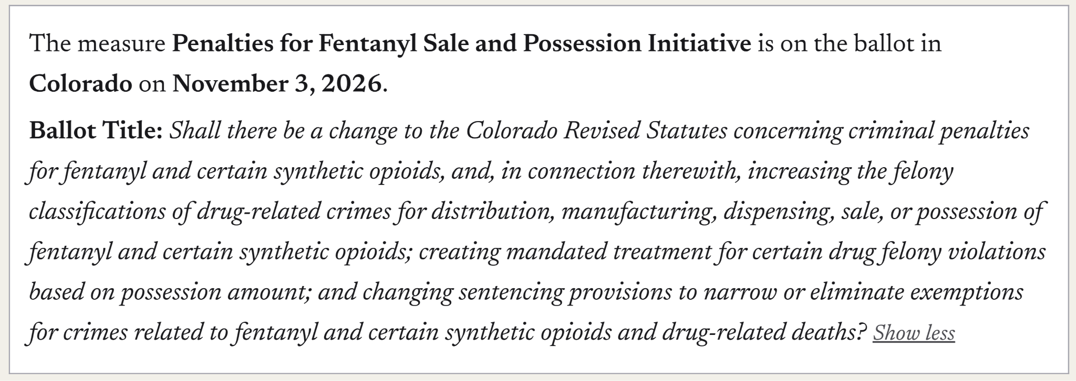
Ballot measures are proposals put to a public vote
Notes:
Ballot measures are a useful setting because voters must make consequential decisions from text that is often legally complex, low-salience, and hard to interpret.

Slide 29
Ballot measures contain complex language
Discourages participation by making measures harder to understand
Increases likelihood that voters leave those questions blank [Reilly and Richey 2011]
Public awareness of ballot measures is low [Bart et al., 2020]
  In 2016, 23% of respondents could not name one measure
  Less than 1% familiar with all measures

Slide 30
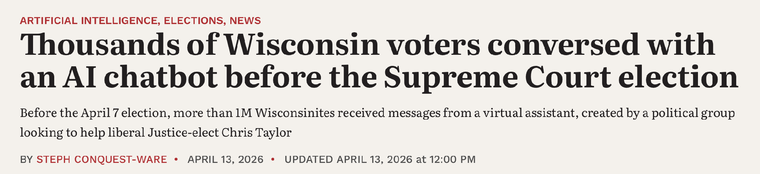
Can AI-based chat interfaces help voters make more informed decisions on ballot measures
… and explain them?
Prior work finds chatbots can be persuasive [Costello et al., 2024]
Notes:
More prior work??
Problem here, do we address this partisanship concern?? m?

Slide 31
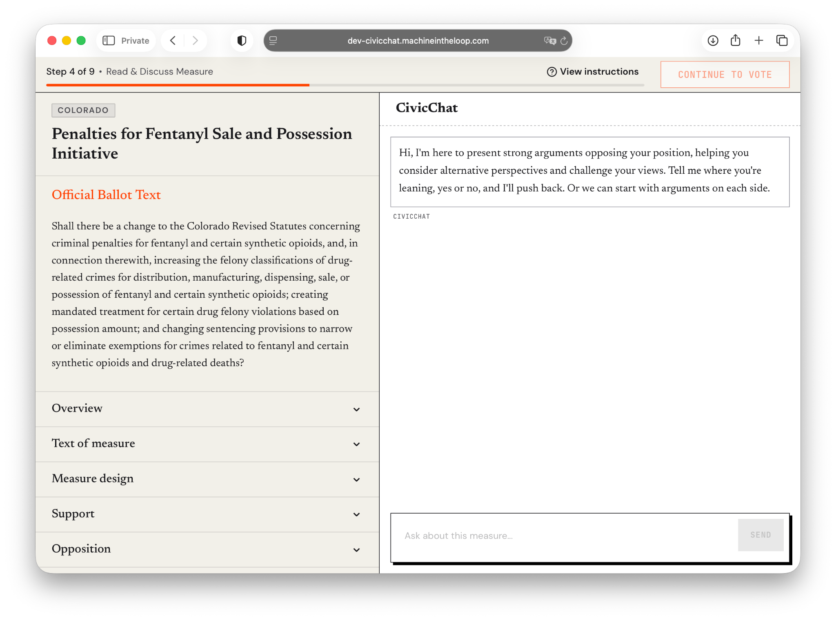

Randomized controlled experiment
Treatment: 3 AI Chatbots
Q&A: Answers questions neutrally
Argumentative: Takes the opposite side and pushes back
Reflective: Asks about values, trade-offs, assumptions
Control:
Official text
Treatment:
Ballotpedia
Notes:
DESCRIBE EACH CHATBOT BETTER
three theoretically-motivated models of how citizens should engage with political questions

Slide 32
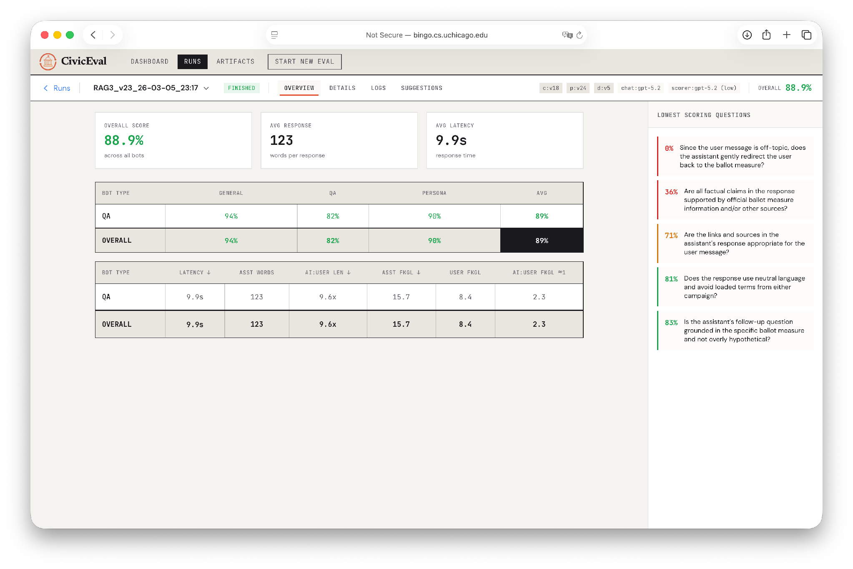
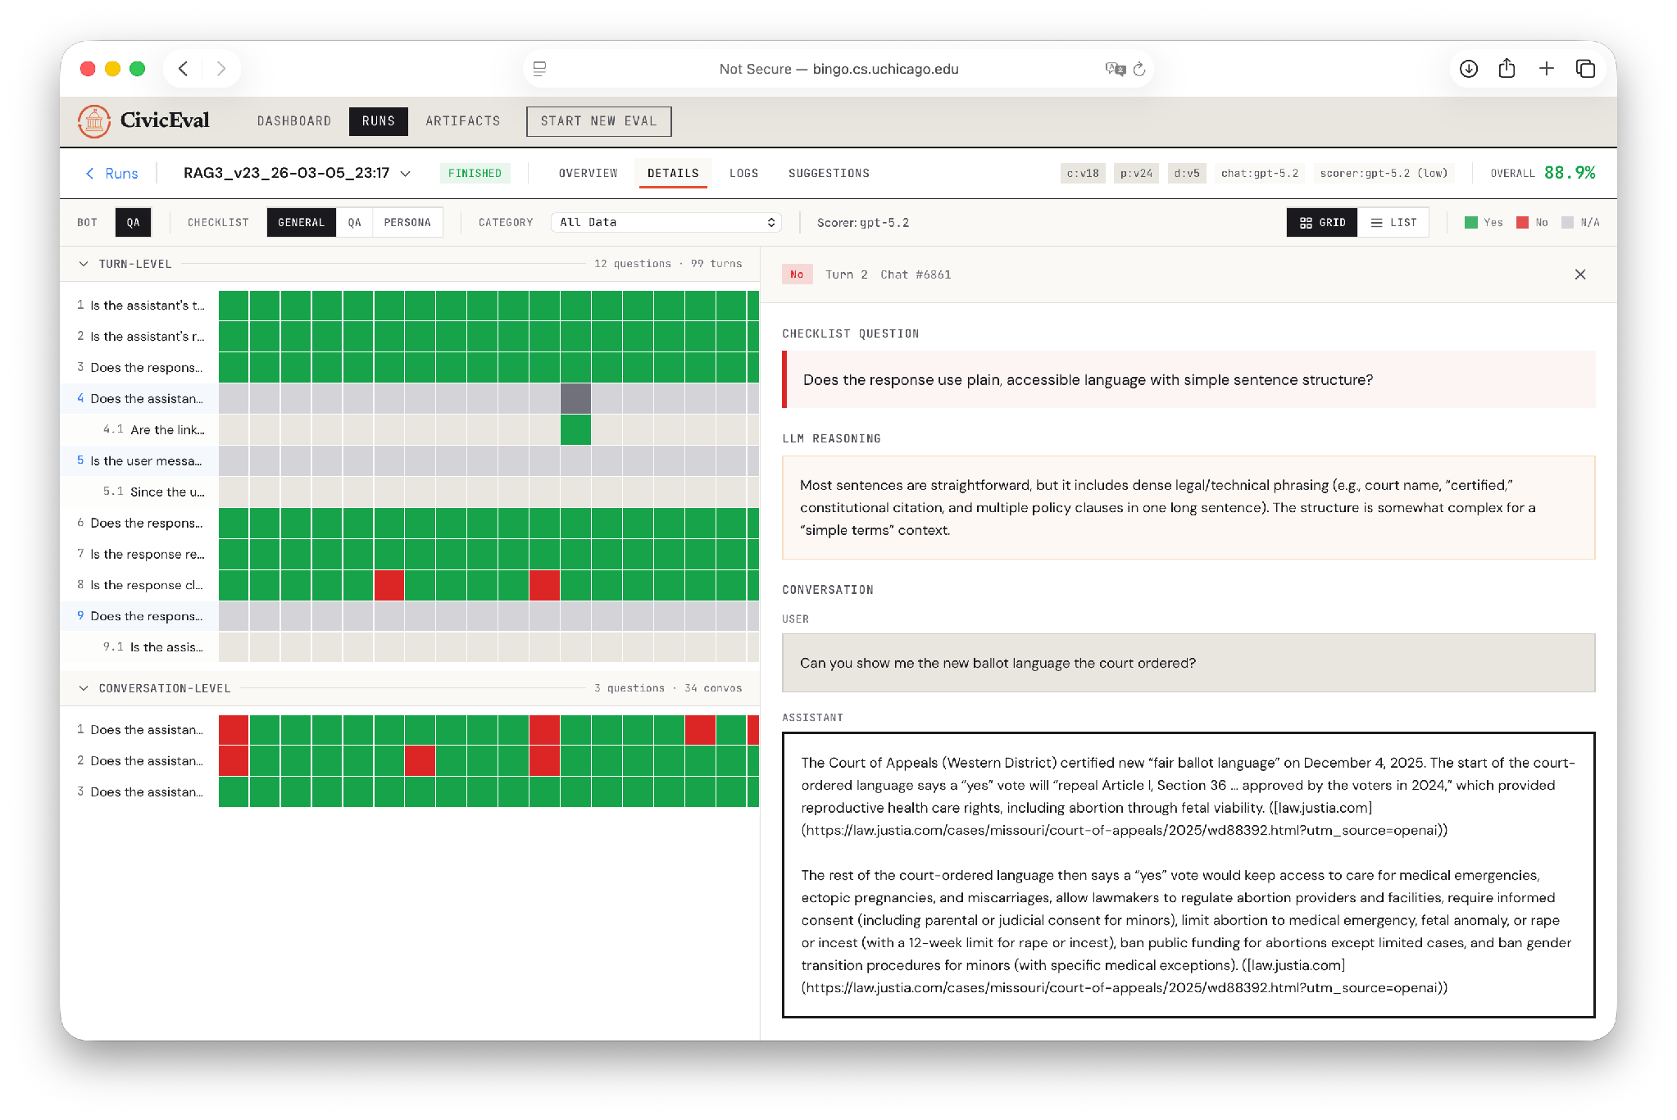
Before running the experiment, we audited and refined chatbot behavior

Slide 33
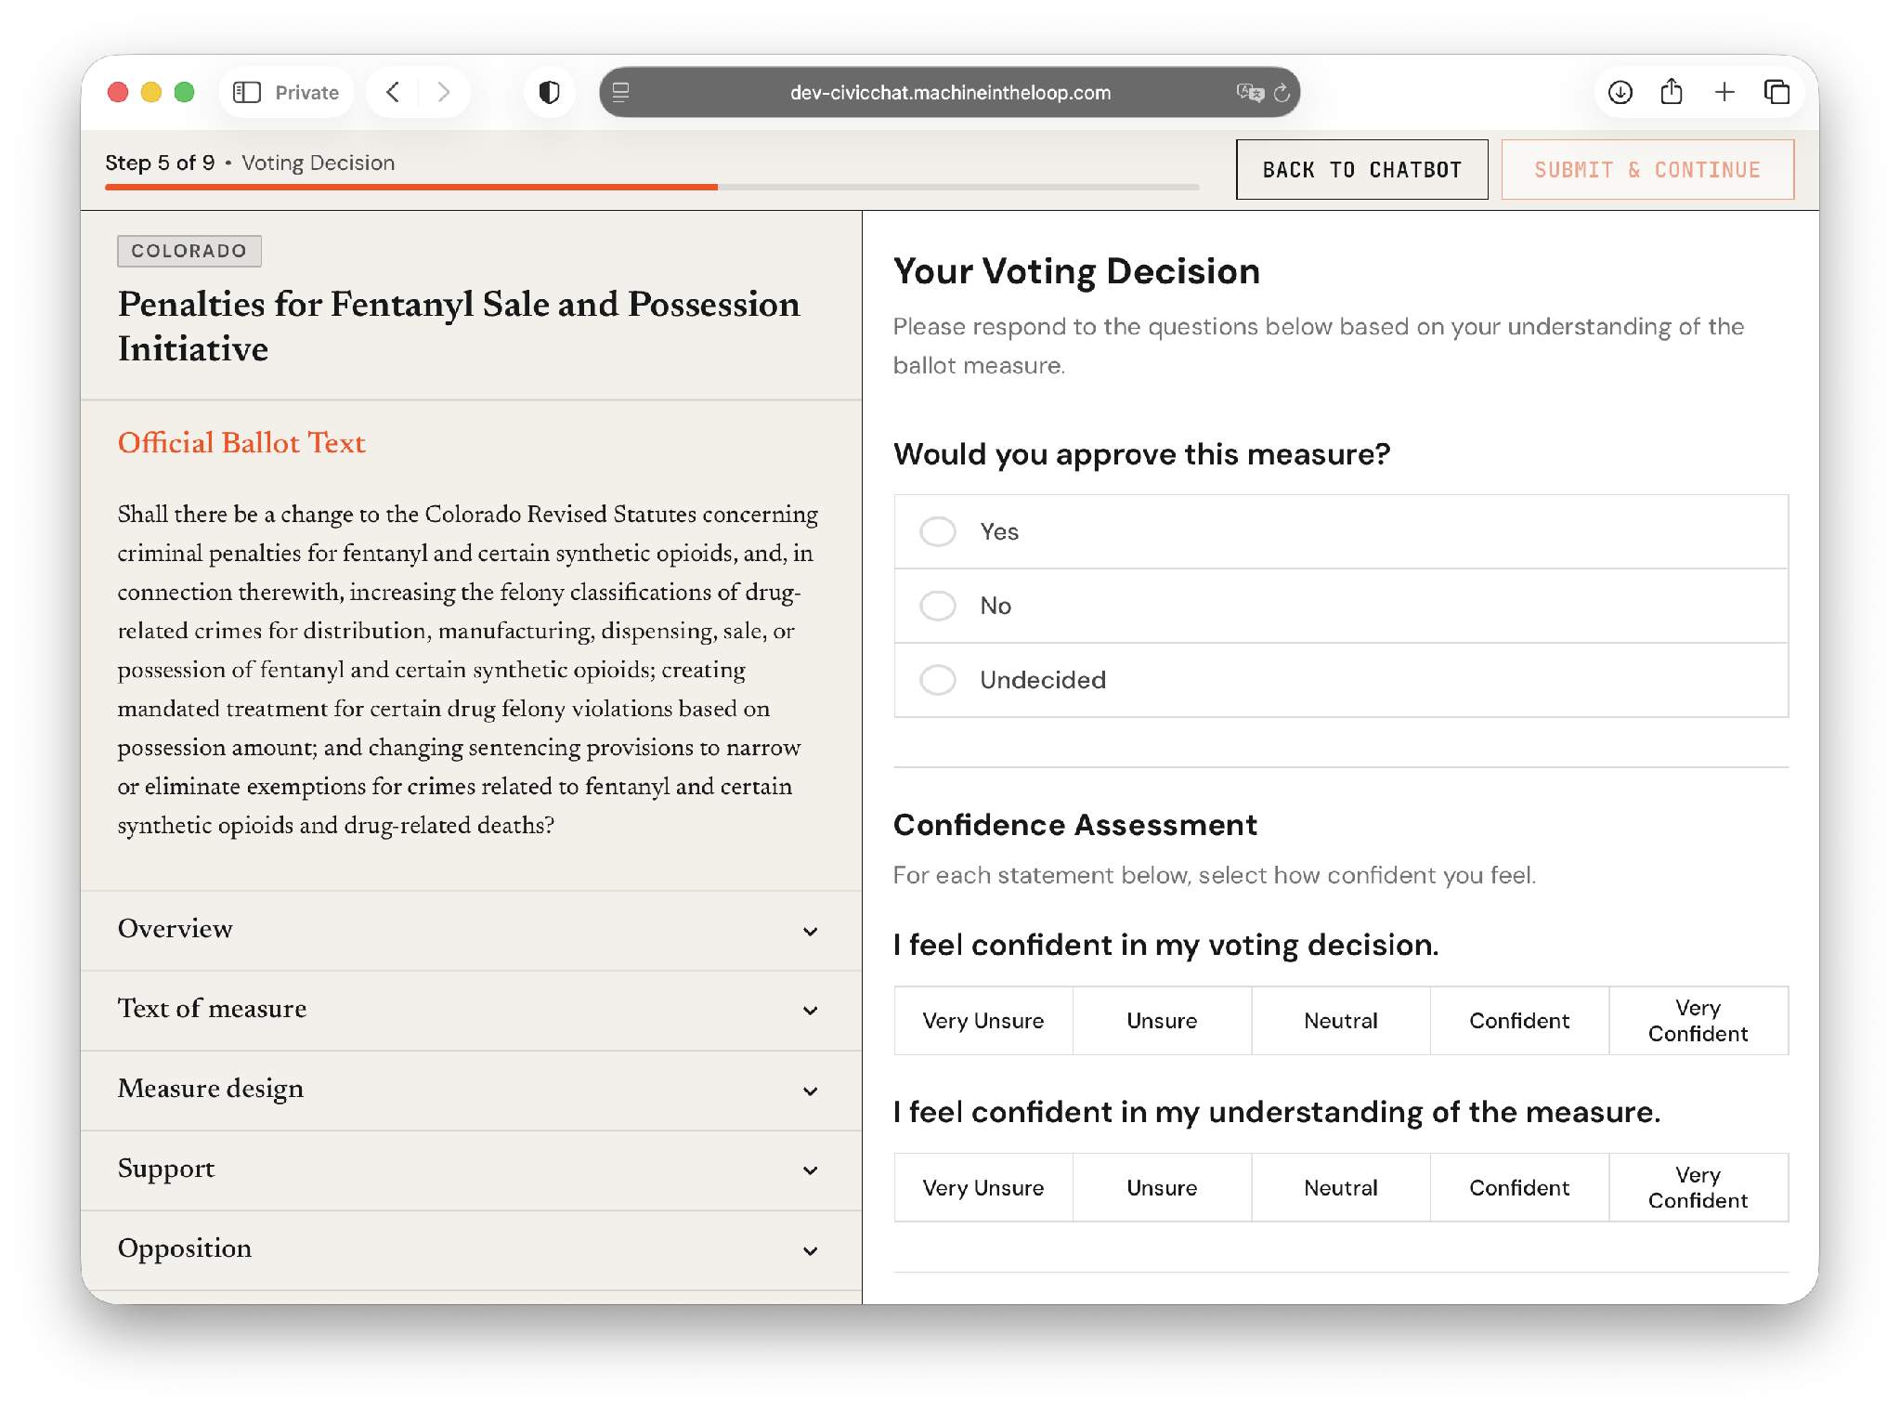
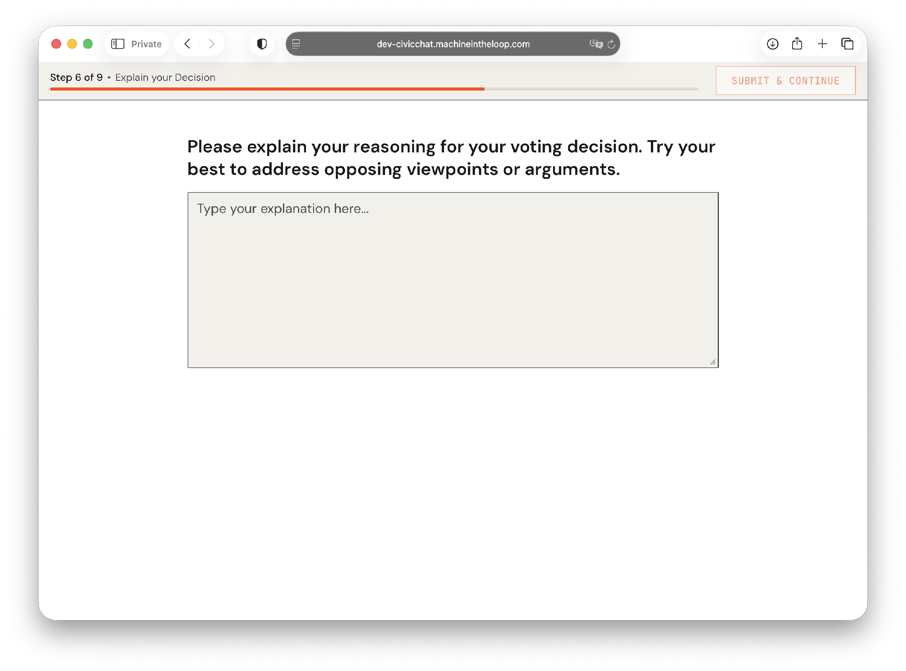
Randomized controlled experiment

Slide 34
We select two measures from CO and FL
CO Penalty for Fentanyl Sales and Possession Initiative (N=200)
  Increases penalties for fentanyl-related offenses
  Requires treatment for certain felony possession cases
FL Changes to Budget Stabilization Fund Amendment (N=400)
  Increases the state’s “rainy-day” fund cap
  Requires regular deposits, with flexibility to pause them in certain situations
Notes:
We chose two measures that differ in topic, complexity, and likely ideological valence. (maybe make this title?)

Slide 35
Hypothesis: Argumentative and Reflective AI will lead to better decision explanations

Slide 36

Argue and Reflect produce preferred explanations across both measures
Notes:
Don’t forget to know/include technical details
but what is better about them?

Slide 37
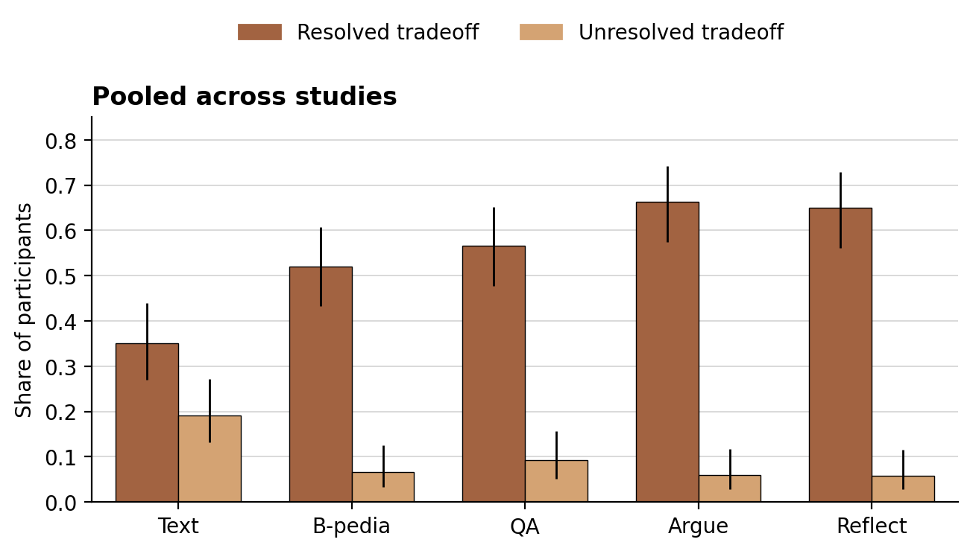
Treatments increase articulation and resolution of tradeoffs, especially chatbots
A tradeoff is a passage where the participant weighs two competing considerations and resolves or accepts the tension
Notes:
these results are pretty cool!

Slide 38
Hypothesis: AI leads to different voting behavior

Slide 39
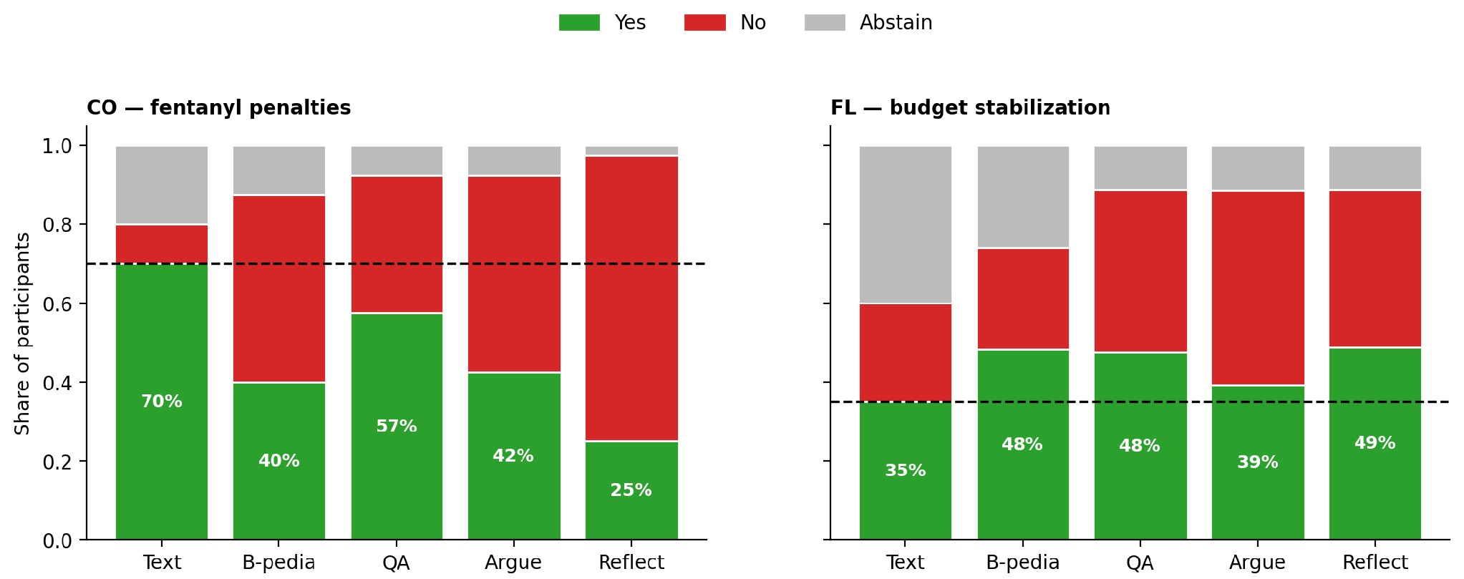
Treatments shift vote distributions across both measures

Slide 40
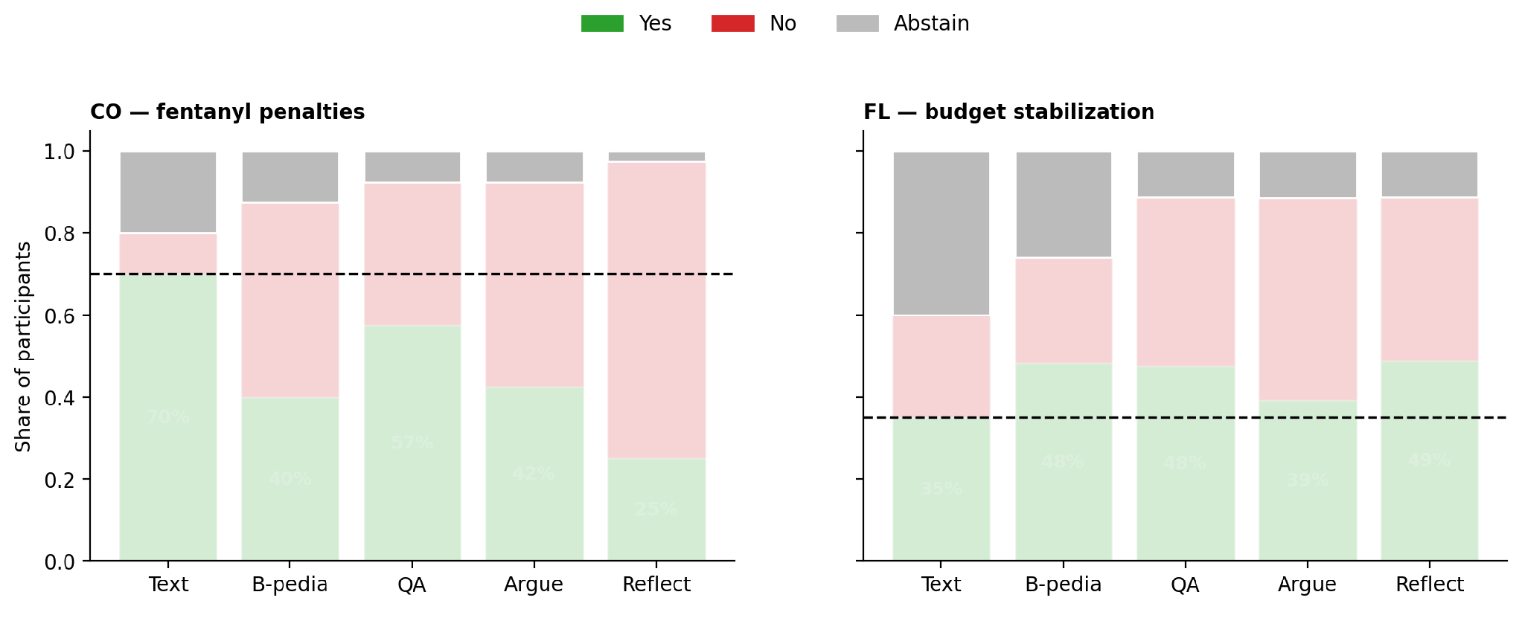
Treatments cut abstain by 28% in FL, 12% in CO
Notes:
treatments shift vote distributions across both MEASURES and REDUCE ABSTENTION.

Slide 41
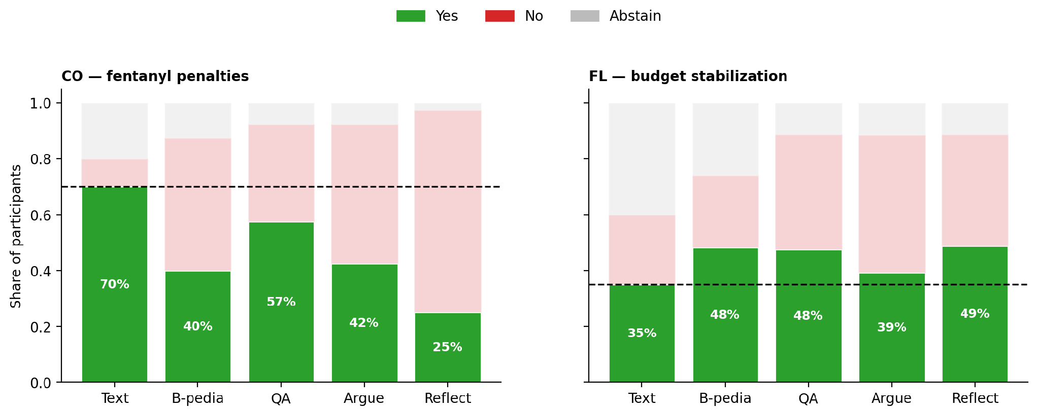
Ballotpedia drops CO yes by 30% but raises FL yes by 13%
Notes:
But when we look at how the Yes vote shifts, we see different patterns across the two measures.
*CLICK*
information intervention is not simply increasing or decreasing support in a single direction.
effects depend on the content of the measure and the reasons participants encounter.
*CLICK*
strength and direction of the effect of the chat conditions varies by measures
INTERESTING - MECHANISMS?

Slide 42
Vote is predicted by # of pro/con arguments mentioned by user in chat
Pro = the argument gives a reason to vote YES on the measure
Con = the argument gives a reason to vote NO on the measure
We find that the number of chatbot arguments is not predictive, only the number of user arguments is.
Condition is also not predictive beyond number of user arguments.
Notes:
Transition: one final related finding

Slide 43
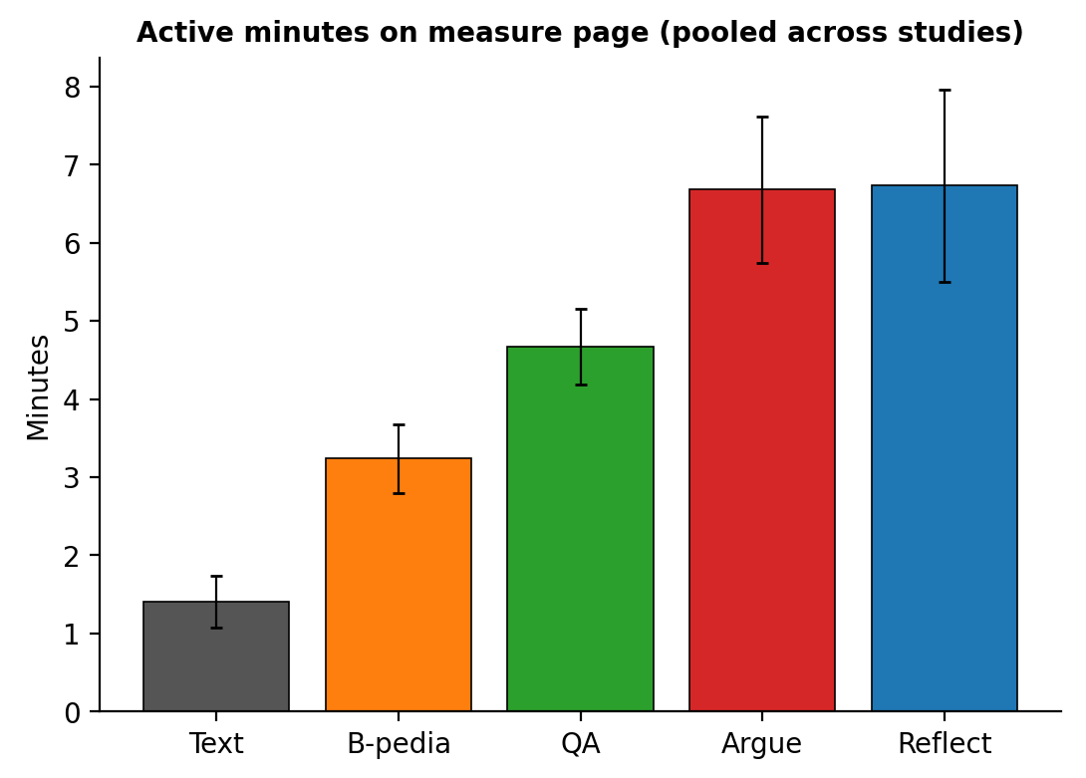
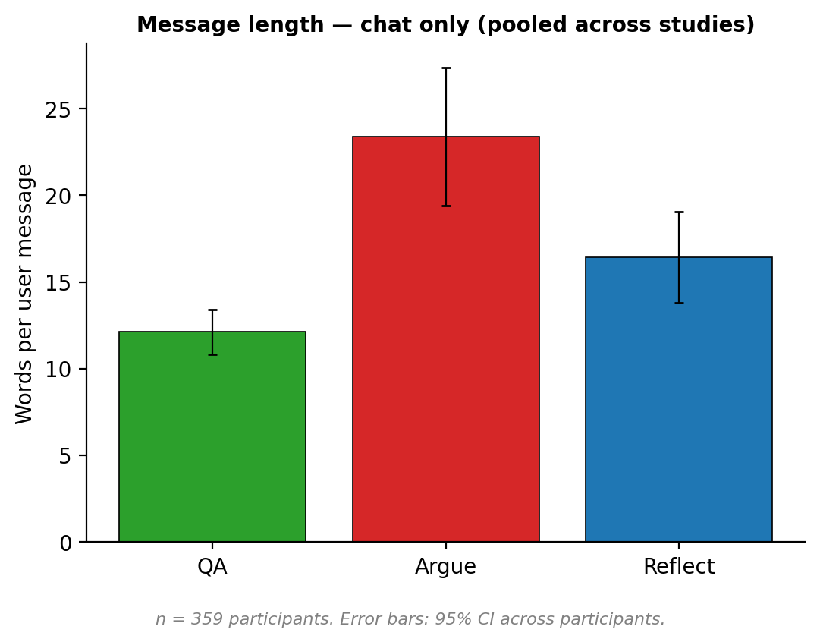
Argue and Reflect Chatbots drive engagement
Notes:
N=360 for right
In argue and reflect, participants spend more time and write longer messages
Further showing how these conditions promote active engagement and DEVELOP ARGUMENTS

Slide 44
Ongoing work
Confirming if effects hold after 1-month via follow-up survey
Validate LLM labeling
Chatbot factuality human evaluation
Additional ballot measure to understand effect of topic

Slide 45
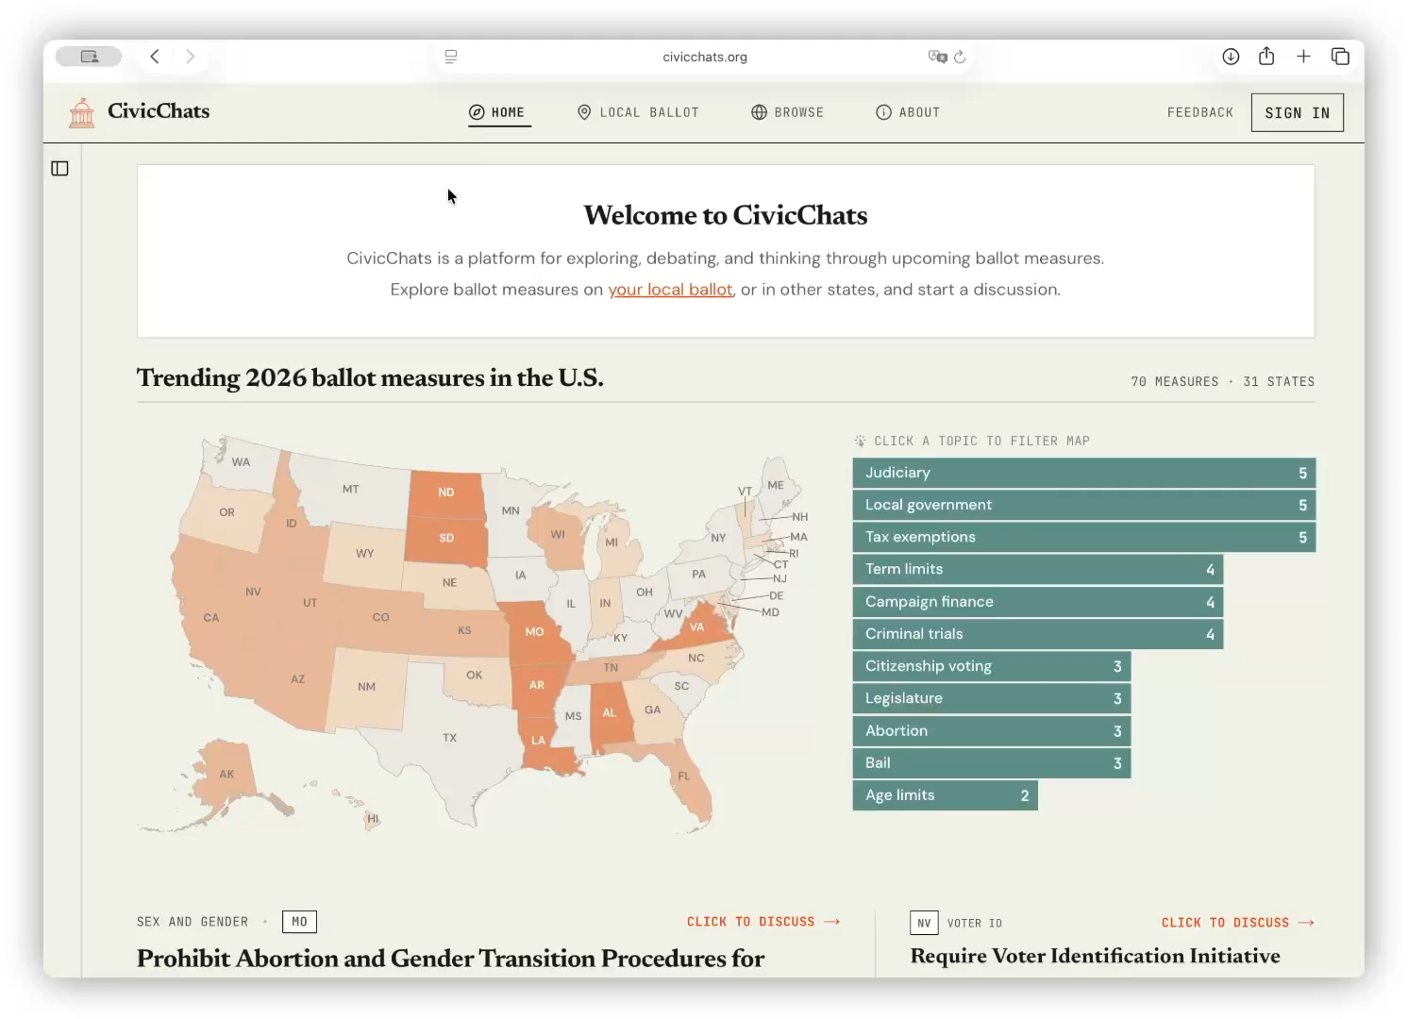
CivicChats.org: Public access and engagement

Slide 46
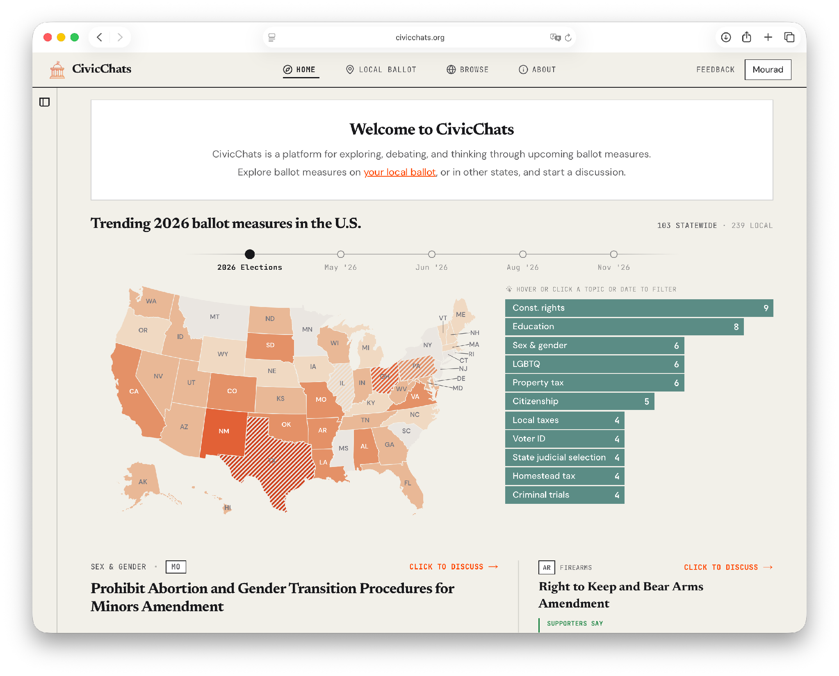
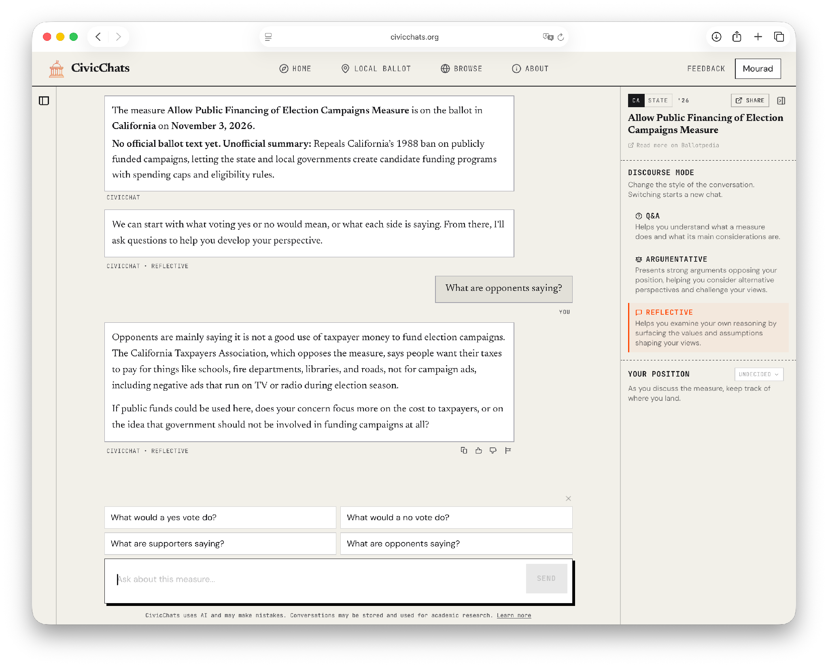
CivicChats.org: Public access and engagement

Slide 47
Contribution Summary
Built CivicChats, a public-facing platform for AI-assisted ballot-measure deliberation
Developed chatbot designs that move beyond neutral Q&A toward argumentation and reflection
Demonstrated through that chatbot interactions improve voters’ decision explanations
Found that treatments increase trade-off reasoning and reduce abstention
Highlighted promise and risks of AI systems that shape civic decision-making

Slide 48
Thesis Conclusions and Future Directions
Open-ended language tasks require models that can handle ambiguity
This dissertation shows how to operationalize ambiguous concepts and measure them at scale
AI systems can help us understand and shape how people reason, explain, and decide
Future direction: develop systems that can can more effectively introduce productive friction

Slide 49
Acknowledgements
Thanks to my advisor, Chenhao Tan, and committee members Ari Holtzman, Alexander Zentefis
Collaborators: Rob Voigt, Anup Malani, Hongyuan Mei, Alexander Zentefis, Karen Zhou, Qingcheng Zeng, Kyle MacMillan
Undergraduate advisors: Noah Smith & Mari Ostendorf
PhD funding sources: UChicago, NSF IIS-2302785, University of Chicago AI initiative
UChicago Computer Science and Data Science Institute

Slide 50
Thanks!

Slide 51
Appendix

Slide 52
This thesis develops methods for making expert judgment explicit and turning it into task definitions and evaluation measures that better capture what good performance means in context-dependent ML problems.
This thesis develops methods for operationalizing expert frameworks — from economics, law, and political theory — into language modeling pipelines for open-ended, consequential domains. This includes defining what tasks mean, evaluating model outputs, and designing systems whose effects matter.
Notes:
Ambiguity
Resist ”x”

Slide 53
Inflation Narratives

Slide 54
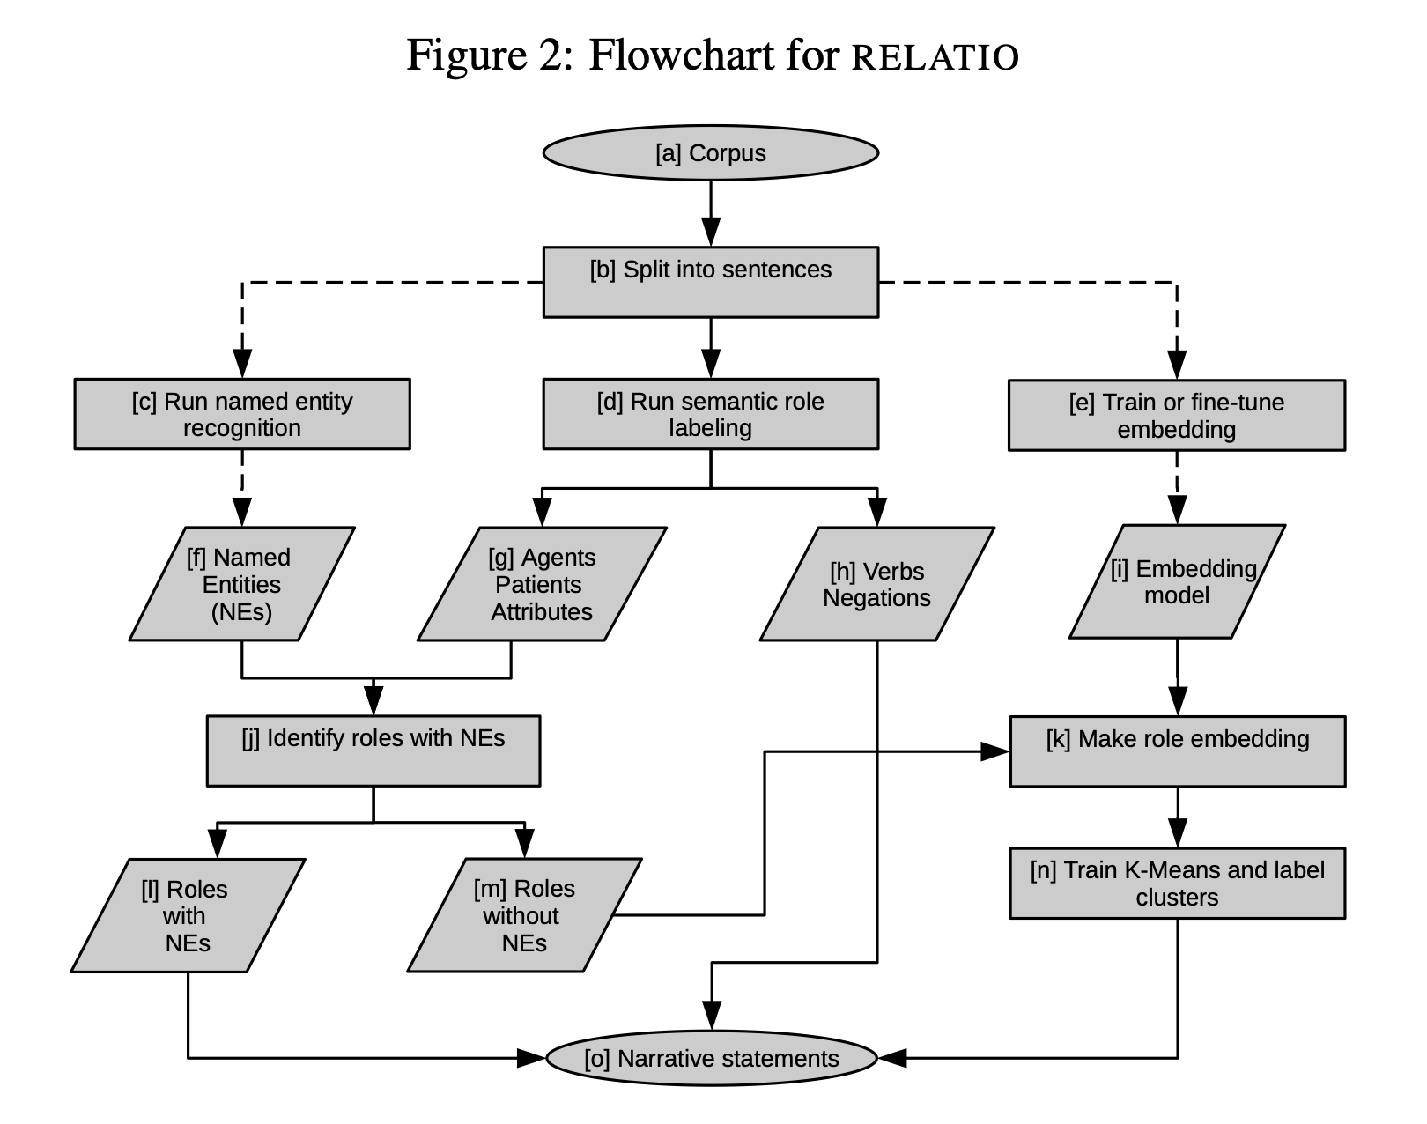
Measuring narratives: prior work captures concept but not scale
Definitions of narrative are not built to be extracted and measured from actual text
Extraction methods are not built around any definition of narrative
  Subject-verb-object tuples
  Sentiment
[Ash et al., 2022]

Slide 55
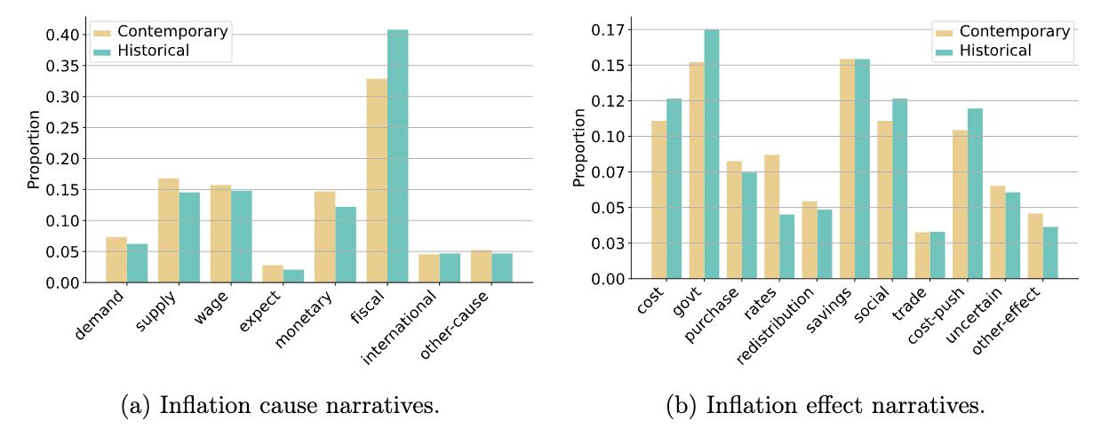
Narrative label distributions

Slide 56
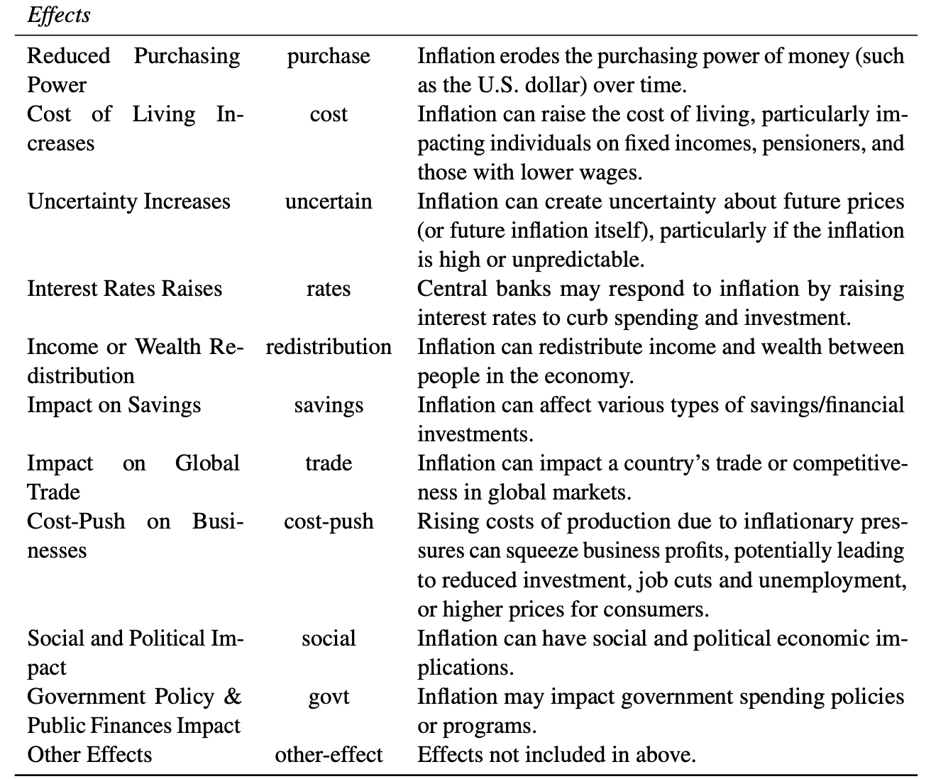
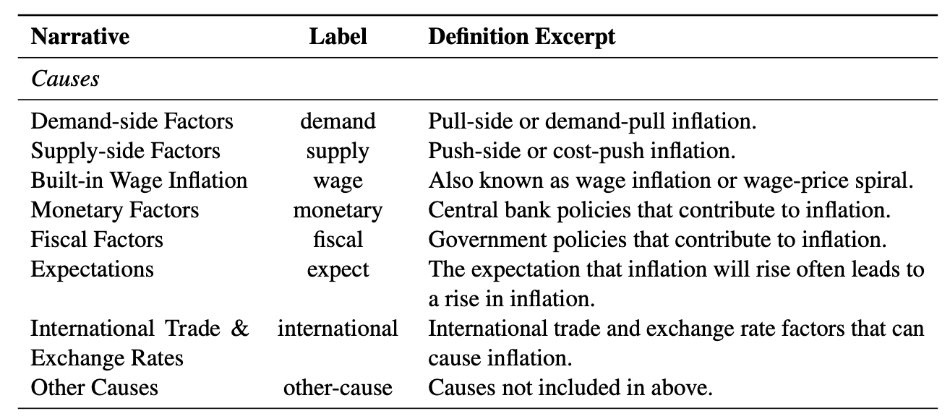
Narrative Definitions

Slide 57
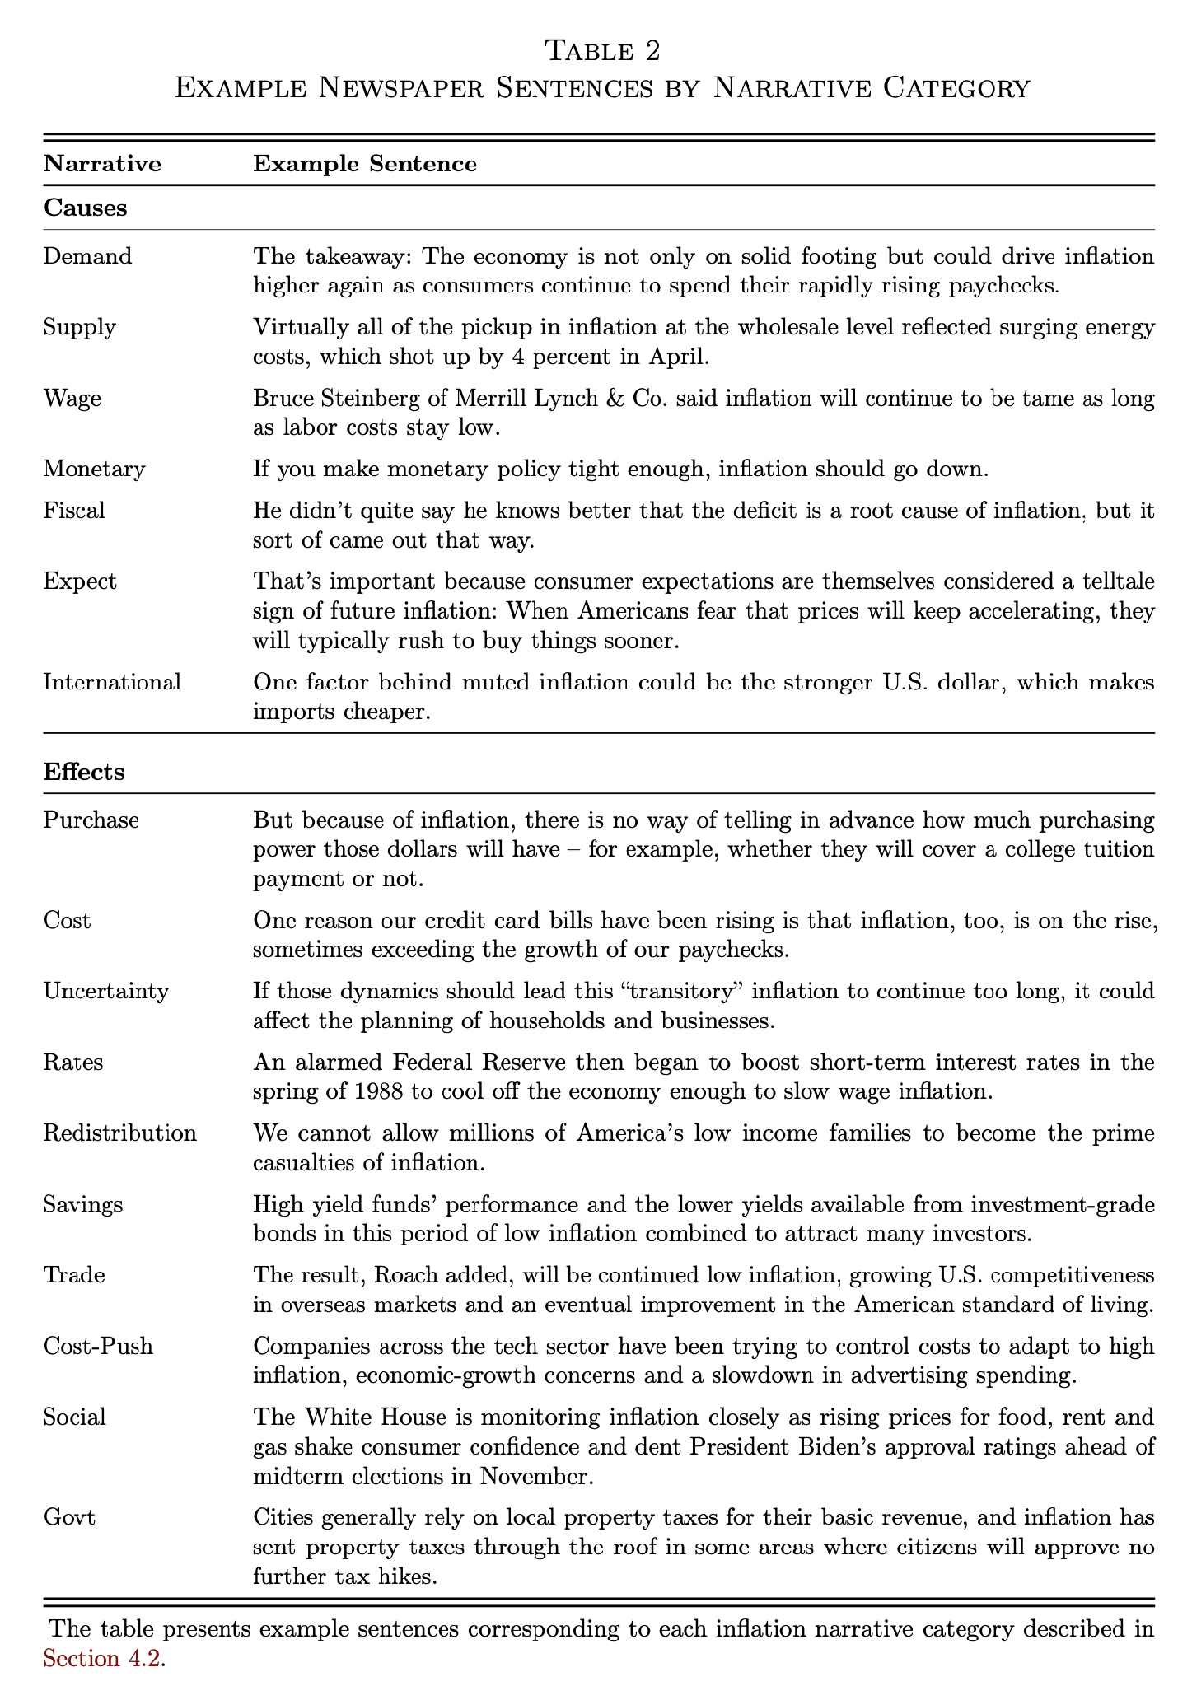
Narrative Examples

Slide 58
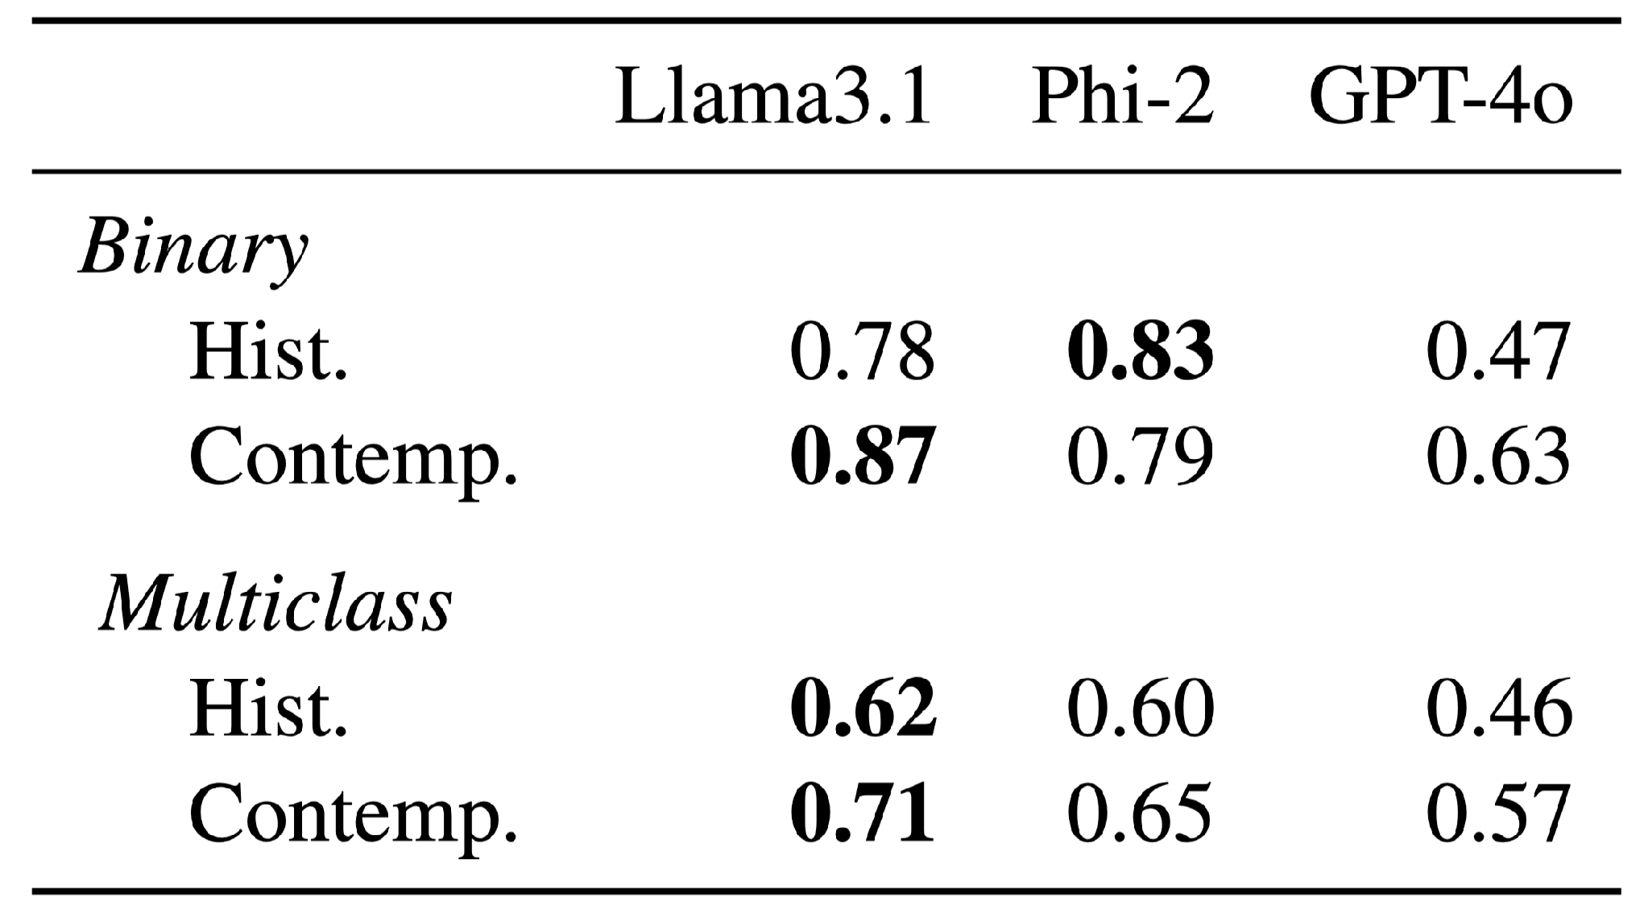

10x smaller fine-tuned models achieve good performance & outperform GPT-4
Fine-tuned
Prompted
Fine-tuned Llama better reflects the natural human disagreements than GPT-4
( r = 0.97 vs 0.70)
Notes:
One important result is that small fine-tuned models can do very well—often better than prompting a frontier model.
This matters operationally: if you want to measure narratives over millions of articles, cost and throughput matter.
These are F1 scores.
And as a methodological point: domain-specific pragmatic tasks were it is hard to explicitly write a comprehensive specification benefit from supervision.

Slide 59
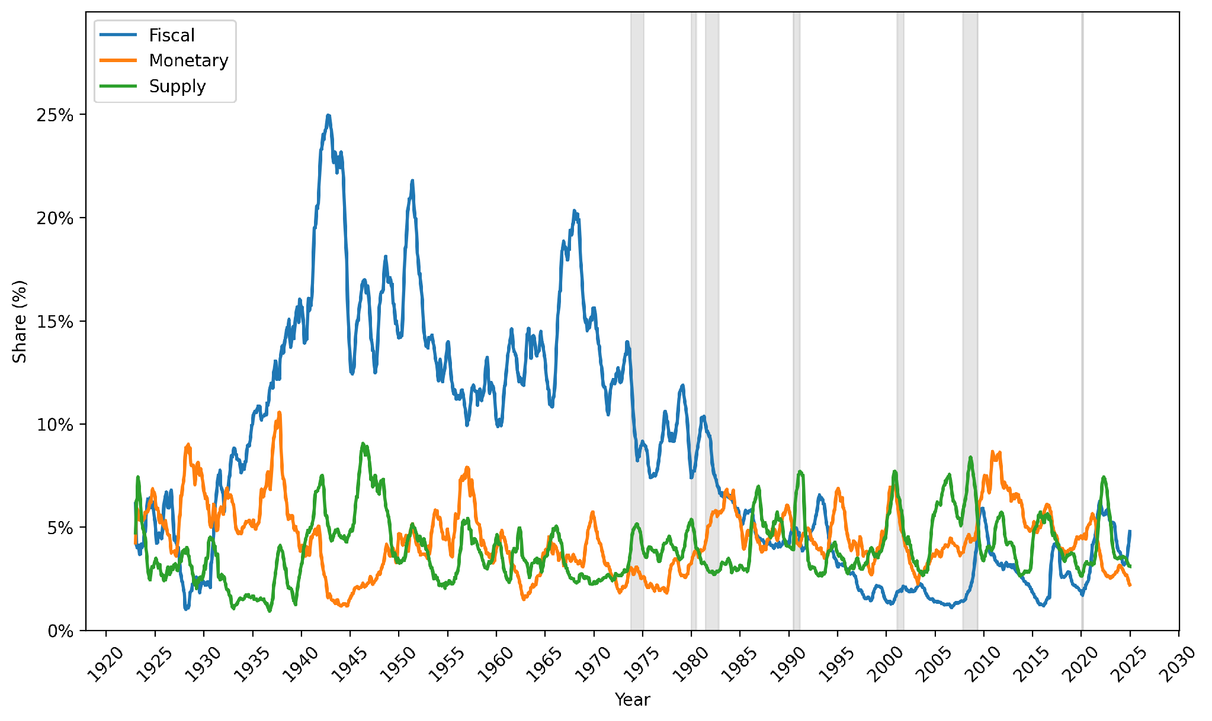
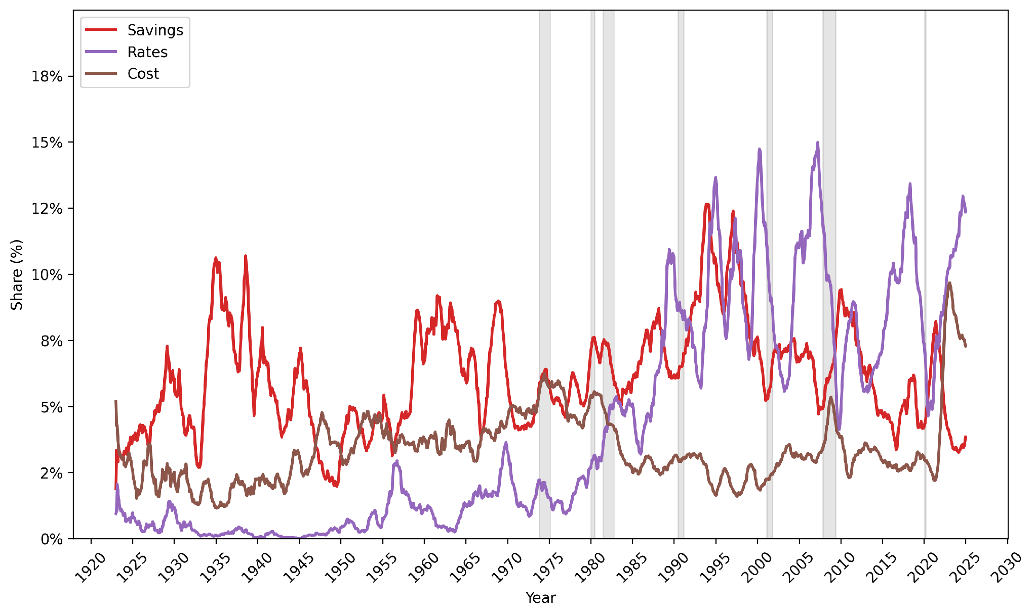
Narrative evolution over time

Slide 60
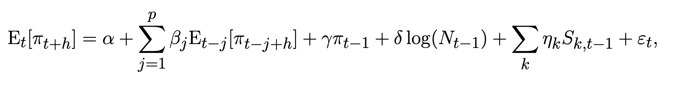
Do narratives predict inflation expectations?
Survey data: “By about what percent do you expect prices to go (up/down) on the average, during the next 12 months?”
We compute narrative prevalence by time and region, then relate them to the inflation expectations survey data
Notes:
Do narratives shape beliefs? (shiller mechanism)

Slide 62


Slide 63
CivicChats

Slide 64
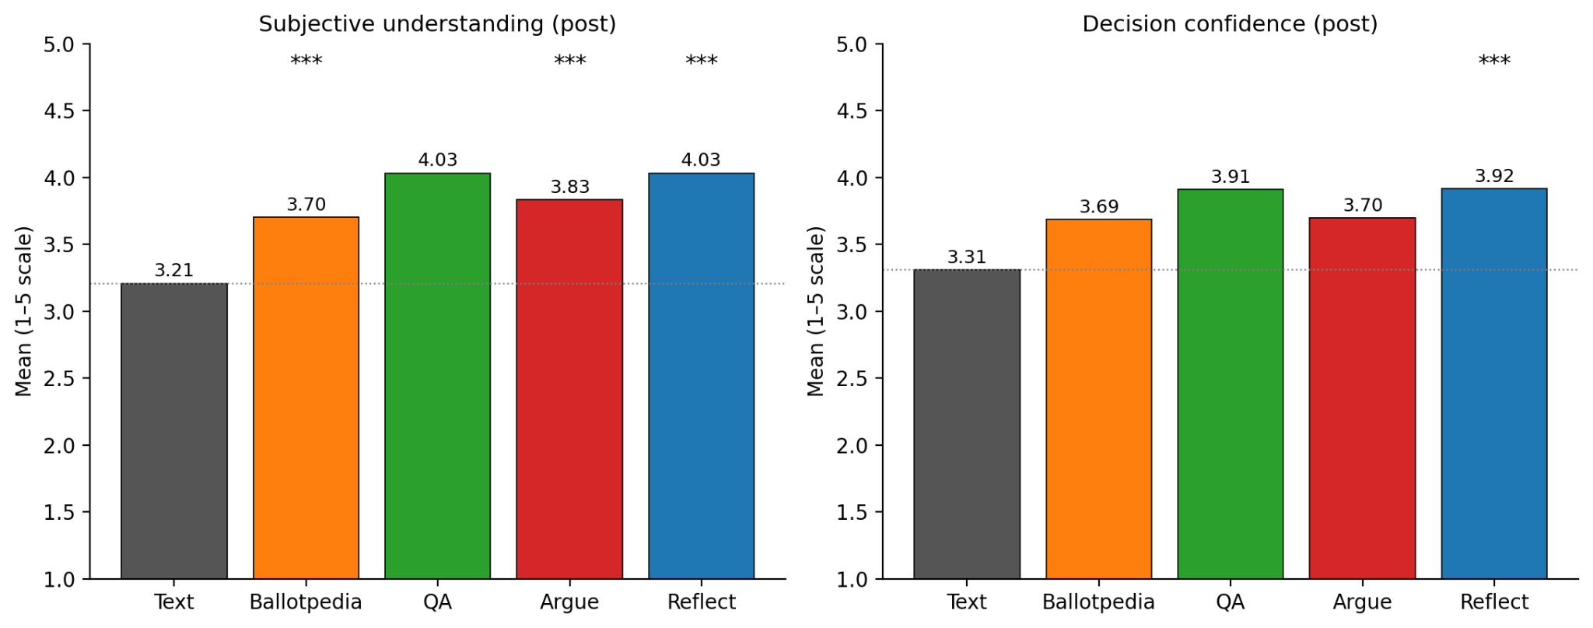
Subjective understanding and decision confidence
Notes:
Remove

Slide 65
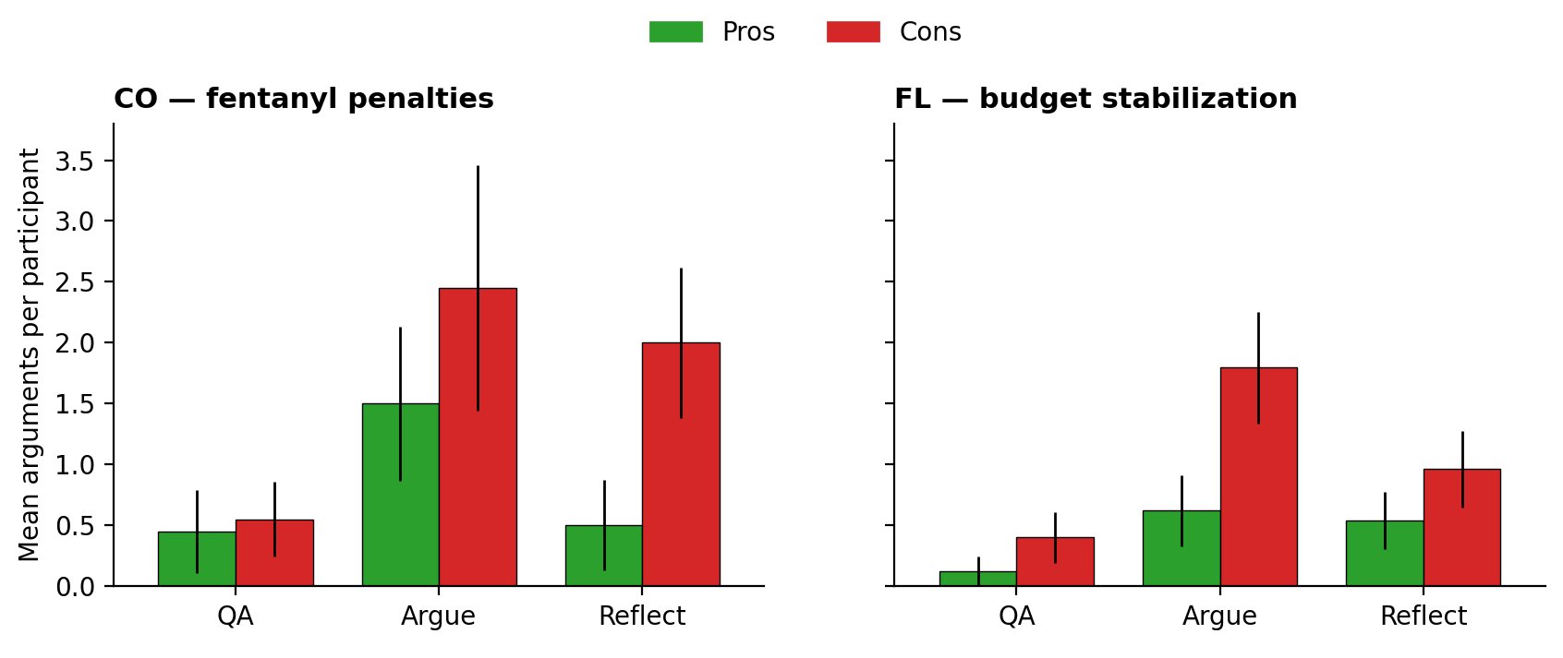
People argue cons during the chat more under reflective in CO and under argumentative in FL
Notes:
Check what error bars are and why. I think these are ”t-based” 95% CI? Compare with Wilson’s?

Slide 66
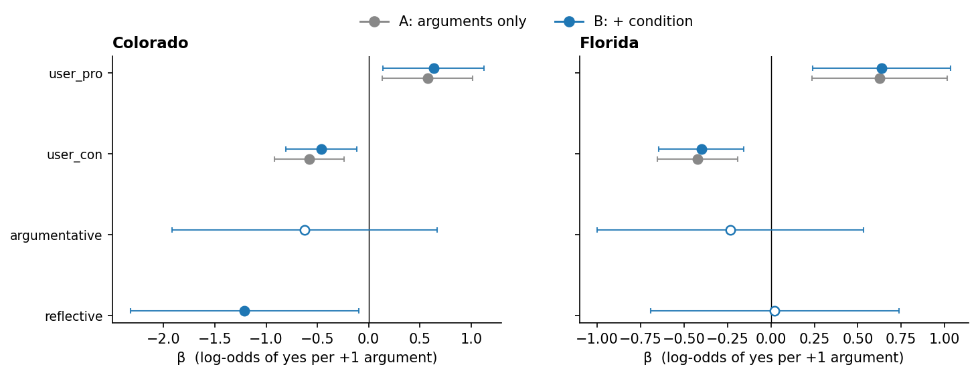
Additional user arguments (pro/con) during chat move the vote about the same regardless of condition

Slide 67
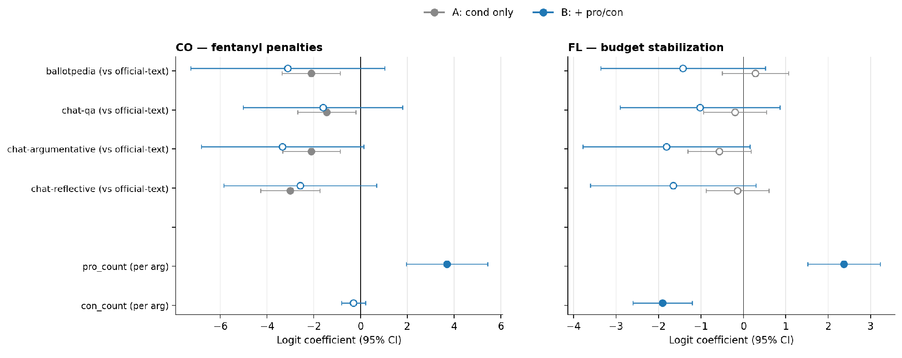
Additional user arguments (pro/con) in their explanations move the vote about the same regardless of condition

Slide 68
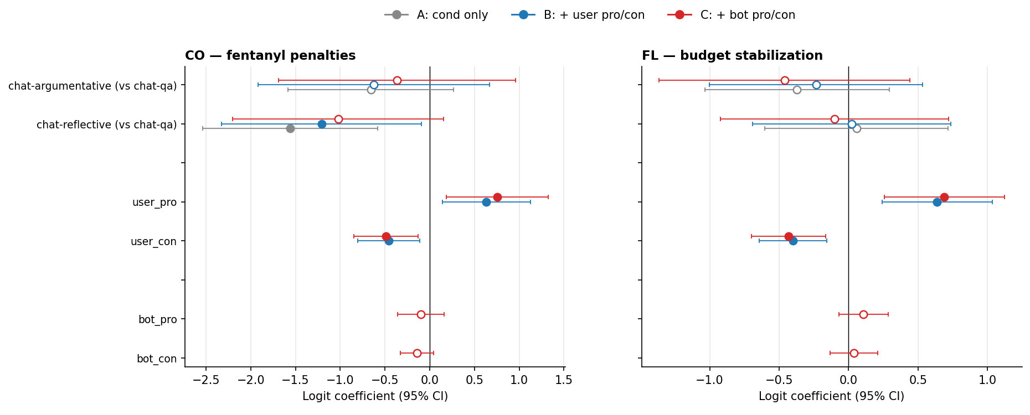

Slide 69

Tradeoffs

Slide 70
Appendix OLD

Slide 71
My research
Combining machine learning approaches and social science to ”solve” important problems
Notes:
Ambiguity
Resist ”x”

Slide 72
My research methodology
Identify an important problem that resists the usual simplifications.
Reformulate concepts from the relevant domain into something measurable, and develop methods to address the problem, without flattening what made the concepts useful.
Show that the methods produce results that matter for the problem.
Notes:
Ambiguity
Resist ”x”

Slide 73
Chatbots enable a new mode of interaction

Slide 74

Inflation narratives vary across local newspapers
Notes:
Narrative prevalence differs systematically: North vs South, Urban vs Rural, Dem vs Rep areas.
North emphasizes fiscal, south cost of living and interest rates
Urban emphasizes savings and fiscal.
Two uses:
1. Descriptive: mapping narrative ecosystems.
2. Causal/forecasting: tying narrative variation to belief and behavior differences.

Slide 75



Economic narratives are a mechanism for behavior change
If we fail to consider and understand the properties of narratives, “we remain blind to a very real, very palpable, very important mechanism for economic change, as well as a crucial element for economic forecasting.” [Shiller, 2017]
Notes:
Narratives don’t just describe the economy—they’re a mechanism that can change behavior.
What people think is causing inflation changes what they do.
So if we want to forecast or understand belief formation, we need tools to measure narrative framing—not just topics or sentiment.
*CLICK*
Shiller hypothesized this idea most prominently in 2017.
Since then work has come out that studies beliefs about the economy that spread contagiously, optimism vs pessimism, and theoretical frame works + structural models for belief change.
In this work we focus on news articles and study what narratives are conveyed in them.
—————————-
Narratives shape beliefs
Theoretical framework + structural model [Benabou et al. 2018]
Beliefs about the economy that spread contagiously [Flynn & Sastry 2022]
Optimism vs. pessimism [Flynn & Sastry 2022]
THIS IS A HYPOTHESIS - CAN WE STUDY THIS EMPIRICALLY?

Slide 76
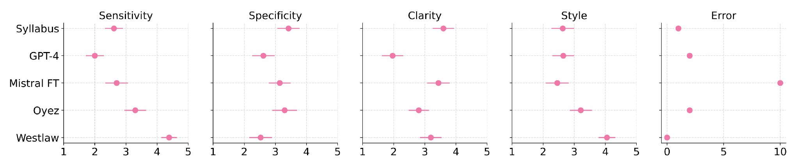
But human experts most often preferred GPT-4, not the fine-tuned LLM
🏆
Rank (lower is better)
# of errors
Sensitivity: did the summary contain all relevant information from the opinion
Specificity: did it exclude irrelevant information
Notes:
When legal experts judge the summaries, they often prefer GPT-4—despite what the overlap metrics say.
We evaluate dimensions like:
•Sensitivity: did you include relevant info?
- Specificity: did you exclude irrelevant info?
plus clarity/style and concrete error counts.
This gets one of the core challenges with summarization, particular in this context:
automatic metrics prefer one behavior; experts prefer another.
Mistral FT: high metric scores, but hallucinations/errors reported by experts.
did the summary contain all relevant information from the opinion (sensitivity)
did it exclude irrelevant information (specificity)
was the summary clear (clarity)
did the summary have a style suggesting it was written by an experienced attorney? (style)
Finally, we asked students to report the number of facts in the summary that were false based on their reading of the opinion (error).

Slide 77
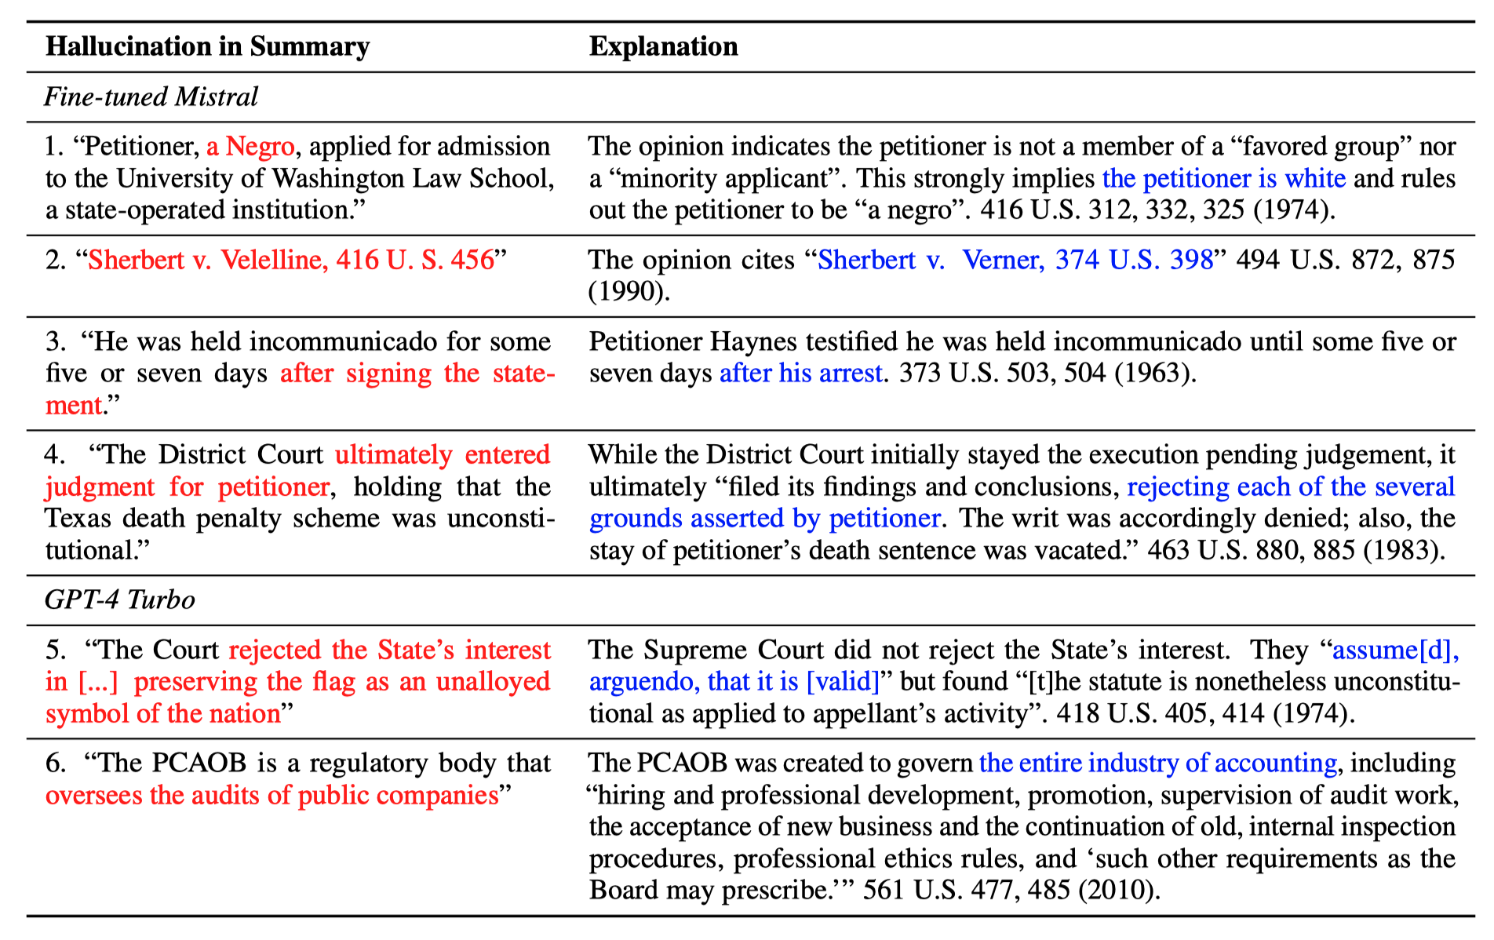
As LLMs improve, “hallucinations” become more subtle and matters of judgement.
Notes:
As models improve, errors aren’t always blatant fabrications.
They’re often subtle shifts that require expertise to and attention to catch. What *details* are key vs which are not.
Let’s consider a couple examples here.
Those are the “hallucinations” we see more of.
So evaluation gets harder as models get more fluent.

Slide 78
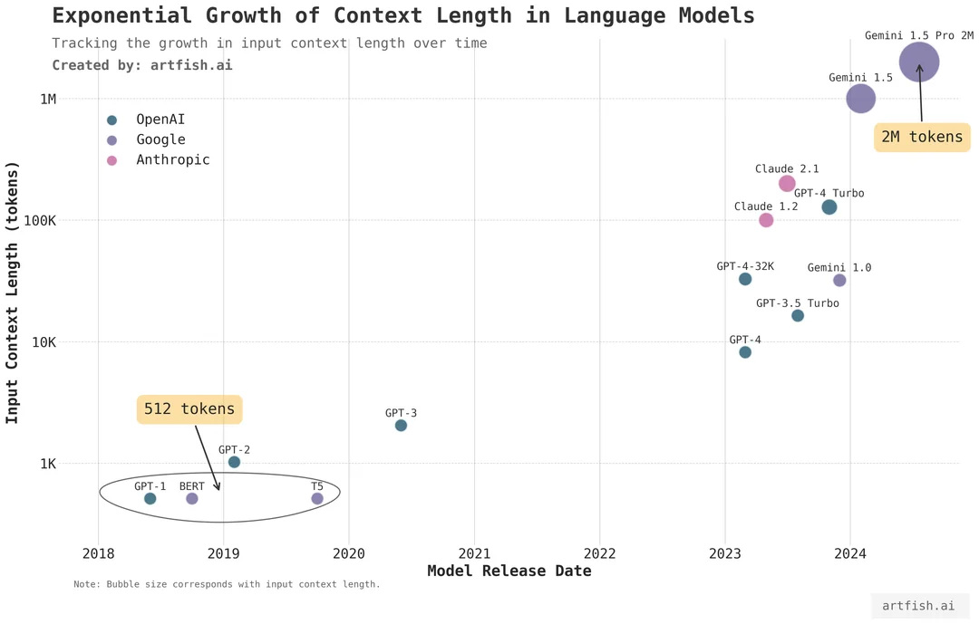
In such domains, documents can be long and complex
LLM context-lengths have grown over time
How well do they perform?

Slide 79
For long legal documents, evaluation is a bottleneck
Summarization involves judgement: what counts as “important” depends on goal and audience.
Long documents make that judgement harder.
In high-stakes settings, these choices have consequences.
LLMs are claimed to handle and summarize long-context well.
  How well remains an open question.
CaseSumm is a benchmark designed around this setting.
Notes:
Summarization requires judgment about what’s important; long documents make that harder.
In law, these choices matter—what you include/exclude can change interpretation.
LLMs are claimed to handle long-context well. The question is: how well, when carefully evaluated
CaseSumm is a benchmark designed around this setting.
DONE
Summarization involves judgment: what counts as “important” depends on the goal and audience.
Long documents make that judgment harder: there are many defensible choices about what to include, omit, and emphasize.
In high-stakes settings, those choices have consequences: small omissions or shifts in emphasis can change the takeaway.
So evaluation is the bottleneck: reference overlap and LLM-based judging can diverge from expert human judgments of quality.

Slide 80

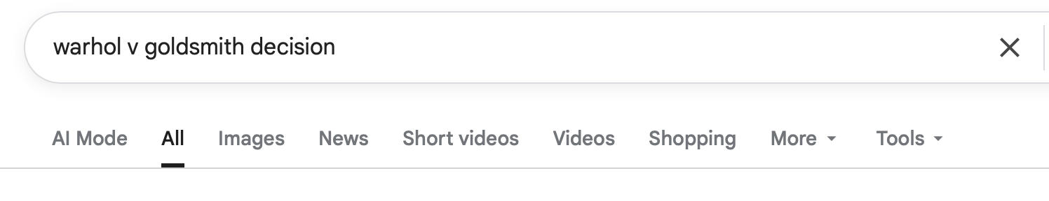
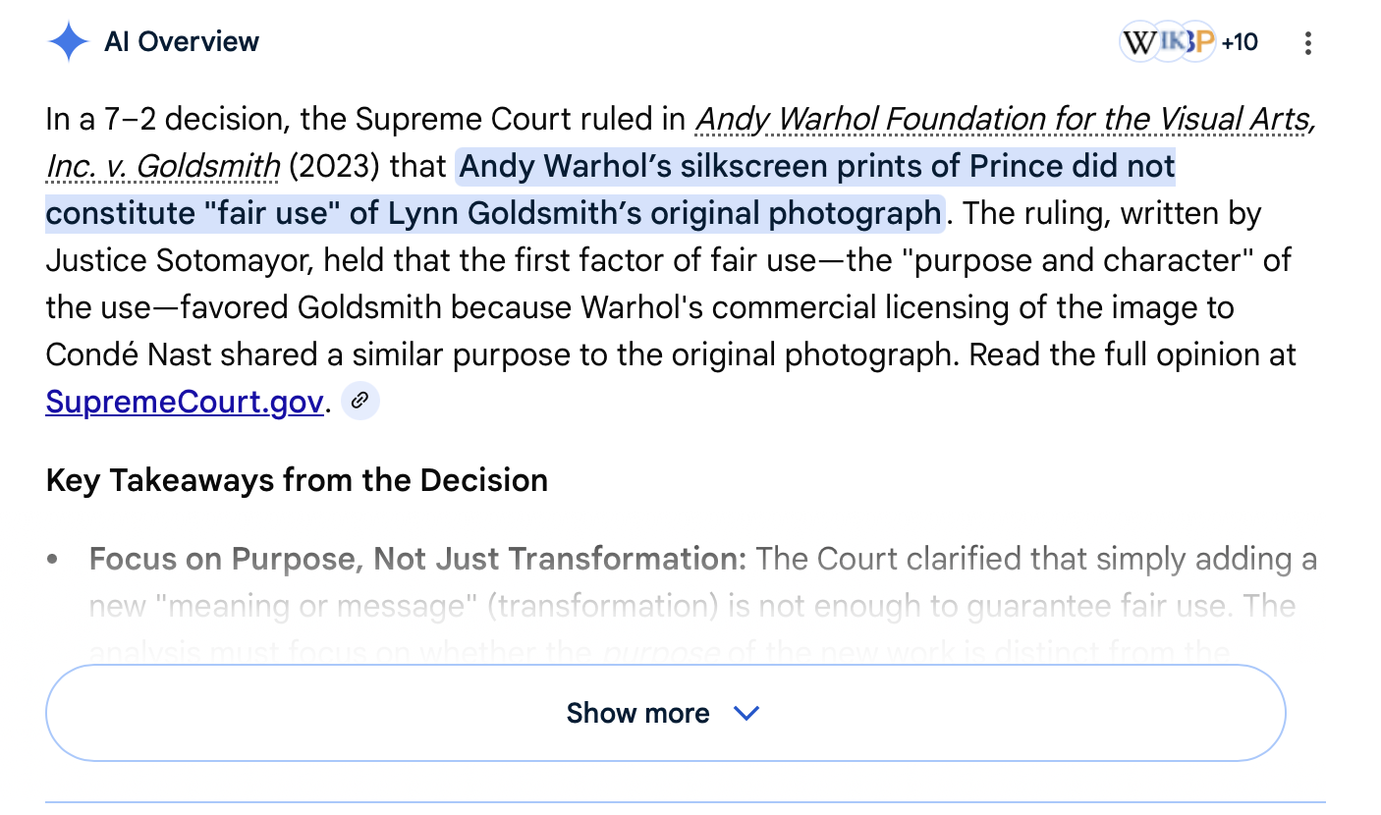

Slide 81
Analyzing causal micro-narratives in millions of articles
1923 - 2025
Predicting inflation expectations:
“By about what percent do you expect prices to go (up/down) on the average, during the next 12 months?”
We compute narrative shares by time and region, then relate them to survey inflation expectations controlling for realized inflation and standard predictors.
…
Notes:
As a starting point we investigate what our narratives can tell us about people’s inflation expectations.
Inflation expectations are important because they can end up driving real inflation and people’s behaviors.
More concretely, the target outcome we are interested in expected inflation over the next 12 months.
Start of simple – we’ll do reduced form regressions with some basic controls
We compute narrative shares by time × region, then relate them to survey inflation expectations controlling for realized inflation and standard predictors.
I’ll highlight some findings from these analyses.

Slide 82
But a good summary varies by task and domain
So generic evaluations are insufficient for measuring summary quality across different domains
We need evaluations that capture what is important
Especially in domains where summaries play a role in high-stakes decisions.
  e.g., law, medicine, finance
Notes:
But summary quality varies by task and domain
So generic task evals are insufficient
So eval of summaries must be domain specific

Slide 83
Evaluation is a bottleneck in long-context summarization
Reference Overlap
Human Evaluation
LLM-based Eval
Fast but rewards overlap with reference not overall quality.
Expensive and requires domain expertise.
Scalable but does it agree with experts?
CaseSumm tests these paradigms with an authoritative reference and expert human evaluation, then measures where they disagree.
Notes:
We test three evaluation approaches:
- Reference-overlap metrics (fast, but can reward superficial overlap),
- Expert human evaluation (gold standard, but expensive),
LLM-based evaluation (scalable, but reliability is the question).
The design goal is not just to score models—it’s to measure where these paradigms disagree.
I’ll discuss more specifics about methods we use as we go through concrete. Let’s do that now.
————
Evaluating long-context summarization is hard for three concrete reasons:
(i) ground-truth summaries often aren’t available,
(ii) even when humans write them, it’s unclear we should treat them as “ground truth,”
and
(iii) “good summary” depends on domain/setting and often requires expertise.
Lexical:
ROUGE, BLEU, METEOR, etc.
Semantic:
BERTScore, BARTScore, etc.

Slide 84
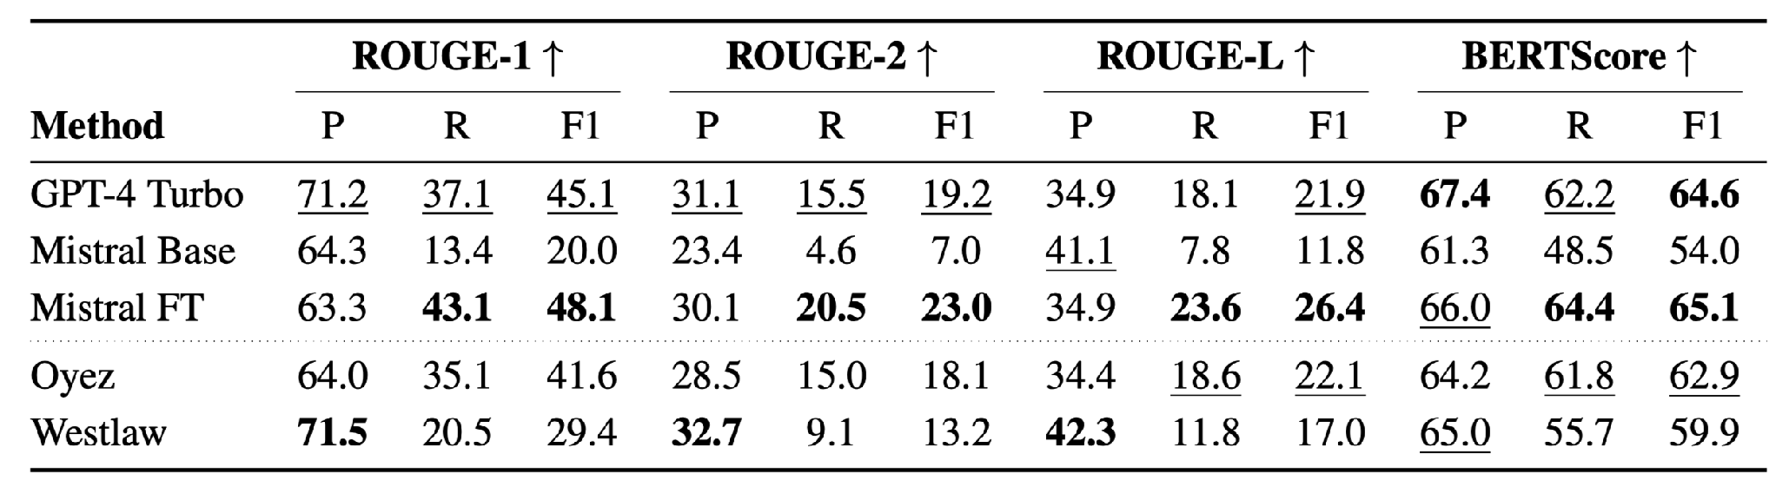
Automatic metrics favor syllabus-like summaries
🏆
Notes:
If you optimize for ROUGE/BERTScore, you tend to produce syllabus-shaped summaries.
A fine-tuned model can ‘win’ on overlap metrics.
But overlap isn’t the same as capturing the opinion’s substance for human readers.

Slide 85
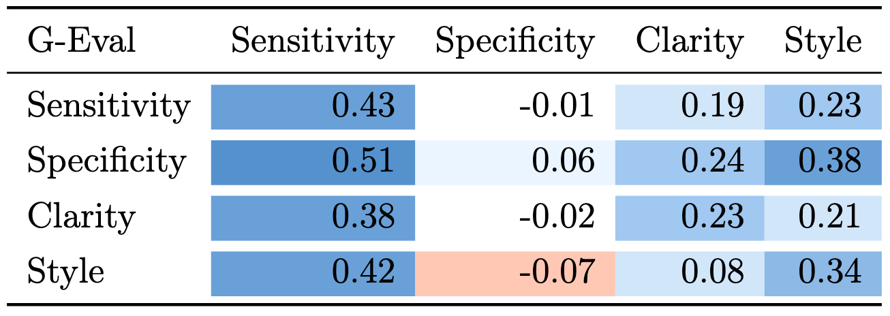
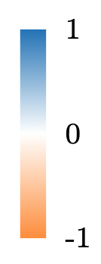
LLM-based eval does not correlate well either with human judgements
Notes:
A tempting fix is: use an LLM as judge.
But agreement with expert judgments is weak and inconsistent—sometimes near zero or even negative.
So we can’t just swap human experts with LLMs without careful validation.
We use G-Eval, which is/was a commonly used LLM-as-a-judge framework.
All G-eval scores correlate with Sensitivity the most. As well as Clarity and Style to a lesser extent.
No G-eval criteria correlates with Specificity.
did the summary contain all relevant information from the opinion (sensitivity)
did it exclude irrelevant information (specificity)
was the summary clear (clarity)
did the summary have a style suggesting it was written by an experienced attorney? (style)
Finally, we asked students to report the number of facts in the summary that were false based on their reading of the opinion (error).

Slide 86
Roadmap for this talk
Language shapes consequential decisions, but measuring and supporting this is hard. I develop methods to:
  Extract decision-relevant language at scale.
    Causal Micro-Narratives
  Evaluate LLM outputs in consequential domains.
    CaseSumm: Long-Context Summarization from U.S. SCOTUS Opinions
    LLMs as negotiators + compressing reasoning
  Develop AI that supports human deliberation.
Notes:
My dissertation agenda: develop methods to model language that shapes decisions—especially in consequential settings.
Three main threads:
1. Extract decision-relevant language at scale (Causal Micro-Narratives).
2. Evaluate LLM outputs in consequential domains (CaseSumm + related eval work).
3. Build AI that supports human deliberation (ongoing/proposed).
I’ll spend most time on the first two, then end with the deliberation direction.

Slide 87
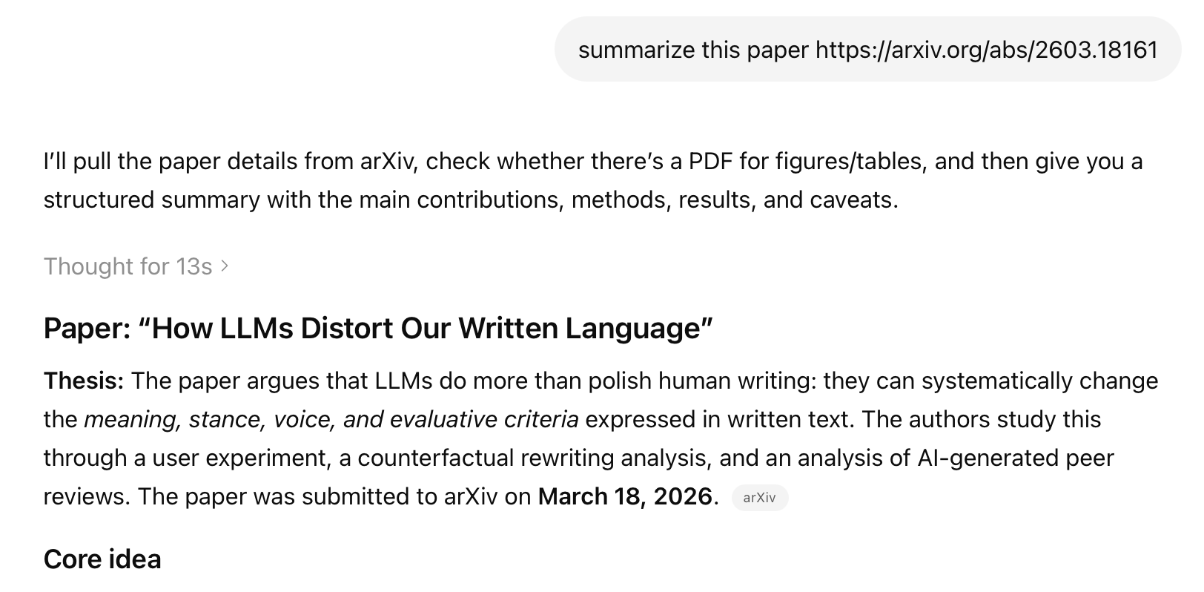
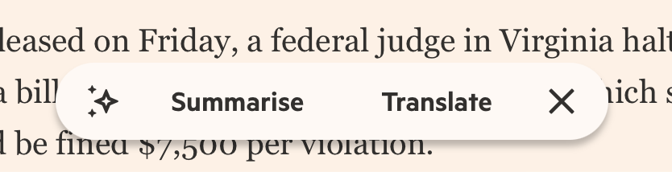
Summaries mediate how we access information
LLMs can make sense of large and complex data
Summarization is an increasingly common use case

Slide 88
Can AI-based chat interfaces help voters make more informed decisions on ballot measures
… and explain them?
Randomized controlled experiment
  Control: Official ballot text
  Treatment:
    Ballotpedia
    3 chatbots: Q&A, argumentative, reflective

Slide 89
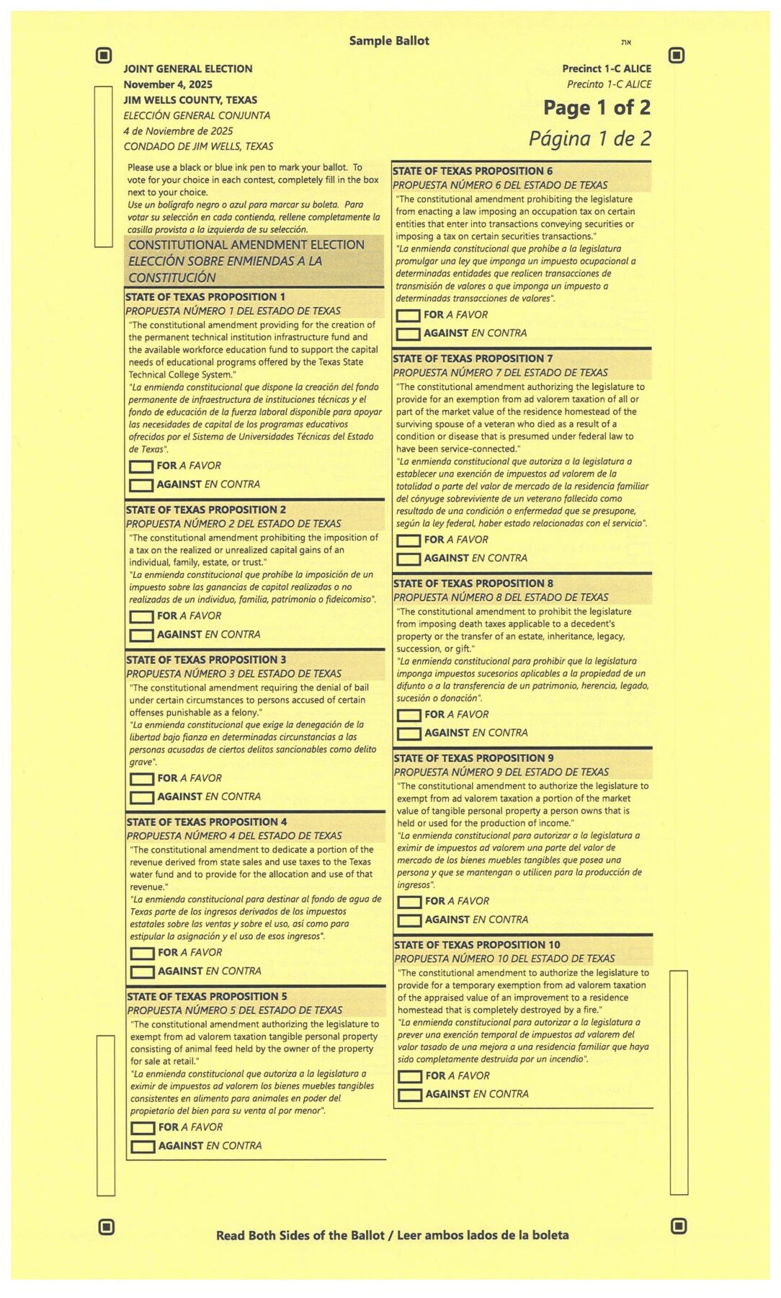
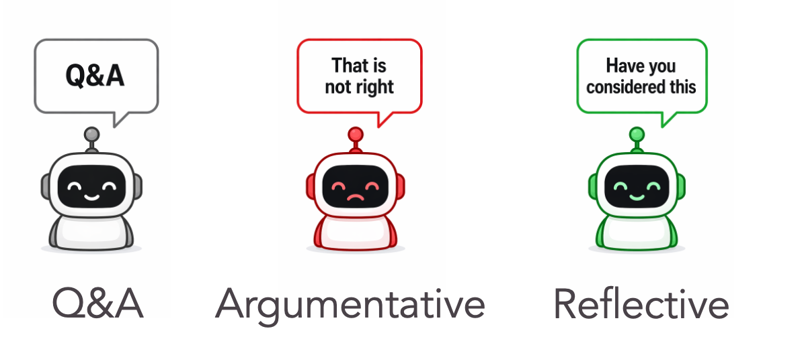

Can AI-based chat interfaces help voters make more informed decisions on ballot measures
… and explain them?
Randomized controlled experiment
Control: Official ballot text
4 Treatment conditions

Slide 90
Related Work on LLM Evaluation & Efficiency
LLMs as negotiators [Shah, Agarwal, Garg, Heddaya 2025]
  LLMs systematically anchor at negotiation extremes and ignore leverage/context, unlike humans, they don't adapt strategies to the situation.
Compressing reasoning traces [Heddaya et al. 2026]
  Reasoning models are slow and costly.
  Full reasoning internalization does not scale to complex domains.
  But reasoning can be significantly compressed with reasonable performance tradeoff.
Notes:
Two shorter threads that connect to the same theme—how language model behavior diverges from what humans need.
LLMs as negotiators: they anchor at extremes and don’t adapt leverage/context like humans.
Compressing reasoning traces: reasoning models are expensive; full internalization doesn’t scale; but you can compress reasoning with manageable tradeoffs.
- Both reinforce: evaluation has to reflect human goals, not just model-internal proxies.
I want to briefly mention to additional works I’ve done which contribute to my overall research agenda.
This first project supports my aim of evaluating LLMs in consequential domains.
The second is about efficiency and real world utility of LLMs, an important consideration when deploying this systems in practice.

Slide 91
Ballotpedia drops CO yes by 30% but raises FL yes by 13%
Notes:
So we've seen two pieces of the story: any treatment reduces abstention, and the
▎ direction of vote shift is set by the topic. But there's something the first two
▎ mechanisms can't explain. Look at just the chat conditions. In Colorado, the
▎ reflective chatbot produces a dramatic shift — three out of four participants vote
▎ no, more than even the argumentative bot achieves. But in Florida, that same
▎ reflective chatbot is no different from the simple Q&A bot. Same prompt, same model
▎ — different result. Whatever's going on with the chat conditions depends on the
▎ topic itself."

Slide 92
Ongoing &
Proposed Work
Notes:
Now Ill discuss some ongoing work that asks if language shapes decisions, can we build AI that helps people learn and deliberate—not just consume text?

Slide 93
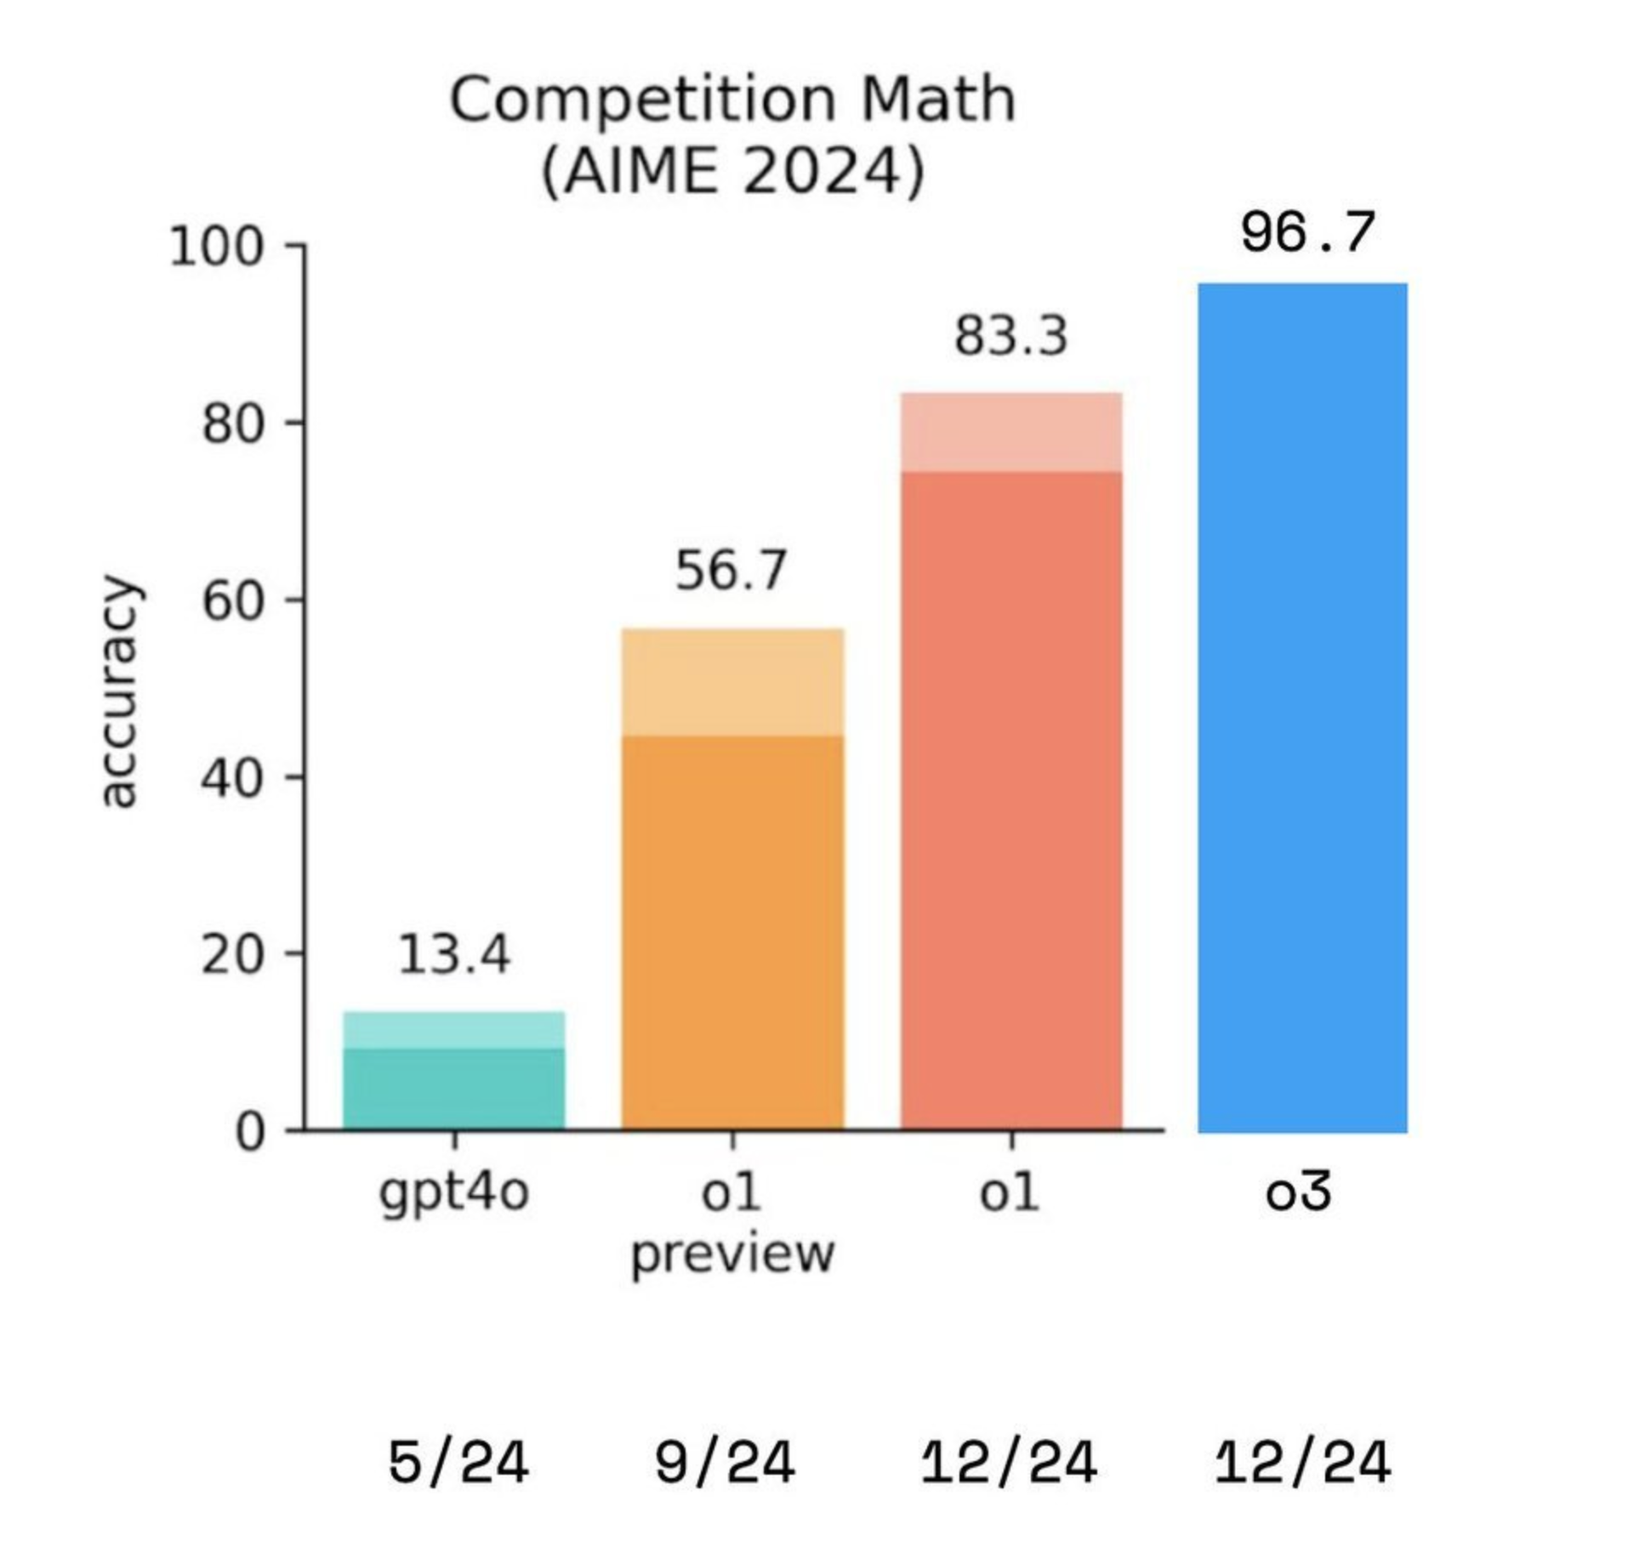
Better LLMs unlock new uses in complex domains…
But evaluation is a bottleneck
  Good data to build benchmarks is hard to find
  Model performance is hard to measure

Slide 94
Developing and evaluating AI interactions that support human deliberation
AI can mediate how people engage with complex decisions.
How do these interactions shape new understanding and challenge existing intuitions or beliefs in consequential domains?
Notes:
AI doesn’t just summarize it can serve as an interaction partner.
So the question becomes: how do different interaction styles shape understanding—especially for complex, consequential decisions?
I’m focused on concrete measurable outcomes: comprehension, reasoning quality.
A particular relevant domain for this we’ve found is voting. One specific context of this is ballot measures.

Slide 95
Voters face complex ballot measures with little support
Ballot measures are laws that citizens in the U.S. vote on directly.
Ballot measures decide consequential policy but are written in dense legal language.
Goal: Support informed judgement without manipulating voter values or preferences.
Notes:
Ballot measures are a good stress test: high stakes, dense legal language, little support.
People are asked to vote based on text that’s hard to parse.
Goal statement: support informed judgment without steering preferences.
https://news.uark.edu/articles/46345/study-finds-majority-of-public-is-unfamiliar-with-ballot-measures
Can result in abstention and shallow or overconfidence decisions.

Slide 96
Engagement vs. understanding
Prior work shows AI dialogue reduced conspiracy beliefs through tailored engagement (Costello et al., 2025)
Chatbots can increase engagement, but effects on deeper comprehension are inconsistent.
Unclear whether interactivity improves comprehension vs. just engagement
Manner of interaction matters
  Deliberation can increase openness, but exposure to opposing views can backfire (Bail et al., 2018)
  Socratic questioning more effective than direct challenges (Chiang et al., 2024)
Notes:
A lot of prior work shows chatbots can boost engagement—even shift beliefs in some contexts.
But deeper comprehension effects are inconsistent: interactivity might entertain without actually improving understanding.
And interaction style matters:
- deliberation can increase openness,
- but opposing views can backfire,
- Socratic questioning may work better than direct challenge.
So: we need experiments that separate engagement from understanding.

Slide 97
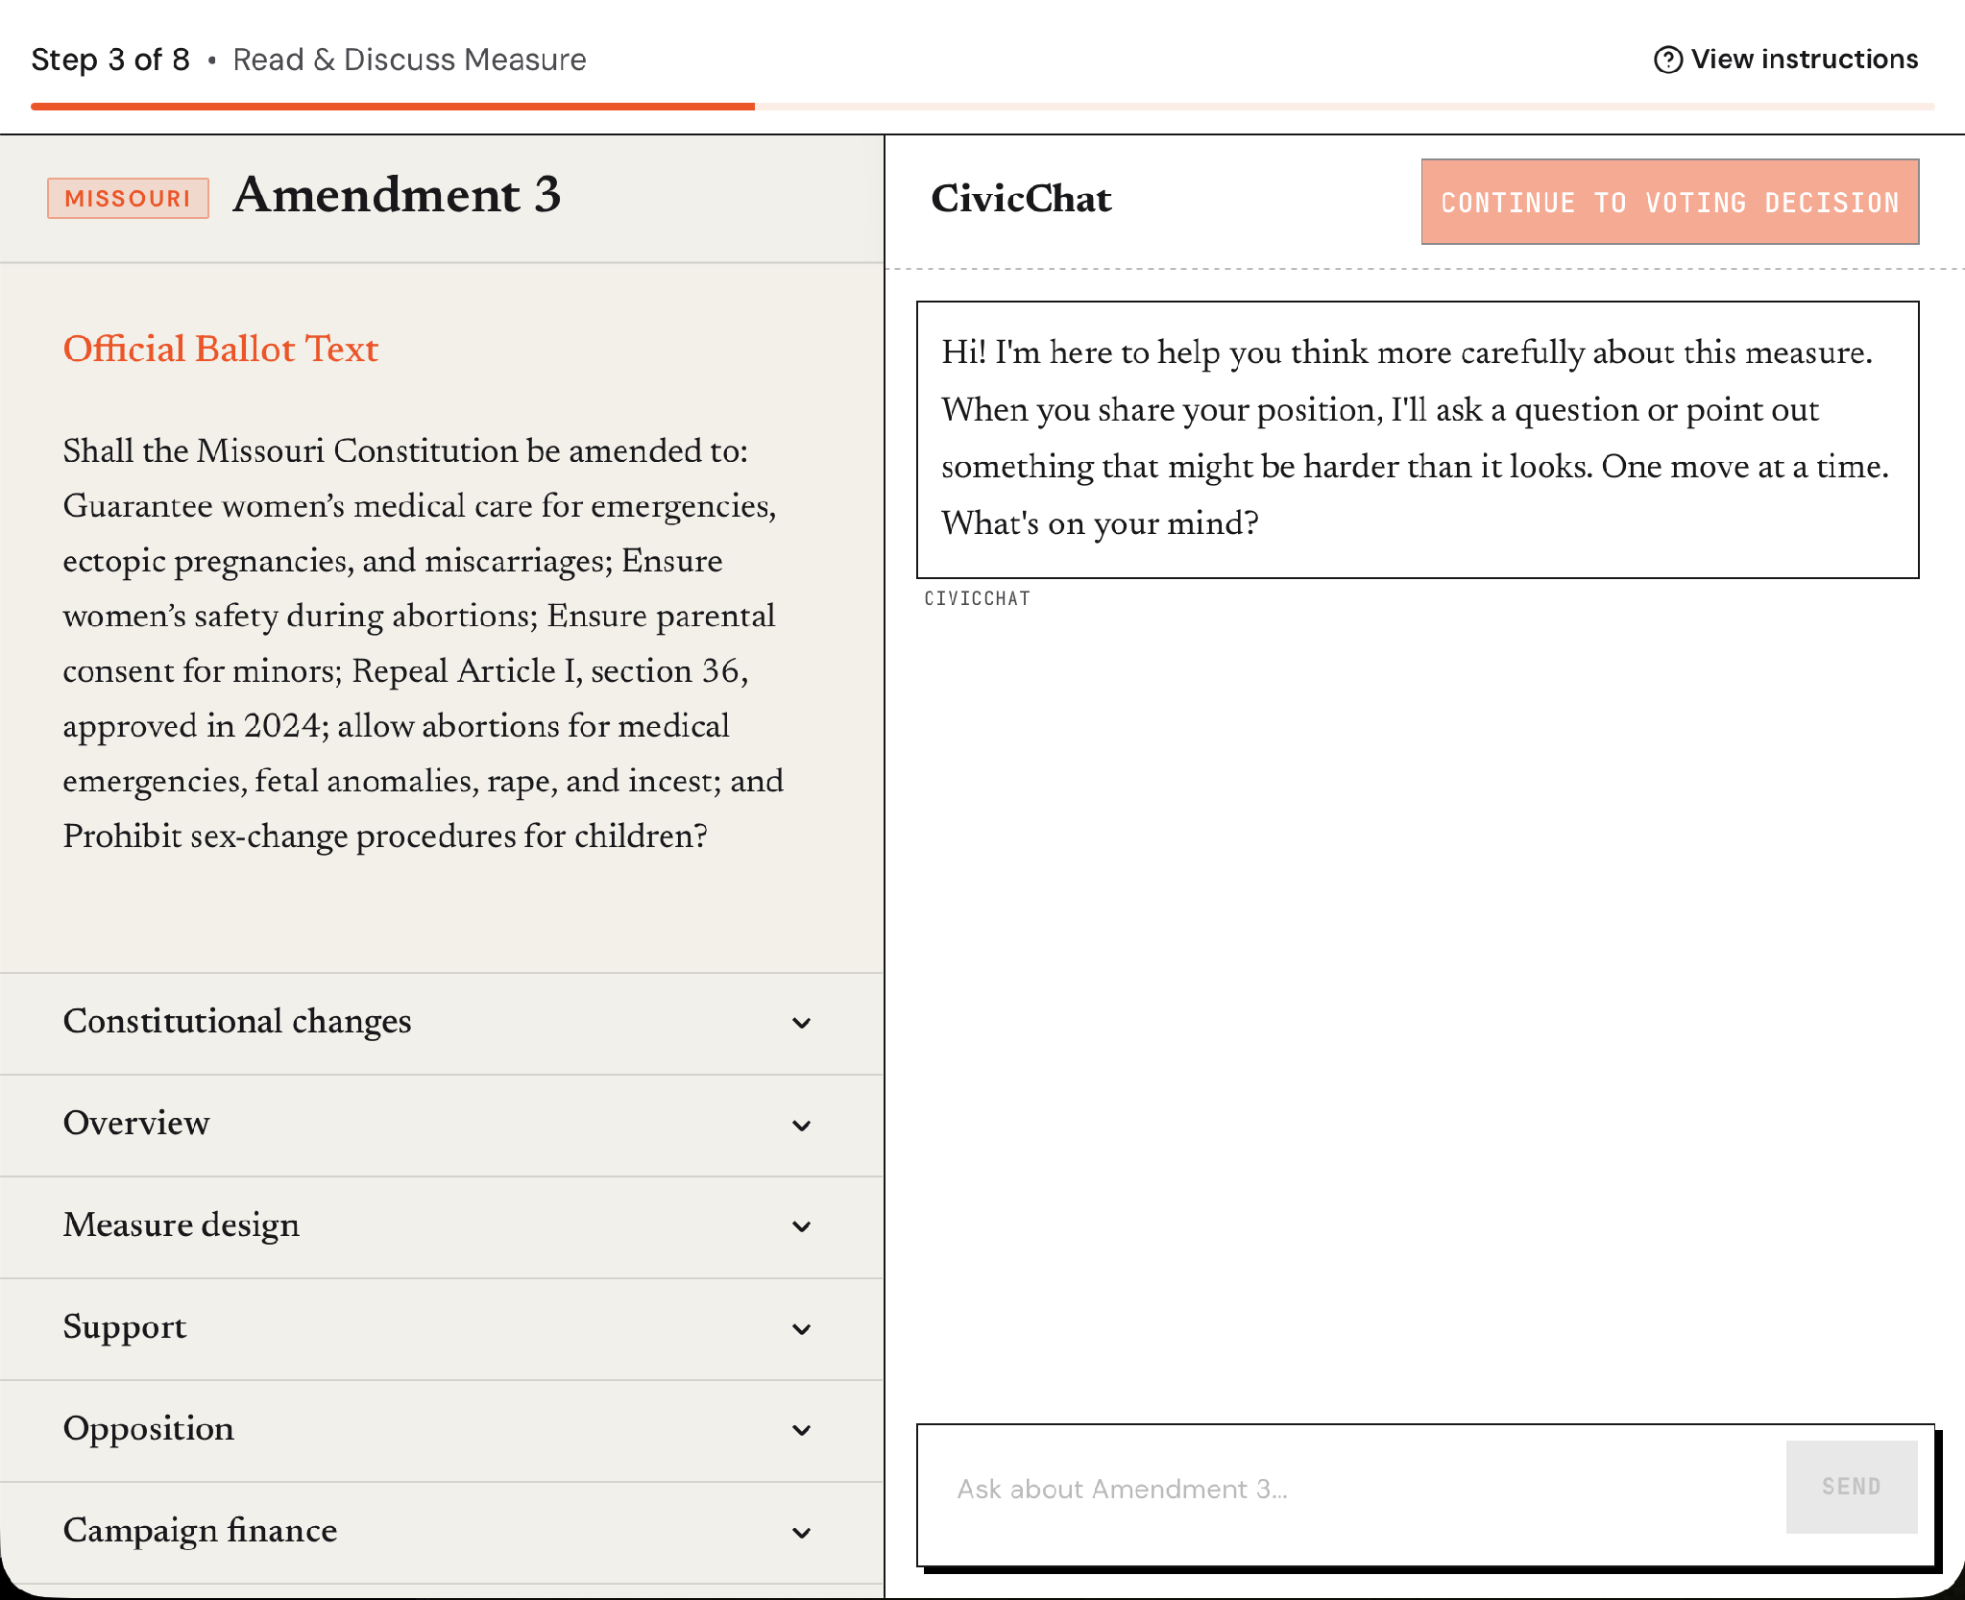
Study: Can AI improve voter understanding?
Preliminary results confirm AI increases engagement.
In follow-up, we target whether different discourse styles can increase comprehension.
  Q&A chatbot
  Argumentative chatbot
  Socratic chatbot
Notes:
In our initial experiments we find that aI increases engagement and can cause ppl to learn more about possible negative consequence of ballot measures.
Now the key test is do specific discourse styles improve comprehension?”
Three conditions:
- Q&A chatbot (information delivery),
- Argumentative chatbot (explicit pushback),
Socratic chatbot (guided questioning).”
We can hold the content constant and vary interaction style.
https://journalistsresource.org/politics-and-government/ballot-measures-election-research/

Slide 98

CivicChat Public App
Public-facing platform for browsing measures and discussing them with AI
Will leverage as an additional data in our study.
Notes:
Parallel piece: a public platform where people browse measures and discuss with AI.
two roles:
1. real-world deployment for access,
2. additional data stream for studying deliberative dialogue and what ‘helpful’ looks like in practice.

Slide 99
Interaction that creates productive disagreement
Notes:
This challenge of getting people to productively engage in disagreement or push back motived an extension.
A so-called ‘Friction bot’—an assistant that doesn’t just comply, but introduces productive friction at the right moments.
The challenge is making friction useful, not annoying.

Slide 100

LLMS are agreeable
LLMs are trained to be helpful, which manifests as agreeable
Models adapt responses to align with user views
Users’ beliefs are reflected back, not critically examined.
Notes:
Baseline problem: LLMs are trained to be helpful, and that often becomes agreeable.
They mirror user beliefs back—even when those beliefs should be examined.
In deliberation settings, sycophancy is dangerous: it can amplify weak reasoning rather than improve it.
https://arxiv.org/pdf/2310.13548

Slide 101
AI For Productive Disagreement
Build an assistant that pushes back usefully.
Prior work shows sycophancy is common but “devil’s advocate” often annoys or backfires.
Find productive pushback in real dialogues, cases that lead to clearer reasons or updated views.
Use that data to develop methods for developing such an assistant.
Notes:
What I want instead is productive disagreement: pushback that helps people clarify reasons or update views.
But naive ‘devil’s advocate’ tends to backfire—people get annoyed or dig in.
Plan:
- identify cases of productive pushback in real dialogues,
- use that as training/eval data,
- develop methods for assistants that challenge in a way that improves reasoning rather than escalating conflict.

Slide 102
Thank you!
Questions, comments?

Slide 103
Prior Work
LLMs are sycophantic by design
  Trained on human preferences that favor agreement (Perez et al., 2022; Sharma et al., 2023)
  Does not improve with scale (Wei et al., 2024)
  Risk: confirmation bias as a service
Existing approaches to introduce disagreement
  Devil's advocate systems struggle to persuade (Chiang et al., 2024; Nemeth, 1995)
  Socratic AI limited to educational contexts (Chang et al., 2023; Wang et al., 2024)
  Direct counterarguments can backfire via biased assimilation (Lord et al., 1979)
Evidence that belief change is possible
  Tailored evidence reduced conspiracy beliefs 20% (Costello et al., 2024)
  Self-persuasion more effective than direct persuasion (Briñol et al., 2012)
  Motivational interviewing: elicitation over assertion (Miller & Rollnick, 2012)

Slide 104



LLMs lack perspective
Notes:
This is crude but illustrates the point well enough I think.

Slide 105
Conclusion
Using LLMs for sophisticated text analysis requires aligning models with the right perspective or framing that we, as the user or researcher, have in mind.
How one accomplishes this will vary depending on one’s goal and difficulty of the task - but it is becoming increasingly feasible.

Slide 106
A couple more tidbits
Syllabus and GPT-4 summaries have the lowest lexical variation from opinions.
If we want longer summaries that correlate with opinion length, fine-tuning is effective.

Slide 107

Collecting Human Annotations

Slide 108


Collecting Human Annotations

Slide 109
The power of narratives
Social scientist recognize the power of narratives (i.e., popular stories about economic, political, or social topics) to shape individual and collective behavior.

Slide 110
The power of narratives
Social scientist recognize the power of narratives (i.e., popular stories about economic, political, or social topics) to shape individual and collective behavior.
If we fail to consider and understand the properties of narratives, “we remain blind to a very real, very palpable, very important mechanism for economic change, as well as a crucial element for economic forecasting” (Shiller, 2017)

Slide 111
[scratch, prior work] What is a narrative & how do we measure it?
narratives are “beliefs about the economy that spread contagiously” (Flynn and Sastry, 2022)
we define a moral narrative as any news, story, life experience or heuristic that has the potential to alter an agent’s beliefs about the tradeoff between private benefits and social costs (or the reverse) faced by a decision-maker, who could be himself, someone he observes, or someone he seeks to influence. (Benabou, 2018)
Causal account (Akerloff & Snower, 2016)
“Political narratives can be regarded as causal models that map actions to consequences” (Eliaz & Spiegler, 2020)
Causal narratives - narratives that tell a causal story about the relationship between variables of interest (Kendall & Charles, 2022)
Notes:
Kendall & Charles + morag & loewenstein – they run a controlled experiment with participants
Akerloff & Snower – case study on narratives about the soviet economy
Eliaz & Spiegler – theoretical analysis of their causal model

Slide 112
The power of narratives
Social scientist recognize the power of narratives (i.e., popular stories about economic, political, or social topics) to shape individual and collective behavior.

Slide 113



Do we know what we’re looking for?
No
  “Discover” narratives from the text
  More easily generalizable
  Noisier but might find something surprising
  Without evaluation, impossible to efficiently optimize method.
Yes!
  Prioritize interpretability and motivating hypothesis.
  Higher precision (more signal)
  Lower recall
Notes:
There is no “true” discovery. But there is still a meaningful distinction

Slide 114
First attempts
GPT4 is such a powerful tool, maybe if I just prompt it right, it’ll just work
  Maybe that works for obvious examples (give example)
  But maybe you use more complex examples that ambiguous (give examples of each)
  Why cant model do this right? How we provide this prior knowledge about what makes a narrative or not?
    Behavior cloning (SFT)
  Ideas: show what process is like for a human determining a narrative

Slide 115
Peter hase talk
Start with research goal
Explain why their goal “why AI safety”
  Explain a bit more
“This talk” slide
From interpretability🡪 control
Break up talk by talk and how it traces his research agenda (interpretability to controllability)
Motivate with examples
Retrieve explanations at test time
  Simple high level explanation
  Then immediately show results with a clear question that the plot answers
For transition – what question is left unanswered and then how the next slide addresses this. Framing
“make data” -> train -> etc

Slide 116
A brief review of LLM-based inference
In-context Learning / Few-shot
Zero-shot
Fine-Tuning
LLM
LLM
LLM
Labeled data
Prompt
Prompt
Instructions
Instructions
Fine-Tuned LLM
Sentence
Example 1
Example 2
Prompt
Example N
Sentence
Sentence
Notes:
Note that when we test big LLMs in zero and few-shot settings and we test smaller LLMs in fine-tuning setting.
Some tradeoffs: latency vs performance vs labeled data
Add some message around “when you know what you want”, ”when you know what you want”
Replace blue with green yellow pairs?

Slide 117

Smaller fine-tuned models outperform large models & better reflect human judgement
Llama, a larger model than Phi-2, continues to learn with additional data (Hist. + Contemp.)
Notes:
We conducted an error analysis of the misclassifications from models vs disagreements between humans and found that fine-tuned better reflect the reasonable human disagreements – SUCCESSFULLY LEARNS OUR INTENDED TASK AND PERSPECTIVE

Slide 118

Causes of inflation
Notes:
Apologize for the small axes labels
Over time we see fluctuations is the relative proportions of narratives being expressed in newspapers.
For example monetary policy becomes an increasingly popular narratives and fiscal policy is discussed significantly less starting the 1990s.

Slide 119
Effects of inflation
Notes:
Again, we see fluctuations with savings and interest rates (monetary policy) and cost of living being the most popular narratives.
An interesting observation that we found, not present on this plot, is that narratives related to the effects of inflation have become significantly more popular over time than those about the causes of inflation.
But this is not our ultimate goal, as we’re interested in modeling if these narratives spread and whether they are predictive of economic outcomes.

Slide 120

CaseSumm: A large-scale SCOTUS Dataset
Notes:
People think the syllabus i
Non obvious to get this data

Slide 121

200+ years of coverage, long documents

Slide 122

Traditional metrics favor Fine-Tuning

Slide 123


Coverage vs. Readability

Slide 124

Llama confusion matrix

Slide 125

Smaller fine-tuned models reflect human disagreements, GPT-4 does not
(gold → pred)
none → none
none → none
fiscal → fiscal
fiscal → fiscal
fiscal → govt
none → social
social → cost
none → govt
govt → fiscal
none → wage
none → supply
none → purchase
none → wage
none → other
Notes:
Correctly learns the distribution of human predictions and errors (“perspective”

Slide 126
But many interesting questions require coherently resolving ambiguity
Now, we can try to un-ravel the simplifying assumptions we made about many tasks and try to use LLMs to tackle challenging questions that require constructing coherent perspectives and framings
Notes:
https://philosophybear.substack.com/p/we-need-to-do-something-about-ai
https://x.com/natolambert/status/1865100884083982560/photo/1

Slide 127
Narratives are ubiquitous and powerful
Narratives are stories people tell themselves, and each other, to make sense of human experience - that is, to organize, explain, justify, predict and sometimes influence its course.
Narratives are instruments of mind in the construction of reality [Bruner 1991, Benabou et al. 2018]
Jane is tired, so she won’t make it to the show tonight.
Notes:
Social scientist recognize the power of narratives (i.e., popular stories about economic, political, or social topics) to shape individual and collective behavior.

Slide 128
Simple n-grams do not correlate well with narratives

Slide 129

Output format

Slide 130

Annotated ~2.5k sentences for training and evaluation
Notes:
What prior work on this kind of causal relationship data was priorly available?

Slide 131

Short, multi-reference
Long, multi-reference
Short, single-reference
Long, single-reference
Simple n-grams do not correlate well with these narratives
Notes:
Add specific datasets in each quadrant

Slide 132
Ongoing Work
Contagion modeling – capture notion of spread, like a disease. Tricky.
Media econ and macro-econ perspective
  How do newspapers choose competing narratives and how does it affect beliefs
Reduced form → structural model
Automated narrative discovery
  Doesn’t require defining an ontology – easily extend to new target events
  Uncover unexpected or uncommon narratives
Notes:
Conundrum:
Pure contagion effect, not the pure macro-effect
We wanna capture the notion of spread (like a diseases) like ”im doing it because youre doing it”, not “im doing it just because I see someone else doing it and im gonna do it bc of that”. That tricky.

Slide 133
Roadmap for this talk
- Applying LLMs in two different settings with natural ambiguity:
When you know what you’re looking for:
  - Causal Micro-Narratives [Heddaya et al. 2024]
When you don’t know what you’re looking for:
  CaseSumm: Long-Context Summarization from U.S. SCOTUS Opinions [Heddaya et al. 2025]
- Ongoing and future work

Slide 134
Research Questions
Do inflation narratives predict economic variables of interest, even controlling for commonly used predictors?
Are inflation narratives “contagious” in the sense of spreading from one location to another? If yes, what are the properties of the contagion and have these properties changed over time?
Methods: Can we discover and/or classify narratives in large scale unstructured text?

Slide 135
Prior work captures important aspects of narratives but measuring them is hard
Narratives map a causal relationship
  DAG mapping actions to consequences [Eliaz & Spiegler 2020]
  Case study of Soviet economy [Akerloff & Snower 2020]
  Controlled experiments to measure effect [Kendall & Charles 2022, Morag & Loewenstein 2023]
Narratives shape beliefs
  Theoretical framework + structural model [Benabou et al. 2018]
  Beliefs about the economy that spread contagiously [Flynn & Sastry 2022]
    Optimism vs. pessimism [Flynn & Sastry 2022]
Text semantics reveal narratives [Ash et al. 2022]
Notes:
GOES BACK TO SIMPLIFICATION PROBLEM!!!! - TRADE OFF BETWEEN CONCEPTUALLY SATISFYING DEFINITION AND AN OPERATIONALIZATION

Slide 136
  Research Questions
What makes a good summary?
How can we compare summaries, taking into account real human preference?
Summarization is open-ended
  Human-written vs. automatically generated summaries

Slide 137


More narrative dispersion = higher expectations and higher uncertainty
Notes:
Panel A: When the diversity of inflation narratives in the media increases by one standard deviation, consumers’ average expected inflation over the next year rises by 0.045 standard deviations.
Panel B: “A one-standard-deviation increase in narrative dispersion increases the standard deviation of 1-year inflation expectations by 0.041 standard deviations. ”

Slide 138
Summarization is important and hard
Summaries are used for
  Producing legal judgments
  Provision of legal services
  Public education
Summaries are difficult to produce.
  Legal text can be very long and dense.
  Low-tolerance for errors.
  Domain-specific language and style.
  Summarization is an open-ended problem.
Notes:
Summaries are used for
- Producing legal judgments
- Provision of legal services
- Public education
Summaries are difficult to produce.
- Legal text can be very long and dense.
- Low-tolerance for errors.
- Domain-specific language and style.
- Summarization is an open-ended problem.
In discussing this work, Ill take a slightly different path.
So, first thing is to start with some data.

Slide 139




We collect various human-written summaries
Opinions (and syllabuses) are long
Notes:
Well people usually think human written summaries are pretty good right? So let’s start there.
Non obvious to get this data
A meaningful contribution to the legal AI field

Slide 140
Three evaluation lenses
Reference-free evaluation
Similarity with syllabus
Human Judgement
LLM-based Judgement
Rank by human preference on:
1. Sensitivity
2. Specificity
3. Clarity
4. Style
5. Error
LLM scores summaries on:
1. Sensitivity
2. Specificity
3. Clarity
4. Style
5. Error
summary
syllabus
Lexical:
ROUGE, BLEU, METEOR, etc.
Semantic:
BERTScore, BARTScore, etc.
All together, we can use these approaches for more robust eval and to understand their trade-offs.

Slide 141






ChatGPT?
Notes:
But maybe you use more complex examples that ambiguous (give examples of each)
Why cant model do this right? How we provide this prior knowledge about what makes a narrative or not?
Behavior cloning (SFT)
Ideas: show what process is like for a human determining a narrative

Slide 142
Identify and classifying narratives
Option 1: “Discover” narratives from the data itself
  Generalizable, might be surprised
  Noisy, hard to optimize
  [Ash et al. 2022]
Option 2: Define important narratives and find them in the data
  Prioritize motivating question
  Easily interpretable
  Stronger signal
  Higher up-front cost
1923 - 2025
…
Notes:
For option 1: Text semantics reveal narratives [Ash et al. 2022]

Slide 143
Identify and classifying narratives
Option 1: “Discover” narratives from the data itself
  Generalizable, might be surprised
  Noisy, hard to optimize
Option 2: Define important narratives and find them in the data
  Prioritize motivating question
  Easily interpretable
  Stronger signal
  Higher up-front cost
1923 - 2025
…

Slide 144
Summarization involves judgement: what counts as “important” depends on goal and audience.
Long documents make that judgement harder.
In high-stakes settings, these choices have consequences.
LLMs are claimed to handle and summarize long-context well.
  How well remains an open question.
CaseSumm is a benchmark designed around this setting.
Notes:
Summarization involves judgment: what counts as “important” depends on the goal and audience.
Long documents make that judgment harder: there are many defensible choices about what to include, omit, and emphasize.
In high-stakes settings, those choices have consequences: small omissions or shifts in emphasis can change the takeaway.
So evaluation is the bottleneck: reference overlap and LLM-based judging can diverge from expert human judgments of quality.
Evaluating long-context summarization is hard for three concrete reasons: (i) ground-truth summaries often aren’t available, (ii) even when humans write them, it’s unclear we should treat them as “ground truth,” and (iii) “good summary” depends on domain/setting and often requires expertise.

Slide 145
Evaluation is a bottleneck in long-context summarization
Most summarization work evaluates against a reference summary (e.g., ROUGE/BERTScore), but reliable “ground truth” is often missing. Even human references aren’t always a definitive target.
Human evaluation is the fallback, but it is expensive and often requires domain expertise to judge omissions, specificity, and errors.
LLM-as-judge is a popular proposal for scalable evaluation, but its alignment with expert human judgment in long-context settings is still uncertain.
CaseSumm tests these paradigms with an authoritative reference and expert human evaluation, then measure where they disagree.
Notes:
Lexical:
ROUGE, BLEU, METEOR, etc.
Semantic:
BERTScore, BARTScore, etc.

Slide 146
In US, ballot measures are consequential yet hard to parse
Ballot measures are a key part of direct democracy in the US.
Often first encounter at the voting booth
Difficult to understand and opaque.
Result is uninformed decisions or abstention
Fails to support communication [??]
https://news.uark.edu/articles/46345/study-finds-majority-of-public-is-unfamiliar-with-ballot-measures

Slide 147

LLMs excel at reasoning
… and are constantly getting better
✅ Math
✅ Coding
✅ Fact-based QA
❌ Open-ended generation
Notes:
I’ll start by highlight recent trends in LLM capabilities and how they relate to this topic.
https://philosophybear.substack.com/p/we-need-to-do-something-about-ai
https://x.com/natolambert/status/1865100884083982560/photo/1

Slide 148
Historically, we simplified tasks to reduce natural ambiguity
E.g., translation, sentiment analysis, natural language inference, extractive summarization, etc.
Makes tasks design and evaluation easier → quick optimization.
More performant LLMs invite us to revisit some of these simplifications and tackle more interesting questions directly.
Notes:
Historically we simplified tasks, like translation, to reduce their ambiguity and make it easier to optimize a model.
But many things we care about as researchers and scientists don’t live in the world of automatic verification and require studying something from a particular angle or perspective

Slide 149
As models improve, the bottleneck shifts from generation to specifying and evaluating what ‘good’ means.
Language shapes consequential decisions, but measuring and supporting this is hard. I develop methods to:
  (1) extract decision-relevant language at scale
  (2) evaluate LLM outputs in high-stakes domains
  (3) design AI interactions that support human deliberation.
Notes:
Historically, we simplified tasks to reduce natural ambiguity
E.g., translation, sentiment analysis, natural language inference, extractive summarization, etc.
Makes tasks design and evaluation easier → quick optimization.
More performant LLMs invite us to revisit some of these simplifications and tackle more interesting questions directly.
But models become increasingly competent, progress increasingly depends on specifying the objective and evaluating it reliably—not just generating good text.

Slide 150
Project | Key Gap in Literature | My Angle
Narratives | No large-scale causal narrative extraction | LLM-based classification at century scale
CaseSumm | Metrics don't predict what experts value | Human evaluation reveals disconnect
Negotiation | No matched human-LLM comparisons | Systematic framework reveals LLM rigidity
Reasoning | Internalization only tested on simple tasks | Complex traces need different targets
BallotBot | Unknown which AI interaction style helps voters | Comparing personas with longitudinal design
FrictionBot | Sycophancy + counterarguments backfire | Elicitation-based critical thinking

Slide 151







Consider two different human-written summaries of a long legal judgement
Notes:
Here’s the core problem in one picture: two humans can summarize the same long opinion differently.
Both might be ‘good’—but for different audiences and purposes.
So benchmarks that assume a single reference summary miss what’s actually hard here.

Slide 152


Inflation expectations are highly persistent but narratives explain some effect
~0.15 SD
By about what percent do you expect prices to go (up/down) on the average, during the next 12 months?
↑ in expected inflation per 1 SD ↑ in lagged realized inflation
x 1/3
0.057 SD
↑ in expected inflation per 1 SD ↑ in share of fiscal narratives
Coefficients are
the shift in expected inflation (in SD terms) per SD increase in the share of a narrative’s media presence
Notes:
Michigan survey ask inflation expectations over next year. Get average over everyone.
People overestimate on average
Wide dispersion
People are affected by what they see in grocery store
Numbers of “inflation” mentions is not predictive – log to look at pct change bc trends high over time – get rid of spurious correlations from consistent upward trends (autocorrelation)
But there are narrative!
Share of n-grams vs share of narratives chart (each x-tick would be a month)
Maybe also show how narratives change over time some increase some go dwon (vs eg raw counts of inflation mentons)
Scatter plot
Pearson correlation
Table 2: disagreement in inflation expectations on two horizons
More than the yoy realization inflation – more than in Table 1 (just 1/3)
Fiscal -> more uncertainty
Negative coefficients? (maybe bc with increase of one, that means others go down so less contention among narratives?)
Social is high
Obivously need more robustnss (what robustness?)
Do regional bc less persistent
Table 3: entropy
If more uncertainty, higher expectations
And high uncertainty in the expectations
We normalize shares so they add to 1 then we calculate the entropy
Disagreement is the more novel stuff – survives robustness
FRAMING: Media econ and macro-econ. How do newspapers choose competing narratives and how does it affect beliefs
Reduced form bc no structural model
We don’t have a model here (no causal) so model could address this
Reverse causation, inflation high -> writing about it -> persistence to it -> affecting expectations
Not causal (eg newspaper could be writing because people believe something and they want to write about that)
Conundrum:
Pure contagion effect, not the pure macro-effect
We wanna capture the notion of spread (like a diseases) like ”im doing it because youre doing it”, not “im doing it just because I see someone else doing it and im gonna do it bc of that”. That tricky.

Slide 153

Fiscal & social narratives increase uncertainty of inflation expectations
Now, narrative coefficients are commensurate with realized inflation.
≈
Coefficients are
the shift in uncertainty of expected inflation (in SD terms) per SD increase in the share of a narrative’s media presence

Slide 154
Prior Work
Ballot measures are hard to understand
  Dense legal language, often first seen in the booth
  Low knowledge → abstention or uninformed decisions
  Affects participation, especially among underrepresented voters (Reichert, 2016)
AI chatbots for information delivery
  VAA chatbot found intuitive and informative for political decisions (Zhu et al., 2025)
  AI dialogue reduced conspiracy beliefs through tailored engagement (Costello et al., 2025)
  Open question: does interactivity improve comprehension, or just engagement?
Manner of interaction matters
  Deliberation can increase openness, but exposure to opposing views can backfire (Bail et al., 2018)
  Socratic questioning more effective than direct challenges (Chiang et al., 2024)
  Suggests chatbot persona may affect outcomes

Slide 155
People increasingly use AI for synthesis
As we saw in this previous work, LLMs can be extremely useful for making sense of large quantities of data.
  But we have to be careful that the semantics of our task are clear (we are properly communicating what we care about)
As ppl increasingly use AI to summarize important and sometimes technical documents, often in high stakes settings (such as law, etc) in this work we study how we can effectively evaluate models in these settings to help provide guidance/signal on appropriate use
We look at legal domain

Slide 156
People increasingly use AI for synthesis
Some concise bullets of before
Summaries cool and useful
Maybe some pics of different summaries in the wild
  Google summary
  Wiki
  Cliff notes
  Ft

Slide 157
Summ quality varies by task
But a good summary depends on what youre trying to get out of the doc/summary
  What youre trying to get out of the document could depend on your domain/setting.
  How to know if youre summaries are good? Whether to trust them?
  EVALUATION

Slide 158
But in some domains are generic evals not sufficient
But a good summary depends on what youre trying to get out of the doc/summary
  What youre trying to get out of the document could depend on your domain/setting.
  How to know if youre summaries are good? Whether to trust them?
  EVALUATION

Slide 159







LLMs excel at tasks with clear answers
But many language tasks are open-ended
?
?
?
?
Notes:
But lots of language tasks don’t have a single correct output.
Even summarizing the same book or document can yield multiple valid summaries—depending on goals.
That means evaluation becomes the bottleneck: what does ‘good’ mean?

Slide 160




LLMs excel at tasks with clear answers
But many language tasks are open-ended
Notes:
The ambiguity isn’t random—it comes from different readers / audiences / objectives.
So the challenge isn’t just generating text. It’s: how do we evaluate language when multiple outputs can be reasonable?
Indeed many things we care about as researchers and scientists don’t live in the world of easily verifiable outputs and require considering a particular angle or perspective
That’s the problem framing I’m going to build on.

