Slide 1
Towards Human-Centered AI: Understanding and Improving Decision Making Through Explanations
Chenhao Tan
Chicago Human+AI Lab
University of Chicago
https://chenhaot.com
@ChenhaoTan
Notes:
I need a new title

Slide 2
Notes:
This talk is about the relationship between humans and AI

Slide 3
In pursuit of “intelligence”
Notes:
One path for developing AI is to make the AI bigger and stronger in pursuit of intelligence.

Slide 4
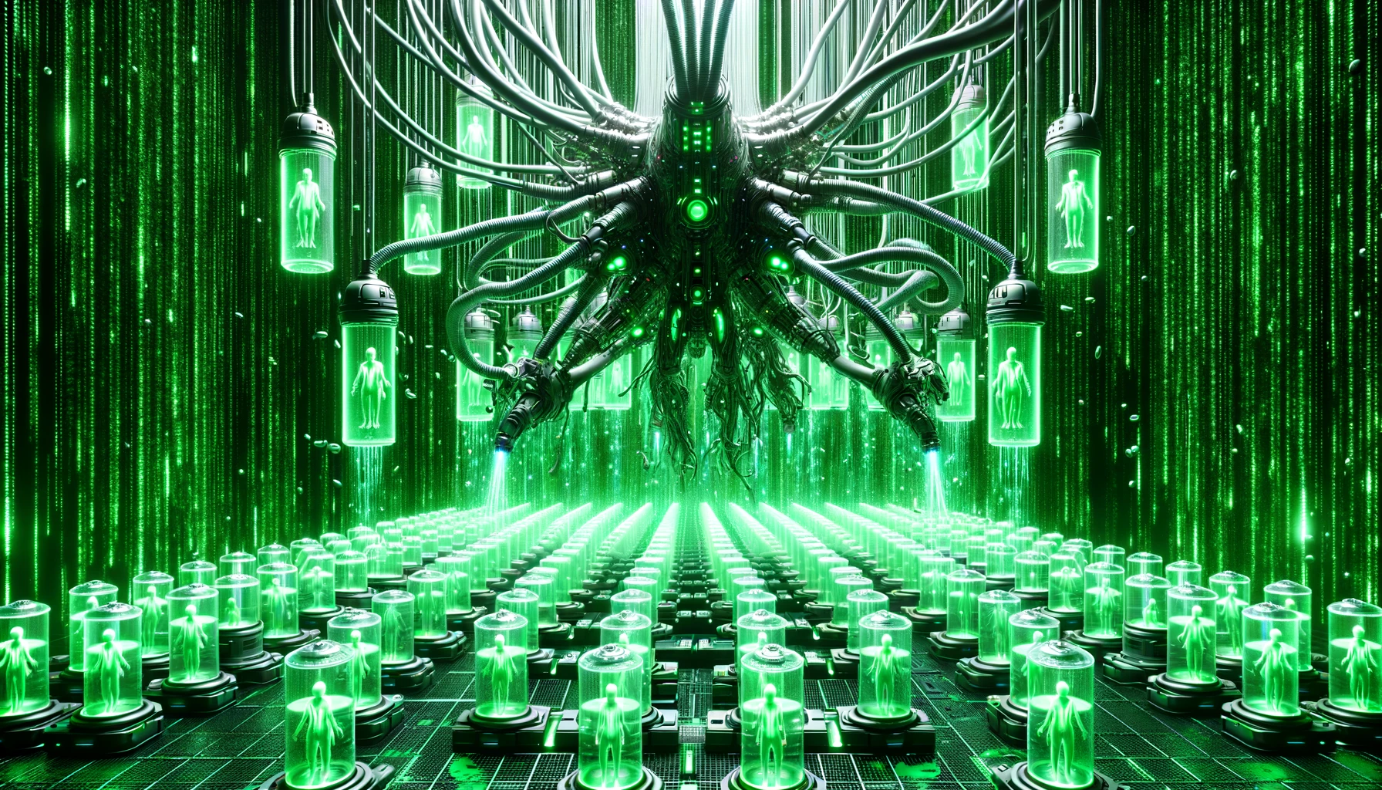
Generated by DALL·E 3

Slide 5
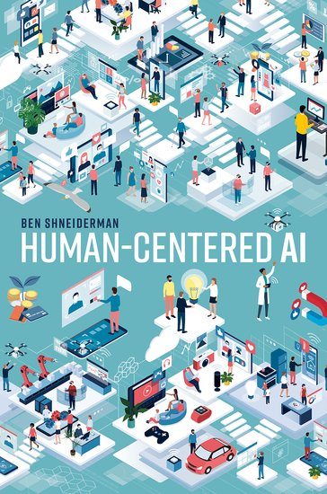
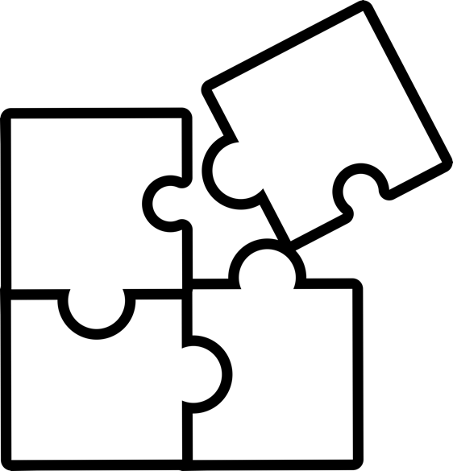
Shift from emulating humans to empowering people
Challenge PNGs by Vecteezy
Notes:
An alternatively reality is to developing AI systems that takes into account humans so that AI empower people and benefit humanity

Slide 6

Shift from emulating humans to empowering people
Challenge PNGs by Vecteezy
Notes:
An alternatively reality is to developing AI systems that takes into account humans so that AI empower people and benefit humanity

Slide 7
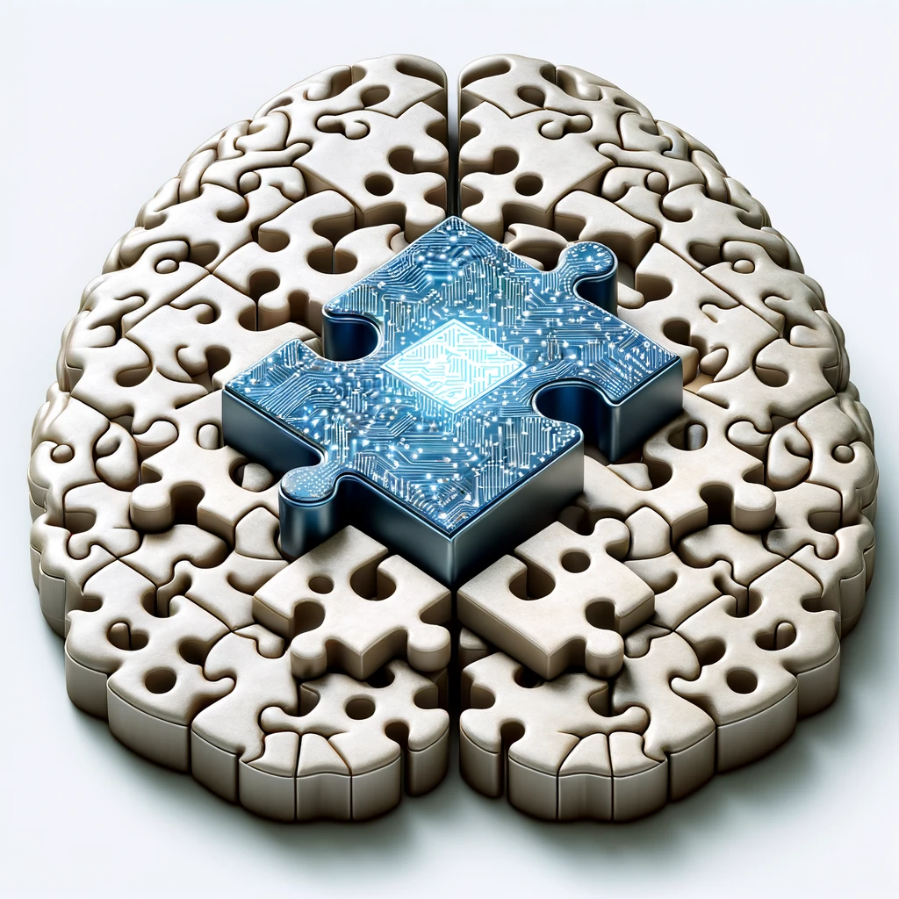
Shift from emulating humans to empowering people
Challenge PNGs by Vecteezy
Notes:
An alternatively reality is to developing AI systems that takes into account humans so that AI empower people and benefit humanity

Slide 8
+
How can we develop the best AI for humans?
Notes:
On the one hand, AI researchers decries about the ability of AI
On the other hand, legal

Slide 9

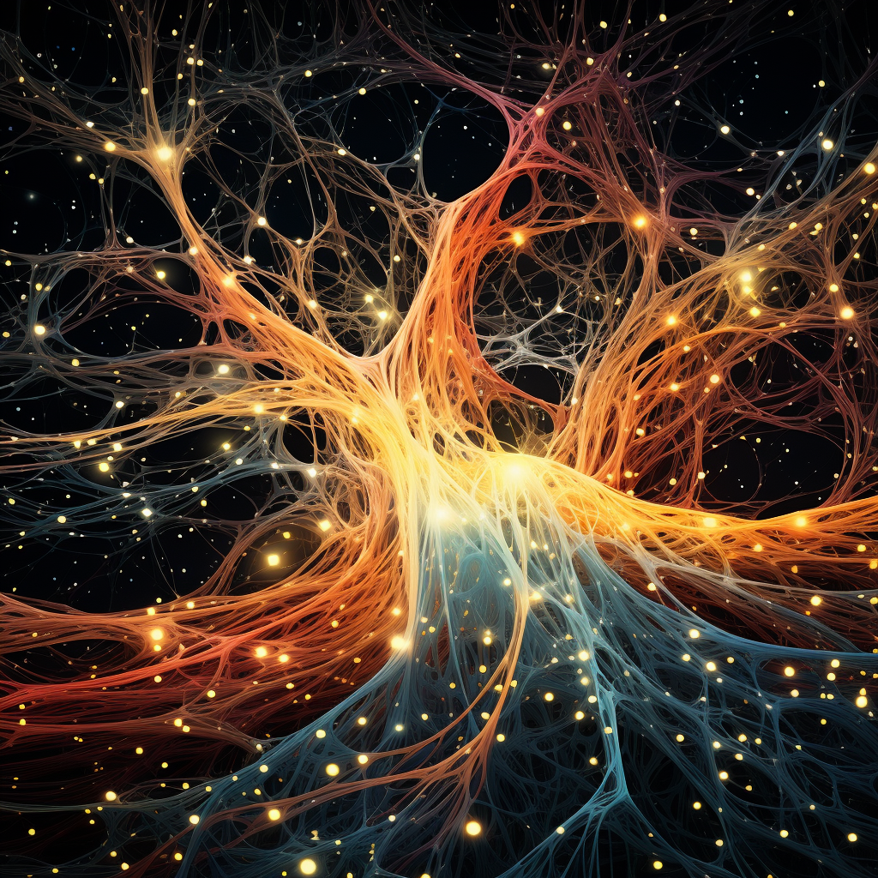

Complementary AI
Advancing theories of human decision making and interaction with AI
Reshaping AI with new objectives, datasets, and algorithms
Design and support effective interaction
Notes:
Motivation outline:
screenshots of human-centered AI
What is human-centered AI?
“empower people and benefit humanity” – UW lab for human AI interaction
For such a big goal, diverse approaches are required
vision of human-centered AI (Alignment, AGI, ethics, fairness, transparency, AI helps people live a better life and have a better world)
Human council with AI in the middle (community-driven, value-based design)
Fairness/ethics
Alignment/safety driven view to avoid bad AI
Augmenting humans in human-AI collaboration
My work focuses on human-AI collaboration, in particular, to further narrow the scope, for this talk I will focus on human-AI decision making
Decisions of interest
High-stake policy decisions
Why humans as the decision maker
Decisions are important
AI is not good enough
Human is not good enough
Explanations

Slide 10
Complementary AI
Understanding decision making through language
Notes:
Motivation outline:
screenshots of human-centered AI
What is human-centered AI?
“empower people and benefit humanity” – UW lab for human AI interaction
For such a big goal, diverse approaches are required
vision of human-centered AI (Alignment, AGI, ethics, fairness, transparency, AI helps people live a better life and have a better world)
Human council with AI in the middle (community-driven, value-based design)
Fairness/ethics
Alignment/safety driven view to avoid bad AI
Augmenting humans in human-AI collaboration
My work focuses on human-AI collaboration, in particular, to further narrow the scope, for this talk I will focus on human-AI decision making
Decisions of interest
High-stake policy decisions
Why humans as the decision maker
Decisions are important
AI is not good enough
Human is not good enough
Explanations

Slide 11
Language is ubiquitous
1 billion visits per year
~
1 billion notes per year
=
2.74 million notes per day
https://www.cdc.gov/nchs/fastats/physician-visits.htm
Notes:
One slide about NLP magic,
These notes contain useful information about future course of the patient, improve doctor diagnosis
emphasizing decision aid, H+M here
https://www.cdc.gov/nchs/fastats/physician-visits.htm

Slide 12
Language <> Decision

Slide 13
Language
Decisions
Clinical notes
Medical diagnosis
Arrest narratives
Bailing/sentencing
Loan applications
Approval/rejection
College applications
Admission
Notes:
medical notes, diagnosis/prognosis
loan application, approval
arrest narrative, bailing
resume, hiring decisions
Bailing decisions can be predicted from arrest narratives

Slide 14
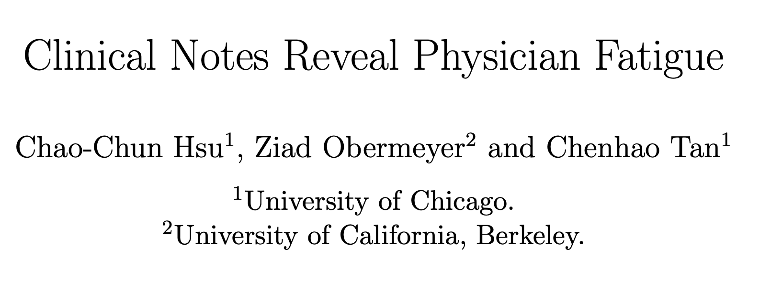

Slide 15
The paradox on physician fatigue
Physician burnout is prevalent
  In the emergency department, 65% of physicians reporting burnout, the highest rate of any medical specialty [Carbajal 2022]

Slide 16
The paradox on physician fatigue
Physician burnout is prevalent
  In the emergency department, 65% of physicians reporting burnout, the highest rate of any medical specialty [Carbajal 2022]
Research has found little evidence fatigue impacts real patient outcomes [Arnedt et al, 2005; Ayas et al, 2006; Barger et al, 2006; Johns et al, 2009; Landrigan et al, 2004; Lockley et al, 2004]
  One of the possible reason is that only coarse measures related to workload were used.

Slide 17
Can clinical notes provide a more fine-grained measure of physician fatigue?
Use clinical notes to predict physician workload
Intuitively, physician workload should not affect clinical notes
However, higher workload can lead to higher fatigue, and fatigue may affect the written notes
Other mechanisms?

Slide 18
Data and prediction task
129,228 emergency department encounters over five years (2010-2014)
60 physicians working 11,592 shifts

Slide 19
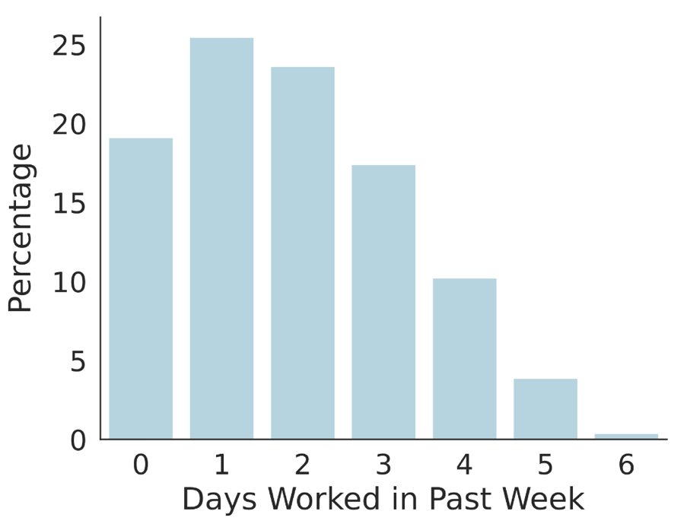
Data and prediction task
129,228 emergency department encounters over five years (2010-2014)
60 physicians working 11,592 shifts

Slide 20
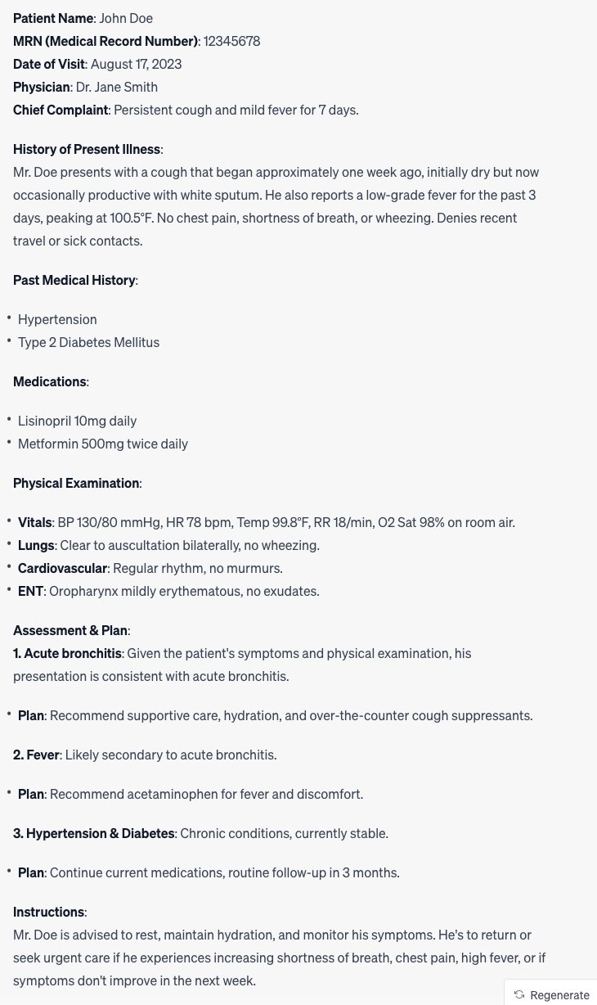
Data and prediction task

Slide 21
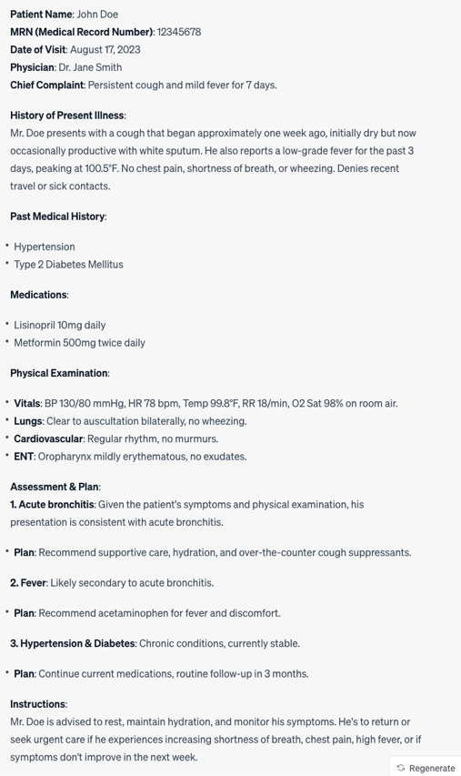
Data and prediction task
Organized by sections
History of Present Illness
Physical Examination
Assessment and plan

Slide 22
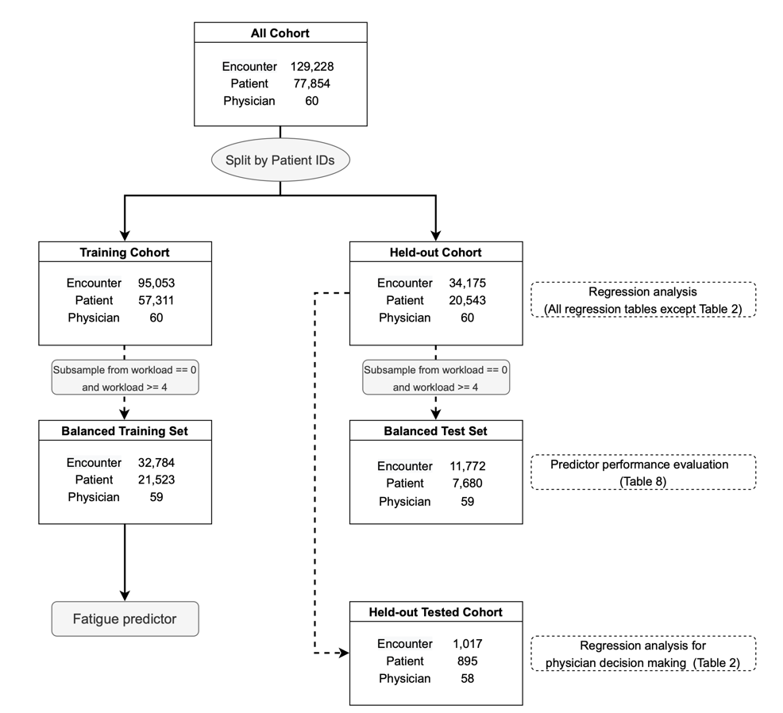
Data and prediction task
X: a given note
Y: High workload vs. low workload

Slide 23
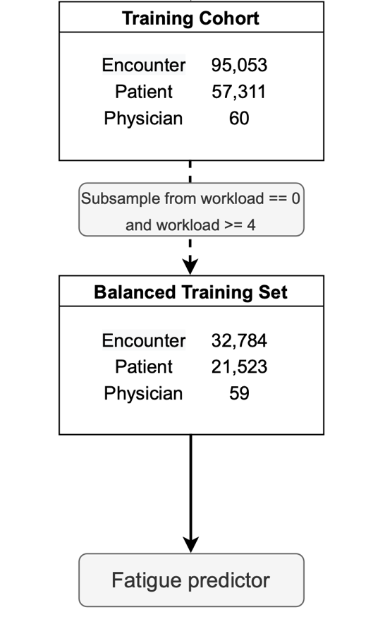
Data and prediction task
X: a given note
Y: High workload vs. low workload

Slide 24
Data and prediction task
X: a given note
Y: High workload vs. low workload
Sanity checking that fatigued doctors do not selectively see patients

Slide 25
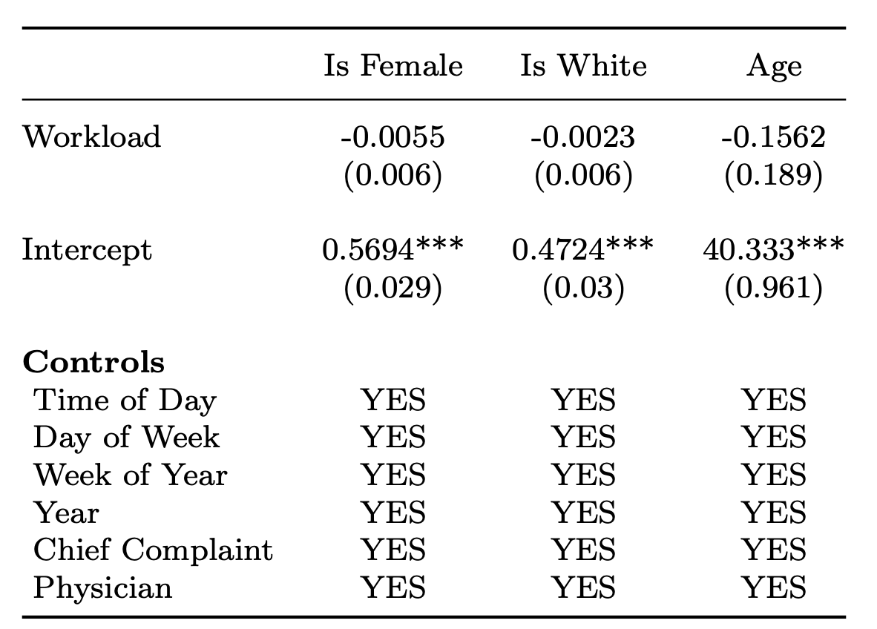
Patient sex, race, and age are not related to workload

Slide 26
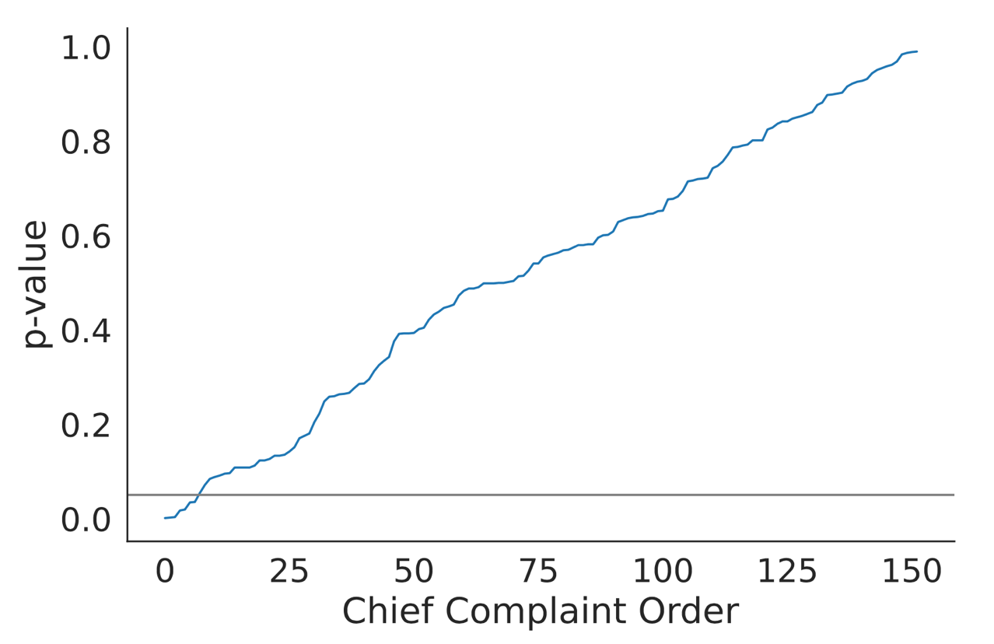
Chief complaints are not related to workload beyond chance

Slide 27

Features
Note length
Note predictability: we fine-tuned GPT-2 on the training set and then compute the negative average log probability of each word (log perplexity)

Slide 28
Features
Note length
Note predictability: we fine-tuned GPT-2 on the training set and then compute the average log probability of each word
Note readability
Counts of lexicons
  Pronoun, affect, cognitive processes (LIWC)
  Medical words from SNOMED
  Stopwords

Slide 29
Prediction performance
 | AUC-ROC | Accuracy | F1
Chief complaint baseline | 50.0 | 50.1 | 38.9
Notes | 60.1 | 57.2 | 56.6

Slide 30
Prediction performance
 | AUC-ROC | Accuracy | F1
Chief complaint baseline | 50.0 | 50.1 | 38.9
Notes | 60.1 | 57.2 | 56.6
Vicuna-7B Zero-shot | 53.5 | 53.2 | 49.1

Slide 31
Other measures of fatigue
Overnight shift: an indicator variable for whether the patient arrived between 1:00am and 5:59am
Circadian disruption: the variance of physician shift start times over the week (including the current shift)
Patients seen prior (order of physician encounter in a shift)

Slide 32
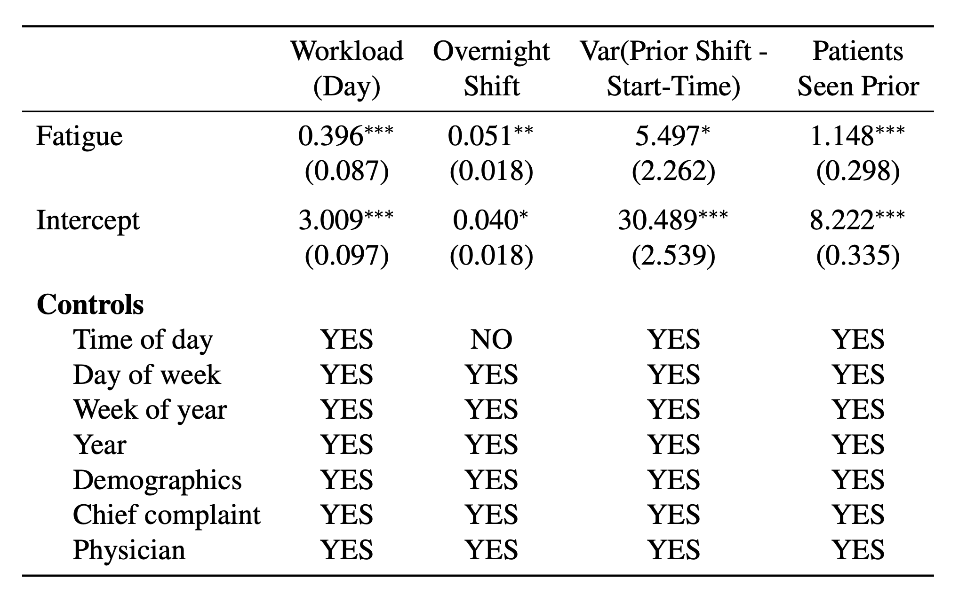
Predicted fatigue is correlated with other measures of fatigue

Slide 33
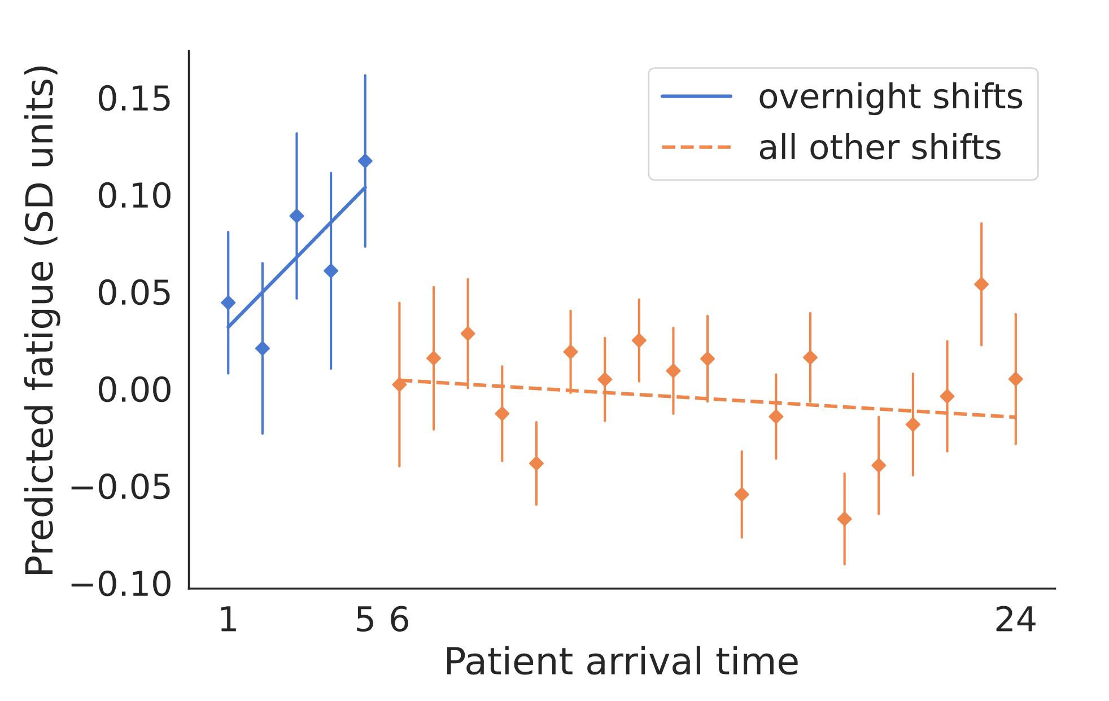
Predicted fatigue vs. patient arriving time

Slide 34
A robust physician fatigue predictor
Connection with
physician decision making
racial bias

Slide 35
Physician decision making
Emergency doctors often need to make a critical decision on whether or not to test a patient for acute coronary syndromes (ACS, colloquially heart attack) [Mullainathan and Obermeyer 2022]
Research has shown widespread over-testing [Hermann et al, 2013; Stripe et al, 2013]
Precision of assigned tests as a measure of decision quality

Slide 36
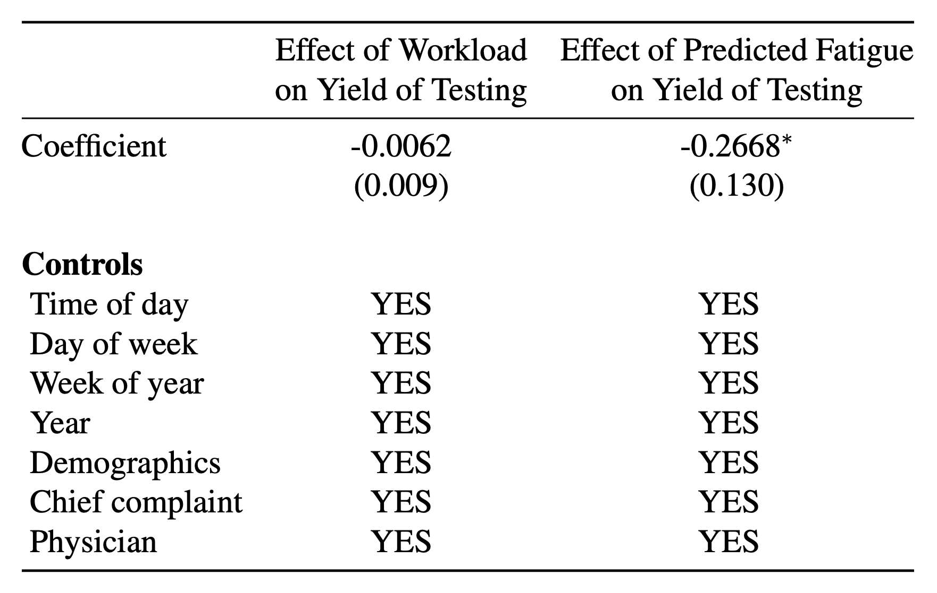
Physician decision making

Slide 37
Physician decision making
For each one standard deviation increase in fatigue, the yield of testing decreases by 18%.

Slide 38
Physician fatigue and racial bias
Growing concerns about bias [Adam et al, 2022; Card et al, 2022; Field and Tsvetkov, 2020; Garg et al, 2018; Harrigian et al, 2023; Park et al, 2021; Rho et al, 2023; Schmidt and Wiegand, 2017; Sun et al, 2022; Voigt et al, 2017]
Our fine-grained measure allows us to have a fatigue measure per note and correlate that with demographic information

Slide 39
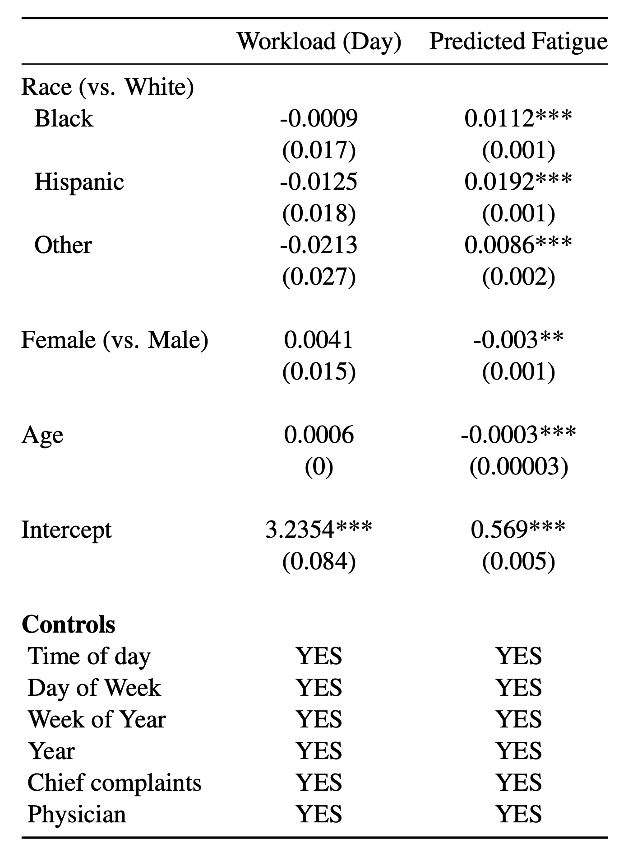
Physician fatigue and racial bias
To contextualize this effect, the effect of Black 2x that of the overnight shift, and the effect of Hispanic is 4x that of the overnight shift

Slide 40
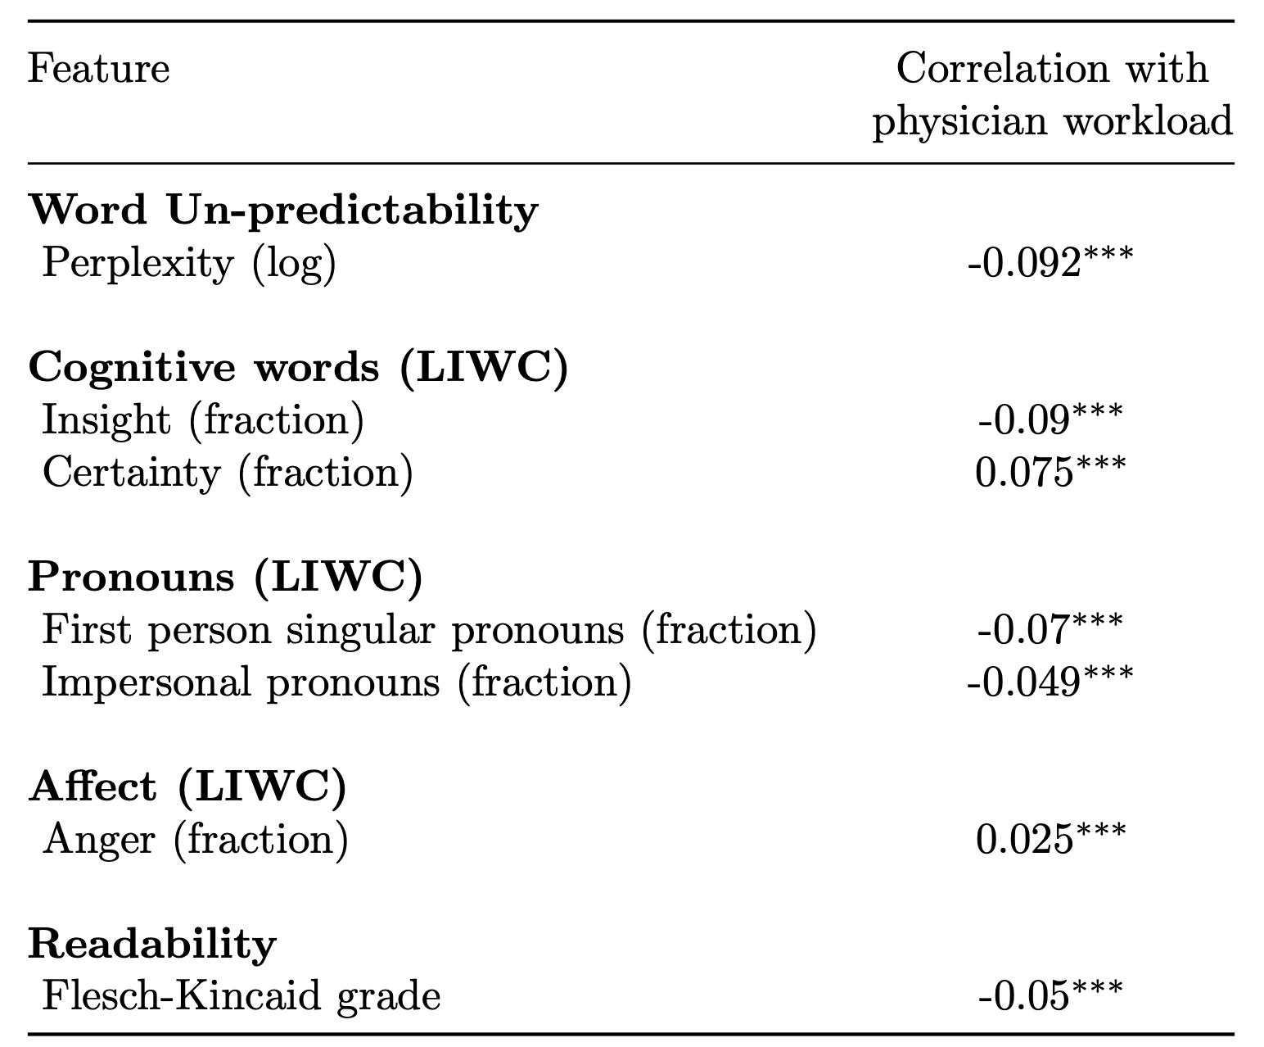
Predictive features

Slide 41
Fatigued physicians tend to write more predictable notes

Slide 42
Fatigued physicians tend to more certain but provide fewer insights

Slide 43
Fatigued physicians tend to be more angry

Slide 44
Implications on LLMs
As we have seen with the Vicuna results, domain- and task-specific model can provide better performance than zero-shot large general models.

Slide 45
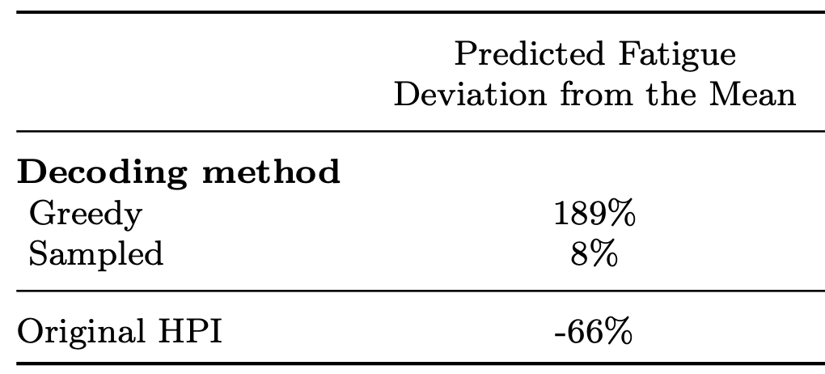
Implications on LLMs
As we have seen with the Vicuna results, domain- and task-specific model can provide better performance than zero-shot large general models.
Texts generated by LLM is predictable and appear “fatigued”
75% or 250% differences!

Slide 46
Implications on LLMs
As we have seen with the Vicuna results, domain- and task-specific model can provide better performance than zero-shot large general models.
Texts generated by LLM is predictable and appear “fatigued”
Rather than automation, LLMs can transform information solicitation and note taking in healthcare
  Physicians can solicit more valuable information
  Separate the process of meeting patients and writing notes from the process of reading notes

Slide 47
Complementary AI
Advancing theories of human decision making and interaction with AI
Reshaping AI with new objectives, datasets, and algorithms
Design and support effective interaction
Notes:
Motivation outline:
screenshots of human-centered AI
What is human-centered AI?
“empower people and benefit humanity” – UW lab for human AI interaction
For such a big goal, diverse approaches are required
vision of human-centered AI (Alignment, AGI, ethics, fairness, transparency, AI helps people live a better life and have a better world)
Human council with AI in the middle (community-driven, value-based design)
Fairness/ethics
Alignment/safety driven view to avoid bad AI
Augmenting humans in human-AI collaboration
My work focuses on human-AI collaboration, in particular, to further narrow the scope, for this talk I will focus on human-AI decision making
Decisions of interest
High-stake policy decisions
Why humans as the decision maker
Decisions are important
AI is not good enough
Human is not good enough
Explanations

Slide 48
AI as a decision aid
AI + Doctor
AI + Judge
AI + Loan officer
AI + HR manager
Notes:
medical notes, diagnosis/prognosis
loan application, approval
arrest narrative, bailing
resume, hiring decisions

Slide 49


Human decision making requires making sense of large amount of information
Notes:
Human decision making requires making sense of large amount of information
This includes reading through tens or hundreds of documents. For example, investors need to read lot of analyst reports or business news to make their decisions.
But, it’s not human’s strength to disgust this amount of information

Slide 50




Summarization can help by identifying the most relevant information
Summary
Notes:
Summarization can help in this scenario by identifying the most relevant information and save people’s efforts

Slide 51
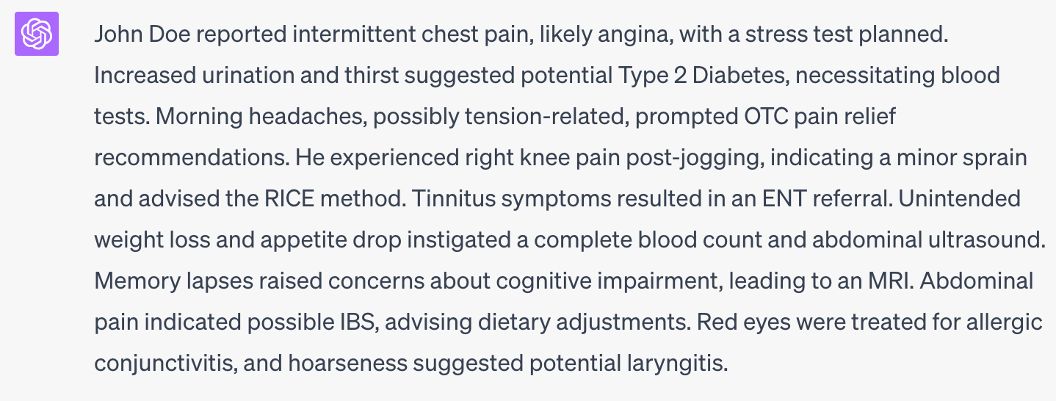
LLMs are great at summaraztion

Slide 52


Typical summarization methods do not account for a target decision
Imagine a doctor making a diagnosis for heart disease
General summary
Notes:
However, Typical summarization methods do not account for a target decision
When the amount of information increases, summarizing for all aspects can be redundant.
Imaging a doctor making a diagnosis for heart disease from a summary of medical notes

Slide 53
Typical summarization methods do not account for a target decision
Imagine a doctor making a diagnosis for heart disease
General summary
Notes:
However, Typical summarization methods do not account for a target decision
When the amount of information increases, summarizing for all aspects can be redundant.
Imaging a doctor making a diagnosis for heart disease from a summary of medical notes

Slide 54


Typical summarization methods do not account for a target decision
Imagine a doctor making a diagnosis for heart disease
General summary
Notes:
However, Typical summarization methods do not account for a target decision
When the amount of information increases, summarizing for all aspects can be redundant.
Imaging a doctor making a diagnosis for heart disease from a summary of medical notes

Slide 55
Typical summarization methods do not account for a target decision
Imagine a doctor making a diagnosis for heart disease
General summary
Notes:
However, Typical summarization methods do not account for a target decision
When the amount of information increases, summarizing for all aspects can be redundant.
Imaging a doctor making a diagnosis for heart disease from a summary of medical notes

Slide 56


Typical summarization methods do not account for a target decision
Imagine a doctor making a diagnosis for heart disease
General summary
Notes:
However, Typical summarization methods do not account for a target decision
When the amount of information increases, summarizing for all aspects can be redundant.
Imaging a doctor making a diagnosis for heart disease from a summary of medical notes

Slide 57
Decision-Focused Summarization
Imagine a doctor making a diagnosis for heart disease
Decision-focused summary
General summary
Notes:
However, Typical summarization methods do not account for a target decision
When the amount of information increases, summarizing for all aspects can be redundant.
Imaging a doctor making a diagnosis for heart disease from a summary of medical notes

Slide 58

Decision-Focused Summarization
Imagine a doctor making a diagnosis for heart disease
Decision-focused summary
General summary
Notes:
However, Typical summarization methods do not account for a target decision
When the amount of information increases, summarizing for all aspects can be redundant.
Imaging a doctor making a diagnosis for heart disease from a summary of medical notes

Slide 59

Problem Formulation:
Decision-Focused Summarization
Given input texts

Slide 60

Problem Formulation:
Decision-Focused Summarization
Select a subset of sentences
Given input texts
Decision-focused
Summary

Slide 61
Problem Formulation:
Decision-Focused Summarization
Select a subset of sentences
To support making the decision
Given input texts
Decision-focused
Summary

Slide 62


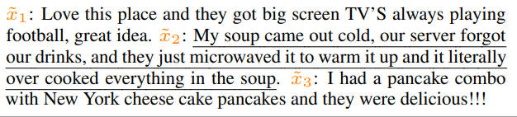
Yelp Future Rating Prediction Task
Select a subset of sentences
To support making the decision
Given input texts
Review 1: Great location! All the staff were very friendly.….
….
Review 5: Probably the worst dining experience I've had in a long time.
…
Review 10: …
2.8 / 5
first 50 reviews
Avg. token length: ~1600
Avg. sentence length: ~100
Notes:
Inspired by investment decisions given analyst reports , we consider a future rating prediction task in the context of Yelp as a testbed.
This allows us to have access to both a dataset and participants who may be able to perform this task.
Specifically, the input here will be sentences of first ten reviews, we can see that the average token length is about 1600 which is hard for human to process.
This task is analogues to the investment scenario. We are asking people to predict a restaurant's future price given current analyses

Slide 63
Yelp Future Rating Prediction Task
Select a subset of sentences
To support making the decision
Given input texts
Review 1: Great location! All the staff were very friendly.….
….
Review 5: Probably the worst dining experience I've had in a long time.
…
Review 10: …
2.8 / 5
first 50 reviews
Avg. token length: ~1600
Avg. sentence length: ~100
Notes:
Inspired by investment decisions given analyst reports , we consider a future rating prediction task in the context of Yelp as a testbed.
This allows us to have access to both a dataset and participants who may be able to perform this task.
Specifically, the input here will be sentences of first ten reviews, we can see that the average token length is about 1600 which is hard for human to process.
This task is analogues to the investment scenario. We are asking people to predict a restaurant's future price given current analyses

Slide 64
Example summary
IHOP
I had a pancake combo with New York cheese cake pancakes and they were delicious ! ! !.
This place was great
I got to eat breakfast and watch the football game !.
Finally a local IHOP, great service and always delicious breakfast.
Nice clean place.
Tasty Kabob
Also they have the best Persian Ice Cream which is only one 1/3 flavor ....
what is the flavor??
(its a secret, you will have to go there
and find out !).
Tasty Kabob is a must see on any
Hookah bar tour.
Tasty Kabob, while among the best Persian restaurants in Arizona, falls short of Famous Kabob in Sacramento and many Los Angeles joints.
Notes:
Add text

Slide 65
DecSum
Supervised model, f : X -> y
Objective components:
      Decision faithfulness
      Decision representativeness
      Textual non-redundancy
Notes:
We also proposed an extractive decision-focused summarization method for this problem
We will use a supervised model that is trained to infer the decision from the full input X
And we have three loss objective components:
Decision faithfulness, decision representativeness, and textual non-redundancy
… … ..
next I will explain each in detail

Slide 66
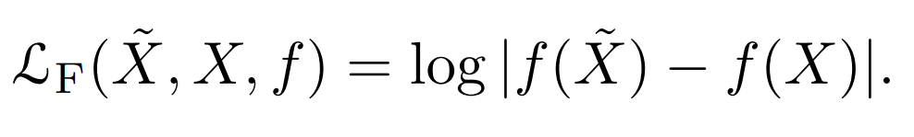




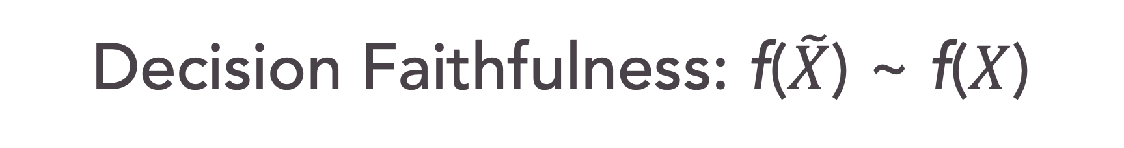
Decision Faithfulness: f($\tilde{X}$) ~ f($X$)
Decision-focused Summary
DecSum results in the same decision
Notes:
In Decision Faithfulness component, we want the generated summary leading to the same decision with using the full input based on the supervised model.
That is, we want the f(tilde X) to be as close as possible to f(X)

Slide 67

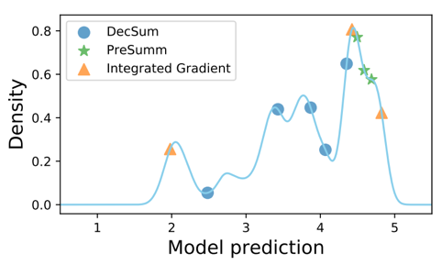
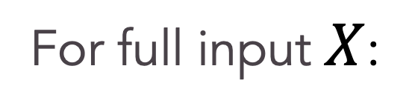
Decision Representativeness
Decision distribution of individual sentences
For full input $X$:
Sentence-level predicted score
Notes:
By applying the supervised model to each of sentence in the summary (tilde X), we can get sentence-level decision distribution of selected summary.
In this decision representativeness component, we compute the distance between decision distributions of full input and summary by Wasserstein distance.

Slide 68


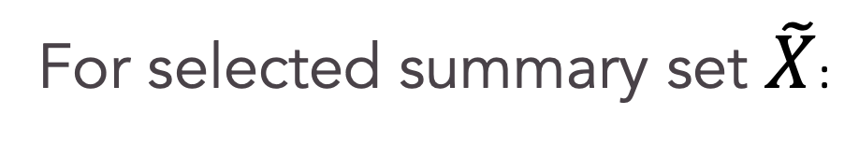
Decision Representativeness
Decision distribution of individual sentences
For full input $X$:
For selected summary set $\tilde{X}$:
Wasserstein Distance
Sentence-level predicted score
Notes:
By applying the supervised model to each of sentence in the summary (tilde X), we can get sentence-level decision distribution of selected summary.
In this decision representativeness component, we compute the distance between decision distributions of full input and summary by Wasserstein distance.

Slide 69
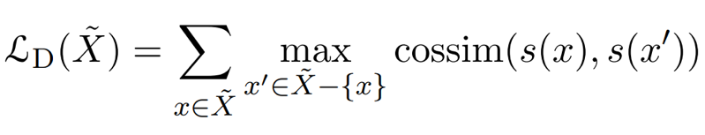
Textual Non-redundancy
Where s(x) means using sentence embedding
from SentBERT [Reimers and Gurevych, 2019]
Notes:
The last component is Textual Non-redundancy. This is similar with typical summarization methods where we want the summary to cover diverse aspects of input documents.
Specifically, for each sentence in the selected summary set, we want it to be dissimilar with other selected sentences.

Slide 70
Greedy algorithm to iteratively select sentences
Notes:
Finally, we use Greedy algorithm to iteratively select sentences with hyperparameters to control the strength of each component

Slide 71
Baselines
  Text-only summarization methods:
    BART – abstractive summarization
    PreSumm – BERT-based extractive summarization
    Random selection
Notes:
In the experiment, we have two groups of baseline methods

Slide 72
Baselines
  Text-only summarization methods:
    BART – abstractive summarization
    PreSumm – BERT-based extractive summarization
    Random selection
  Model-based explanation methods
  (based on supervised model):
    Integrated Gradient (IG)
    Attention
Notes:
We also compare with model-based explanation methods because they also use the supervised model to assign sentence importance scores: they are integrated gradient and attention

Slide 73
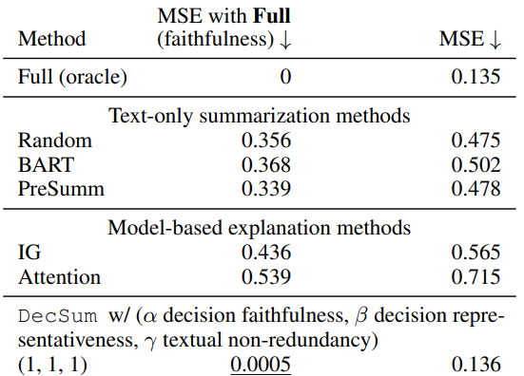
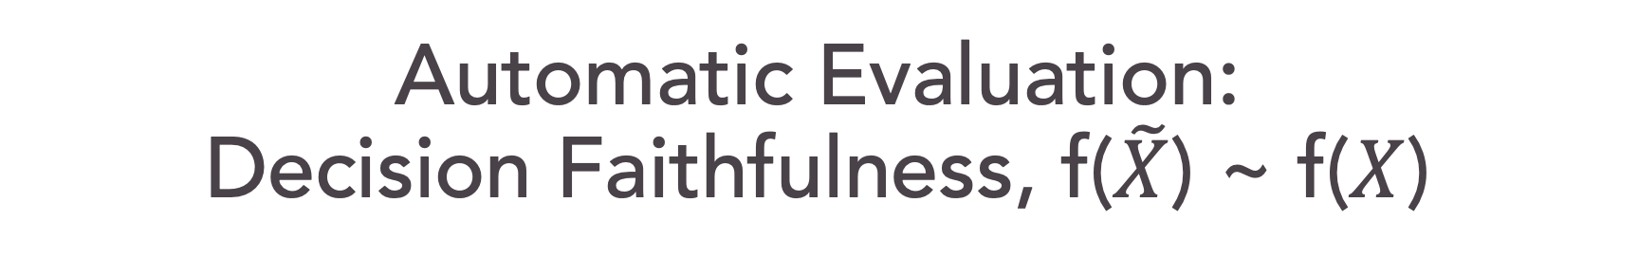
Automatic Evaluation:
Decision Faithfulness, f($\tilde{X}$) ~ f($X$)
Notes:
Let see the columns in the middle , MSE with Full means mean square error between f(tilde x) and f(x). The lower the better.

Slide 74
Automatic Evaluation:
Decision Faithfulness, f($\tilde{X}$) ~ f($X$)

Slide 75
Automatic Evaluation:
Decision Faithfulness, f($\tilde{X}$) ~ f($X$)
Notes:
And finally, it’s the proposed DecSum, we can see that with three components on with hyperparameters (1,1,1,).
Which means our method can select the set of sentences that lead to similar decision compared with using all 10 reviews

Slide 76
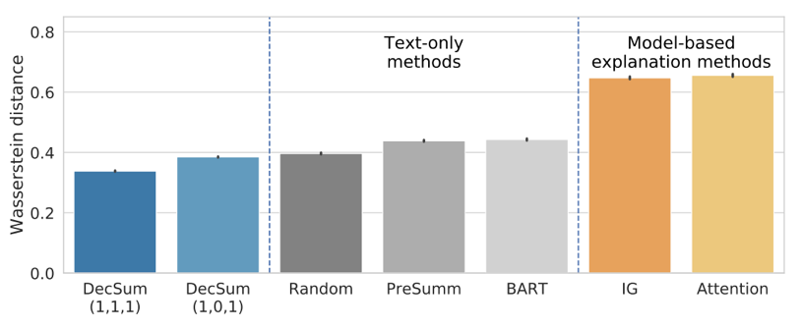



Automatic Evaluation:
Decision Representativeness
Notes:
In automatic evaluation of decision representativeness, we measure the distance of sentence-level decision distribution of selected summary and full input by Wasserstein distance
On the right hand size, model based explanation methods are much worse than other methods because they tend to select sentences with extreme sentiment.

Slide 77
Simplified task for human evaluation:
Compare future ratings of two restaurants
First 10 reviews of the restaurant A
3.8/5, first 10 reviews
First 10 reviews of the restaurant B
3.8/5, first 10 reviews
Notes:
Then we generate the summaries of two restaurants based on the same summarization method

Slide 78
Simplified task for human evaluation:
Compare future ratings of two restaurants
First 10 reviews of the restaurant A
3.8/5, first 10 reviews
First 10 reviews of the restaurant B
3.8/5, first 10 reviews
Using the same summarization method
Summary A
Summary B
Notes:
Then we generate the summaries of two restaurants based on the same summarization method

Slide 79
Simplified task for human evaluation:
Compare future ratings of two restaurants
First 10 reviews of the restaurant A
3.8/5, first 10 reviews
First 10 reviews of the restaurant B
3.8/5, first 10 reviews
Summary A
Summary B
Which restaurant will be rated better after 50 reviews?
Notes:
Then we generate the summaries of two restaurants based on the same summarization method

Slide 80
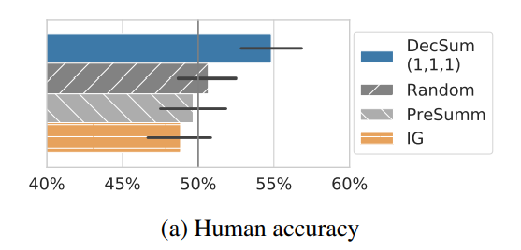
Human Performance
This task is very challenging for humans
Only DecSum allows humans to outperform random (50%)
Notes:
x-axis is human accuracy on 200 restaurant pairs .

Slide 81
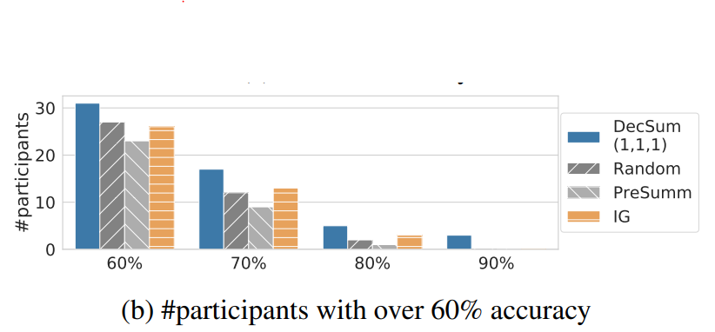
Human Performance
This task is very challenging for humans
Only DecSum allows humans to outperform random (50%)
3 participants can achieve 90% acc. with DecSum
Notes:
x-axis is human accuracy on 200 restaurant pairs .

Slide 82
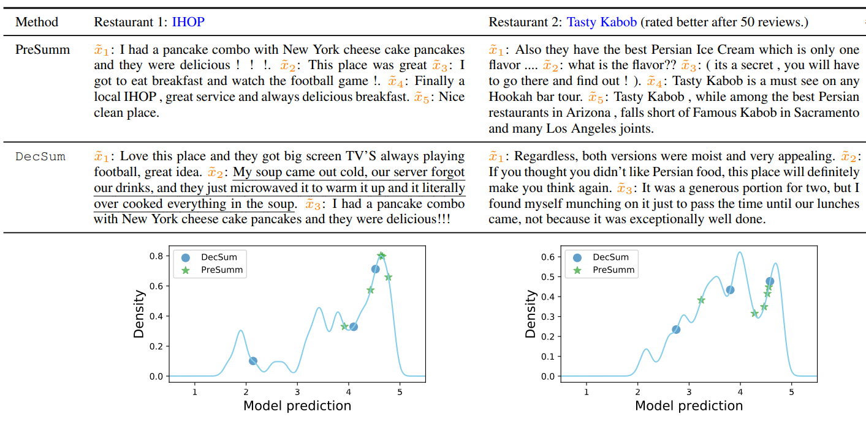
Example revisisted
Notes:
This is the example restaurant pairs from two methods
We can see that on the decision distribution plots, the green stars are sentences of presumm.
They are all lie in the region that is indicative of higher future ratings on two plot, so humans can not distinguish the future rating with PreSumm.
In contrast, DecSum can select a sentence That is indicative of future lower ratings and help humans to make a correct prediction that IHOP will be rated lower after 50 reviews.

Slide 83
Summary
A new summarization formulation: decision-focused summarization
DecSum method can outperform text-only summarization methods and model-based explanation methods on both automatic evaluations and human evaluation
Many future applications in finance and medicine
Notes:
Add contact information, and figure 1

Slide 84
Human-centered AI
Advancing theories of human decision making and interaction with AI
Reshaping AI with new objectives, datasets, and algorithms
Design and support effective interaction
chenhao@chenhaot.com
Notes:
Motivation outline:
screenshots of human-centered AI
What is human-centered AI?
“empower people and benefit humanity” – UW lab for human AI interaction
For such a big goal, diverse approaches are required
vision of human-centered AI (Alignment, AGI, ethics, fairness, transparency, AI helps people live a better life and have a better world)
Human council with AI in the middle (community-driven, value-based design)
Fairness/ethics
Alignment/safety driven view to avoid bad AI
Augmenting humans in human-AI collaboration
My work focuses on human-AI collaboration, in particular, to further narrow the scope, for this talk I will focus on human-AI decision making
Decisions of interest
High-stake policy decisions
Why humans as the decision maker
Decisions are important
AI is not good enough
Human is not good enough
Explanations

