Slide 1
Towards Human-centered AI: How to Generate Useful Explanations for Human-AI Decision Making
Chenhao Tan
Chicago Human+AI Lab
University of Chicago
https://chenhaot.com
chenhao@uchicago.edu

Slide 2



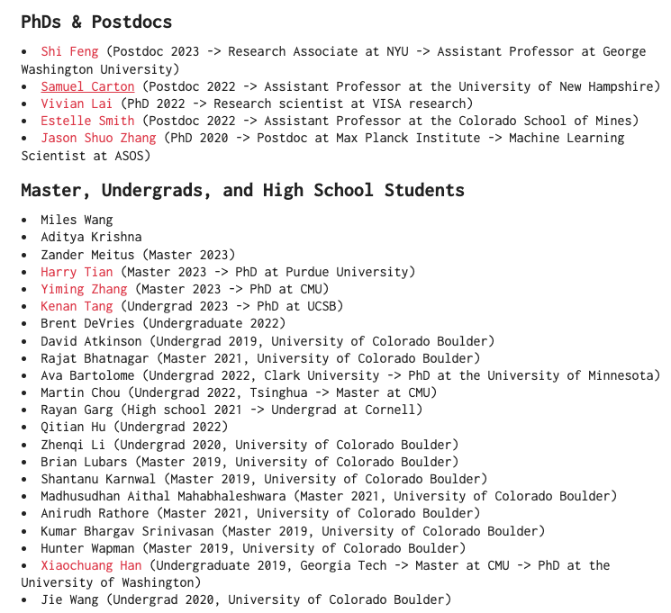







Members of CHAI
Notes:
Sameer, hima, amit, vera, allison

Slide 3
Notes:
This talk is about the relationship between humans and AI

Slide 4
In pursuit of “intelligence”
Notes:
One path for developing AI is to make the AI bigger and stronger in pursuit of intelligence.

Slide 5

Generated by DALL·E 3

Slide 6
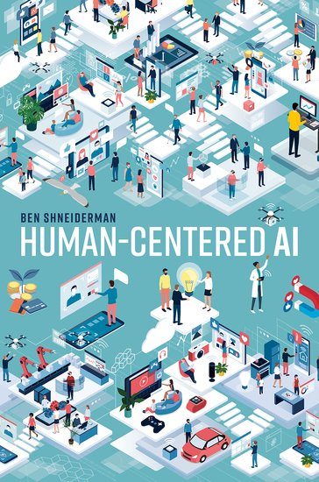
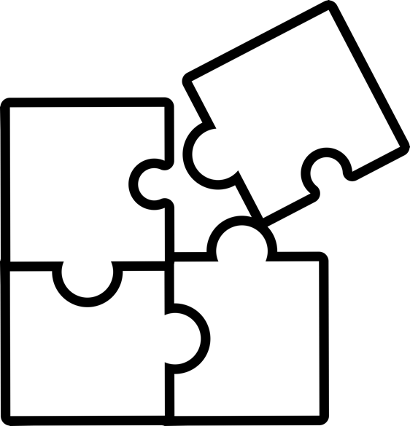
Shift from emulating humans to empowering people
Challenge PNGs by Vecteezy
Notes:
An alternatively reality is to developing AI systems that takes into account humans so that AI empower people and benefit humanity

Slide 7

Shift from emulating humans to empowering people
Challenge PNGs by Vecteezy
Notes:
An alternatively reality is to developing AI systems that takes into account humans so that AI empower people and benefit humanity

Slide 8
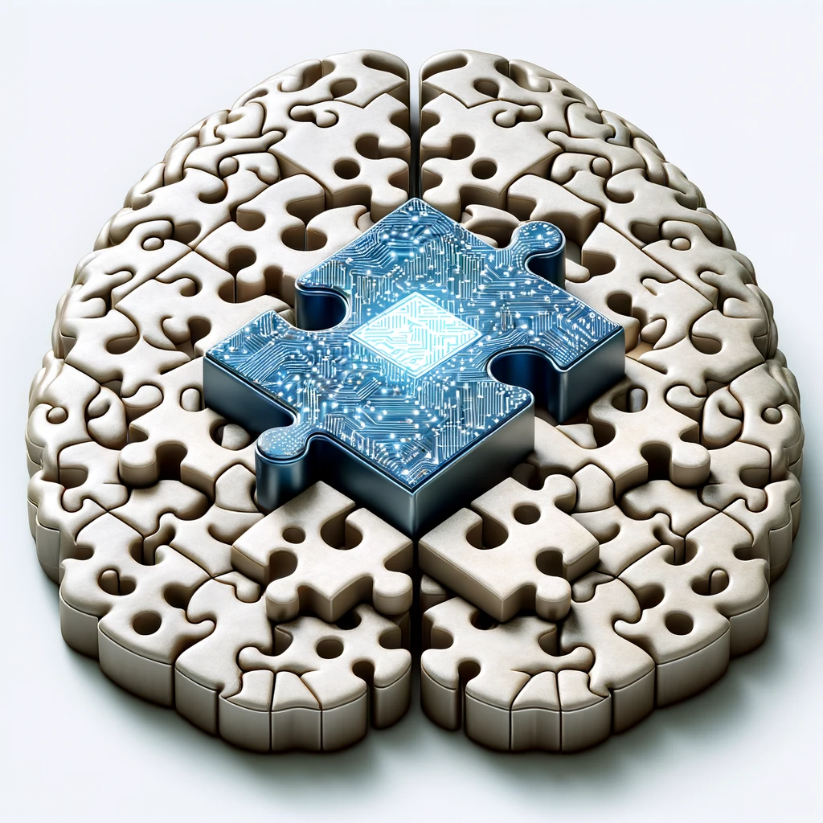
Shift from emulating humans to empowering people
Notes:
An alternatively reality is to developing AI systems that takes into account humans so that AI empower people and benefit humanity

Slide 9
+
How can we effectively develop AI to
support humans in decision making?
Notes:
On the one hand, AI researchers decries about the ability of AI
On the other hand, legal

Slide 10



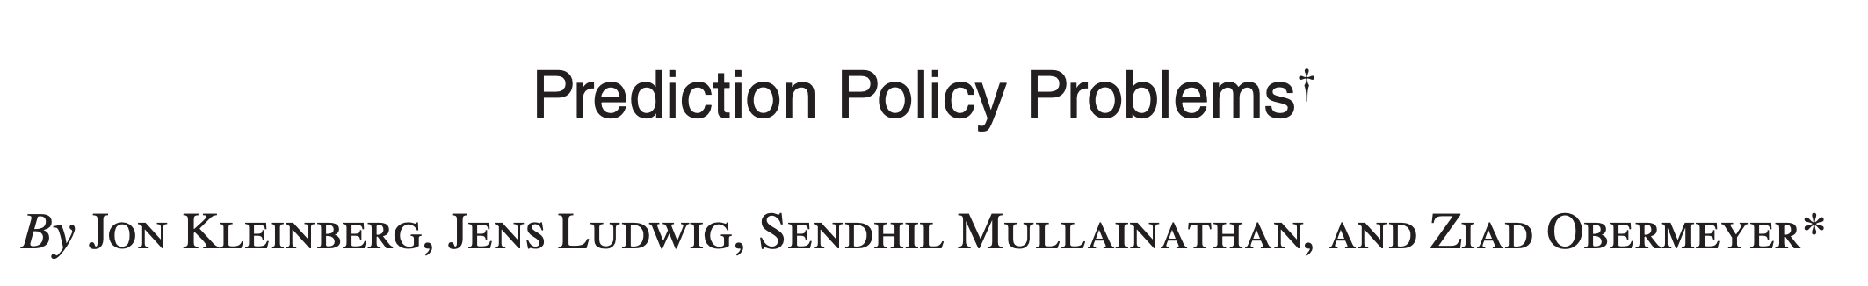
Decisions
Notes:
Bailing decisions, long covid,
Mention the prediction policy problems paper

Slide 11
Humans should be in charge
Accountability, law, ethics
“a COMPAS risk assessment should not be used to determine the severity of a sentence or whether an offender is incarcerated …”
and “… judges be made aware of the limitations of risk assessment tools.. ”
Supreme Court of Wisconsin 2016

Slide 12
Human decisions are far from perfect
High-stakes decisions often involve reasoning about complicated social and biological processes with inherent uncertainty
Humans have mechanisms, biases and preferences in decision making

Slide 13
Human decisions are far from perfect
High-stakes decisions often involve reasoning about complicated social and biological processes with inherent uncertainty
Humans have mechanisms, biases and preferences in decision making

Slide 14
Ripe opportunities for AI Assistance
+
This talk will focus on explanations
Notes:
On the one hand, AI researchers decries about the ability of AI
On the other hand, legal

Slide 15
Explanations may help humans make sense of AI predictions and improve their decision making
Notes:
Our primary interest is about how to benefit human

Slide 16
”Open the black box”
LIME [Ribeiro et al. 2016]
SHAP [Lundberg & Lee 2017]
Attention [Jain and Wallace 2019, Wiergreffe and Pinter 2019, Serrano and Smith 2019]
Integrated gradients [Sundararajan et al. 2017]
Influence function [Koh & Liang 2017]
Counterfactual examples [Mothilal et al. 2019]
…
Explanation
Most algorithms for generating explanations ignore humans, both in evaluation and generation
Notes:
Our primary interest is about how to benefit human

Slide 17
Explanation
Interpretation

Slide 18

Explanation
Interpretation
Human-centered application-grounded evaluations
Theoretical framework for AI explanation and human understanding
Align AI explanations with human intuitions

Slide 19
Explanation
Interpretation
Human-centered application-grounded evaluations
Theoretical framework for AI explanation and human understanding
Align AI explanations with human intuitions

Slide 20
On Human Predictions with Explanations and Predictions of Machine Learning Models:
A Case Study on Deception Detection
FAccT 2019
Vivian Lai, Chenhao Tan

Slide 21
Is the review genuine or deceptive?
My stay at the Talbott was a wonderful experience. The service at this upscale hotel was beyond my expectations, the Gold Coast location is close to Michigan Ave, the museums, and many of the other sites Chicago has to offer. If you are visiting Chicago, I highly recommend the Talbott!
[Li et al. 2014; Ott et al. 2011; Ott et al. 2013]
Notes:
The most straightforward assistance is to show the machine predicted label. In fact, this is what is done in the COMPAS case for risk assessment in justice systems. Here we show an example in deception detection and says that the machine predicts the review to be deceptive.

Slide 22
Feature-based explanations
My stay at the Talbott was a wonderful experience. The service at this upscale hotel was beyond my expectations, the Gold Coast location is close to Michigan Ave, the museums, and many of the other sites Chicago has to offer. If you are visiting Chicago, I highly recommend the Talbott!
[Li et al. 2014; Ott et al. 2011; Ott et al. 2013]
Notes:
In this case, we can highlight important words. You can see that Chicago is highlighted in this review. Why? This is puzzling since this dataset is built for hotels in Chicago. Extensive prior work has looked into this issue. The reason is that humans are less specific when writing about imagined experience, so they are more likely to mention the city name instead of specific places. There are some genuine insights here that one may generalize even beyond Chicago, but it can be hard to understand based on these highlights alone.

Slide 23
Example-based explanations
My stay at the Talbott was a wonderful experience. The service at this upscale hotel was beyond my expectations, the Gold Coast location is close to Michigan Ave, the museums, and many of the other sites Chicago has to offer. If you are visiting Chicago, I highly recommend the Talbott!
Deceptive example
Genuine example
I recently had the pleasure of spending three nights at the Hotel Allegro Chicago to attend a corporate meeting. To say the rooms at this beautifully renovated hotel are stylish is an understatement. I stayed in one of the more moderately priced rooms yet found all the amenities of premium rooms at other hotels. My room was spacious and furnished in a retro-modern style. A fully stocked refreshment center, wet bar, […]
My husband, teenage son and myself stayed at this hotel last August. We were transferred there by tour operator who had sent us to a terrible hotel on the other side of Chicago. When I complained I asked for us to be transferred to the Sheraton which they arranged for us. I have stayed at many hotels in my life and this has been the best. The room (although I know it was not the largest) was beautiful and very clean with every amenity you needed. […]
Notes:
Alternatively, we can also use examples. You can see that it incurs a lot of cognitive burden. So it might be even worse than highlighting words.
Deceptive: I recently had the pleasure of spending three nights at the Hotel Allegro Chicago to attend a corporate meeting. To say the rooms at this beautifully renovated hotel are stylish is an understatement. I stayed in one of the more moderately priced rooms yet found all the amenities of premium rooms at other hotels. My room was spacious and furnished in a retro-modern style. A fully stocked refreshment center, wet bar, and LCD HD TV were amongst the standard items. The Allegro is in the center of everything, the Chicago Loop of the financial district, the Chicago Theatre district, great shopping on Slate Street and fine dinning is available adjacent to the hotel (I suggest the 312 Lunch Club). The fitness room is well equipped and clean. The professional and friendly service was the icing on the cake during my stay at the Allegro. My next visit to the Chicago area will definitely include a stay at the Hotel Allegro Chicago.
Genuine: My husband, teenage son and myself stayed at this hotel last August. We were transferred there by tour operator who had sent us to a terrible hotel on the other side of Chicago. When I complained I asked for us to be transferred to the Sheraton which they arranged for us. I have stayed at many hotels in my life and this has been the best. The room (although I know it was not the largest) was beautiful and very clean with every amenity you needed. It also had superb views of the river and the lake. The entrance hall to the Sheraton is so imressive as is the leisure centre. In fact all areas are fantastic. The best thing about the hotel though was the staff! From the bellboy, to the receptionists, the dining staff to the concierge - each one was courteous and so very helpful. One of the conciergies spent fifteen minutes on the phone trying to locate a specific pair of trainers for my son! Above and beyond the call I would say! I cannot reccomend this hotel highly enough. The breakfast buffet cost about 10 dollars each but you could eat as much as you like and take as long as you like which we did!! It lasted us all day. If you have the choice of where to stay I think you will enjoy the Sheraton! We did!!

Slide 24
A spectrum between full human agency & full automation
Showing machine
predicted labels and explanations
Showing only explanations
Showing machine predicted labels
Showing machine predicted labels and suggesting high accuracy
Full human
agency
Full
automation
The amount of information from the machine generally increases as we move from the left to the right.
https://machineintheloop.com/
Notes:
That completes the spectrum of AI-assisted decision making, which was first proposed in this work. The amount of information from the machine increases as we move from the left to the right. There has been more work that enrich this spectrum with additional designs and help us better understand decision making with a machine in the loop.

Slide 25
A spectrum between full human agency & full automation
Showing machine
predicted labels and explanations
Showing only explanations
Showing machine predicted labels
Showing machine predicted labels and suggesting high accuracy
Full human
agency
Full
automation
The amount of information from the machine generally increases as we move from the left to the right.
Human performance
Trust
https://machineintheloop.com/
Notes:
That completes the spectrum of AI-assisted decision making, which was first proposed in this work. The amount of information from the machine increases as we move from the left to the right. There has been more work that enrich this spectrum with additional designs and help us better understand decision making with a machine in the loop.

Slide 26
A spectrum between full human agency & full automation
Showing machine
predicted labels and explanations
Showing only explanations
Showing machine predicted labels
Showing machine predicted labels and suggesting high accuracy
Full human
agency
Full
automation
The amount of information from the machine generally increases as we move from the left to the right.
Human performance
Trust
https://machineintheloop.com/
Notes:
That completes the spectrum of AI-assisted decision making, which was first proposed in this work. The amount of information from the machine increases as we move from the left to the right. There has been more work that enrich this spectrum with additional designs and help us better understand decision making with a machine in the loop.

Slide 27
Notes:
We find that explanations alone slightly improve human performance. If we use heatmap highlights, human performance is significantly better than without any assistance, but is still below 60%.

Slide 28
Human+AI < AI
Notes:
We find that explanations alone slightly improve human performance. If we use heatmap highlights, human performance is significantly better than without any assistance, but is still below 60%.

Slide 29
[Agarwal et al. 2023; Angelova et al 2023; Carton et al. 2020; Green and Chen 2019; Lai et al. 2021; Lai and Tan 2019; Lin et al. 2020; Wang and Yin 2021; and many more]
Human+AI < AI
Notes:
We find that explanations alone slightly improve human performance. If we use heatmap highlights, human performance is significantly better than without any assistance, but is still below 60%.

Slide 30

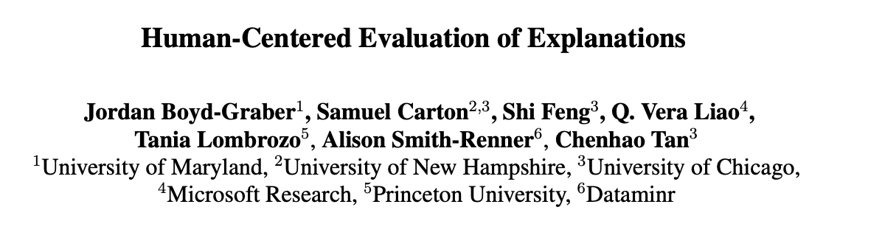


Slide 31
[Agarwal et al. 2023; Angelova et al 2023; Carton et al. 2020; Green and Chen 2019; Lai et al. 2021; Lai and Tan 2019; Lin et al. 2020; Wang and Yin 2021; and many more]
Scalable oversight
[Bowman et al. 2022]
Human+AI < AI
Notes:
We find that explanations alone slightly improve human performance. If we use heatmap highlights, human performance is significantly better than without any assistance, but is still below 60%.

Slide 32
Explanation
Interpretation
Human-centered evaluations reveal that current explanations fail to improve human decision making
Theoretical framework for AI explanation and human understanding
Align AI explanations with human intuitions

Slide 33
Explanation
Interpretation
Human-centered evaluations reveal that current explanations fail to improve human decision making
Theoretical framework for AI explanation and human understanding
Align AI explanations with human intuitions

Slide 34



Machine Explanations and Human Understanding
TMLR 2023; FAccT 2023
Chacha Chen, Shi Feng, Amit Sharma, Chenhao Tan

Slide 35
Mixed and even conflicting results on the effect of explanations

With feature importance in decision making, human + AI < AI
[Lai & Tan, 2019]
Interpretation

Slide 36
Mixed and even conflicting results on the effect of explanations

With feature importance in decision making, human + AI < AI
[Lai & Tan, 2019]

Interpretation
Feature importance improve
model debugging.
[Ribeiro et al., 2016]

Slide 37
Making sense of current results
What are we trying to achieve with explanations?
Under what conditions, can explanation improve human understanding, and in which way?

Slide 38
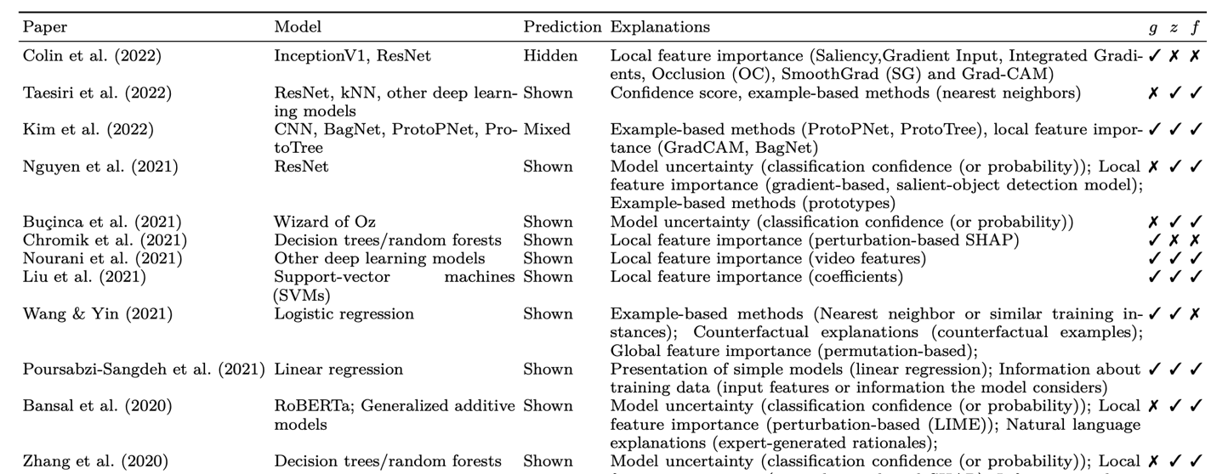
What are we trying to achieve with explanations?
30+ papers
https://github.com/Chacha-Chen/Explanations-Human-Studies
Notes:
So we looked at the literature and summarized all recent papers from major conferences that have human studies to quantitatively measure human understanding.
We found 30 papers in total.
And you can find more details in Table 2 in our paper.
The goal of doing that is to find a consensus on the definition of human understanding.

Slide 39
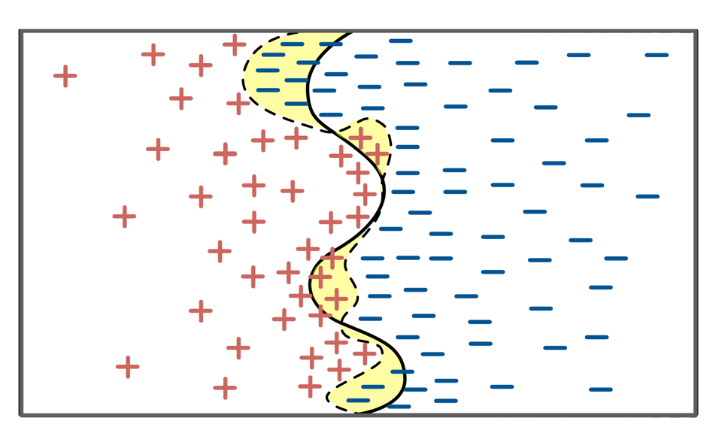
Three core concepts of human understanding
Notes:
From this literature review, we identified three
The figure is an Illustration of the three core concepts using a binary classification problem.

Slide 40
Three core concepts of human understanding
Notes:
From this literature review, we identified three
The figure is an Illustration of the three core concepts using a binary classification problem.

Slide 41
Three core concepts of human understanding
Notes:
From this literature review, we identified three
The figure is an Illustration of the three core concepts using a binary classification problem.

Slide 42
Three core concepts of human understanding
Notes:
From this literature review, we identified three
The figure is an Illustration of the three core concepts using a binary classification problem.

Slide 43
Existing quantitative measures of human understanding map to one of these three concepts.
Notes:
From this literature review, we identified three
The figure is an Illustration of the three core concepts using a binary classification problem.

Slide 44
Existing quantitative measures of human understanding map to one of these three concepts.
Measuring human understanding of task decision boundary
Human + AI performance [Doshi-Velez & Kim, 2017; Bucinca et al., 2021; Poursabzi-Sangdeh et al., 2021; Bansal et al., 2020; Zhang et al., 2020; ……]
Measuring human understanding of model decision boundary
Human simulatability [Chandrasekaran et al., 2018; Poursabzi-Sangdeh et al., 2021; Wang & Yin, 2021; Ribeiro et al., 2018; Alqaraawi et al., 2020;……]
Counterfactual reasoning [Friedler et al., 2019; Lucic et al., 2020]
Feature importance [Wang & Yin, 2021; Ribeiro et al., 2016]
Measuring human understanding of model error
Human trust [Wang & Yin, 2021; Bucinca et al., 2021; Zhang et al., 2020, Bansal et al., 2019; Poursabzi-Sangdeh et al., 2021; Bansal et al., 2020;……]
Notes:
Here are some examples of how current papers can be mapped into our identified three core concepts.
as mentioned earlier, the common way of measuring human understanding of the model decision boundary is by human simulatability.
An example of measuring human understanding of task decision boundary is via human plus AI performance.
we can also measure model error by human trust.

Slide 45
A formal framework to describe the interaction between AI explanations and human understanding
Notes:
We use causal diagrams to discuss on different conditions how explanations can or can not help improve human understanding.
This is an overview.
Due to the time limit, I won't go into the details of the framework. But i encourage you to check our paper.
In the highest level, this framework allows us to have a rigorous formal discussion of how explanations interact with human understanding.

Slide 46
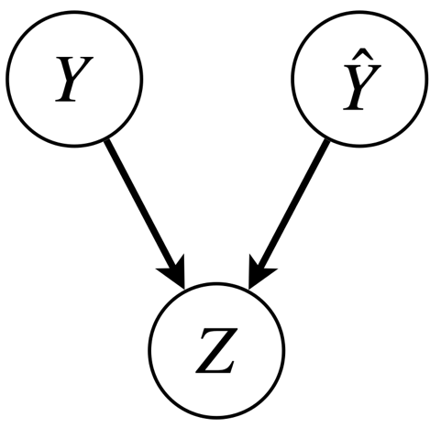
Formalizing core concepts and human understanding of them
Notes:
We use causal diagrams to discuss on different conditions how explanations can or can not help improve human understanding.
This is an overview.
Due to the time limit, I won't go into the details of the framework. But i encourage you to check our paper.
In the highest level, this framework allows us to have a rigorous formal discussion of how explanations interact with human understanding.

Slide 47
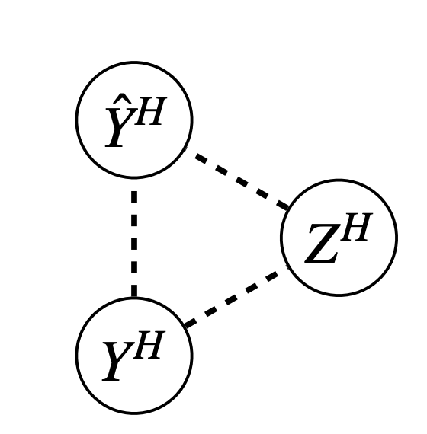
Formalizing core concepts and human understanding of them
Notes:
We use causal diagrams to discuss on different conditions how explanations can or can not help improve human understanding.
This is an overview.
Due to the time limit, I won't go into the details of the framework. But i encourage you to check our paper.
In the highest level, this framework allows us to have a rigorous formal discussion of how explanations interact with human understanding.

Slide 48
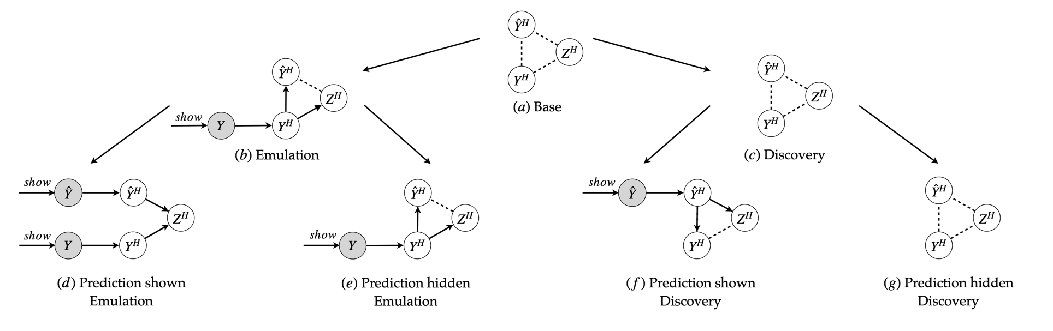
Unfolding the relationships without explanations
Notes:
We use causal diagrams to discuss on different conditions how explanations can or can not help improve human understanding.
This is an overview.
Due to the time limit, I won't go into the details of the framework. But i encourage you to check our paper.
In the highest level, this framework allows us to have a rigorous formal discussion of how explanations interact with human understanding.

Slide 49
Unfolding the relationships without explanations
Notes:
We use causal diagrams to discuss on different conditions how explanations can or can not help improve human understanding.
This is an overview.
Due to the time limit, I won't go into the details of the framework. But i encourage you to check our paper.
In the highest level, this framework allows us to have a rigorous formal discussion of how explanations interact with human understanding.

Slide 50
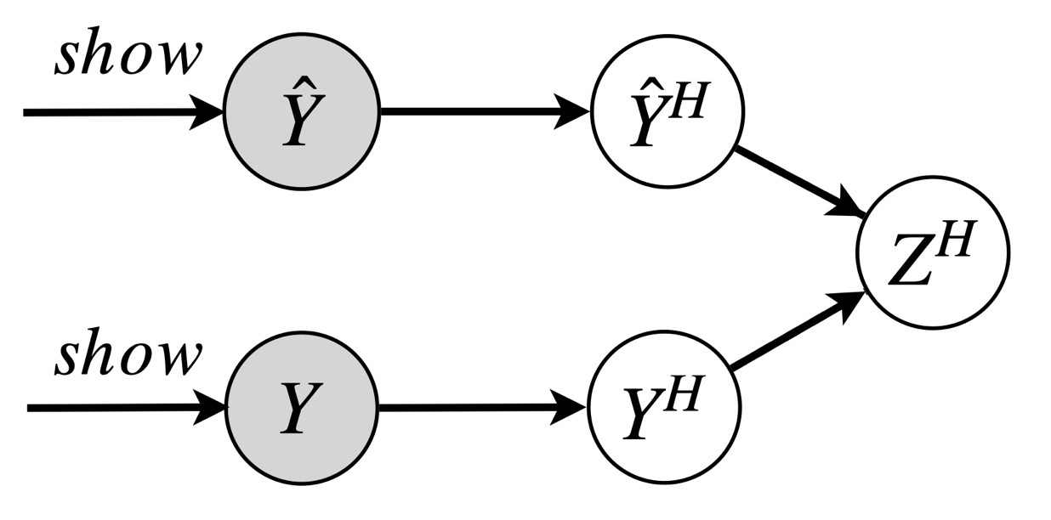
Unfolding the relationships without explanations
Notes:
We use causal diagrams to discuss on different conditions how explanations can or can not help improve human understanding.
This is an overview.
Due to the time limit, I won't go into the details of the framework. But i encourage you to check our paper.
In the highest level, this framework allows us to have a rigorous formal discussion of how explanations interact with human understanding.

Slide 51
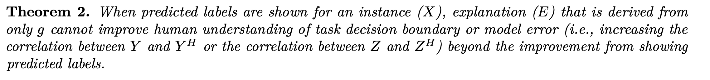
Role of explanations
Notes:
our key finding is that human intuitions are necessary for effective machine explanations.
Without assumptions about task-specific human intuitions,
Machine explanations may potentially improve

Slide 52
Role of explanations
Without assumptions about task-specific human intuitions, explanations can improve human understanding of

model decision boundary

task decision boundary

model error
Notes:
our key finding is that human intuitions are necessary for effective machine explanations.
Without assumptions about task-specific human intuitions,
Machine explanations may potentially improve

Slide 53
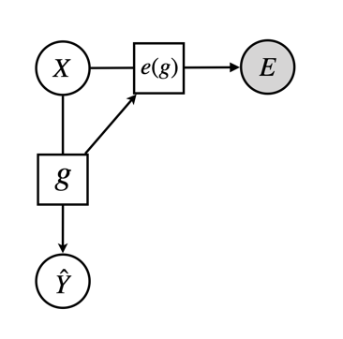

Existing explanations are mostly generated from AI
A theoretical framework.
Explanation
Notes:
To contextualize this, here is a causal diagram showing that existing explanations are derived from model decision boundary.
In the figure, we have input X, and the trained machine learning model g, and a prediction yhat.
Explanations are generated from a function of the trained model g and the input X, symbolized here as e(g)
So, what we're seeing is that the explanations we usually get are inherently tied to the model’s decision boundary.

Slide 54

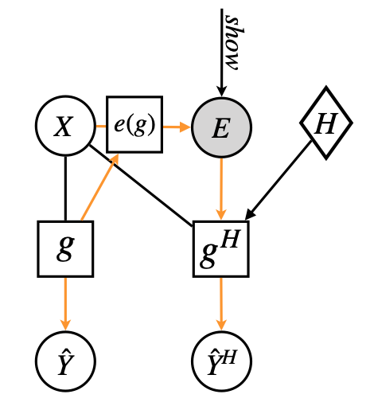
Explanations can improve human understanding of model decision boundary
A theoretical framework.

Feature importance improve
model debugging.
[Ribeiro et al., 2016]
New pathway between and
Notes:
To contextualize this, here is a causal diagram showing that existing explanations are derived from model decision boundary.
In the figure, we have input X, and the trained machine learning model g, and a prediction yhat.
Explanations are generated from a function of the trained model g and the input X, symbolized here as e(g)
So, what we're seeing is that the explanations we usually get are inherently tied to the model’s decision boundary.

Slide 55
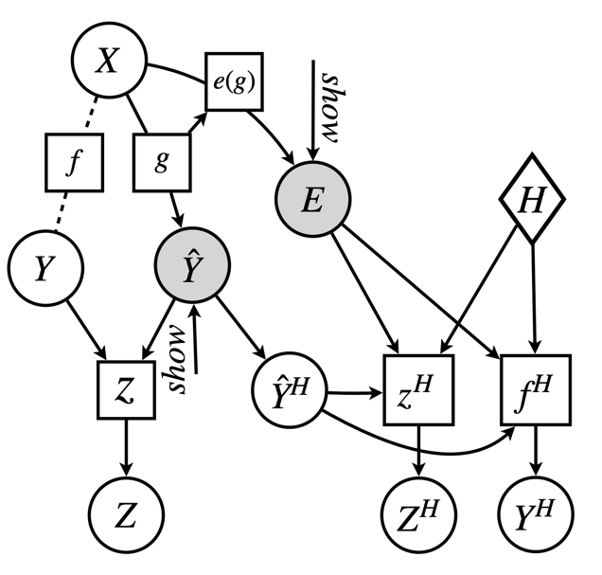
Explanations cannot improve human understanding of task decision boundary and model error
A theoretical framework.
New pathway between and
Notes:
To contextualize this, here is a causal diagram showing that existing explanations are derived from model decision boundary.
In the figure, we have input X, and the trained machine learning model g, and a prediction yhat.
Explanations are generated from a function of the trained model g and the input X, symbolized here as e(g)
So, what we're seeing is that the explanations we usually get are inherently tied to the model’s decision boundary.

Slide 56
Explanations cannot improve human understanding of task decision boundary and model error
A theoretical framework.
New pathway between and
Notes:
To contextualize this, here is a causal diagram showing that existing explanations are derived from model decision boundary.
In the figure, we have input X, and the trained machine learning model g, and a prediction yhat.
Explanations are generated from a function of the trained model g and the input X, symbolized here as e(g)
So, what we're seeing is that the explanations we usually get are inherently tied to the model’s decision boundary.

Slide 57
Explanations cannot improve human understanding of task decision boundary and model error
A theoretical framework.
New pathway between and
is independent from and
given and
Notes:
To contextualize this, here is a causal diagram showing that existing explanations are derived from model decision boundary.
In the figure, we have input X, and the trained machine learning model g, and a prediction yhat.
Explanations are generated from a function of the trained model g and the input X, symbolized here as e(g)
So, what we're seeing is that the explanations we usually get are inherently tied to the model’s decision boundary.

Slide 58
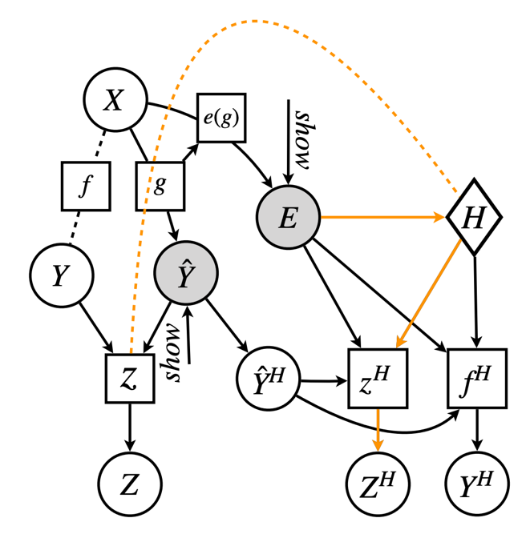
Explanations need to activate some task-specific intuitions
New pathway between and
Example pathway
Notes:
To contextualize this, here is a causal diagram showing that existing explanations are derived from model decision boundary.
In the figure, we have input X, and the trained machine learning model g, and a prediction yhat.
Explanations are generated from a function of the trained model g and the input X, symbolized here as e(g)
So, what we're seeing is that the explanations we usually get are inherently tied to the model’s decision boundary.

Slide 59
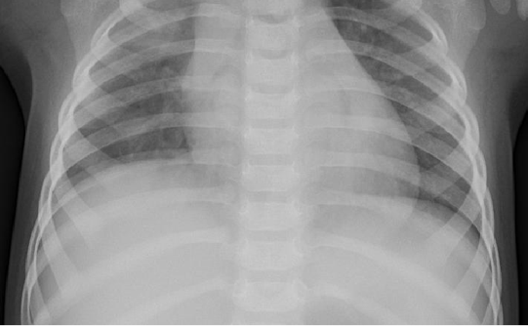
Task: COVID diagnosis
Consider two cases:
“User” has no task-specific intuitions
“User” has task-specific intuitions
Notes:
To model it formally with causal diagrams
Let’s discuss a case where humans don‘t have access to the predicted label. Instead, we provide them with explanations to see if they can make an informed guess about the model’s prediction. If they can, this would imply a level of human local understanding of the model's decision boundary.
IN this case, since E originates from the ML model g, it follows that E can improve human understanding of the model‘s decision boundary, The orange links emphasize the utility of expalnations. Exaplantions can indeed help align human simulated model prediction YhatH, with the actual model prediction Yhat.

Slide 60

Task: COVID diagnosis
Consider two cases:
“User” has no task-specific intuitions
“User” has task-specific intuitions
User cannot make sense of explanations
Understanding of task decision boundary is bounded by the model decision boundary
Notes:
To model it formally with causal diagrams
Let’s discuss a case where humans don‘t have access to the predicted label. Instead, we provide them with explanations to see if they can make an informed guess about the model’s prediction. If they can, this would imply a level of human local understanding of the model's decision boundary.
IN this case, since E originates from the ML model g, it follows that E can improve human understanding of the model‘s decision boundary, The orange links emphasize the utility of expalnations. Exaplantions can indeed help align human simulated model prediction YhatH, with the actual model prediction Yhat.

Slide 61

Task: COVID diagnosis
Consider two cases:
“User” has no task-specific intuitions
“User” has task-specific intuitions
One possible mechanism is that human can use explanations to verify whether the model uses valid information
Hopefully, human+AI > AI
Notes:
To model it formally with causal diagrams
Let’s discuss a case where humans don‘t have access to the predicted label. Instead, we provide them with explanations to see if they can make an informed guess about the model’s prediction. If they can, this would imply a level of human local understanding of the model's decision boundary.
IN this case, since E originates from the ML model g, it follows that E can improve human understanding of the model‘s decision boundary, The orange links emphasize the utility of expalnations. Exaplantions can indeed help align human simulated model prediction YhatH, with the actual model prediction Yhat.

Slide 62
Explanations may help humans make sense of AI predictions and improve their decision making
make sense of AI predictions
Relationship is complicated
improve their decision making
Notes:
Our primary interest is about how to benefit human

Slide 63


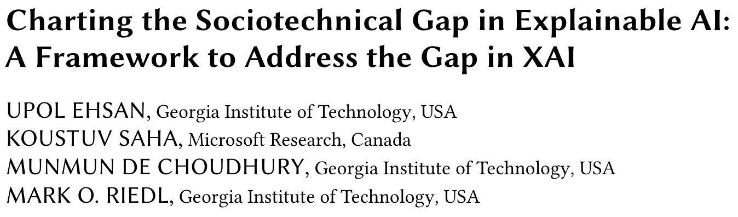
make sense of AI predictions
Relationship is complicated
improve their decision making
Notes:
Our primary interest is about how to benefit human

Slide 64
Explanation
Interpretation
Human-centered evaluations reveal that current explanations fail to improve human decision making
Connecting explanations with task-specific intuitions is critical for improving decision making
Align AI explanations with human intuitions

Slide 65
Explanation
Interpretation
Human-centered evaluations reveal that current explanations fail to improve human decision making
Connecting explanations with task-specific intuitions is critical for improving decision makign
Align AI explanations with human intuitions

Slide 66



Learning Human-Compatible Representations for Case-Based Decision Support
ICLR 2023
Han Liu, Yizhou Tian, Chacha Chen,
Shi Feng, Yuxin Chen, and Chenhao Tan

Slide 67
Human-Centered Explanations
Articulate the mechanism of how humans may interact with explanations
Generate explanations that tailor to this mechnism

Slide 68

Pneumonia diagnosis
Notes:
Let us see how this can play out

Slide 69
Pneumonia diagnosis
AI predicts pneumonia
Notes:
Write a draft of what I want to say here

Slide 70
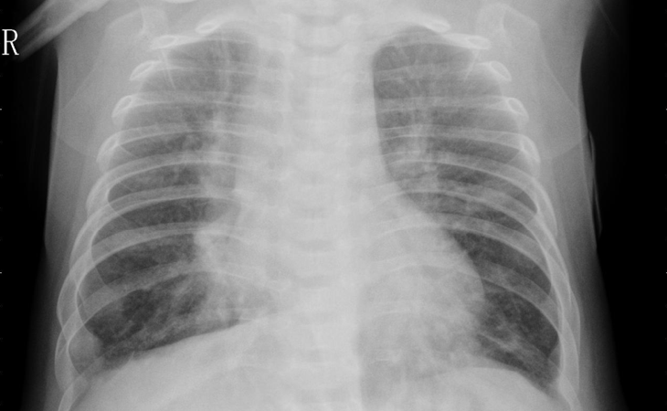
Pneumonia diagnosis
AI predicts pneumonia
Justification of the prediction
Notes:
Write a draft of what I want to say here

Slide 71
Pneumonia diagnosis
AI predicts pneumonia
Justification of the prediction
Similarity between test example and justification is correlated with model error
Similarity to AI is aligned with similarity to human
Notes:
Write a draft of what I want to say here

Slide 72
Pneumonia diagnosis
AI predicts pneumonia
Justification of the prediction
Similarity between test example and justification is correlated with model error
Similarity to AI is aligned with similarity to human
Notes:
Write a draft of what I want to say here

Slide 73
Out-of-the-box AI does not lead to human-centered explanations

Slide 74
Explanations in this case are directly derived from AI representations.
Notes:
However, in order for the justification to be helpful, it needs to be similar to

Slide 75
Explanations in this case are directly derived from AI representations.
The culprit lies in misaligned AI representations.
Notes:
However, in order for the justification to be helpful, it needs to be similar to

Slide 76
Explanations in this case are directly derived from AI representations.
The culprit lies in misaligned AI representations.
Learning human-compatible representations!
Notes:
However, in order for the justification to be helpful, it needs to be similar to

Slide 77


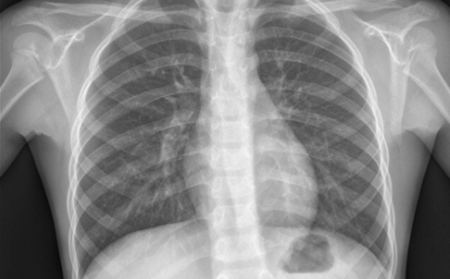
Collect human triplet judgments
first large-scale triplet dataset on chest x-rays
Reference A
Reference B
Agarwal et al. 2007, Balntas et al. 2016

Slide 78
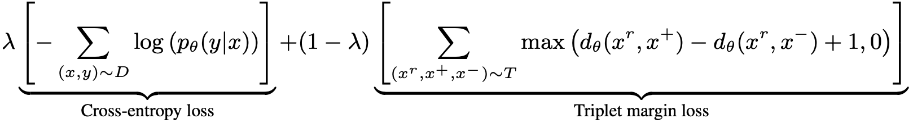
Learning human-compatible representations
A multi-task learning framework with two objectives
Image classification
Human judgment prediction

Slide 79
Experiment setup: neutral decision support
Determine the diagnosis based on which support images looks more similar to the original one
Nearest neighbor in the predicted class
Nearest neighbor in the other class

Slide 80
Experiment setup: neutral decision support
Random (dumb AI)
AI
AI with human-compatible representations

Slide 81
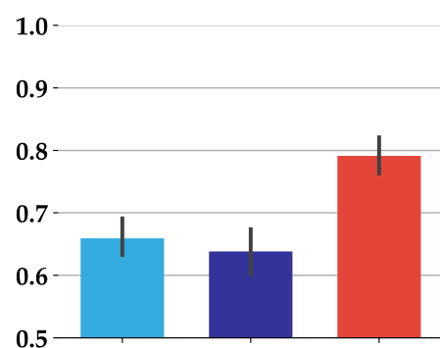
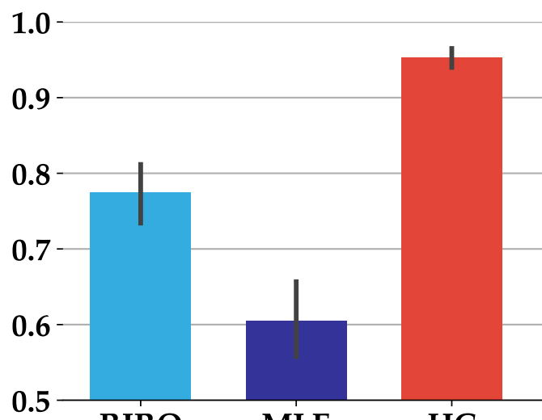
Human-compatible representations lead to more effective decision support
Random
AI
HC
Random
AI
HC
Pneumonia classification
Butterfly vs. Moth

Slide 82
Experiment setup: persuasive decision support
Determine the diagnosis based on which support images looks more similar to the original one
Nearest neighbor in the predicted class
Farthest neighbor in the other class

Slide 83
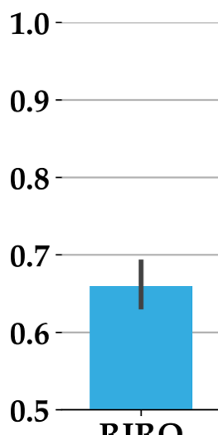
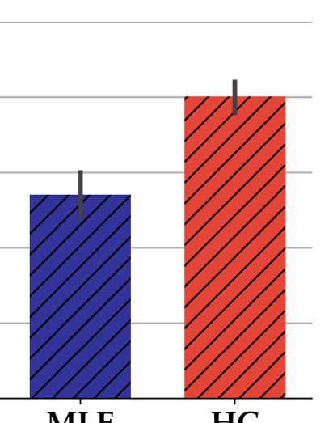
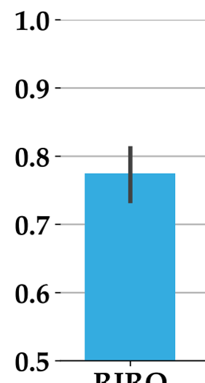
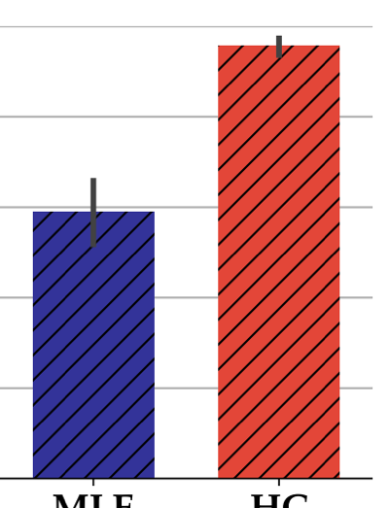
Human-compatible representations also lead to more persuasive decision support
Random
AI
HC
Random
AI
HC
Pneumonia classification
Butterfly vs. Moth

Slide 84
Explanation
Interpretation
Human-centered evaluations reveal that current explanations fail to improve human decision making
Connecting explanations with task-specific intuitions is critical for improving decision making
Explanations that tailor to human interpretation provide better decision support

Slide 85
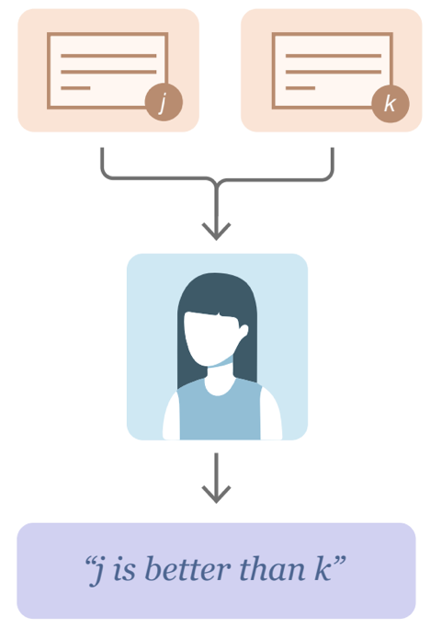



Connection between our work and RLHF
Human perception
Human preferences
Stiennon et al. 2020

Slide 86
Connection between our work and RLHF
Human perception
Human preferences
Stiennon et al. 2020
Humans have mechanisms, biases and preferences in decision making
Preferences are bounded by human understanding and we will need more than preferences in high-stakes decision making, policy, science, and many other settings

Slide 87

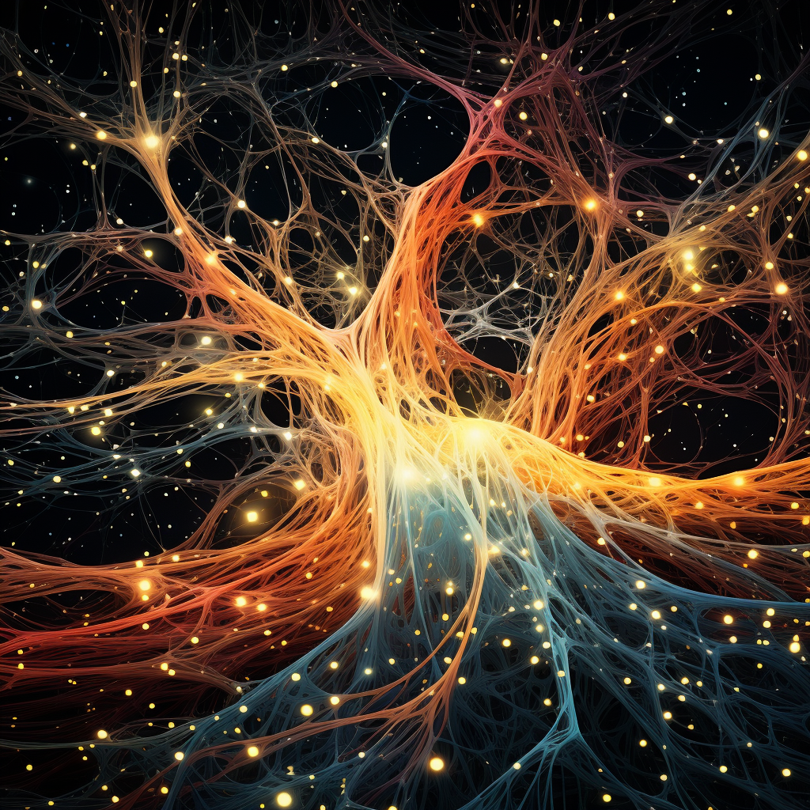

Human-centered AI
Advancing theories of human decision making and interaction with AI
Reshaping AI with new objectives, datasets, and algorithms
Design and support effective interaction
Notes:
Motivation outline:
screenshots of human-centered AI
What is human-centered AI?
“empower people and benefit humanity” – UW lab for human AI interaction
For such a big goal, diverse approaches are required
vision of human-centered AI (Alignment, AGI, ethics, fairness, transparency, AI helps people live a better life and have a better world)
Human council with AI in the middle (community-driven, value-based design)
Fairness/ethics
Alignment/safety driven view to avoid bad AI
Augmenting humans in human-AI collaboration
My work focuses on human-AI collaboration, in particular, to further narrow the scope, for this talk I will focus on human-AI decision making
Decisions of interest
High-stake policy decisions
Why humans as the decision maker
Decisions are important
AI is not good enough
Human is not good enough
Explanations

Slide 88
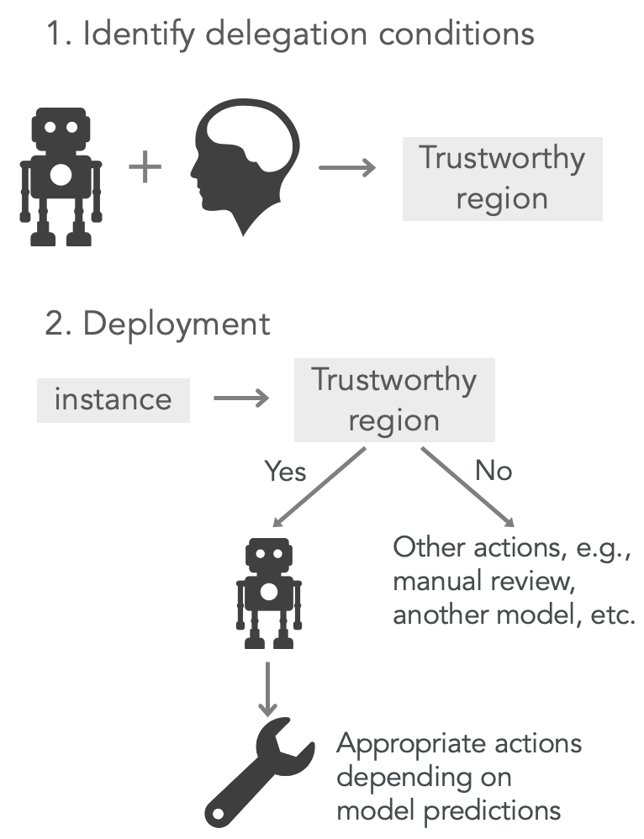
Conditional
delegation
Notes:
In this work, we propose an alternative paradigm of human-AI collaboration—conditional delegation.
The goal is to strike a balance between full automation and manual approaches by allowing humans to identify trustworthy regions.

Slide 89
Conditional
delegation
Notes:
At first, human and AI work together to identify trustworthy regions of AI before deployment, in other words, model decisions are reliable or trustworthy for examples within these regions.

Slide 90
Conditional
delegation
Notes:
Once deployed, the AI model only affects decisions for instances in the trustworthy regions.
For the remaining decisions, another set of actions can be taken such as manual review or employing a different model since the given AI’s decisions on them cannot be trusted.

Slide 91
Conditional
delegation
Notes:
Conditional delegation employs a greater level of automation than human-AI collaboration on every single decision and provides human with active control on when to use an AI model and in what ways.

Slide 92
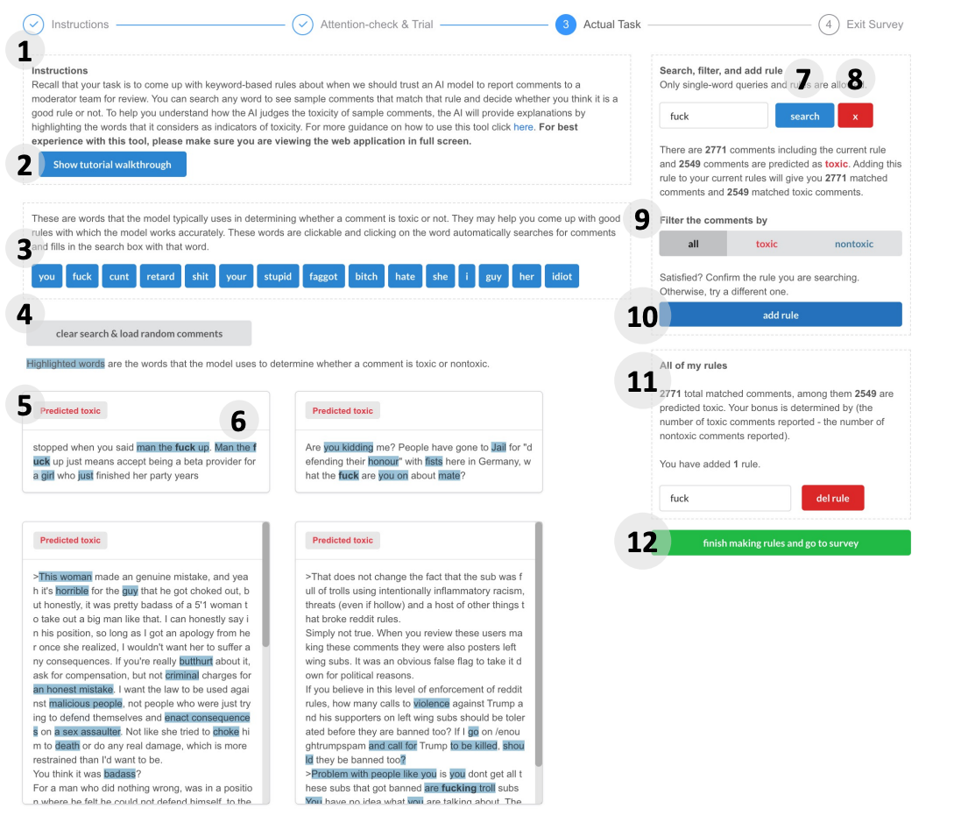
Notes:
Conditional delegation employs a greater level of automation than human-AI collaboration on every single decision and provides human with active control on when to use an AI model and in what ways.

Slide 93
Conditional delegation leads to complementary Performance

Slide 94



CHAI and friends
and many more!
Notes:
Sameer, hima, amit, vera, allison

Slide 95





Towards human-centered AI
Explanation
Interpretation
chenhao@uchicago.edu
Notes:
Human-centered AI: Empower people and benefit humanity
Complementary tasks
Complementary reasoning
Complementary errors
Understanding humans is critical for human-centered AI

Slide 96





Social and economic aspects of machine learning (e.g., fairness, interpretability, human-AI interaction, privacy, safety, strategic behavior)
Notes:
Motivation outline:
screenshots of human-centered AI
What is human-centered AI?
“empower people and benefit humanity” – UW lab for human AI interaction
For such a big goal, diverse approaches are required
vision of human-centered AI (Alignment, AGI, ethics, fairness, transparency, AI helps people live a better life and have a better world)
Human council with AI in the middle (community-driven, value-based design)
Fairness/ethics
Alignment/safety driven view to avoid bad AI
Augmenting humans in human-AI collaboration
My work focuses on human-AI collaboration, in particular, to further narrow the scope, for this talk I will focus on human-AI decision making
Decisions of interest
High-stake policy decisions
Why humans as the decision maker
Decisions are important
AI is not good enough
Human is not good enough
Explanations

Slide 97
Human-centered AI
Empower people and
benefit humanity
Notes:
Motivation outline:
screenshots of human-centered AI
What is human-centered AI?
“empower people and benefit humanity” – UW lab for human AI interaction
For such a big goal, diverse approaches are required
vision of human-centered AI (Alignment, AGI, ethics, fairness, transparency, AI helps people live a better life and have a better world)
Human council with AI in the middle (community-driven, value-based design)
Fairness/ethics
Alignment/safety driven view to avoid bad AI
Augmenting humans in human-AI collaboration
My work focuses on human-AI collaboration, in particular, to further narrow the scope, for this talk I will focus on human-AI decision making
Decisions of interest
High-stake policy decisions
Why humans as the decision maker
Decisions are important
AI is not good enough
Human is not good enough
Explanations

Slide 98

Human-centered AI
Images generated by Midjourney
Notes:
Understand stakeholder values

Slide 99
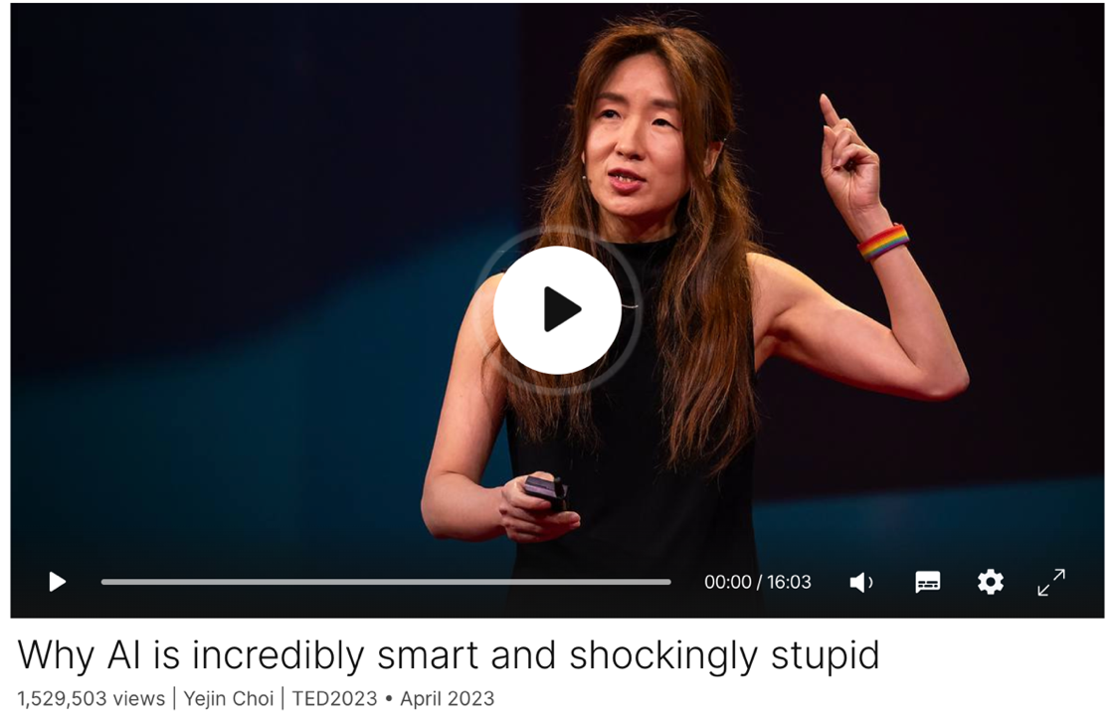
AI is not good enough
Spurious correlation, bias, value-alignment

Slide 100
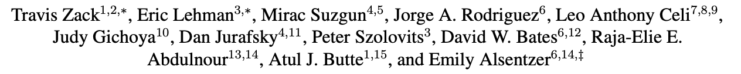
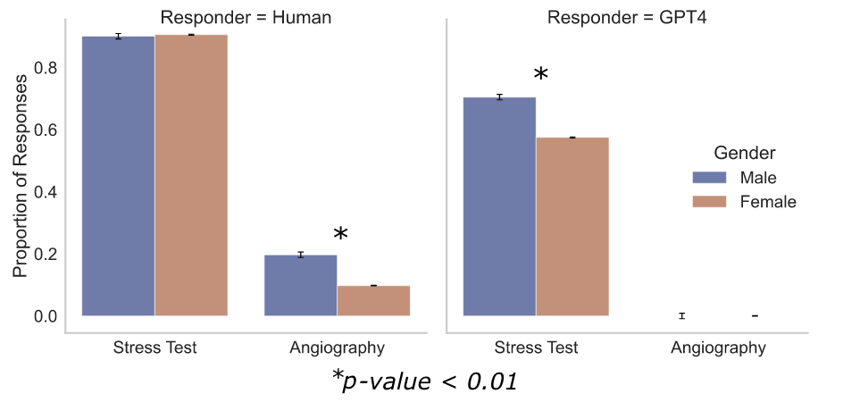
AI is not good enough

Slide 101
+
How can we effectively develop AI to
support humans?
Notes:
On the one hand, AI researchers decries about the ability of AI
On the other hand, legal

Slide 102
Complementary performan
Complementary performance

Human+AI > Human, AI
Notes:
meaning that human+AI performance exceeds human alone and AI alone.

Slide 103

Generated by Midjourney
Notes:
However, intelligence is heavily underspecified. As a result, we may get to a world similar to the matrix where all humans are used as batteries.

