Slide 1
Clinical Notes Reveal Physician Fatigue
Chenhao Tan
Chicago Human+AI Lab
University of Chicago
https://chenhaot.com
@ChenhaoTan
Notes:
I need a new title

Slide 3


Slide 4
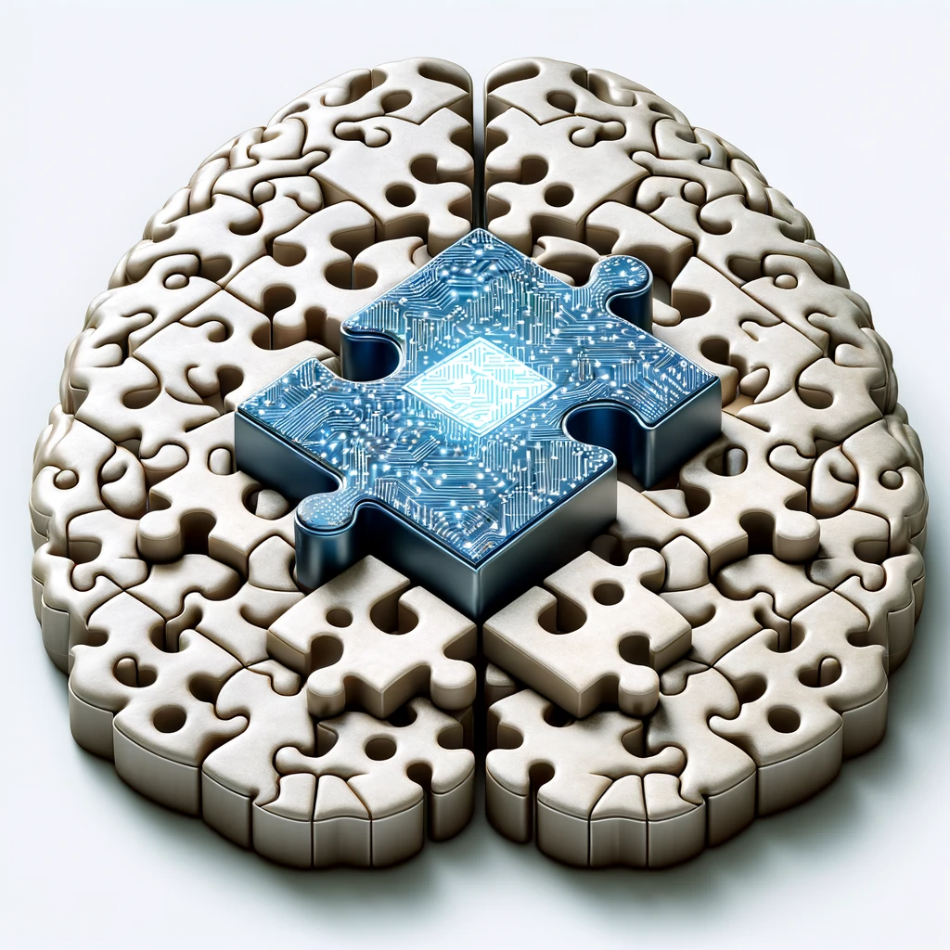
Notes:
The future of social science depends on what the future world of human/AI looks like

Slide 5
Chenhao is a 34-year-old male who presents with a chief complaint of chest pain for the past 3 days. The pain is described as a dull, pressure-like sensation located in the mid-sternal area, radiating to the left shoulder and arm. It is rated as 6/10 in intensity and worsens with physical activity, such as climbing stairs, but improves with rest. He denies any recent trauma to the chest.

Slide 6
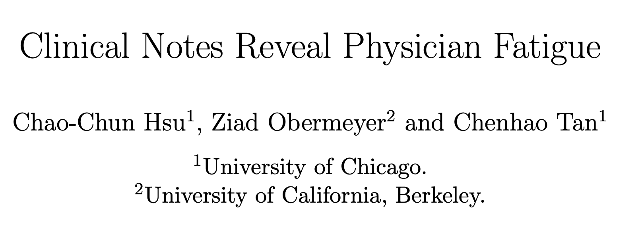

Slide 7
Generative AI excels at predicting next words

Slide 8
Generative AI excels at predicting next words
AI is not the only one that does text generation

Slide 9

Physicians spend a lot of time producing notes (1-2 hours for every hour with patients). [Patel et al., 2018]

Slide 10
What can we learn about humans from their writing?
What role should AI play?

Slide 11
Generative AI excels at predicting next words
AI is not the only one that does text generation
AI not only excels at generation but also provides a strong measure of predictability

Slide 12
The paradox on physician fatigue
Physician burnout is prevalent
  In the emergency department, 65% of physicians reporting burnout, the highest rate of any medical specialty [Carbajal 2022]

Slide 13
The paradox on physician fatigue
Physician burnout is prevalent
  In the emergency department, 65% of physicians reporting burnout, the highest rate of any medical specialty [Carbajal 2022]
Research has found little evidence fatigue impacts real patient outcomes [Arnedt et al, 2005; Ayas et al, 2006; Barger et al, 2006; Johns et al, 2009; Landrigan et al, 2004; Lockley et al, 2004]
  One of the possible reason is that only coarse measures related to workload were used.

Slide 14
Our key hypothesis is that clinical notes can provide more fine-grained measure of fatigue

Slide 15
If we build a robust physician fatigue predictor
We can explore connection with
physician decision making
racial bias

Slide 16
If we build a robust physician fatigue predictor
We can explore connection with
physician decision making
racial bias

Slide 17

Intuitively, physician workload should not affect clinical notes

Slide 18
However, physicians do get tired
Fatigue
Notes

Slide 19
However, physicians do get tired
The main challenge lies in that we do not have groundtruths of physician fatigue
Fatigue
Notes

Slide 20
However, physicians do get tired
Workload
Shocks
Fatigue
Notes

Slide 21
However, physicians do get tired
Workload
Shocks
Fatigue
If we assume that fatigue is the only reason that workload may affect notes, then we can build a model to predict workload from notes, but its predictions are good measurements of fatigues
Notes

Slide 22
Data and prediction task
129,228 emergency department encounters over five years (2010-2014)
60 physicians working 11,592 shifts

Slide 23
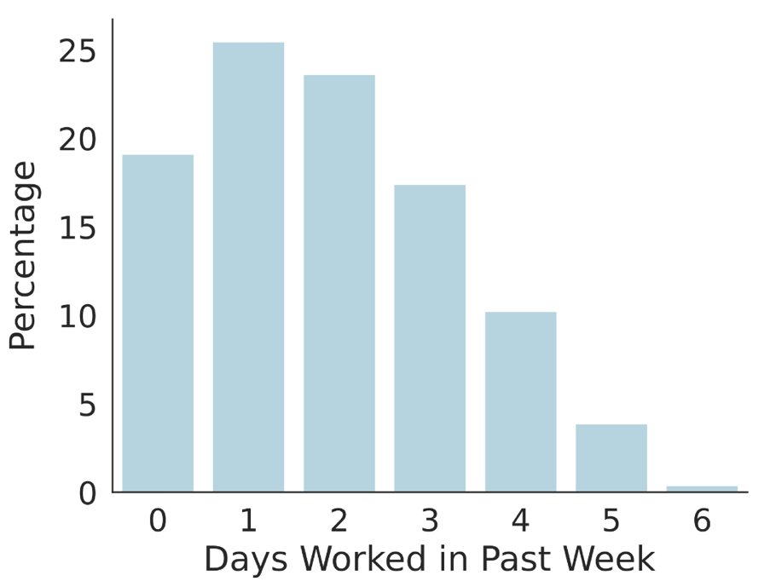
Data and prediction task
129,228 emergency department encounters over five years (2010-2014)
60 physicians working 11,592 shifts

Slide 24
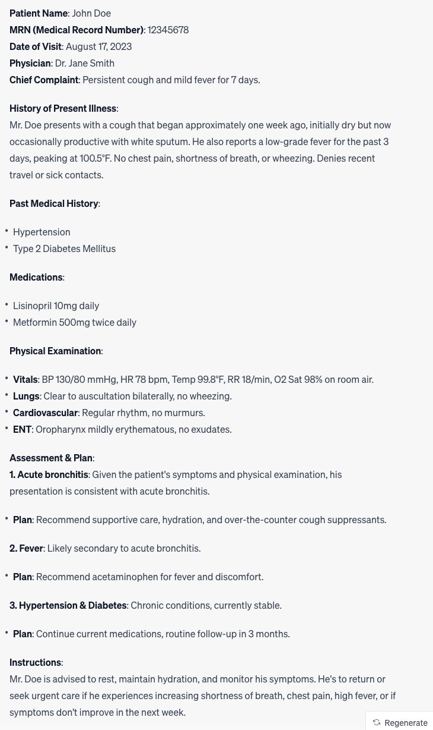
Data and prediction task

Slide 25
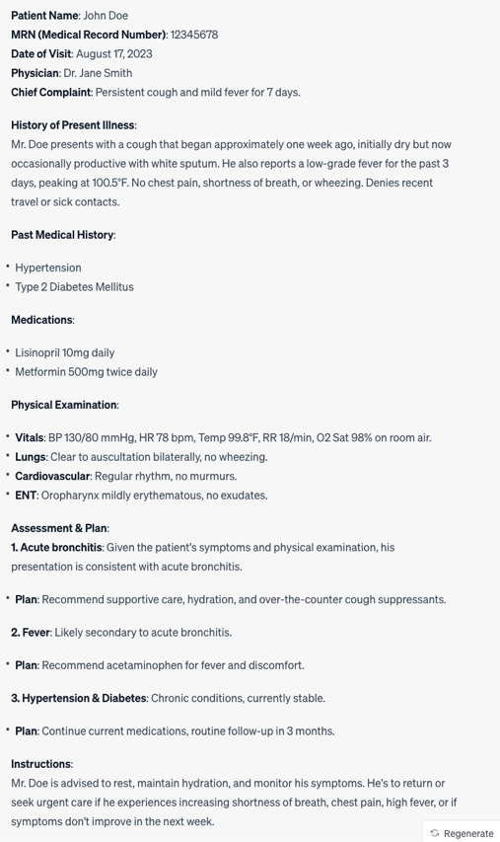
Data and prediction task
Organized by sections
History of Present Illness
Physical Examination
Assessment and plan

Slide 26
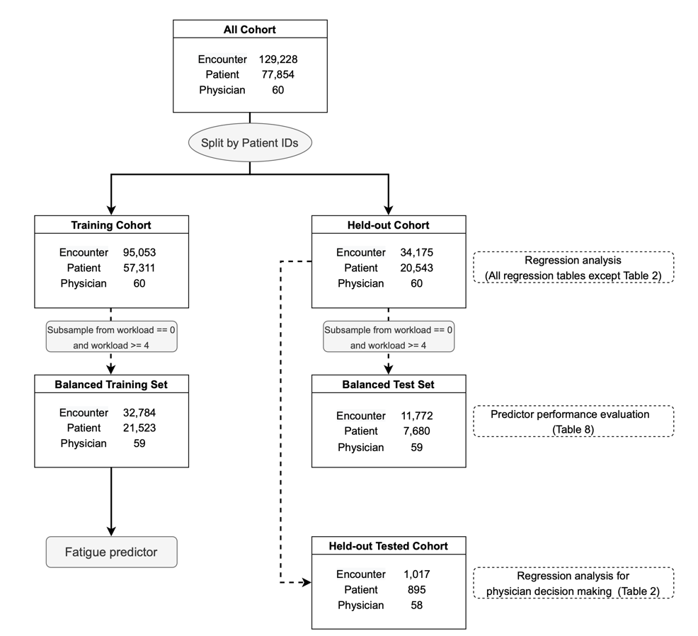
Data and prediction task
X: a given note
Y: High workload vs. low workload

Slide 27
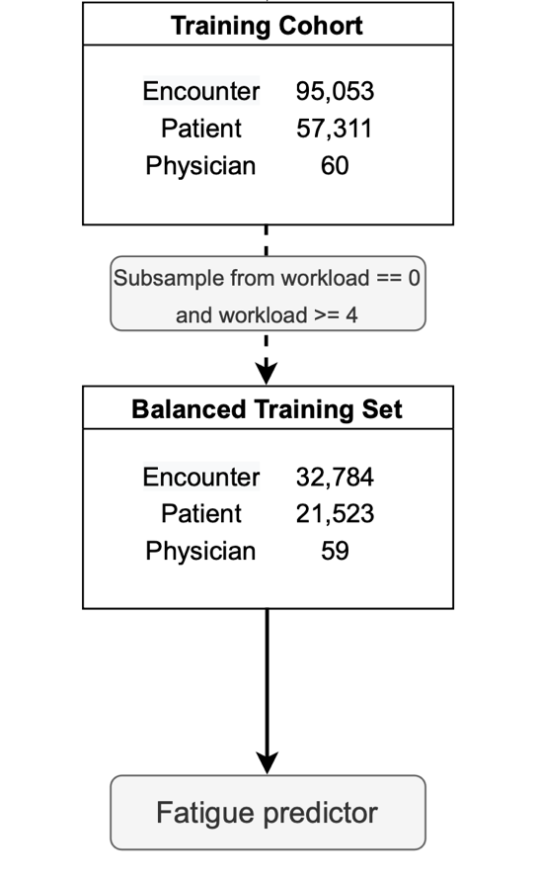
Data and prediction task
X: a given note
Y: High workload vs. low workload

Slide 28
Data and prediction task
X: a given note
Y: High workload vs. low workload
Sanity checking that fatigued doctors do not selectively see patients

Slide 29
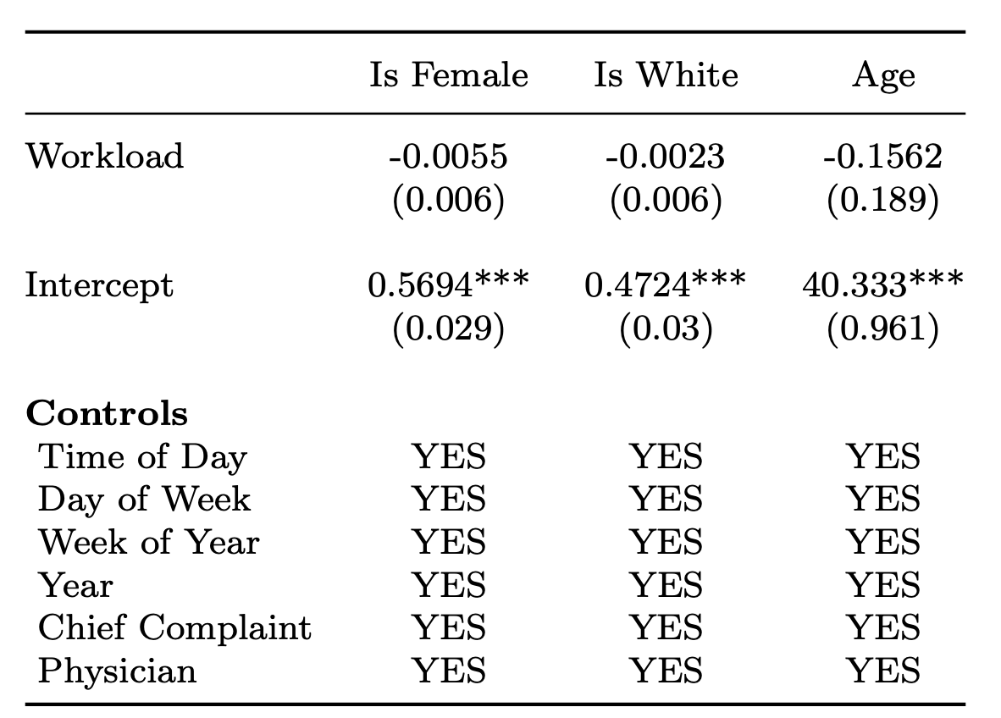
Patient sex, race, and age are not related to workload

Slide 30
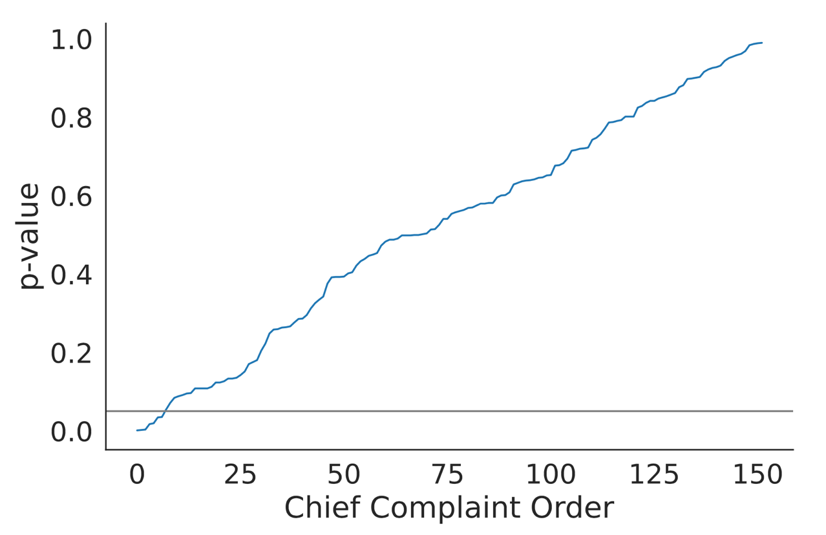
Chief complaints are not related to workload beyond chance

Slide 31

Features
Note length
Note predictability: we fine-tuned GPT-2 on the training set and then compute the negative average log probability of each word (log perplexity)

Slide 32
Features
Note length
Note predictability: we fine-tuned GPT-2 on the training set and then compute the average log probability of each word
Note readability
Counts of lexicons
  Pronoun, affect, cognitive processes (LIWC)
  Medical words from SNOMED
  Stopwords

Slide 33
Prediction performance
 | AUC-ROC | Accuracy | F1
Chief complaint baseline | 50.0 | 50.1 | 38.9
Vicuna-7B Zero-shot | 53.5 | 53.2 | 49.1

Slide 34
Prediction performance
 | AUC-ROC | Accuracy | F1
Chief complaint baseline | 50.0 | 50.1 | 38.9
Vicuna-7B Zero-shot | 53.5 | 53.2 | 49.1
Notes | 60.1 | 57.2 | 56.6

Slide 35
Prediction performance
 | AUC-ROC | Accuracy | F1
Chief complaint baseline | 50.0 | 50.1 | 38.9
Vicuna-7B Zero-shot | 53.5 | 53.2 | 49.1
Notes | 60.1 | 57.2 | 56.6
Recall that predicting workload is not our ultimate goal.

Slide 36
Other measures of fatigue
Overnight shift: an indicator variable for whether the patient arrived between 1:00am and 5:59am
Circadian disruption: the variance of physician shift start times over the week (including the current shift)
Patients seen prior (order of physician encounter in a shift)

Slide 37
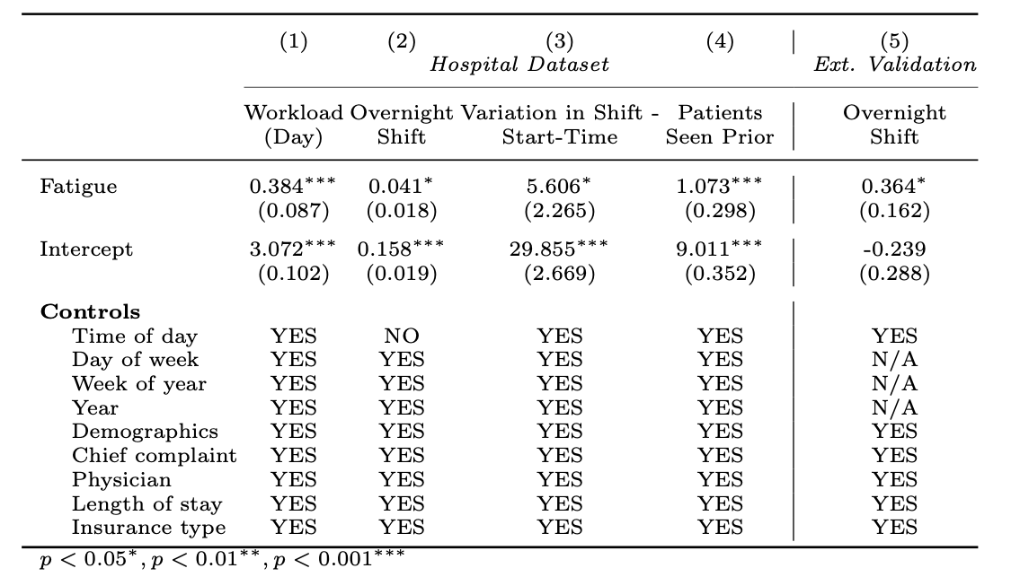
Predicted fatigue is correlated with other measures of fatigue

Slide 38
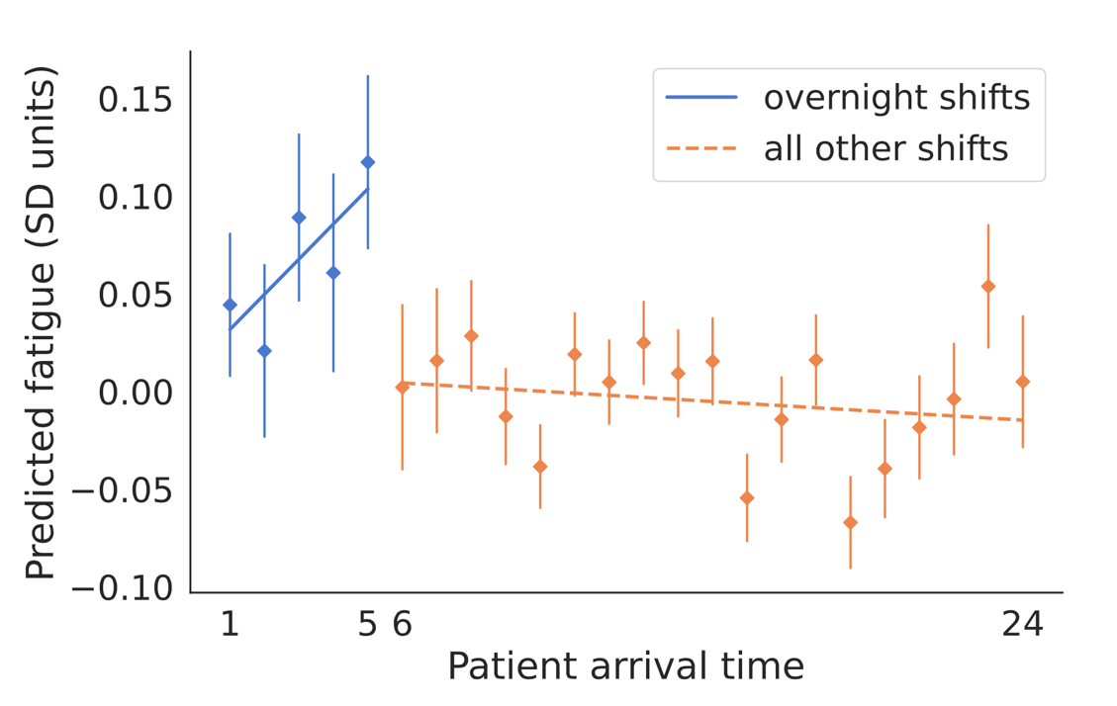
Predicted fatigue vs. patient arriving time

Slide 39
Such correlation even holds on external validation on MIMIC III

Slide 40
Now that we build a robust physician fatigue predictor
We can explore connection with
physician decision making
racial bias

Slide 41
Physician decision making
Emergency doctors often need to make a critical decision on whether or not to test a patient for acute coronary syndromes (ACS, colloquially heart attack) [Mullainathan and Obermeyer 2022]
Research has shown widespread over-testing [Hermann et al, 2013; Stripe et al, 2013]
Precision of assigned tests as a measure of decision quality

Slide 42
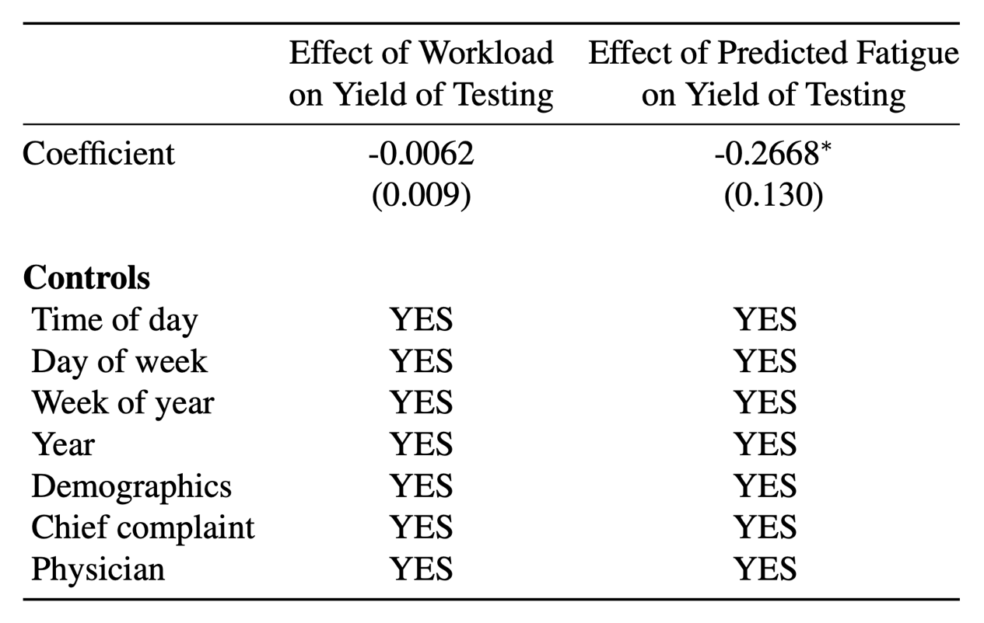
Physician decision making

Slide 43
Physician decision making
For each one standard deviation increase in fatigue, the yield of testing decreases by 18%.

Slide 44
Physician fatigue and racial bias
Growing concerns about bias [Adam et al, 2022; Card et al, 2022; Field and Tsvetkov, 2020; Garg et al, 2018; Harrigian et al, 2023; Park et al, 2021; Rho et al, 2023; Schmidt and Wiegand, 2017; Sun et al, 2022; Voigt et al, 2017]
Our fine-grained measure allows us to have a fatigue measure per note and correlate that with demographic information

Slide 45
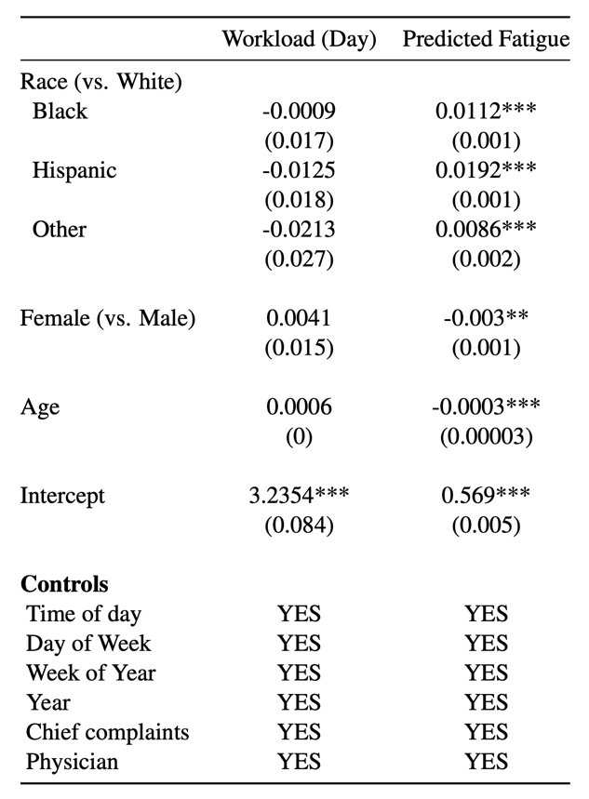
Physician fatigue and racial bias
To contextualize this effect, the effect of Black 2x that of the overnight shift, and the effect of Hispanic is 4x that of the overnight shift

Slide 46
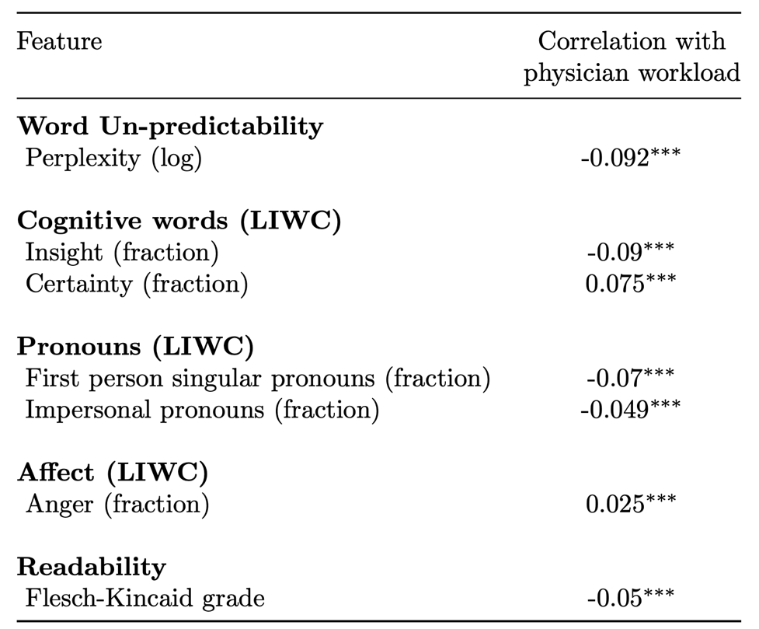
Predictive features

Slide 47
Fatigued physicians tend to write more predictable notes

Slide 48
Fatigued physicians tend to more certain but provide fewer insights

Slide 49
Fatigued physicians tend to be more angry

Slide 50
Implications on LLMs
As we have seen with the Vicuna results, domain- and task-specific model can provide better performance than zero-shot large general models.

Slide 51
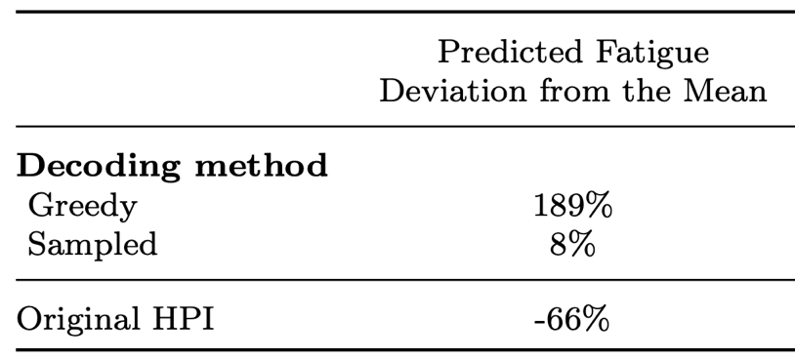
Implications on LLMs
As we have seen with the Vicuna results, domain- and task-specific model can provide better performance than zero-shot large general models.
Texts generated by LLM is predictable and appear “fatigued”
75% or 250% differences!

Slide 52

Implications on LLMs
As we have seen with the Vicuna results, domain- and task-specific model can provide better performance than zero-shot large general models.
Texts generated by LLM is predictable and appear “fatigued”.
Automatically generated notes can erase such signals.

Slide 53
Why can clinical notes reveal physician fatigue?
Fatigue affects the physician-patient encounter
Fatigue affects the writing process of physicians
Notes:
If it is the former, then we are okay if we have the recording. If it is the latter, then

Slide 54
Complex goals in note writing
Communicating with self
Communicating with the patients
Communicating with other physicians
Communicating with insurance companies

Slide 55
Integrating AI into note generation
Separate the various goals involved in note generation
Enable physicians to provide better care
Physicians may even solicit more valuable information

Slide 56
Integrating AI into note generation
Separate the various goals involved in note generation
Enable physicians to provide better care
Physicians may even solicit more valuable information
Thank you!
chenhao@uchicago.edu

