Slide 1
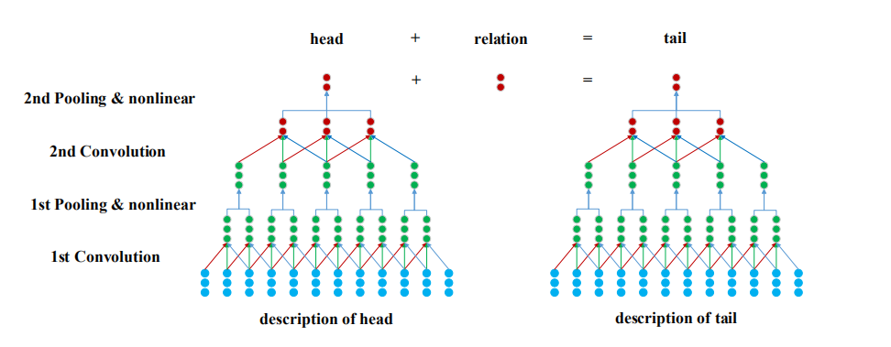
DKRL: 输入 【KG + 实体的描述文本】 输出 【文本的向量和实体的向量】
处理的问题包括两类：
open-world: 测试集中有未在训练集中出现的实体，采用文本的描述来作为当前实体的向量
close-world

Slide 2
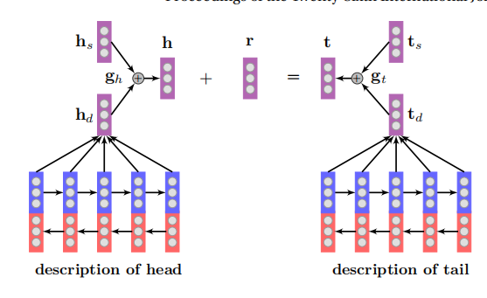
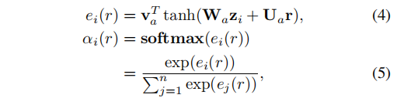

IJCAI 16： 输入【 实体的描述文本和KG】 ，输出【文本的向量和KG的向量】
实验：close_world的知识图谱补全 ,对比的实验是DKRL
文本的描述体现的是实体的不同方面，但是具体的关系只关心文本中的一部分的信息
采用的做法是attention机制

Slide 3
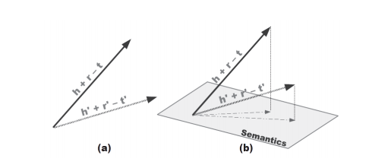
SSP: 输入【 实体的描述文本和KG】 ，输出【文本的向量和KG的向量】
从实验结果来看，在close-world的实验上,SSP的效果是最好的，但是没有考虑到开放世界的知识图谱的补全问题
对比的实验是DKRL(仅仅是对比在close-world的图谱补全):
并且从实验数据来看，SSP是目前实验效果最好的模型

Slide 4
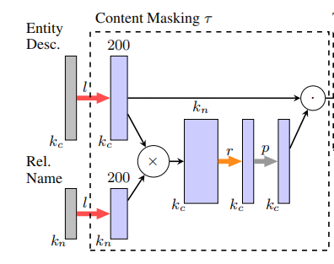
ConMask: Open-World Knowledge Graph Completion
输入【 实体的描述文本和KG】 ，输出【文本的向量和KG的向量】
实验：close-world、open-world的图谱补全(两个新的主要用于open-world的数据集)
实体的文本向量
全连接
卷积
神经网络
挑选描述文本中的词的方法：利用词向量来找到指示词，然后截取指示词后的所有词。

Slide 5
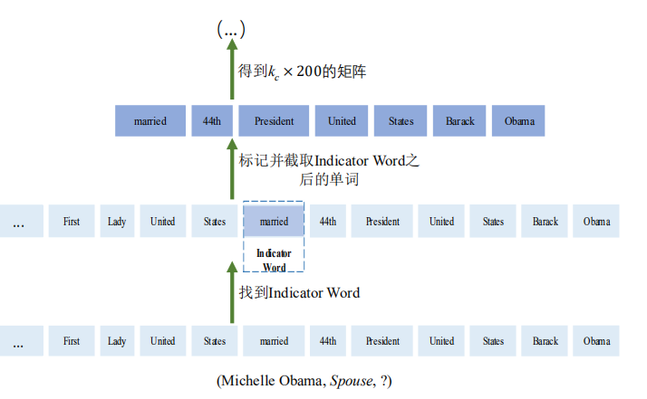
三元组: <MIchale Obama, Spouse , ? >

Slide 6
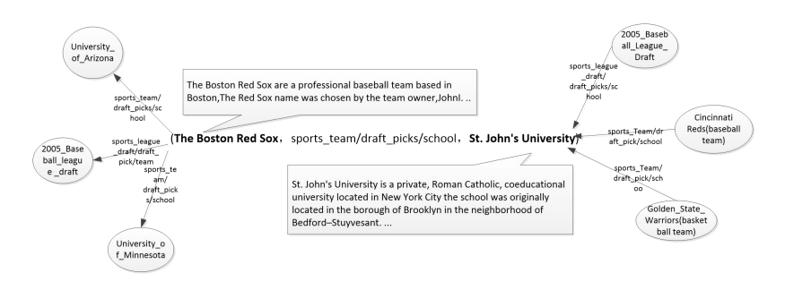
根据邻居挑选词存在的问题：
1、邻居的数量太多，并且没有直观意义
2、已有的论文根据关系来选择词直观
3、只是有时还是不能直接从文本中得到

Slide 7
h
得到的文本的向量
x1
x2
x3
x4
q1 q2 q3 q4
词的权重

Slide 8
/m/014g22
Mary Nell Steenburgen is an American actress. She won an Academy Award and a Golden Globe for playing the role of Lynda Dummar in Jonathan Demme's 1980 film Melvin and Howard."@en
spouse
/m/01c65z
Malcolm McDowell is an English actor, known for his boisterous and sometimes villainous roles, whose career spans more than four decades. He trained as an actor at the London Academy of Music and Dramatic Art.\nMcDowell is known for the controversial films If...., O Lucky Man!, Caligula and A Clockwork Orange, for which he was nominated for a Golden Globe for his portrayal of Alex DeLarge. He has also played varied roles in films and television series of different genres, including The Employer, Tank Girl, Franklin and Bash, Time After Time, Star Trek Generations, the television series Our Friends in the North, Entourage, Heroes, Metalocalypse, the animated film Bolt, and Dr. Sam Loomis in the 2007 remake of Halloween. He also appeared in the music video for the 2009 Slipknot song \"Snuff\". He also narrated the 1982 documentary The Compleat Beatles. He received a star on the Hollywood Walk of Fame in 2012."@en

Slide 9
/m/05zdk2
"Raakhee Majumdar is an Indian film actress, who has primarily appeared in Hindi films, as well as several Bengali films. She is popularly known as Raakhee Gulzar after her marriage to lyricist-director Gulzar. In four decades of acting, Raakhee won three Filmfare Awards and a National Film Award, among others. At the Filmfare, Raakhee has been nominated 16 times, making her the overall most-nominated performer in the female acting categories."@en
------spouse ----Sampooran Singh Kalra
-----profession----Actor
------nationality-----India
/m/05q9g1
Sampooran Singh Kalra, known popularly by his pen name Gulzar, is an Indian poet, lyricist and Movie director. He primarily writes in Hindustani and Punjabi; besides several dialects of Hindi such as Braj Bhasha, Khariboli, Haryanvi and Marwari.\nGulzar was awarded the Padma Bhushan in 2004 for his contribution to the arts and the Sahitya Akademi Award in 2002. He has won a number of National Film Awards and 20 Filmfare Awards. At the 81st Academy Awards, he won the Academy Award for Best Original Song for \"Jai Ho\", for the film Slumdog Millionaire. On 31 January 2010, the same song won him a Grammy Award in the category of Grammy Award for Best Song Written for a Motion Picture, Television or Other Visual Media.\nGulzar's poetry is partly published in three compilations: Chand Pukhraaj Ka, Raat Pashminey Ki and Pandrah Paanch Pachattar. His short stories are published in Raavi-paar and Dhuan.\nAs a lyricist, Gulzar is best known for his association with the music directors Rahul Dev Burman, A. R. Rahman and Vishal Bhardwaj. He has also worked with other leading Bollywood music directors including Sachin Dev Burman, Salil Chowdhury, Shankar Jaikishan, Hemant Kumar, Laxmikant-Pyarelal, Madan Mohan, Rajesh Roshan, Anu Malik, and Shankar–Ehsaan–Loy. Along with lyrics, he has also contributed in many films as script, story and dialogue writer. Films directed by him have also won numerous awards and have been critically acclaimed. He also had worked on small screen by creating series Mirza Ghalib and Tahreer Munshi Premchand ki among others. He wrote lyrics for several Doordarshan serials including Hello Zindagi, Potli Baba ki and Jungle Book."@en

