Slide 1

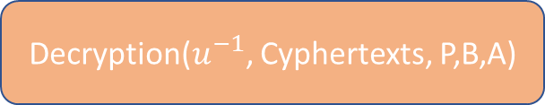
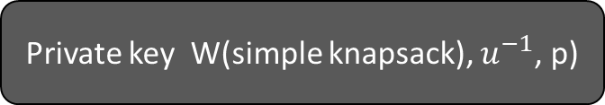

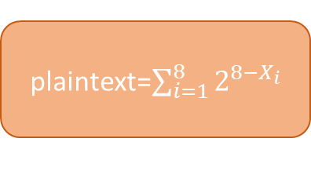
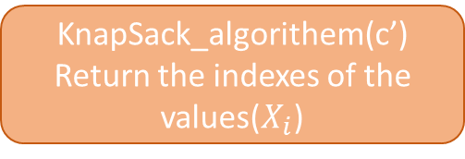
Public key
(Hard knapsack)
Vector B
B[i]=W[i]*u modp
Private key W(simple knapsack), $u^{−1}$, p)
Encryption(message, B)
Decryption($u^{−1}$, Cyphertexts, P,B,A)
Compute
C’= Cyphertexts*u^-1 modp
binaryM =Convert the message from decimal to binary
$$\gcd\left(u,p\right)=1 they are coprime$$
KnapSack_algorithem(c’)
Return the indexes of the values($X_{i}$)
Cyphertexts=B[i]*binaryM[i]
plaintext=$\sum_{i=1}^{8}{2^{8−X_{i}}}$
u
P

