Slide 1
The Embedder’s New Groove
Duncan Wood, Harrison Chen, Utkarsh Agrawal

Slide 2
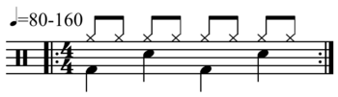
What’s in a groove?
From Wikipedia: groove is the sense of an effect ("feel") of changing pattern in a propulsive rhythm or sense of "swing".
Music notation supports a basic description of the rhythmic feel in a piece
Notation badly fails to capture subtleties – it is shorthand designed to be read efficiently and interpreted by a musician
A basic notation of a rock backbeat

Slide 3
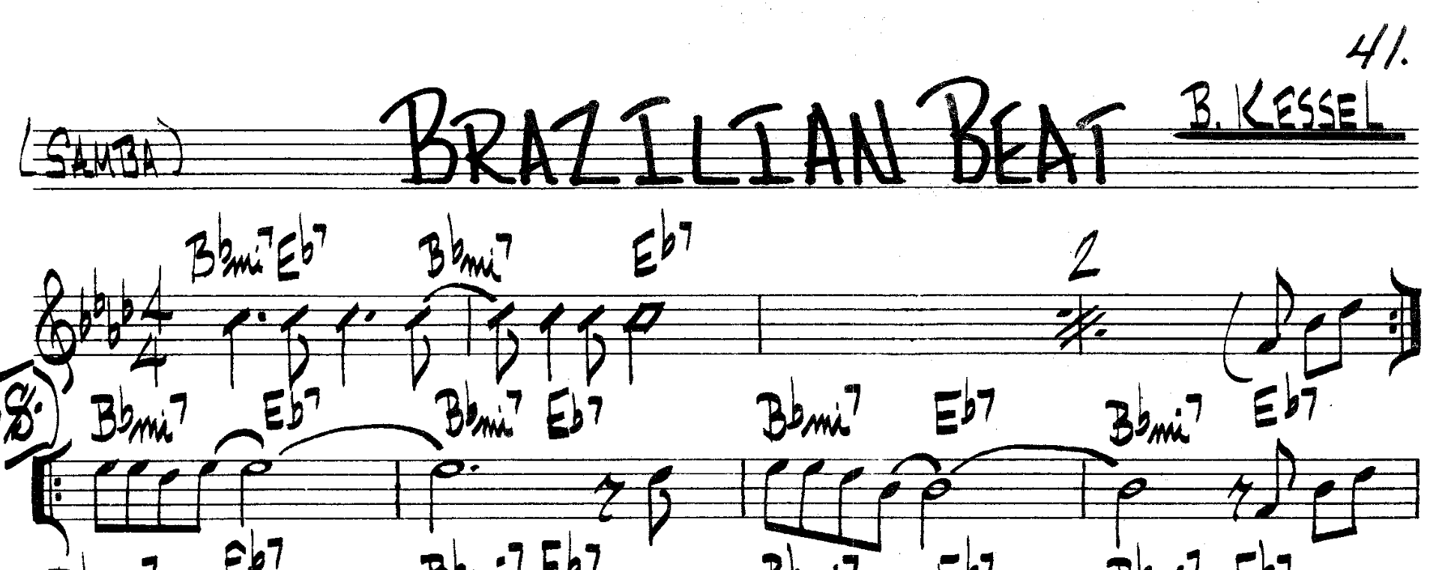
What’s in a groove?
Musical genres and idioms have rather specific grooves which are learned by listening, in a sense an oral tradition.
Once learned, a musician can interpret the groove of a piece based on a short description, e.g. “Samba” (pictured).
A groove can encapsulate tempo, time signature, emphasis and voicing of parts of the measure or measures, and even more subtle aspects and idioms.

Slide 4
The embedding
Our goal with this project has been to design a complete, robust and intuitive encoding to describe the groove of a recorded piece of music.
Such an embedding would enable quantitative methods to objectively analyze the similarities and differences between recordings across and within all kinds of music.
Instead of training neural nets to make sense of ~40k datapoints per second of music, we aim to use classical signal processing to reduce the space to something more concise.

Slide 5
The embedding
A difficult prerequisite: audio with labeled downbeats. This embedding needs to know a musical feature of the audio, which is the locations in time for downbeats, which demarcate musical measures (also called bars). This has been the principal bottleneck of scaling this project.
BeatNet is a neural network approach to locating the beats in music. However, we’ve found that its real performance is quite poor, finding even remotely accurate beat information much less than 50% of the time.
The Lakh MIDI dataset contains MIDI interpretations of audio tracks, and contains beat information. However, the beat information is even worse than BeatNet performance, probably worse than ~10%.

Slide 6
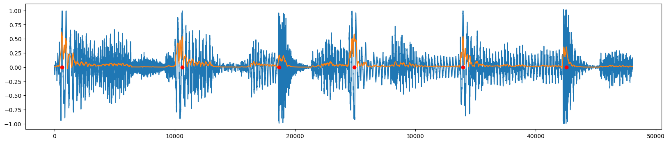
Pre-processing for beat extraction
Power of a signal is proportional to its RMS
Applied Savitzky—Golay filter to find 2nd order smoothing of square of signal
Tested by playing pings at peaks over original audio
Blue: original signal Orange: pre-processed Red: pings

Slide 7
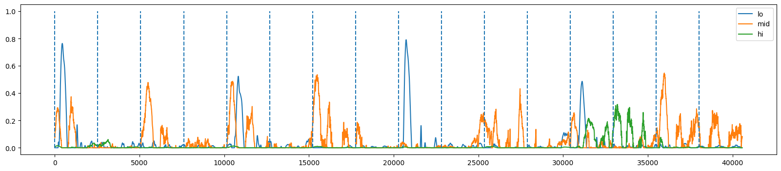
Pre-processing for beat extraction

Slide 8
Segmented subdivision embedding
Embedding algorithm:
BeatNet to identify downbeats, separate into measures
Segmented raw audio by frequency (low, mid, high)
Applied smooth power processing
Integrated against Gaussian kernel at subdivisions of measures into:
3, 4, 6, 8, 9, 12, 15, 16, 18, 20, 21, 24
Result: 468-dimensional vector

Slide 9
Finding representative beats in a song
Algorithm:
Do PCA to reduce components to 95% of explained variance
Fit a Gaussian mixture with varying number of clusters
Compare BIC to select best number k of clusters
Re-fit Gaussian mixture to original data (before PCA) with k clusters
Need initial PCA because irrelevant components overpenalize increasing number of clusters in BIC
Good results experimentally

Slide 10
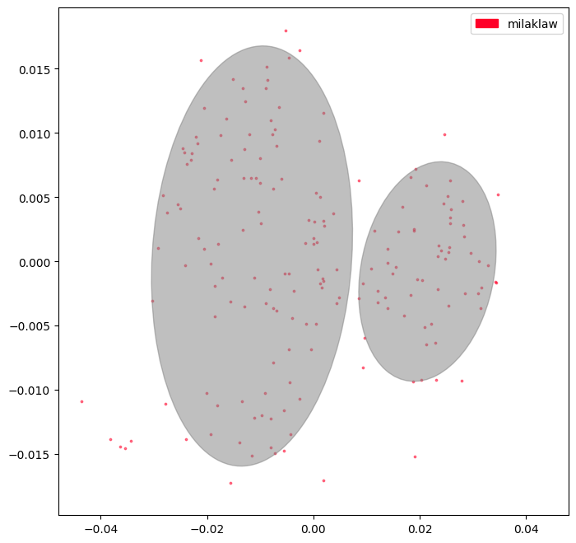
Testing clustering algorithm
Tested embedding to see if it could isolate similar beats within a single song
Found measure closest to center in each cluster
Listened to audio to check that good representatives are being chosen

Slide 11
DEMO: D’Angelo

Slide 12
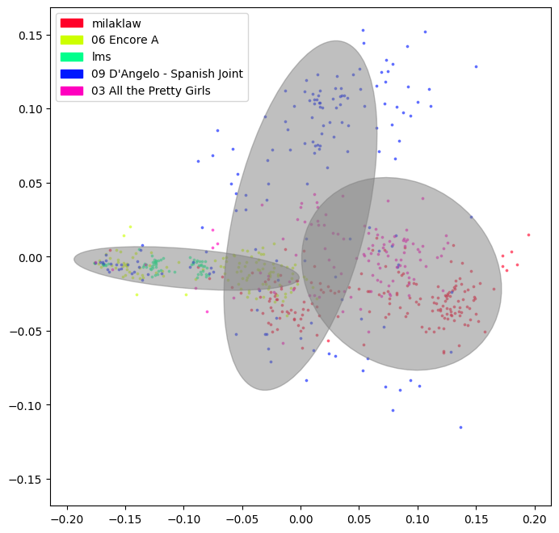
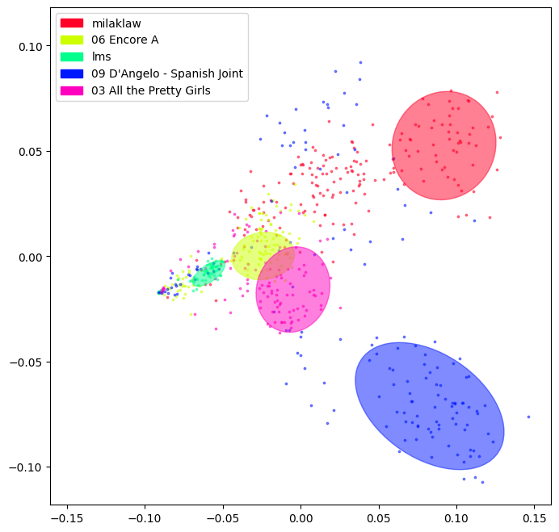
Distinguishing different songs
Embedding should be able to distinguish between different songs when their measures are thrown together
Clustering all songs together
Top cluster from each song individually

Slide 13
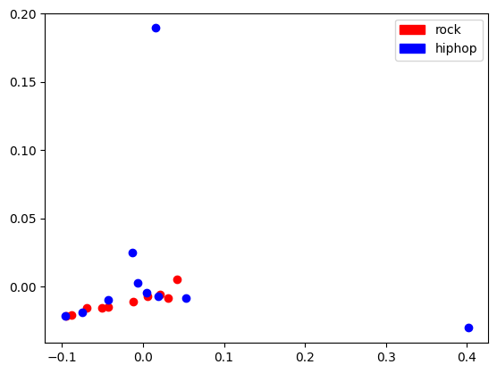
Comparing many songs across genres
Embedding was not successful in distinguishing genres
Ten rock and ten hiphop songs used as a test, visually not distinguished
2-means clustering yields poor results
Probably due to bad BeatNet results
Top two PCA components

Slide 14
Next steps
Address the difficulty of finding downbeats and tempos!
A few approaches:
Use only music recorded along a fixed tempo grid. This is somewhat ubiquitous in modern pop music. Unfortunately music with this recording philosophy tends to be more homogenous in groove, and less interesting to study.
Find a well labeled dataset
Find a way to correct or detect and remove poorly labeled measures from existing solutions, and only use the good sections of music
Note that this is a genuinely difficult problem. It requires an intuition for musical idioms that is hard to teach a computer with generality.

Slide 15
Next steps
Find a transformation for the current encoding to better distinguish instruments. The bass drum, snare, and hi hats all contain broadband power, and a simple filter doesn’t completely separate them. Moreover, different recordings use different instruments and equipment with different sound signatures, even though the musical functions of bass drum, snare, and hi hats stay fairly fixed. One could perform either a clustering algorithm in frequency space or NN methods to learn within each song what these components sound like, to better compare across recordings.

Slide 16
Next Steps
Leverage the encoding to draw connections between genres
Simply clustering on the Euclidean metric in this embedding space does pretty well distinguishing explicitly what groove is being played in a given clip. But musical styles contain families of grooves that may be far apart in this metric. A learning algorithm should be able to build associations between these vectors and give more insight into related beats.

