Slide 2
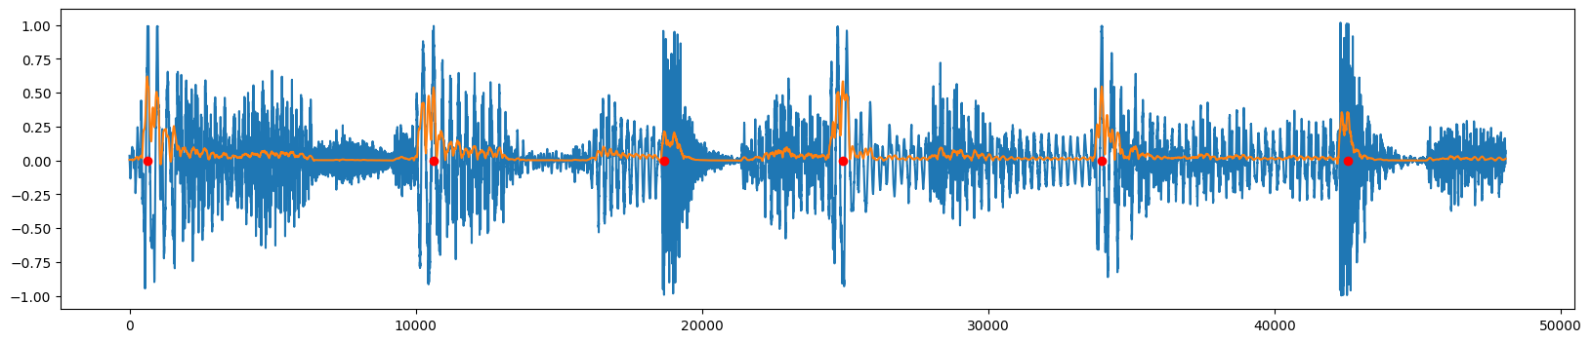
Pre-processing for beat extraction
Applied Savitzky—Golay filter to find 2nd order smoothing of square of signal
Tested by playing pings at peaks over original audio
Blue: original signal Orange: pre-processed Red: pings

Slide 3
Segmented subdivision embedding
Embedding algorithm:
BeatNet to identify downbeats, separate into measures
Segmented raw audio by frequency (low, mid, high)
Applied smooth power processing
Integrated against Gaussian kernel at subdivisions of measures into:
3, 4, 6, 8, 9, 12, 15, 16, 18, 20, 21, 24
Result: 468-dimensional vector

Slide 4
Finding representative beats in a song
Algorithm:
Do PCA to reduce components to 95% of explained variance
Fit a Gaussian mixture with varying number of clusters
Compare BIC to select best number k of clusters
Re-fit Gaussian mixture to original data (before PCA) with k clusters
Need initial PCA because irrelevant components overpenalize increasing number of clusters in BIC
Good results experimentally

Slide 5
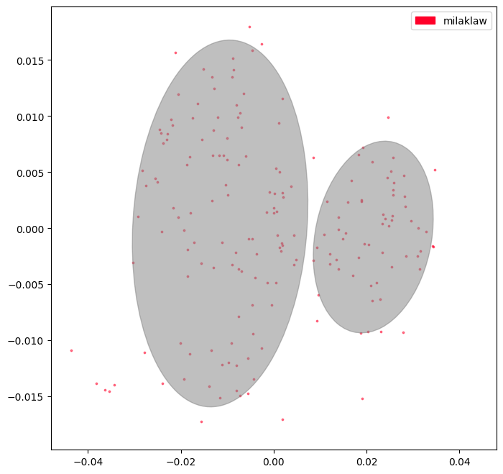
Testing clustering algorithm
Tested embedding to see if it could isolate similar beats within a single song
Found measure closest to center in each cluster
Listened to audio to check that good representatives are being chosen

Slide 6
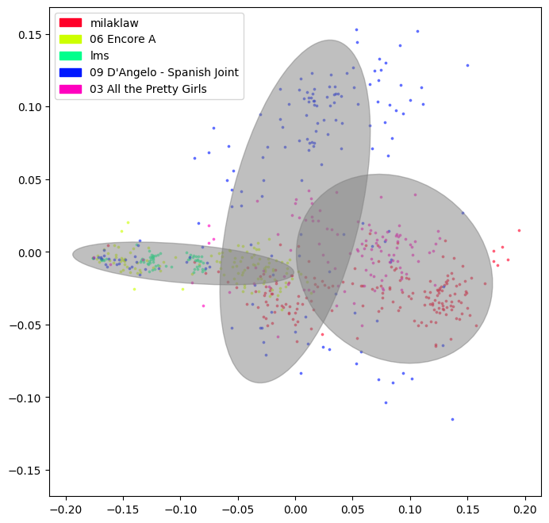
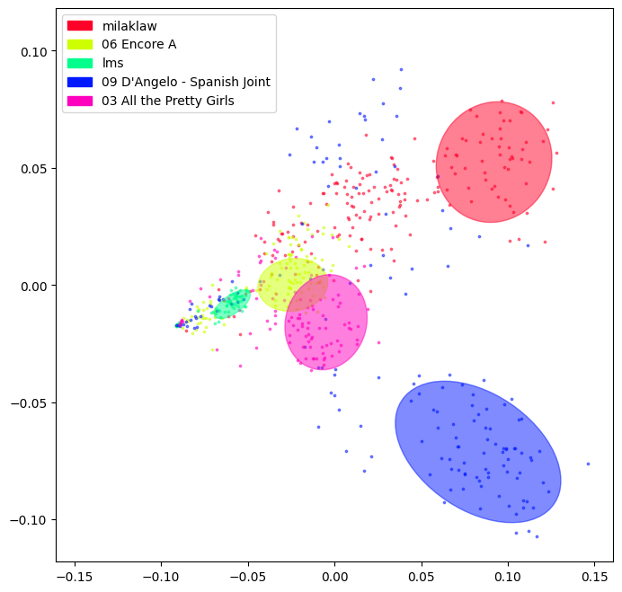
Distinguishing different songs
Embedding should be able to distinguish between different songs when their measures are thrown together
Clustering all songs together
Top cluster from each song individually

Slide 7
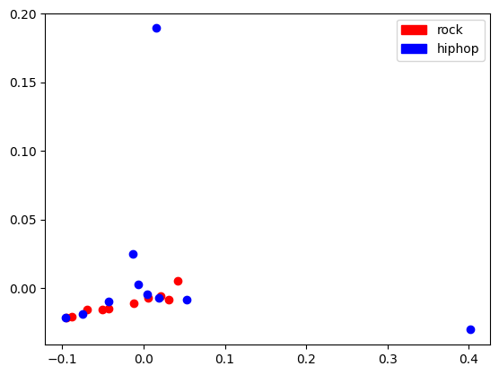
Comparing many songs across genres
Embedding was not successful in distinguishing genres
Ten rock and ten hiphop songs used as a test, visually not distinguished
2-means clustering yields poor results
Top two PCA components

Slide 8
Next steps
Use neural network to enhance embedding
TODO WRITE MORE

