Slide 1
1-6 常用bool数组方法、数组排序与去重
常用bool数组方法:
布尔数组的sum方法
import numpy as np
import pandas as pd
random_ar=np.random.randint(22,50,size=(80,20))
random_ar
Out[4]:
array([[47, 40, 22, ..., 23, 31, 26],
[43, 48, 24, ..., 33, 34, 22],
[29, 39, 27, ..., 31, 40, 41],
...,
[43, 25, 42, ..., 47, 44, 41],
[36, 25, 47, ..., 28, 33, 49],
[48, 46, 22, ..., 33, 31, 35]])
bool_ar=(random_ar<=36) & (random_ar>=23)
#通过sum()函数可以统计bool_ar中的True的数量，这就意味着我们可以统计出符合条件的数据量
bool_ar.sum()
Out[9]: 816
#
bool_ar.sum(axis=0)
Out[10]:
array([37, 39, 42, 36, 40, 46, 43, 42, 45, 37, 45, 38, 34, 40, 38, 41, 37,
50, 43, 43])
bool_ar.sum(axis=1)
Out[11]:
array([11, 7, 11, 8, 13, 6, 7, 8, 10, 14, 11, 7, 11, 12, 7, 11, 12,
12, 12, 13, 10, 11, 13, 9, 10, 13, 7, 14, 11, 8, 10, 15, 7, 12,
12, 10, 11, 14, 8, 8, 9, 8, 14, 9, 8, 7, 8, 6, 6, 11, 8,
7, 11, 11, 13, 11, 7, 11, 11, 8, 13, 7, 11, 13, 15, 11, 10, 12,
11, 8, 15, 9, 9, 13, 11, 10, 10, 8, 9, 11])
布尔数组的all和any方法：
bool_ar[:,0].any()
Out[17]: True
bool_ar[:,0].all()
Out[18]: False
#any（）说明数组里有true，all（）检验数组是不是全是true。可用于检验是否存在特征数据

Slide 2
例子：
random_ar[:,1]
Out[20]:
array([40, 48, 39, 30, 36, 34, 38, 23, 41, 47, 44, 46, 35, 34, 45, 26, 41,
30, 29, 26, 44, 22, 49, 43, 37, 40, 41, 44, 40, 29, 31, 31, 23, 38,
38, 34, 38, 27, 37, 31, 38, 45, 29, 45, 35, 37, 44, 34, 26, 37, 28,
33, 38, 35, 27, 33, 39, 27, 35, 47, 33, 38, 35, 34, 38, 45, 29, 22,
43, 41, 35, 34, 41, 36, 34, 36, 41, 25, 25, 46])
random_ar[:,1]==26#假设26是特征值，我们在随机数组的第一列中寻找特征值26
Out[21]:
array([False, False, False, False, False, False, False, False, False,
False, False, False, False, False, False, True, False, False,
False, True, False, False, False, False, False, False, False,
False, False, False, False, False, False, False, False, False,
False, False, False, False, False, False, False, False, False,
False, False, False, True, False, False, False, False, False,
False, False, False, False, False, False, False, False, False,
False, False, False, False, False, False, False, False, False,
False, False, False, False, False, False, False, False], dtype=bool)
random_ar[:,1].any()#如果随机数组random_ar的第一列中有特征值26，则返回为true
Out[22]: True
例：对白酒价格进行分组（见表格：白酒价格）
import xlrd
name=r'C:\Users\dongfeng\Desktop\数据分析\白酒价格.xlsx'
test1=xlrd.open_workbook(name)
table = test1.sheet_by_name(u'Sheet1')
daten1=[]
nrows = table.nrows
for j in range(1,nrows,1):
daten1.append(list(table.row_values(j)))
spirit_ar=np.array(daten1,dtype=object)
spirit_ar
Out[35]:
array([[537013830676.0, '江小白品鉴酒更多优惠请见详情页非卖品请勿下单！', 29.0],
[525501233363.0, '牛栏山 46度二锅头500mL*12整箱（绿瓶）装 清香型', 78.0],
[540011154689.0, '泸州老窖 泸州原浆柔和 52度 500mL 白酒浓香型', 20.0],
...,
[43066022456.0, '【天猫超市】53度茅台迎宾酒（2013款）500ml*6瓶整箱酒厂直供', 408.0],
[538926498510.0, '【天猫超市】安达情闷倒驴45度白大闷500ml*12清香型白酒整箱装', 108.0],
[525891954625.0, '【天猫超市】金六福双福星52度475mL浓香型白酒中国人的福酒', 29.0]], dtype=object)

Slide 3
接下来人们可以用两种方法进行空字符串处理，请任选一种：
方法1：
bool1=spirit_ar[:,2]==''#对‘价格’列进行空值，即空字符串判断
spirit_ar_new=spirit_ar#对中间数组进行初始化
for j in range(len(bool1)-1,-1,-1):#对数组从下向上循环
if bool1[j]:
spirit_ar_new=np.delete(spirit_ar_new,j,0)#从最后一行向上逐步删除含有空字符串的行
方法2
Dlist=sorted(list(np.where(spirit_ar[:,2]=='')[0]),reverse=True)
spirit_ar_new=np.delete(spirit_ar,Dlist,0)
spirit_ar_new_float=spirit_ar_new[:,2].astype(np.float64)
spirit_ar_new_float.min(),spirit_ar_new_float.max()
Out[21]: (0.0, 11512.799999999999)
#发现0值，对于价格来说，这是违背逻辑的异常值，必须删除
spirit_ar_new_float_d0=np.delete(spirit_ar_new_float,np.where(spirit_ar_new_float==0)[0][0],0)
下面我们对其进行分组：
price_ar=list(np.array(range(0,41))*288)#这段代码学员自己加上注释
indexs=[]
values=[]
count_1=0
for j in price_ar:
if j!=11520:
for price in spirit_ar_new_float_d0:
if (price<288+j)&(price>=j):
count_1+=1
indexs.append('%u-%u'% (j,j+288));values.append(count_1)
count_1=0
Serdata=pd.Series(values,index=indexs)
Serdata
Out[49]:
0-288 5002
288-576 1723
576-864 612
864-1152 253
1152-1440 123
1440-1728 65
1728-2016 116
2016-2304 79

Slide 4
2304-2592 53
2592-2880 36
2880-3168 14
3168-3456 13
3456-3744 4
3744-4032 5
4032-4320 3
4320-4608 3
4608-4896 1
4896-5184 7
5184-5472 8
5472-5760 8
5760-6048 0
6048-6336 0
6336-6624 5
6624-6912 0
6912-7200 0
7200-7488 0
7488-7776 0
7776-8064 0
8064-8352 0
8352-8640 0
8640-8928 0
8928-9216 0
9216-9504 0
9504-9792 3
9792-10080 0
10080-10368 0
10368-10656 0
10656-10944 0
10944-11232 0
11232-11520 2
dtype: int64
为了优化算法，大大提高计算速度，我们把上面加粗的红色代码作如下改进：
indexs=[]
values=[]
count_1=0
for j in price_ar:
if j!=11520:
Bool_ser=(spirit_ar_new_float_d0<288+j)&(spirit_ar_new_float_d0>=j)
count_1=list(Bool_ser).count(True)
indexs.append('%u-%u'% (j,j+288));values.append(count_1)
count_1=0
Serdata=pd.Series(values,index=indexs)

Slide 5
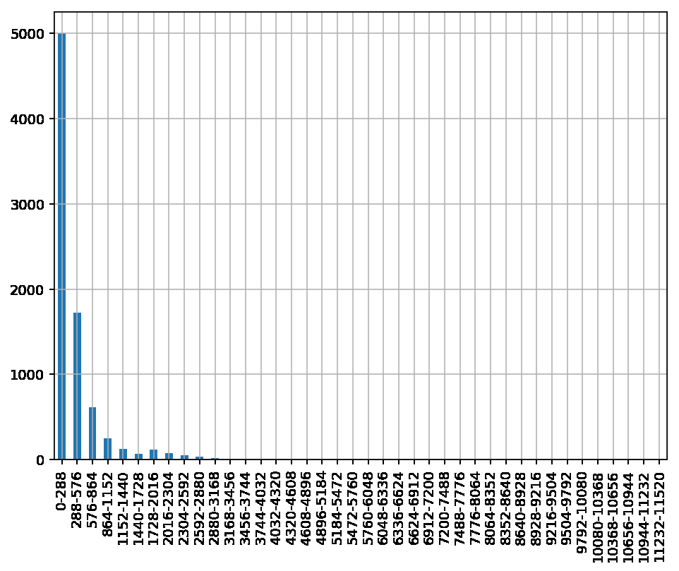
import matplotlib.pyplot as plt
ery,sdyu=plt.subplots(1,1,dpi=140,figsize=(8,6))
Serdata.plot(kind='bar',ax=sdyu,grid=True)
Out[53]: <matplotlib.axes._subplots.AxesSubplot at 0x8b08bb62e8>
plt.show()
观察上图，我们得到以下结论
a.市场上销售的白酒价格主要集中在0-600元之间
b.随着价格的增长，市场上在销白酒品种迅速下降。
为了观察3168元以后的数据图像，现对上图局部放大。
观察局部放大图，并没有发现任何特别明显的规律性：
其大致规律为：市场上在销高价酒的价格主要集中在3100-4700元之间。

Slide 6
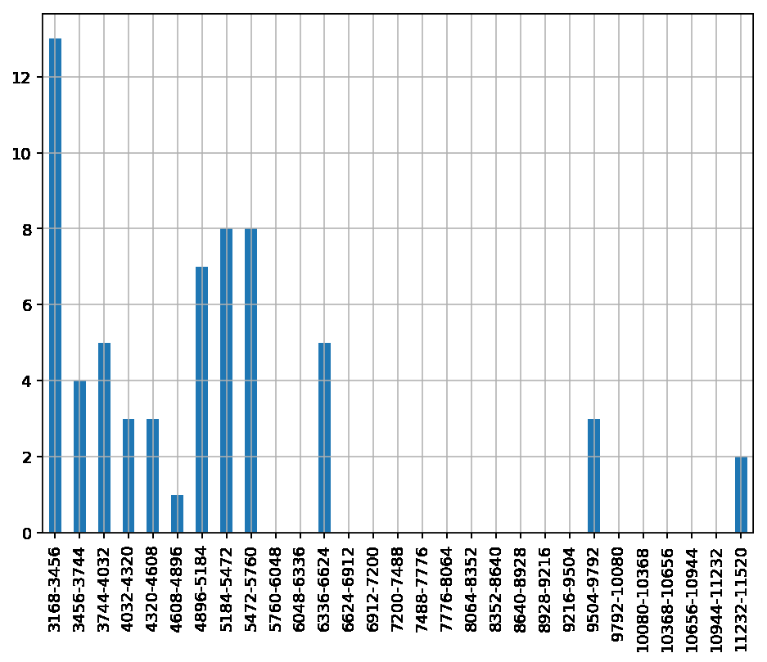
数组的排序与去重
数组的排序主要是通过sort函数来完成的，但是sort作为方法和作为函数是完全不一样的。下面通过一个例子来做比较。
ar123=np.random.randint(6,26,size=(20,6))
ar123
Out[74]:
array([[19, 24, 6, 22, 15, 7],
[14, 24, 6, 7, 25, 18],
[22, 21, 7, 23, 20, 10],
[20, 8, 16, 10, 11, 14],
[11, 16, 18, 25, 21, 20],
[13, 7, 10, 14, 22, 17],
[12, 22, 10, 8, 14, 16],
[15, 18, 14, 7, 14, 24],
[22, 13, 12, 7, 18, 6],
[ 7, 7, 21, 17, 7, 12],
[17, 14, 13, 10, 14, 12],
[18, 13, 20, 22, 12, 23],

Slide 7
[23, 15, 15, 24, 10, 19],
[14, 25, 15, 16, 12, 15],
[14, 13, 19, 17, 21, 12],
[24, 8, 20, 9, 22, 19],
[14, 18, 25, 10, 17, 21],
[24, 7, 7, 6, 20, 18],
[11, 21, 13, 10, 17, 18],
[15, 22, 23, 9, 23, 12]])
ar123.sort(0)
ar123
Out[76]:
array([[ 7, 7, 6, 6, 7, 6],
[11, 7, 6, 7, 10, 7],
[11, 7, 7, 7, 11, 10],
[12, 8, 7, 7, 12, 12],
[13, 8, 10, 8, 12, 12],
[14, 13, 10, 9, 14, 12],
[14, 13, 12, 9, 14, 12],
[14, 13, 13, 10, 14, 14],
[14, 14, 13, 10, 15, 15],
[15, 15, 14, 10, 17, 16],
[15, 16, 15, 10, 17, 17],
[17, 18, 15, 14, 18, 18],
[18, 18, 16, 16, 20, 18],
[19, 21, 18, 17, 20, 18],
[20, 21, 19, 17, 21, 19],
[22, 22, 20, 22, 21, 19],
[22, 22, 20, 22, 22, 20],
[23, 24, 21, 23, 22, 21],
[24, 24, 23, 24, 23, 23],
[24, 25, 25, 25, 25, 24]])
#对每一列进行排序
ar123=np.random.randint(6,26,size=(20,6))
ar123

Slide 8
ar123.sort(1)
ar123
Out[72]:
array([[10, 16, 17, 20, 21, 25],
[12, 14, 15, 15, 15, 23],
[ 6, 9, 13, 19, 22, 25],
[ 7, 9, 9, 14, 15, 24],
[11, 17, 21, 22, 24, 24],
[ 8, 8, 12, 13, 14, 16],
[10, 12, 14, 16, 17, 19],
[ 8, 11, 14, 18, 21, 23],
[ 9, 10, 14, 17, 20, 22],
[ 6, 7, 12, 20, 20, 24],
[ 6, 6, 6, 11, 14, 15],
[ 6, 10, 12, 18, 19, 24],
[13, 14, 15, 17, 20, 23],
[12, 14, 15, 16, 17, 23],
[12, 14, 19, 21, 21, 22],
[ 9, 11, 15, 15, 16, 21],
[ 9, 9, 11, 13, 14, 21],
[ 8, 10, 11, 16, 18, 25],
[ 8, 11, 14, 16, 23, 24],
[ 7, 8, 14, 20, 21, 22]])
#对每一行进行排序
下面sort用作函数
ar12=np.random.randint(6,26,size=(6,5))
ar12
Out[80]:
array([[10, 12, 11, 6, 22],
[11, 13, 9, 9, 11],
[18, 13, 24, 13, 19],
[12, 20, 6, 22, 24],
[23, 21, 9, 15, 22],
[ 9, 9, 15, 20, 6]])
np.sort(ar12,1)#对行进行排序
Out[81]:
array([[ 6, 10, 11, 12, 22],
[ 9, 9, 11, 11, 13],
[13, 13, 18, 19, 24],
[ 6, 12, 20, 22, 24],
[ 9, 15, 21, 22, 23],
[ 6, 9, 9, 15, 20]])

Slide 9
ar12#再次调用ar12，发现又恢复到源数据。这就说明sort用做函数是一次性排序。
Out[82]:
array([[10, 12, 11, 6, 22],
[11, 13, 9, 9, 11],
[18, 13, 24, 13, 19],
[12, 20, 6, 22, 24],
[23, 21, 9, 15, 22],
[ 9, 9, 15, 20, 6]])
np.sort(ar12,0)#对列进行排序
Out[83]:
array([[ 9, 9, 6, 6, 6],
[10, 12, 9, 9, 11],
[11, 13, 9, 13, 19],
[12, 13, 11, 15, 22],
[18, 20, 15, 20, 22],
[23, 21, 24, 22, 24]])
总结：sort用作函数（np.sort）是一次性排序，用做方法（.sort）是永久性排序。
数组去重
ar_2dim=np.vstack((np.arange(1,13).reshape(2,6),np.random.randint(2,16,size=(2,6)),np.arange(1,7),np.random.randint(2,16,size=(2,6)),np.arange(1,13).reshape(2,6)))
ar_2dim
Out[97]:
array([[ 1, 2, 3, 4, 5, 6],
[ 7, 8, 9, 10, 11, 12],
[12, 10, 15, 11, 15, 10],
[ 5, 2, 13, 7, 13, 6],
[ 1, 2, 3, 4, 5, 6],
[13, 3, 15, 5, 15, 14],
[ 7, 7, 14, 2, 14, 2],
[ 1, 2, 3, 4, 5, 6],
[ 7, 8, 9, 10, 11, 12]])
np.unique(ar_2dim,axis=0)#删除重复行并对第一列进行排序
Out[98]:
array([[ 1, 2, 3, 4, 5, 6],
[ 5, 2, 13, 7, 13, 6],
[ 7, 7, 14, 2, 14, 2],
[ 7, 8, 9, 10, 11, 12],
[12, 10, 15, 11, 15, 10],
[13, 3, 15, 5, 15, 14]])

Slide 10
ar_2dim_ver=np.column_stack((np.arange(1,13).reshape(6,2),np.random.randint(2,16,size=(6,2)),np.arange(1,7),np.random.randint(2,16,size=(6,2)),np.arange(1,13).reshape(6,2)))
ar_2dim_ver
Out[102]:
array([[ 1, 2, 6, 5, 1, 14, 6, 1, 2],
[ 3, 4, 5, 5, 2, 10, 5, 3, 4],
[ 5, 6, 2, 8, 3, 3, 7, 5, 6],
[ 7, 8, 14, 11, 4, 13, 7, 7, 8],
[ 9, 10, 12, 8, 5, 13, 7, 9, 10],
[11, 12, 10, 2, 6, 10, 11, 11, 12]])
np.unique(ar_2dim_ver,axis=1)删除重复列并对第一行进行排序
Out[103]:
array([[ 1, 1, 2, 5, 6, 6, 14],
[ 2, 3, 4, 5, 5, 5, 10],
[ 3, 5, 6, 8, 2, 7, 3],
[ 4, 7, 8, 11, 14, 7, 13],
[ 5, 9, 10, 8, 12, 7, 13],
[ 6, 11, 12, 2, 10, 11, 10]])

