Slide 1
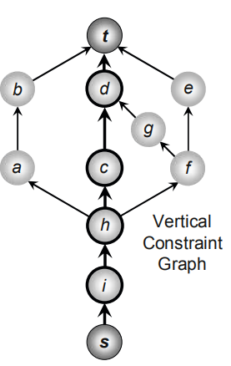
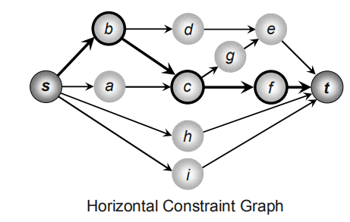
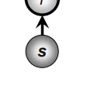


capture the relations between block positions
edges
vertical constraint graph
constraint-graph pair
one source node s
n + 2
weighted
nodes
horizontal constraint graph
one sink node t
n block nodes
v1, v2, … , vn
n blocks m1, m2, … , mn

