Slide 1
Panoply: Low-TCB Linux Applications With SGX Enclaves
Shweta Shinde Dat Le Tien
Shruti Tople Prateek Saxena
National University of Singapore

Slide 2



TCB: Hosting a Web Server
Current systems have a large TCB
183 KLOC
Webserver
10 MLOC
150 KLOC
Operating
System
Hypervisor

Slide 3

SGX: Hardware-root of Trust
RAM
Web Server Enclave
Other Applications
Ring 3
Operating System / VMM
Ring 0 - 2
EPC
Trusted
Untrusted

Slide 4
SGX: Hardware-root of Trust
183 KLOC
Enclave
Webserver
10 MLOC
150 KLOC
Operating
System
Hypervisor
Confidentiality
and Integrity
Hardware

Slide 5
..but limits the expressiveness of the applications (e.g., no syscalls)
SGX eliminates all the
non-application software from TCB..

Slide 6
TCB & Expressiveness Trade-off
TCB
LibraryOS
~1MLOC
Haven [OSDI’14]
Graphene-SGX [EuroSys’14]
Containers
~100KLOC
?
Scone [OSDI’16]
Ryoan [OSDI’16]
~KLOC
Syscall Threads Event Mgmt
Syscall Threads Event Mgmt Fork/ exec
Expressiveness
Syscall Threads
Syscall

Slide 7
Contributions
Panoply
Expressiveness: All standard POSIX APIs
Low TCB: 2 orders of magnitude smaller than LibraryOS
Library-enclaves for fine-grained TCB
Evaluation
Absolute 24% and 5-10% compared to LibraryOS

Slide 8
Problem

Slide 9
Challenge I: Expressiveness vs TCB
Webserver
Syscalls
Threading
Event Handling
Forking
Fork Emulation
Event Management
Thread Handling
Syscall Emulation
Web Server
Legacy Application Design
Enclave
TCB

Slide 10

Challenge I: Expressiveness vs. TCB
Expressiveness
TCB

Slide 11

Challenge II: Multi-Enclave Applications
zlib
zlib
Web Server
libssl
libevent
libevent
libcrypto
libcrypto
libssl
Operating System
libssl
Web Server
Web Server
Single Enclave
Application
Multi-Enclave
Application

Slide 12

Attacks on Multi-Enclave Applications
session_t session; certificate_credentials_t xcred;
/* Specify callback function*/
/* Initialize TLS session */ init (&session, TLS_CLIENT);
certificate_set_verify_function (...);
[SSL Lib]
OS
Set SSL Callback
Webserver
Enclave
SSL Library Enclave

Slide 13

Attacks on Multi-Enclave Applications
OS
Webserver
Enclave
SSL Library Enclave
Drop
Spoof
Replay

Slide 14
Our Solution: Panoply

Slide 15
Panoply Runtime
Microns keep libc outside the enclave
Micron
Enclave-bound Logic
Enclave
Panoply Shim Lib
Trusted SGX Lib
libc.so
Non-enclave
Logic
Untrusted SGX Lib
Non- Enclave
Linux User-level Process

Slide 16


Overview
Source
Code
Compiler
Instrumentation
Creating
Enclaves
1
2
Enclave-bound
Code
E1
E1
Add calls to
Panoply API
E2
E3
Panoply
Shim
Intel
SGX
SDK
E2
Ap
Add Flow Checks
Programmer
Annotations
Panoply
Application
Panoply

Slide 17
Challenge I: Expressiveness
Delegate rather than emulate
Enclave
Syscalls
On-demand threading
Multi-processing
Event Handling

Slide 18
Expressiveness: Panoply APIs
Core Services
Process Creation and Control | 5
Signals | 6
Timers | 5
File and Directory Operations | 37
Pipes | 4
C Library (Standard C) | 66
I/O Port Interface and Control | 40
Real-time Extensions
Real-Time Signals | 4
Clocks and Timers | 1
Semaphores | 2
Message Passing | 7
Shared Memory | 6
Asynchronous and Synchronous I/O | 29
Memory Locking Interface | 6
Thread Extensions
Thread Creation, Control, and Cleanup | 17
Thread Scheduling | 4
Thread Synchronization | 10
Signal Delivery | 2
Signal Handling | 3
POSIX APIs
Supported for
Commodity Linux Apps

Slide 19
Expressiveness Example: Fork
LibraryOSes emulate fork semantics
Fork Semantics
LibraryOS Fork Implementation
Parent
Process
Child
Process
Parent
Enclave
Child
Enclave
Page Copy
Page Copy
OS
PID Mgmt
PID Mgmt
Page Copy
PID Mgmt
OS

Slide 20
Expressiveness Example: Delegating Fork
Creating child process and child enclave
Parent Enclave
Child Enclave
Parent Process
Child Process
Panoply
Fork
OS
PID Mgmt
Child enclave has a clean memory state

Slide 21

Expressiveness Example: Achieving Fork Semantics
Mirroring parent’s memory in child enclave
After the fork call, before resuming execution
Parent Enclave
Child Enclave
Stack
Heap
Data
Stack
Heap
Data
Parent Process
Child Process
OS
Sealed Data

Slide 22
Expressiveness Example: Achieving Fork Semantics
Mirroring parent’s memory in child enclave
Full replica: default mode in Panoply
Alternative strategies to full replica
Copy on demand: Requires page-fault support from SGX v2
Copy on need: Replicate selected addresses which are pre-determined by static analysis

Slide 23
Expressiveness Example: Multi-Threading
Virtual Threads
TCS1 | TCS2 | TCS3
TCS1 | TCS2 | TCS3
Micron A
Micron A’
Panoply Shim
Panoply Shim
Thread Control Manager Micron
Shared Variables

Slide 24
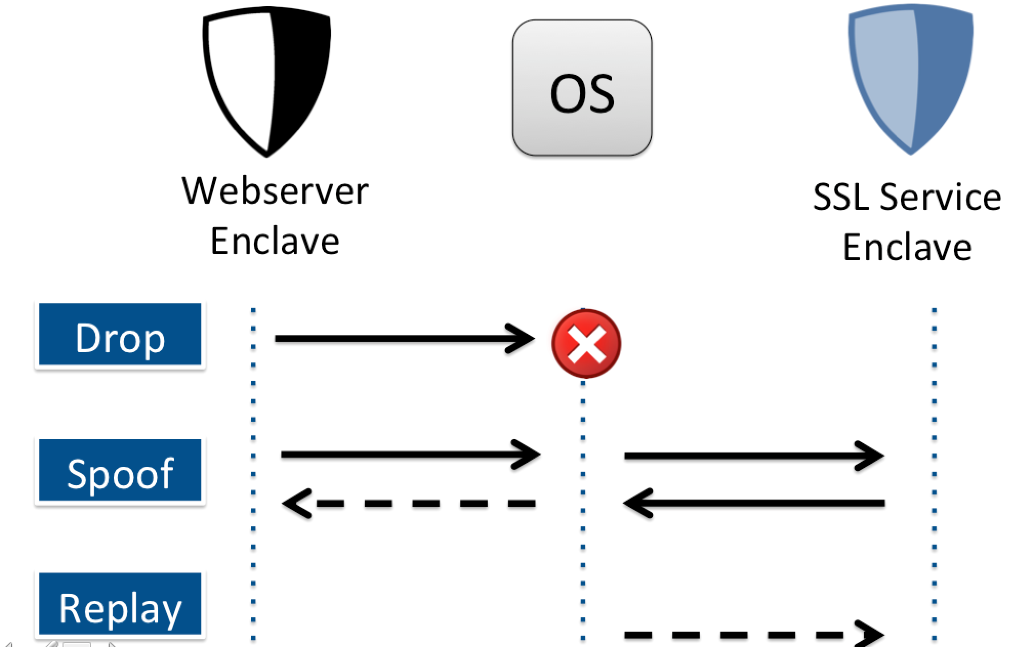
Challenge II: Multi-enclave Applications

Slide 25
Securing Multi-Enclave Apps
Enclave Identity
Pair-wise Nonce
OS
Call Ack
Enclave 1
Enclave 2
Attack | Security Property
Spoofing | Sender / Receiver Authentication
Replay | Message Freshness
Silent Drops | Reliable Delivery

Slide 26
Evaluation

Slide 27




Benchmarks
Real-world use-cases for SGX
4 apps: Tor, H2O web server, FreeTDS, OpenSSL
Operating system stress testing
26 LMBench benchmarks tests
17 metrics for memory, network, signal, syscall APIs

Slide 28
TCB Evaluation
Panoply
Graphene-SGX
Component | LOC
Panoply Library | 10425
API Wrappers | 9788
Total | 20213
Component | LOC
Glibc | 1156740
libPal-LinuxSGX | 16901
libPal-enclave | 33103
Total | 1206744
Panoply reduces TCB by 2 orders of magnitude

Slide 29
Performance Evaluation
Create delete takes large fraction of the time
Overhead increases with number of Out-Calls
Panoply incurs 24% overhead
App | Panoply | Empty Enclave | Overhead (% increase)
OpenSSL | 3.16 | 2.79 | 13
H2O | 8.79 | 6.56 | 34
FreeTDS | 8.74 | 8.60 | 1
Tor | 6.72 | 4.54 | 48
Average |  |  | 24

Slide 30
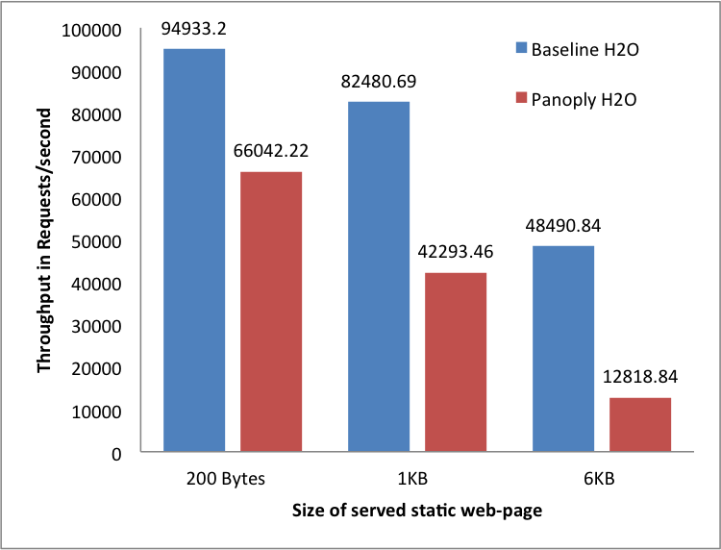
Throughput Evaluation

Slide 31
Throughput Evaluation
Overhead for SGX-apps is proportional to the size of requests

Slide 32
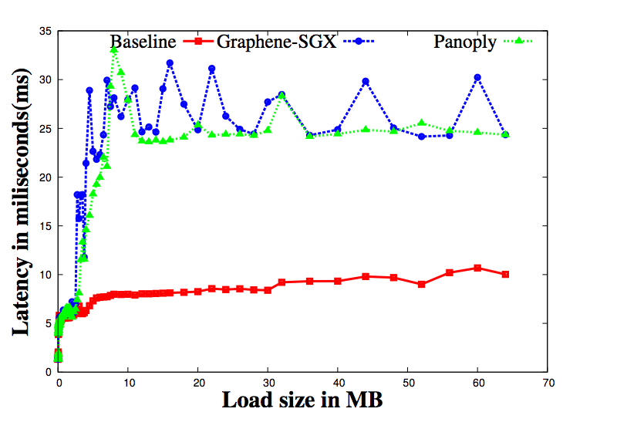
Comparison with Graphene-SGX

Slide 33
Comparison with Graphene-SGX
Panoply performance varies by 5-10% as compared to Graphene-SGX

Slide 34
Conclusion
TCB
~1MLOC
~100KLOC
- 254 APIs - 20KLOC - 24%Overhead
Panoply
~KLOC
Syscall Threads Event Mgmt
Syscall Threads Event Mgmt Fork/ exec
Expressiveness
Syscall Threads
Syscall

Slide 35
Contact
Shweta Shinde
shweta24@comp.nus.edu.sg
Panoply Benchmarks & Case-studies:http://shwetasshinde24.github.io/Panoply/
Thank You !

Slide 36
References
[OSDI’ 14] A. Baumann, M. Peinado, and G. Hunt, Shielding Applications from an Untrusted Cloud with Haven
[OSDI’ 16] S. Arnautov, B. Trach, F. Gregor, T. Knauth, A. Martin, C. Priebe, J. Lind, D. Muthukumaran, D. O’Keeffe, M. L. Stillwell, D. Goltzsche, D. Eyers, R. Kapitza, P. Pietzuch, and C. Fetzer, SCONE: Secure Linux Containers with Intel SGX
[OSDI’ 16] T. Hunt, Z. Zhu, Y. Xu, S. Peter, and E. Witchel, Ryoan: A Distributed Sandbox for Untrusted Computation on Secret Data
[EuroSys’ 14] Graphene-SGX Library OS - a library OS for Linux multi-process applications, with Intel SGX support

