Slide 1
Parallel Scalability
CS 420 Fall 2012
Osman Sarood

Slide 2
How faster can we run?
Suppose we have this serial problem with 12 tasks. How fast can we run given 3 processors?

Slide 3
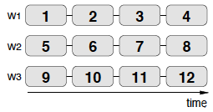
Running in parallel
Execution time reduces from 12 secs to 4 secs!

Slide 4
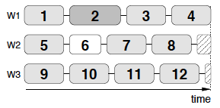
Load imbalance
What if all processors can’t execute tasks with the same speed?
  Load imbalance (ending parts for W2 and W3)

Slide 5
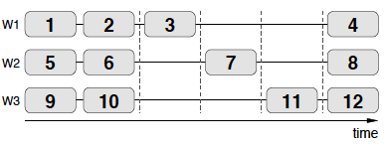
Dependence amongst tasks
What if tasks 3, 7 and 11 are dependent?
  Execution time increases from 4 to 6!

Slide 6
Scalability
How much faster can a given problem be solved with N workers instead of one?
How much more work can be done with N workers instead of one?
What impact for the communication requirements of the parallel application have on performance?
What fraction of the resources is actually used productively for solving the problem?

Slide 7
Scalability
Simple model
  s: is the serial part p: is the parallel part
Why serial part?
  Algorithm limitations: dependencies
  Bottlenecks: shared resources
  Startup overhead: starting a parallel program
  Communication: interacting with others workers

Slide 8
Scaling
Strong Scaling: Keeping the problem size fixed and pushing in more workers or processors
  Goal: Minimize time to solution for a given problem
Weak Scaling: Keeping the work per worker fixed and adding more workers/processors (the overall problem size increases)
  Goal: solve the larger problems

Slide 9


Strong Scaling
Work done
Single worker runtime:
Same problem in parallel on N workers takes:

Slide 10



Weak Scaling
Work done
Single worker runtime:
Same problem in parallel on N workers takes:

Slide 11



Performance: Strong Scaling
Performance = work / time
Strong scaling:
  Serial performance:
  Parallel performance:
  Speedup:
The same!

Slide 12

Example: Strong Scaling
s: 0.1, p: 0.9, N: 1000 | s: 0.9, p: 0.1, N: 1000
Strong scaling:
  Serial performance:
  1 | 1
  Parallel performance and speedup:
  9.91 | 1.11

Slide 13



Strong Scaling changing “work”
Work: p ( only the parallelizable part)
Strong scaling:
  Serial performance:
  since
  Parallel performance:
  Speedup:
Differ by factor of ‘p’
But speedup is the same

Slide 14



Example: Strong Scaling
s: 0.1, p: 0.9, N: 1000 | s: 0.9, p: 0.1, N: 1000
Strong scaling:
  Serial performance:
  0.9 | 0.1
  Parallel performance:
  8.9 | 0.11
  Speedup:
9.9 | 1.11

Slide 15


Performance: Weak Scaling
Weak scaling:
  Serial performance:
  Parallel performance:

Slide 16

Gustafson’s law
In case we recover Amdahl’s law.
For and when N is large,
  is linear in
  hence, we can cross Amdahl’s law and get unlimited performance!

Slide 17
Gustafson’s law
In the case
  Speedup is linear in N

Slide 18



Weak Scaling changing “work”
Work: p ( only the parallelizable part)
Weak scaling:
  Serial performance:
  Parallel performance:
  Speedup:
Differ by factor of ‘p’

Slide 19
Scalability: Weak Scaling
For ,
  Linear in with a slope of 1
  Makes us believer that all is well and application scales perfectly
  Remember previously, in Gustafson’s equation, it had a slope of (1-s)<1

Slide 20


Parallel Efficiency
How effectively CPU computational power can be used in a parallel program.

Slide 21

Effect of
For , (is there any significance of it?)
  As N increases, decreases to 0
For ,
  Efficiency reaches a limit of 1-s=p. Weak scaling enables us to use at least a certain fraction of CPU power even when N is large
  The more CPUs are used, the more CPU cycles are wasted (What do you understand by it?)

Slide 22

Changing “work”
If work is defined as only the parallel part ‘p’
For , we get
  Implied perfect scalability!
  And no CPU cycles are wasted!
  Is that true?

Slide 23
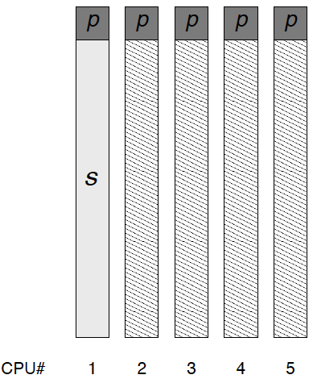
Example
Some application has flops only in the parallel region
s: 0.9 and p: 0.1
4 CPUs spend 90% idle!
MFLOPs rate a factor of N higher than serial case

Slide 24
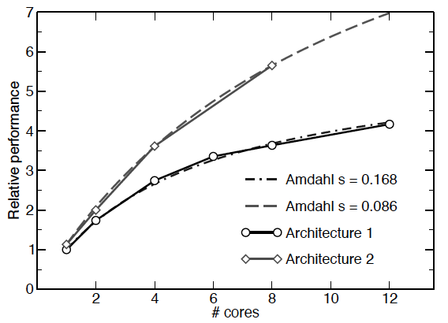
Serial performance and strong scalability
Ran the same code on 2 different architectures
Single thread performance is the same
Serial fraction `s’ much smaller on arch2 due to greater memory bandwidth

Slide 25



Serial performance and strong scalability
Scalar optimizations (studied earlier) should be done in serial or parallel parts?
Assuming serial part can be accelerated by parallel performance becomes:
In case parallel part is improved parallel performance becomes:

Slide 26

Serial performance and strong scalability
When does optimizing the serial part pays off more than optimizing the parallel part:
Does not depend on
If , it pays off to optimize parallel region as serial optimization would be beneficial after a very large value of N.

Slide 27
Are these simple models enough?
Amdahl’s law for strong scaling
Gustafson’s law for weak scaling
Problems with these models?
  Communication
  More memory (affects both strong and weak scaling?)
  More cache (affects both strong and weak scaling?)

Slide 28
Accounting communication
Where do we account for communication?
  Do we increase the work done?
  Do we increase the execution time?
It should affect the parallel execution time only as it doesn’t affect the work done (its not ‘useful’ work)

Slide 29

Weak scaling: Speedup
Speedup reduces due to communication:
What is ?
  It depends on the type of network
    Blocking
    Non blocking
  Depends on (latency) and (time taken to transmit depending on number of bytes ‘n’ and bandwidth ‘B’

Slide 30

Effects of communication on Speedup
Blocking network:
is dependent of N since network is blocking and one proc can send msg at a time.
Speedup goes -> 0 for large N due to communication bottleneck

Slide 31

Effects of communication on Speedup
non-Blocking network, constant size message:
is independent of N since network is nonblocking and procs can send msg at the same time.
Speedup settles to a lower value than what it was without incorporating communication
Better than blocking case

Slide 32

Effects of communication on Speedup
non-Blocking network with ghost layer communication:
is inversely dependent on N. Why?
Speedup settles to a lower value than what it was without incorporating communication
Better than non-blocking constant comm. cost.

Slide 33

Effects of communication on Speedup
non-Blocking network with ghost layer communication, :
is independent of N (constant) since the problem size also grows linearly with N
Speedup is linear as this is weak scaling
But less than what it was w/o communication

Slide 34
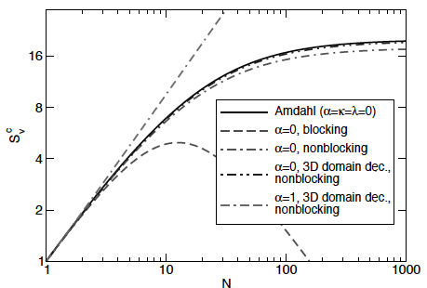
Predicted Scalability for different models
Speedup for:
  Weak scaling keeps on increasing linearly
  Strong scaling is projectile and hits zero for large N
  Other models lie in between
  All strong scaling models less than Amdahl’s

Slide 35
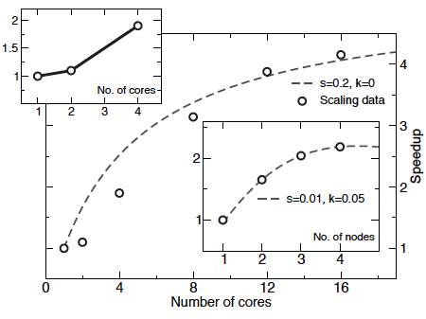
Scaling baseline
How do we normalize the results for determining speedup?
Speedup using model slide 30

Slide 36
Scaling baseline (main figure)
The main figure shows higher serial part: 0.2 with no effect from communication k: 0
The actual points are way from the prediction (for small core count)
Main figure is normalized using single core performance

Slide 37
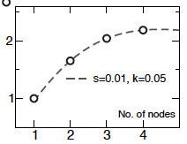
Right smaller figure
Change baseline from per core to per node
Almost a perfect fit!
Serial fraction s:0.01, comm k=0.05
Much more dependence on comm!

Slide 38
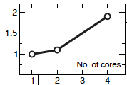
Left smaller figure
Changes baseline to per core but only shows whats going on inside a node
Bad speedup moving from 1core->2core (due to use of same socket)
Sudden jump in speedup from 2-4 cores (an additional socket)

Slide 39
Scaling baseline takeaway
Scaling behavior for inter and intra node cases should be studied seperately

Slide 40
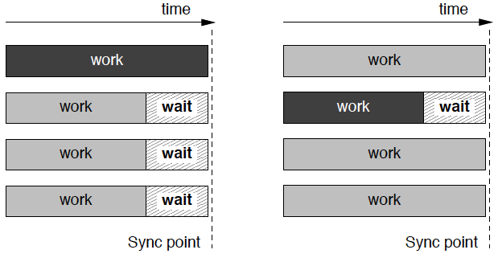
Load imbalance
What is load imbalance?
Speeder
Lagger

Slide 41
Load imbalance
Both speeder and laggers are bad.
Which one is worse?
  A few laggers (majority speeders)
  A few speeders (majority laggers)
How much time is spent idle?

Slide 42
Reasons for load imbalance (1)
The method chosen for distributing work among the workers may not be compatible with the structure of the problem
JDS sparse matrix-vector multiply
  Allocate equal number of row to all procs
    Some rows might have significantly more non-zeros compared to others

Slide 43
Reasons for load imbalance (2)
It may not be known at compile time how much time a “chunk” of work actually takes
Applications having the concept of convergence. Each chunk needs to execute until it converges. You can’t determine the number of instructions to convergence before hand (mostly)

Slide 44
Reasons for load imbalance (3)
There may be a coarse granularity to the problem, limiting the available parallelism.
This happens usually when the number of workers is not significantly smaller than the number of work packages.
  Imagine having 10000 tasks with 6000 processors

Slide 45
Reasons for load imbalance (4)
If a worker has to wait for resources like, e.g., I/O or communication devices.
overhead of this kind is often statistical in nature, causing erratic load imbalance behavior
How can we remedy such problems?
For communication we can try and overlap communication and computation

Slide 46
Reasons for load imbalance (5)
Dynamically changing workload
  Adaptive Mesh Refinement, Molecular dynamics
    Workload might be balanced to start with but can change gradually over time
Adapting to such dynamic workload is not easy for MPI programmers

Slide 47
Charm++
Based on object based over-decomposition
Programmer can think in terms of objects instead of processors.
Offers automatic:
  dynamic load balancing
  Fault tolerance
  Energy/Power efficient HPC applications
More to come in later lectures

Slide 48

OS Jitter
Interference from OS
Causes load imbalance
Statistical in nature e.g. 1 out of 4 four processors will get OS interference in 1 sec

Slide 49
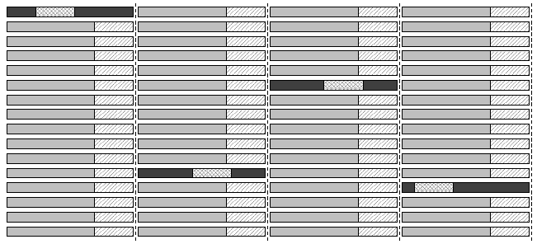
OS Jitter on larger machines
OS jitter much more harmful in larger machines

Slide 50
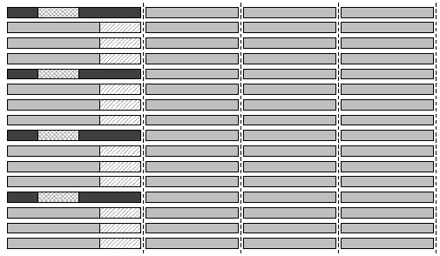
OS Jitter synchronization
Synchronize processors so that OS jitters happen roughly at the same time for all processors
Difficult to do (requires significant OS hacking)

