Slide 1
Analyzing Customer Support in Twitter
The purpose of the project is to understand what questions customers and ask and how to respond to them.

Slide 2
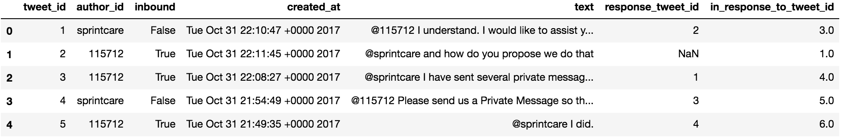
Data
Kaggle dataset accessed from: https://www.kaggle.com/thoughtvector/customer-support-on-twitter
2811774 tweets from 4/1/2016 to 9/28/2016

Slide 3
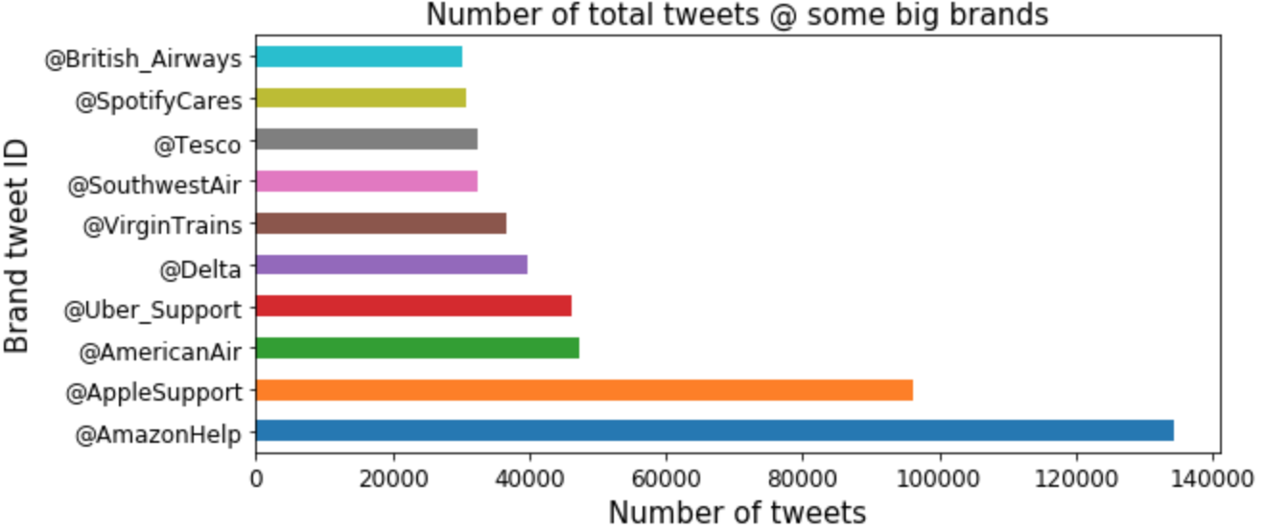
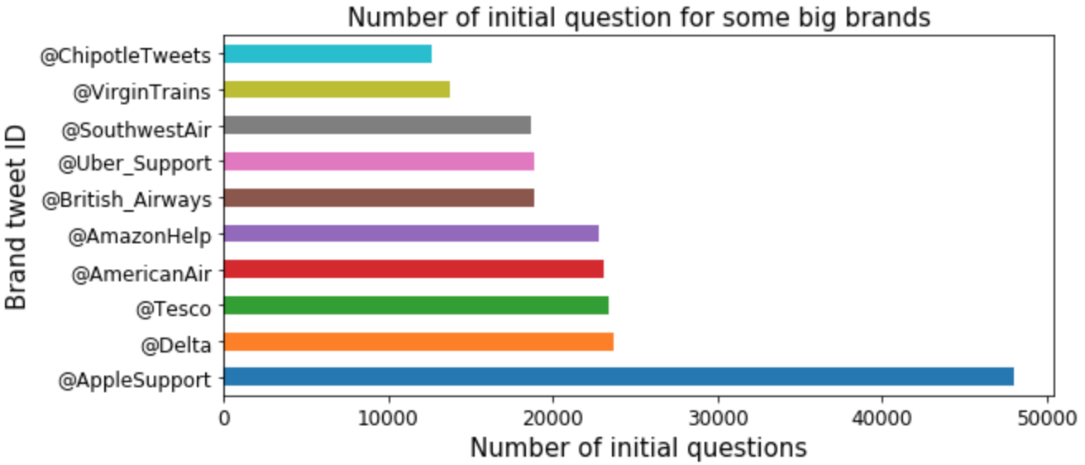
Only top 10 brands are included in the plot.
AppleSupport received the most number of initial questions /comments.
But, conversations are the most active at AmazonHelp.

Slide 4
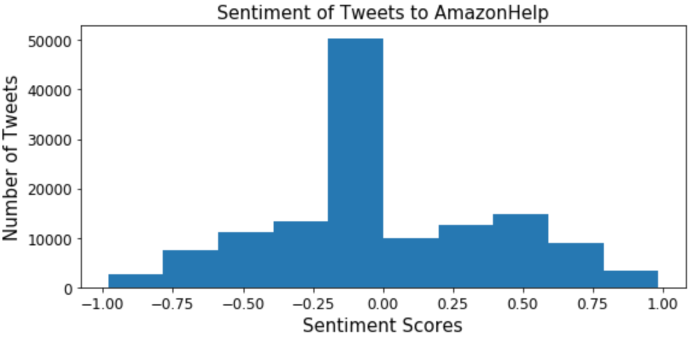
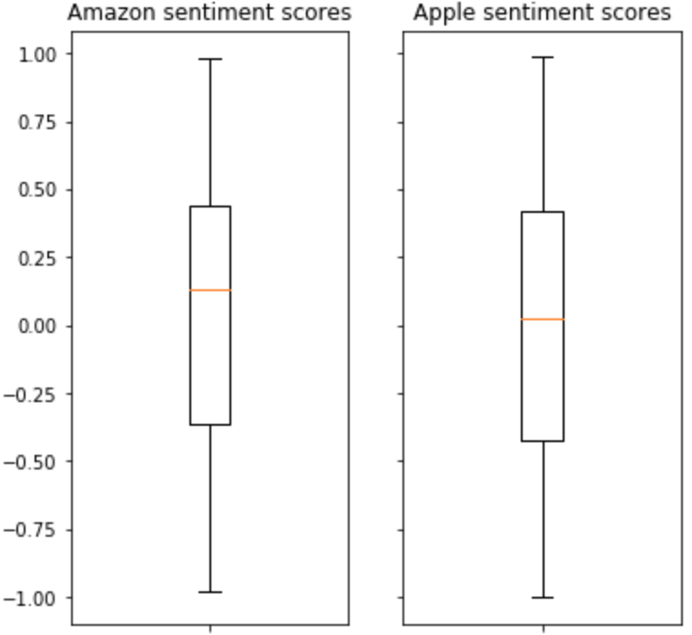
Interpretation:
Calculating sentiment scores using vaderSentiment library. There are about the same number of positive and negative comments/questions @ AmazonHelp. And AmazonHelp in overall, has lightly more positive comments than AppleSupport.

Slide 5
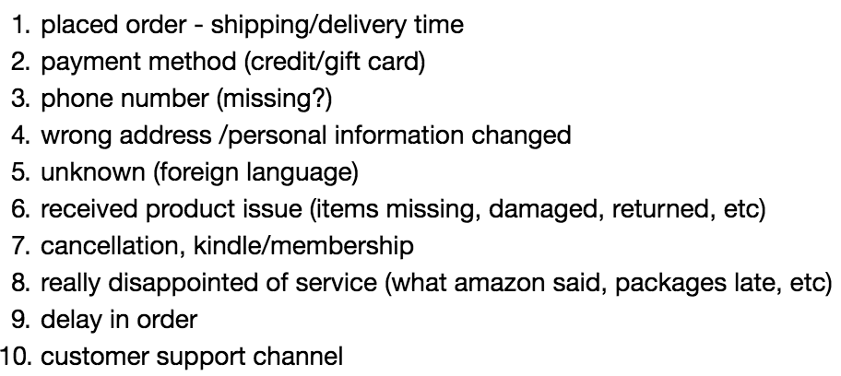
Topics people asked
Topic modeling methods: LDA and NMF
Result: LDA indeed does a bad job on tweets (short texts)
So, 10 topics in the questions interpreted from NMF top 20 words are:

Slide 6
Predicting a response to an initial question
Modified existing sequence to sequence model
Result:
Fitted on 10,000 tweets
Fitted on 30,000 tweets

Slide 7
Challenges
Data reshaping: matching questions and responses.
Data cleaning: filtering out numbers, links and most importantly foreign languages before topic modeling. I was able to remove most of foreign words, but there are still some remained.
Used enchant library to check language and TextBlob to translate (Not good enough).
Different cleaning steps for difference modeling purpose.
Sequence to sequence model: hard to understand and took really long to run. I made the decision to move to AWS in the last day.

