Slide 1
#Support
Topic Modeling and Sentiment Analysis of Twitter Customer Service Conversations

Slide 2


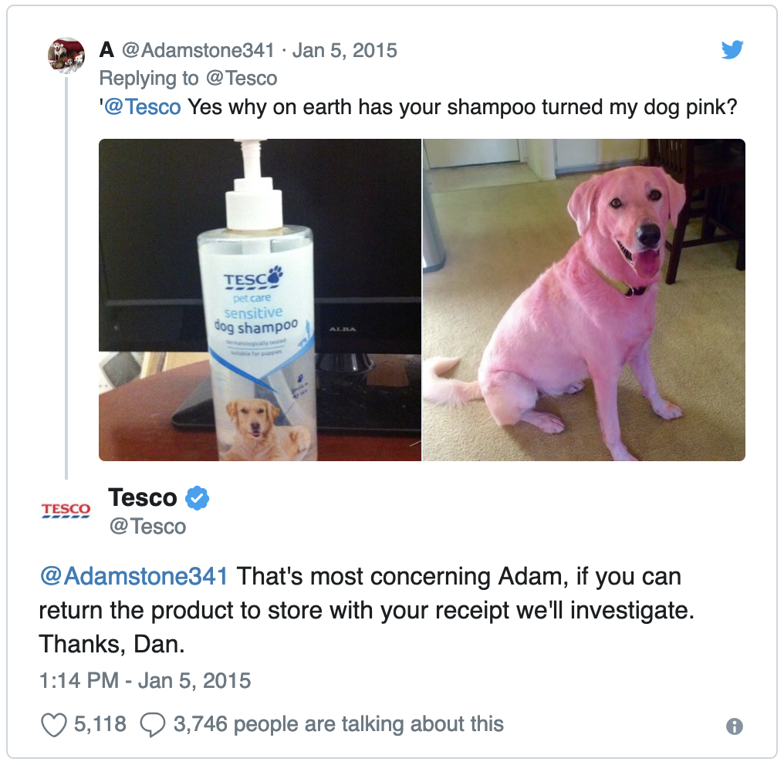




Slide 3
#SentimentAnalysis

Slide 4
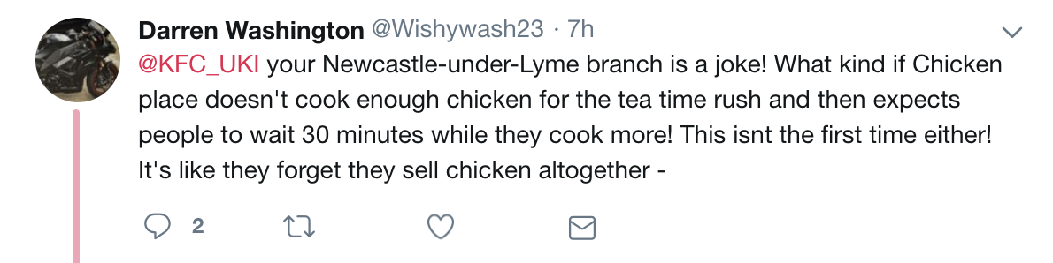
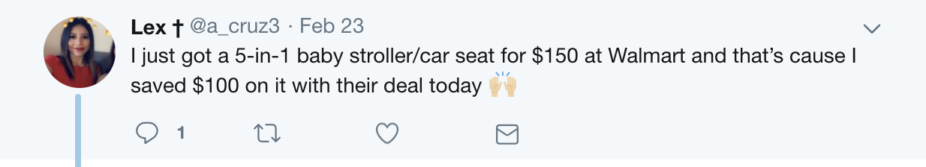

Slide 5
0.634
@Walmart
-0.251
@KFC_UKI_Help

Slide 6
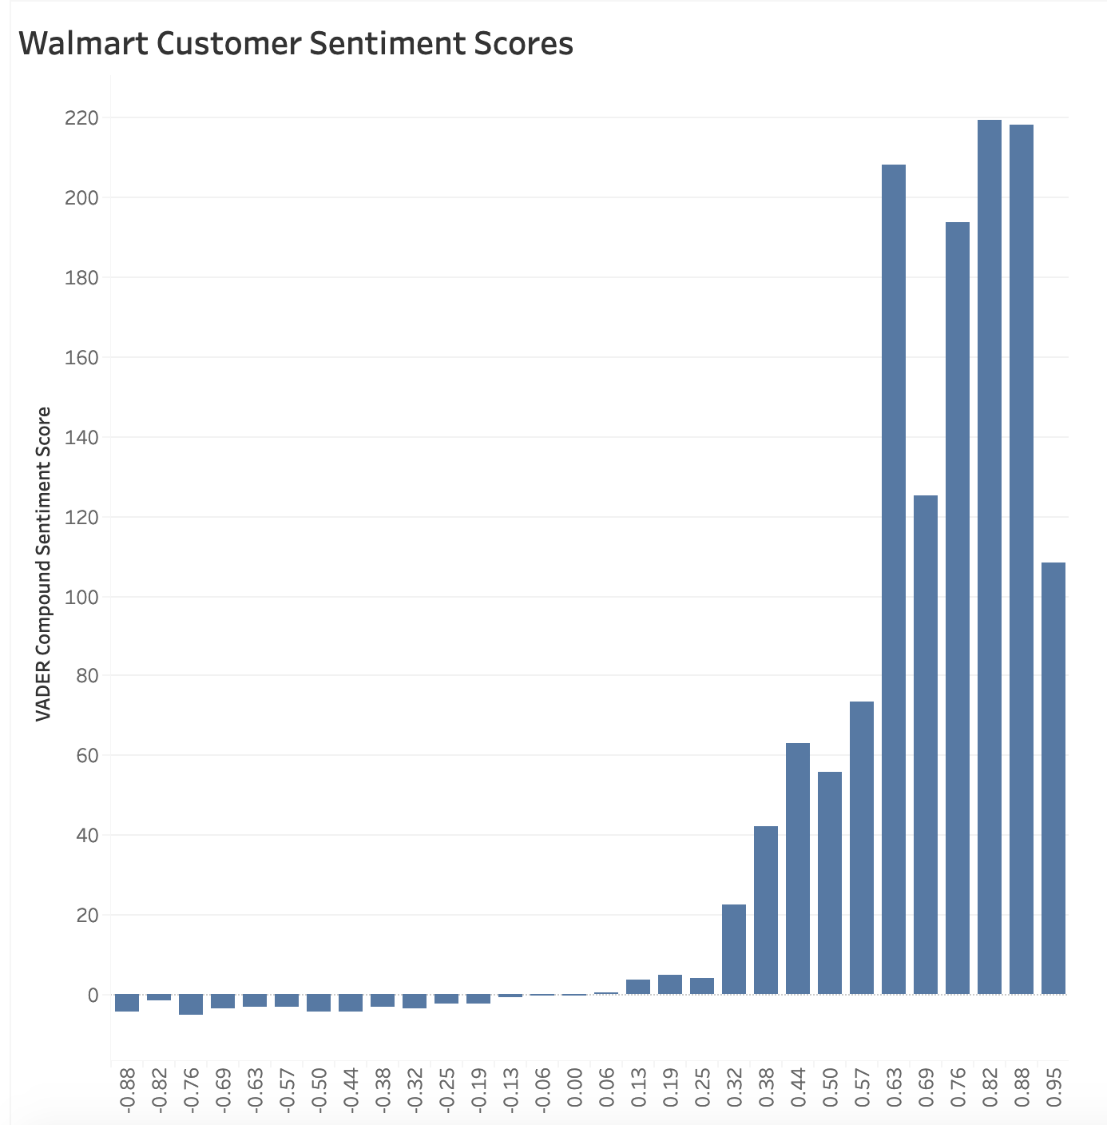
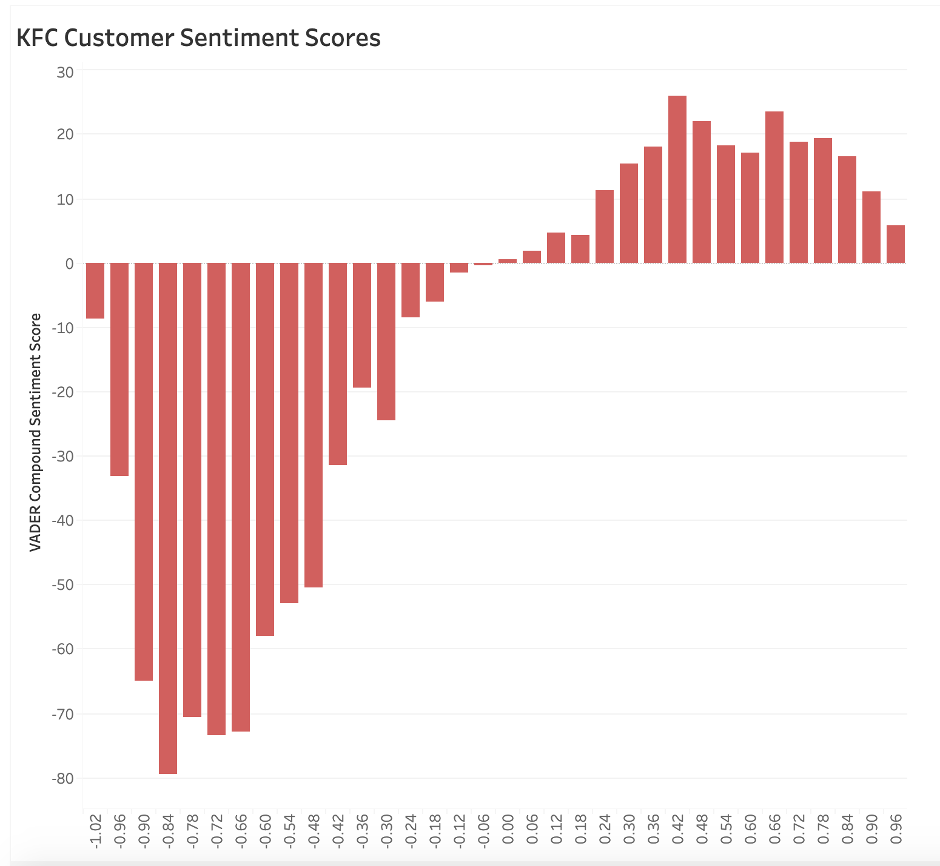

Slide 7
#TopicModeling

Slide 8
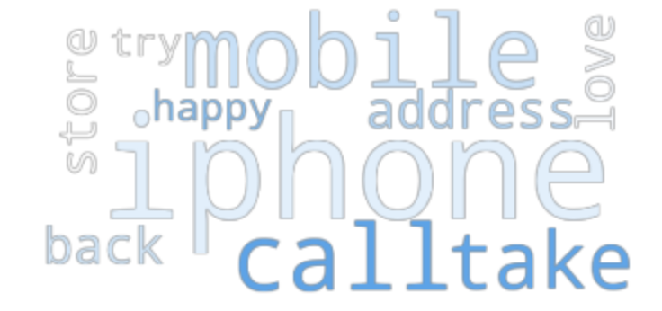
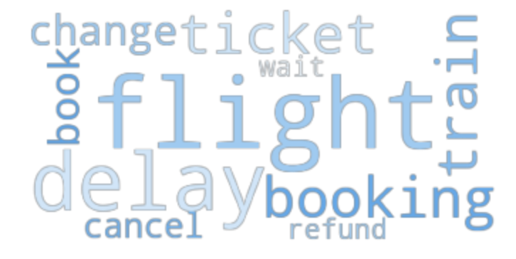
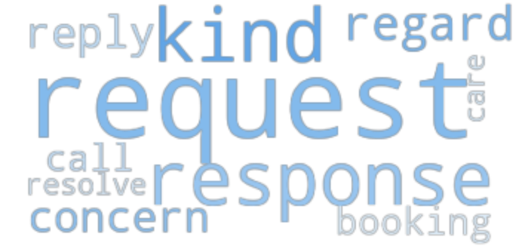
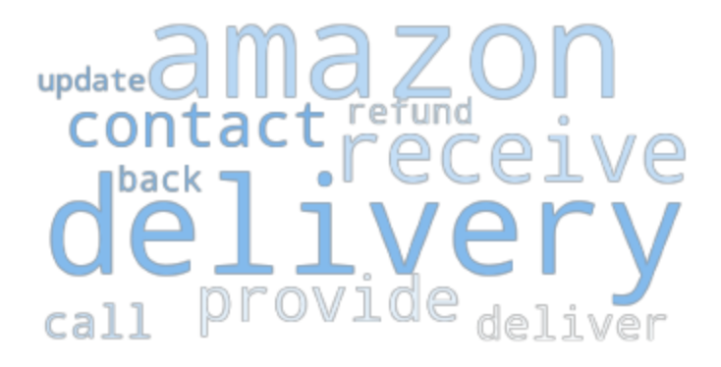
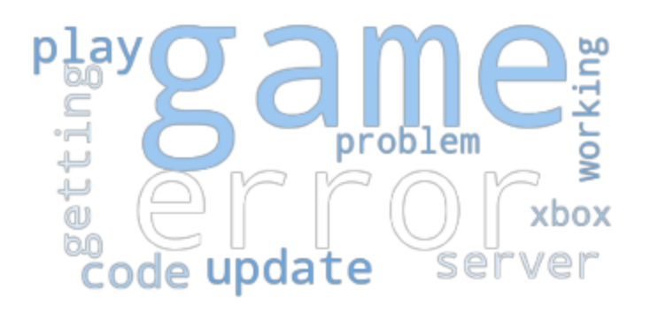
1
Phones
4
Travel
2
Attention
5
Deliveries
3
Gaming

Slide 9


Slide 10
Future Work:
Clustering on a conversation level
Comparing tweet sentiment with customer reviews from Yelp or Google My Business

Slide 11
Thank You!

