Slide 1
Project Mcnulty
MLB Pitcher Injury Prediction
Kari Davis

Slide 2

Introduction
The Challenge:
Predict MLB pitcher injuries using binary classification.
Baseball-Reference.com
BrooksBaseball.com
Spotrac.com
Kaggle
MLB.com

Slide 3
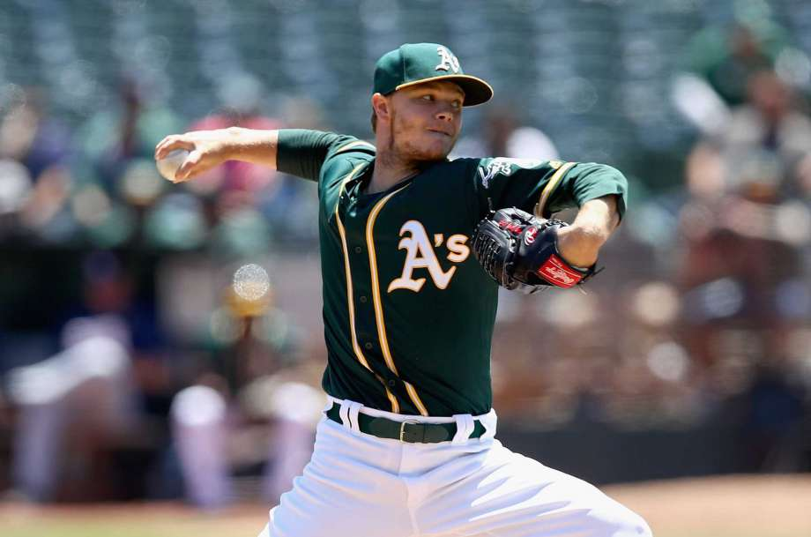
Exploring the Data
Feature | Injured | Healthy
Most Common Age | 29 | 25
Avg Speed | 86 | 83
Tommy John | 29.4% | 17.3%
Avg W-L Record | 0.430 | 0.368
Avg IP/Game | 2.89 | 2.41

Slide 4
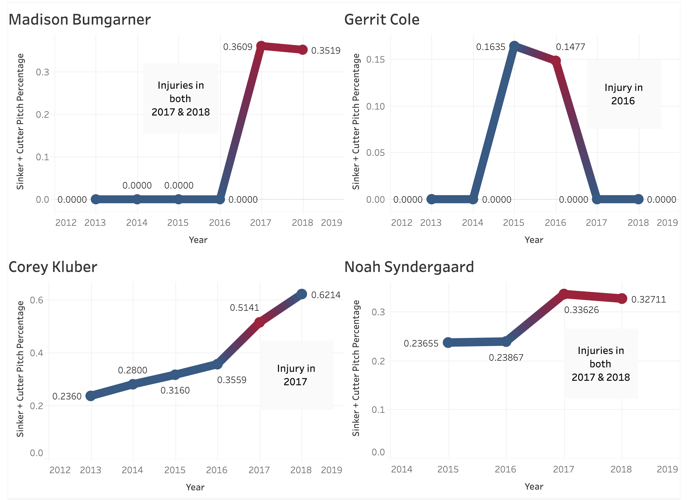

Slide 5
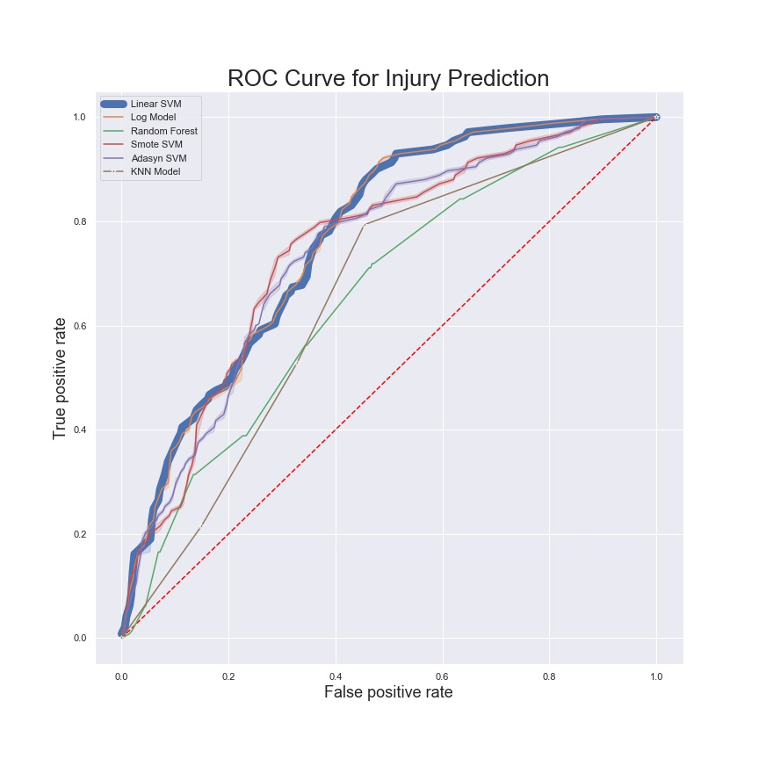
Modeling
CLASSIFICATION MODEL | ROC AUC
Logistic Regression | 0.6773
K-Nearest Neighbors | 0.6003
Linear SVM | 0.6969
Random Forest | 0.5940
Linear SVM with Smote | 0.6906
Linear SVM with Adasyn | 0.6965

Slide 6
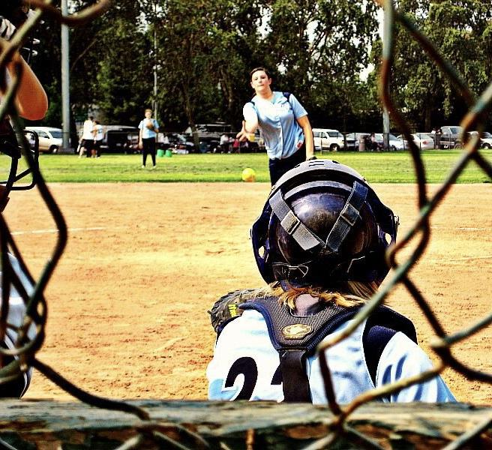
Results
0.7072 ROC AUC on hold out data (2018 injuries)
Flask App with pitcher stats pages and 2019 injury predictions

Slide 7


Slide 8
Thank You!

