Slide 1
Calculating Information Leakage using Model Checking Tools
Jia Chen
Advisor: Dr. Rohit Chadha

Slide 2
Outline
Title Explanation
Method
Experiment and Result
Conclusion and Discussion

Slide 3
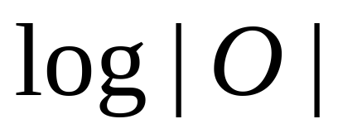
Calculating Information Leakage using Model Checking Tools
Quantify information leakage
Min-entropy & Shannon entropy
Deterministic programs->
Count the number of different outputs

Slide 4
Calculating Information Leakage using Model Checking Tools
Model checking tools
  Getafix
  jMoped
Reachability

Slide 5
Calculating Information Leakage using Model Checking Tools
Problem:
Count the number of different outputs of a program using reachability-checking tools.

Slide 6
Outline
Title Explanation
Method
Experiment and Result
Conclusion and Discussion

Slide 7
Problem setting
P: a program with one input and one output, both are int.
Bit length: I/O range
S: Input [0, SMax]
O: Output [0, OMax]
1<<bit length -1

Slide 8
Overview
Architecture
Count number of outputs using a counter
Program to be tested
if (counter == desired value){
reach: 0<1;
}

Slide 9
Counting approach 1
Single loop and array
OHit[OMax + 1] ← [0]
for S = 0 to SMax do
SIn ← S
OOut ← P (SIn)
if OHit[OOut] = 0 then
      OCounter ← OCounter + 1
      OHit[OOut] ← 1
end if
end for

Slide 10
Counting approach 2
Double loop
for O = 0 to OMax do
for S = 0 to SMax do
    SIn ← S
    OOut ← P (SIn)
    if OOut = O then
    OCounter ← OCounter + 1
    break
    end if
end for
end for

Slide 11
Intuitive comparison
@ 32 bits
Empty double loop
  ~1403 years to complete
Single loop and array
  2³² = 0.5 GByte for bit array

Slide 12
Quantitative comparison
Growth on bit length + 1
We choose the double loop approach.
 | Double loop | Single loop & array
Time | ×4 | ×2
Memory | +7 | ~×2

Slide 13
Improvement 1st try
Discovery by mistake
for O = 0 to OMax do
for (;S ≤ SMax;S++) do
    SIn ← S
    OOut ← P (SIn)
    if OOut = O then
    OCounter ← OCounter + 1
    break
    end if
end for
end for

Slide 14
Improvement 1st try
Requires P to be
  Monotonically increasing within range [0, n]
  Output for [0, n]starts with 0 and is continuous
  Output for [n + 1, OMax] are covered by output from [0, n]

Slide 15
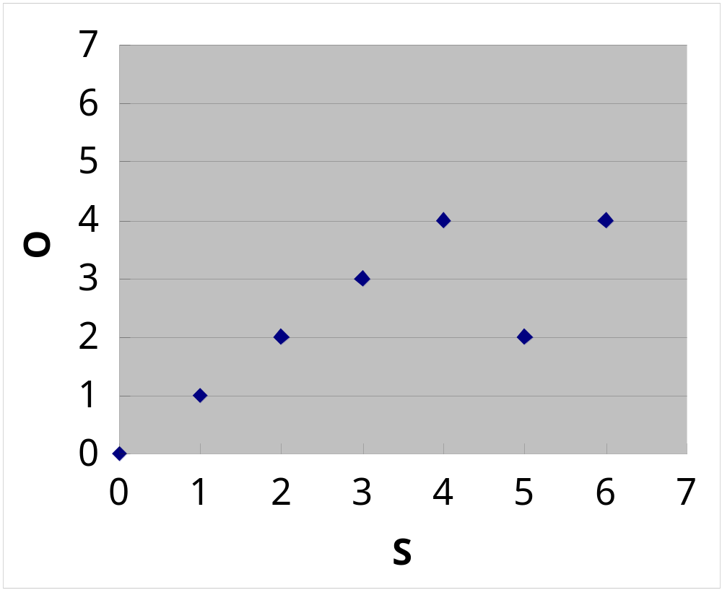
Improvement 1st try
Requirement

Slide 16
Improvement 2nd try
Optimization
for S = 0 to SMax do
SIn ← S
OOut ← P (SIn)
if OOut > Max then
      OCounter ← OCounter + 1
      Max = OOut
end if
end for

Slide 17
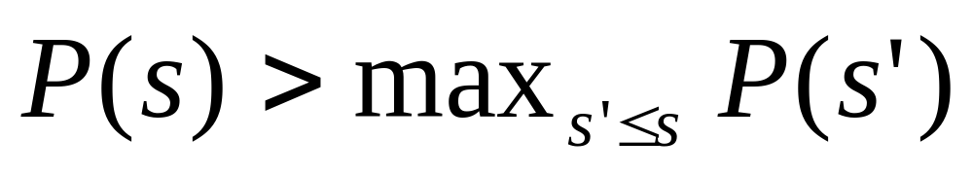
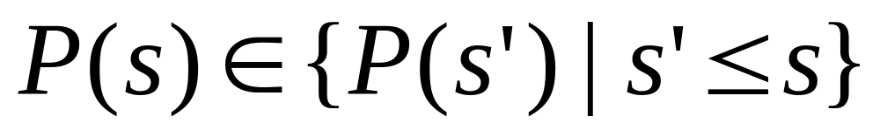
Improvement 2nd try
Requirement
Either
Or

Slide 18
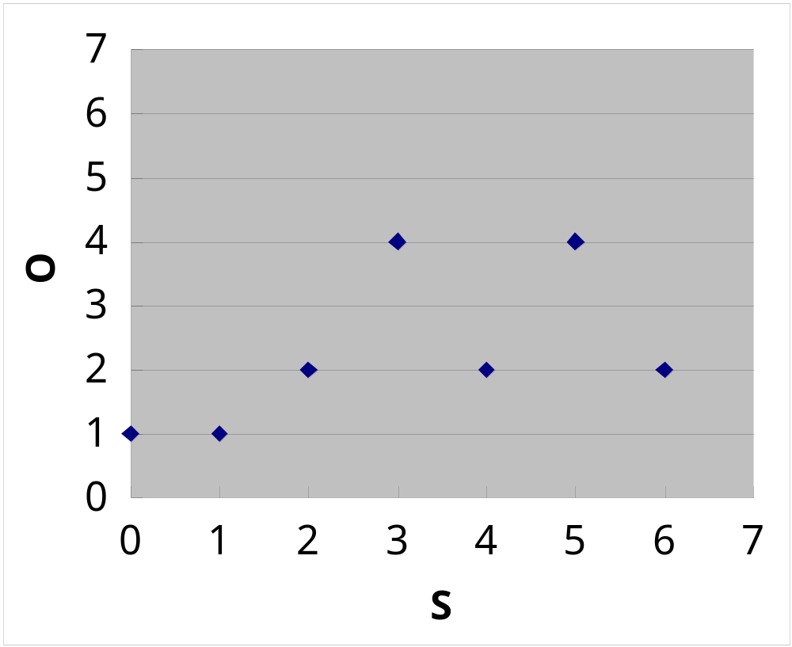
Improvement 2nd try
Requirement

Slide 19
2nd try remarks
Increasing/decreasing

Slide 20
Outline
Title Explanation
Method
Experiment and Result
Conclusion and Discussion

Slide 21
Environment
Lenovo ideapad Y580-IFI
Ubuntu 14.04 LTS 32-bit
Model checkers:
Getafix and jMoped

Slide 22
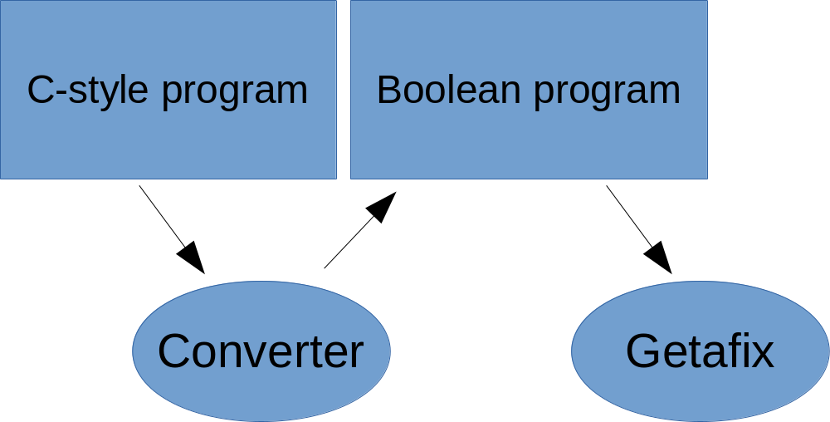
Converter
Converter for Getafix
  2000 LOC
Converts C-style code to boolean program

Slide 23
Experiment Overview
7 tests total
Electronic purse
Masked copy

Slide 24
Electronic purse
Assume S<20
4 outputs
O = 0;
while(S >= 5) {
S = S - 5;
O = O + 1;
}

Slide 25
Electronic purse
bit length(bit) | Getafix(s) | Getafix optimized(s) | jMoped(s) | jMoped optimized(s)
5 | 10.411 | 2.7805 | 1.7 | 0.305

Slide 26
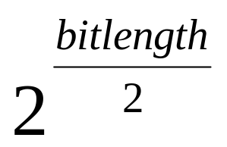
Masked copy
Output count:
O = S & 240₁₀
O = S & 11110000₂

Slide 27
Implicit flow
bit length(bit) | Getafix(s) | Getafix optimized(s) | jMoped(s) | jMoped optimized(s)
6 | 58.834 |  | 11.87
7 | 289.919 | 8.265 | 63.56 | 0.58
8 | >600 | 22.644 | 325.76 | 0.97
9 |  | 61.464 |  | 1.86
10 |  | 182.130 |  | 3.57
11 |  |  |  | 7.21
12 |  |  |  | 15.75
13 |  |  |  | 36.31
14 |  |  |  | 81.53
15 |  |  |  | 182.01
16 |  |  |  | 415.69

Slide 28
Outline
Title Explanation
Method
Experiment and Result
Conclusion and Discussion

Slide 29
Conclusion
Calculating information leakage using model checking tools
jMoped is faster than Getafix
jMoped + opt = best result

Slide 30
Conclusion
Issues
16 is a small number. We want to go to 128~256 bits eventually
Exponential growth

Slide 31
Conclusion
Getafix and jMoped does not scale well under our approach.
  Works well for semi-monotonic programs
Try another model checker?
Optimize jMoped directly for computing min-entropy
  R. Chadha, U. Mathur and S. Schwoon
Refine the counting algorithm?
How to check monotonicity?

Slide 32
The End
Thank you for listening

