Slide 1
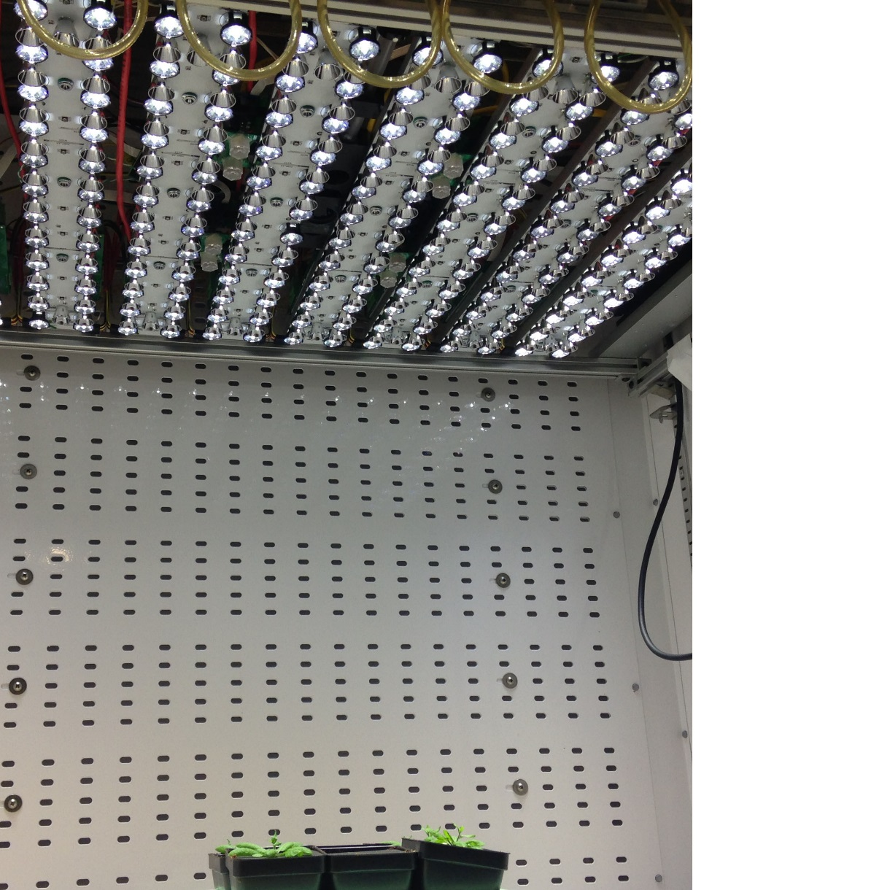
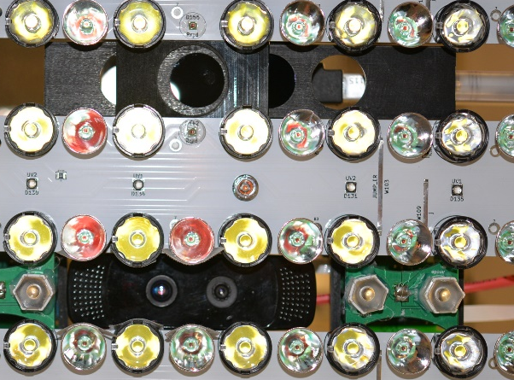
RGB color and depth camera
Florescence and IR camera
LED
Infrared LED

Slide 2
Florescence and IR camera
RGB color and depth camera
LED light bulbs
Infrared LED light bulbs

