Slide 1
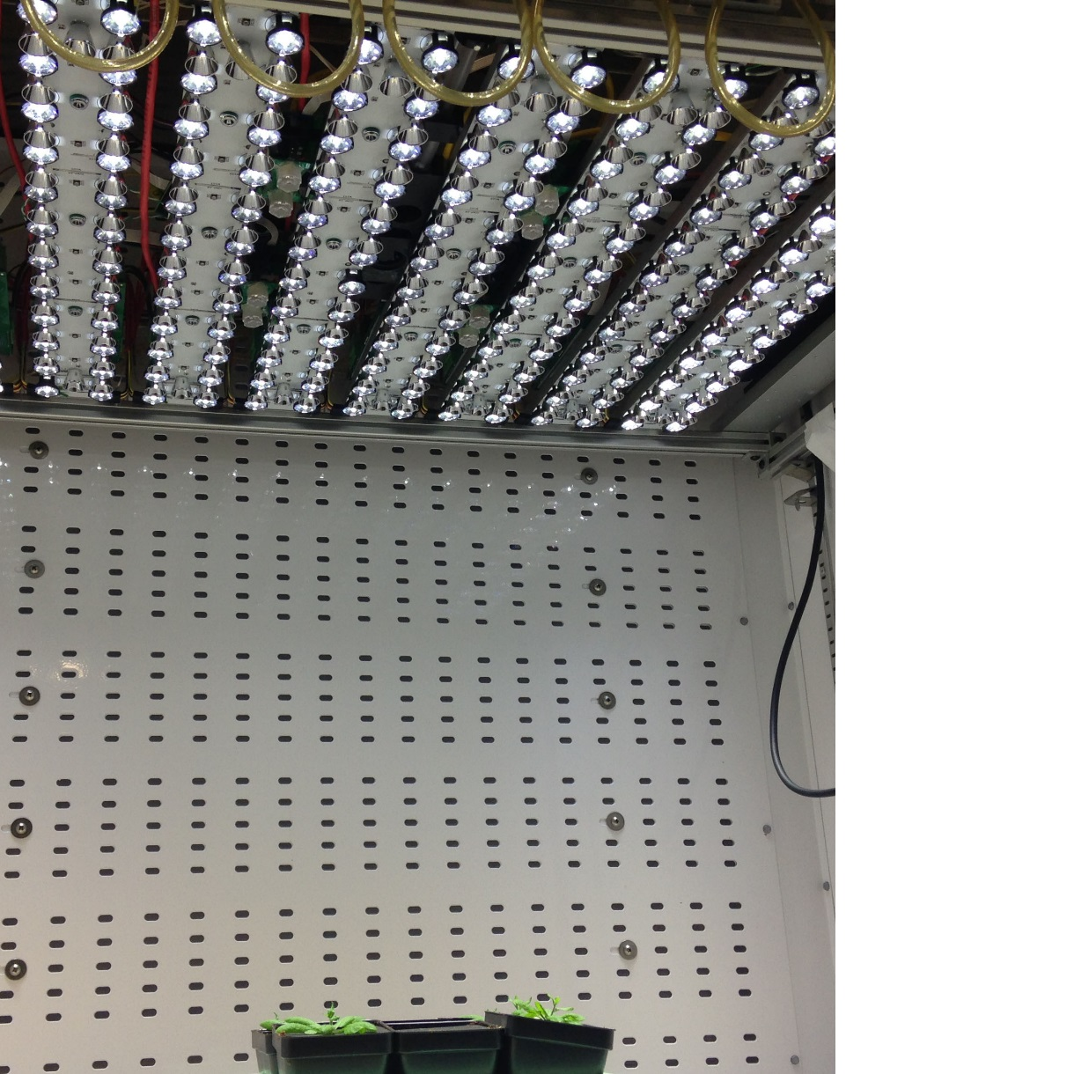
Florescence and IR camera
RGB color and depth camera
LED light bulbs
Infrared LED light bulbs

