Slide 1
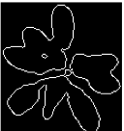
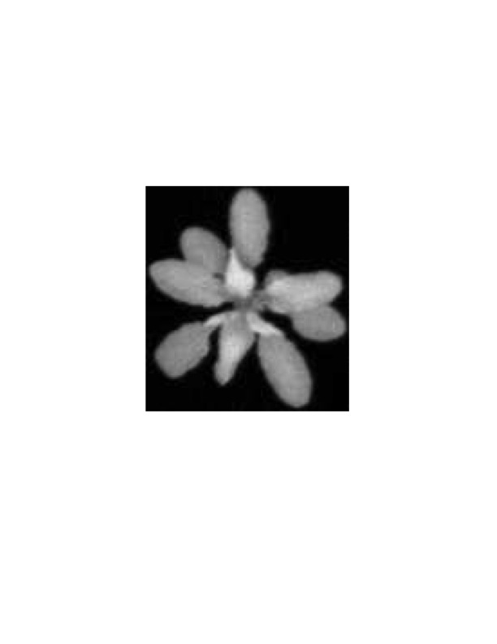


Templates
Chamfer
Matching
Alignment
Optimization
Tracking Results:
Frame t
….
Leaf Candidates
t
….
t-1
Frame t-1, …, 1
Update
1
NO
Initialization
Tracking
Optimization
Small/new
Candidate?
YES
Delete/generate
Candidate

