Slide 1

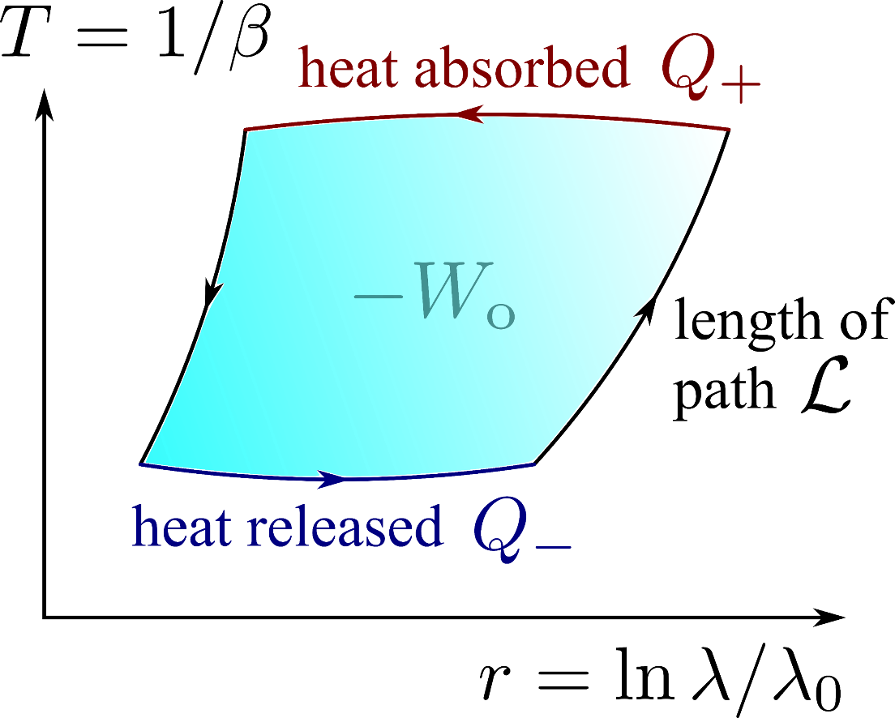
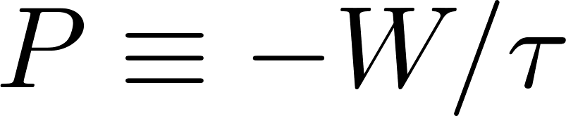
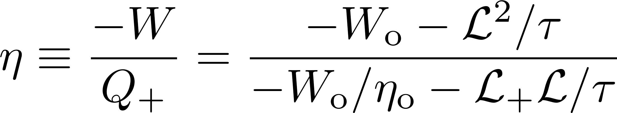
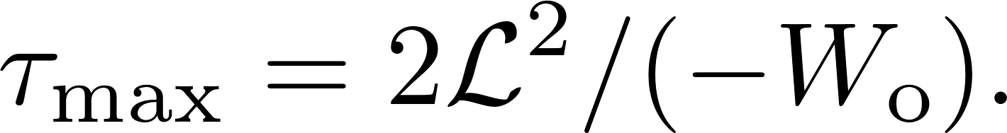
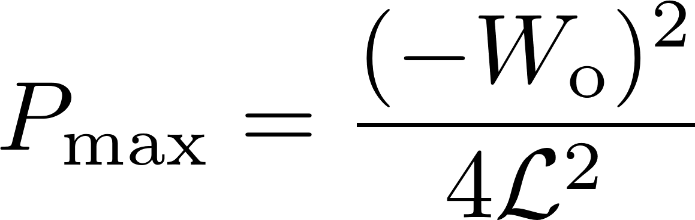
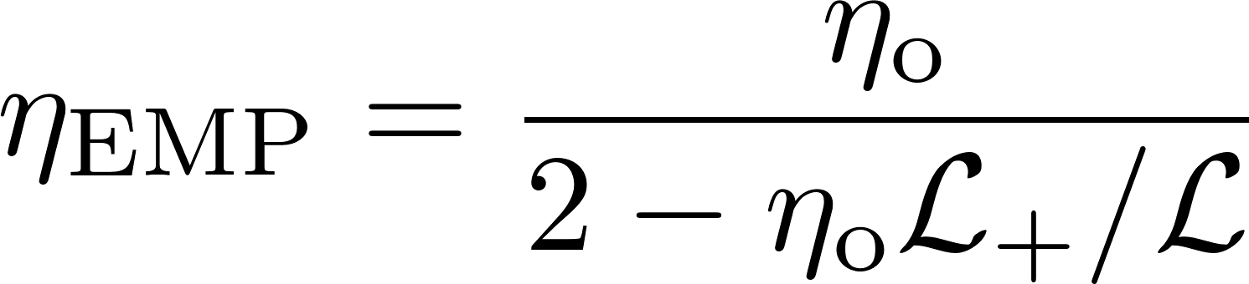

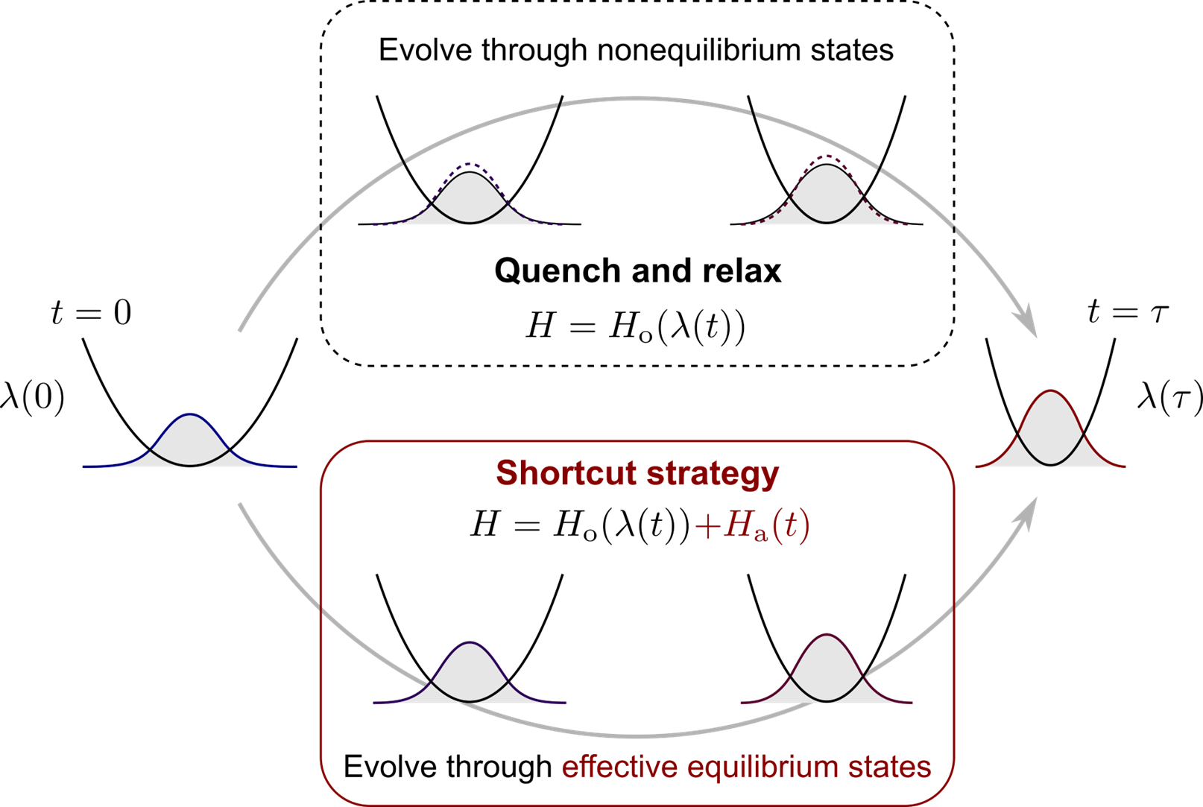
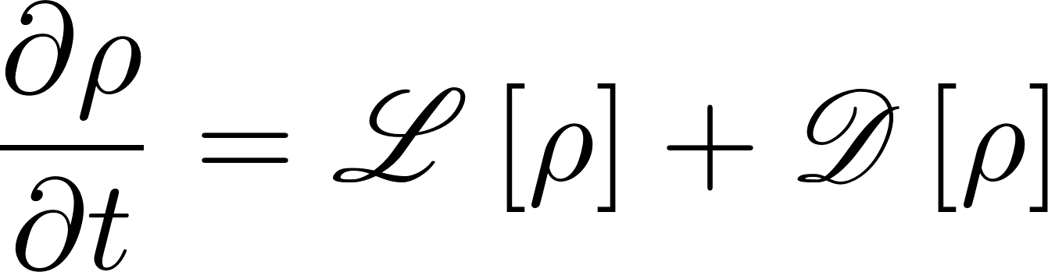
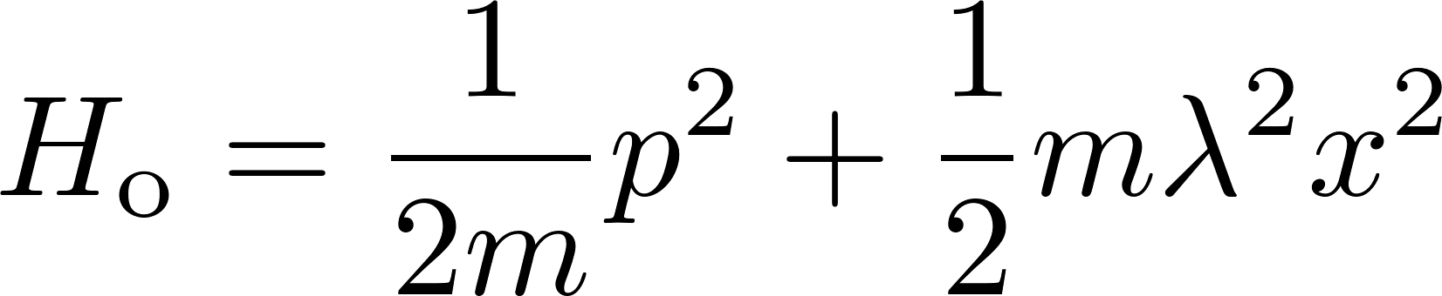
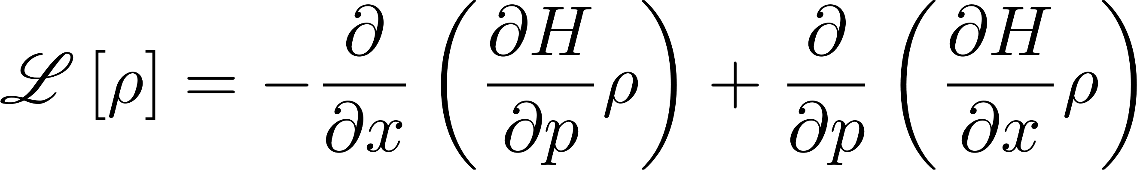
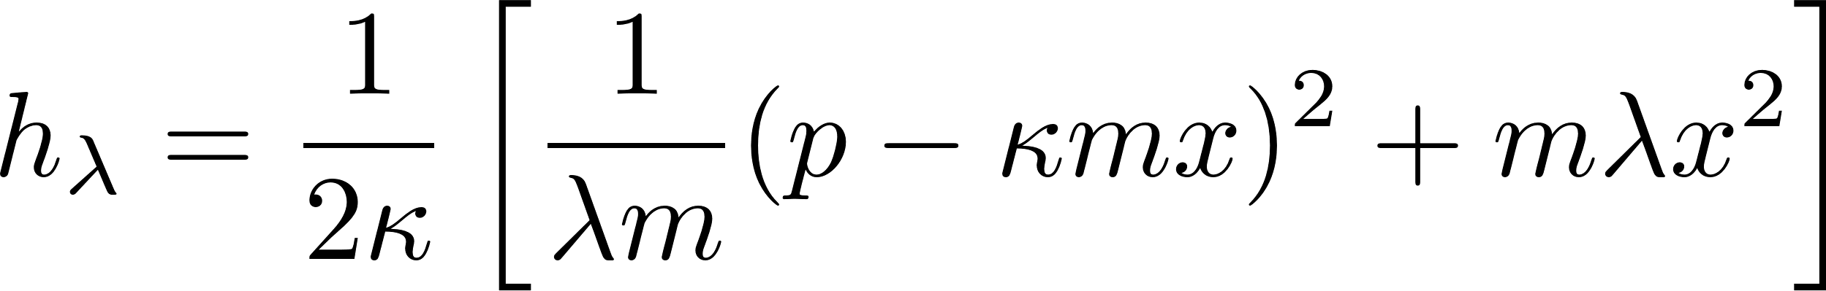
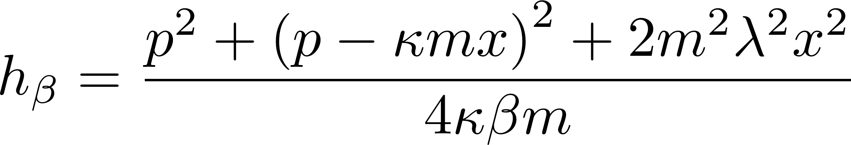
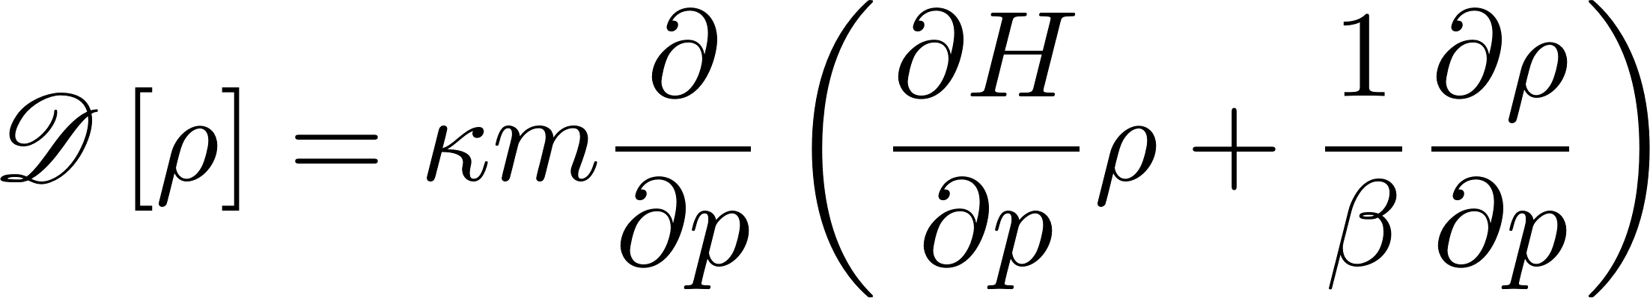
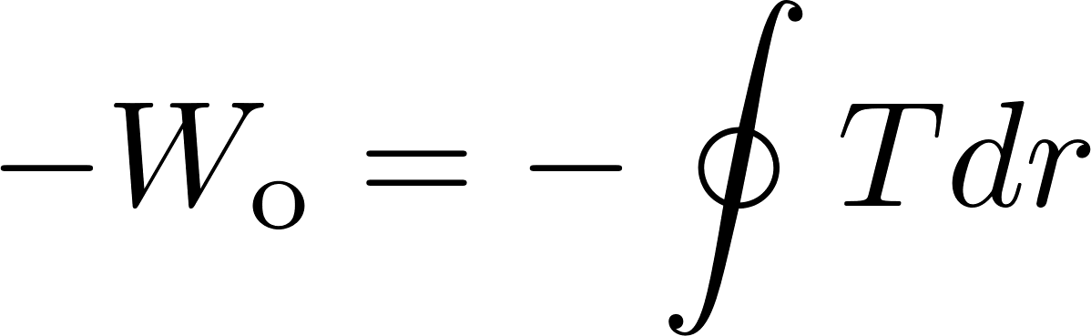
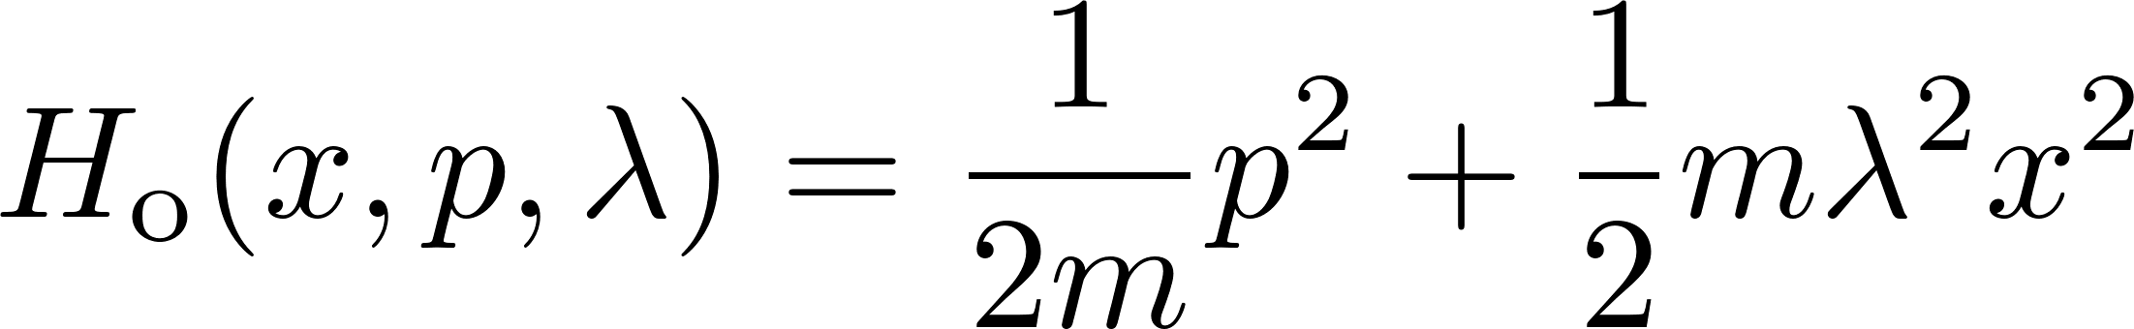
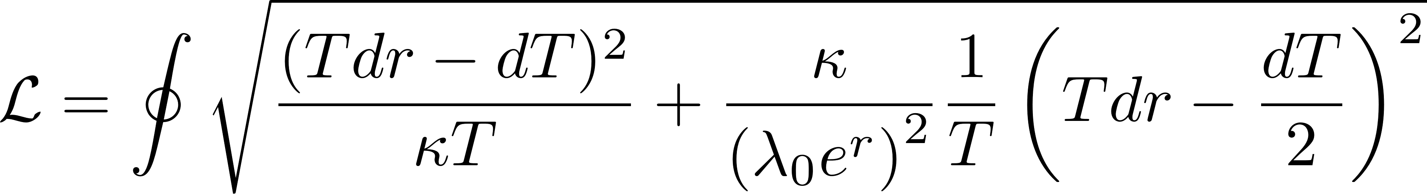
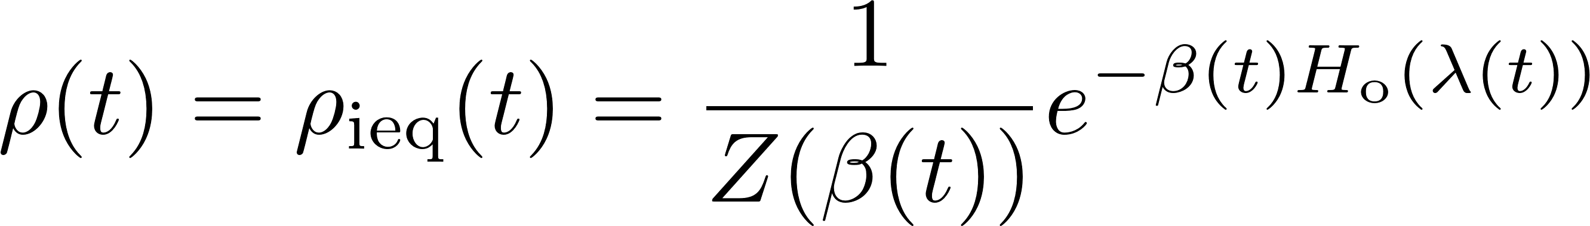
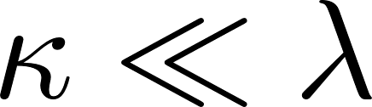
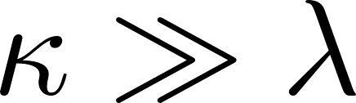
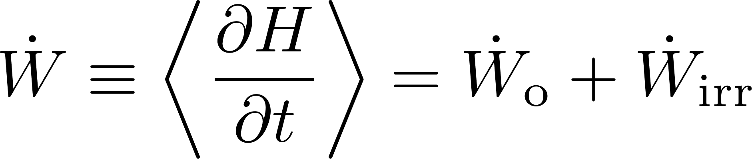
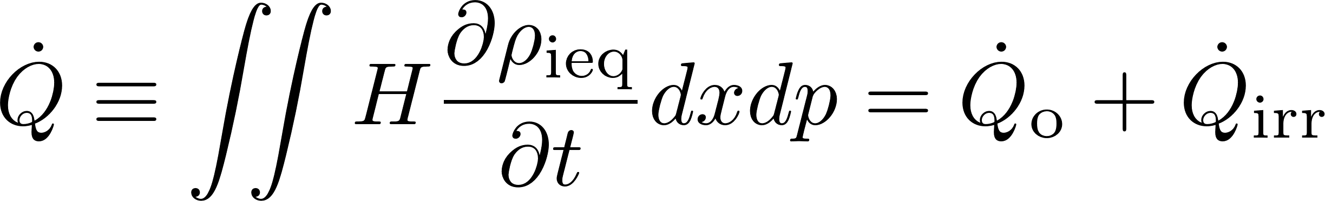
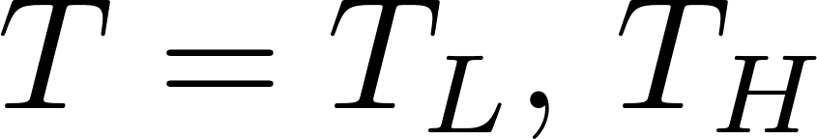
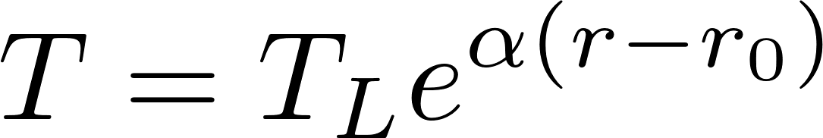
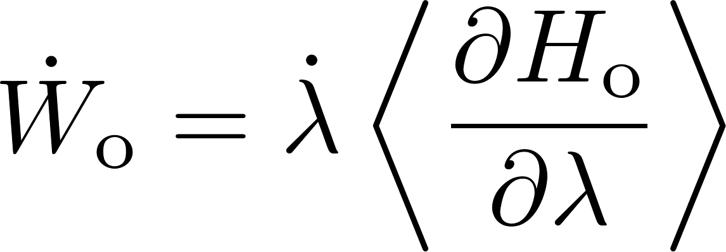
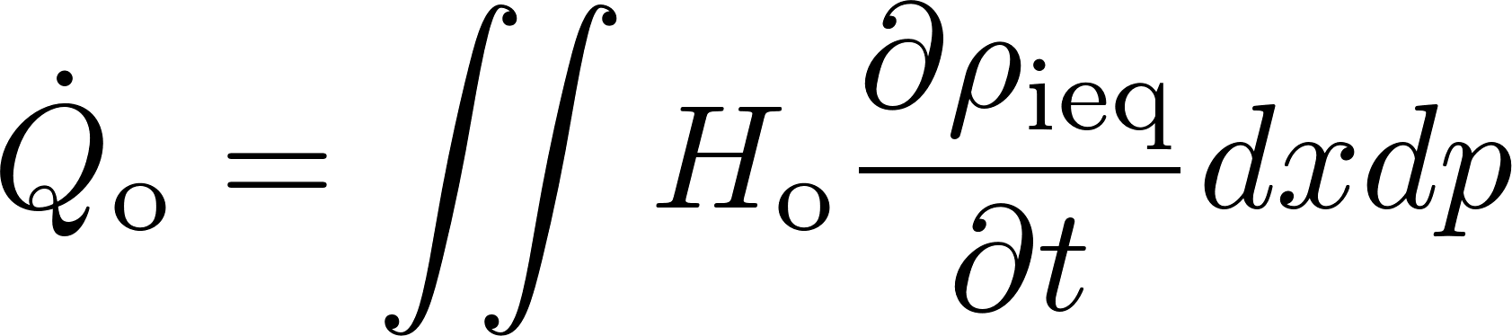
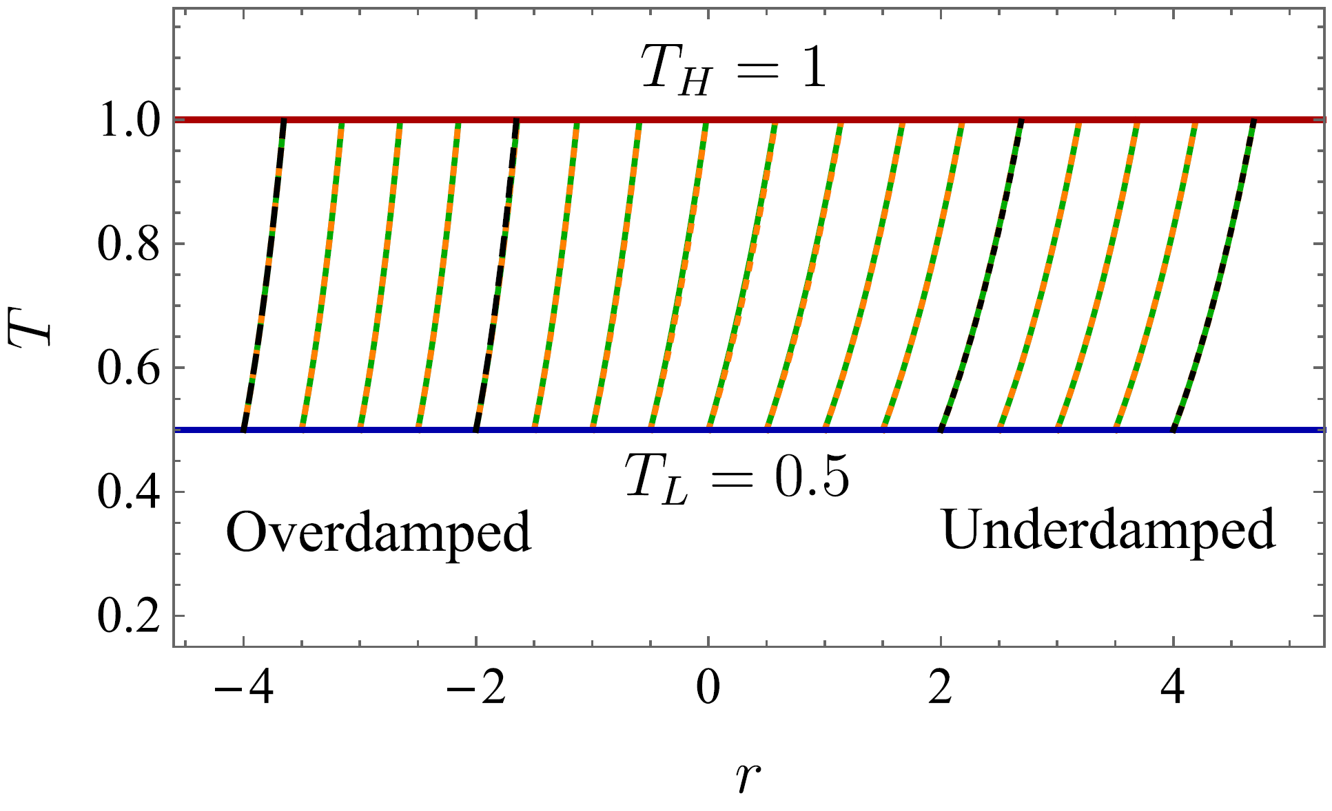
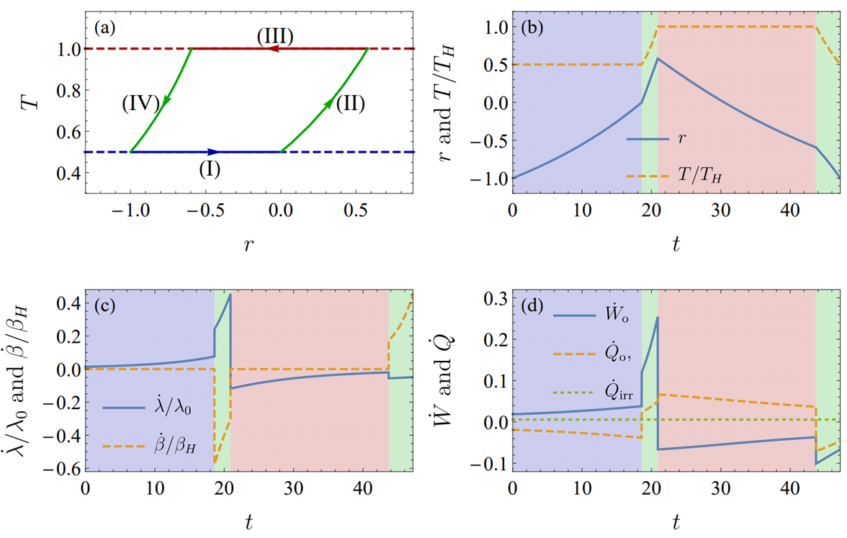
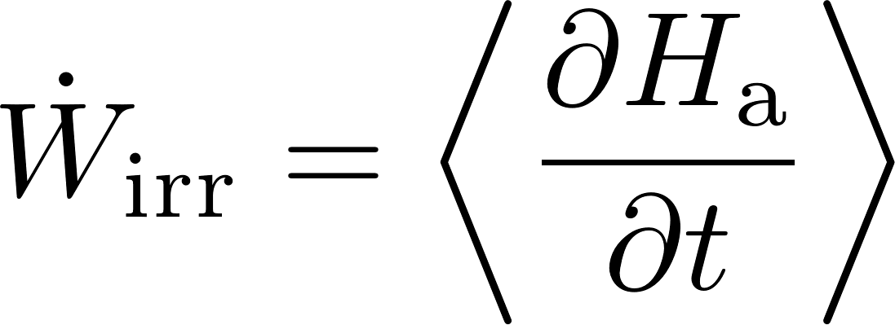
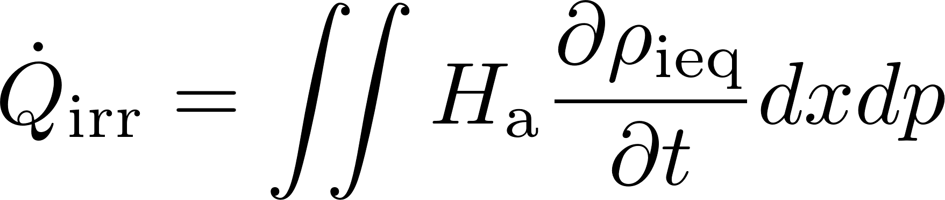
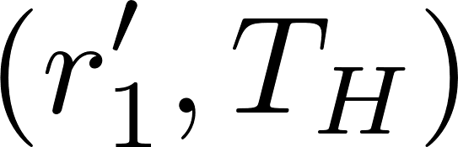
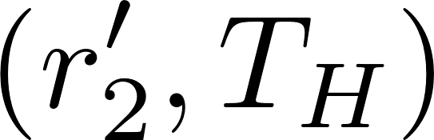
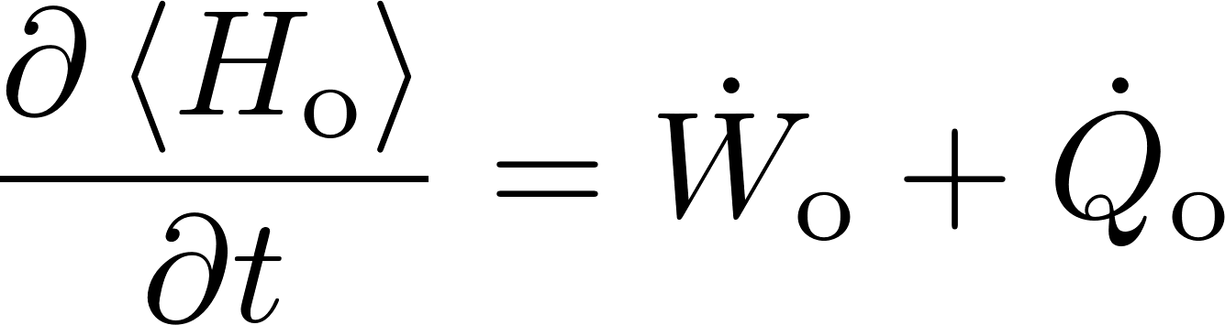
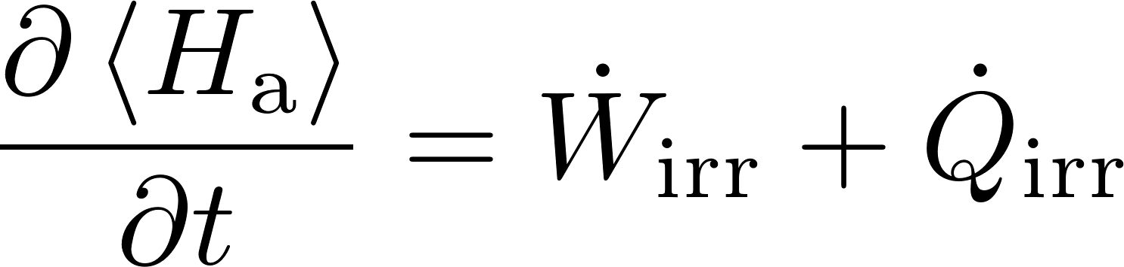
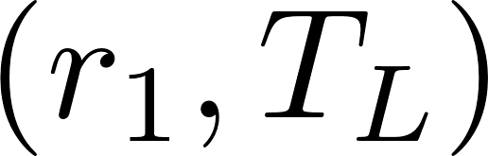
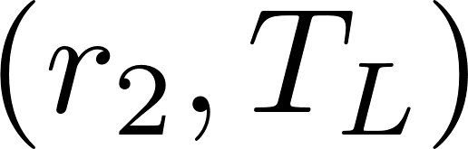
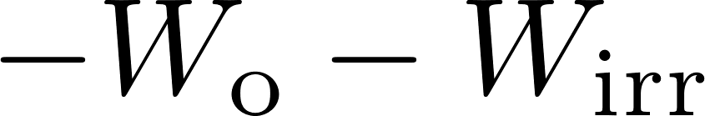

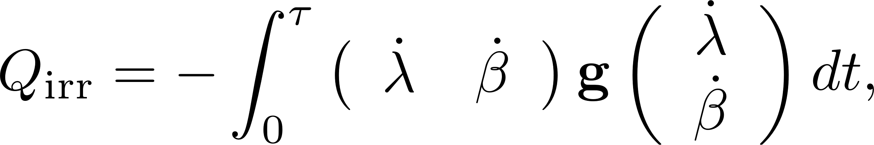
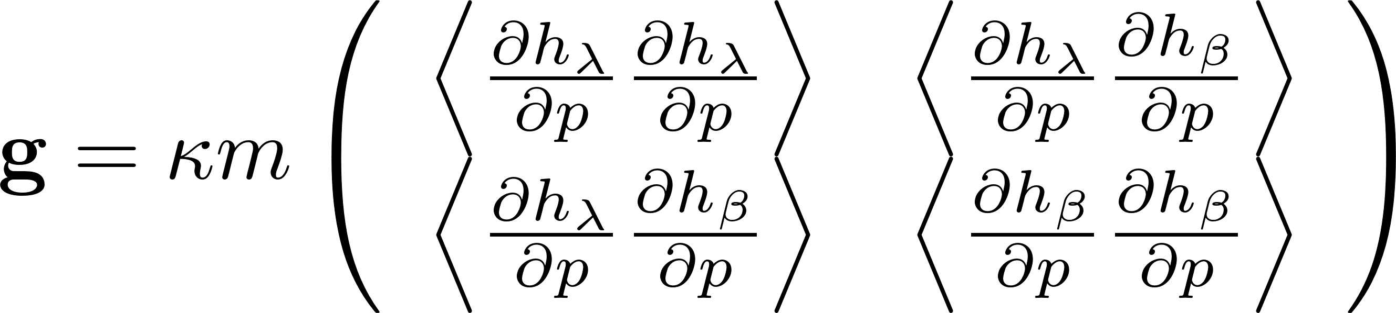
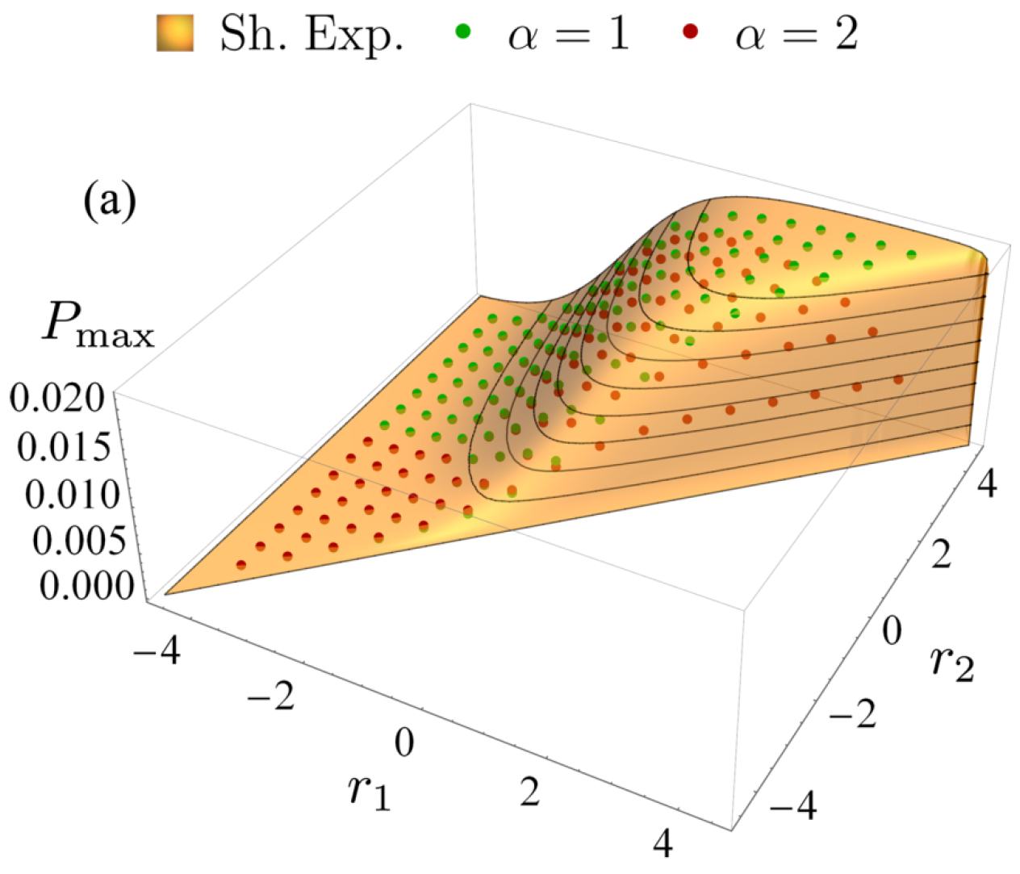
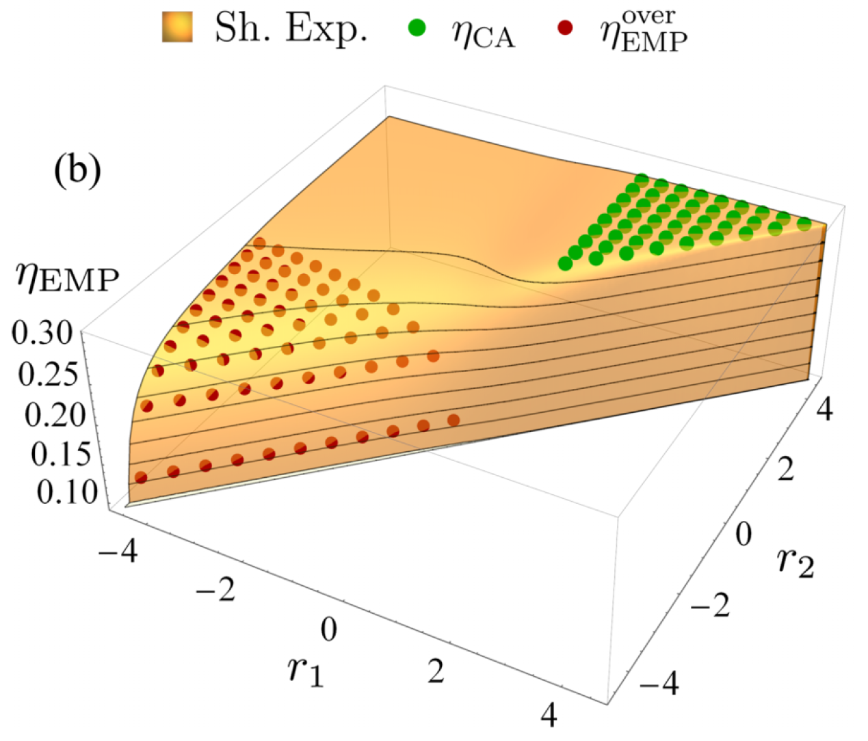
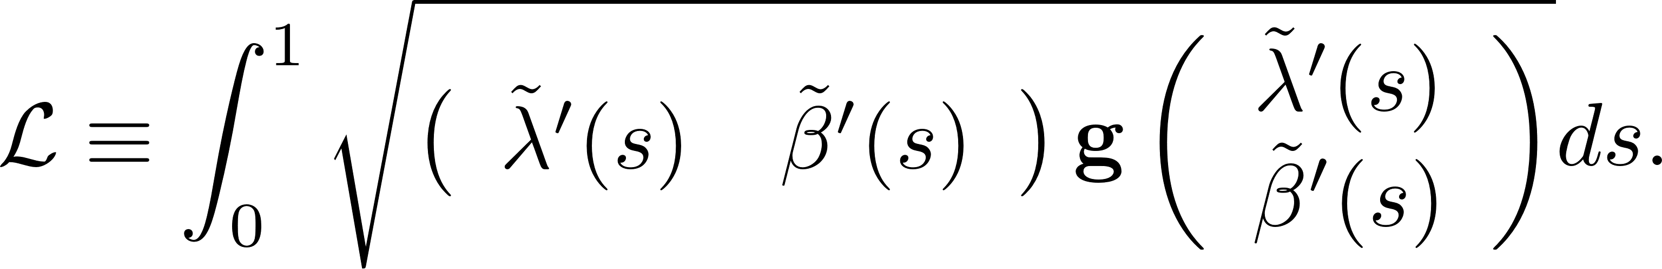
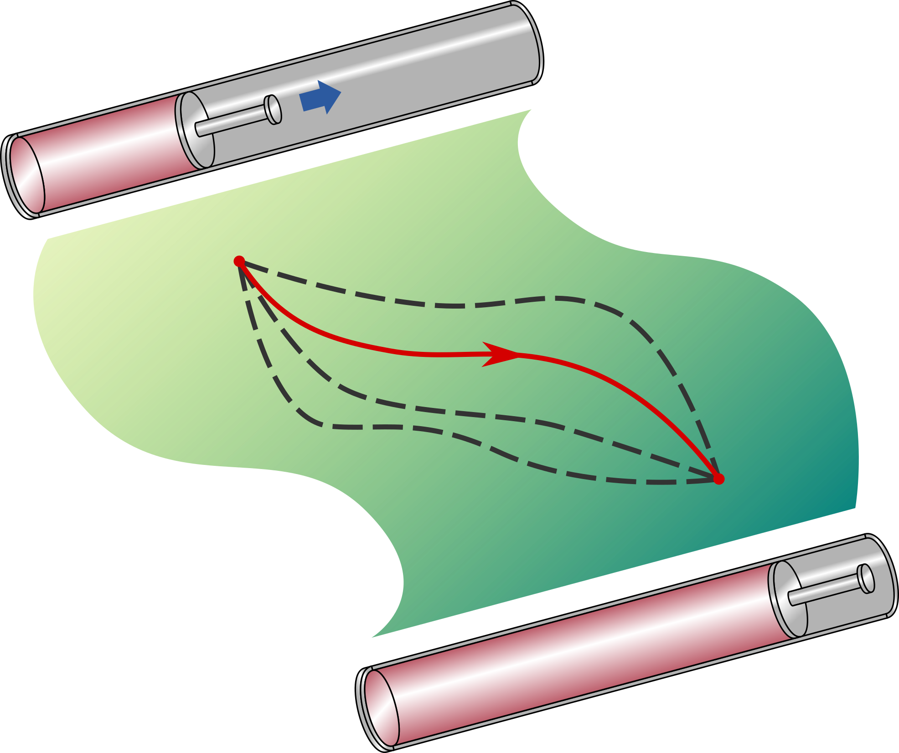
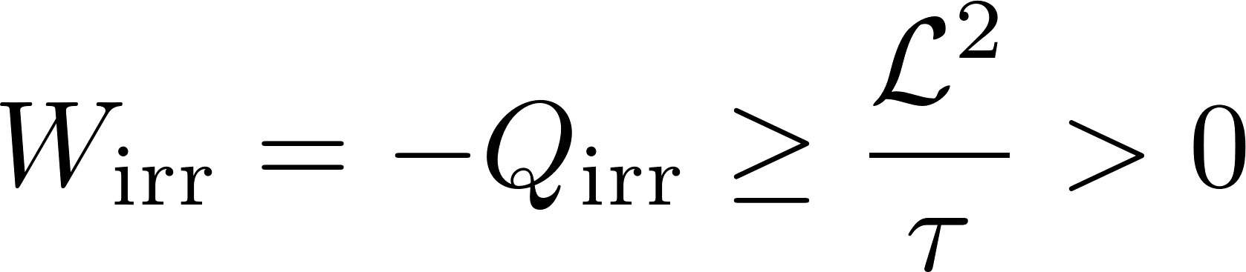
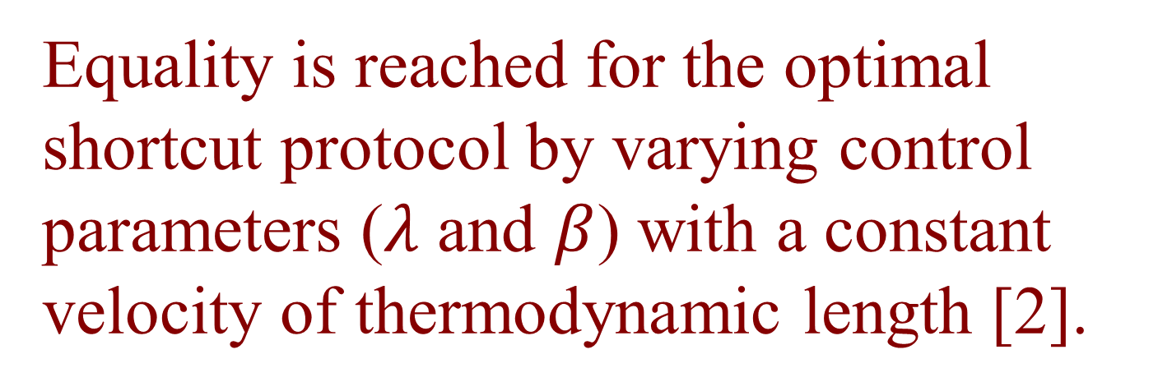
Optimizing Brownian heat engine with shortcut strategy
Jin-Fu Chen
School of Physics, Peking University, Beijing 100871, China
Email: chenjinfu@pku.edu.cn
Published in Phys. Rev. E 106, 054108 (2022)
Abstract
Brownian heat engines with shortcut strategy
Shortcut strategy [1] provides a powerful control method to speed up quasistatic thermodynamic processes within finite-time manipulation.
We use the shortcut strategy to construct and optimize Brownian heat engines in a class of power-law potentials, and formulate a geometric description of energetics with the thermodynamic length.
A tight bound of output power for shortcut-driven heat engines can be reached with the optimal shortcut control.
We extend previous results of maximum power and efficiency at maximum power in either underdamped limit or overdamped limit to general damped situation.
Consider a closed path of the cycle in control parameter space.
Output work is bounded by
Power: Efficiency:
To maximize output power, we choose
Shortcut strategy
Maximum power: Efficiency at maximum power:
: efficiency of
quasistatic cycle
System: a Brownian particle in a harmonic potential
Dynamics: Fokker-Planck equation
Results for harmonic potential
Hamiltonian:
Shortcut control [3]:
Explicit results of quasistatic work and thermodynamic length:
Control of Hamiltonians
“Euclidean” area of closed path
Energetics in shortcut processes
Dissipation in underdamped limit Dissipation in overdamped limit
Construction of the heat-engine cycle:
Work: Heat:
two isothermal processes + two connecting processes
Quasistatic:
Cycle diagram Control of cycle
Irreversible:
First law:
Maximizing output work = maximizing
Maximum power Efficiency at maximum power
Irreversible heat: Metric:
large power in underdamped
regime
EMP in [4]
Thermodynamic length:
Using Cauchy-Schwarz inequality, irreversible work is bounded by
EMP in [5]
References
Equality is reached for the optimal shortcut protocol by varying control parameters ($λ$ and $β$) with a constant velocity of thermodynamic length [2].
[1] G. Li, H. T. Quan and Z. C. Tu, Phys. Rev. E 96, 012144 (2017)
[2] G. Li, JFC, C. P. Sun, H. Dong, Phys. Rev. Lett. 128, 230603 (2022)
[3] Y. Jun and P. Y. Lai, Phys. Rev. Res. 3, 033130 (2021)
[4] F. L. Curzon and B. Ahlborn, Am. J. Phys 43, 22 (1975).
[5] T. Schmiedl and U. Seifert, Europhys. Lett. 81, 20003 (2007)

