Slide 1


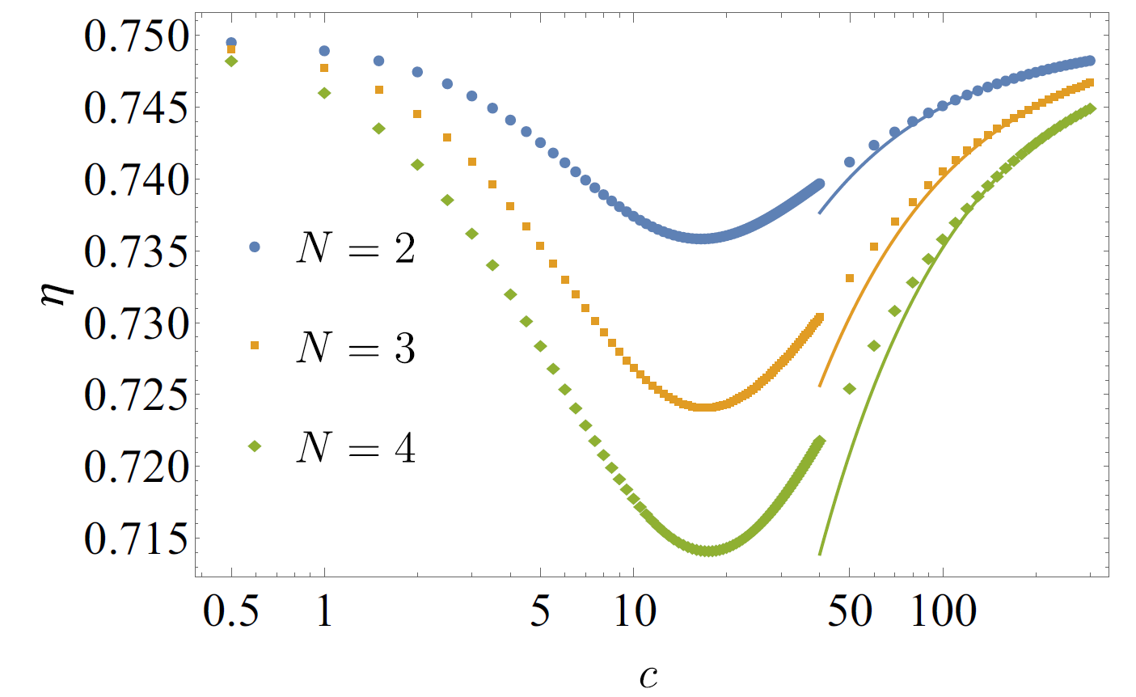

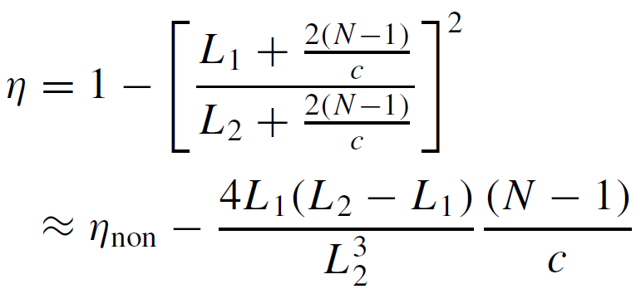








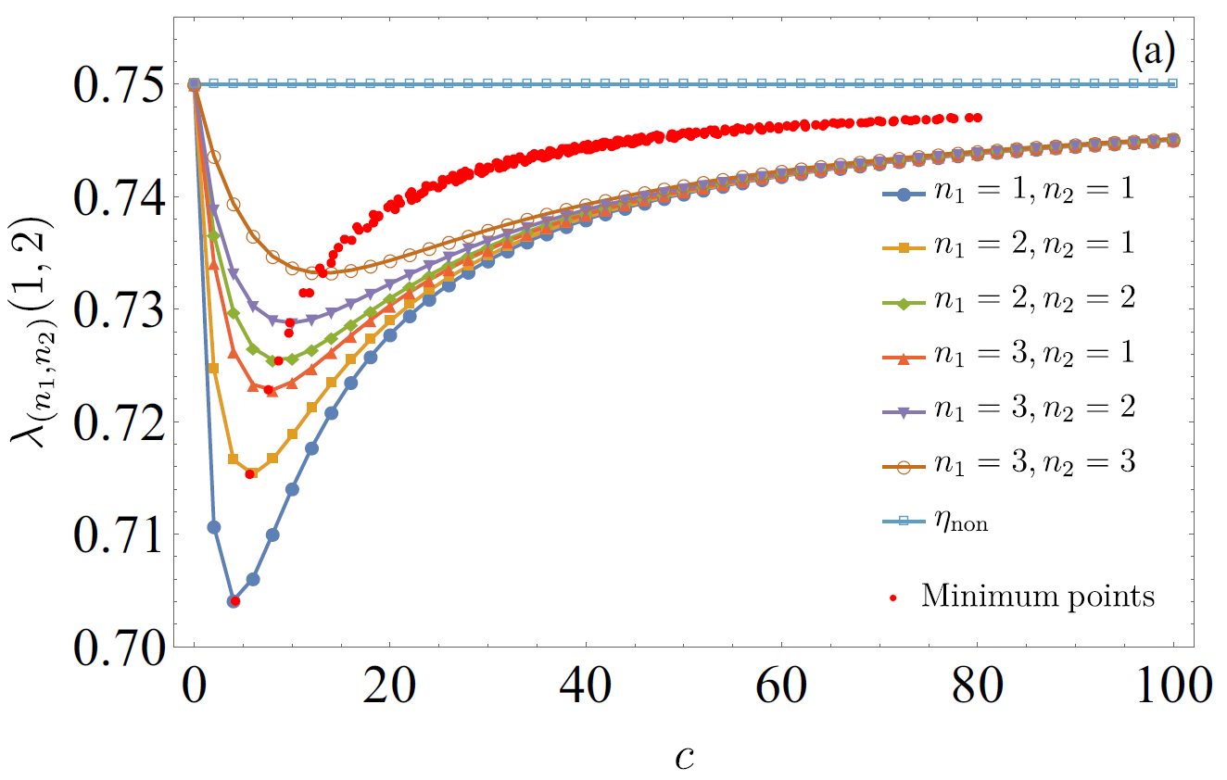
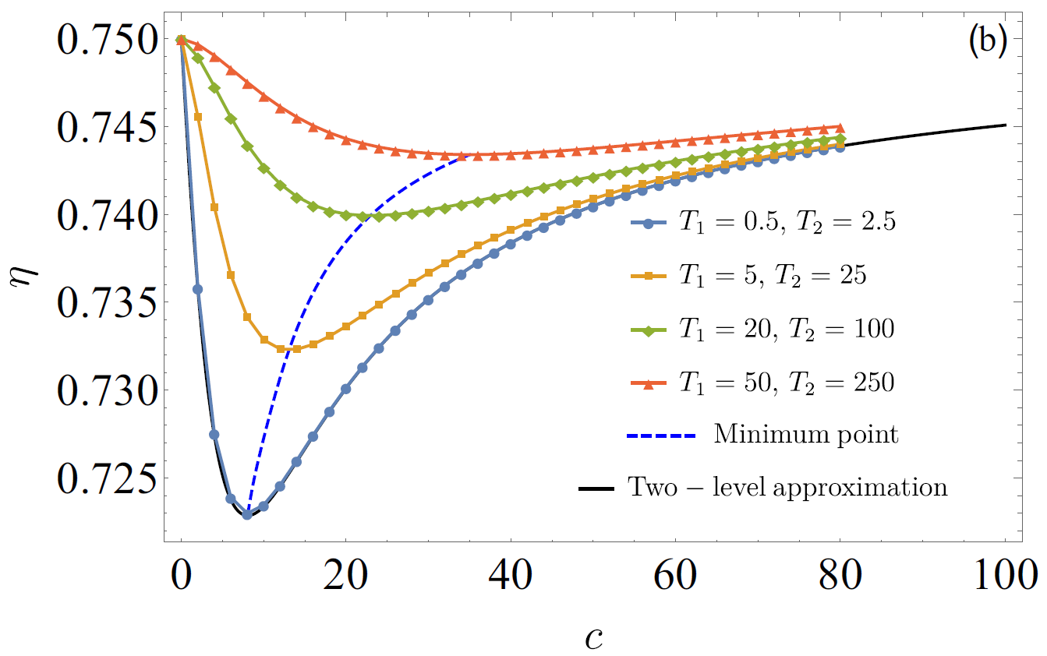
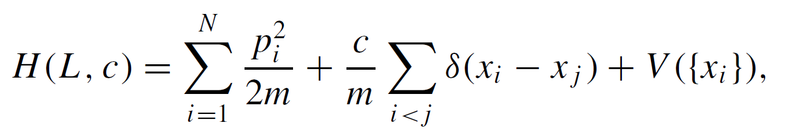
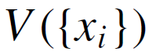

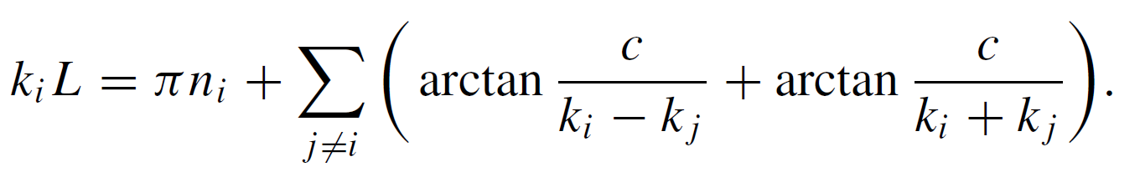
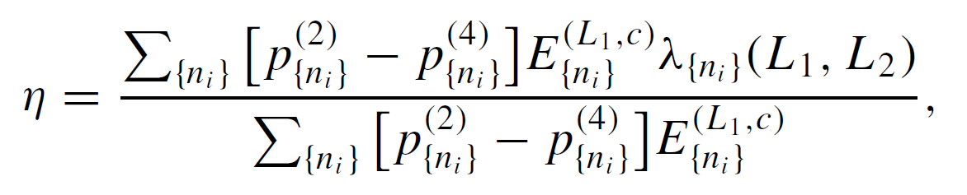


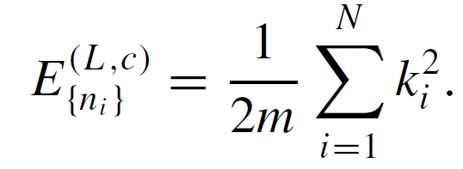

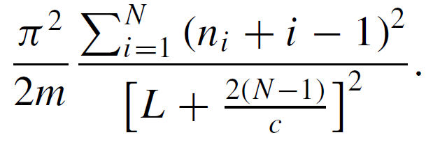
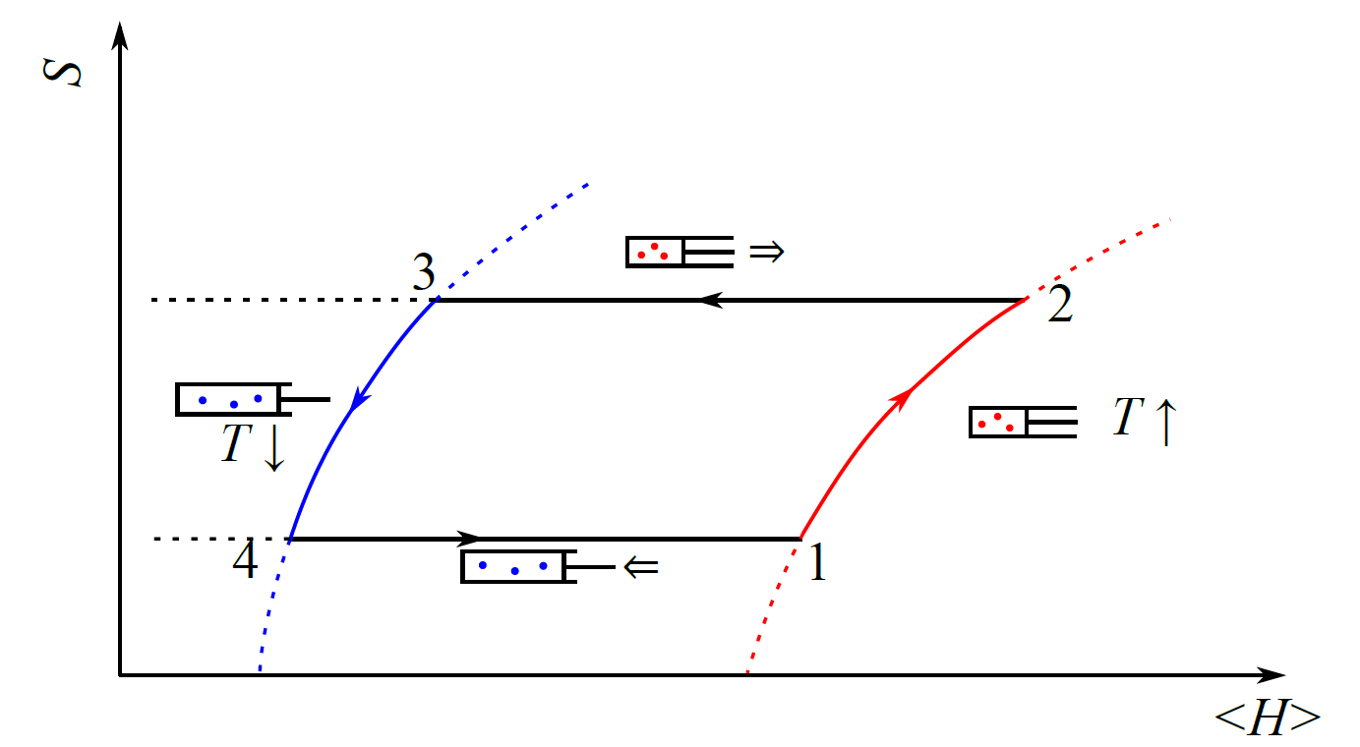







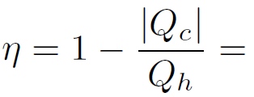
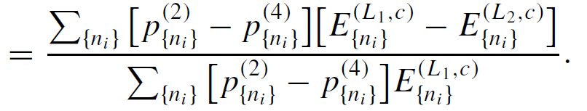
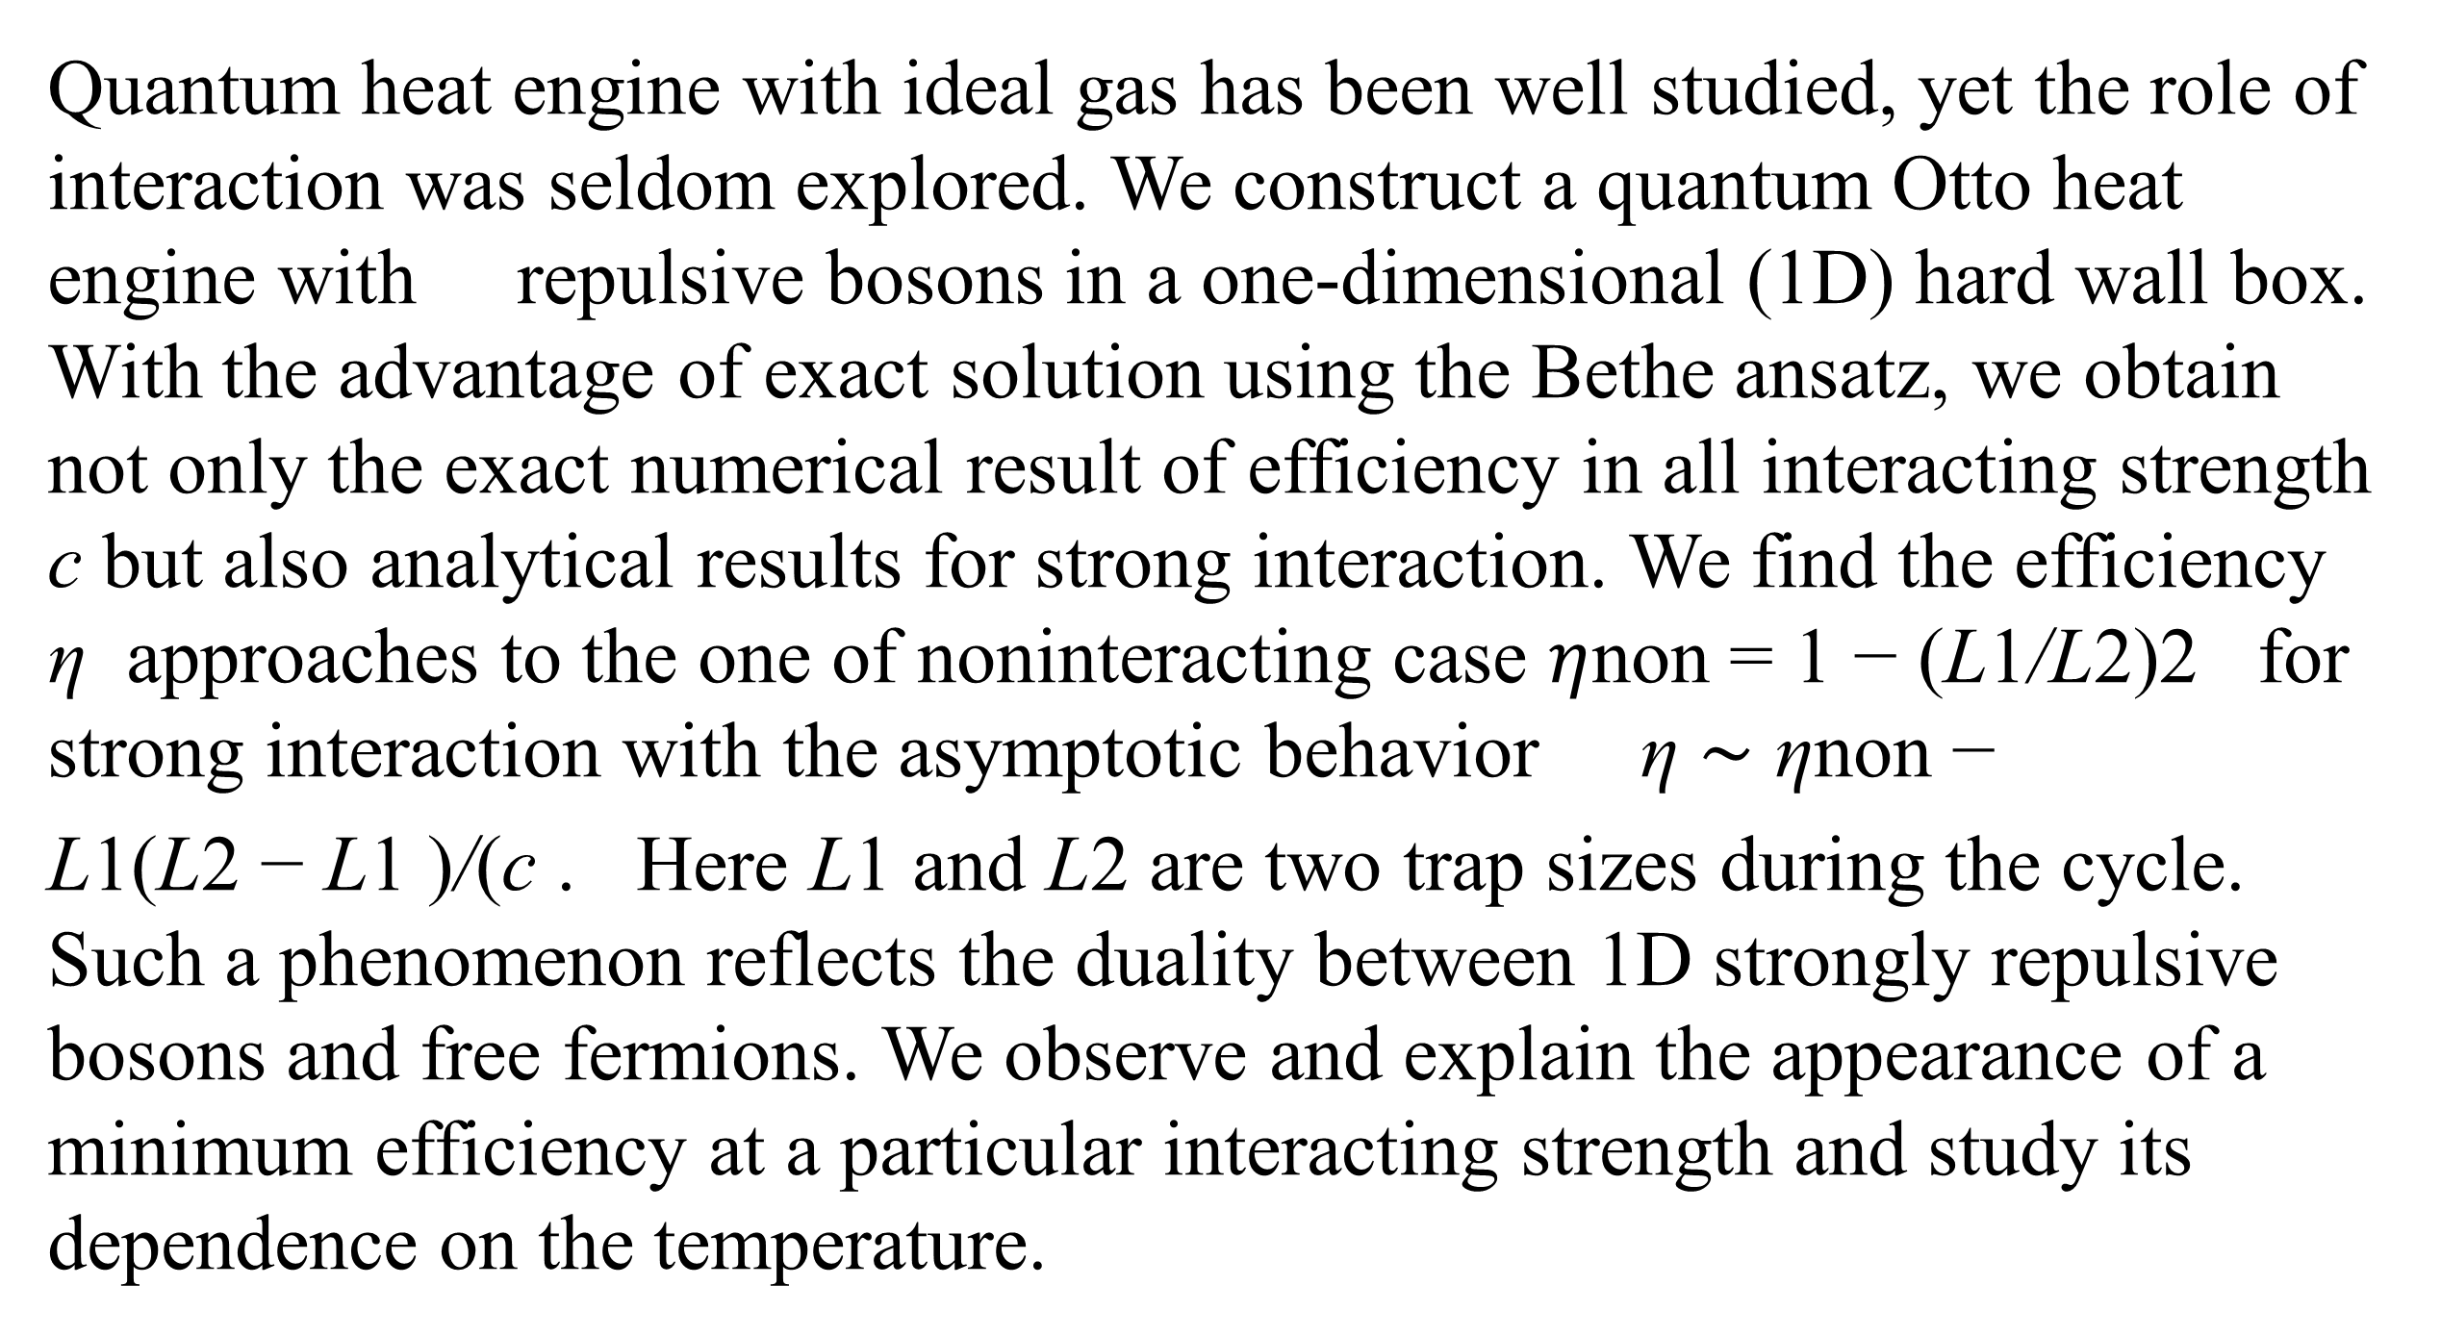
Bose-Fermi duality in a quantum Otto heat engine with trapped repulsive bosons
Jinfu Chen, Hui Dong, and Chang-Pu Sun
Beijing Computational Science Research Center, Beijing 100193, China
Graduate School of China Academy of Engineering Physics, Haidian District, Beijing 100193, China
Abstract
Efficiency and Interaction
Quantum heat engine with ideal gas has been well studied, yet the role of interaction was seldom explored. We construct a quantum Otto heat engine with repulsive bosons in a one-dimensional (1D) hard wall box. With the advantage of exact solution using the Bethe ansatz, we obtain not only the exact numerical result of efficiency in all interacting strength c but also analytical results for strong interaction. We find the efficiency η approaches to the one of noninteracting case $η$non = 1 − (L1/L2)2 for strong interaction with the asymptotic behavior η ∼ ηnon −
L1(L2 − L1 )/(c . Here L1 and L2 are two trap sizes during the cycle. Such a phenomenon reflects the duality between 1D strongly repulsive bosons and free fermions. We observe and explain the appearance of a minimum efficiency at a particular interacting strength and study its dependence on the temperature.
The efficiency at strong interaction limit (the solid curve) approaches to the one of noninteracting bosons or fermions
The recovery of the efficiency at strong coupling limit is caused by the duality between fermions and interacting bosons in 1D [3].
.
The exact numerical result of the efficiency with different interacting strength c. The temperatures are chosen as T2=50 T4=8 with the trap size L1=1, L2=2 .
1D Trapped Repulsive Bose Gas
A practical heat engine usually contains many particles as the working medium. The internal interaction of the particles might affects the performance of the heat engine. We design the quantum Otto heat engine with trapped 1D repulsive Bose gas [2] to study the effect of the internal interaction. The Hamiltonian is
where the trap potential is the infinite square potential with the trap size . The Bethe equation [2] requires the wave vectors to satisfy
Here, {ni} is a set of ordered positive integers, and gives an eigenstate of the many-body system. The corresponding energy of the eigenstate is
Ratio of the energy for two bosons .
Efficiency at different temperatures.
The efficiency is related to the ratio of the energy
Here, as is the ratio of the energy.
the Otto cycle
Conclusion
The Otto cycle consists of four strokes.
Stroke I (1 → 2): Isochoric heating.
Stroke II (2 → 3): Adiabatic expansion.
Stroke III (3 → 4): Isochoric cooling.
Stroke IV (4 → 1): Adiabatic compression.
For weak interaction, the efficiency of the Otto heat engine is lower than the one of noninteracting case. For strong interaction, the efficiency approaches to the one of noninteracting case.
For fixed interacting strength, the efficiency decreases with the lower temperatures of the reservoirs. The minimum value of efficiency is related to the dip of .
Entropy-energy (S -H) diagram for the quantum Otto heat engine.
We consider quantum adiabatic approximation for the adiabatic processes. The trap size is modulated slowly enough to keep the occupation number a of different eigenstates unchanged. After a whole cycle, the efficiency of the Otto cycle is determined by
Reference
[1] J. Chen, H. Dong, and C.-P. Sun, Phys. Rev. E 98, 062119 (2018).
[2] M. Gaudin, Phys. Rev. A 4, 386 (1971).
[3] M. Girardeau, J. Math. Phys. 1, 516 (1960).
Contacts
chenjinfu@csrc.ac.cn hdong@gscaep.ac.cn

