Slide 1
Quantum Otto heat engine on piston model: the effect of interaction and finite time
2019年量子物理专题研讨会
2019年1月5日 吉林长春 东北师范大学物理学院
陈劲夫
合作者：孙昌璞，董辉

Slide 2
Outline
Quantum Otto Heat Engine with Trapped Repulsive Bosons
  1D repulsive bosons in a hard wall box
  The effect of the interaction on the efficiency
Finite-time Otto Heat Engine with Piston Model
  Finite-time adiabatic process
  Finite-time Otto heat engine
  Realization on piston model

Slide 3
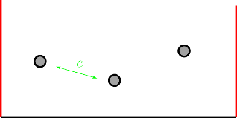
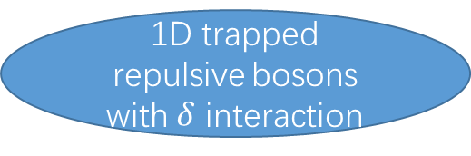
Quantum Otto Heat Engine with Trapped Repulsive Bosons
H. T. Quan, Y. X. Liu, C. P. Sun, and F. Nori, Phys. Rev. E 76, 031105 (2007).
Ideal Quasi-static thermodynamic cycle
Many-body system
Interacting Bose gas confined in a time-dependent harmonic trap
J. Jaramillo, M. Beau, and A. del Campo, New J. Phys. 18,
075019 (2016).
Quantum Szilard Engine with Attractively Interacting Bosons
J. Bengtsson, M. N. Tengstrand, A. Wacker, P. Samuelsson, M. Ueda, H. Linke, and S. M. Reimann, Phys. Rev. Lett. 120, 100601 (2018).
Interaction affects the spectrum
How interaction affects the efficiency?
Not ideal (With Interaction)
Bethe ansatz
M. Gaudin, Phys. Rev. A 4, 386 (1971).
1D trapped repulsive bosons with $δ$ interaction

Slide 4


  1D Repulsive Bosons in a Hard Wall Box
The Hamiltonian is
$$H\left(L,c\right)=\sum_{i=1}^{N}{\frac{p_{i}^{2}}{2m}}+\frac{c}{m}\sum_{i<j}{δ\left(x_{i}−x_{j}\right)}+V(\left\{x_{j}\right\})$$

Slide 5
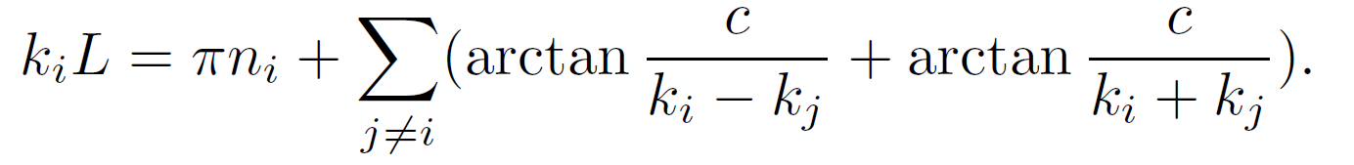

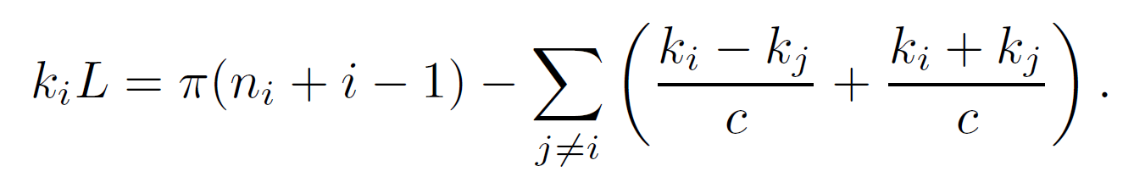
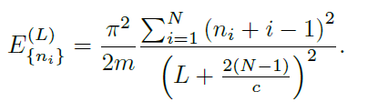
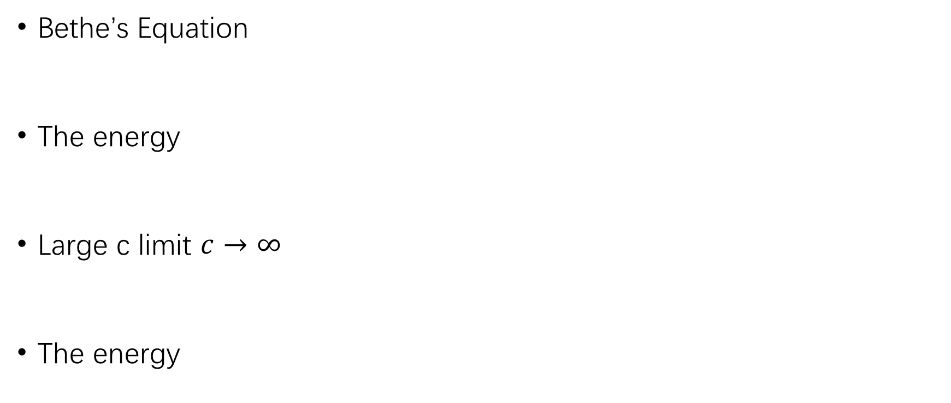
1D Repulsive Bosons in a Hard Wall Box
Bethe’s Equation
The energy
Large c limit $c→∞$
The energy
M. Gaudin, Phys. Rev. A 4, 386 (1971).

Slide 6
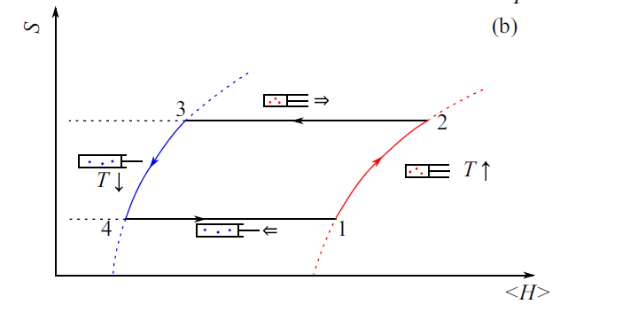




Quantum Otto Cycle
For quantum adiabatic processes II & IV, the probability distribution does not change.
Stroke II (2 → 3):
Quantum adiabatic expansion.
Stroke III (3 → 4):
Isochoric cooling.
Stroke I (1 → 2):
Isochoric heating.
Stroke IV (4 → 1):
Quantum adiabatic compressing.

Slide 7
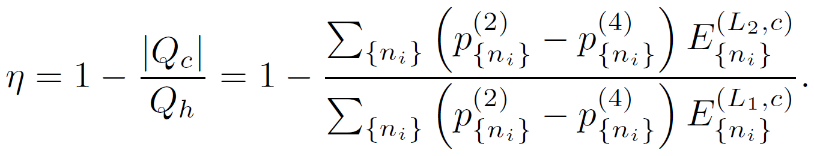
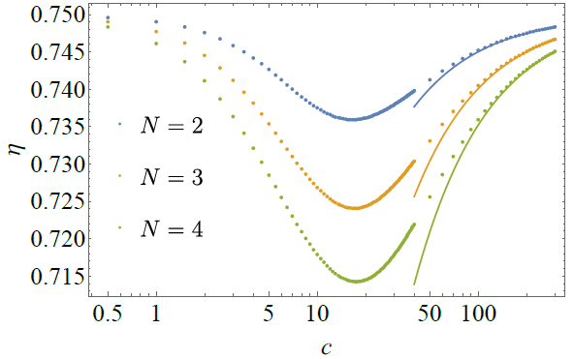
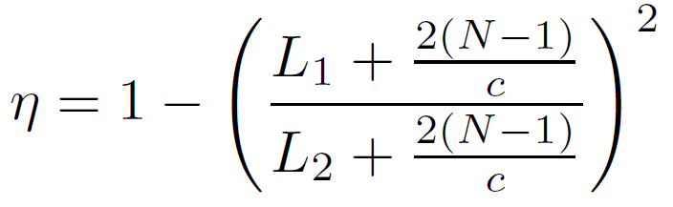

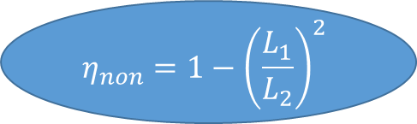
  Interaction Effect on Efficiency
The efficiency is
For large c, we have
$$c→∞$$
$$η_{non}=1−{\left(\frac{L_{1}}{L_{2}}\right)}^{2}$$

Slide 8
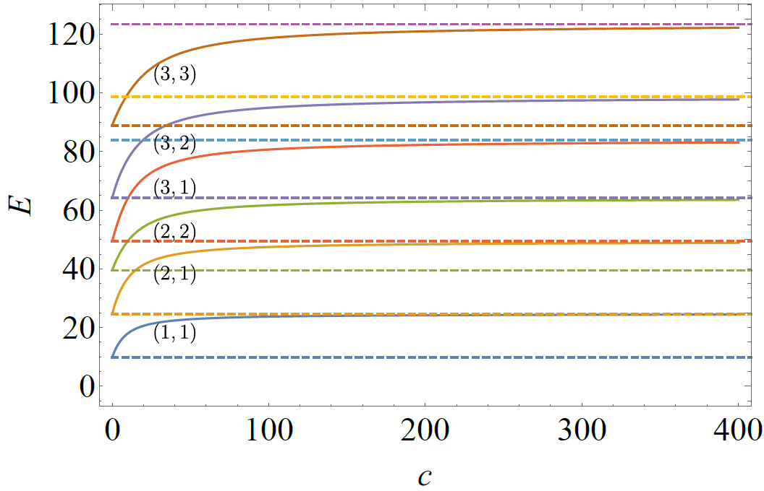

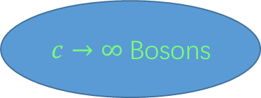
Bose-Fermi duality for 1D interacting Bose gas
$c→∞$ Bosons
Free Fermions
The Energy for two interacting Bosons
M. Girardeau, J. Math. Phys. 1, 516 (1960).

Slide 9
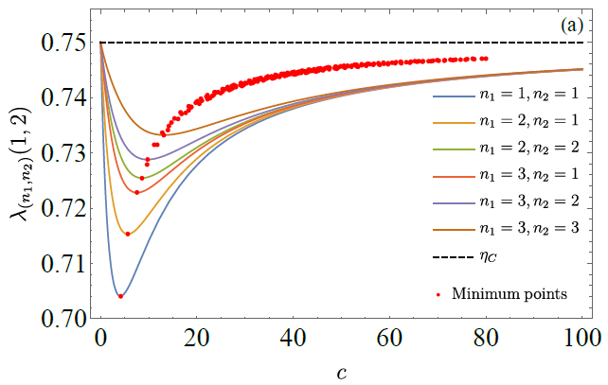
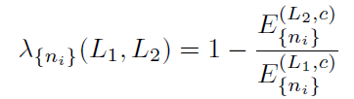
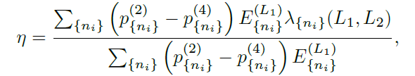
Interaction Effect on Efficiency
With a ratio between two energy
The efficiency is rewritten as

Slide 10
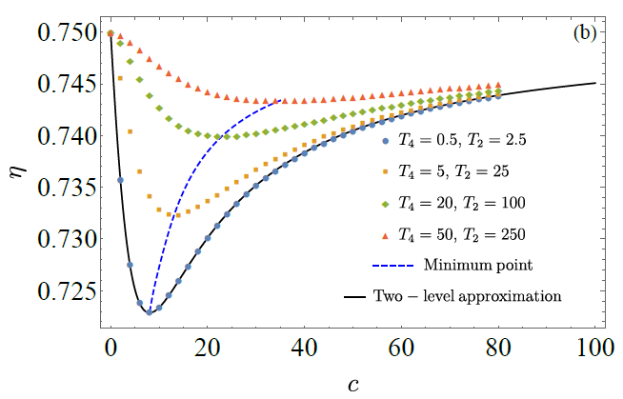
Interaction Effect on Efficiency
For different temperature of the cold and hot bath

Slide 11


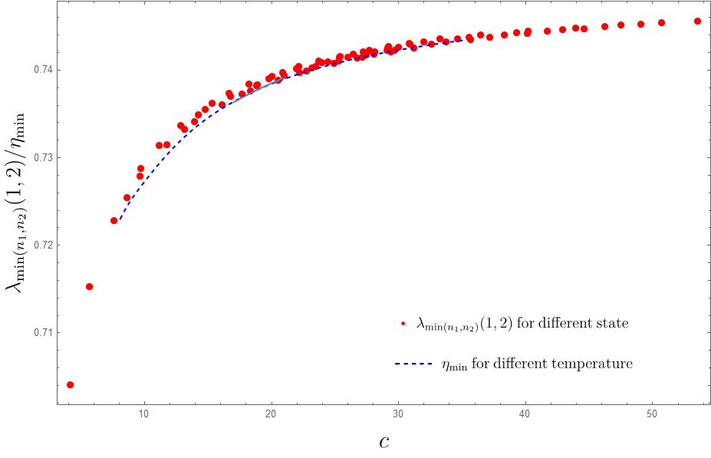
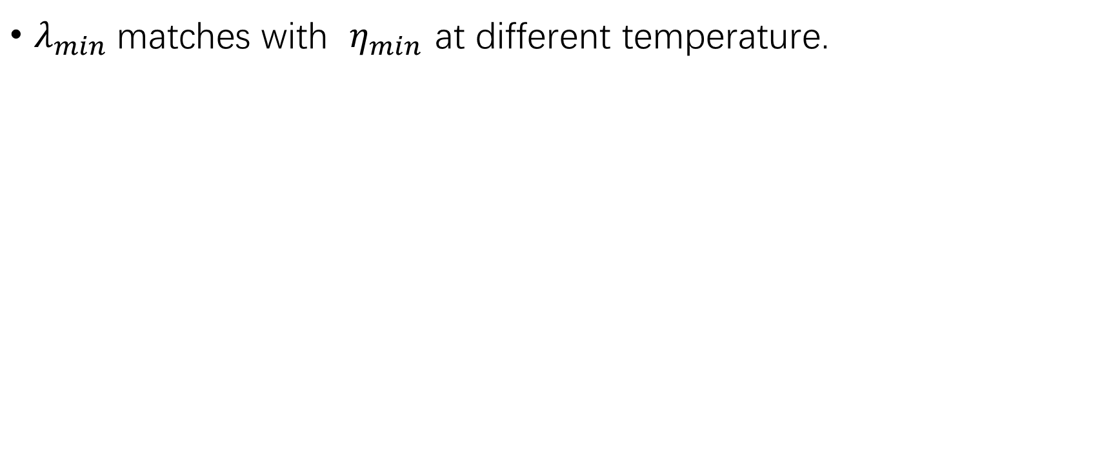
Interaction Effect on Efficiency
$λ_{min}$matches with $η_{min}$ at different temperature.

Slide 12

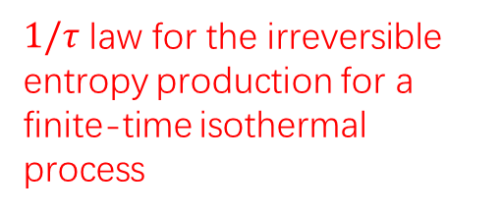
Finite-time Otto Heat Engine with Piston Model
Ideal Quasi-static thermodynamic cycle
Finite-time Carnot heat engine
Curzon-Ahlborn efficiency
F. Curzon and B. Ahlborn, Am. J. Phys. 43, 22 (1975)
Low-dissipation heat engine
M. Esposito, et, al, PRL 105, 150603
Y.-H. Ma, D. Xu, H. Dong, and C.-P. Sun, Physical Review E 98, 042112
Shortcut in finite-time Otto heat engine
PRE.94.032116
PRE.98.032121
Not quasi-static （In finite time）
Finite-time adiabatic process
Finite-time Otto cycle
$1/τ$ law for the irreversible entropy production for a finite-time isothermal process
We optimize the duration of the finite-time adiabatic process to gain high power.

Slide 13
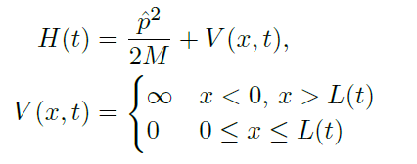

Finite-time Otto Heat Engine with Piston Model
Realize on piston model.
The exact solution exists
S. W. Doescher and M. H. Rice, American Journal of Physics 37, 1246
Validity of nonequilibrium work relations for the rapidly expanding quantum piston
H. T. Quan and C. Jarzynski, Physical Review E 85, 031102 (2012).

Slide 14
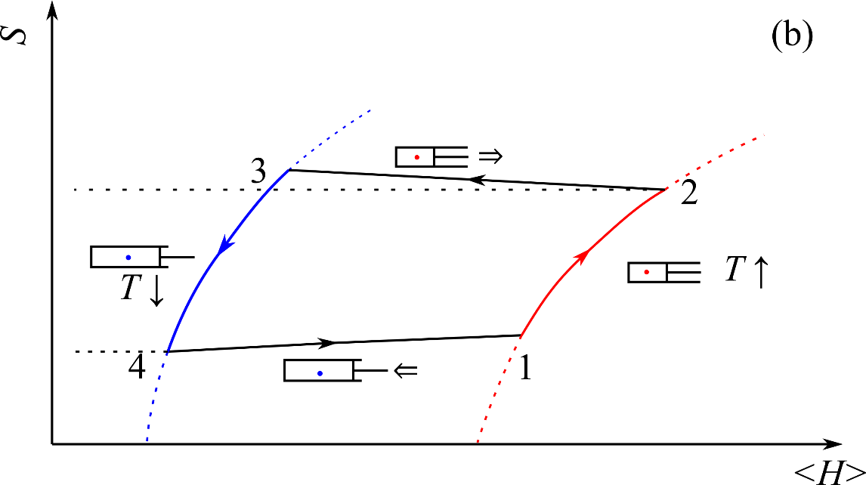
Finite-time Otto Heat Engine
For finite-time adiabatic processes II & IV, the evolution is determined by the Schrodinger equation
Stroke II (2 → 3):
Quantum adiabatic expansion.
Finite -time
Stroke III (3 → 4):
Isochoric cooling.
Stroke I (1 → 2):
Isochoric heating.
Stroke IV (4 → 1):
Quantum adiabatic compressing.
Finite -time

Slide 15
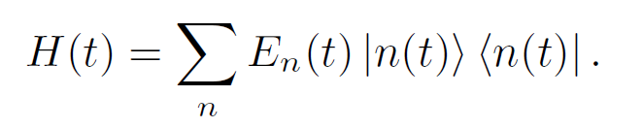



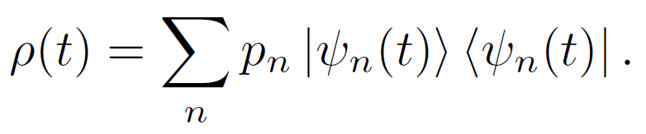
  Finite-time Adiabatic Process
The control Hamiltonian
The von Neumann equation
with a initial thermal state
follows as

Slide 16
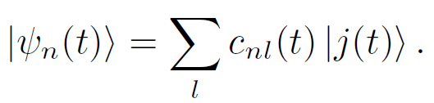

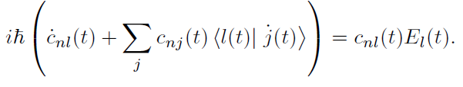
Finite-time Adiabatic Process
On the instantaneous eigenstate, we have
is obtained by

Slide 17


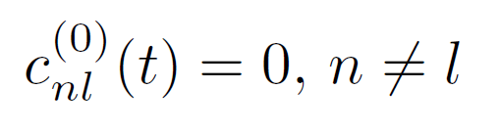
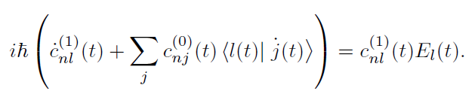
Finite-time Adiabatic Process
The quantum adiabatic approximation gives
We solve to the next order

Slide 18
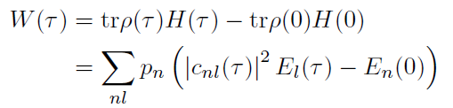

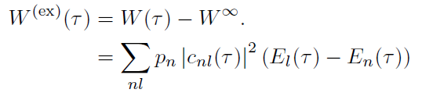
Finite-time Adiabatic Process
The work for the finite-time adiabatic process
The work for quasi-static process
We define the extra work

Slide 19






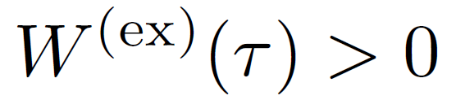
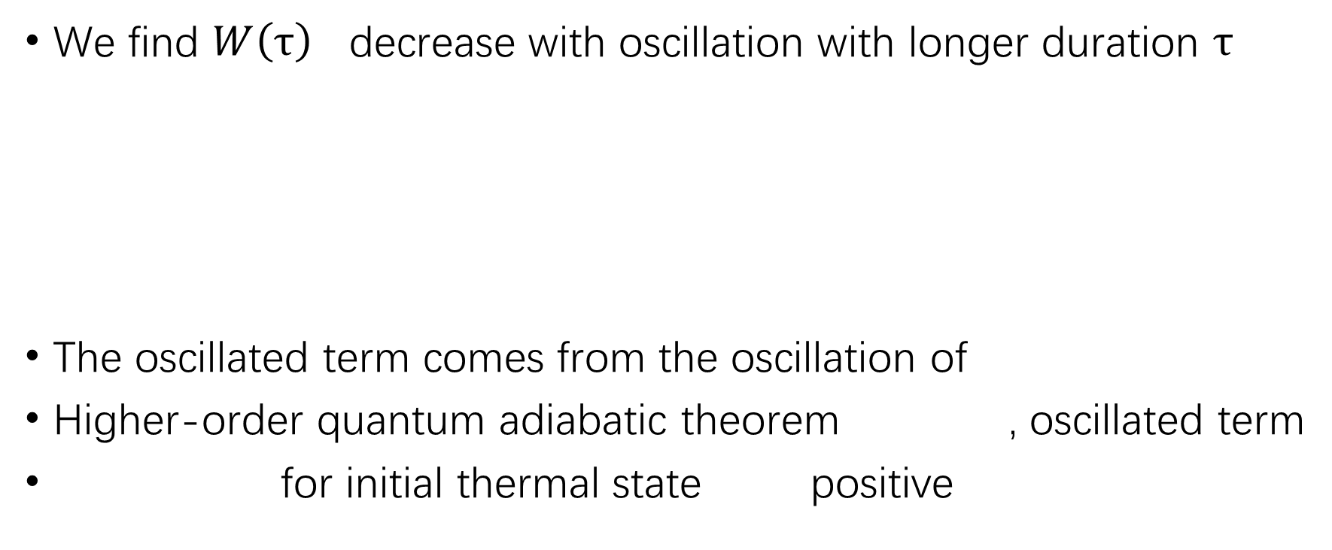
Finite-time Adiabatic Process
We find $W\left(τ\right)$ decrease with oscillation with longer duration $τ$
The oscillated term comes from the oscillation of
Higher-order quantum adiabatic theorem , oscillated term
for initial thermal state positive

Slide 20
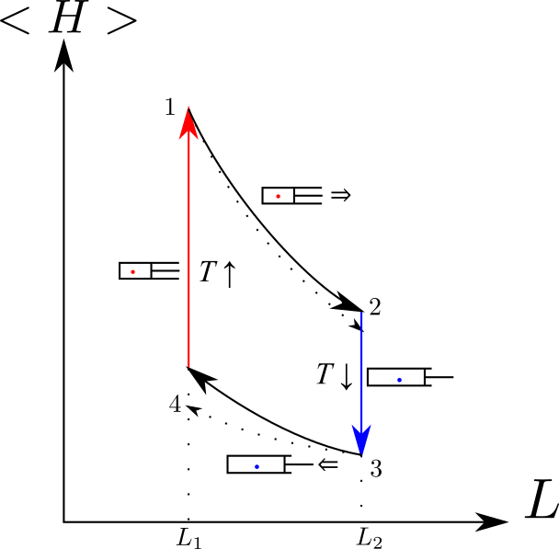


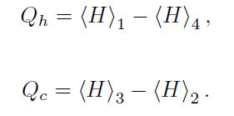

  Finite-time Otto Heat Engine
Neglect the time consuming of the isochoric process
Maximum power

Slide 21
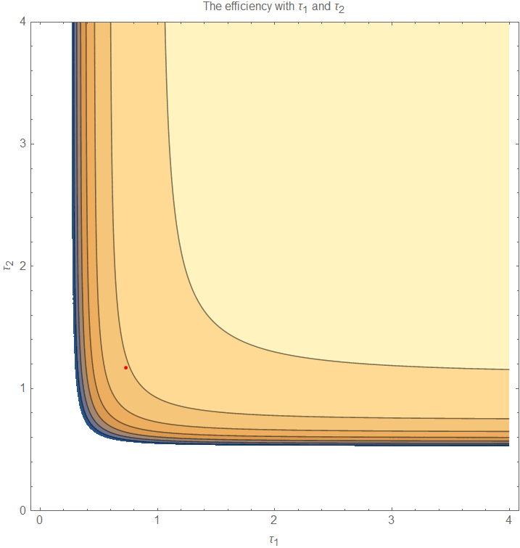
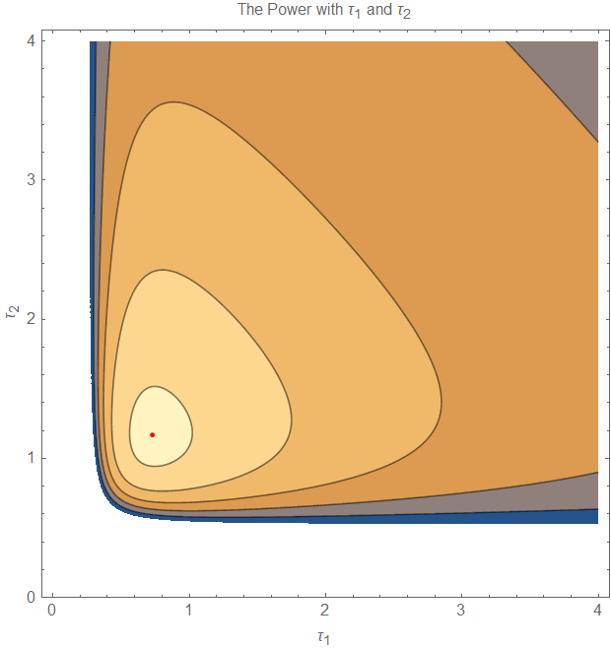
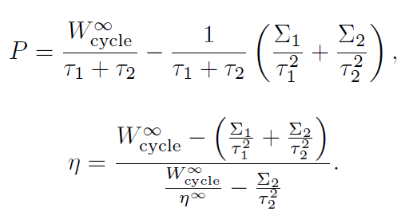
Finite-time Otto Heat Engine
The power and the efficiency is

Slide 22

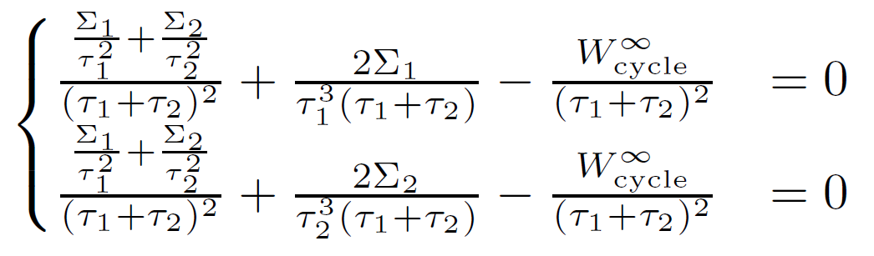
Finite-time Otto Heat Engine
The optimal power is obtained by

Slide 23
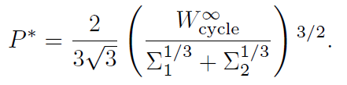

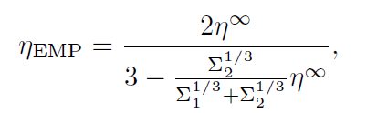
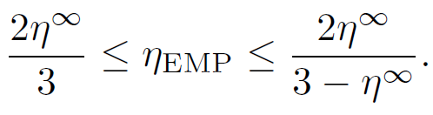
Finite-time Otto Heat Engine
The maximum power
The efficiency at maximum power
satisfying

Slide 24
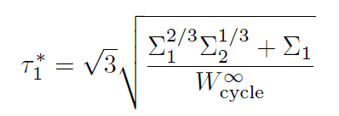
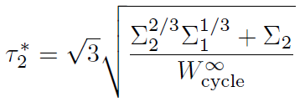

Finite-time Otto Heat Engine
The optimal duration and the work for quasi-static cycle
What is microscopically?

Slide 25
Realization on Piston Model
We consider a single particle in a box with time-dependent length
The protocol is

Slide 26
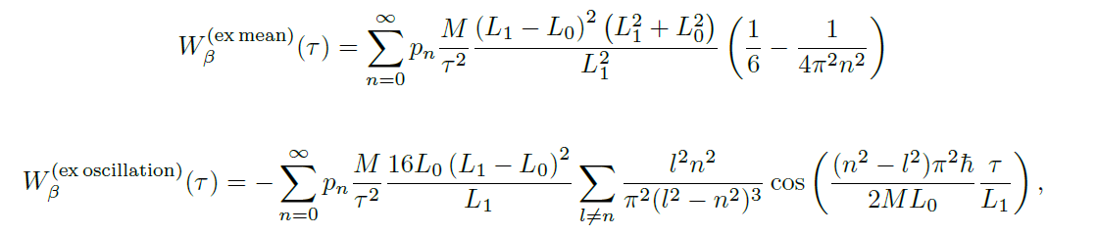
Realization on Piston Model
At quantum adiabatic limit, the mean part and the oscillation part are

Slide 27
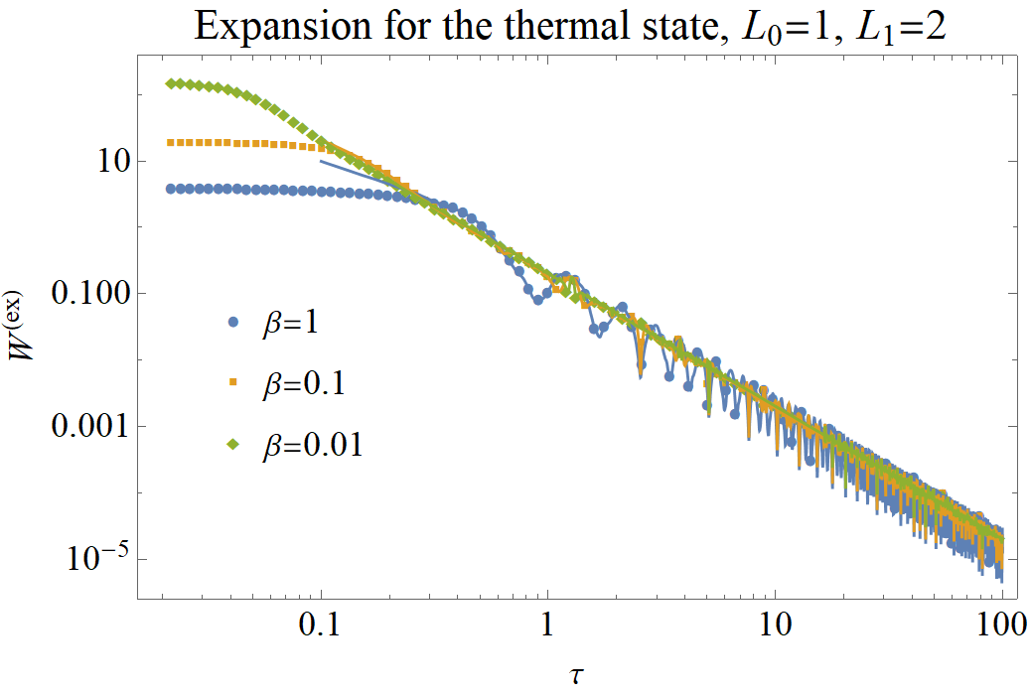
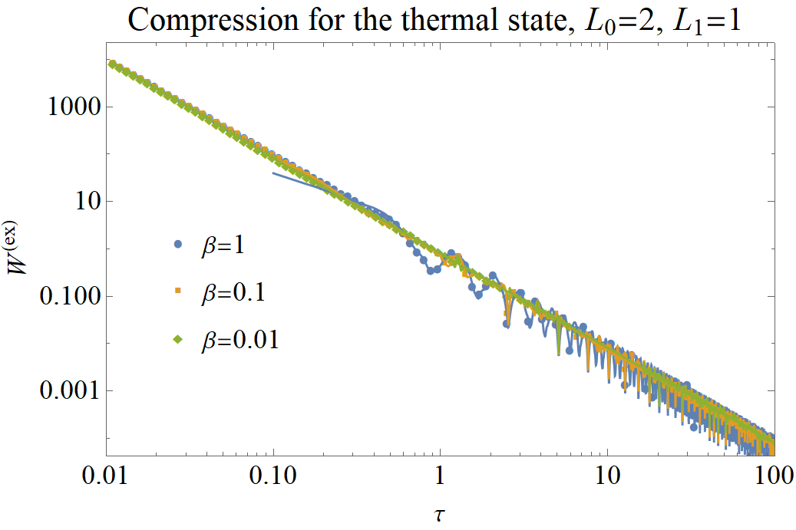
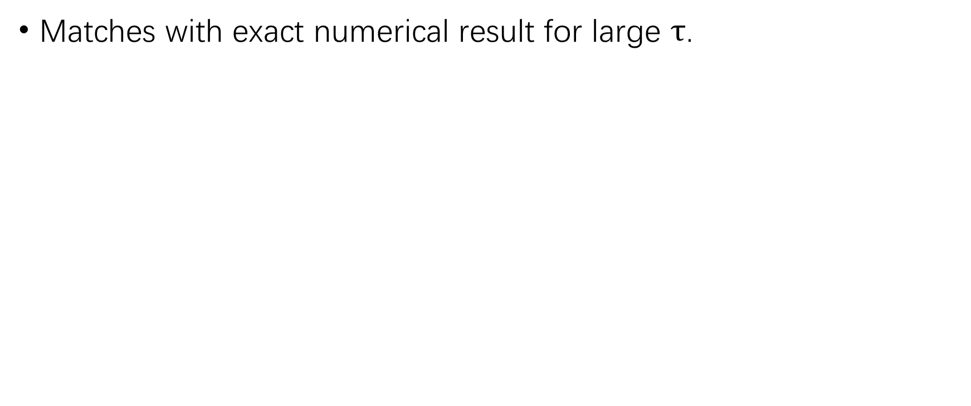
Realization on Piston Model
Matches with exact numerical result for large $τ$.

Slide 28
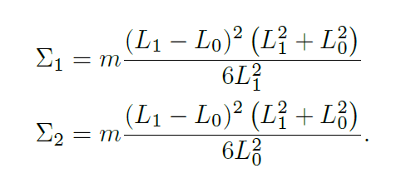
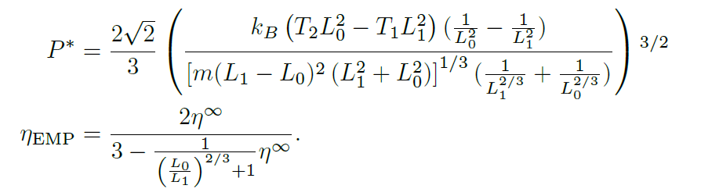
Realization on Piston Model
The corresponding coefficient for high temperature is
The optimal power and the corresponding efficiency is

Slide 29
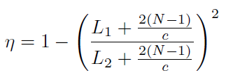

Summary
Bose-Fermi Duality
For finite-time adiabatic process, ;
The EMP for a finite-time Otto cycle .

Slide 30


