Slide 1

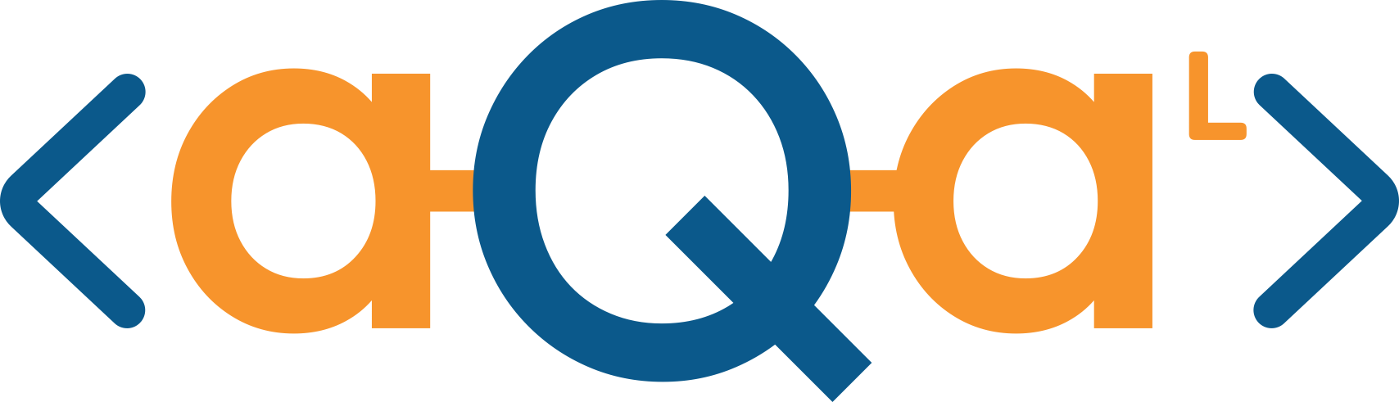
Optimizing quantum violation for multipartite facet Bell inequalities
Jinfu Chen | @ NWO Physics, 20.1.2026
arXiv:2511.07523 with Mengyao Hu, Jordi Tura
Applied Quantum Algorithms

Slide 2
Outline
Motivation
Background on nonlocality
Optimization algorithm
Applications
  CHSH inequality
  Permutation-invariant multipartite Bell inequality
Conclusion

Slide 3
Quantum
computer

Slide 4
Applied quantum algorithms:
Classical
input
Data encoding
Quantum
computer
Samplings
Classical output
Reliability?

Slide 5
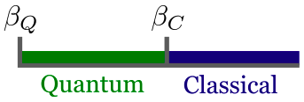
Applied quantum algorithms:
Quantum certification:
Classical
input
Measurement
input
Data encoding
Quantum
computer
Quantum
computer
Preparing quantum
state
Samplings
Classical output
Measurement
output
Reliability?

Slide 6
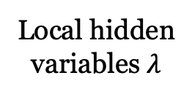
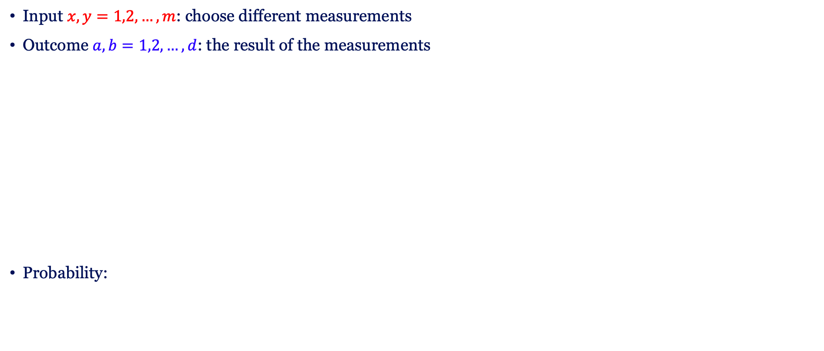
A crash course on nonlocality
Input $x,y=1,2,…,m$: choose different measurements
Outcome $a,b=1,2,…,d$: the result of the measurements
Probability:
Alice
Local hidden
variables $λ$
Bob
…

Slide 7
A crash course on nonlocality
Input $x,y=1,2,…,m$: choose different measurements
Outcome $a,b=1,2,…,d$: the result of the measurements
Probability:
Alice
Local hidden
variables $λ$
Bob
…

Slide 8
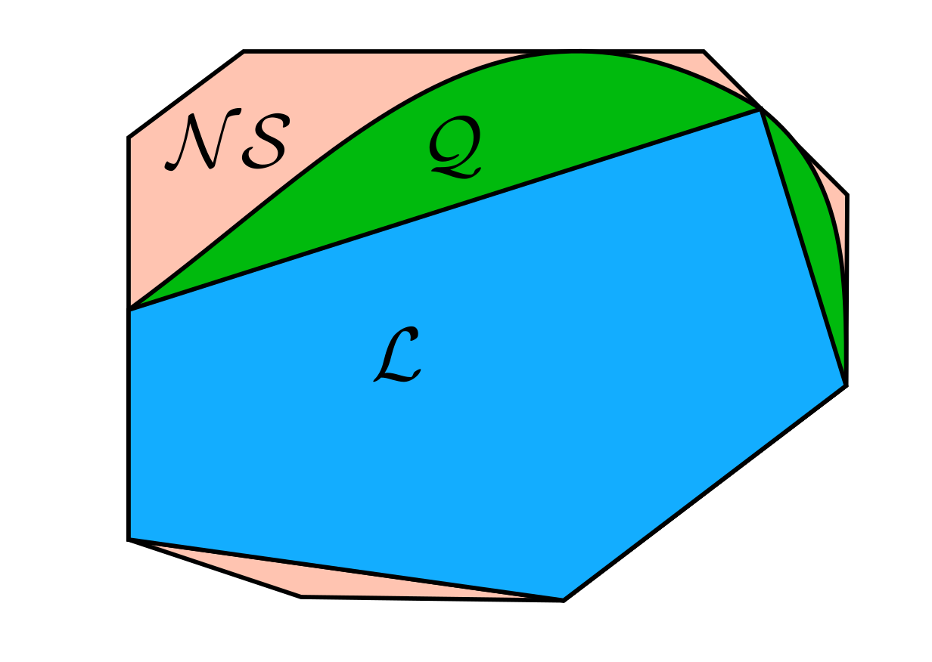


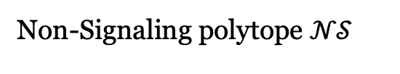
Bell inequalities
Linear functional in probability space
Classical bound: min in Local polytope $ℒ$
Quantum value: min in Quantum set $𝒬$
Non-Signaling polytope $𝒩𝒮$
Bell operator
N. Brunner, D. Cavalcanti, S. Pironio, V. Scarani, and S. Wehner, Bell nonlocality, Rev. Mod. Phys. 86, 419 (2014).

Slide 9
Bell inequalities
Linear functional in probability space
Tight Bell inequality = Facet
Classical bound: min in Local polytope $ℒ$
Quantum value: min in Quantum set $𝒬$
Non-Signaling polytope $𝒩𝒮$
Bell operator
N. Brunner, D. Cavalcanti, S. Pironio, V. Scarani, and S. Wehner, Bell nonlocality, Rev. Mod. Phys. 86, 419 (2014).

Slide 10
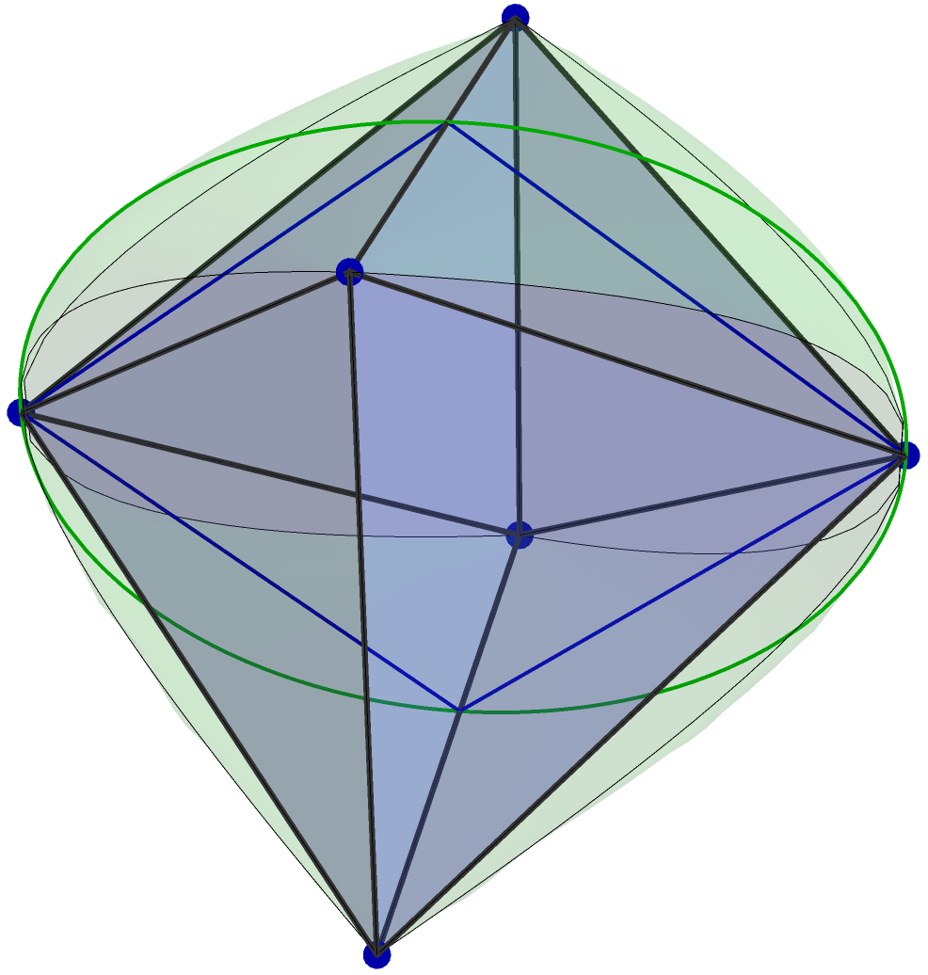
Bell inequalities
Linear functional in probability space
2 parties, 2 measurements, 2 outcomes
Facet: CHSH inequality
Classical bound: min in Local polytope $ℒ$
Quantum value: min in Quantum set $𝒬$
Bell operator
Local polytope
Quantum set
N. Brunner, D. Cavalcanti, S. Pironio, V. Scarani, and S. Wehner, Bell nonlocality, Rev. Mod. Phys. 86, 419 (2014).

Slide 11
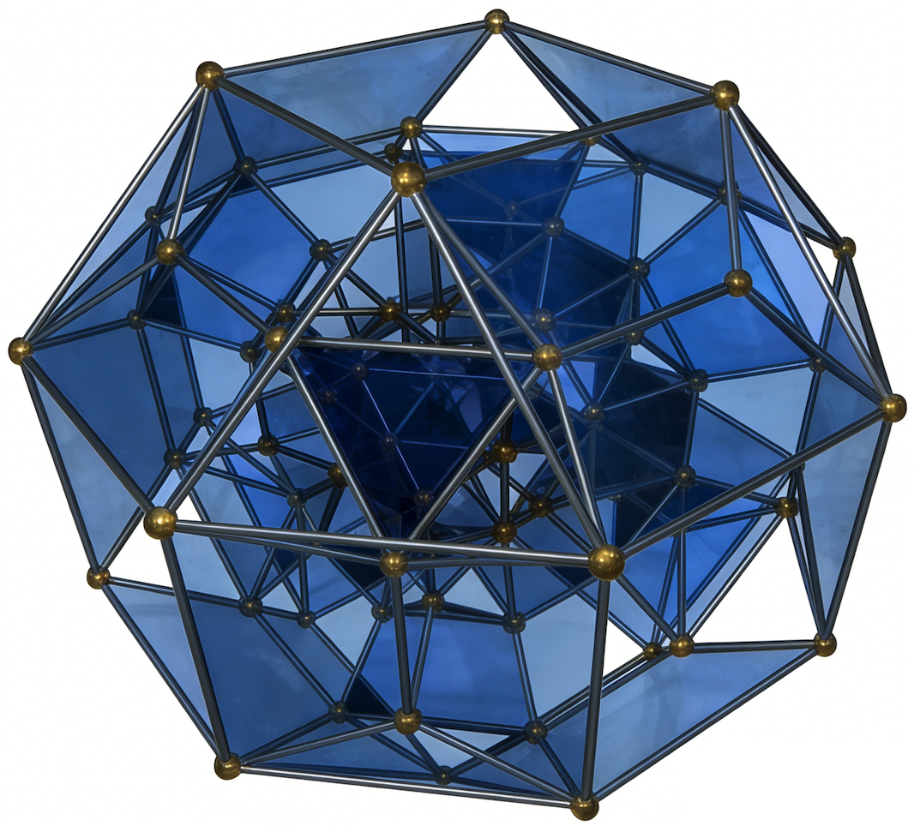
Bell correlation in many-body regime
Multipartite Bell correlation are harder:
  Exponential curse in many-body physics
Robust multipartite Bell inequalities?
Useful in
  Certify your quantum computer
  Genuine multipartite entanglement
  Collective advantage in metrology
  Quantum network and distributed quantum computing
Handle by adding symmetry or locality constraint
Quantum violation?

Slide 12
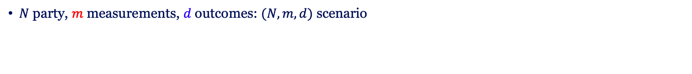
Bell correlation in many-body regime
$N$ party, $m$ measurements, $d$ outcomes: $(N,m,d)$ scenario
Finding all tight Bell inequalities

Slide 13
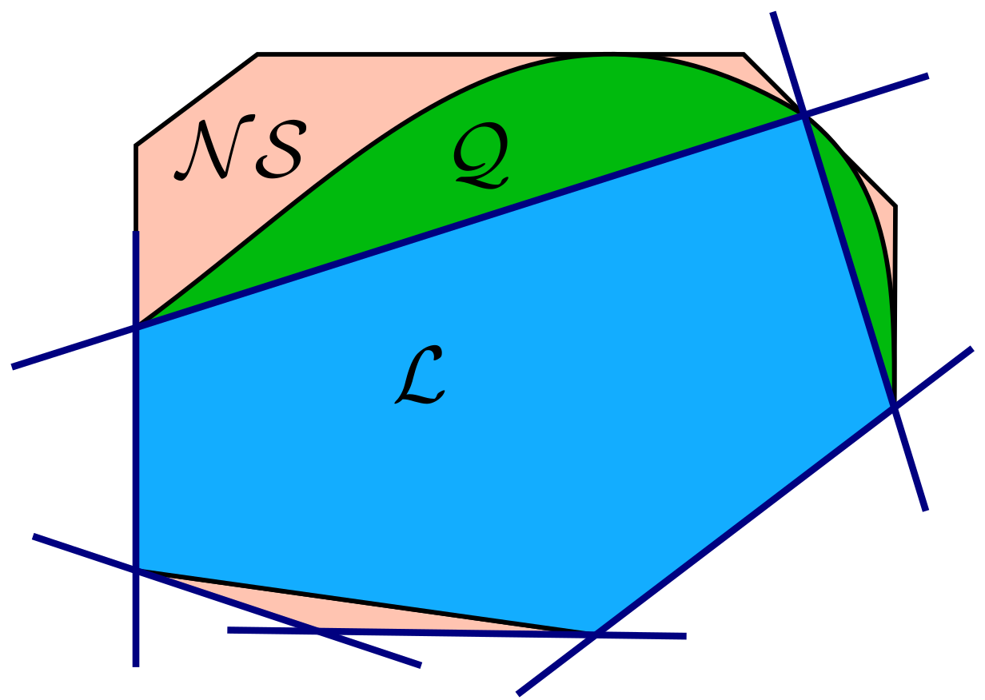
Bell correlation in many-body regime
$N$ party, $m$ measurements, $d$ outcomes: $(N,m,d)$ scenario
Finding all tight Bell inequalities
All facets of local polytope

Slide 14

Bell correlation in many-body regime
$N$ party, $m$ measurements, $d$ outcomes: $(N,m,d)$ scenario
Finding all tight Bell inequalities
All facets of local polytope
Brute searching is not realistic:
  Complexity:
  Number of vertices:
  Dimension of local polytope:
B. Chazelle, An optimal convex hull algorithm in any fixed dimension, Discrete Comput. Geom. 10 377409 (1993)

Slide 15
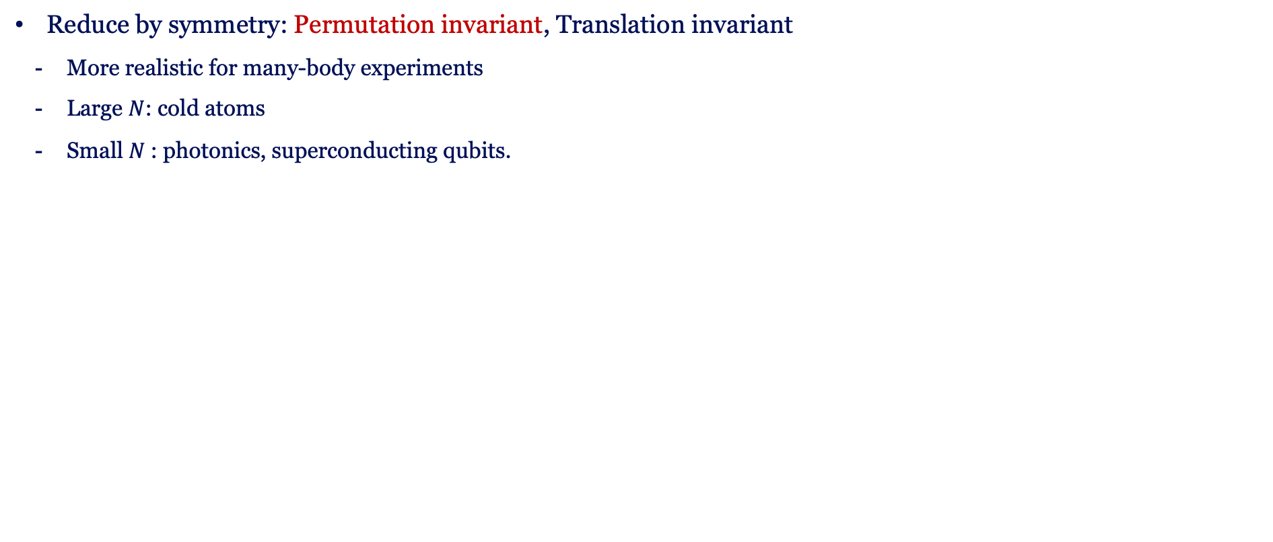
Tackle the bottleneck
Reduce by symmetry: Permutation invariant, Translation invariant
  More realistic for many-body experiments
  Large $N$: cold atoms
  Small $N$: photonics, superconducting qubits.
N. J. Engelsen, R. Krishnakumar, O. Hosten, and M. A. Kasevich, Phys. Rev. Lett. 118, 140401 (2017)

Slide 16
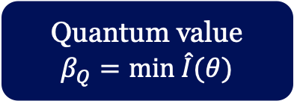



Tackle the bottleneck
Reduce by symmetry: Permutation invariant, Translation invariant
  More realistic for many-body experiments
  Large $N$: cold atoms
  Small $N$: photonics, superconducting qubits.
N. J. Engelsen, R. Krishnakumar, O. Hosten, and M. A. Kasevich, Phys. Rev. Lett. 118, 140401 (2017)
Bell Inequality
$I$
assign measurement
Bell Operator
$$\hat{I}(θ)$$
Classical
spin model
Quantum
Hamiltonian
Deterministic
strategies
Classical bound
$$β_{C}=min I$$
Quantum value
$$β_{Q}=min \hat{I}(θ)$$
Gradient-based
optimization
J. Tura, G. De las Cuevas, R. Augusiak, M. Lewenstein, A. Acín, and J. I. Cirac,
Energy as a Detector of Nonlocality of Many-Body Spin Systems, Phys. Rev. X 7, 021005 (2017)

Slide 17
Tackle the bottleneck
Certification typically requires only some noise-tolerant inequalities
No need to enumerate all tight Bell inequalities
Finding more robust
Bell inequality:
Enhancing
quantum-classical ratio

Slide 18
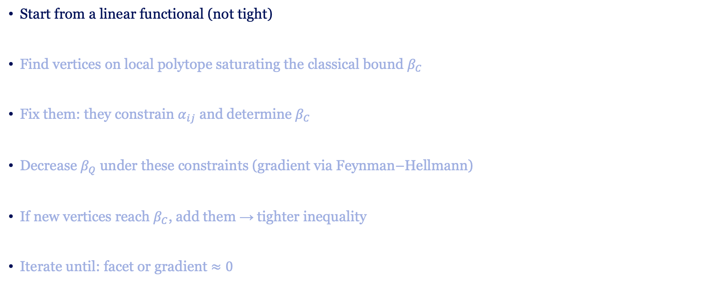
Optimization procedure
Start from a linear functional (not tight)
Find vertices on local polytope saturating the classical bound $β_{C}$
Fix them: they constrain $α_{ij}$ and determine $β_{C}$
Decrease $β_{Q}$ under these constraints (gradient via Feynman–Hellmann)
If new vertices reach $β_{C}$, add them → tighter inequality
Iterate until: facet or gradient $≈0$

Slide 19
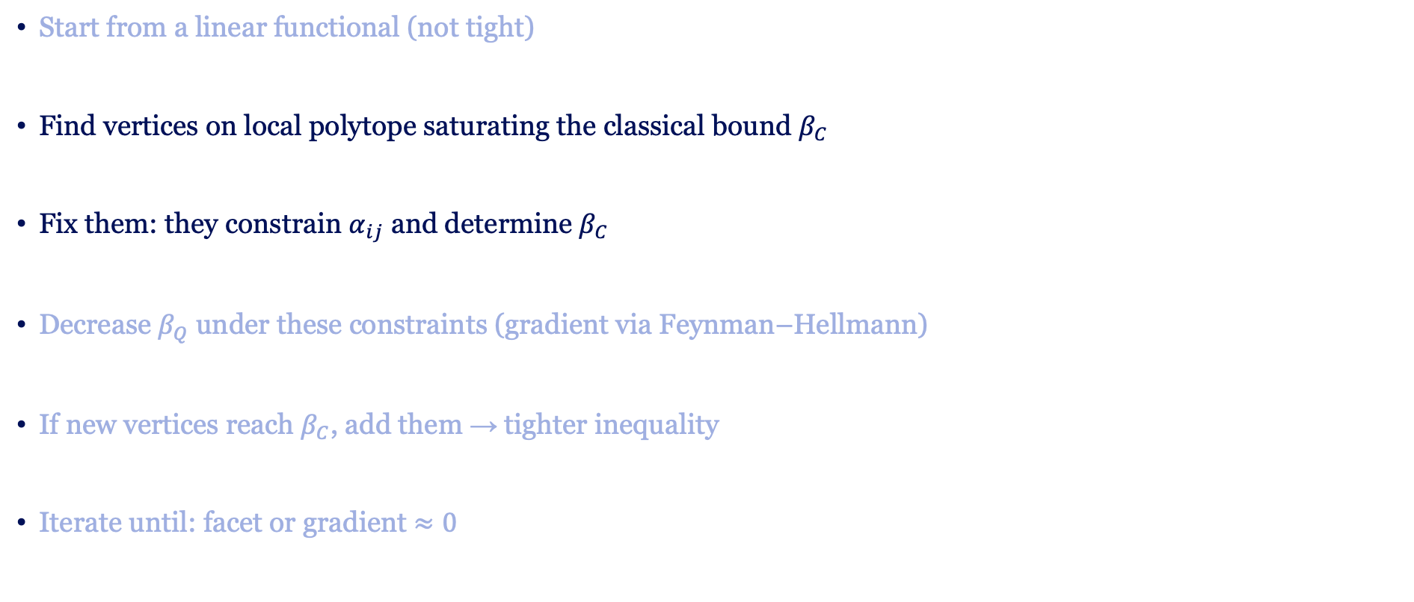
Optimization procedure
Start from a linear functional (not tight)
Find vertices on local polytope saturating the classical bound $β_{C}$
Fix them: they constrain $α_{ij}$ and determine $β_{C}$
Decrease $β_{Q}$ under these constraints (gradient via Feynman–Hellmann)
If new vertices reach $β_{C}$, add them → tighter inequality
Iterate until: facet or gradient $≈0$

Slide 20
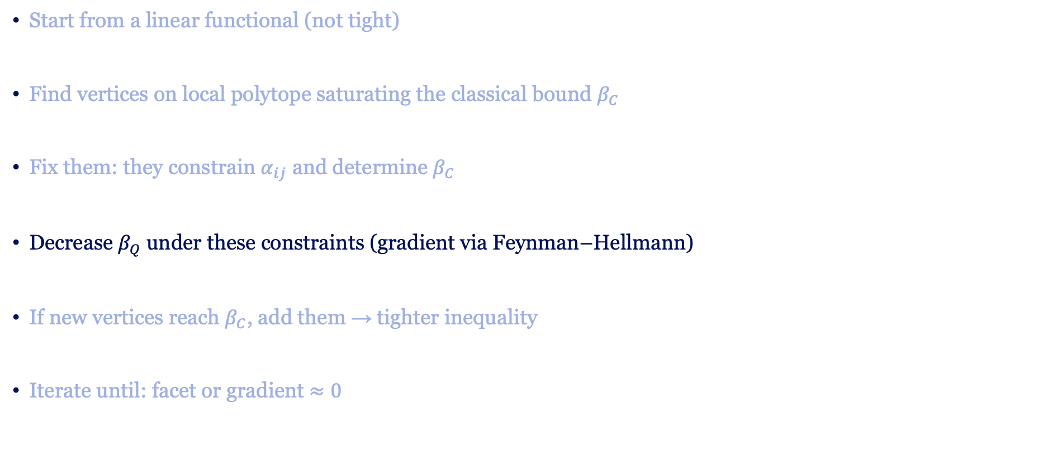
Optimization procedure
Start from a linear functional (not tight)
Find vertices on local polytope saturating the classical bound $β_{C}$
Fix them: they constrain $α_{ij}$ and determine $β_{C}$
Decrease $β_{Q}$ under these constraints (gradient via Feynman–Hellmann)
If new vertices reach $β_{C}$, add them → tighter inequality
Iterate until: facet or gradient $≈0$

Slide 21
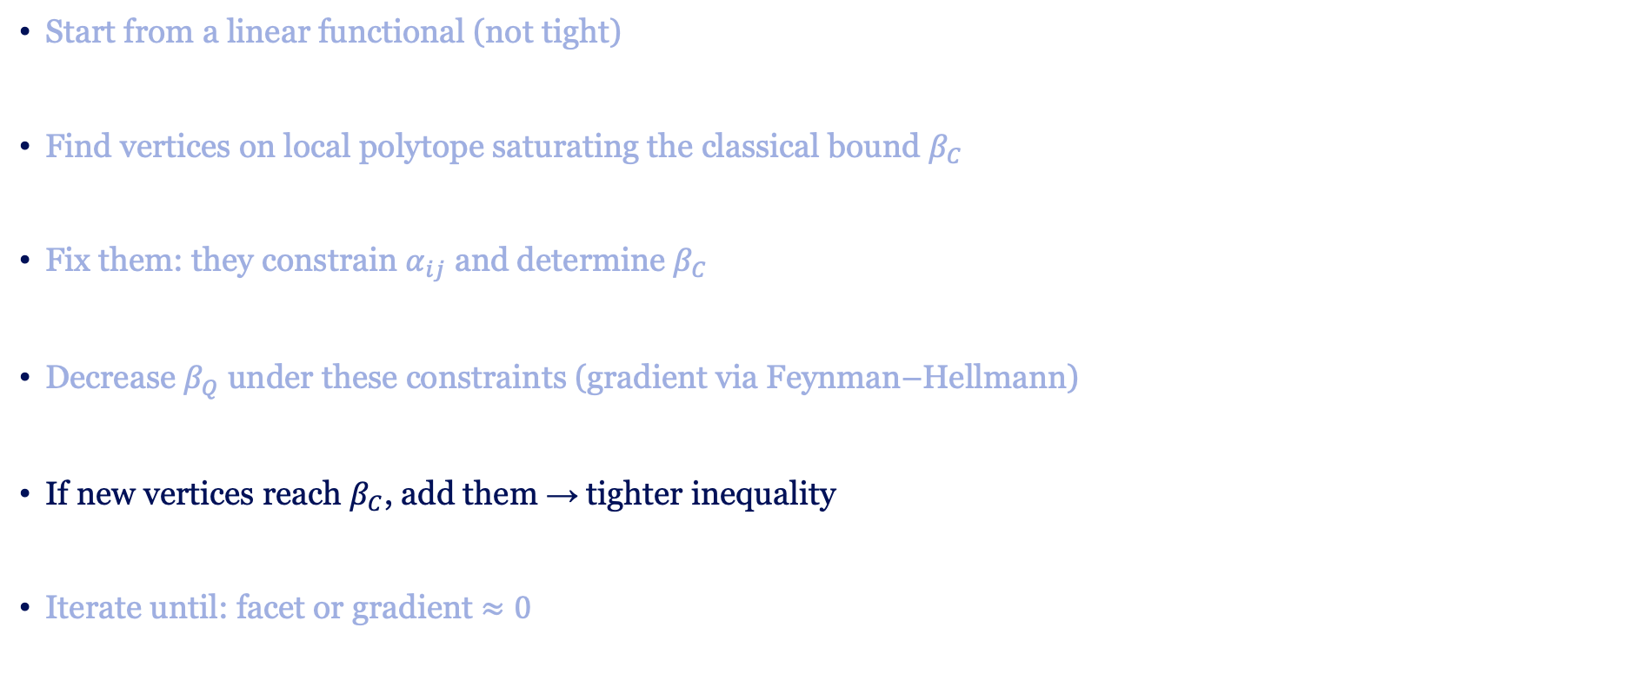
Optimization procedure
Start from a linear functional (not tight)
Find vertices on local polytope saturating the classical bound $β_{C}$
Fix them: they constrain $α_{ij}$ and determine $β_{C}$
Decrease $β_{Q}$ under these constraints (gradient via Feynman–Hellmann)
If new vertices reach $β_{C}$, add them → tighter inequality
Iterate until: facet or gradient $≈0$

Slide 22
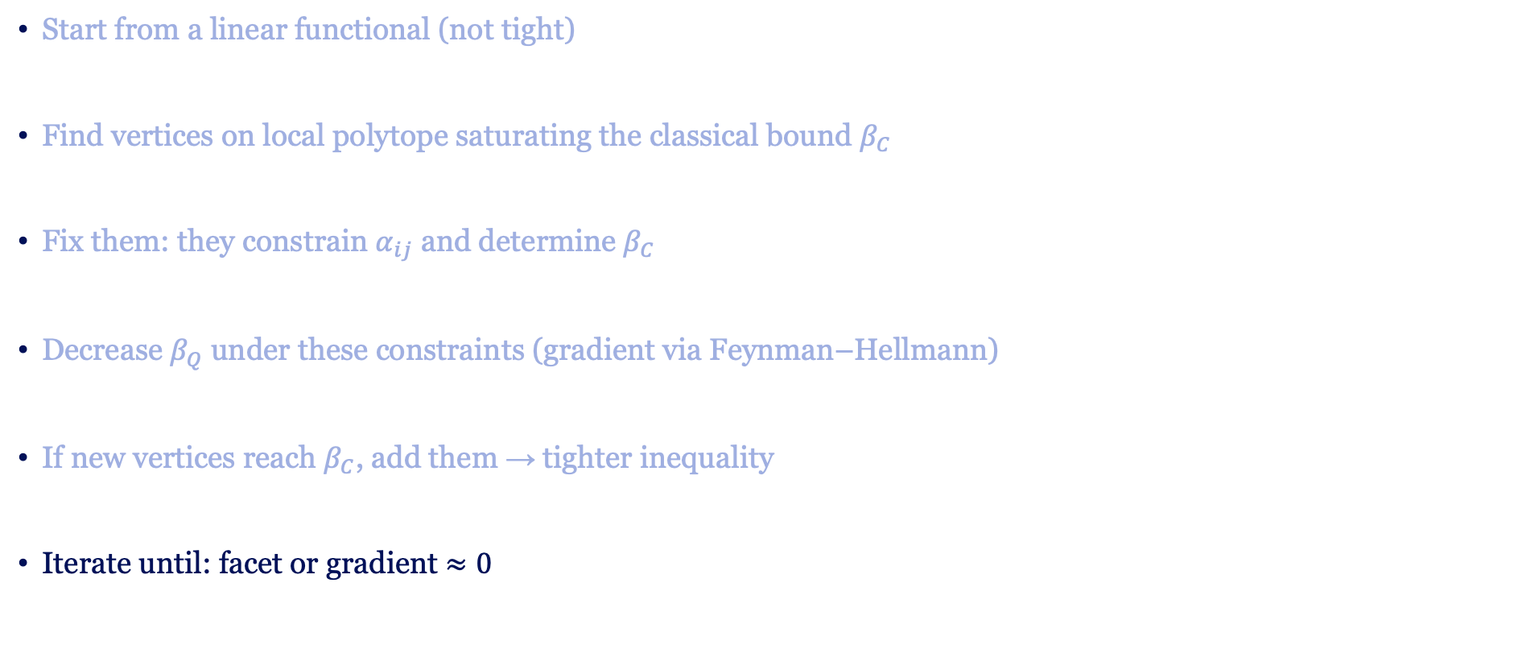
Optimization procedure
Start from a linear functional (not tight)
Find vertices on local polytope saturating the classical bound $β_{C}$
Fix them: they constrain $α_{ij}$ and determine $β_{C}$
Decrease $β_{Q}$ under these constraints (gradient via Feynman–Hellmann)
If new vertices reach $β_{C}$, add them → tighter inequality
Iterate until: facet or gradient $≈0$

Slide 23
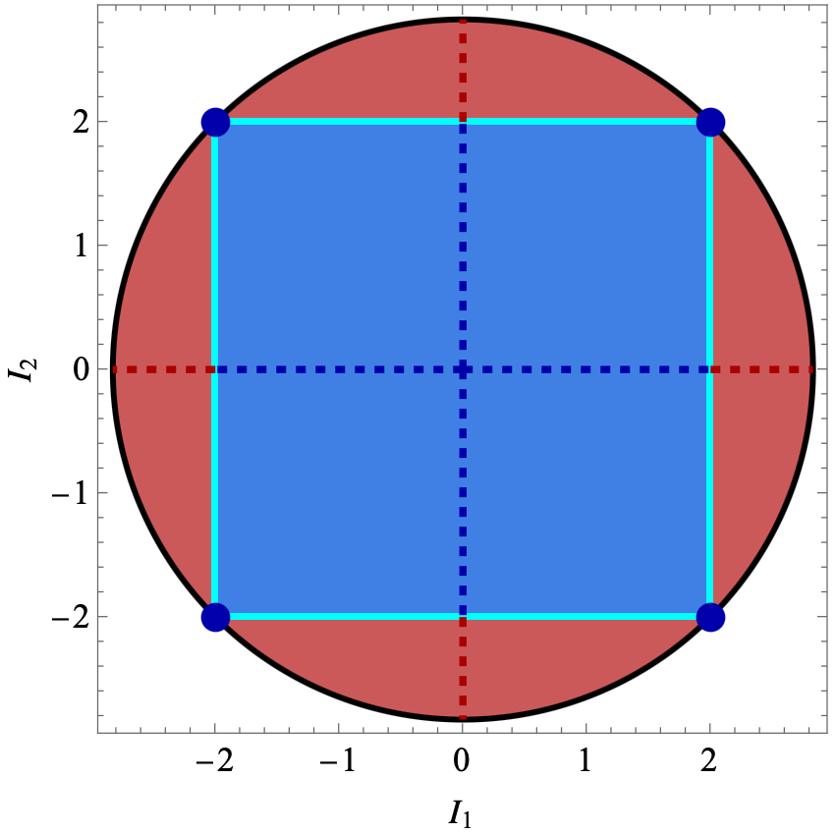
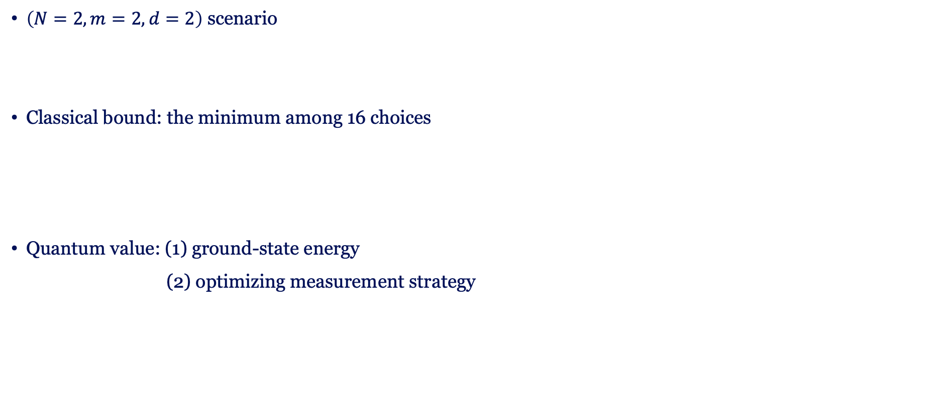
Benchmark: Bipartite scenario
$\left(N=2,m=2,d=2\right)$ scenario
Classical bound: the minimum among 16 choices
Quantum value: (1) ground-state energy
    (2) optimizing measurement strategy

Slide 24
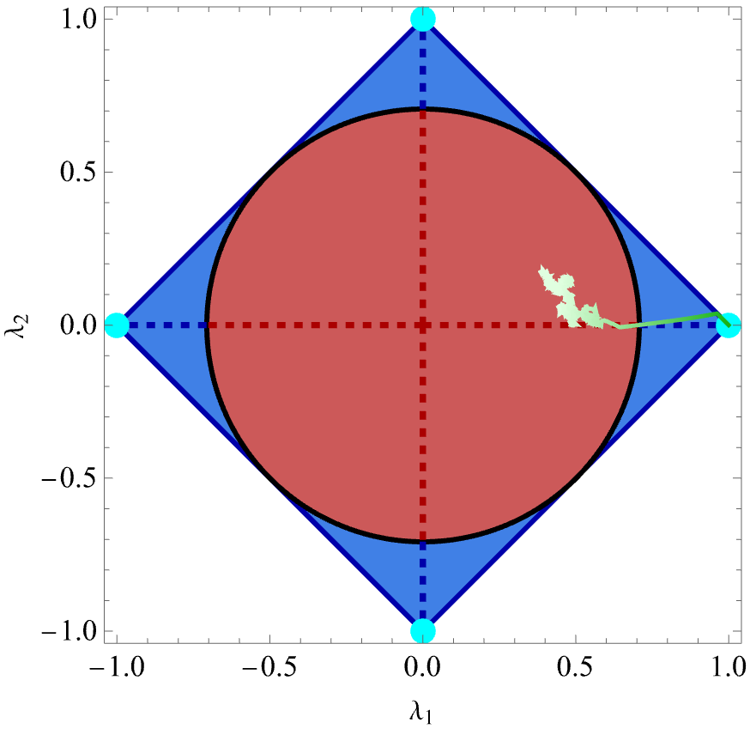
Benchmark: Bipartite scenario
$\left(N=2,m=2,d=2\right)$ scenario
Classical bound: the minimum among 16 choices
Quantum value: (1) ground-state energy
    (2) optimizing measurement strategy

Slide 25

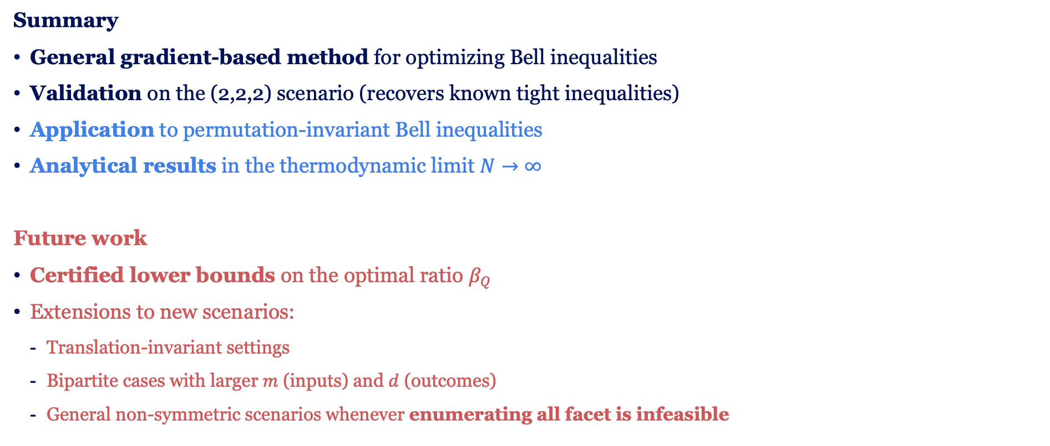
Summary and outlook
Summary
General gradient-based method for optimizing Bell inequalities
Validation on the (2,2,2) scenario (recovers known tight inequalities)
Application to permutation-invariant Bell inequalities
Analytical results in the thermodynamic limit $N→∞$
Future work
Certified lower bounds on the optimal ratio $β_{Q}$
Extensions to new scenarios:
  Translation-invariant settings
  Bipartite cases with larger $m$ (inputs) and $d$ (outcomes)
  General non-symmetric scenarios whenever enumerating all facet is infeasible
see arXiv:2511.07523

Slide 26
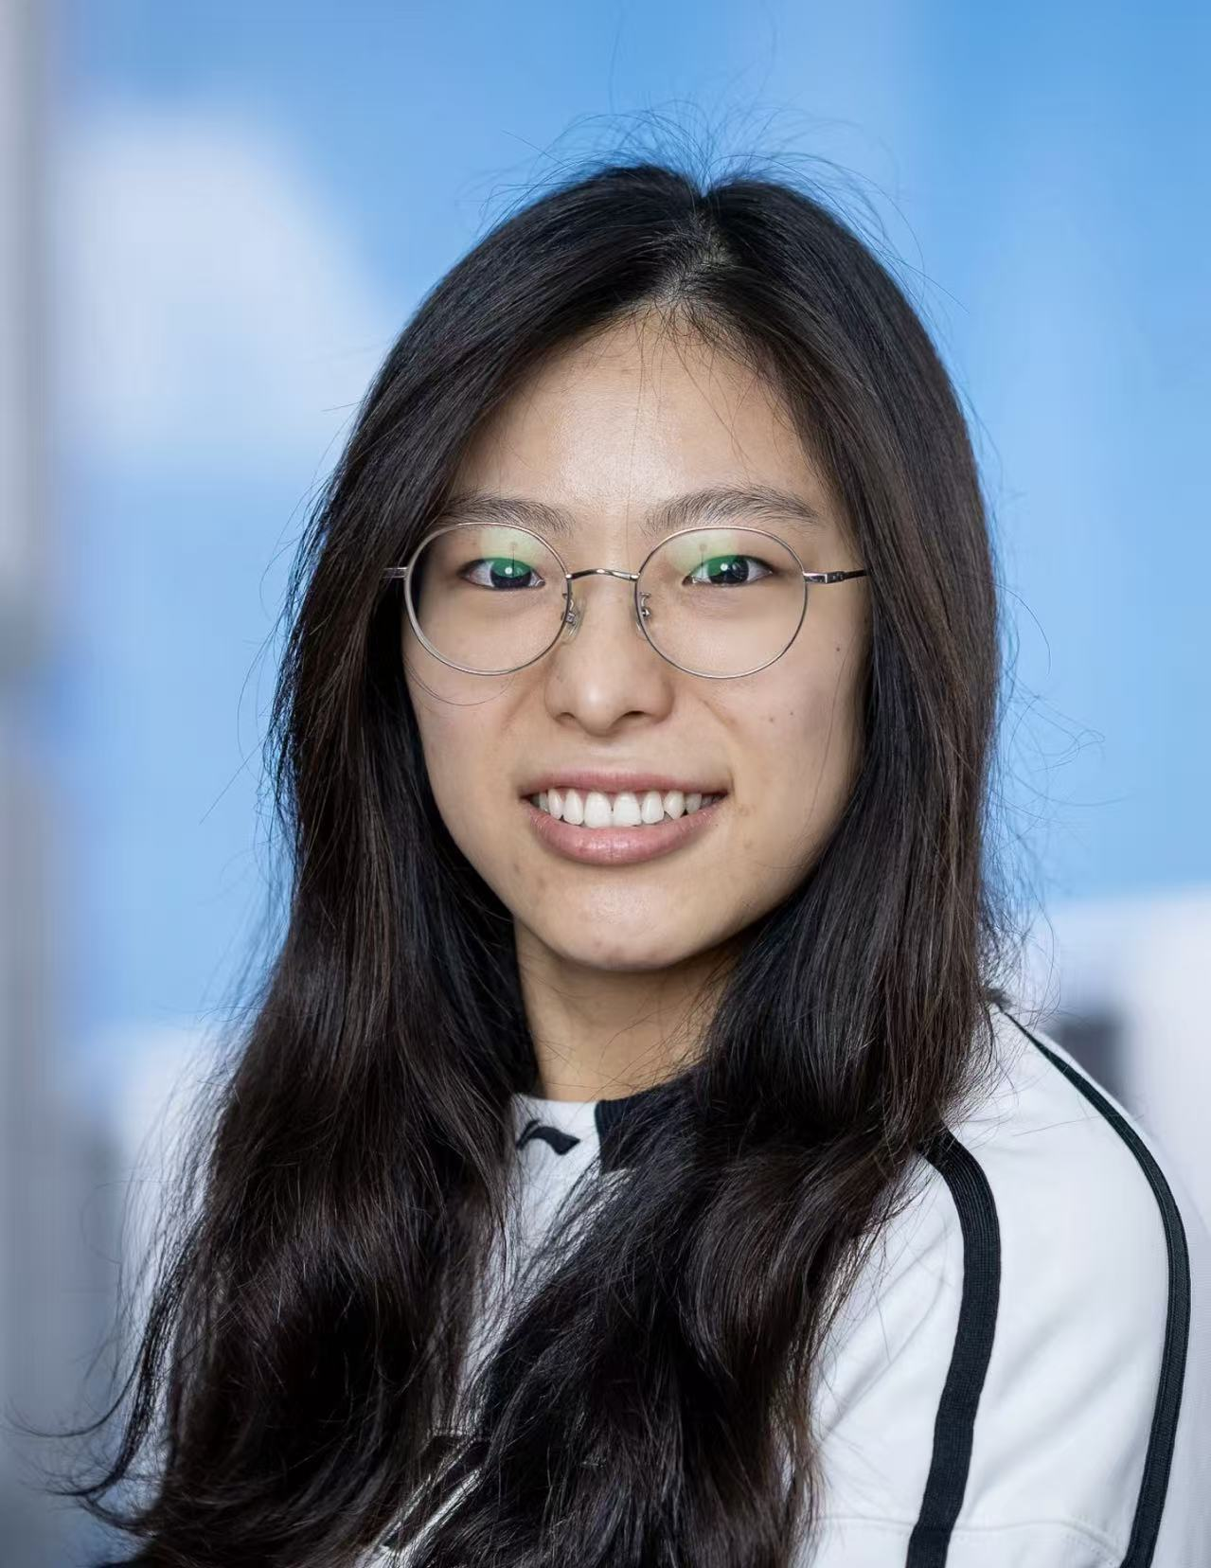
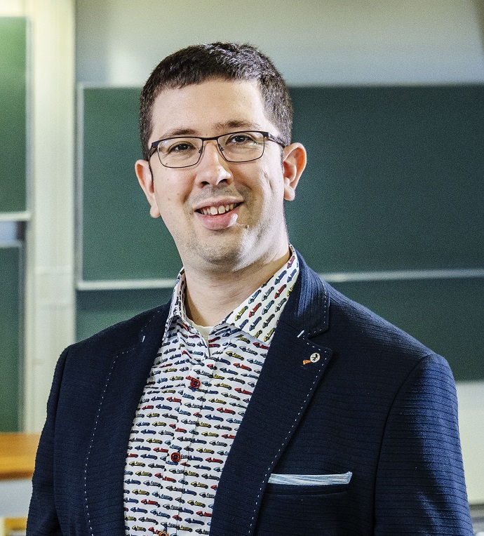

Thank you!
Collaborators:
Mengyao Hu
Jordi Tura

