Slide 1


Geodesic path for the minimal energy cost in shortcuts to isothermality
Geng Li, Jin-Fu Chen, C. P. Sun, and Hui Dong
Graduate School of China Academy of Engineering Physics
Beijing Computational Science Research Center
2021/12/16
arXiv: 2110.09137

Slide 2
Content
Shortcuts to isothermality
Irreversible work
Thermodynamic length and optimal protocol
Conclusion

Slide 3
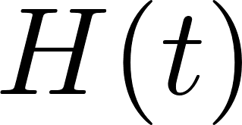
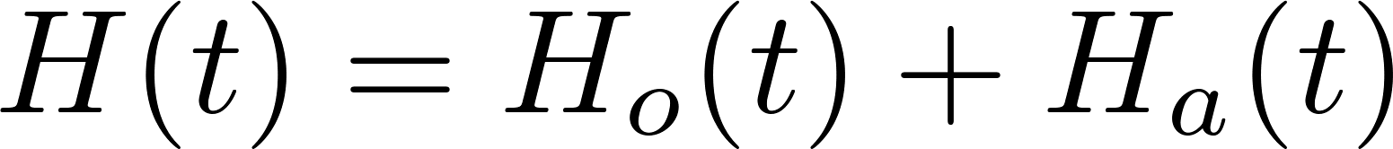
Shortcuts to adiabacity
Origin Hamiltonian
Adiabatic approximation
Find such that
The auxiliary Hamiltonian is added as
One can boost quantum adiabatic processes in arbitrary finite time.
dynamical
Berry
M. V. Berry, J. Phys. A: Math. Theor. 42, 365303 (2009)

Slide 4
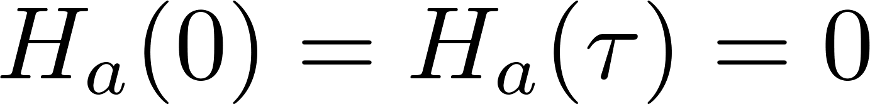
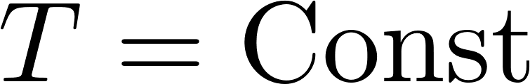
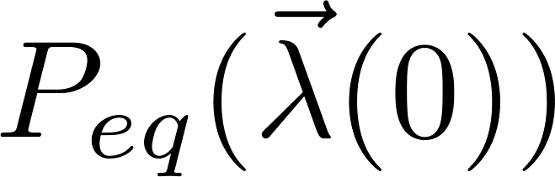
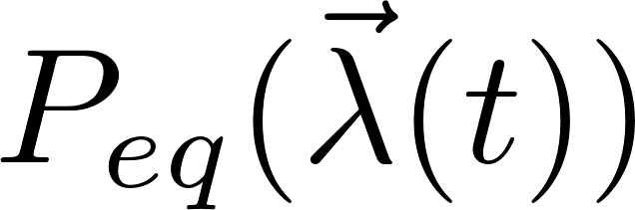
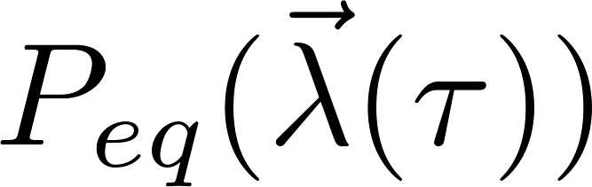
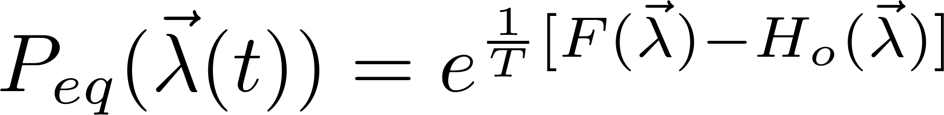


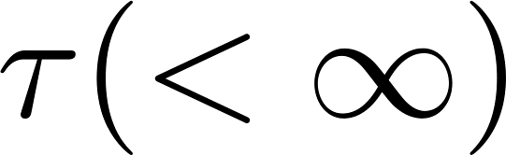
Shortcuts to isothermality
A similar idea can be applied for isothermal processes
Total Hamiltonian
Boundary condition
Temperature
The shortcut control scheme has been constructed for the classical Brownian motion model.
G. Li, H. T. Quan and Z. C. Tu, Phys. Rev. E 96, 012144 (2017).

Slide 5
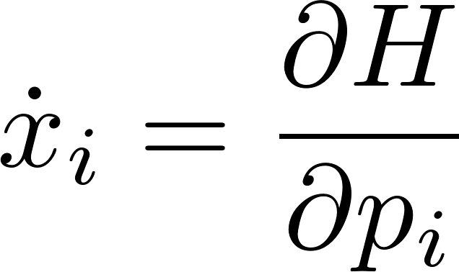
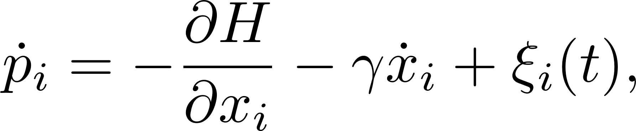
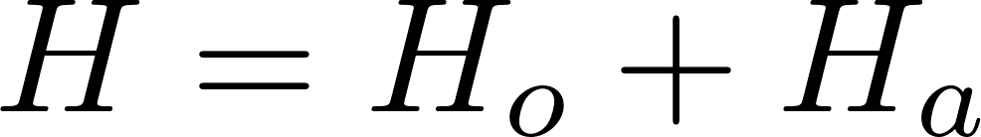
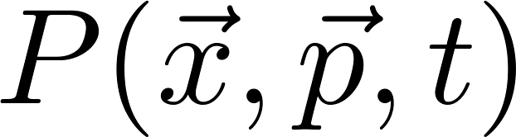
Dynamics of underdamped Brownian motion
The complete Langevin equation of a single Brownian particle
Fluctuation-Dissipation relation
Total Hamiltonian
The evolution of the probability distribution is described by the Kramers equation
deterministic
dissipation

Slide 6
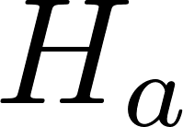
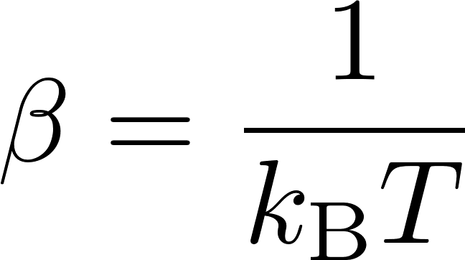
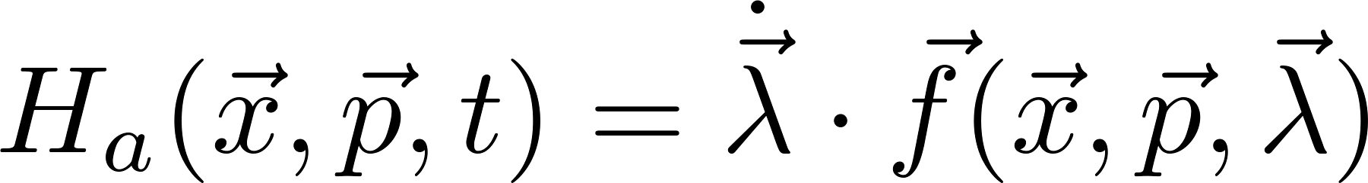
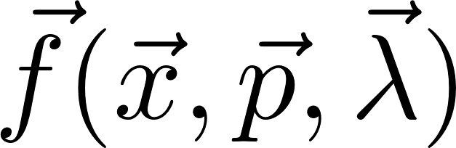
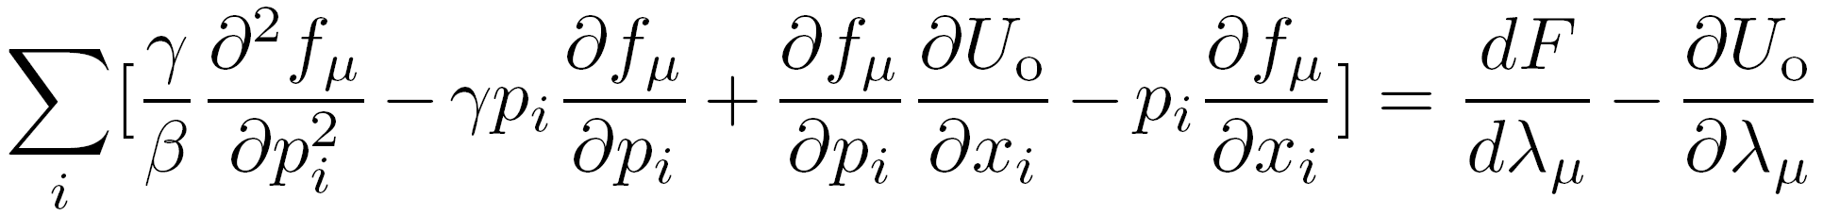
Shortcuts to isothermality
The auxiliary Hamiltonian is employed to realize the shortcut
Plugging the solution to the Kramers equation, the form of the auxiliary Hamiltonian was found to be
where satisfies
The explicit expression can be determined with the given potential
G. Li, H. T. Quan and Z. C. Tu, Phys. Rev. E 96, 012144 (2017).

Slide 7
Content
Shortcuts to isothermality
Irreversible work
Thermodynamic length and optimal protocol
Conclusion

Slide 8
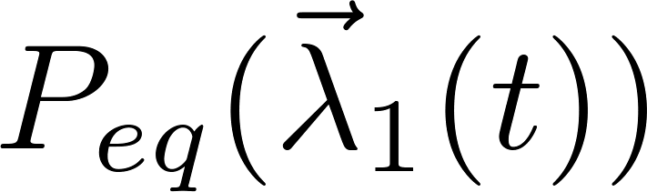
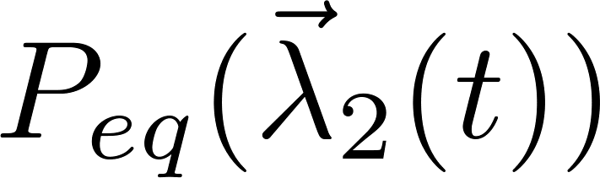
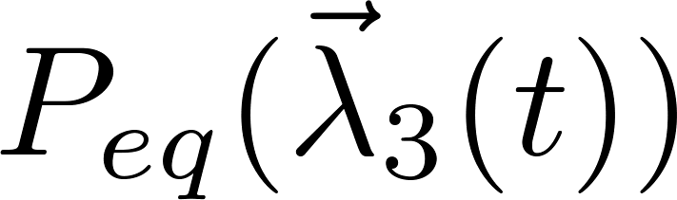
Irreversible work
Different shortcuts exist for given initial and final states
Which one consume the minimal energy?

Slide 9
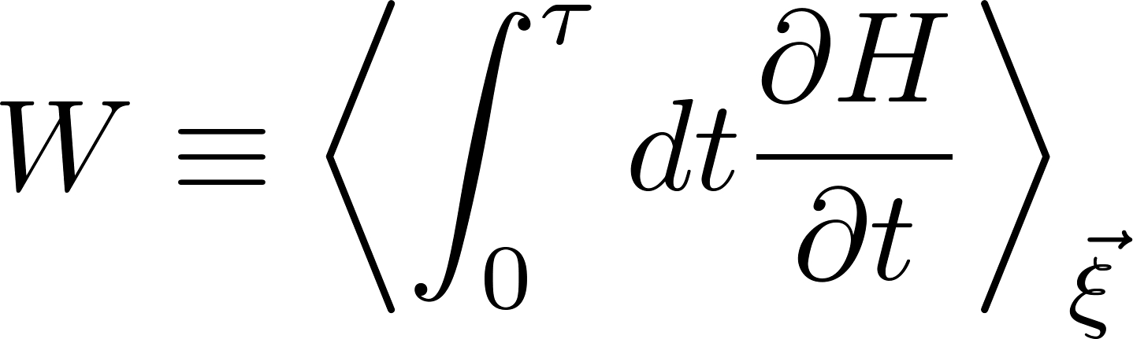
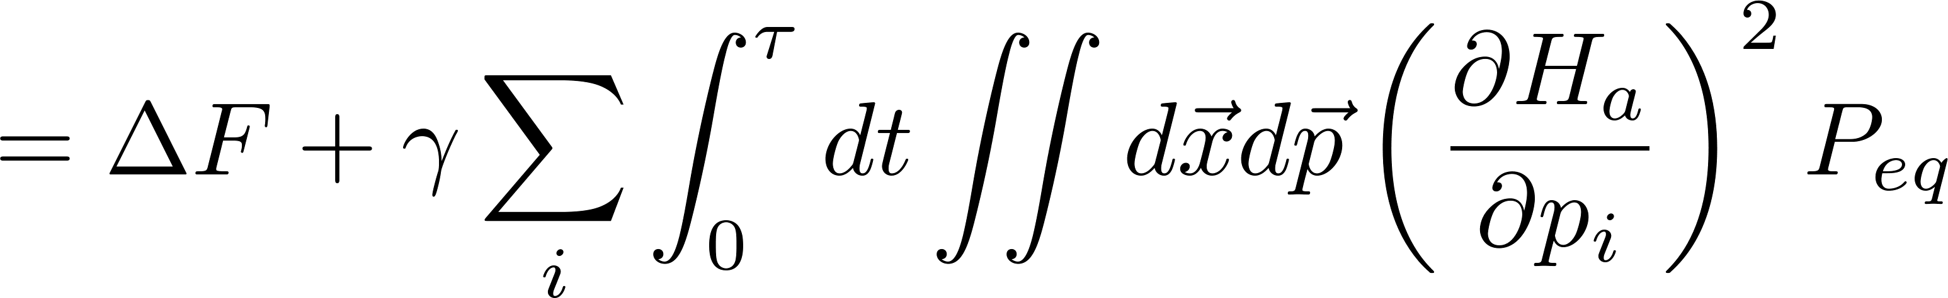
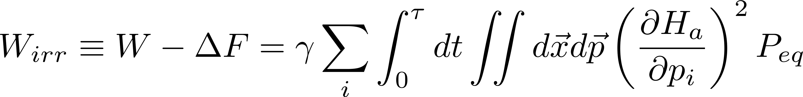
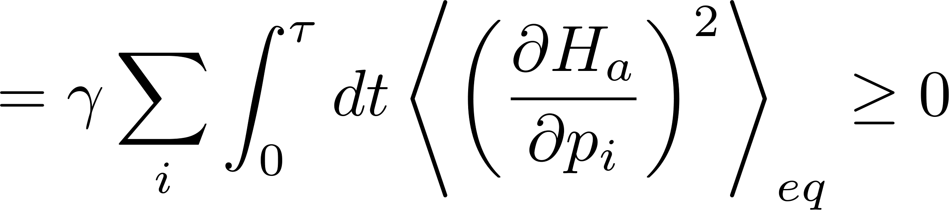
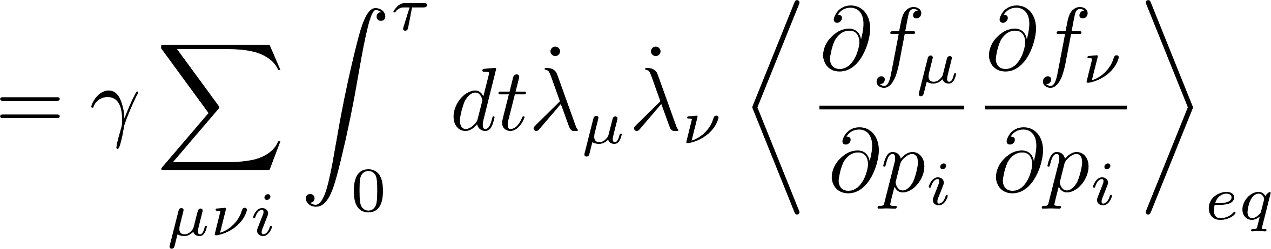
Irreversible work
Average work in shortcuts to isothermality
Free energy difference of initial and final states
Irreversible work

Slide 10
Content
Shortcuts to isothermality
Irreversible work
Thermodynamic length and optimal protocol
Conclusion

Slide 11
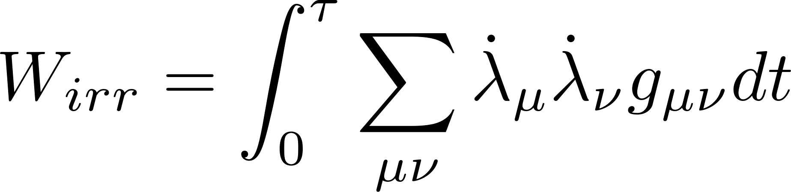
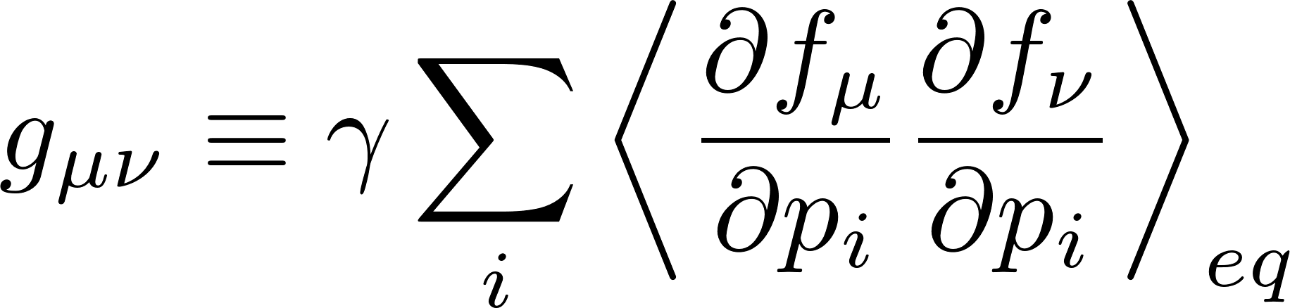
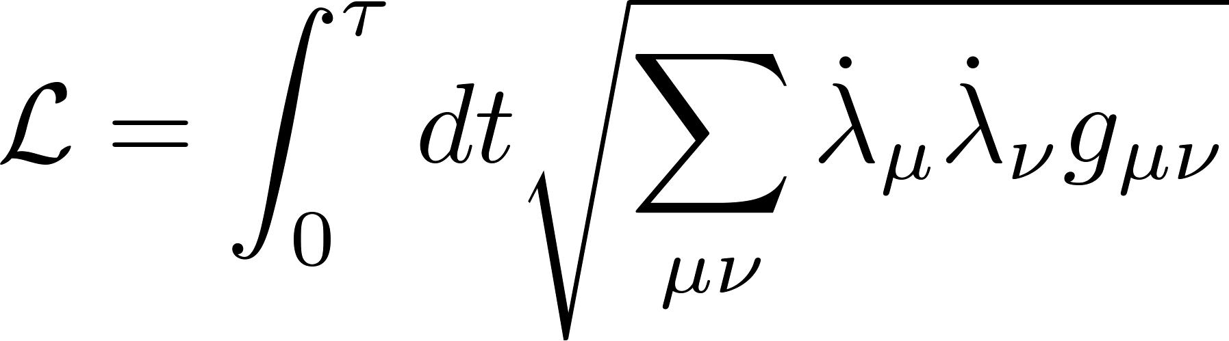
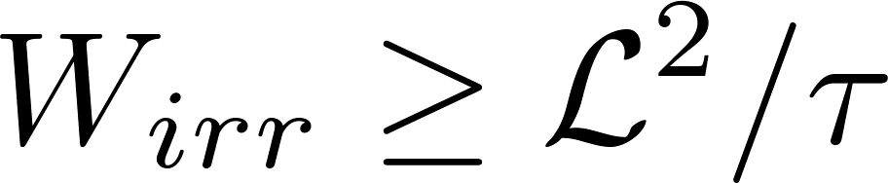
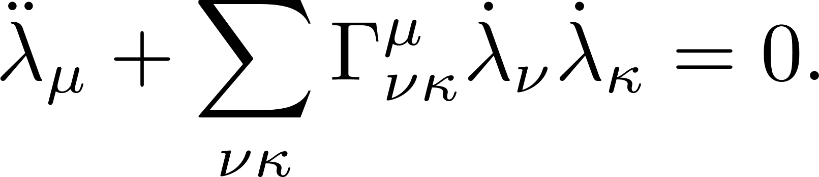
Thermodynamic length
Rewrite the irreversible work with the metric
Define the thermodynamic length
Cauchy-Schwarz inequality leads to
The geodesic curve gives the path of the optimal control

Slide 12
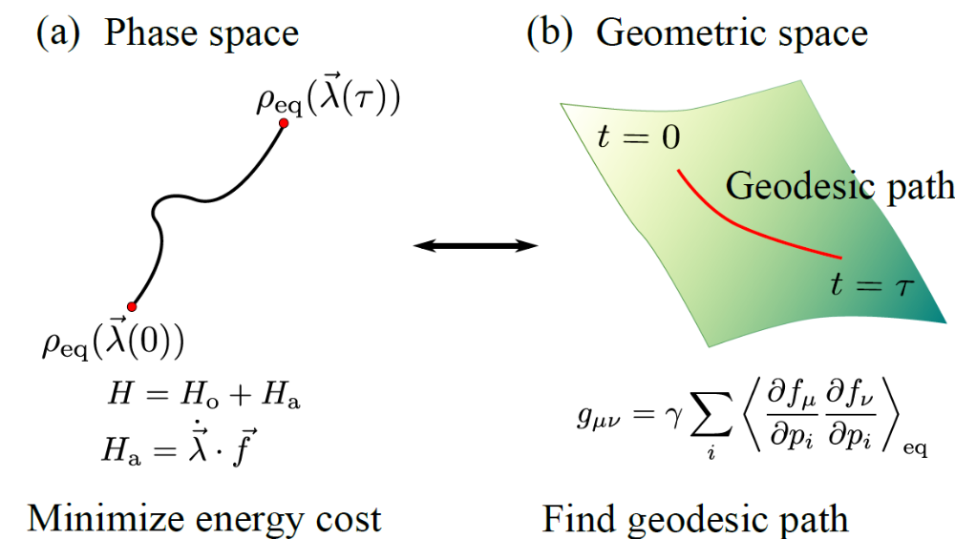
Thermodynamic length
Some references about thermodynamic length
P. Salamon and R. S. Berry, Phys. Rev. Lett. 51, 1127 (1983).
G. E. Crooks, Phys. Rev. Lett. 99, 100602 (2007).
D. A. Sivak and G. E. Crooks, Phys. Rev. Lett. 108, 190602 (2012).
M. Scandi and M. Perarnau-Llobet, Quantum 3, 197 (2019).
J.-F. Chen, C. P. Sun, and H. Dong, Phys. Rev. E 104, 034117 (2021).

Slide 13
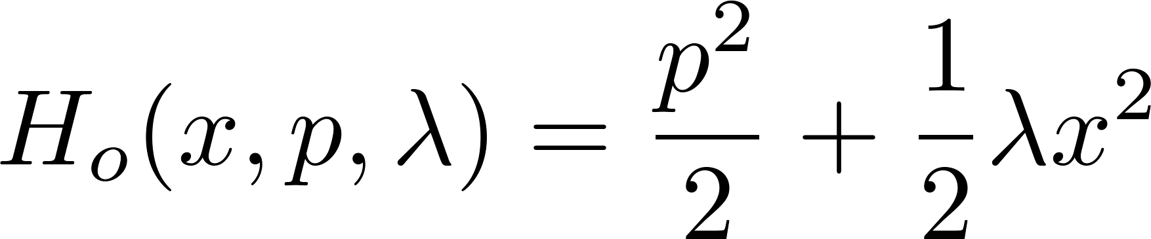
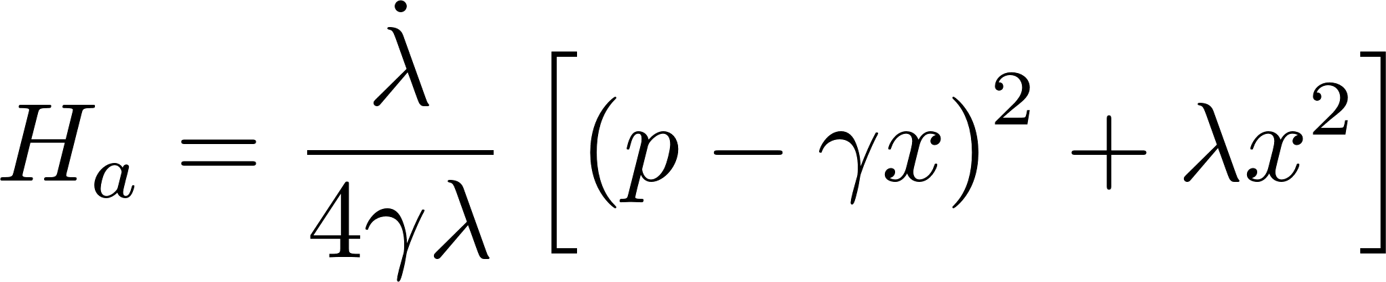
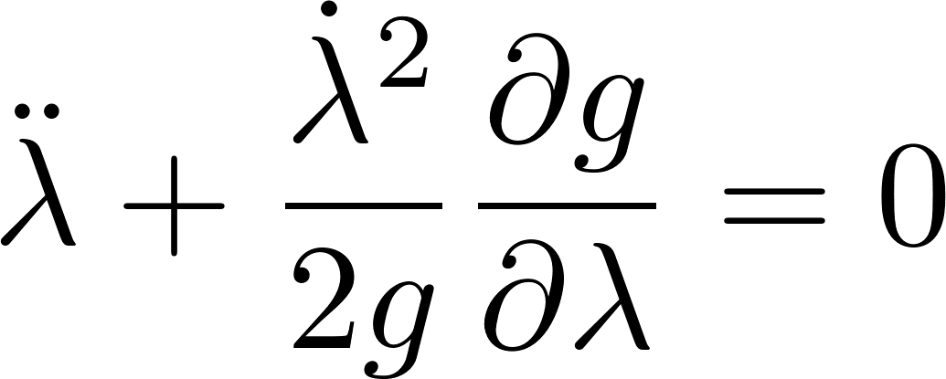
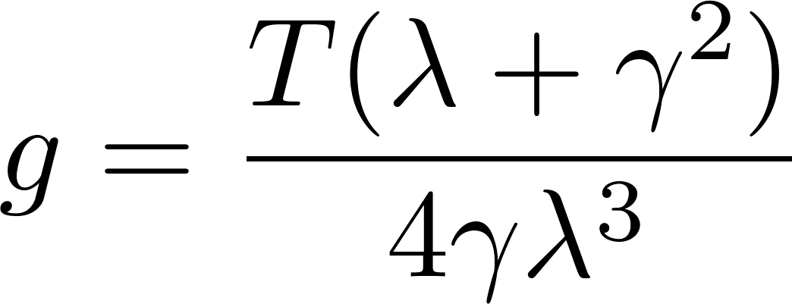
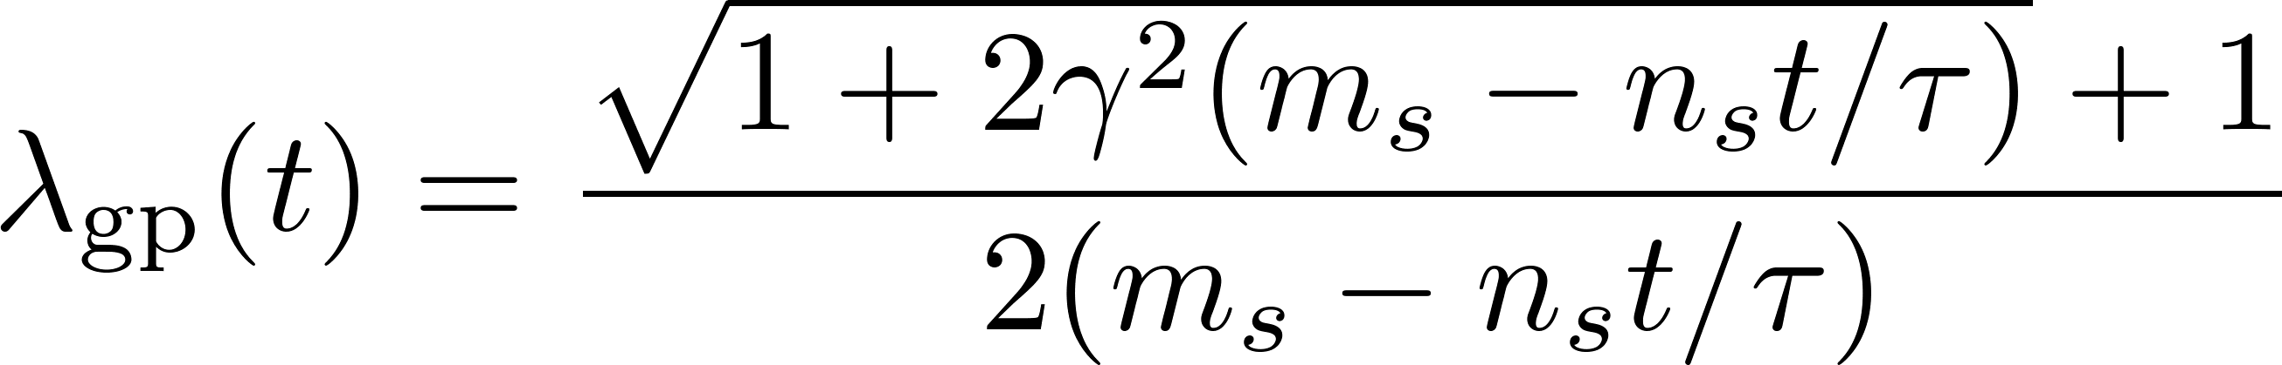
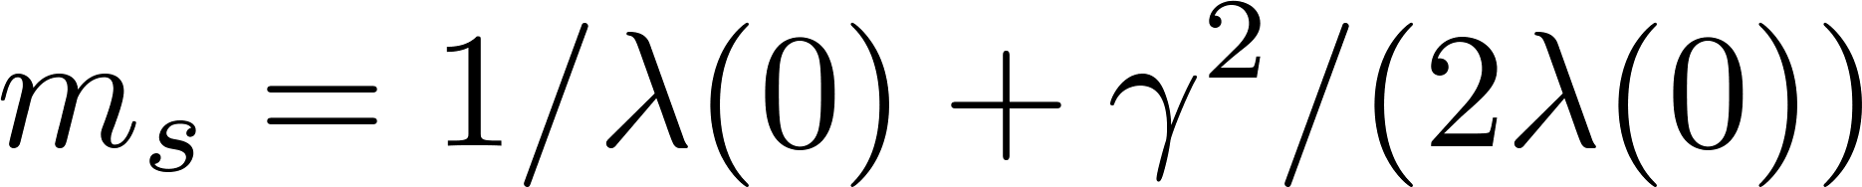
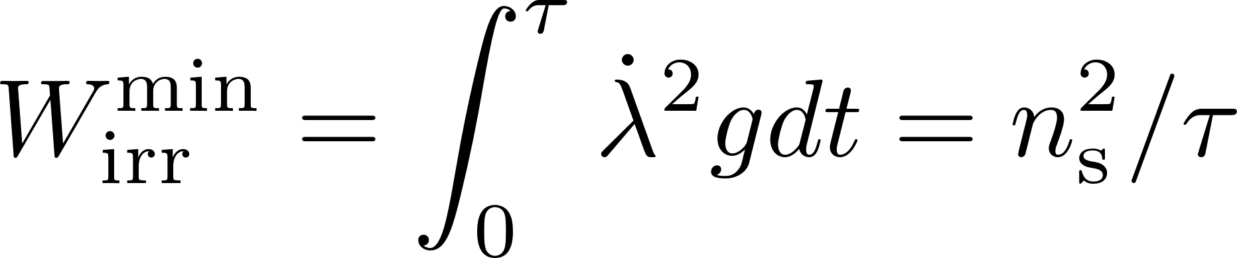

Single control parameter
First example
The auxiliary Hamiltonian is
Geodesic path
Metric
The optimal control with operation time $τ$ is
with
The irreversible work is

Slide 14
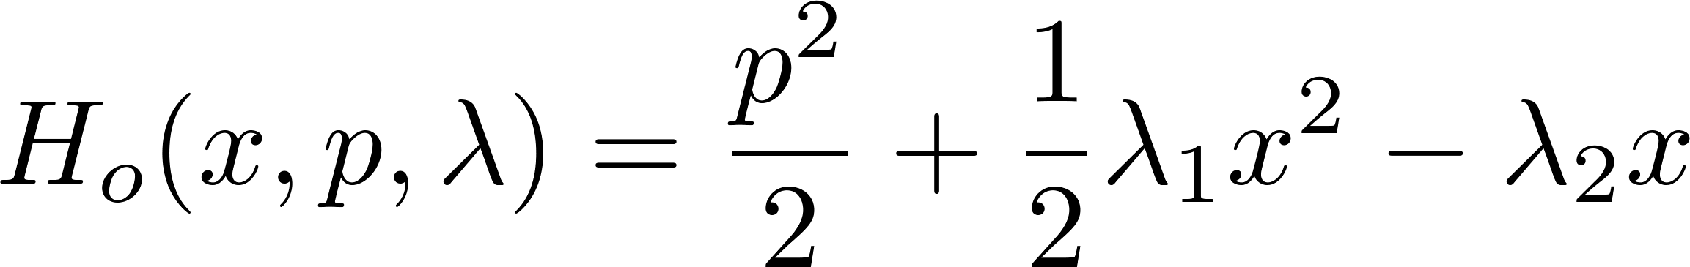
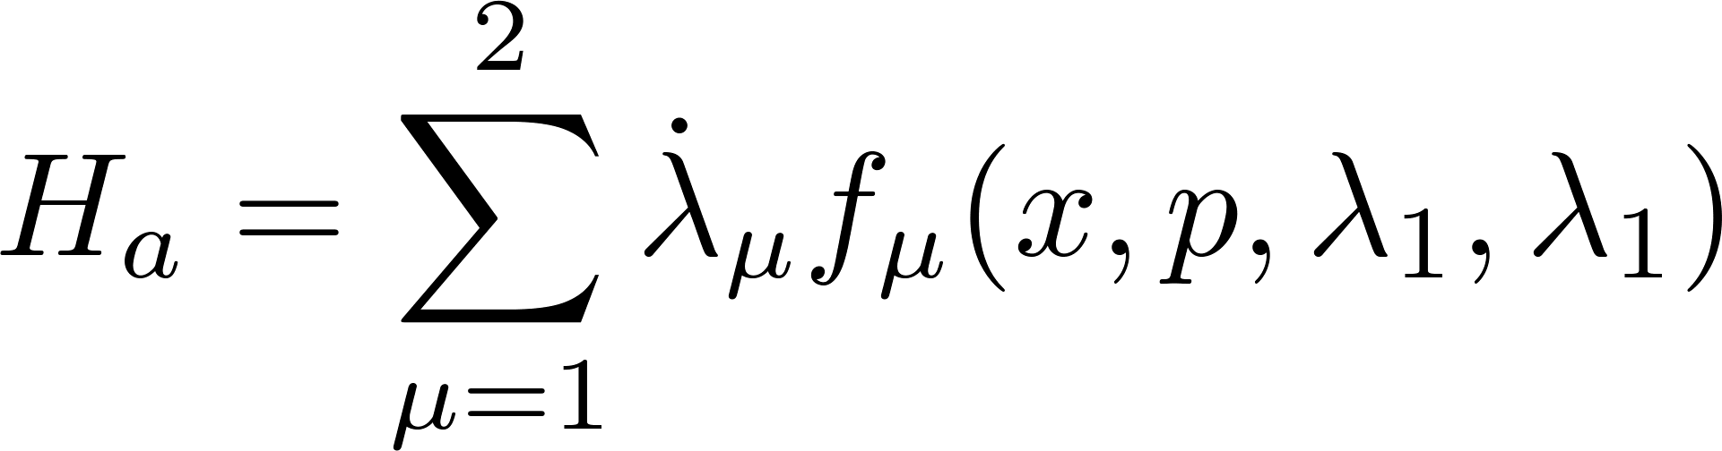
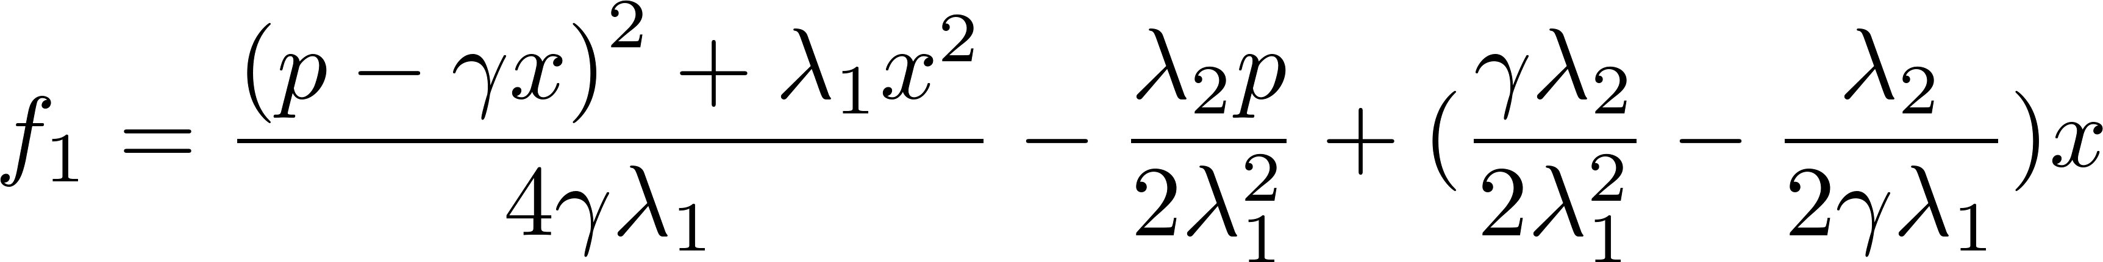
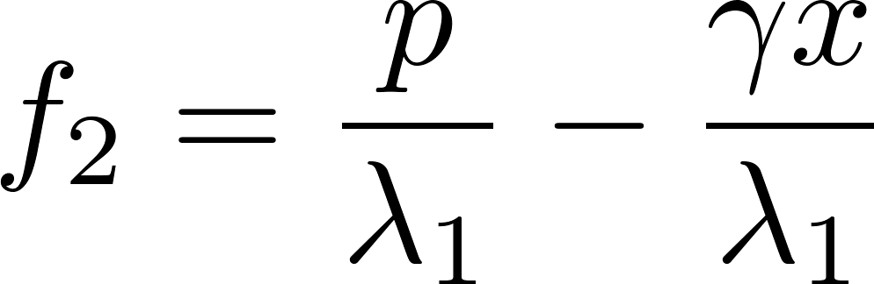
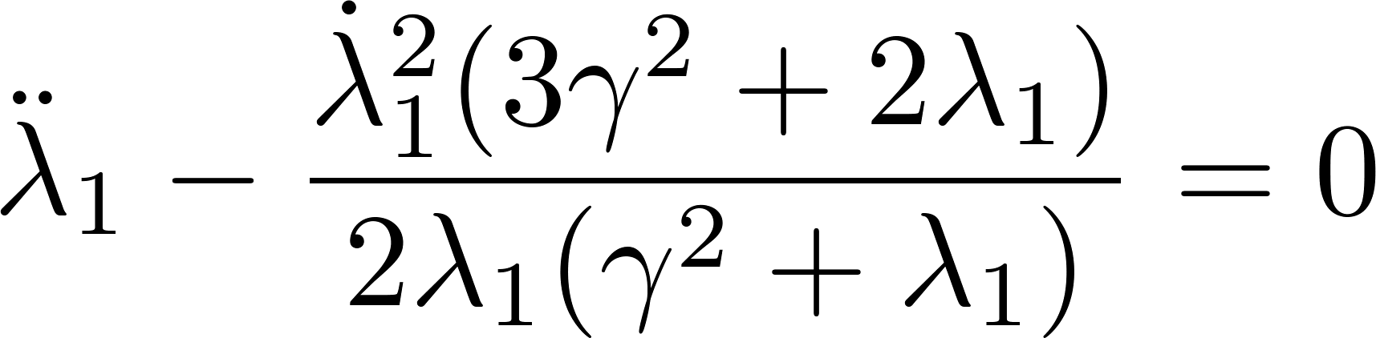
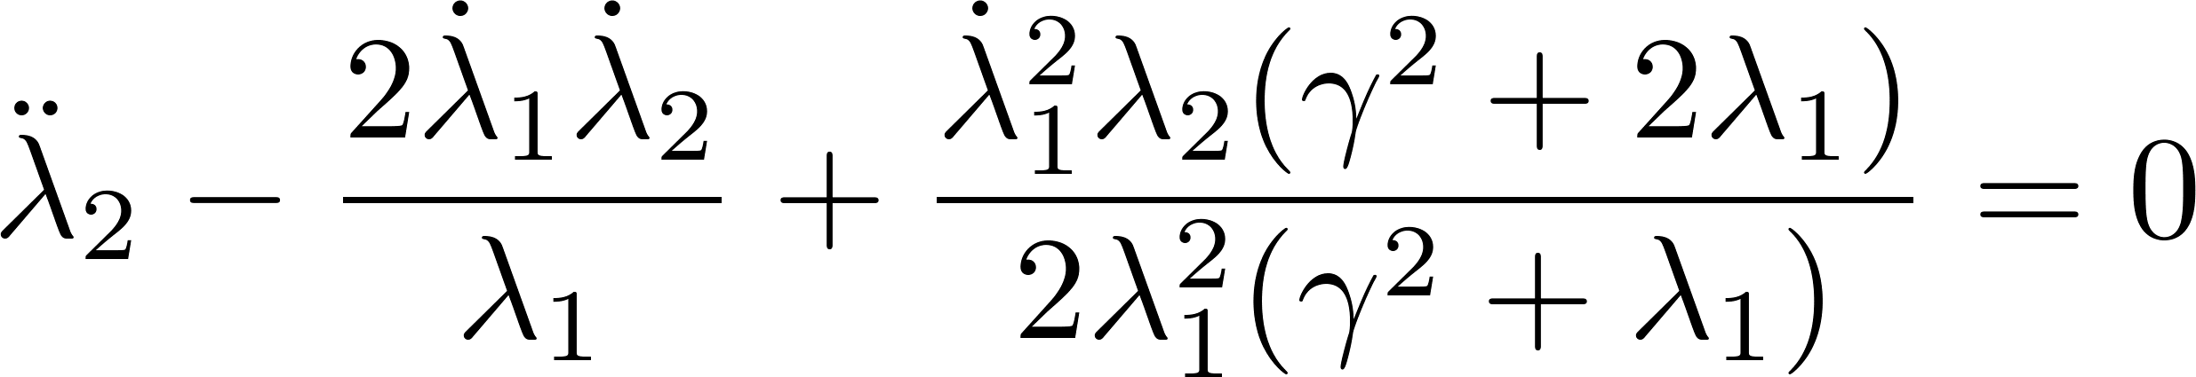
Two control parameters
Second example
The auxiliary Hamiltonian
The optimal control is determined by

Slide 15
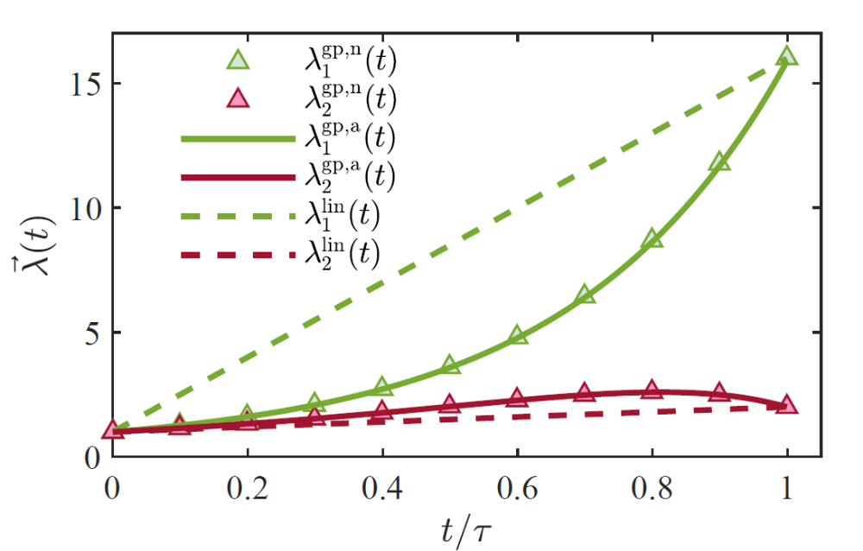
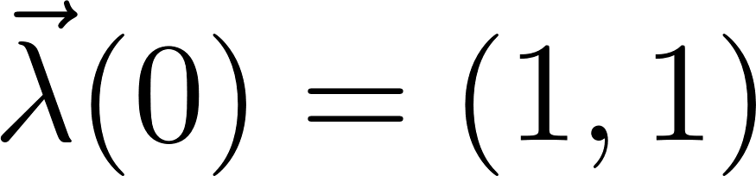
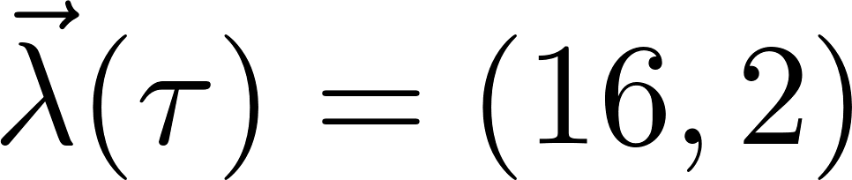
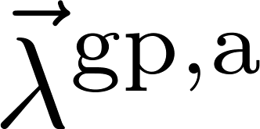
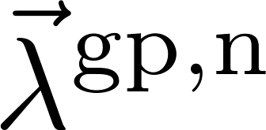

Two control parameters
Comparison between the optimal control and the linear control
analytical:
numerical:
linear control:

Slide 16


Two control parameters
The irreversible work in the linear and the optimal controls
The thermodynamic length is given by

Slide 17

Conclusion
A geometric approach to find the optimal control via shortcut to isothermality.
The irreversible work is bounded by the thermodynamic length.
The strict $1/τ$ scaling of the irreversible work for the Brownian motion model.

Slide 18


