Slide 1
Speeding up quantum adiabatic processes with dynamical quantum geometric tensor
Jinfu Chen

Slide 2



Finite-time thermodynamic processes
In textbooks of thermodynamics, all thermodynamic processes are usually considered quasistatically. It requires infinite time to run a cycle of a Carnot heat engine.
For the real purpose, we hope to possibly reduce the operation time of thermodynamic processes and also their thermodynamic cost.
Thus, we require the evolution equations of the processes.
Isothermal:
Control parameter:
Isolated:

Slide 3
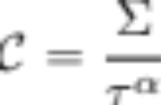
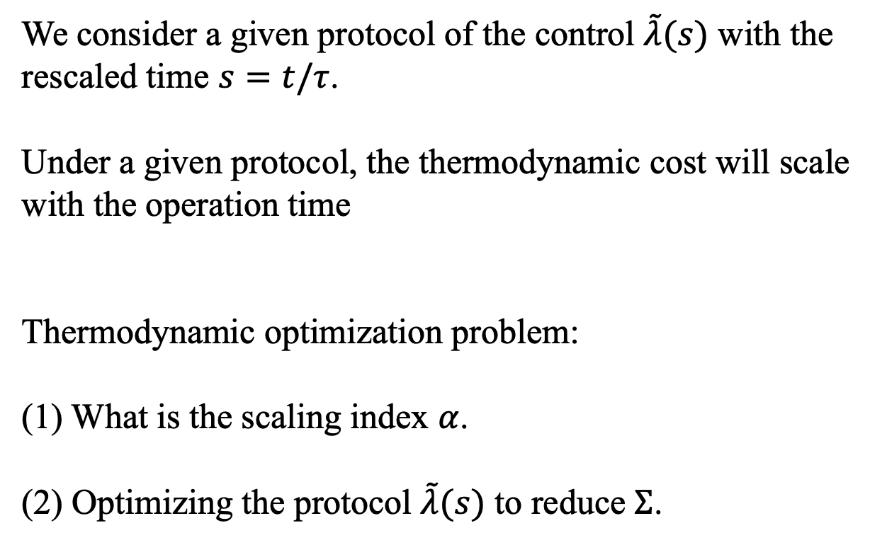
Finite-time thermodynamic processes
We consider a given protocol of the control $\tilde{λ}(s)$ with the rescaled time $s=t/τ$.
Under a given protocol, the thermodynamic cost will scale with the operation time
Thermodynamic optimization problem:
(1) What is the scaling index $α$.
(2) Optimizing the protocol $\tilde{λ}(s)$ to reduce $Σ$.

Slide 4
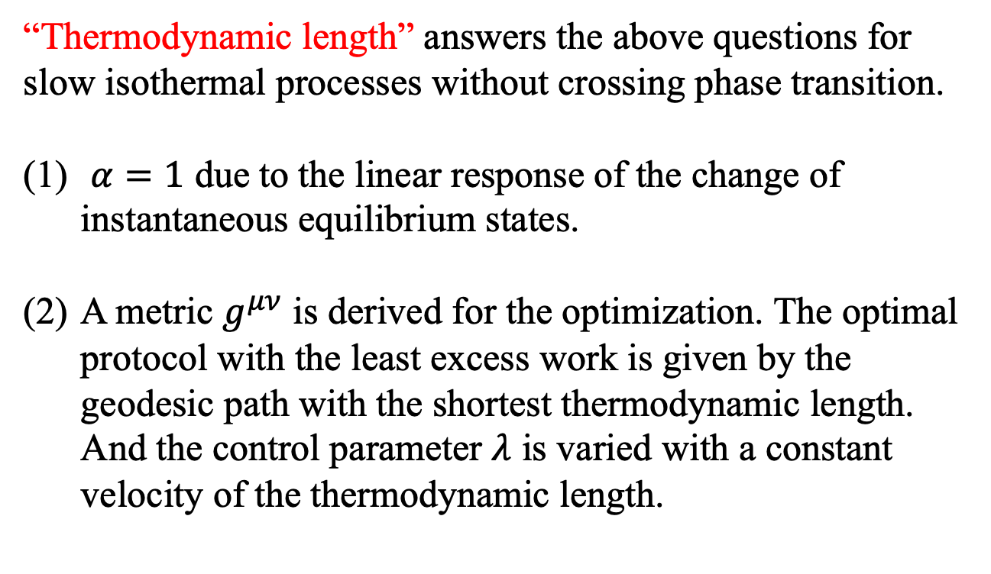
Finite-time isothermal processes
“Thermodynamic length” answers the above questions for slow isothermal processes without crossing phase transition.
$α=1$ due to the linear response of the change of instantaneous equilibrium states.
A metric $g^{μν}$ is derived for the optimization. The optimal protocol with the least excess work is given by the geodesic path with the shortest thermodynamic length. And the control parameter $λ$ is varied with a constant velocity of the thermodynamic length.
P. Salamon, R.S. Berry, PRL 51, 1127-1130 (1983)
M. Scandi and M. Perarnau-Llobet, Quantum 3, 197 (2019)
J. F. Chen, C. P. Sun, H. Dong, PRE 104, 034117 (2021)

Slide 5
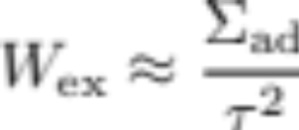
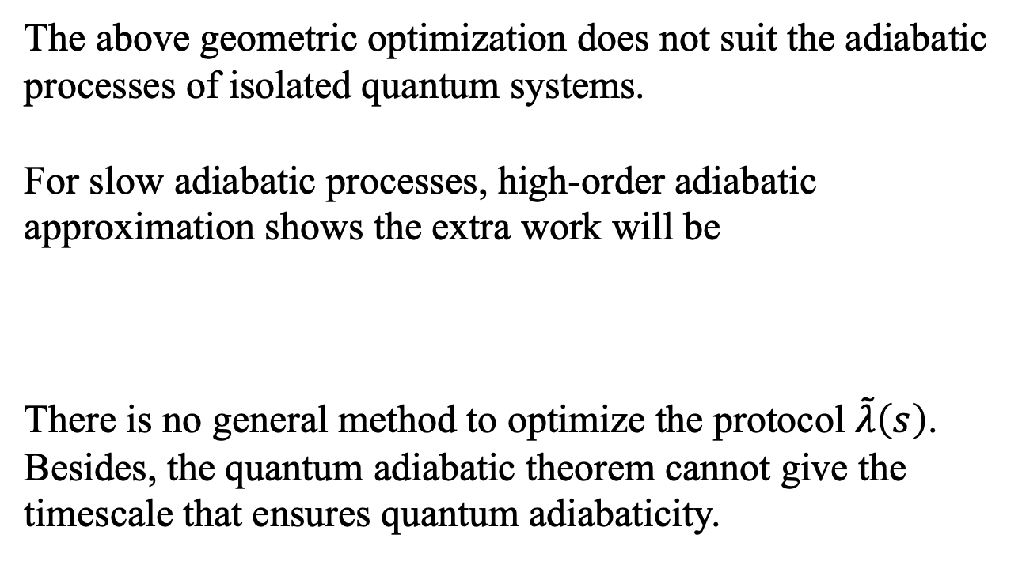
Finite-time adiabatic processes
The above geometric optimization does not suit the adiabatic processes of isolated quantum systems.
For slow adiabatic processes, high-order adiabatic approximation shows the extra work will be
There is no general method to optimize the protocol $\tilde{λ}\left(s\right)$. Besides, the quantum adiabatic theorem cannot give the timescale that ensures quantum adiabaticity.
C.-P. Sun, J. Phys. A: Math. Gen. 21, 1595 (1988).
J. F. Chen, C. P. Sun, H. Dong, PRE 100, 032144 (2019)

Slide 6
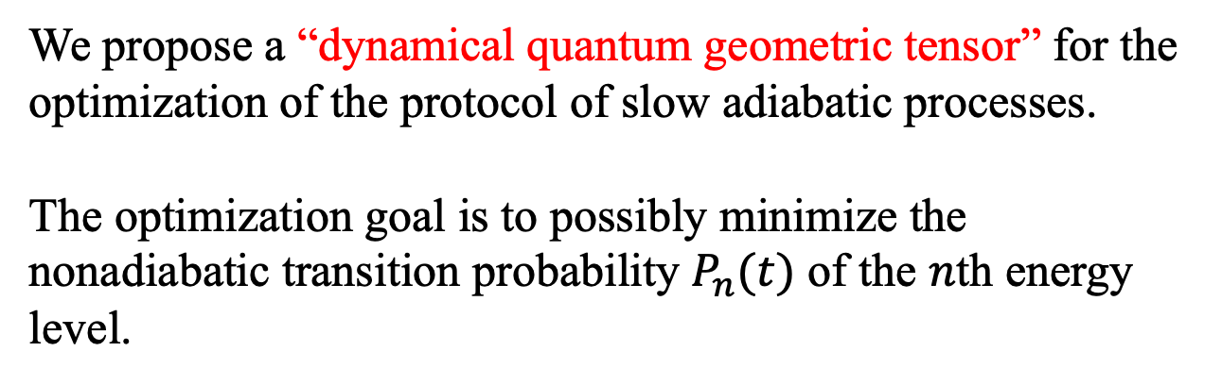
Finite-time adiabatic processes
We propose a “dynamical quantum geometric tensor” for the optimization of the protocol of slow adiabatic processes.
The optimization goal is to possibly minimize the nonadiabatic transition probability $P_{n}(t)$ of the $n$th energy level.

Slide 7
Outline
General theory
Examples:
  Landau-Zener model
  1D transverse Ising model
Conclusion and outlook

Slide 8
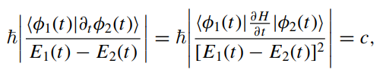
绝热过程操控方式的优化
绝热捷径方法：依赖于过程时间
快速准绝热方法：
此方法适用于一维的绝热过程的调控
能否借鉴热力学长度的思想，利用度规建立绝热过程的普遍优化？

Slide 9
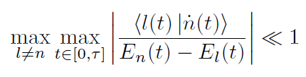

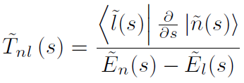
量子绝热近似
对非简并系统，量子绝热条件为
非绝热跃迁率记为

Slide 10
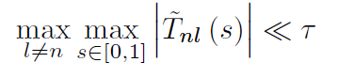

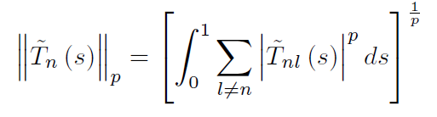



量子绝热近似
绝热条件可改写为
好的调控方案应使上式左侧尽可能的小
将 看成$l$的向量，在$0≤s≤1$上的范数为
满足
当

Slide 11
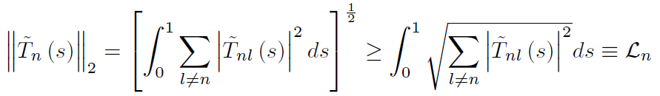
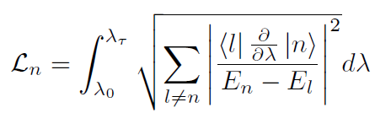


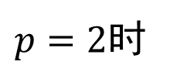
绝热调控的优化
$p=2$时
右边积分定义为量子绝热长度，不依赖于调控方式，只依赖于路径
的优化需要：
① 尽可能小
②不等式取等号

Slide 12
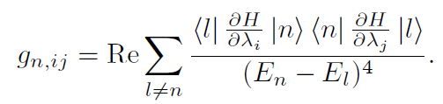

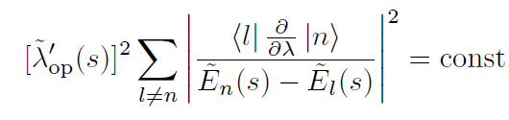
绝热调控的优化
对①，单参数调控不需要考虑，多参数调控需要引入度规
参数调控的路径选取为如上度规下的测地线
对②，最优调控方案需满足

Slide 13

讨论
最小时， 也会较小，但不是严格最小
以上优化相当于选取 为目标函数(cost function)
优化后的操控方案具有最好的量子绝热性。过程结束后的非绝热跃迁概率较小，达到量子绝热所需要的时间较短

Slide 14




高阶绝热展开方法
以下给出长时间过程的绝热展开方法
其中
以瞬时本征态展开

Slide 15

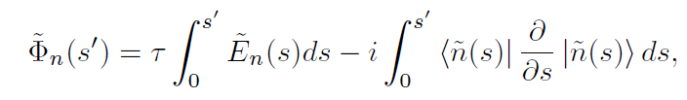
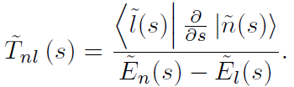


高阶绝热展开方法
一阶绝热近似解
发生非绝热跃迁的概率为

Slide 16



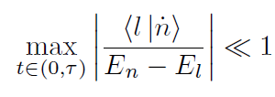

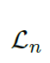
量子绝热长度的物理意义
对优化的调控
忽略振荡项，发生非绝热跃迁的概率可估计为
给出了量子绝热所需的最短时间
对其他操控方式，需更长时间达到量子绝热
降低
减小
寻找测地线

Slide 17

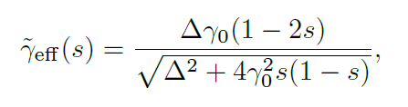

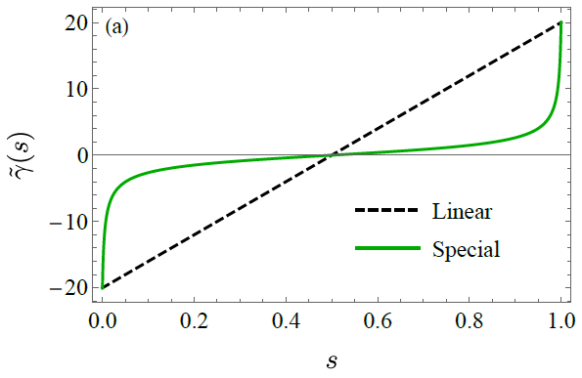
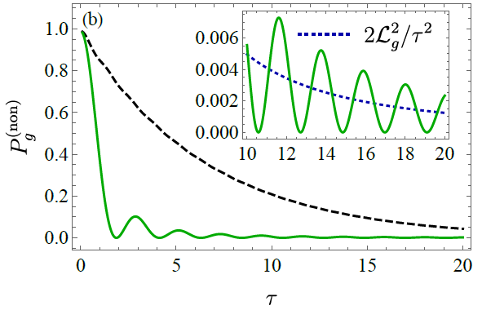

例子：Landau-Zener跃迁
优化操控
线性操控

Slide 18
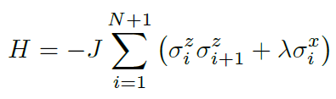

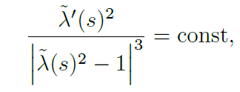
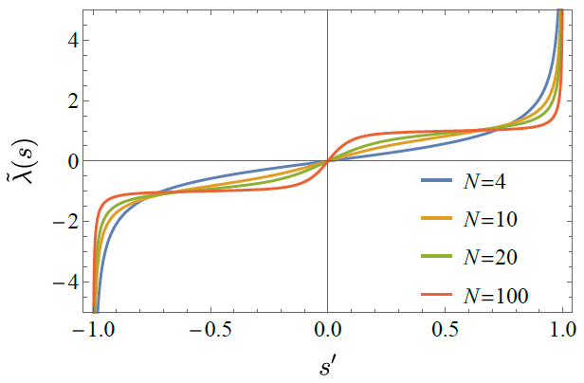
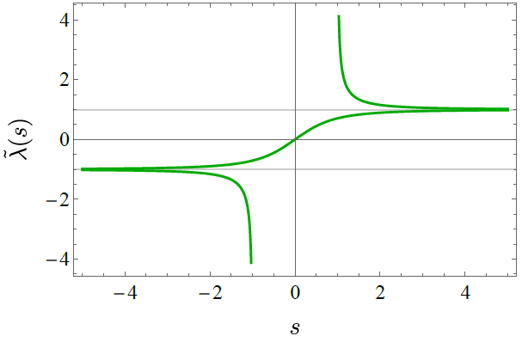
例子：横场Ising模型
优化操控满足
热力学极限下，优化操控为

Slide 19
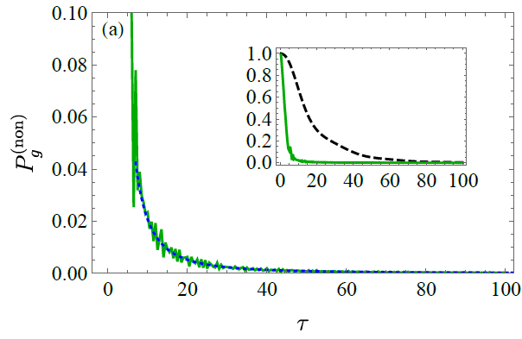
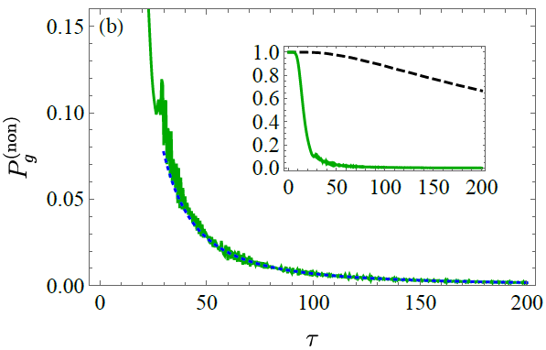




例子：横场Ising模型
线性调控和优化调控的非绝热跃迁概率
参数选取为

Slide 20
总结
优化的绝热过程操控方案需“匀速”地调整操控参量
对多操控参数情形，可选测地线减少量子绝热的时间

Slide 21


